Slide 1
K-CHOPORE
A reproducible nanopore Direct RNA-seq pipelinefor the plant m6A epitranscriptome Pelayo G. de Lena Rodríguez · Chus Pascual · Luis Valledor

Slide 2
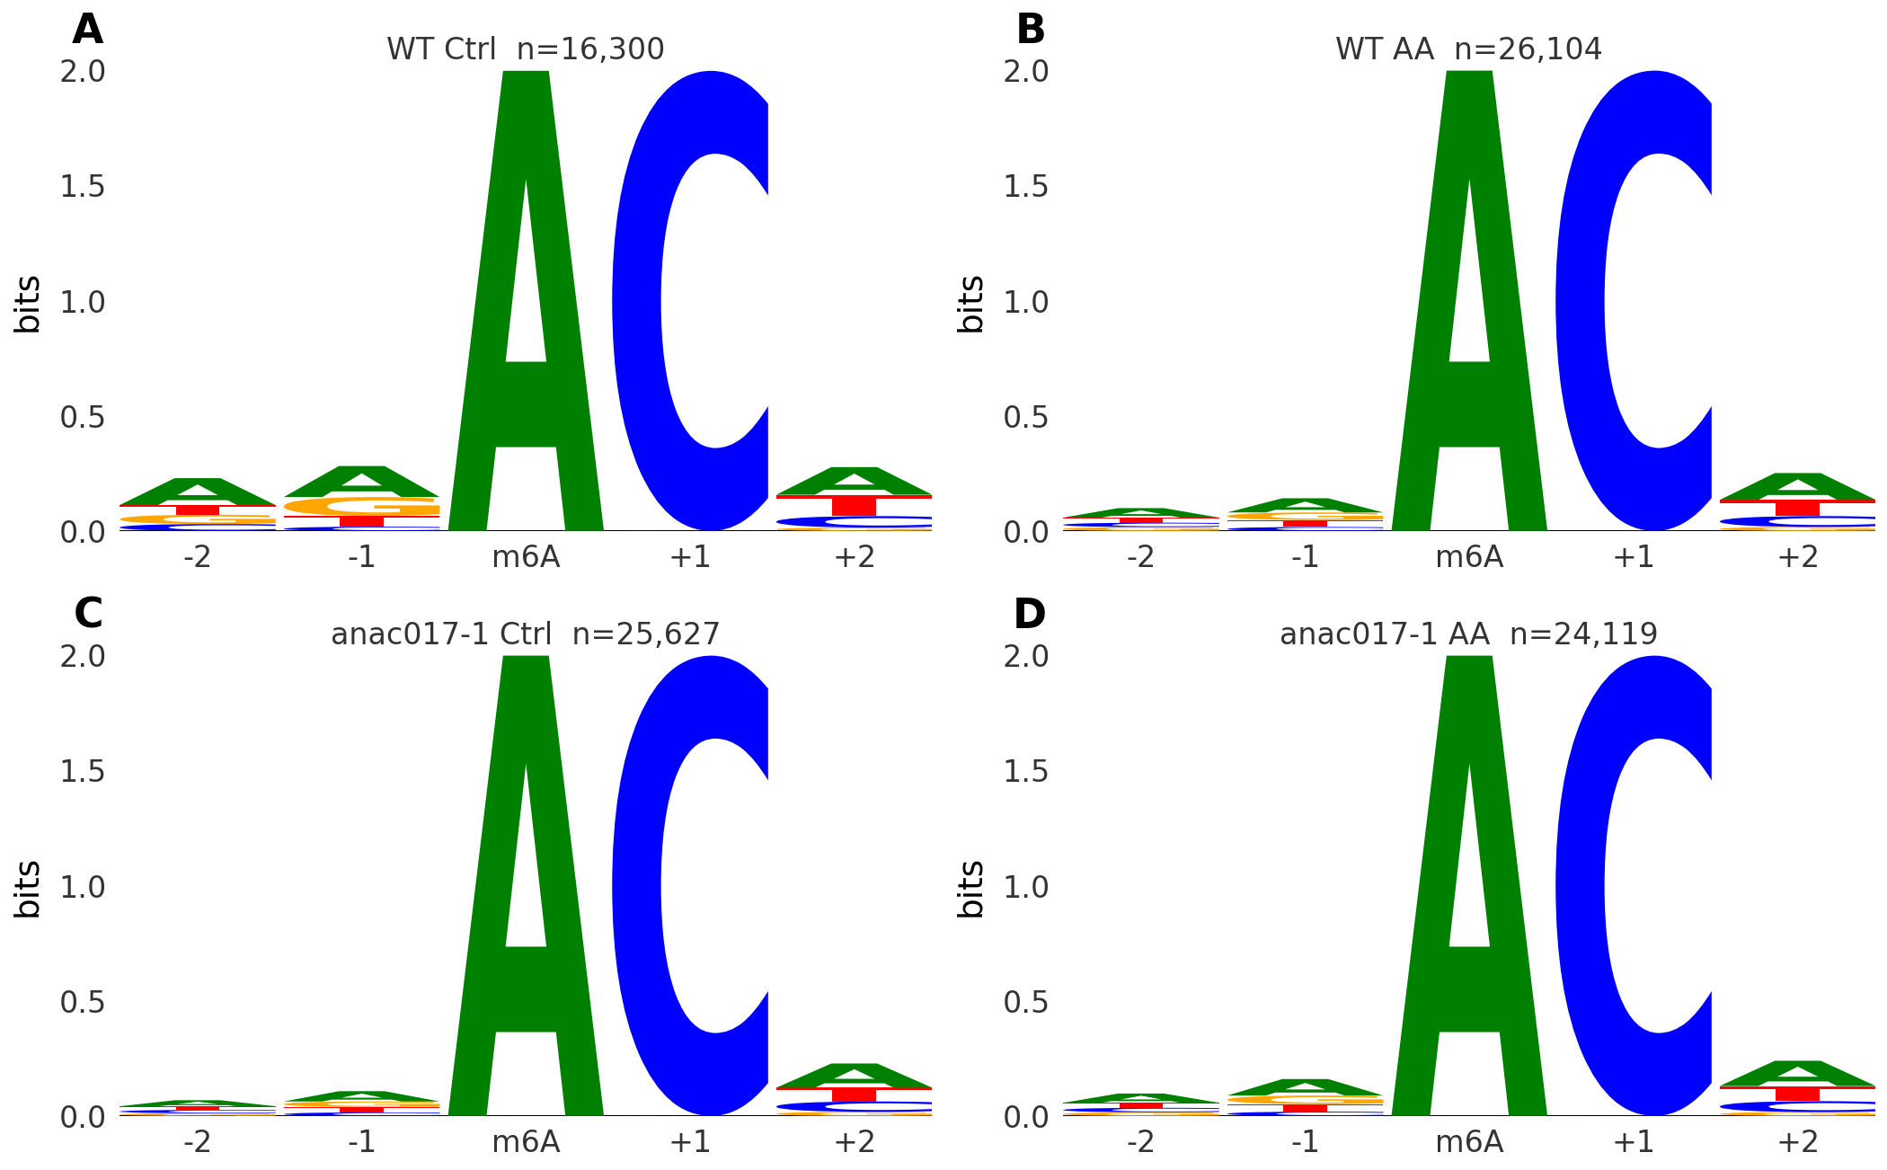
The gap
m6A is the most abundant mRNA modification — it tunes stability, splicing, translation.
Nanopore Direct RNA-seq (DRS) reads it on native RNA.
But plant-ready, reproducible workflows are scarce.
K-CHOPORE — signal → m6A map → expression → function, in one reproducible (Docker/FAIR) pipeline.

Slide 3
The pipeline

Slide 4
One Snakemake config controls the whole run; precomputed steps are reused, only what changed re-runs.

Slide 5
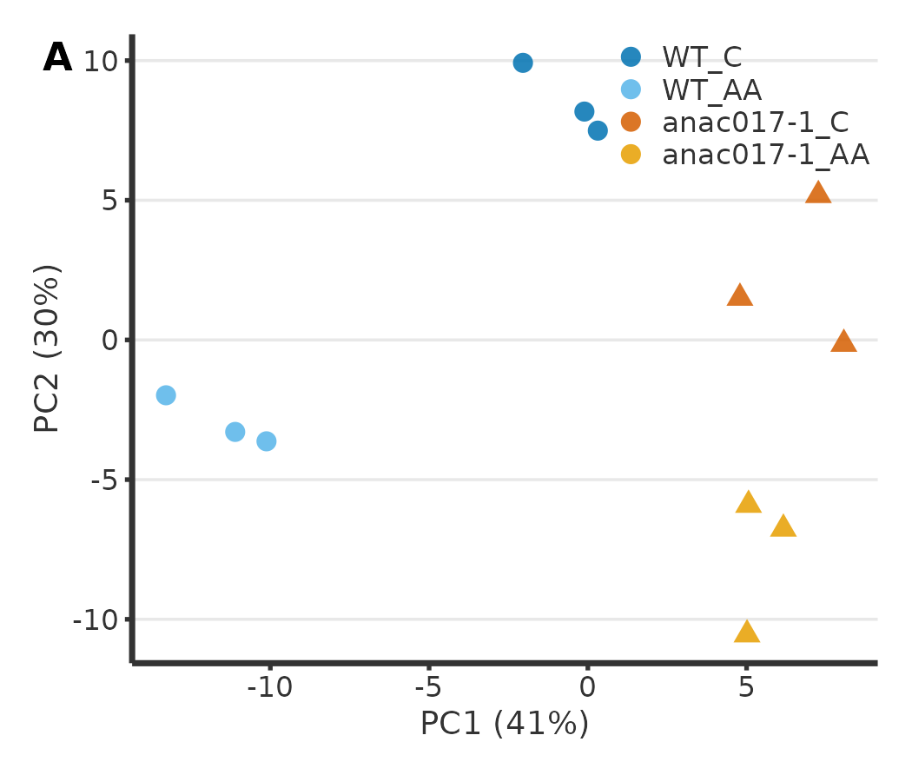
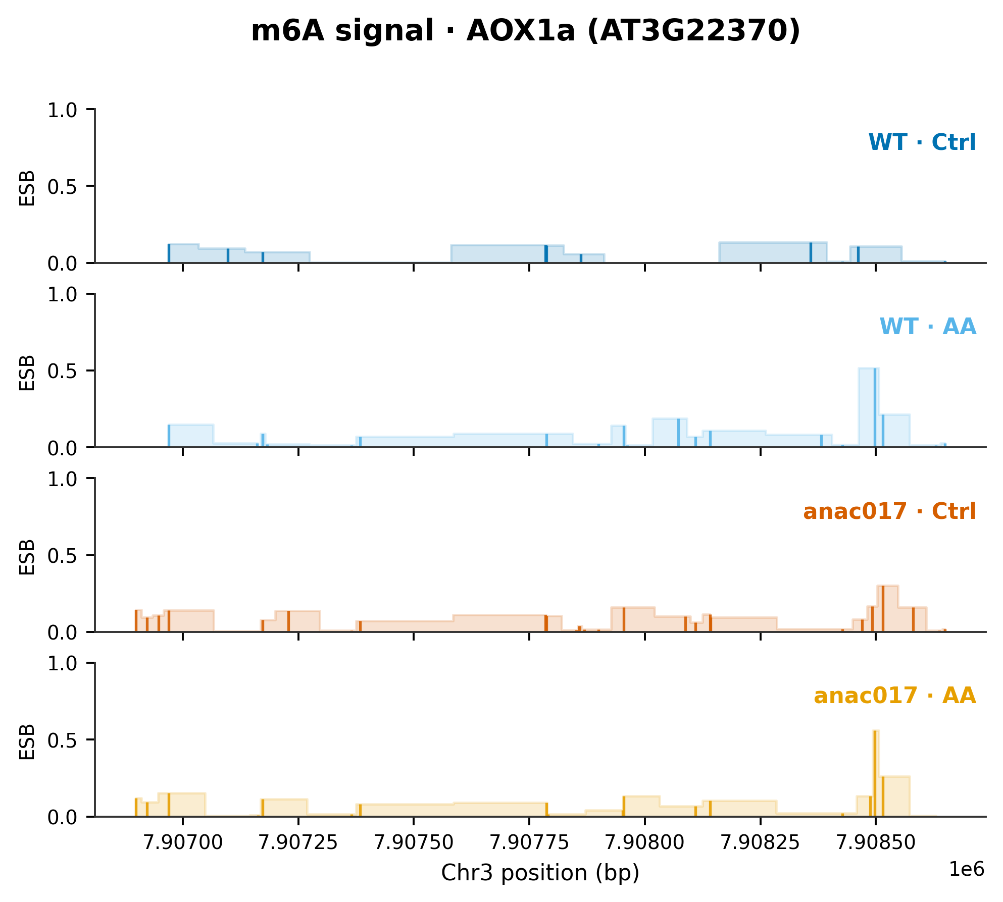
Case study: mitochondrial retrograde response
2×2 design · WT vs anac017-1 × Control vs Antimycin A · n = 3
PCA: PC1 = genotype, PC2 = treatment
m6A gained at AOX1a under Antimycin A

Slide 6
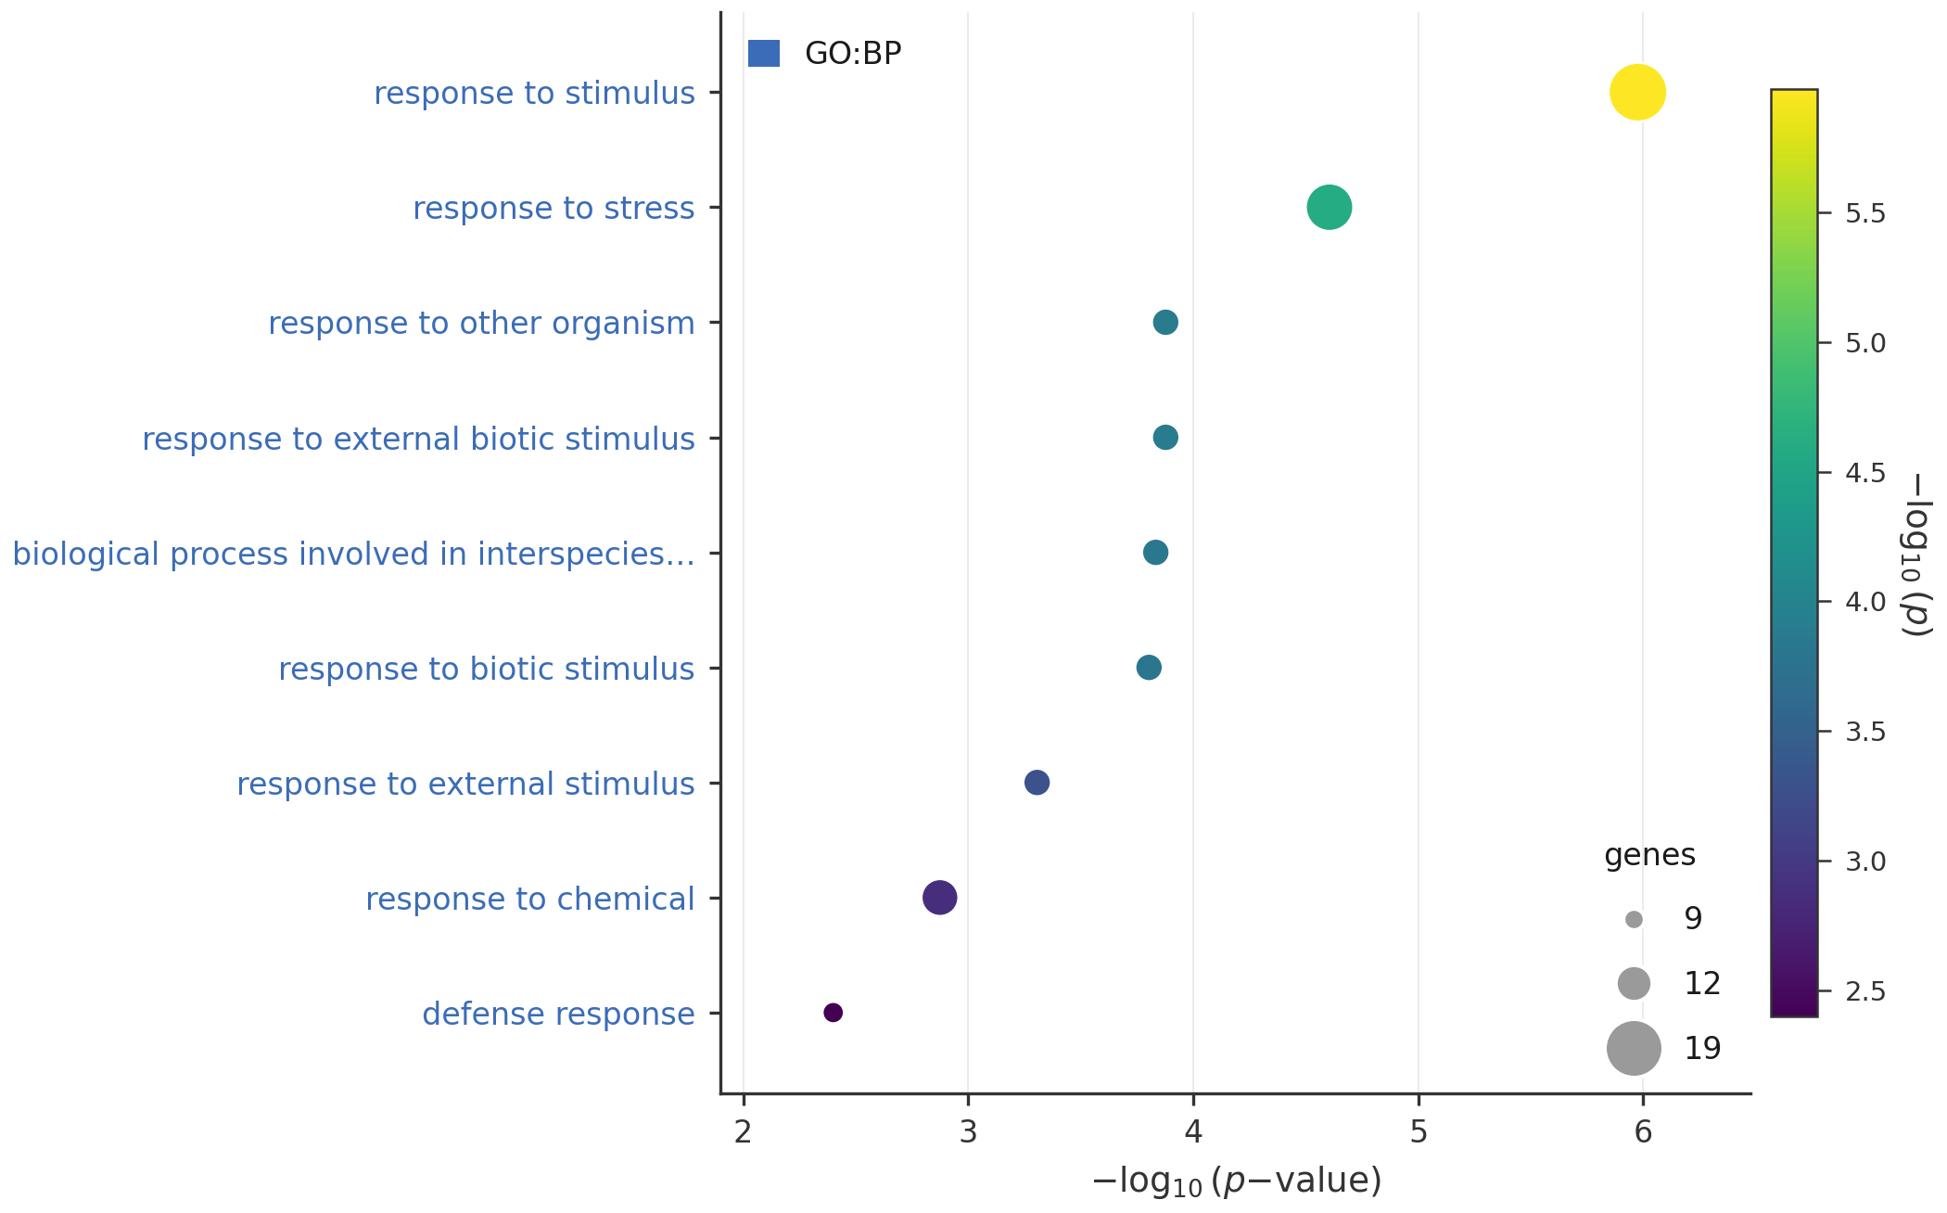
What we find
175 transcripts respond to AA; 32 in an ANAC017-dependent way (interaction).
~89% of AA-gained m6A sites in WT are ANAC017-dependent.
AA-responsive genes enriched in stress / hypoxia (e.g. CYP81D8).

Slide 7
Reproducible by design
Docker image + Snakemake + one config
Clone → docker run → edit config → run.
🔗 github.com/biopelayo/kchopore-anac017-drs
A reusable, FAIR resource for plant epitranscriptomics.

Slide 8
Thank you
K-CHOPORE turns raw nanopore signal into a coverage-controlled m6A map — reproducibly.
Pelayo G. de Lena Rodríguez · bio.pelayo@gmail.com Univ. Oviedo / FINBA · 1st EpiCrops Conference, Oviedo 2026

