Slide 1

ISSUE 1
Rat moves horizontally and finds food.
Action reinforced by both red cells.
The upper cell reinforces the action a lot.
The lower cell reinforces the action a bit.
Problems:
The lower action does not make sense.
The reinforced action should point towards the position reached by the rat.
If using random movements this issue might be partially hidden, never the less, if any bias repeats the action often, the lower action will be reinforced reppitedly and may dominate the action selection process.

Slide 2
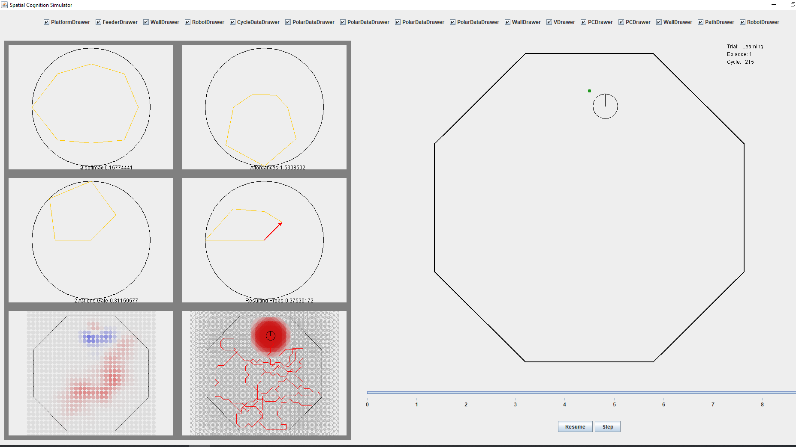
ISSUE 2: Negative value ring forms around reward site. Possibly related to issue 1, plus issue with equations of the model (see issue 3).

Slide 3
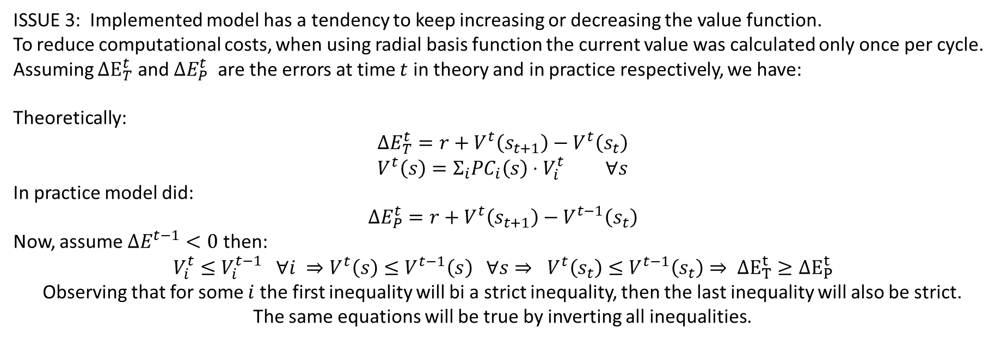
ISSUE 3: Implemented model has a tendency to keep increasing or decreasing the value function. To reduce computational costs, when using radial basis function the current value was calculated only once per cycle.
Assuming $ΔE_{T}^{t}$ and $ΔE_{P}^{t}$ are the errors at time $t$ in theory and in practice respectively, we have:
Theoretically:
$$ΔE_{T}^{t}=r+V^{t}\left(s_{t+1}\right)−V^{t}\left(s_{t}\right) \\ V^{t}\left(s\right)=Σ_{i}PC_{i}\left(s\right)⋅V_{i}^{t} ∀s$$
In practice model did:
$$ΔE_{P}^{t}=r+V^{t}\left(s_{t+1}\right)−V^{t−1}\left(s_{t}\right)$$
Now, assume $ΔE^{t−1}<0$ then:
$$V_{i}^{t}≤V_{i}^{t−1} ∀i ⇒V^{t}\left(s\right)≤V^{t−1}\left(s\right) ∀s⇒ V^{t}\left(s_{t}\right)≤V^{t−1}\left(s_{t}\right)⇒ ΔE_{T}^{t}≥ΔE_{P}^{t}$$
Observing that for some $i$ the first inequality will bi a strict inequality, then the last inequality will also be strict.
The same equations will be true by inverting all inequalities.

Slide 4












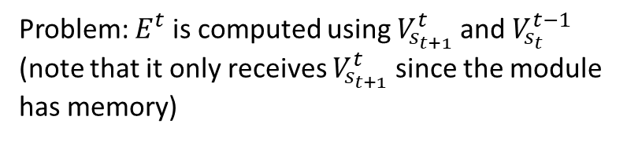












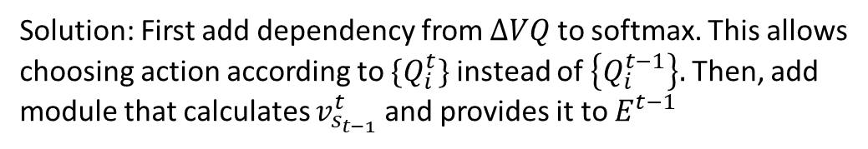






Issue 3 – modifying awake model to solve issue
Note: dashed arrows mean that the element is used before updating (i.e: use instance at t-1).
Note: dashed boxes means the box is the same as another one with the same name. The solid box indicates where is the module calculated
Before
After
$${\{Q}_{i}^{t}\}$$
$${\{Q}_{i}^{t}\}$$
$$\{PC_{i}^{t}\}$$
$$ate^{t−1}$$
$$r^{t−1}$$
$$ate^{t−1}$$
$$r^{t−1}$$
$${\{V}_{i}^{t}\}$$
$$\{PC_{i}^{t}\}$$
$${\{V}_{i}^{t}\}$$
$${\{V}_{i}^{t}\}$$
$$V_{s_{t}}^{t−1}$$
$$E^{t−1}$$
$$ΔVQ$$
$${\{V}_{i}^{t}\}$$
$$V_{s_{t}}^{t−1}$$
$$E^{t−1}$$
$$ΔVQ$$
$${\{V}_{i}^{t}\}$$
$$s_{t}$$
$$\{PC_{i}^{t}\}$$
$$s_{t}$$
$$\{PC_{i}^{t}\}$$
$$V_{s_{t}}^{t}$$
$${\{Q}_{i}^{t}\}$$
Max
isMax
$${\{Q}_{i}^{t−1}\}$$
$$Q_{s_{t}}^{t−1}$$
$$Q_{s_{t}}^{t}$$
Max
isMax
softmax
B1
B2
$$a_{t}$$
softmax
B1
B2
$$a_{t}$$
Problem: $E^{t}$ is computed using $V_{s_{t+1}}^{t}$ and $V_{s_{t}}^{t−1}$ (note that it only receives $V_{s_{t+1}}^{t}$ since the module has memory)
Solution: First add dependency from $ΔVQ$ to softmax. This allows choosing action according to $\{Q_{i}^{t}\}$ instead of $\left\{Q_{i}^{t−1}\right\}.$ Then, add module that calculates $v_{s_{t−1}}^{t}$ and provides it to $E^{t−1}$

Slide 5


















Issue 3 – modifying asleep model to solve issue
After
$${\{Q}_{i}^{t}\}$$
$$\{PC_{i}^{t}\}$$
$$ate^{t−1}$$
$$r^{t−1}$$
$${\{V}_{i}^{t}\}$$
$${\{V}_{i}^{t}\}$$
$$V_{s_{t}}^{t−1}$$
$$E^{t−1}$$
$$ΔVQ$$
$${\{V}_{i}^{t}\}$$
$$s_{t}$$
$$\{PC_{i}^{t}\}$$
$$V_{t}^{t}$$
$${\{Q}_{i}^{t}\}$$
$$Q_{s_{t}}^{t}$$
Max
isMax
$$W_{ij}$$
nextActivePC
nextPos
$$a_{t}$$
$$s_{t}$$
Solution: Idem to RL in awake state but substituting action selection mechanism

Slide 6
















07/10/2018 – Q update was modified, see log
Note: dashed arrows mean that the element is used before updating (i.e: use instance at t-1).
Note: dashed boxes means the box is the same as another one with the same name. The solid box indicates where is the module calculated
After
$${\{Q}_{i}^{t}\}$$
$$\{PC_{i}^{t}\}$$
$$ate^{t−1}$$
$$r^{t−1}$$
$${\{V}_{i}^{t}\}$$
$${\{V}_{i}^{t}\}$$
$$V_{s_{t}}^{t−1}$$
$$E^{t−1}$$
$$ΔVQ$$
$${\{V}_{i}^{t}\}$$
$$s_{t}$$
$$\{PC_{i}^{t}\}$$
$$V_{s_{t}}^{t}$$
$${\{Q}_{i}^{t}\}$$
$$Q_{s_{t}}^{t}$$
Max
isMax
The max calculation was moved to the module which calculates the error.
Now, two different error signals are calculated.
Same for replay model.
softmax
B1
B2
$$a_{t}$$

Slide 7
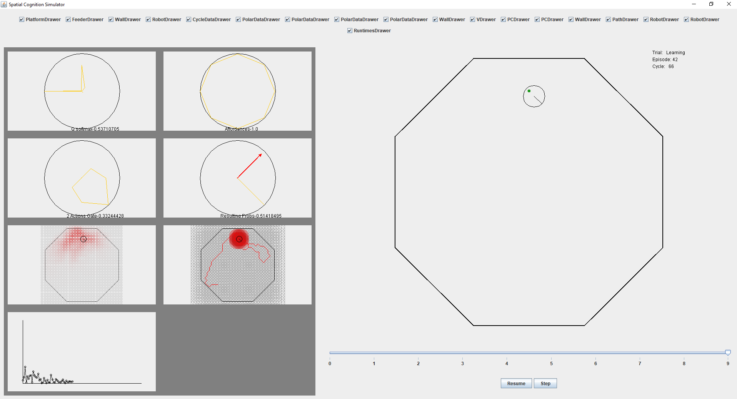
Issue 4 – For better performance HD cells are required, otherwise it is difficult to distinguish between different scenarios. Take for example the point near the food, that point may end up having a preference for all directions since Radial basis functions generalize the policy value to all vicinity.

Slide 8
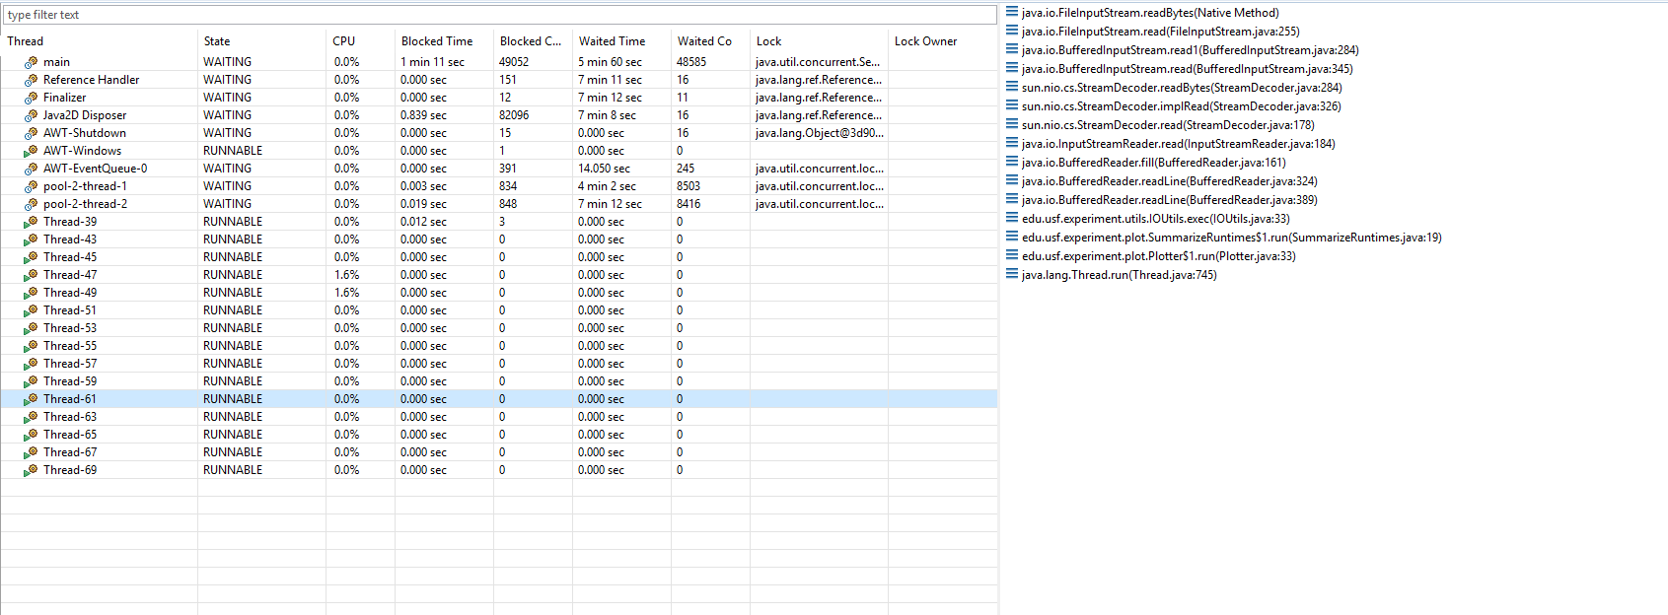
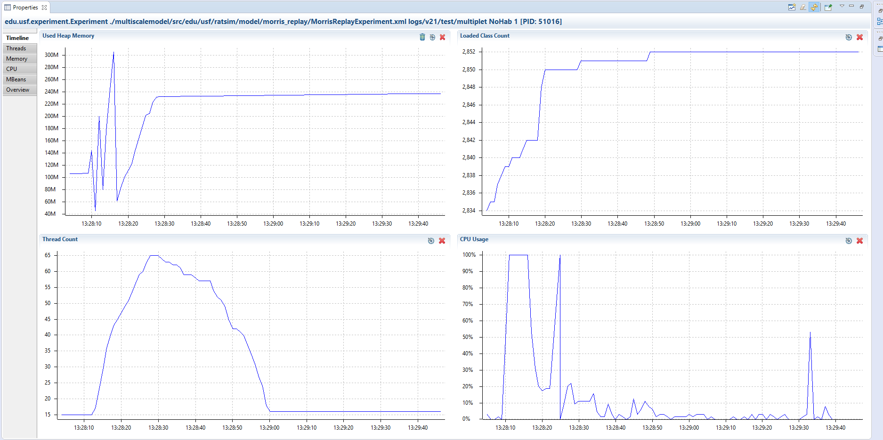
Skipped issue 5 – Matrix update equation, see log Issue 6 – When running in async mode speed at which threads are created is bigger than speed at which they are closed. See following profiler data plots: Cause: plotters and loggers
Current solution: do not use current logs and plots
Future solution: reimplement logging and plotting.

Slide 9
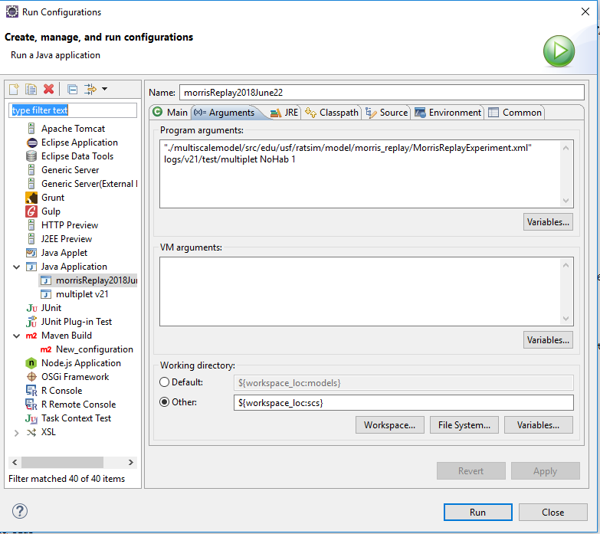
Reproducing issue 6: Go to branch v2.1 commit#: 2fd3db47247e46e1500a200db25eca5cf861346c of date: 07/11/2018
Run following configuration

