Slide 1

ISSUE 1
Rat moves horizontally and finds food.
Action reinforced by both red cells.
The upper cell reinforces the action a lot.
The lower cell reinforces the action a bit.
Problems:
The lower action does not make sense.
The reinforced action should point towards the position reached by the rat.
If using random movements this issue might be partially hidden, never the less, if any bias repeats the action often, the lower action will be reinforced reppitedly and may dominate the action selection process.

Slide 2
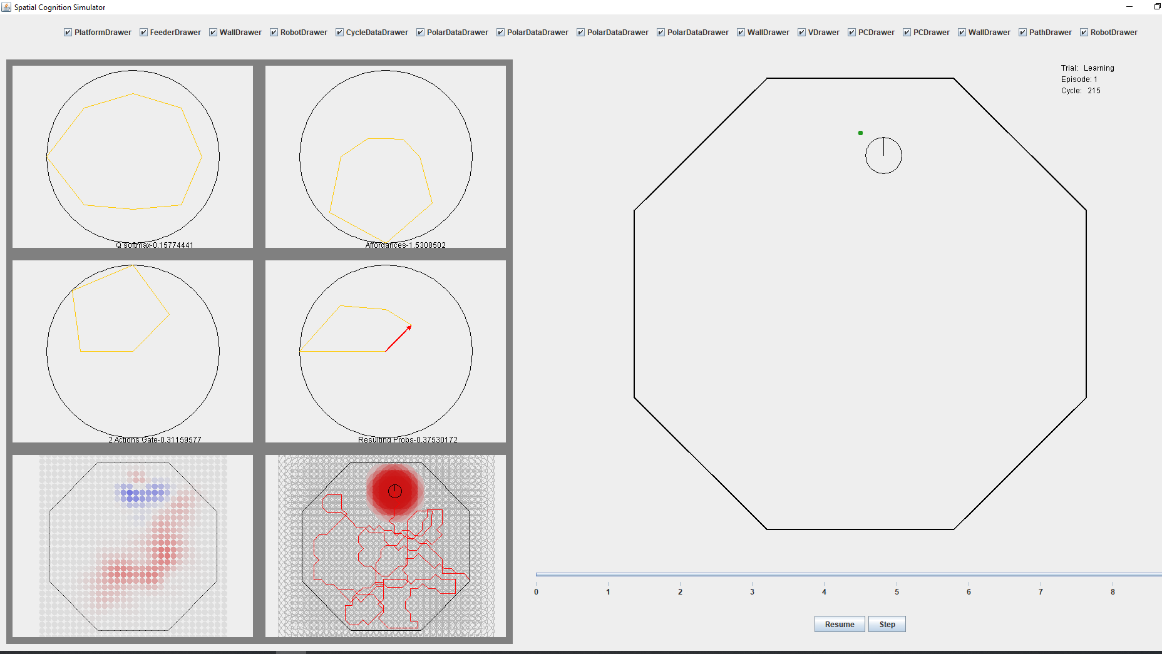
ISSUE 2: Negative value ring forms around reward site. Possibly related to issue 1, plus issue with equations of the model (see issue 3).

Slide 3
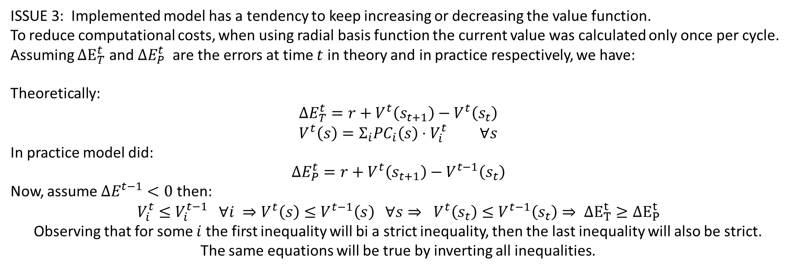
ISSUE 3: Implemented model has a tendency to keep increasing or decreasing the value function. To reduce computational costs, when using radial basis function the current value was calculated only once per cycle.
Assuming $ΔE_{T}^{t}$ and $ΔE_{P}^{t}$ are the errors at time $t$ in theory and in practice respectively, we have:
Theoretically:
$$ΔE_{T}^{t}=r+V^{t}\left(s_{t+1}\right)−V^{t}\left(s_{t}\right) \\ V^{t}\left(s\right)=Σ_{i}PC_{i}\left(s\right)⋅V_{i}^{t} ∀s$$
In practice model did:
$$ΔE_{P}^{t}=r+V^{t}\left(s_{t+1}\right)−V^{t−1}\left(s_{t}\right)$$
Now, assume $ΔE^{t−1}<0$ then:
$$V_{i}^{t}≤V_{i}^{t−1} ∀i ⇒V^{t}\left(s\right)≤V^{t−1}\left(s\right) ∀s⇒ V^{t}\left(s_{t}\right)≤V^{t−1}\left(s_{t}\right)⇒ ΔE_{T}^{t}≥ΔE_{P}^{t}$$
Observing that for some $i$ the first inequality will bi a strict inequality, then the last inequality will also be strict.
The same equations will be true by inverting all inequalities.

Slide 4












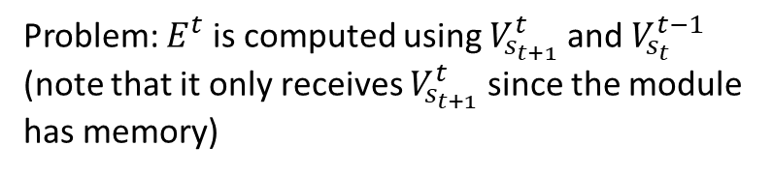



















Issue 3 – modifying awake model to solve issue
Note: dashed arrows mean that the element is used before updating (i.e: use instance at t-1).
Note: dashed boxes means the box is the same as another one with the same name. The solid box indicates where is the module calculated
Before
After
$${\{Q}_{i}^{t}\}$$
$${\{Q}_{i}^{t}\}$$
$$\{PC_{i}^{t}\}$$
$$ate^{t−1}$$
$$r^{t−1}$$
$$ate^{t−1}$$
$$r^{t−1}$$
$${\{V}_{i}^{t}\}$$
$$\{PC_{i}^{t}\}$$
$${\{V}_{i}^{t}\}$$
$${\{V}_{i}^{t}\}$$
$$V_{s_{t}}^{t−1}$$
$$E^{t−1}$$
$$ΔVQ$$
$${\{V}_{i}^{t}\}$$
$$V_{s_{t}}^{t−1}$$
$$E^{t−1}$$
$$ΔVQ$$
$${\{V}_{i}^{t}\}$$
$$s_{t}$$
$$\{PC_{i}^{t}\}$$
$$s_{t}$$
$$\{PC_{i}^{t}\}$$
$$V_{s_{t}}^{t}$$
$${\{Q}_{i}^{t}\}$$
Max
isMax
$${\{Q}_{i}^{t−1}\}$$
$$Q_{s_{t}}^{t−1}$$
$$Q_{s_{t}}^{t}$$
Max
isMax
softmax
B1
B2
$$a_{t}$$
softmax
B1
B2
$$a_{t}$$
Problem: $E^{t}$ is computed using $V_{s_{t+1}}^{t}$ and $V_{s_{t}}^{t−1}$ (note that it only receives $V_{s_{t+1}}^{t}$ since the module has memory)
Solution: First add dependency from $ΔVQ$ to softmax. This allows choosing action according to $\{Q_{i}^{t}\}$ instead of $\left\{Q_{i}^{t−1}\right\}.$ Then, add module that calculates $v_{s_{t−1}}^{t}$ and provides it to $E^{t−1}$

Slide 5


















Issue 3 – modifying asleep model to solve issue
After
$${\{Q}_{i}^{t}\}$$
$$\{PC_{i}^{t}\}$$
$$ate^{t−1}$$
$$r^{t−1}$$
$${\{V}_{i}^{t}\}$$
$${\{V}_{i}^{t}\}$$
$$V_{s_{t}}^{t−1}$$
$$E^{t−1}$$
$$ΔVQ$$
$${\{V}_{i}^{t}\}$$
$$s_{t}$$
$$\{PC_{i}^{t}\}$$
$$V_{t}^{t}$$
$${\{Q}_{i}^{t}\}$$
$$Q_{s_{t}}^{t}$$
Max
isMax
$$W_{ij}$$
nextActivePC
nextPos
$$a_{t}$$
$$s_{t}$$
Solution: Idem to RL in awake state but substituting action selection mechanism

Slide 6
















07/10/2018 – Q update was modified, see log
Note: dashed arrows mean that the element is used before updating (i.e: use instance at t-1).
Note: dashed boxes means the box is the same as another one with the same name. The solid box indicates where is the module calculated
After
$${\{Q}_{i}^{t}\}$$
$$\{PC_{i}^{t}\}$$
$$ate^{t−1}$$
$$r^{t−1}$$
$${\{V}_{i}^{t}\}$$
$${\{V}_{i}^{t}\}$$
$$V_{s_{t}}^{t−1}$$
$$E^{t−1}$$
$$ΔVQ$$
$${\{V}_{i}^{t}\}$$
$$s_{t}$$
$$\{PC_{i}^{t}\}$$
$$V_{s_{t}}^{t}$$
$${\{Q}_{i}^{t}\}$$
$$Q_{s_{t}}^{t}$$
Max
isMax
The max calculation was moved to the module which calculates the error.
Now, two different error signals are calculated.
Same for replay model.
softmax
B1
B2
$$a_{t}$$

Slide 7
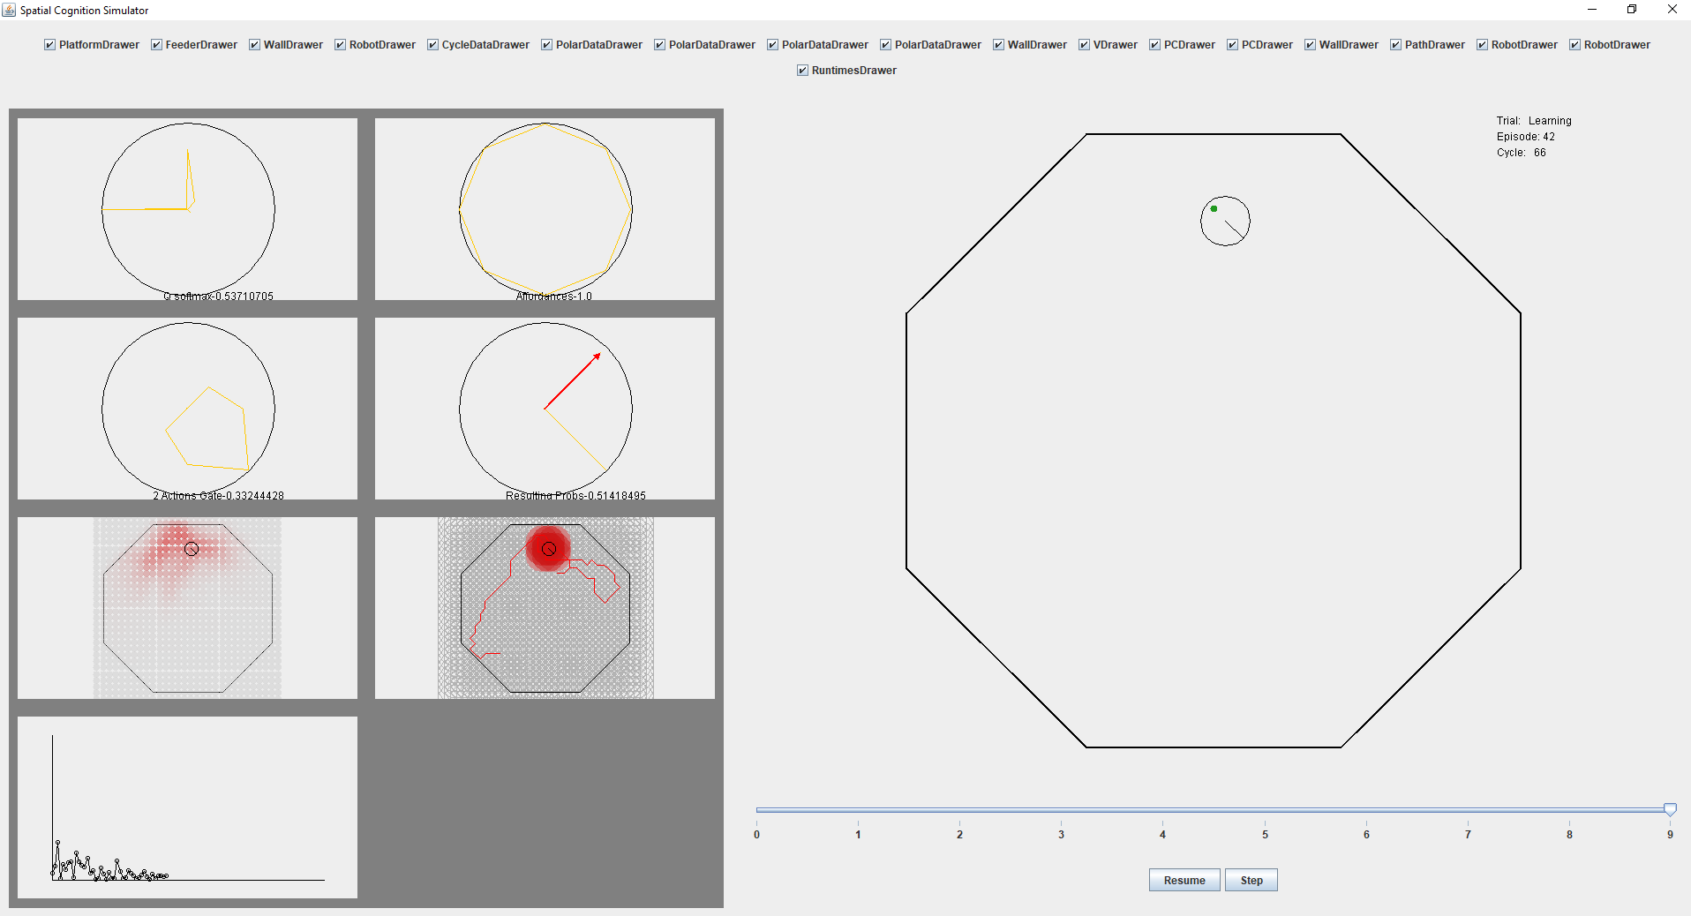
Issue 4 – For better performance HD cells are required, otherwise it is difficult to distinguish between different scenarios. Take for example the point near the food, that point may end up having a preference for all directions since Radial basis functions generalize the policy value to all vicinity.

Slide 8
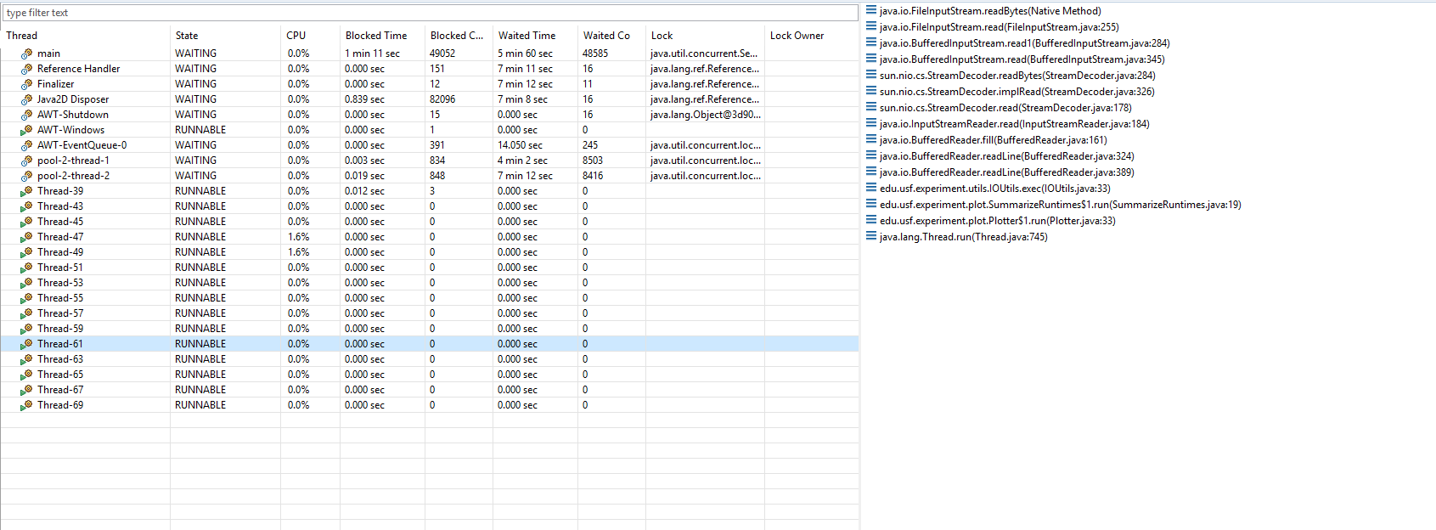
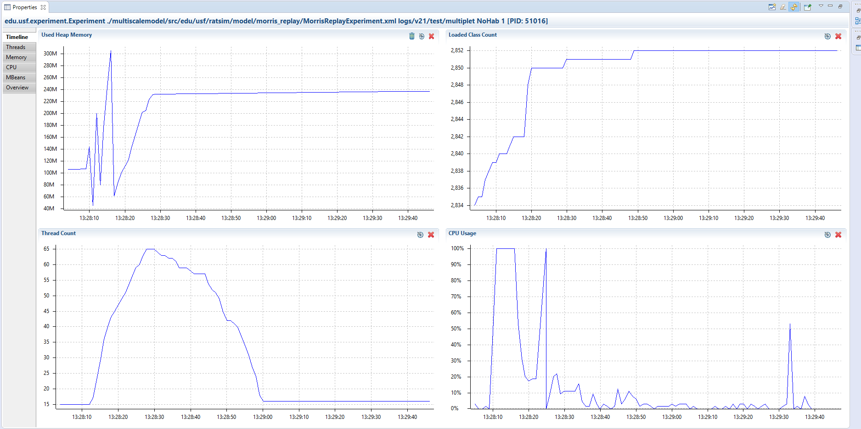
Skipped issue 5 – Matrix update equation, see log Issue 6 – When running in async mode speed at which threads are created is bigger than speed at which they are closed. See following profiler data plots: Cause: plotters and loggers
Current solution: do not use current logs and plots
Future solution: reimplement logging and plotting.

Slide 9

Reproducing issue 5 (said 6 – I think its issue 5): Go to branch v2.1 commit#: 2fd3db47247e46e1500a200db25eca5cf861346c of date: 07/11/2018
Run following configuration

Slide 10
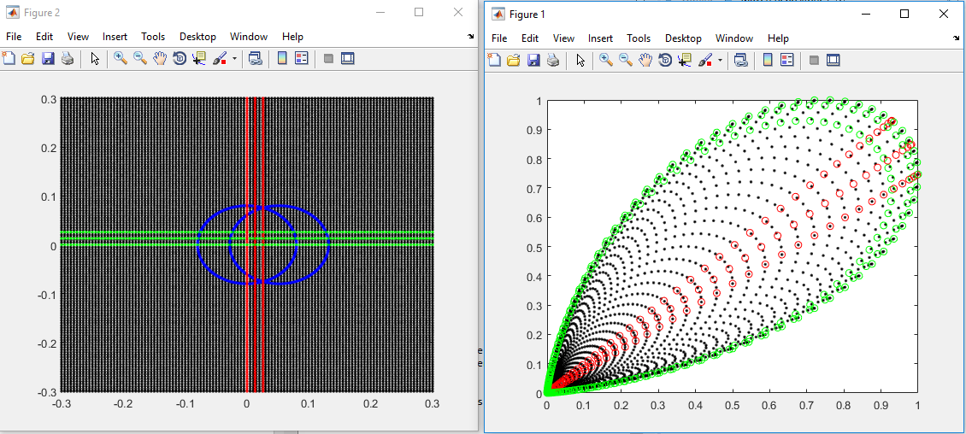
Observation 7: PC vector space. 2 Place cells (in blue) located on the x axis. Radius=0.08, separation=0.65*radius. Figure on left shows space as x,y coordinates. Figure on right shows space as PC1, PC2 coordinates. Most points translate to coordinates 0,0. In simulation, the lowest possible activation is 0.2
Archivo: c:\Users\bucef\Documents\Matlab\Pcspace.m

Slide 11
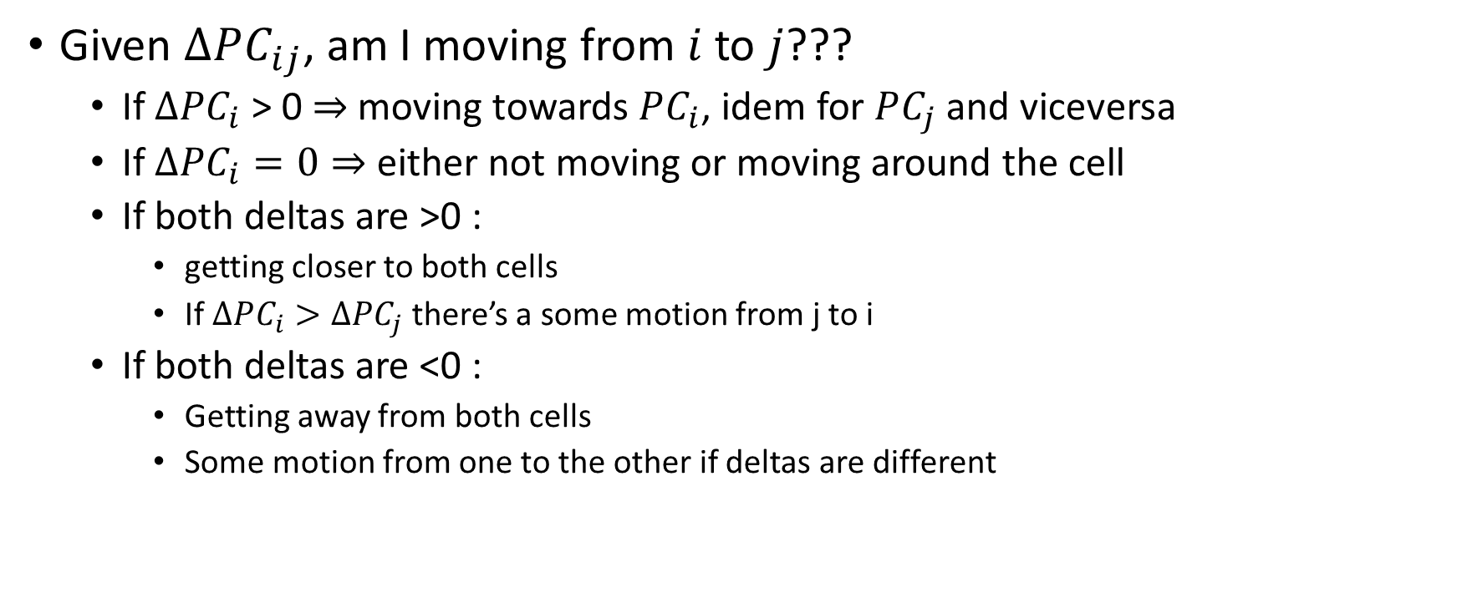
PC Space Analysis
Given $ΔPC_{ij}$, am I moving from $i$ to $j$???
If $ΔPC_{i}$ > 0 $⇒$moving towards $PC_{i}$, idem for $PC_{j}$ and viceversa
If $ΔPC_{i}=0⇒$ either not moving or moving around the cell
If both deltas are >0 :
getting closer to both cells
If $ΔPC_{i}>ΔPC_{j}$ there’s a some motion from j to i
If both deltas are <0 :
Getting away from both cells
Some motion from one to the other if deltas are different

Slide 12
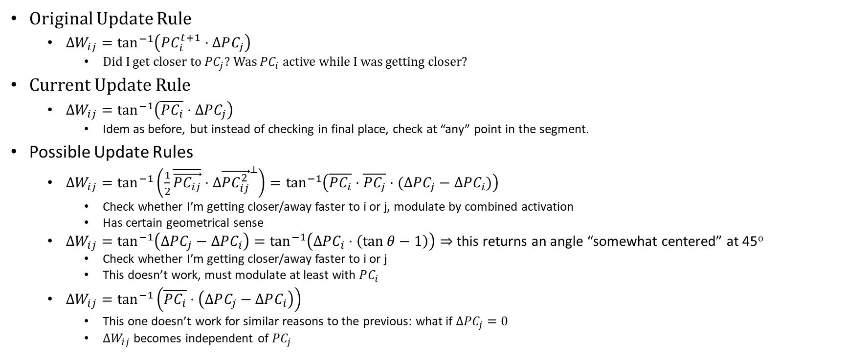
Current Update Rule
Original Update Rule
$ΔW_{ij}=\tan^{−1}\left(PC_{i}^{t+1}⋅ΔPC_{j}\right)$
Did I get closer to $PC_{j}$? Was $PC_{i}$ active while I was getting closer?
Current Update Rule
$ΔW_{ij}=\tan^{−1}\left(\overline{PC_{i}}⋅ΔPC_{j}\right)$
Idem as before, but instead of checking in final place, check at “any” point in the segment.
Possible Update Rules
$ΔW_{ij}=\tan^{−1}\left(\frac{1}{2}\overline{\vec{PC_{ij}}}⋅Δ{\vec{PC_{ij}^{2}}}^{⊥}\right)=\tan^{−1}\left(\overline{PC_{i}}⋅\overline{PC_{j}}⋅(ΔPC_{j}−ΔPC_{i})\right)$
Check whether I’m getting closer/away faster to i or j, modulate by combined activation
Has certain geometrical sense
$ΔW_{ij}=\tan^{−1}\left(ΔPC_{j}−ΔPC_{i}\right)=\tan^{−1}\left(ΔPC_{i}⋅\left(\tan{θ}−1\right)\right)⇒$ this returns an angle “somewhat centered” at 45º
Check whether I’m getting closer/away faster to i or j
This doesn’t work, must modulate at least with $PC_{i}$
$ΔW_{ij}=\tan^{−1}\left(\overline{PC_{i}}⋅\left(ΔPC_{j}−ΔPC_{i}\right)\right)$
This one doesn’t work for similar reasons to the previous: what if $ΔPC_{j}=0$
$ΔW_{ij}$ becomes independent of $PC_{j}$

Slide 13
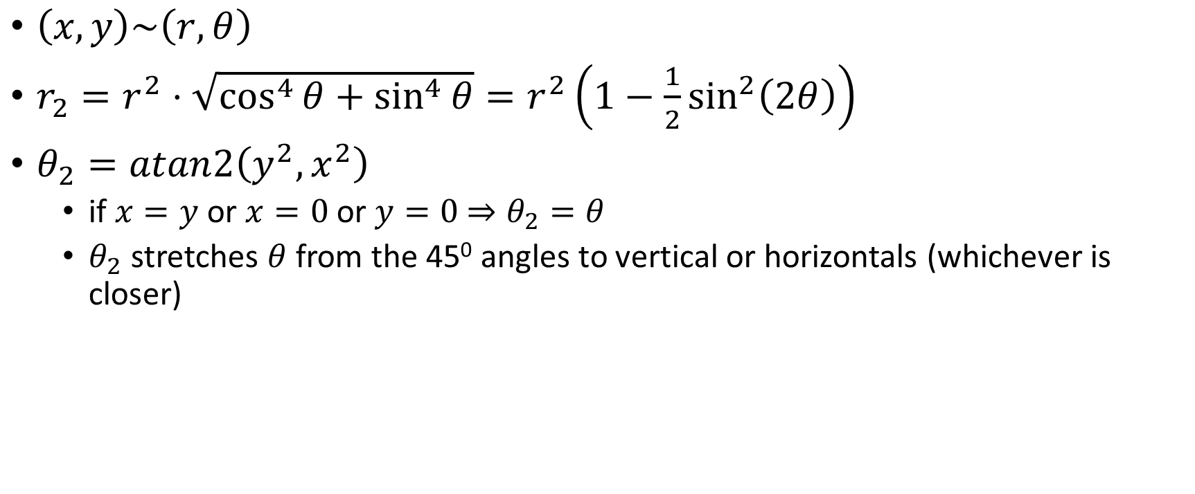

Conversion $\left(x,y\right)→(x^{2},y^{2})$
$\left(x,y\right)\sim \left(r,θ\right)$
$r_{2}=r^{2}⋅\sqrt{\cos^{4}{θ}+\sin^{4}{θ}}=r^{2}\left(1−\frac{1}{2}\sin^{2}\left(2θ\right)\right)$
$θ_{2}=atan2\left(y^{2},x^{2}\right)$
if $x=y$ or $x=0$ or $y=0$ $⇒θ_{2}=θ$
$θ_{2}$ stretches $θ$ from the 45⁰ angles to vertical or horizontals (whichever is closer)

Slide 14
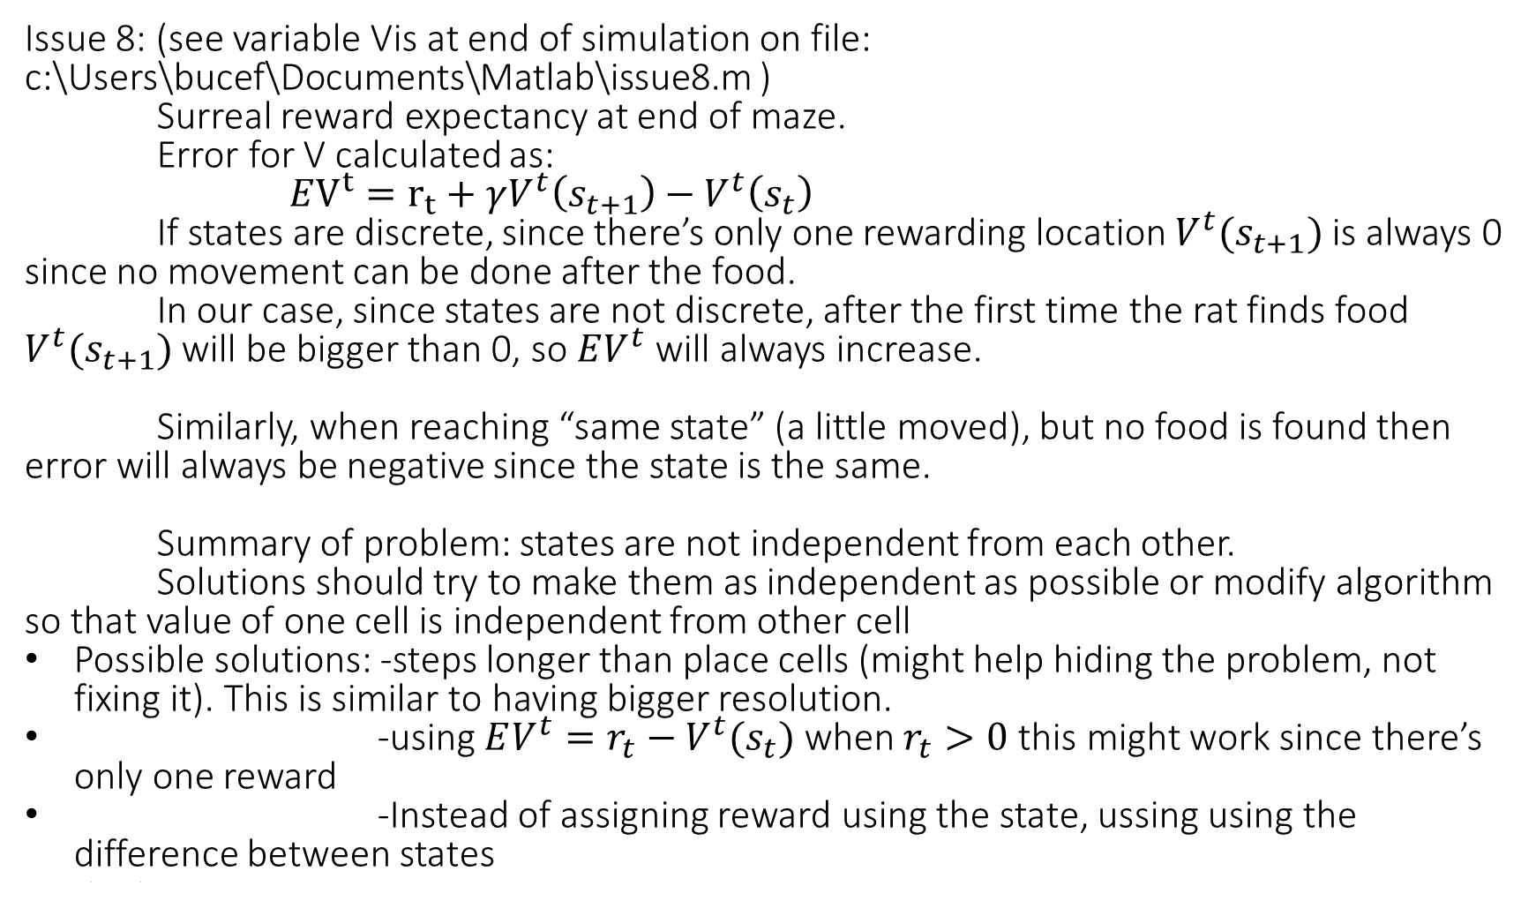
Issue 8: (see variable Vis at end of simulation on file: c:\Users\bucef\Documents\Matlab\issue8.m ) Surreal reward expectancy at end of maze.
Error for V calculated as:
$EV^{t}=r_{t}+γV^{t}\left(s_{t+1}\right)−V^{t}\left(s_{t}\right)$
If states are discrete, since there’s only one rewarding location $V^{t}(s_{t+1})$ is always 0 since no movement can be done after the food.
In our case, since states are not discrete, after the first time the rat finds food $V^{t}(s_{t+1})$ will be bigger than 0, so $EV^{t}$ will always increase.
Similarly, when reaching “same state” (a little moved), but no food is found then error will always be negative since the state is the same.
Summary of problem: states are not independent from each other.
Solutions should try to make them as independent as possible or modify algorithm so that value of one cell is independent from other cell
Possible solutions: -steps longer than place cells (might help hiding the problem, not fixing it). This is similar to having bigger resolution.
-using $EV^{t}=r_{t}−V^{t}(s_{t})$ when $r_{t}>0$ this might work since there’s only one reward
-Instead of assigning reward using the state, ussing using the difference between states
s

Slide 15
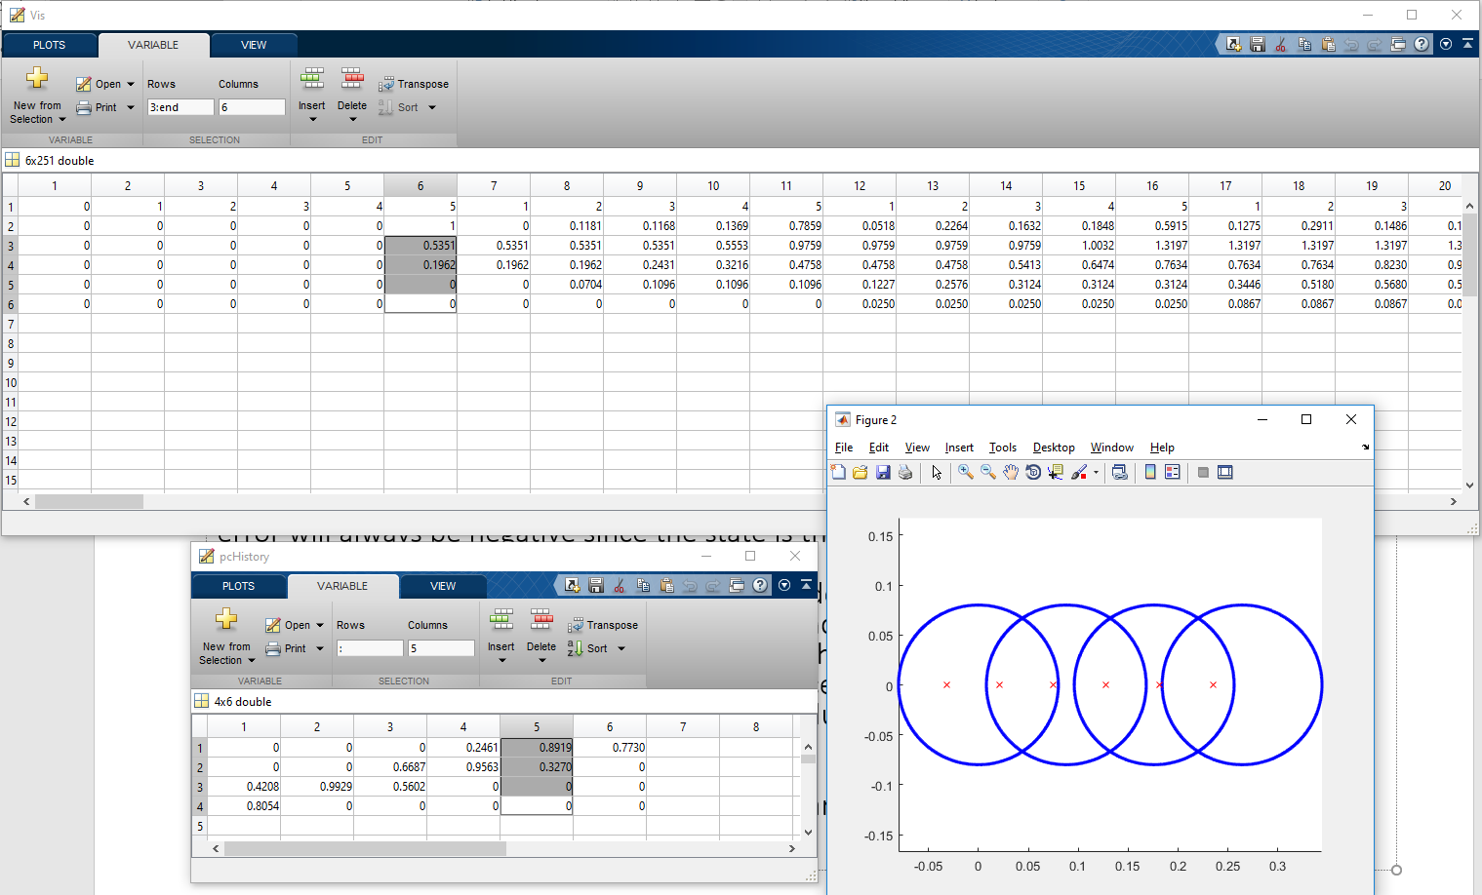
Issue 8 sample output:

Slide 16
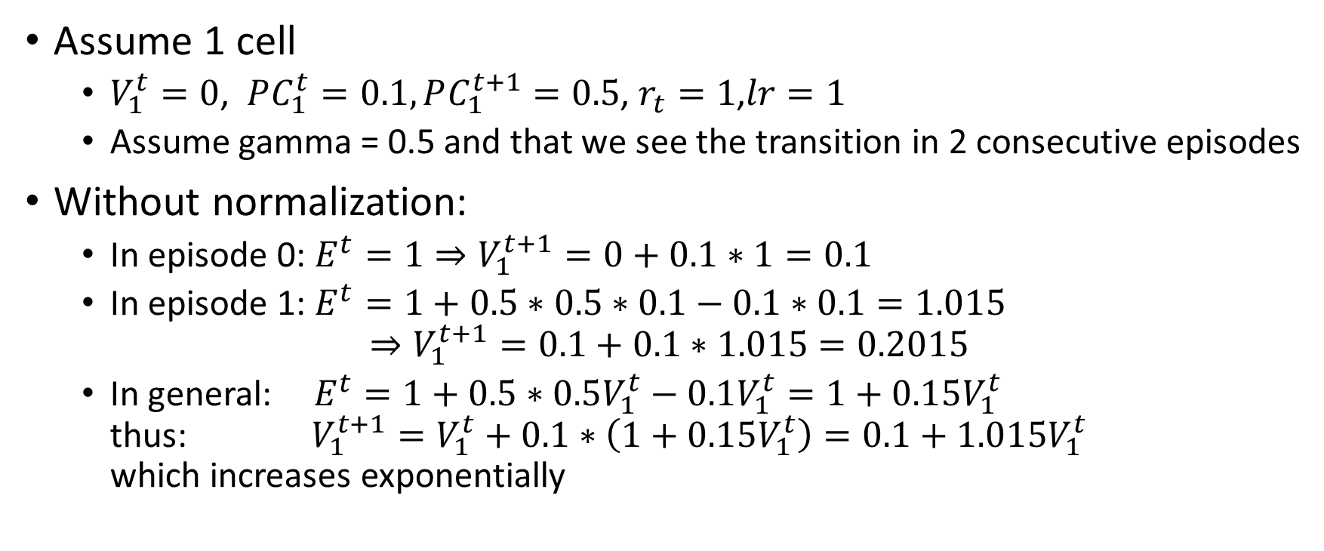
Issue 8 simpler example: (without normalization)
Assume 1 cell
$V_{1}^{t}=0$, $PC_{1}^{t}=0.1, PC_{1}^{t+1}=0.5$, $r_{t}=1$,$lr=1$
Assume gamma = 0.5 and that we see the transition in 2 consecutive episodes
Without normalization:
In episode 0: $E^{t}=1⇒V_{1}^{t+1}=0+0.1∗1=0.1$
In episode 1: $E^{t}=1+0.5∗0.5∗0.1−0.1∗0.1=1.015$ $⇒V_{1}^{t+1}=0.1+0.1∗1.015=0.2015$
In general: $E^{t}=1+0.5∗0.5V_{1}^{t}−0.1V_{1}^{t}=1+0.15V_{1}^{t}$ thus: $V_{1}^{t+1}=V_{1}^{t}+0.1∗\left(1+0.15V_{1}^{t}\right)=0.1+1.015V_{1}^{t}$ which increases exponentially

Slide 17
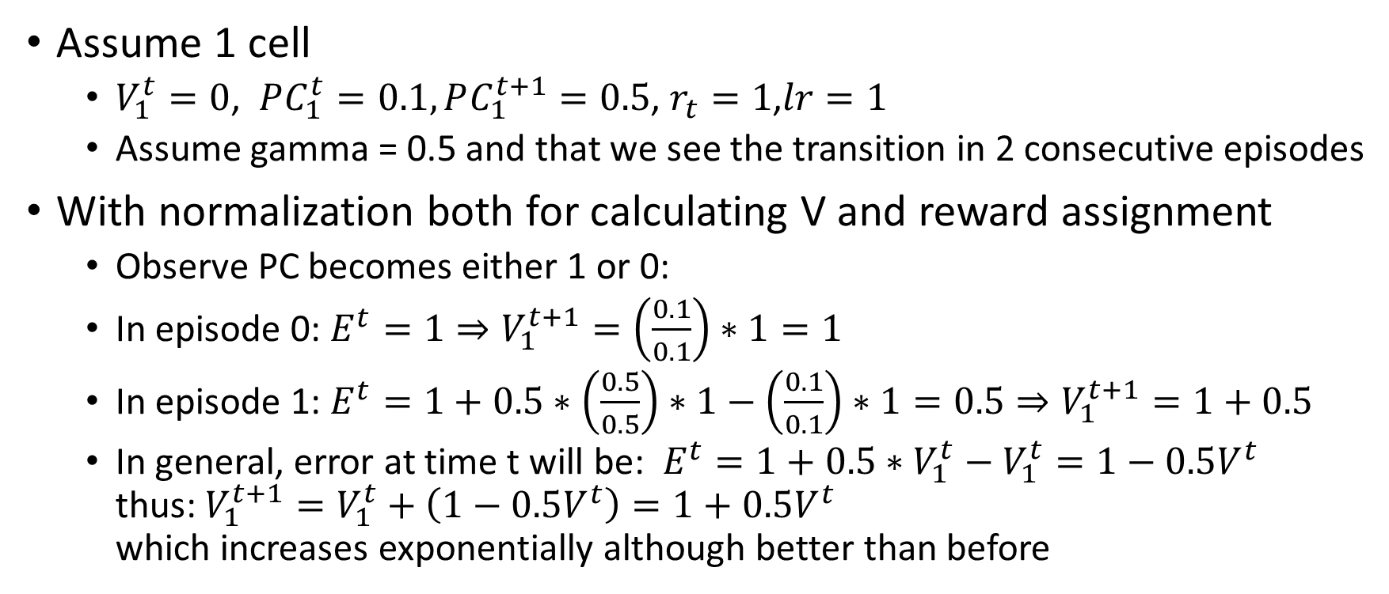
Issue 8 simpler example: (with normalization both in calculating V and reward assignment)
Assume 1 cell
$V_{1}^{t}=0$, $PC_{1}^{t}=0.1, PC_{1}^{t+1}=0.5$, $r_{t}=1$,$lr=1$
Assume gamma = 0.5 and that we see the transition in 2 consecutive episodes
With normalization both for calculating V and reward assignment
Observe PC becomes either 1 or 0:
In episode 0: $E^{t}=1⇒V_{1}^{t+1}=\left(\frac{0.1}{0.1}\right)∗1=1$
In episode 1: $E^{t}=1+0.5∗\left(\frac{0.5}{0.5}\right)∗1−\left(\frac{0.1}{0.1}\right)∗1=0.5⇒V_{1}^{t+1}=1+0.5$
In general, error at time t will be: $E^{t}=1+0.5∗V_{1}^{t}−V_{1}^{t}=1−0.5V^{t}$ thus: $V_{1}^{t+1}=V_{1}^{t}+\left(1−0.5V^{t}\right)=1+0.5V^{t}$ which increases exponentially although better than before

Slide 18
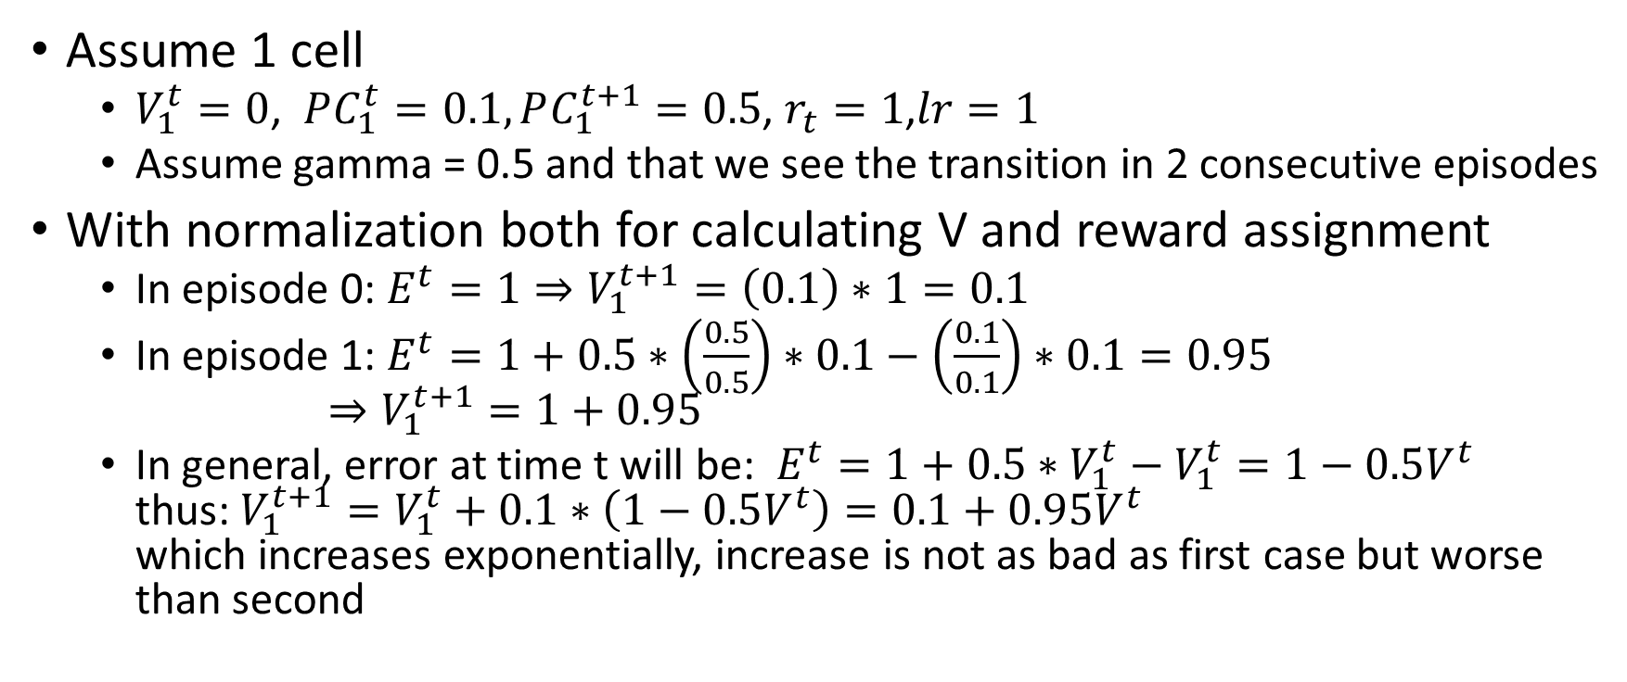
Issue 8 simpler example: (with normalization only for calculating V)
Assume 1 cell
$V_{1}^{t}=0$, $PC_{1}^{t}=0.1, PC_{1}^{t+1}=0.5$, $r_{t}=1$,$lr=1$
Assume gamma = 0.5 and that we see the transition in 2 consecutive episodes
With normalization both for calculating V and reward assignment
In episode 0: $E^{t}=1⇒V_{1}^{t+1}=\left(0.1\right)∗1=0.1$
In episode 1: $E^{t}=1+0.5∗\left(\frac{0.5}{0.5}\right)∗0.1−\left(\frac{0.1}{0.1}\right)∗0.1=0.95$ $⇒V_{1}^{t+1}=1+0.95$
In general, error at time t will be: $E^{t}=1+0.5∗V_{1}^{t}−V_{1}^{t}=1−0.5V^{t}$ thus: $V_{1}^{t+1}=V_{1}^{t}+0.1∗\left(1−0.5V^{t}\right)=0.1+0.95V^{t}$ which increases exponentially, increase is not as bad as first case but worse than second

Slide 19
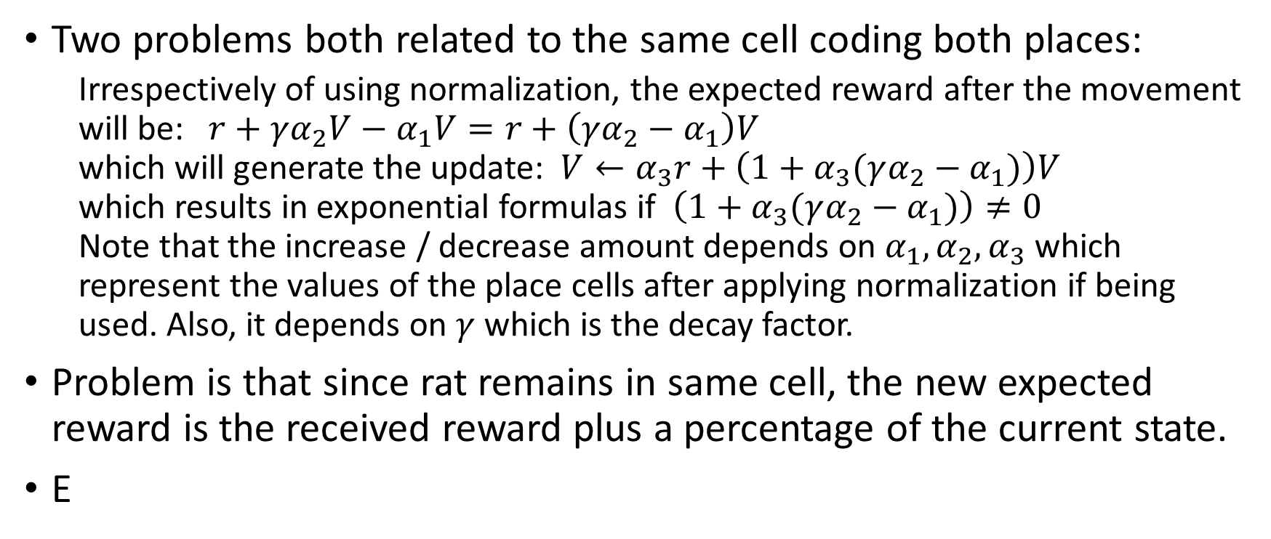
Issue 8 – simple example summary
Two problems both related to the same cell coding both places:
Irrespectively of using normalization, the expected reward after the movement will be: $r+γα_{2}V−α_{1}V=r+\left(γα_{2}−α_{1}\right)V$ which will generate the update: $V←α_{3}r+\left(1+α_{3}(γα_{2}−α_{1})\right)V$ which results in exponential formulas if $\left(1+α_{3}(γα_{2}−α_{1})\right)≠0$ Note that the increase / decrease amount depends on $α_{1}, α_{2}, α_{3}$ which represent the values of the place cells after applying normalization if being used. Also, it depends on $γ$ which is the decay factor.
Problem is that since rat remains in same cell, the new expected reward is the received reward plus a percentage of the current state.
E

