Slide 1
Barbian RNAseq Study (bulk)
EICC Project ID: RJO12354

Slide 2
RNASeq Analysis Workflow
QC at .fastq stage
FastQC , Fastq-Screen, MultiQC, & Trimmomatic
Alignment to reference genome
STAR – mm10 genome for Mus musculus, UCSC
Sort and index .bam files
Generation of raw counts from alignment .bam files
featureCounts
Differential Expression Analysis
DESeq2
Notes: Please see our RNASeq (bulk) analysis page in our Methods section for a publication-friendly write-up of our workflow

Slide 3
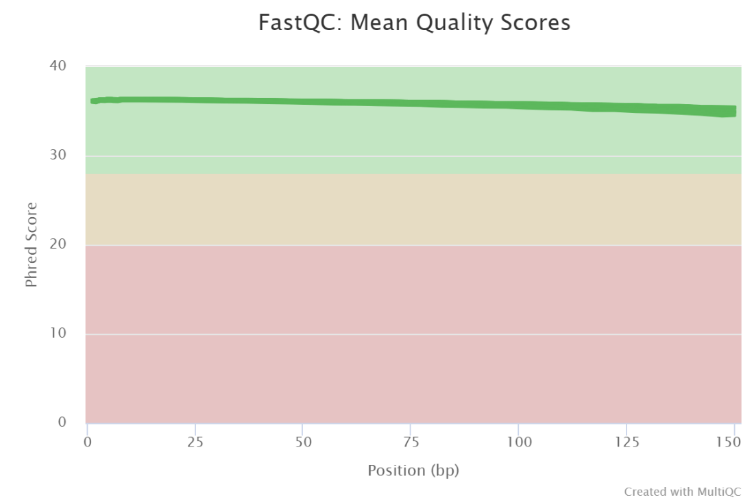
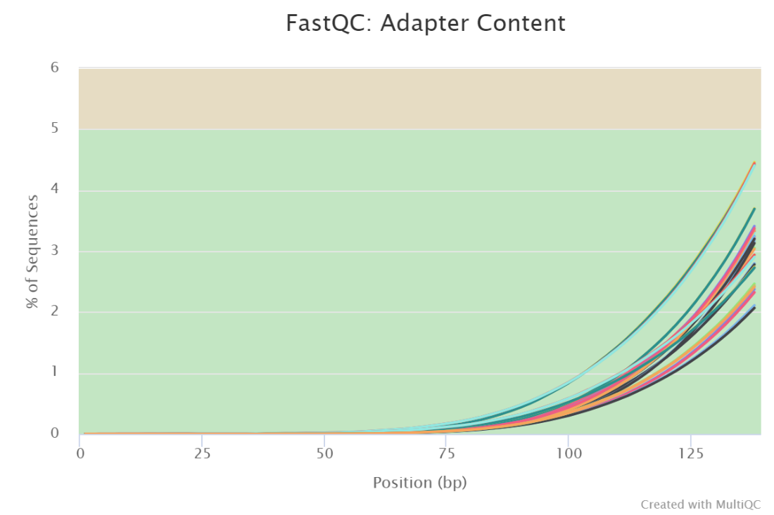
FastQC
Mean Quality Scores – Untrimmed reads
Data yields were between 52.4 M – 59.2 M reads/samples
PHRED33 scores >35; excellent
Reads had lots of Illumina adapter content

Slide 4
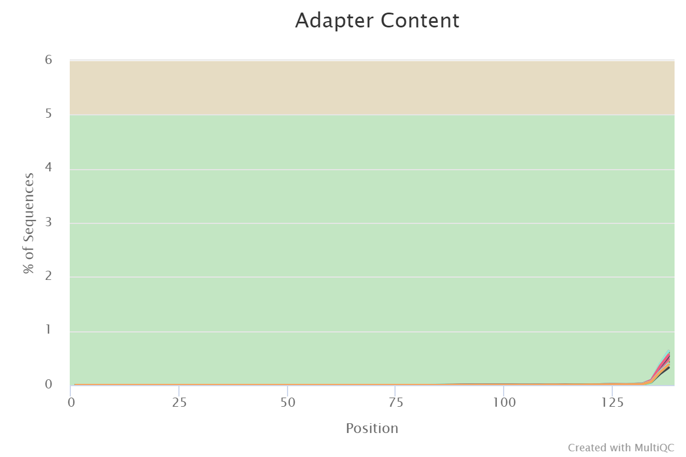
FastQC
Mean Quality Scores –Trimmed reads
Data yields were between 52.4M – 59.2M reads/samples
Trimmomatic used to remove Illumina adapters from your reads.

Slide 5
STAR alignment
STAR was run to align compressed *.fastq.gz files against the mm10 reference genome (UCSC)
Annotations from UCSC were also used to determine gene content that would later be used to derive counts
Using samtools, resulting .sam alignment files converted to .bam, sorted, and then indexed prior to running through featureCounts to capture raw RNAseq “counts” per gene

Slide 6
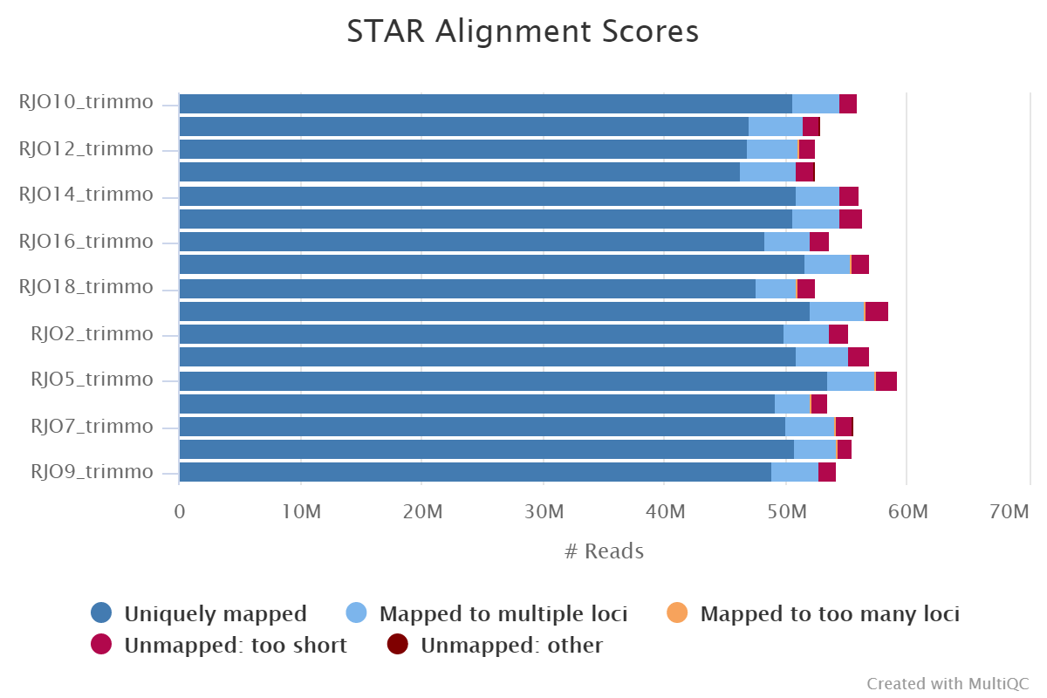
STAR alignment - Statistics
88.3-91.1% uniquely aligned reads
Good quality alignment from the reads, all >85%

Slide 7
featureCounts count table generation
The .bam files from the STAR alignment step were compared to the USCS mm10 annotation using featureCounts to convert gene annotation and alignment information into a counts table for each sample
The resulting raw counts file was then used for differential expression analyses.
See our Methods section for a publication-friendly format of our workflow

Slide 8
Data
17 samples prepared and analyzed
9 butyrate-treated samples and 8 control samples
1 group compared: Butyrate vs control samples

Slide 9
Hypothesis
With DEG analysis using the Wald test we are looking to reject the idea that the variances (s) in two groups of samples are the same
Hnull: s in group A = s in group B (no difference)
Halternative: s in group A ≠ s in group B (difference)
Testing this hypothesis will tell us if the differences between the groups are statistically significant. Statistical significance is necessary but not sufficient for clinical significance.

Slide 10
False Discovery Rate (adjusted p-value)
Each gene in typical DE analysis has a p-value generated as a single hypothesis test but it was one of multiple genes/hypotheses tested
Adjusting the p-value corrects for the multiple hypotheses tested by scaling each p-value by the number of genes/hypotheses tested starting at the smallest p-value
If more than one gene is examined for DE analysis, FDR (adjusted p-value) should be reported instead of p-value and not in combination

Slide 11
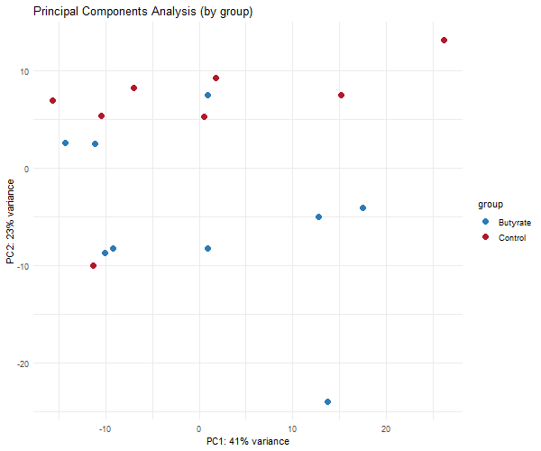
Bulk RNASeq: PCA plot (by treatment group)
23% of the differences between these samples is due to them belonging to different groups
Suggests that we should be able to detect some differences if they exist

Slide 12
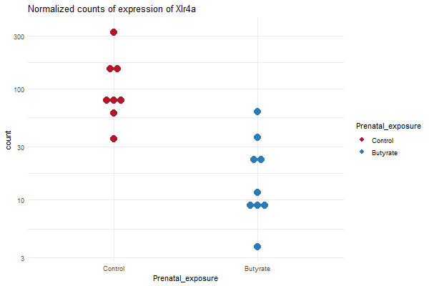
Bulk RNASeq: Counts plot
In order to describe the differences in expression within each animal, I generated plots of the normalized counts of the gene with the lowest FDR in the results
This is consistent with the PCA plot in that it shows the animals were each affected by exposure and in the case of this gene that their expressions were altered very similarly with little variation between individuals
These plots can be created with any gene of interest upon request

Slide 13
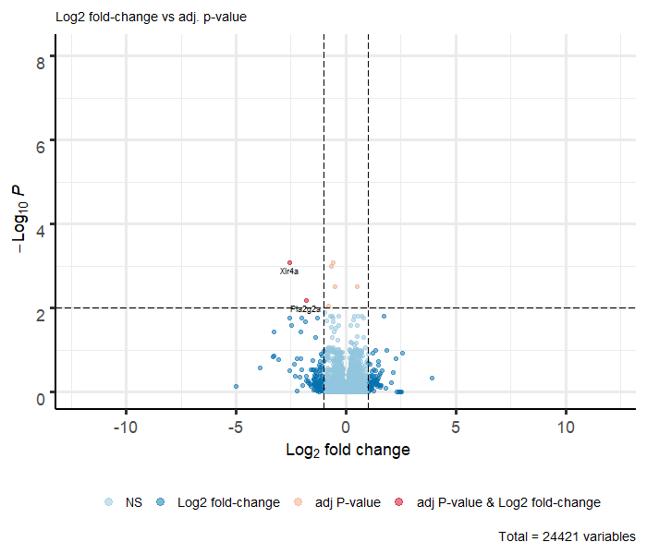
Bulk RNASeq: Volcano plot
FDR ≤ 0. 01
Log(2) Fold change cutoff on graph set at 1.0
11 (0.05%) up regulated genes
26 (0.13%) down regulated genes
No outlier genes removed by Cook’s distance criteria
3189 (15 %) of genes filtered for mean normalized counts < 2
Genes have been identified with their gene symbol or name

Slide 14
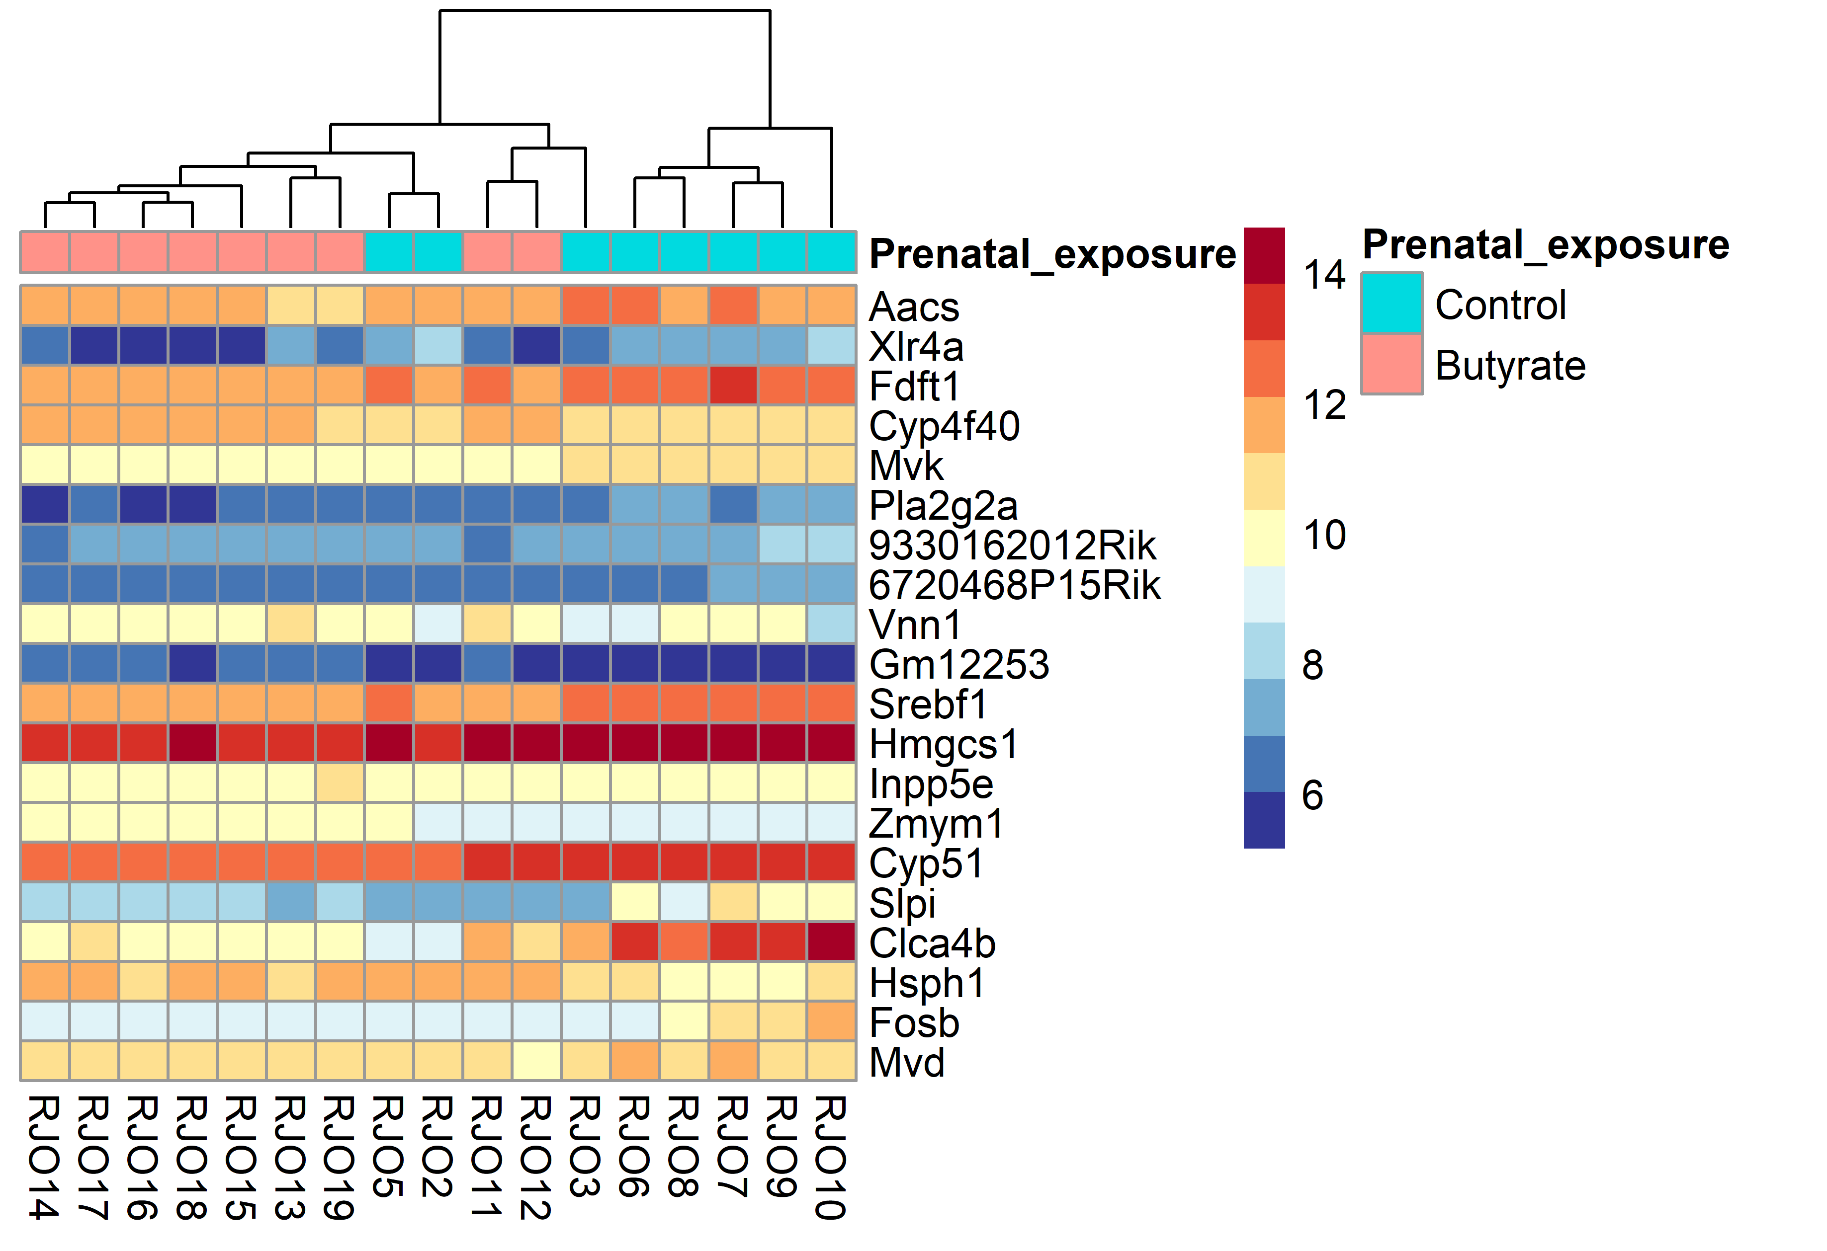
Bulk RNASeq: Heatmap
Heatmap:
Color and intensity of the boxes represent counts transformed using a variance stabilizing transformation (vst) which is similar to a log2 transformation but accounts for the sampling variability of genes with low counts
Red indicates vst transformed counts closer to 16 and blue indicates vst transformed counts closer to 8
Genes are sorted by lowest local FDR
Samples show some separation by group in DE genes, genes in Butyrate group largely down regulated

Slide 15
Files in Box folder
Summary Presentation
Qc
scripts for trimming and generating QC report
Qc reports
DE Analysis
DE genes
vst transformed counts
mean normalized counts
Graphs
PCA plots
counts plots
heat maps
volcano plots

Slide 16
References
Anders, S., Pyl, P. T. & Huber, W. HTSeq-A Python framework to work with high-throughput sequencing data. Bioinformatics (2015). doi:10.1093/bioinformatics/btu638
Blighe, K., (2019). EnhancedVolcano: Publication-ready volcano plots with enhanced colouring and labeling. R package version 1.2.0. https://github.com/kevinblighe/EnhancedVolcano
Dobin, A. et al. STAR: Ultrafast universal RNA-seq aligner. Bioinformatics (2013). doi:10.1093/bioinformatics/bts635
Ewels, P., Magnusson, M., Lundin, S. & Käller, M. MultiQC: Summarize analysis results for multiple tools and samples in a single report. Bioinformatics 32, 3047–3048 (2016).
Kirill Müller (2017). here: A Simpler Way to Find Your Files. R package version 0.1. https://CRAN.R-project.org/package=here
Love, M. I., Anders, S. & Huber, W. Differential analysis of count data - the DESeq2 package. Genome Biology (2014). doi:110.1186/s13059-014-0550-8
Raivo Kolde (2019). pheatmap: Pretty Heatmaps. R package version 1.0.12. https://CRAN.R-project.org/package=pheatmap
Sam Firke (2020). janitor: Simple Tools for Examining and Cleaning Dirty Data. R package version 1.2.1. https://CRAN.R-project.org/package=janitor
Tony Fischetti (2019). assertr: Assertive Programming for R Analysis Pipelines. R package version 2.6. https://CRAN.R-project.org/package=assertr
Wickham et al., (2019). Welcome to the tidyverse. Journal of Open Source Software, 4(43), 1686, https://doi.org/10.21105/joss.01686
Hadley Wickham, Jim Hester and Romain Francois (2018). readr: Read Rectangular Text Data. R package version 1.3.1. https://CRAN.R-project.org/package=readr
Wolfgang Huber, Anja von Heydebreck, Holger Sueltmann, Annemarie Poustka and Martin Vingron. Variance Stabilization Applied to Microarray Data Calibration and to the Quantification of Differential Expression. Bioinformatics 18, S96-S104 (2002).
Zhu A, Ibrahim JG, Love MI (2018). “Heavy-tailed prior distributions for sequence count data: removing the noise and preserving large differences.” Bioinformatics. doi: 10.1093/bioinformatics/bty895.

