Slide 1
BioRuby and the KEGG API
Toshiaki Katayama
k@bioruby.org
Bioinformatics center, Kyoto U., Japan
Notes:
Good afternoon, I'm Katayama from Kyoto University, located in Japan.
I'll talk about the BioRuby and the KEGG API -- a new feature of KEGG database.
This is my first time to make an oral presentation in English, so my explanation might be insufficient. In such a case,

Slide 2
Use the source!
Notes:
... please consult the source code as always. Or ask me during ISMB, of course.

Slide 3
What is BioRuby?
Yet another BioPerl written in Ruby
  since Nov 2000
Developed in Japan
  includes support for Japanese resources like KEGG
Notes:
OK, what is the BioRuby? BioRuby is a project similar to BioPerl, Biopython and BioJava which made a library for Bioinformatics.
BioRuby project starts in November 2000 and have been developed by Japanese community.
From this background, BioRuby contains a lot of supports for Japanese bioinformatics resources like KEGG.

Slide 4
So, what is Ruby?
Scripting language
  clean syntax, v. easy to use/read/write
Everything is object
  Integer, String, Regexp, Exception etc. w/o exception
Created by Japanese author 'matz'
Notes:
So, what is ruby? Ruby is an object oriented scripting language.
Ruby has simple and clean syntax, so the program becomes easy to understand for everyone.
In Ruby, everything is object without exception. Exception is also an object.
Numbers are object, String, Array, Hash and Regular Expression are object. Everything.
This simple rule and the powerful syntax enable a small code can do a lot.
Regular expression is built-in and its capability is same as Perl's.
Most object can make use of built in Iterator for many purposes.
These features are good for Bioinformatics especially in text handring.
Additionally, Ruby is made by Japanese. That's one reason I started ruby.

Slide 5

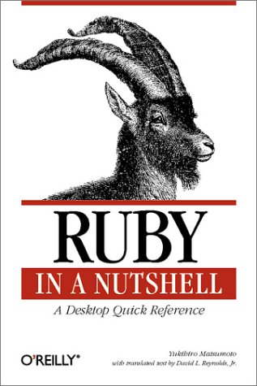
So, what is Ruby?
Pre-installed in Mac OS X !
Notes:
If you are using Mac OS X, you are ready to try ruby.
(But I know some files needed for developers are missing in the default instllation.
So if you became a ruby hacker, you should re-install ruby by yourself.)
But, I'm using on Linux, usually.

Slide 6
What the Ruby code looks like?
#!/usr/bin/ruby
puts "Hello world!"
Notes:
Here is a classic sample code.

Slide 7
What the BioRuby code looks like?
#!/usr/bin/env ruby
require 'bio'
gene = Bio::Seq::NA.new("catgaattattgtagannntgataaagacttgac")
prot = gene.translate
# => "HELL*XW*RLD" (Bio::Seq::AA object)
puts prot.split('X').join(' ').capitalize.gsub(/\*/, 'o') << '!'
# => "Hello World!"
Notes:
Here's more complex version of the same program.
In BioRuby, you can treat nucleic acid and amino acid Sequence as a String object having biological methods.

Slide 8
Bio::Sequence
Bio::Sequence (aliased to Bio::Seq)
  seq.composition
  seq.window_search
  seq.randomize
  seq.to_fasta
Bio::Sequence::NA
  seq.complement
  seq.splicing
  seq.translate
  seq.to_re
Bio::Sequence::AA
  seq.molecular_weight
#!/usr/bin/env ruby
require 'bio'
seq = Bio::Seq::NA.new("atggcttcagt..
seq.window_search(15, 3) do |sub|
puts sub.translate.molecular_weight
end
Notes:
like this.

Slide 9
What BioRuby can do more?
Biological sequence manipulations
Run applications (Blast etc.) and parse its report
Database entry retrieval, parsing
PubMed reference DB search, reformatting
Accessing OBDA, DAS, KEGG API

Slide 10
Bio::Applications
Bio::Blast, Fasta, HMMER, EMBOSS
Bio::Genscan
Bio::PSORT, TargetP
Bio::SOSUI, TMHMM
  each contains Report class for parsing the results
Notes:
BioRuby can use these applications.
Especially, Blast and Fasta can be executed for local and remote server in the unified way.
Most of these classes also have "Bio::*::Report" class for parsing the application's report.

Slide 11
example
#!/usr/bin/env ruby
require 'bio'
File.open("my_blast_output.xml") do |file|
Bio::Blast.reports(file) do |report|
report.hits do |hit|
puts hit.num, hit.query_id, hit.target_id,
hit.bit_score, hit.evalue, hit.overlap
end
end
end
Notes:
This scripts extract hits and the scores from blast XML output.
You can also get into more detail of the each HSP by iterating on each Hit object.

Slide 12
Bio::DB
Bio::GenBank, EMBL, SwissProt, ...
Bio::FastaFormat, GFF, GO
Bio::MEDLINE, LITDB
Bio::TRANSFAC, PROSITE
Bio::FANTOM
Bio::KEGG::GENES, ENZYME, Microarray, ...
Bio::AAindex
Notes:
BioRuby has parsers for various database formats.
Here, GenBank includes similar format databases like GenPept, Refseq, and DDBJ.
EMBL/Swissprot parser can treat TrEMBL, too.
FANTOM is a mouse cDNA database developed by RIKEN, Japan.
These classes can open its flatfile database and iterates on each entry to extract informations from each field.
Additionally, Bio::FlatFile class can do automatic detection of the file format.

Slide 13
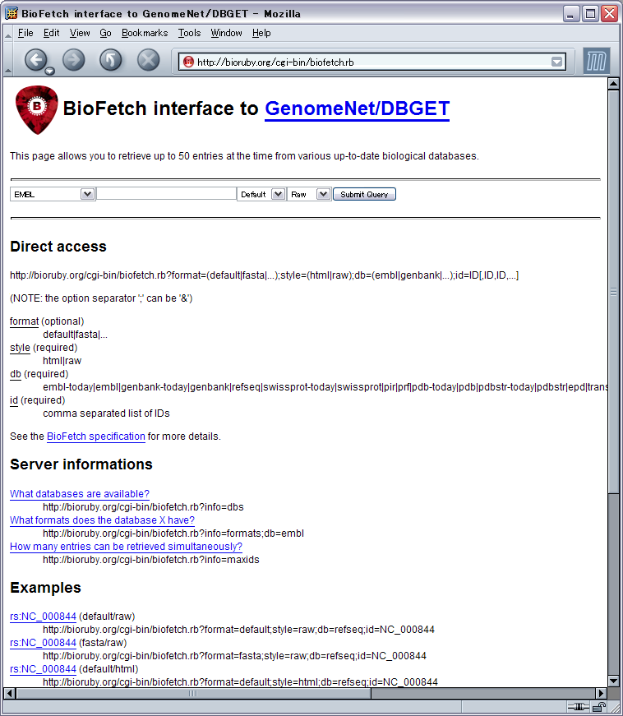
OBDA -- Open Bio* DB Access
Bio::Registry
Bio::Fetch
Bio::FlatFile
Bio::SQL
  +
Bio::DAS
Notes:
These various database entries can be retrieved also by OBDA.
BioFetch uses HTTP and CGI to retrieve the entry from server.
BioRuby provides both BioFetch server and client.
Bio::FlatFile is for local indexing of the flat file database making easy and high speed extraction of the entry.
BioRuby can do both creating and searching the indices.
Bio::SQL is a RDB schema for storing and retrieving the sequence data in MySQL, PostgreSQL and Oracle as described by Hilmer in the previous session.
And, Bio::Registry is a over all configuration wrapper which enable user to specify the protocols and the server locations for each database.
Additionally, this is not in the OBDA spec, BioRuby can access DAS server to retrieve genome annotation data.

Slide 14
OBDA example
~/.bioinformatics/seqdatabase.ini
  [embl]
  protocol=biofetch
  location=http://bioruby.org/cgi-bin/biofetch.rb
  dbname=embl
  [swissprot]
  protocol=biosql
  location=db.bioruby.org
  dbname=biosql
  driver=mysql
  biodbname=sp
  [genbank]
  protcol=flat
  location=/export/database/
  dbname=genbank
#!/usr/bin/env ruby
require 'bio'
reg = Bio::Registry.new
sp = reg.get_database('swissprot')
puts sp.get_by_id('CYC_BOVIN')
gb = reg.get_database('genbank')
puts gb.get_by_id('AA2CG')
Notes:
This is a configuration file of the OBDA called seqdatabase.ini
All the Open Bio* projects uses this file located in /etc/bioinformatics or in user's home directory shown in here.
By using Bio::Registry, user can easily retrieve an entry from the database in the unified way.

Slide 15
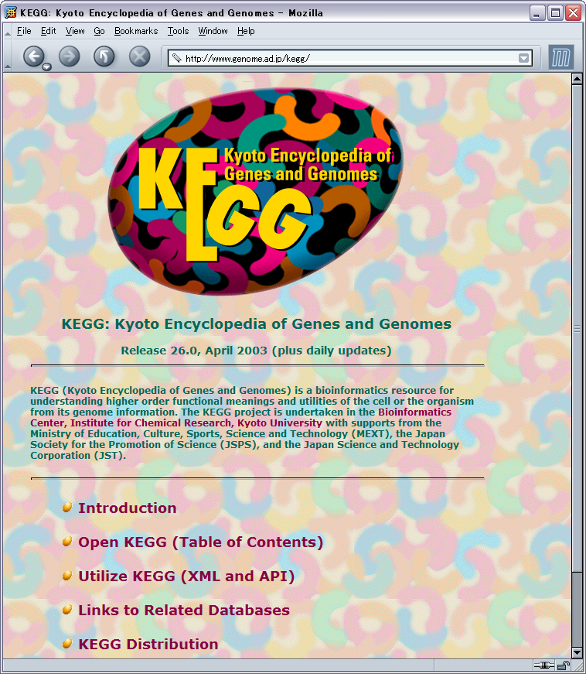
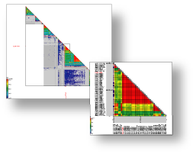
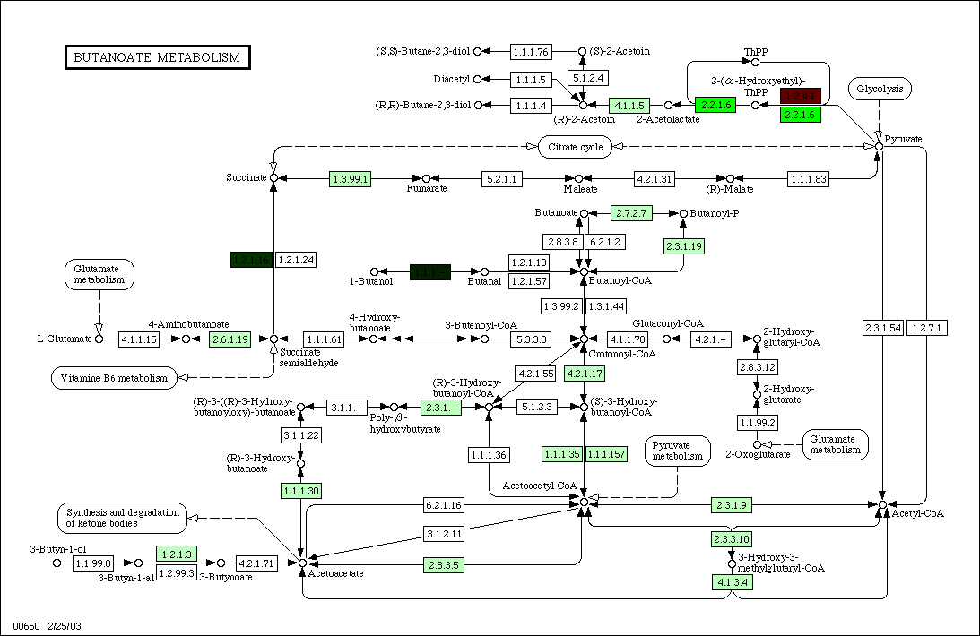
What is KEGG?
GENOME, GENES
PATHWAY
SSDB
etc.
Notes:
OK, next section describes, KEGG and the KEGG API.
Here is a limited summary of the KEGG database. KEGG system consists of a number of databases and tools for analysis.
KEGG GENOME and GENES are manually curated gene annotation and sequence database of all the completed genomes.
Currently up to 144 organisms are included.
(click)
KEGG is also famous for its PATHWAY database including metabolic and other biological pathways.
These are also manually developed in our laboratory and currenty contains 234 diagrams.
(click)
SSDB is a database of the Smith-Waterman scores between all gene combinations in KEGG GENES database.
By using SSDB, user can extract proteomic information such as detecting orthologous gene group, find genes in best-best relation between the organisms and so on.

Slide 16
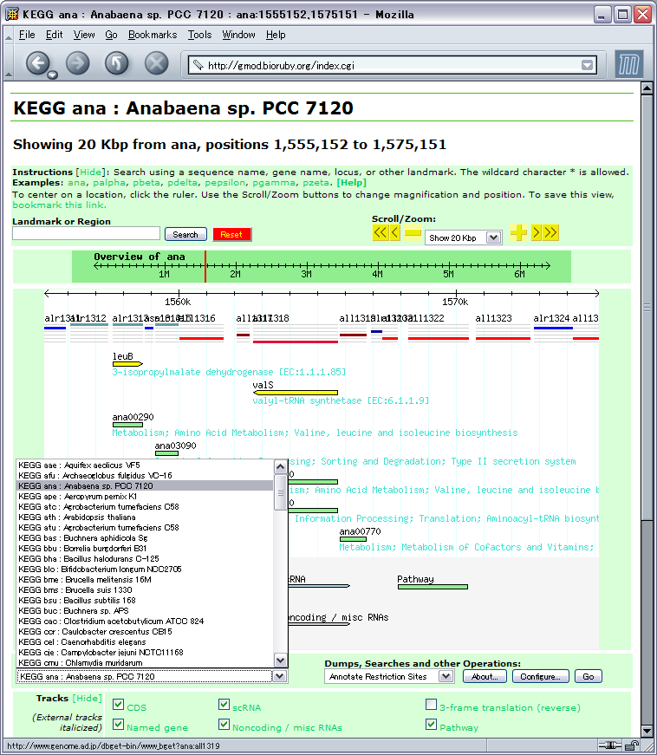
KEGG in GMOD
http://gmod.bioruby.org
Import KEGG/GENES and KEGG/PATHWAY into GMOD browser (converted by BioRuby)
Over 100 organisms in unified form
linked to GENES and PATHWAY database
Notes:
Here is a sample usage of GMOD genome browser to show all the KEGG GENOME and GENES annotations.
You can use this for all the Bacteria, Archaea and Eukaryotes in KEGG.
KEGG data is converted to GFF format by BioRuby.
Each track has links to KEGG GENES and PATHWAY databases.

Slide 17
KEGG API
http://www.genome.ad.jp/kegg/soap/
SOAP/WSDL based web service
  XML, HTTP
Proteome and pathway analysis
  KEGG/GENES
  KEGG/SSDB
  KEGG/PATHWAY
Notes:
OK, let's move to KEGG API.
KEGG API is a new web service based on SOAP and WSDL technology developed to use KEGG from user's program.
Currently, KEGG API supports GENES, SSDB and PATHWAY to make automated procedures of your analysis.

Slide 18
example
ISMB poster D-25
#!/usr/bin/env ruby
require 'bio'
serv = Bio::KEGG::API.new
puts serv.get_best_neighbors_by_gene('eco:b0002')
# serv.get_best_neighbors_by_gene('eco:b0002', 500)
# serv.get_best_neighbors_by_gene('eco:b0002', 500, ['hin', 'syn'])
list = ['ec:1.1.1.1', 'ec:1.2.1.1']
puts serv.get_genes_by_enzymes(list, ['eco', 'syn'])
list = ['eco:b0600', 'eco:b1190']
puts serv.mark_all_pathways_by_genes('eco', list)
Notes:
Here is a short example to demonstrate how to use KEGG API from BioRuby.
Bio::KEGG::API.new automatically retrieve a WSDL file and generates server object to accept all the KEGG API methods.
This 'get_best_neighbors_by_gene' method will search SSDB for best hit in each organism in KEGG and reports the list of gene and its Smith-Waterman score. You can narrow this selection by adding threshold score or specify organisms to search.
The second sample 'get_genes_by_enzymes' will search all genes assigned to the enzyme code 1.1.1.1 and 1.2.1.1 in E. coli and Synecho.
The third example 'mark_all_pathways_by_genes' will search pathways which contains all of the given genes.]
(click, pamphlet)
You can receive this special pamphlet describing all the KEGG API methods at the ISMB poster section D- 25 for more details.

Slide 19
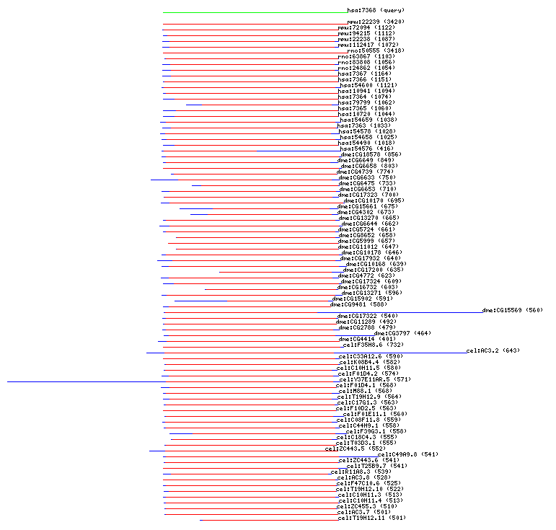
Example : Ortholog cluster and common motif
#!/usr/bin/ruby
require 'bio'
serv = Bio::KEGG::API.new
homologs = serv.get_all_neighbors_by_gene('hsa:7368', 500)
pfams = {}
homologs.each do |g|
motifs = serv.get_common_motifs_by_genes(g[0])
motifs.each do |m|
if m[0] =~ /pf:/
if pfams.key?(m)
pfams[m] << g[0]
else
pfams[m] = [g[0]]
end
end
end
end
pfams.each do |m|
p m
end
Notes:
Here's a schimatic image of real usage of the KEGG API.
Here user extract an orthologous gene group from SSDB by using KEGG API
and find all the common motifs among in them.

Slide 20
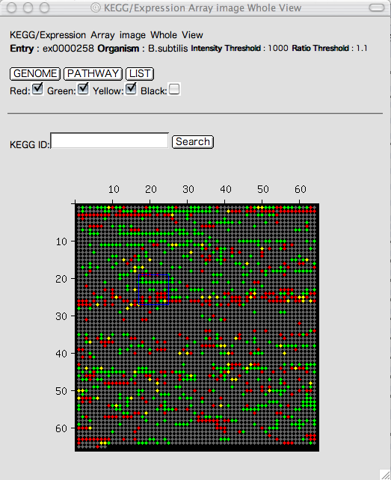
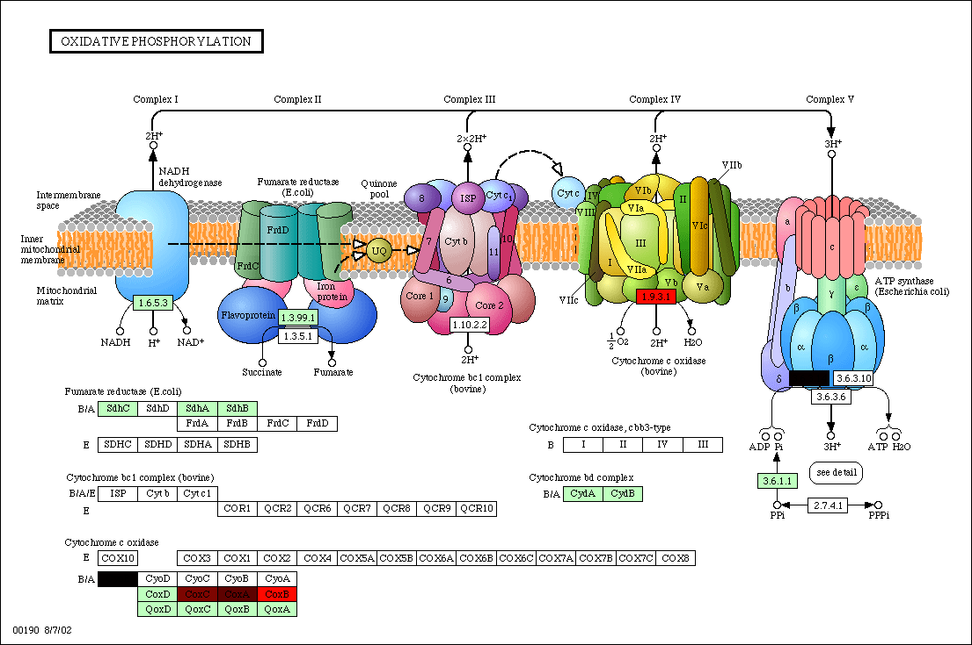
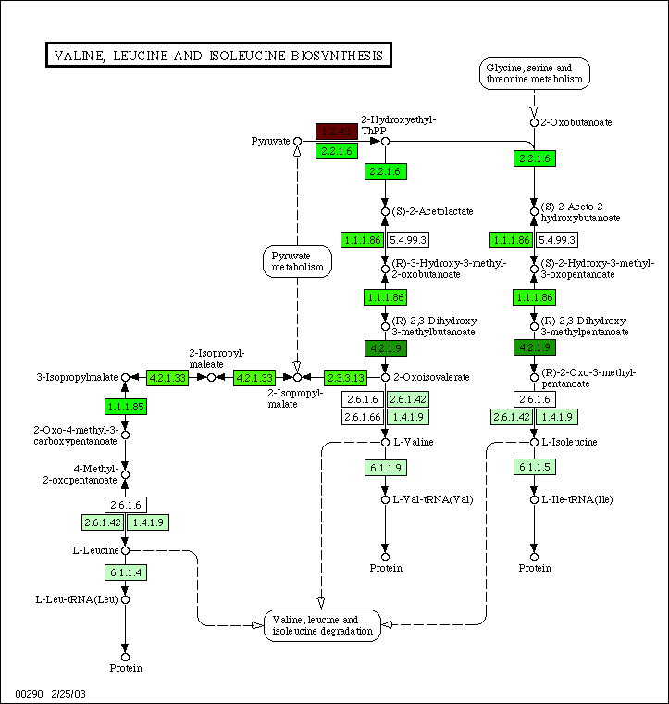
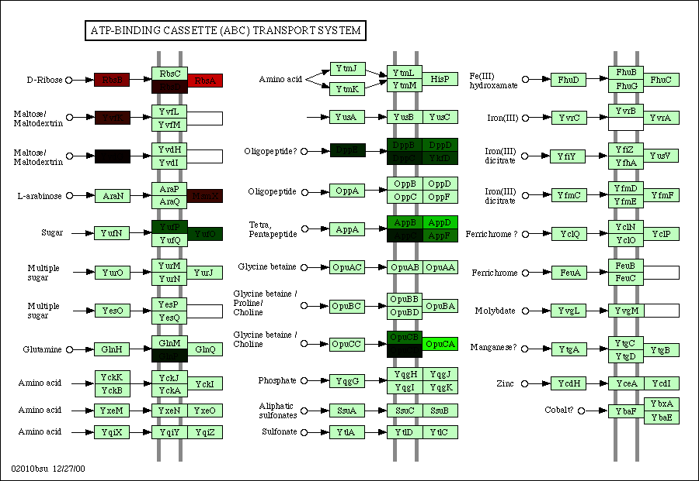
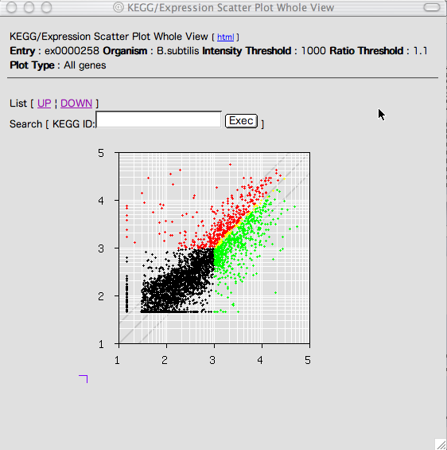
Example: Gene expression and Pathway analysis by KEGG API
serv = Bio::KEGG::API.new
regulated_genes.each do |gene|
map_id = serv.get_pathways_by_genes(["bsu:#{gene[0]}"])
map_id.each do |entry|
entry.gsub!('map', 'bsu')
entry.gsub!('path', 'map')
if map_gene.key?(entry)
map_gene[entry] << gene[0]
else
map_gene[entry] = [gene[0]]
end
end
end
map_gene.each do |k, v|
colors = []
v.each do |g|
colors << "##{ma.orf2rgb[g]}"
end
p serv.color_pathway_by_genes("bsu:#{k}", v, colors)
end
Notes:
This is another real world example.
User have their own microarray data or have a KEGG Microarray database entry.
The data is converted to colorcode by using BioRuby
and colors KEGG PATHWAY diagram by using KEGG API
to see how the pathwa is regulated by gene expression.

Slide 21
Acknowledgement
BioRuby developers
  Naohisa Goto, Mitsuteru Nakao, Yoshinori Okuji, Shuichi Kawashima, Masumi Itoh and many more.
KEGG and KEGG API curators / developers
  Bioinformatics center, Kyoto University, Japan
  Yoko Sato, Shuichi Kawashima, Minoru Kanehisa
Open Bio* community
Notes:
I would like to say thanks for BioRuby and KEGG developers and the Open Bio* community.
(click to URL)

Slide 22
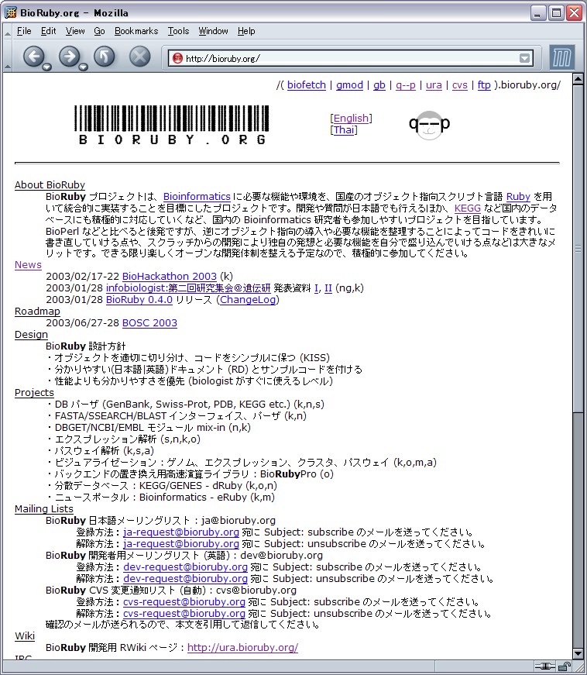
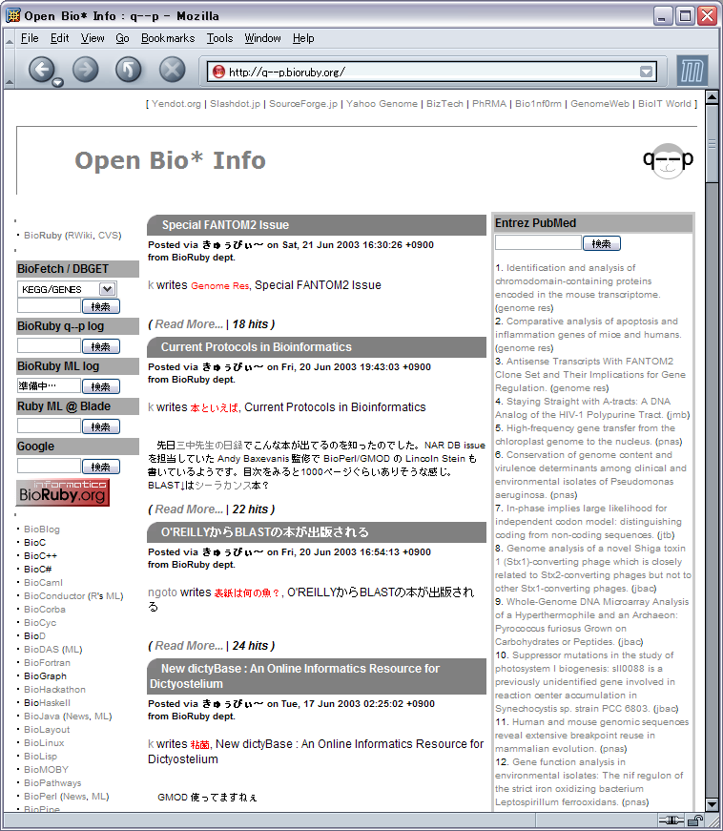
http://bioruby.org/
BioRuby 0.5.0 is out!
25 Jun 2003
Notes:
You can get latest release of the BioRuby at bioruby.org.
Thank you.

