Slide 1
BioRuby + KEGG API + KEGG DAS = wiring knowledge for genome and pathway
Toshiaki Katayama <k@bioruby.org>
Human Genome Center, University of Tokyo, Japan
http://bioruby.org/
http://www.genome.jp/kegg/soap/
http://das.hgc.jp/
Notes:
Hello, I’m Toshiaki Katayama from Japan.
I started BioRuby project in November 2000.
I also worked for KEGG in Kyoto university and
last year I have moved to University of Tokyo.
In this talk, I'm going to introduce BioRuby and
two KEGG related projects KEGG API and KEGG DAS.

Slide 2
What is BioRuby?
Yet another BioPerl written in Ruby
  since Nov 2000
Mainly developed in Japan
  including supports for Japanese resources like KEGG
Notes:
BioRuby is a project similar to BioPerl, Biopython and BioJava which made a library for Bioinformatics.
BioRuby project starts in November 2000 and have been developed mainly by Japanese community.
From this background, BioRuby contains a lot of supports for Japanese bioinformatics resources like KEGG.

Slide 3

What is Ruby?
Created by Japanese author 'matz'
Scripting language
  clean syntax, easy to learn, powerful enough
Purely object oriented
  Integer, String, Regexp, Exception etc. w/o exception
Sufficient libraries
  You can use most of the BioRuby functionallity without install additional libraries.
Notes:
Ruby is also created by Japanese.
Ruby is an object oriented scripting language.
Ruby has simple and clean syntax, so the program becomes easy to understand for everyone.
And its functionality is comparable with Perl or Python.
In Ruby, everything is object:
for example, Numbers, String, Array, Hash, Regular Expression, Exceptions etc.
Regular expression is built-in and its capability is same as Perl's.
Most object can make use of a built in Iterator for various purposes.
These features and its powerful syntax enable a small code can do a lot.
Ruby comes with various libraries by default such as CGI, HTTP, XML, SOAP etc.
which are often required for daily Bioinformatics tasks.

Slide 4
What you can do with BioRuby?
Biological sequence manipulation
Database entry retrieval and parsing
Running and parsing usual applications
Graph computation

Slide 5
Sequence manipulations
Splicing
Reverse complement
Translation
Composition
Molecular weight
Window search
#!/usr/bin/env ruby
require 'bio'
seq = Bio::Sequence::NA.new(ARGF.read)
puts seq.subseq(1,3)
puts seq.splicing("join(1..23,45..67)")
puts seq.complement
puts seq.translate
puts seq.gc_percent
puts seq.composition
seq.window_search(15, 3) do |subseq|
peptide = subseq.translate
puts peptide.molecular_weight
end
# print in FASTA format
puts seq.to_fasta("foo", 60)
# for selenoproteins
ct =Bio::CodonTable.copy(1)
ct['tga'] = 'U'
puts seq.translate
puts seq.translate(1, ct)
Notes:
In BioRuby, you can treat nucleic acid and amino acid Sequence as a String object having biological methods.

Slide 6
Entry parsers
GenBank, GenPept, RefSeq, DDBJ
EMBL, UniProt (TrEMBL, SwissProt)
PDB
KEGG/GenomeNet
  GENES, GENOME, ENZYME, COMPOUND, KO, BRITE, CELL, Expression, Keggtab, AAindex
GFF
GO
FANTOM
Transfac, Prosite
LITDB, MEDLINE
NBRF, PIR
FASTA format
#!/usr/bin/env ruby
# Usage:
# % auto.rb dbfile
require 'bio'
Bio::FlatFile.auto(ARGF) do |ff|
ff.each do |entry|
# do something
end
end
Notes:
BioRuby has parsers for various database formats.
These classes can open its flatfile database and iterates on each entry to extract information from each field.
Additionally, FlatFile class automatically detect these database formats
so user doesn't need to care about how to open and iterates on each entry.
The object that the variable entry points to is a already parsed database
entry object according to which database the entry comes from.

Slide 7
Database access
OBDA (Open Bio* Database Access)
  BioRegistry
  BioFlat
  BioFetch
  BioSQL
PubMed
DAS
  Ensembl, WormBase etc.
  KEGG DAS
SOAP
  KEGG API
  DDBJ XML
  NCBI ESOAP
Notes:
Database entries can be obtained through various ways.
BioFetch uses HTTP and CGI to retrieve the entry from server.
BioRuby provides both BioFetch server and client.
Bio::FlatFile is for local indexing of the flat file database making easy and high speed extraction of the entry.
BioRuby can do both creating and searching the indices.
Bio::SQL is a RDB schema for storing and retrieving the sequence data in MySQL, PostgreSQL and Oracle as described by Hilmer in the previous session.
And, Bio::Registry is a over all configuration wrapper which enable user to specify the protocols and the server locations for each database.
BioRuby is also able to access DAS server to retrieve genome annotation data
and access to SOAP servers to use various web services.

Slide 8
OBDA configuration
~/.bioinformatics/seqdatabase.ini
/etc/bioinformatics/seqdatabase.ini
http://www.open-bio.org/registry/seqdatabase.ini
VERSION=1.00
[genbank]
protcol=flat
location=/export/database/
dbname=genbank
[swissprot]
protocol=biosql
location=db.bioruby.org
dbname=biosql
driver=mysql
biodbname=sp
[embl]
protocol=biofetch
location=http://bioruby.org/cgi-bin/biofetch.rb
dbname=embl
#!/usr/bin/env ruby
require 'bio'
reg = Bio::Registry.new
sp = reg.get_database('swissprot')
puts sp.get_by_id('CYC_BOVIN')
gb = reg.get_database('genbank')
puts gb.get_by_id('AA2CG')
Notes:
This is a configuration file of the OBDA called seqdatabase.ini
All the Open Bio* projects uses this file located in /etc/bioinformatics or in user's home directory shown here.
By using Bio::Registry, user can easily retrieve an entry from the database in the unified way.
For example, procedure for getting entry from OBDA is like this.

Slide 9
Running applications
Bio::Blast, Fasta, HMMER, EMBOSS
Bio::ClustalW, MAFFT
Bio::Genscan
Bio::PSORT, TargetP
Bio::SOSUI, TMHMM
#!/usr/bin/env ruby
require 'bio'
File.open("my_blast_output.xml") do |file|
Bio::Blast.reports(file) do |report|
report.hits do |hit|
hit.each do |hsp|
puts hsp.query_id, hsp.target_id,
hsp.bit_score, hsp.evalue, hsp.overlap
end
end
end
Notes:
BioRuby also able to execute these applications
and parser the results to extract needed information.
This script extracts BLAST HSP scores from XML output of the BLAST run.

Slide 10
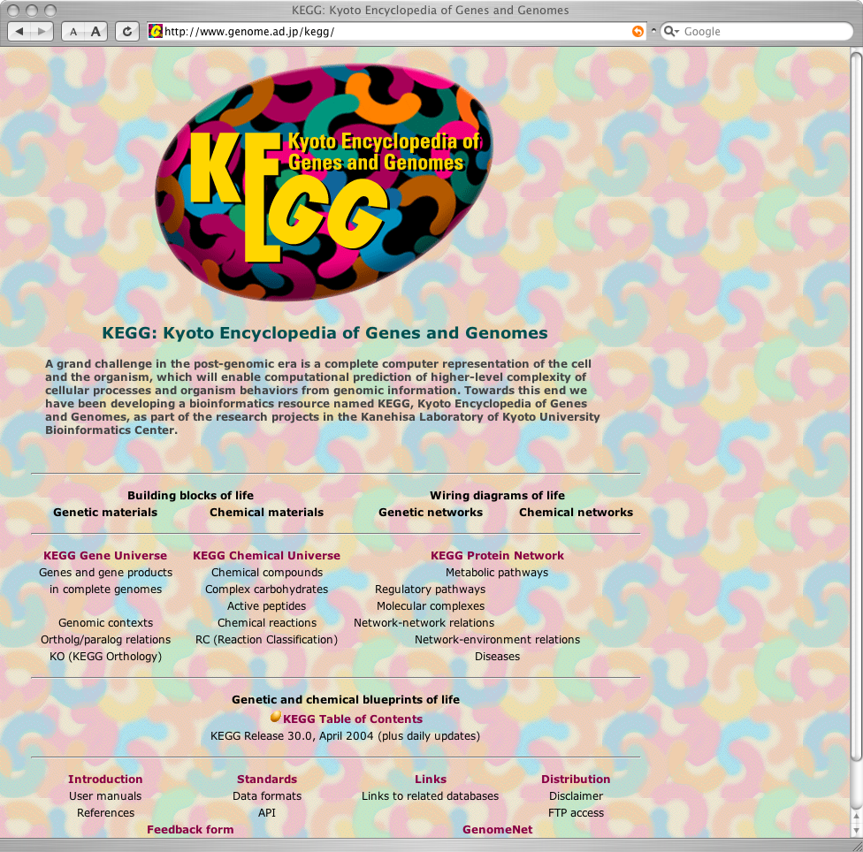
What is KEGG? Kyoto Encyclopedia of Genes and Genomes
http://www.genome.jp/kegg/
  PATHWAY
    LIGAND
  GENES, GENOME
  KO
  SSDB
  Expression
  Glycan
  etc.
Notes:
KEGG is a project headed by Prof. Kanehisa at Bioinformatics Center in Kyoto University.
I was there and worked for KEGG for past few years.
My new laboratory in Tokyo is also headed by him so that I’m still working with KEGG.
Here is a limited summary of the KEGG database.
KEGG system consists of a number of databases and tools for analysis.
metabolic and regulatory pathways linked to chemical reaction database LIGAND which includes ENZYME, COMPOUND and REACTION databaess
GENES and GENOME are curated gene annotation database for completely sequenced genomes
KO is a KEGG Orthology which is curated annotation of the orthologous relations between genes
SSDB is a pre-calculated Sequence Similarity database based on Smith-Waterman score
Microarray expression profile repository
Glycan is newly added molecular databases for sugar chain

Slide 11
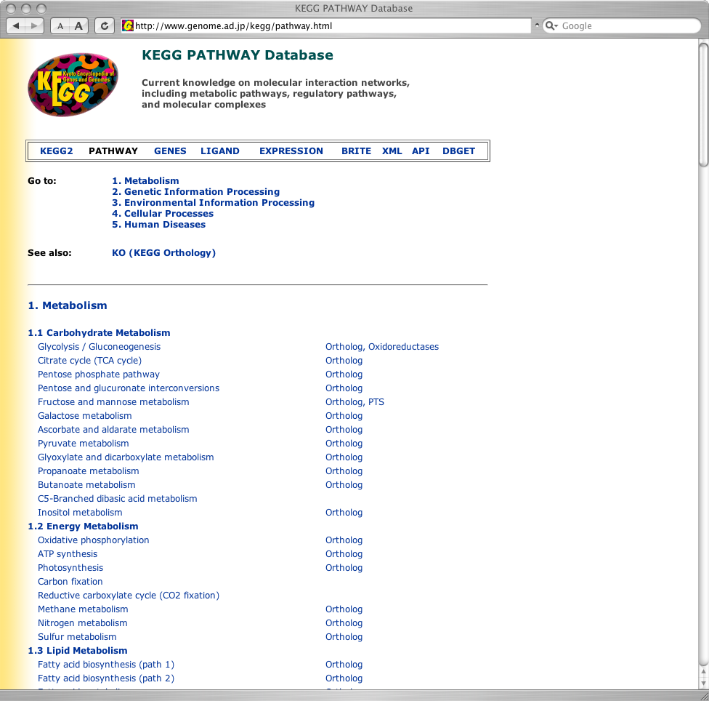
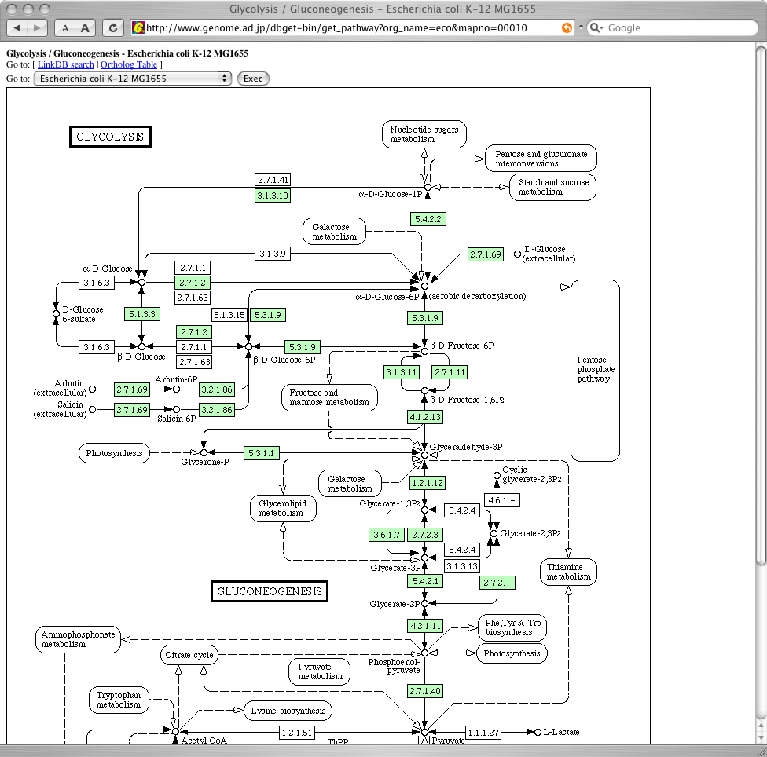
KEGG PATHWAY
Notes:
These are screen shots of the KEGG PATHWAY database.
Left side shows a list of available biological pathways in KEGG
and right is showing GLYCOLYSIS pathway for E. coli K-12.
Boxes filled in green are linked to the KEGG GENES entry

Slide 12
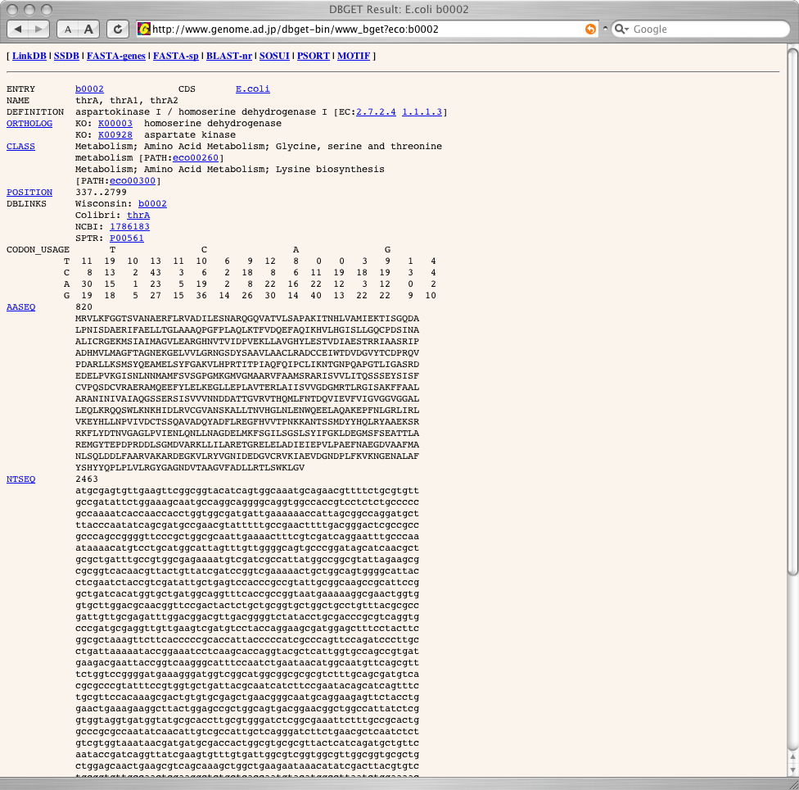
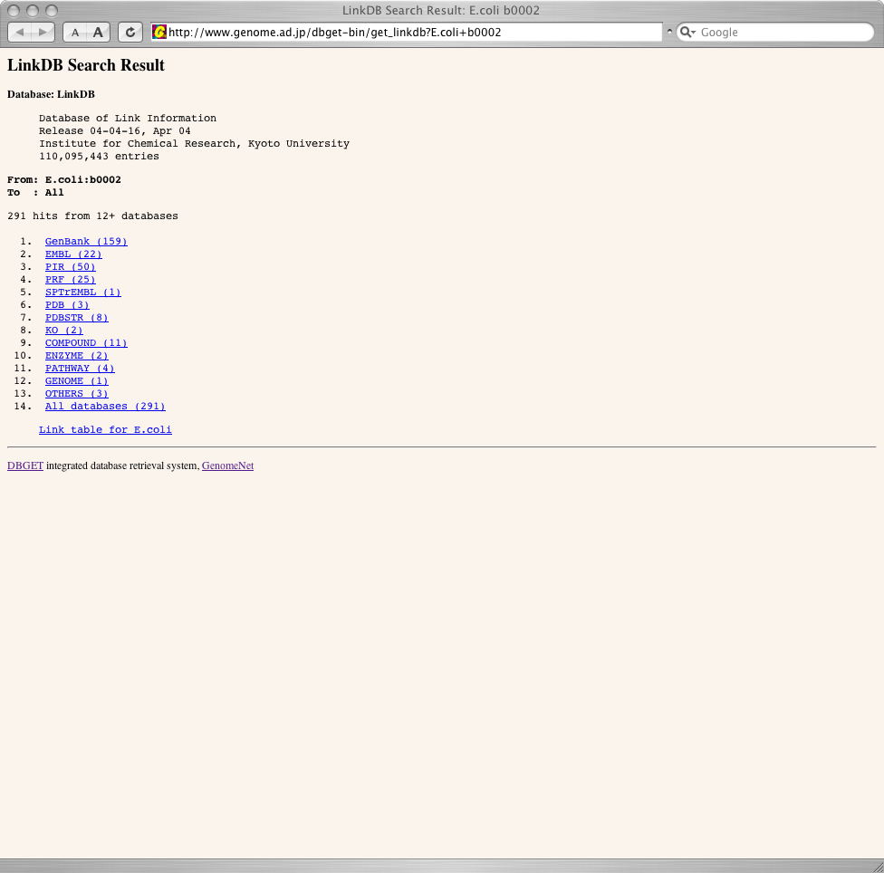
KEGG GENES
Notes:
and this is an KEGG GENES entry which is showing thrA gene of E. coli
having annotations, link to other databases and sequence data.
Now we have 0.6 million genes from about 200 organisms, Among them (next slide)

Slide 13
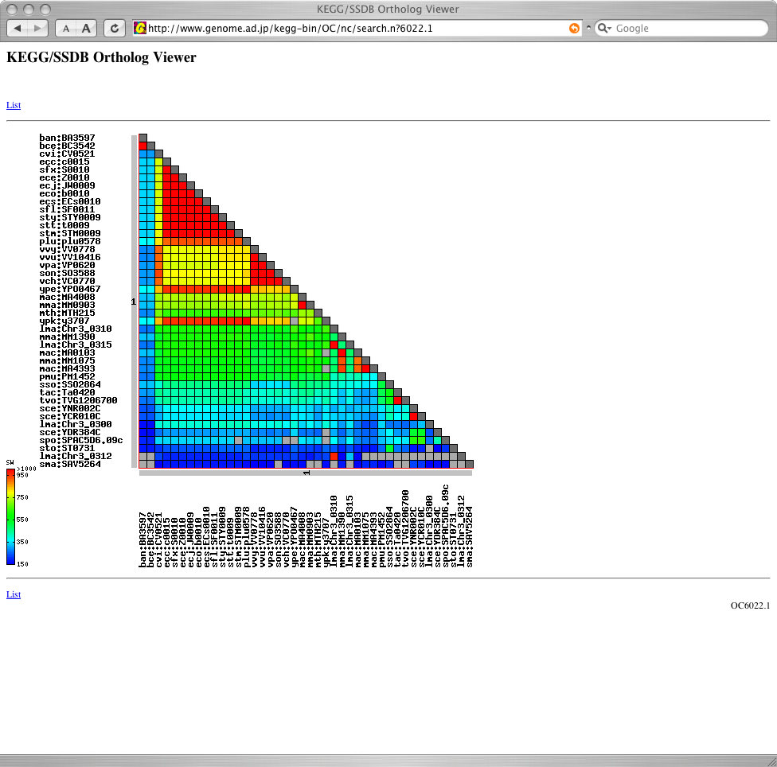
KEGG SSDB and OC
Eukaryotes
9576
996
153
658
Bacteria
25226
Archaea
3099
1440
Number of OCs across 3 kingdoms
Notes:
We have calculated similarity of all gene pairs by ssearch
and stored the results in the SSDB database.
So that, SSDB is a database of the Smith-Waterman scores
between all gene combinations in KEGG GENES database.
By using SSDB, user can extract orthologous and paralogous gene group,
find genes in best-best relation between the organisms and so on.
Then, we have grouped all genes into ortholog clusters by in-house
developed method.
KEGG OC is similar to NCBI COG but it has broader coverage of organisms
currently includes over 180 organisms from bacteria to eukaryotes.

Slide 14
KEGG standardization
KGML
  ISMB2004 poster C-45
KEGG API
  ISMB2004 poster G-17
KEGG DAS
  ISMB2004 poster E-29
Notes:
Currently we have three projects to make KEGG usable from your computer program.
KGML is a XML representation of the KEGG PATHWAY database.
KEGG API is a SOAP/WSDL based web service which provides a number of methods
to use KEGG in your program.
KEGG DAS is a genomic view of the GENES database linked to other KEGG databases,
also linked to other KEGG databases.

Slide 15
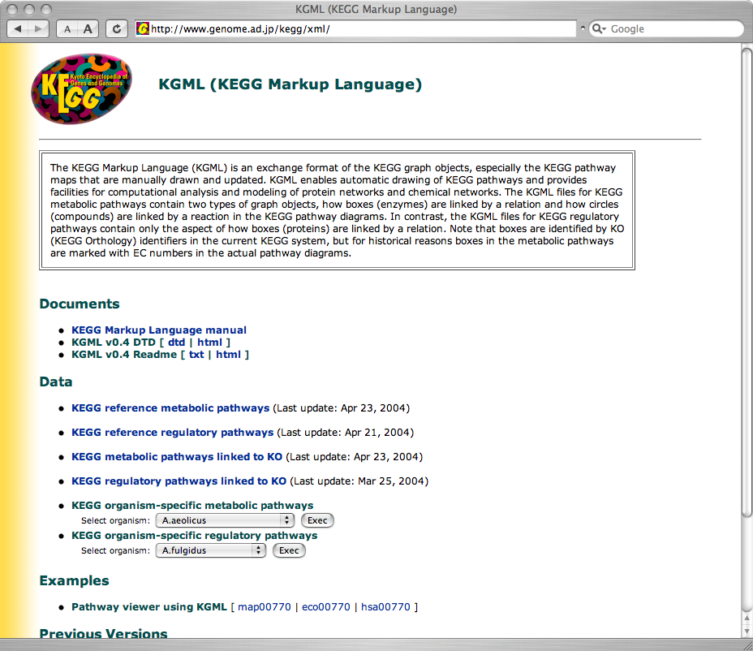
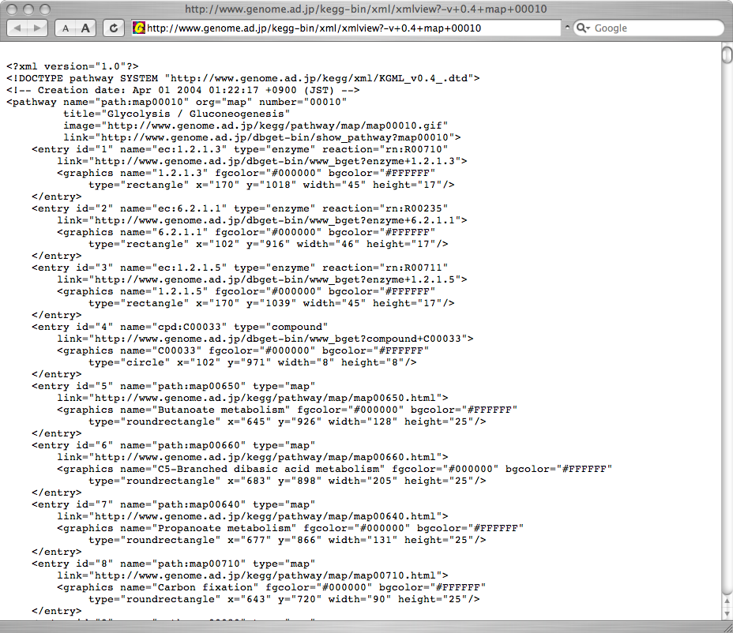
KGML
Notes:
By using KGML, user can extract objects on the KEGG PATHWAY,
and relations between the objects, and their coordinates on
graphical image.
It is especially suitable to find how the objects on the pathway are
connected to each other.

Slide 16
KEGG API
http://www.genome.jp/kegg/soap/
SOAP/WSDL based web service
  XML, HTTP
  Can be accessed by any language
Proteome and pathway analysis
  KEGG GENES, SSDB, PATHWAY
  DBGET, LinkDB
Updated to v3.0 (May 2004)
Notes:
KEGG API is a web service based on SOAP and WSDL technology.
It is developed for using KEGG from user's program.
As it comes with WSDL, creating KEGG API client is very easy for
most languages.
Currently, KEGG API supports GENES, SSDB and PATHWAY databases
and DBGET, LinkDB systems to make automated procedures for your analysis.

Slide 17
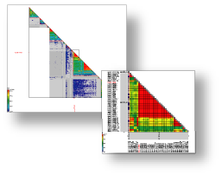
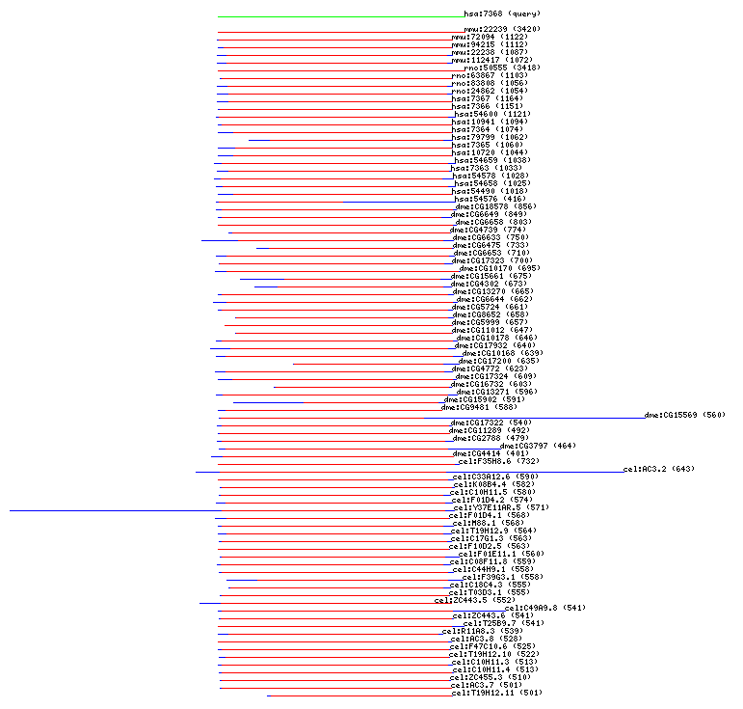
Example: obtain homologs and motifs by SSDB
#!/usr/bin/env ruby
require 'bio'
serv = Bio::KEGG::API.new
homologs = serv.get_all_best_neighbors_by_gene("hsa:7368")
homologs.each do |hit|
gene = hit.genes_id2
if motifs = serv.get_motifs_by_gene(gene, "pfam")
motifs.each do |motif|
name = motif.motif_id
desc = motif.definition
puts "#{gene}: #{name} #{desc}"
end
end
end
Notes:
Here I'll show you serveral very easy examples how the KEGG API can be
used with BioRuby.
Here user is extracting a homologous gene group for human gene 7368
from SSDB using KEGG API method get_best_neighbors_by_gene
This method searches SSDB and returns a list of genes
having a best score with the query gene in each organisms in KEGG
Then, for each genes returned, user is searching motif hits and print the results.
You can summerize common motifs etc. afterwards.

Slide 18
Example: KO, OC, PC
#!/usr/bin/env ruby
require 'bio'
serv = Bio::KEGG::API.new
ko_list = serv.get_ko_by_gene("eco:b0002")
# list of genes assigned same KO (KEGG orthology)
ko_genes = serv.get_ko_members(ko_list.first)
# list of genes assigned to same OC (ortholog cluster)
oc_genes = serv.get_all_oc_members_by_gene("hsa:7368")
# list of genes assigned to same PC (paralog cluster)
pc_genes = serv.get_all_pc_members_by_gene("hsa:7368")
puts "# KO", ko_genes, "# OC", oc_genes, "# PC", pc_genes
Notes:
Similarly, you can obtain genes which belongs to the same KO with
the query gene.
KO genes are curated orthologous gene group.
On the otherhand, OC and PC is automatically determined ortholog
gene cluster and paralogous gene cluster.
You can obtain list of these cluster members in same way.

Slide 19
Example: getting database info/entries
#!/usr/bin/env ruby
require 'bio'
serv = Bio::KEGG::API.new
# lists available organisms in KEGG
orgs = serv.list_organisms
orgs.each do |entry|
puts "#{entry.entry_id} #{entry.definition}"
end
# lists available pathways in KEGG
list = serv.list_pathways("hsa")
list.each do |entry|
puts "#{entry.entry_id} #{entry.definition}"
end
# getting EMBL entry
puts serv.bget("embl:BUM")
# getting entries from KEGG GENES
puts serv.bget("hsa:7368 hsa:7369")
Notes:
This example shows how to obtain list of available organisms in KEGG
and list of available pathways for specific organism.
In each case, you can iterates on results to extract ID and
description of the each organism and pathway.
Following two examples are showing how to retrieve DB entries by KEGG API,
for example, EMBL and KEGG GENES entries.
You can also do keyword search for these DBs by other methods 'bfind'.

Slide 20
Example: using PATHWAY
#!/usr/bin/env ruby
require 'bio'
serv = Bio::KEGG::API.new
# lists gene ids on pathway
genes = serv.get_genes_by_pathway("path:hsa00020")
puts "# genes on human's pathway 00020"
genes.each do |gene|
puts gene
end
# converts EC numbers to genes
list = ["ec:1.1.1.1", "ec:1.2.1.1"]
list.each do |ec|
puts "# E. coli genes for #{ec}"
puts serv.get_genes_by_enzyme(ec, "eco")
end
Notes:
Next example shows how to deal with pathways.
You can easily obtain list of gene IDs on a specified pathway.
Some methods to convert genes ID with EC numbers,
EC numbers with associated COMPOUND IDs etc. are also available.
In this example, finding corresponding genes of EC 1.1.1.1 and 1.2.1.1 in E.coli

Slide 21
Example: coloring PATHWAY
#!/usr/bin/env ruby
require 'bio'
serv = Bio::KEGG::API.new
# mark pathway
objs = ['eco:b0002', 'cpd:C00263']
url1 = serv.mark_pathway_by_objects('path:eco00260', objs)
# color pathway
fg_list = ['blue', 'green']
bg_list = ['#ff0000', 'yellow']
url2 = serv.color_pathway_by_objects('path:eco00260',
objs, fg_list, bg_list)
# save the result images
serv.save_image(url1, "marked_pathway.gif")
serv.save_image(url2, "colored_pathway.gif")
Notes:
Here comes a example for coloring pathway.
1st part is making 2 objects on the pathway to be marked in red on a specified pathway.
In this case, E.coli's gene b0002 and compound C00263 is marked on E.coli's pathway 00260,
and the URL for the generated image file is returned.
2nd part is more colorful way to marking pathway.
For the same set of objecs, you can also specify foreground and background colors.
You can use color names and RGB code in hex.
Lastly, downloading and saving the generated image using BioRuby function.

Slide 22
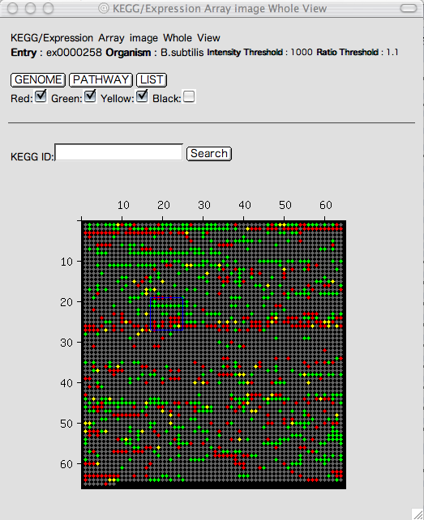
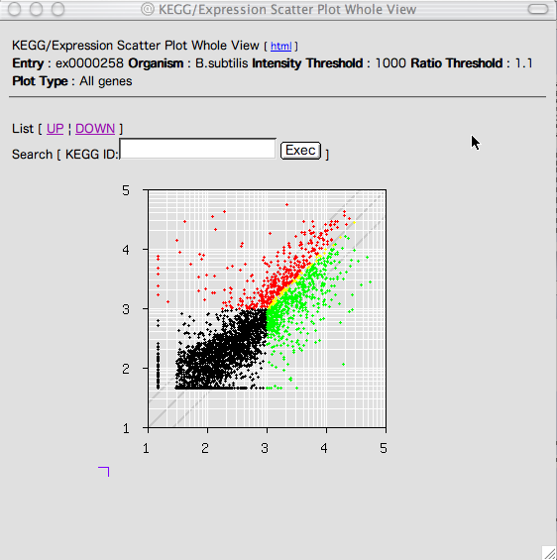
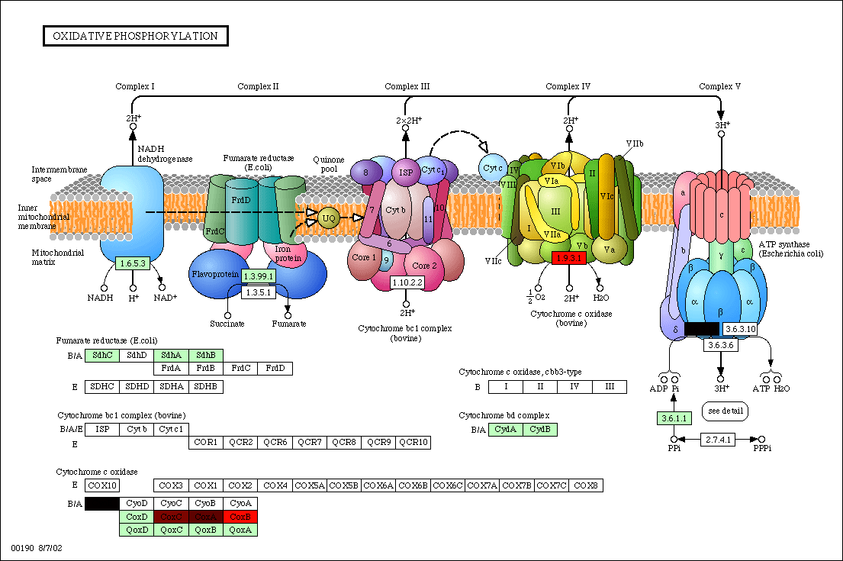
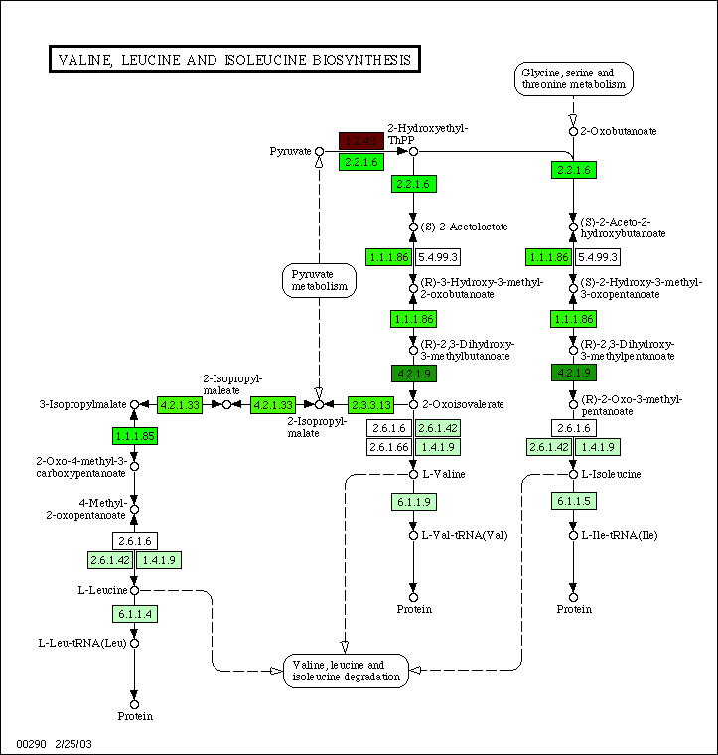
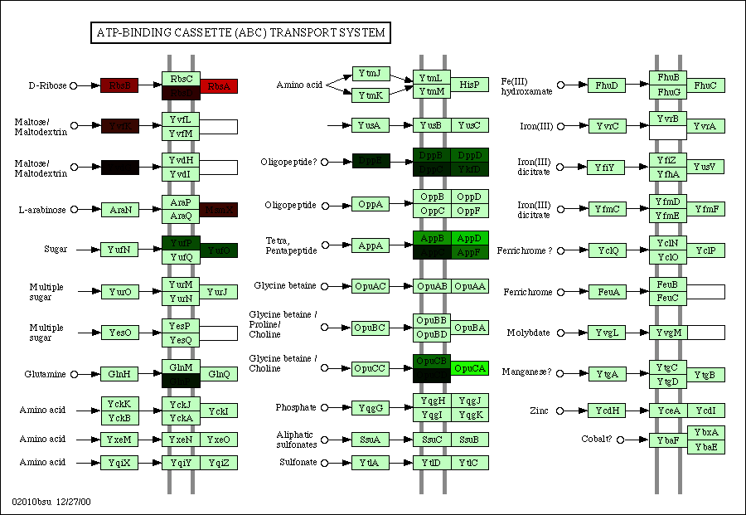
Example: gene expression and pathway analysis
serv = Bio::KEGG::API.new
list = serv.get_genes_by_pathway("path:bsu00020")
fg_colors = Array.new
bg_colors = Array.new
list.each do |gene|
fg_colors << "black"
bg_colors << ratio2rgb(gene)
end
url = serv.color_pathway_by_objects(
"path:bsu00020", list, fg_colors, bg_colors)
Notes:
Previous methods are useful for coloring pathway by microarray expression profiles.
Suppose you have your own microarray data, and if you generates color codes for each gene,
then paint KEGG pathway by their colors.
Useful to see how the pathway is regulated by gene expression.

Slide 23
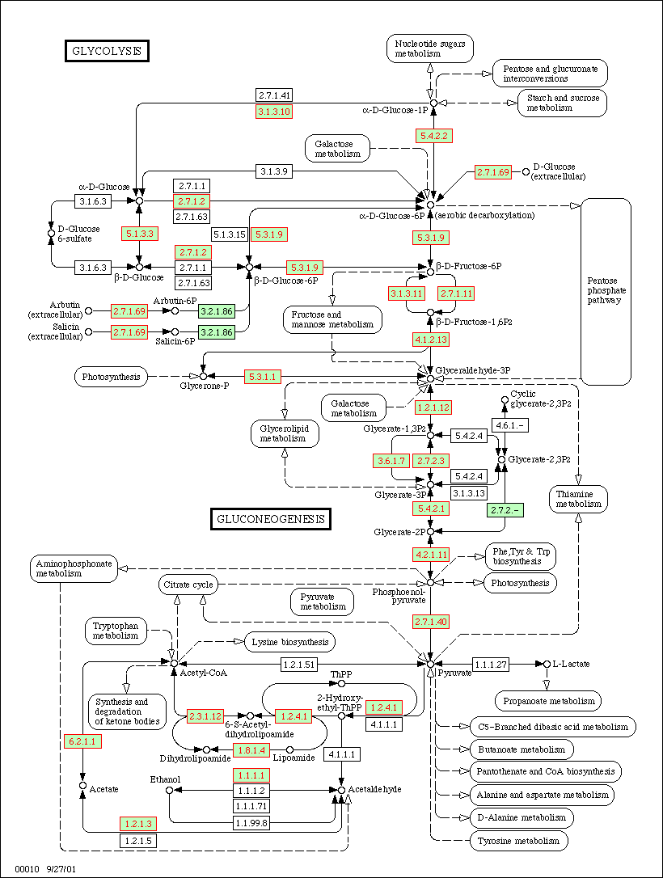
Example: mapping PDB on pathway
#!/usr/bin/env ruby
require 'bio'
serv = Bio::KEGG::API.new
# list of genes on specified pathway
path = ARGV.shift || "path:eco00010"
genes = serv.get_genes_by_pathway(path)
# search DB links to PDB using LinkDB
results = Hash.new
genes.each do |gene|
if pdb_links = serv.get_all_linkdb_by_entry(gene, "pdb")
pdb_links.each do |link|
results[gene] = true
end
end
end
# generates colored image
url = serv.mark_pathway_by_objects(path, results.keys)
# save the image
serv.save_image(url, "linked_to_pdb.gif")
Notes:
Last example also marking KEGG pathway.
In this example, find a list of genes on a pathway,
then search database links to PDB protein structural database.
If the link is found, remember the gene name having that link,
and finally, mark the corresponding boxes on the pathway.
This example shows E. coli's Glycolysis pathway in which
protein structure (probably linked by EC number) is
available for each gene is marked in red.

Slide 24
KEGG DAS
http://das.hgc.jp/
  Currently including 188 organisms
  Data from KEGG GENOME and GENES
  Build on to of the GMOD/GBrowse
Notes:
KEGG DAS is a DAS server for all organisms including bacteria and archaea
in addition to eukaryotes.
It uses GMOD/GBrowse and data converted from KEGG GENES using BioRuby.
We hope that KEGG DAS to serve as a reference database for organisms
which don’t have their own MODs projects in a unified manner.
KEGG DAS is available at http://das.hgc.jp/
You can also find more detail on KEGG DAS at ISMB2004 poster E-29.

Slide 25
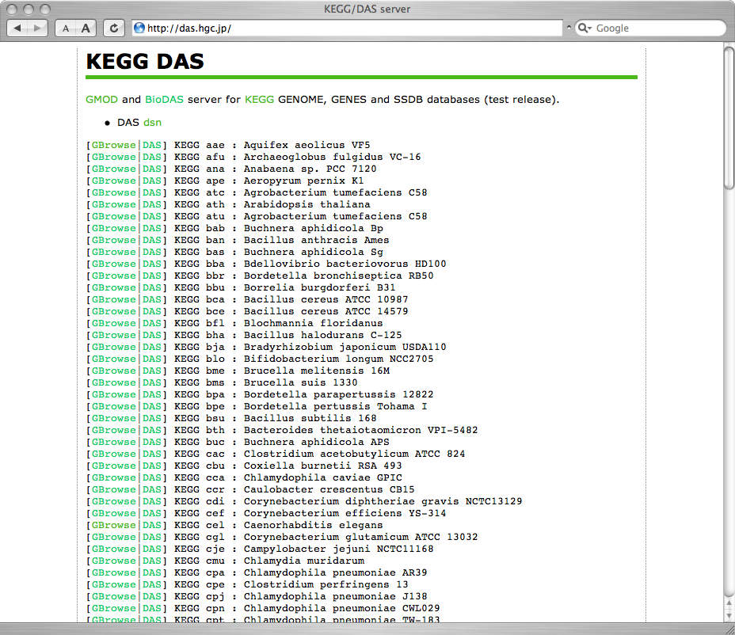
Organisms in KEGG DAS
Notes:
Here is a list of available organisms.
User can choose GBrowse view or DAS XML access to this database
as GBrowse has already integrated DAS server.

Slide 26
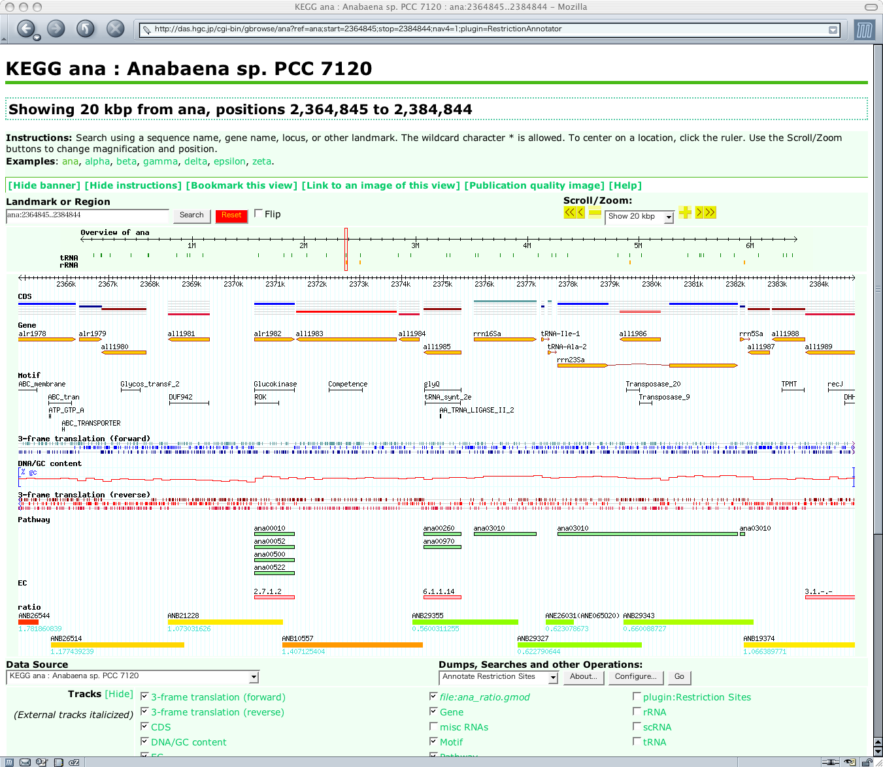
KEGG ana
Notes:
Here is a sample usage of GMOD genome browser to show all the KEGG GENOME and GENES annotations.
You can use this for all the Bacteria, Archaea and Eukaryotes in KEGG.
This is a sample view of a cyanobacteria.
Gene is linked to KEGG GENES page,
Motif is linked to Pfam, TIGRFAM, PROSITE entry,
Pathway is linked to KEGG PATHWAY with the corresponding gene marked
and EC is linked to the LIGAND database.
The last track is user uploaded microarray expression profile data.

Slide 27
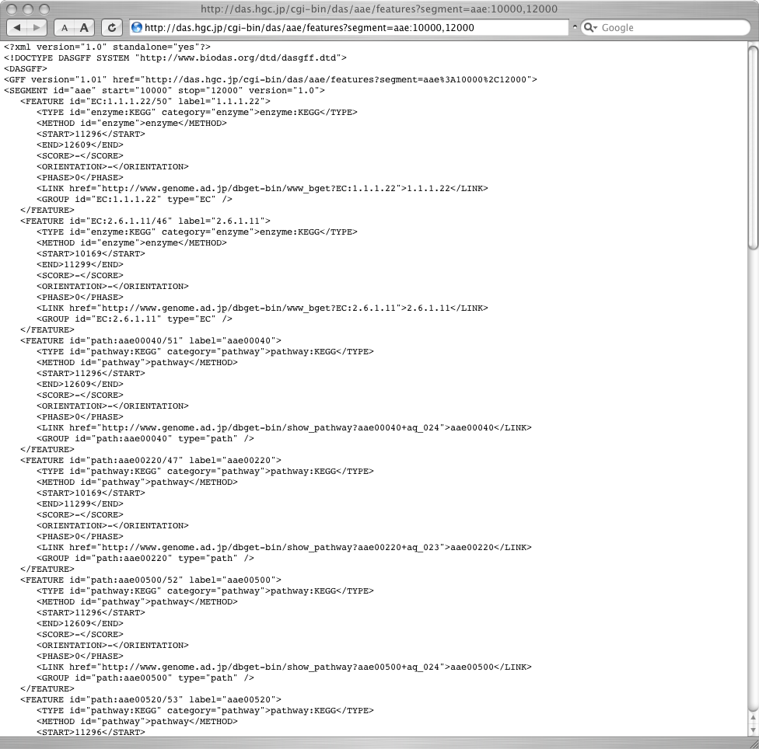
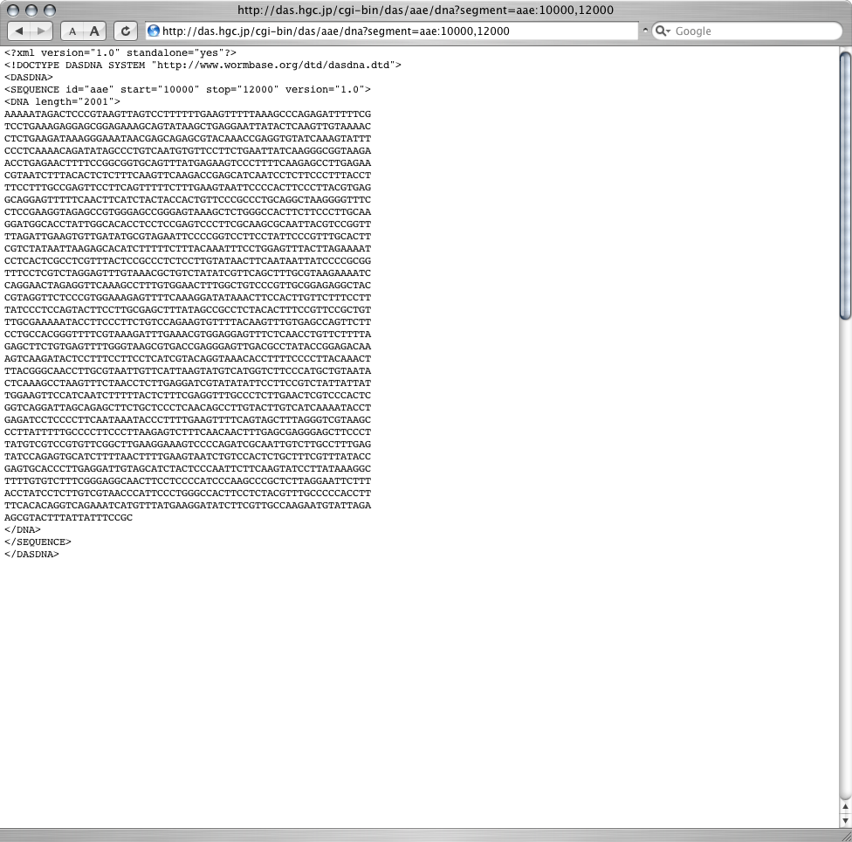
DAS view
Notes:
And this is a DAS XML view for the same data.

Slide 28
Example: sequence and annotations by DAS
#!/usr/bin/env ruby
require 'bio'
serv = Bio::DAS.new("http://das.hgc.jp/cgi-bin/")
segment = Bio::DAS::SEGMENT.region("I", 1001, 2000)
# get DNA sequence from S. cerevisiae
list = serv.get_dna("sce", segment)
list.each do |dna|
puts dna.sequence
end
# get features
list = serv.get_features("sce", segment)
list.segments.each do |segment|
segment.features.each do |feature|
puts feature.entry_id
puts feature.start
end
end
Notes:
This code shows how to obtain DNA sequence and features by DAS in BioRuby.
I think KEGG API and KEGG DAS will complement each other.
For example, KEGG OC is not linked from the KEGG DAS, however, you can
obtain a list of genes from a specific region of your interest from KEGG DAS
and can find ortholog cluster members by using KEGG API method like
get_oc_members_by_gene.
Or having a list of genes on a specific pathway by KEGG API method
get_genes_by_pathway and gather upstream region for each gene via
KEGG DAS then compare the sequence with the gene expression data.

Slide 29
Acknowledgements
BioRuby developers
  Naohisa Goto, Mitsuteru Nakao, Yoshinori Okuji, Shuichi Kawashima, Masumi Itoh, Alex Gutteridge and some other contributors on the net.
KEGG curators and KEGG API developers
  Bioinformatics center, Human genome center
  Yoko Sato, Miho Matsubayashi, Satoshi Miyazaki
KEGG DAS
  Mayumi Takashio, Mari Watanabe
Open Bio* community
Notes:
I would like to thank for BioRuby and KEGG developers and the Open Bio* community.

Slide 30
URL
BioRuby
  http://bioruby.org/
  CVS, ML - hosted at open-bio.org
KEGG API
  http://www.genome.jp/kegg/soap/
KEGG DAS
  http://das.hgc.jp/
ISMB posters at E-29 G-17 C-45
Notes:
Thanks.

