Slide 1
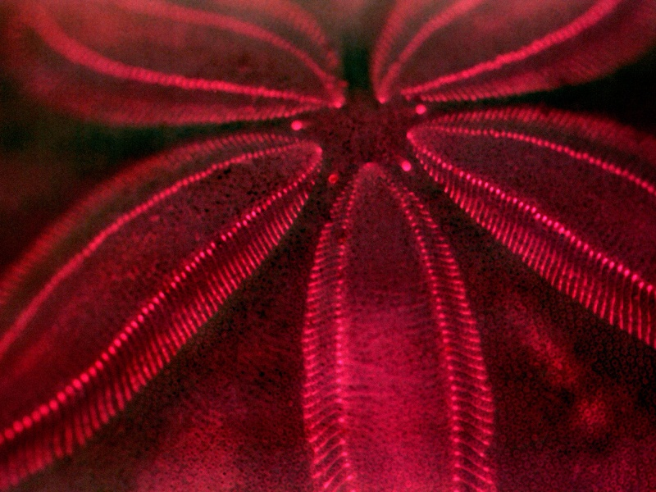
BioRuby 2005
Bioinformatics Open Source Conference, June 23-24 2005, Detroit
Toshiaki Katayama <k@bioruby.org>
http://bioruby.org/
Human Genome Center,University of Tokyo, Japan

Slide 2

What's BioRuby?
BioPerl for the Ruby programmer
Notes:
BioRuby is a BioPerl for the Ruby lover.
Ruby is getting popular, so I skip explanation on this OO scripting language made in Japan. :)

Slide 3
BioRuby updates
BioRuby 0.6.2 released
  Sim4, BLAT, Spidey parsers are added
  Unit tests is being added by Moses Hohman
  KEGG GLYCAN database is supported
KEGG API 4.0 released (tested with BioRuby)
  APIs for LIGAND, GLYCAN, REACTION databases
  Colored PATHWAY in HTML format is available
Notes:
Unfortunately not so many developments have been achieved past year...
We have released version 0.6.2 in December.
in which ...
And this is not a BioRuby issue, but we have released KEGG API v4.0
KEGG API is a SOAP based web service for KEGG and I have tested it with BioRuby.
in this release, we have added support for LIGAND, GLYCAN, and REACTION
databases along with some other featuers.

Slide 4

What's coming next?
BioRuby 0.6.3 will be released soon
  Bug fixes
  We will not continue to support Ruby 1.6
  RubyGems for easy installation
    % gem install bioruby
ChemRuby project started
  Nobuya Tanaka (KEGG lab.)
Financial support for developping docs/tests and integration of Bio and Chem -Ruby
Ruby1.8
inside!
Notes:
We will release version 0.6.3 soon
This will be a final release of the 0.6 series which can be used with
ancient Ruby 1.6 which is released in 2002.
Now, OS X Tiger is shipped with Ruby 1.8.
This version of Ruby comes with libraries to handle XML and SOAP
so you are ready to use KEGG API without any extra installation.
We'll also provide a Ruby gem package which makes your installation procedure easier.
It will automatically download and setup BioRuby within a few minutes :)
We also started ChemRuby project.
It develops a Ruby library for cheminformatics headed by Nobuya Tanaka
And we've got financial support for ...

Slide 5

Exploratory Software Project
1 year financial support from IPA
  Infotech Promoting Agency, Japan
"BioRuby + ChemRuby"
  4 core developers
  documentations, unit tests
  develop new features
  integration of these projects
Bio(Chem)RubyHackathon every month!?
Notes:
This is a 1 year financial support from Japanese government and
we will be able to have Bio and Chem -Ruby Hackathon every month.

Slide 6
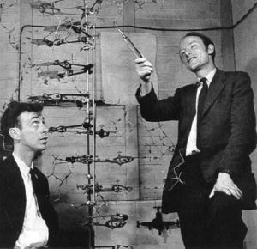
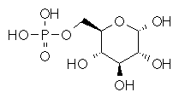
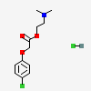








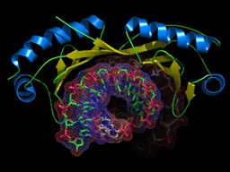
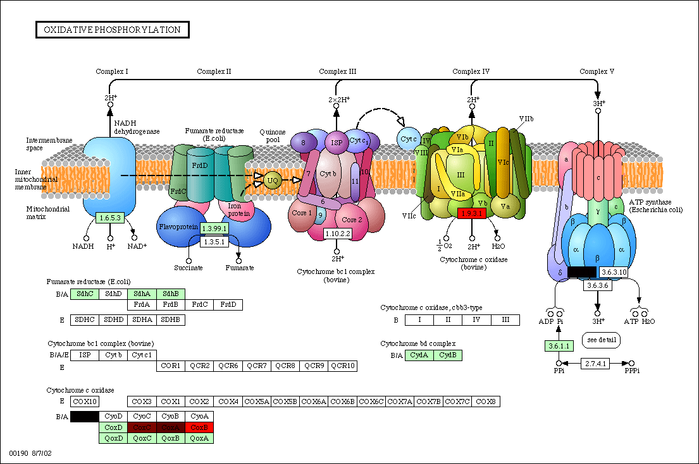
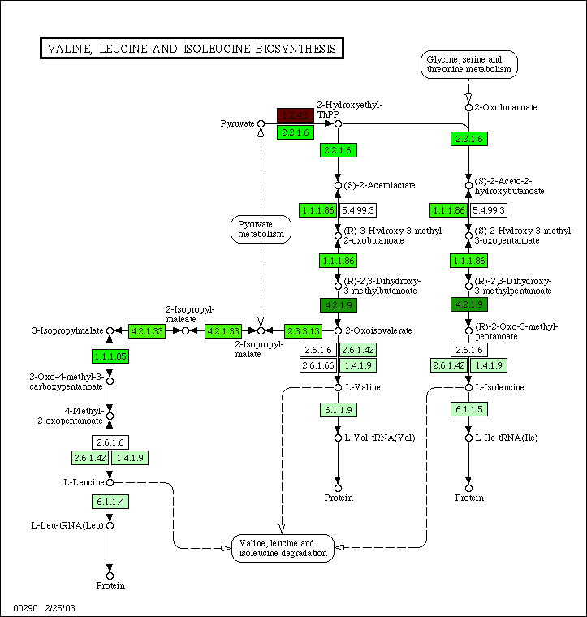

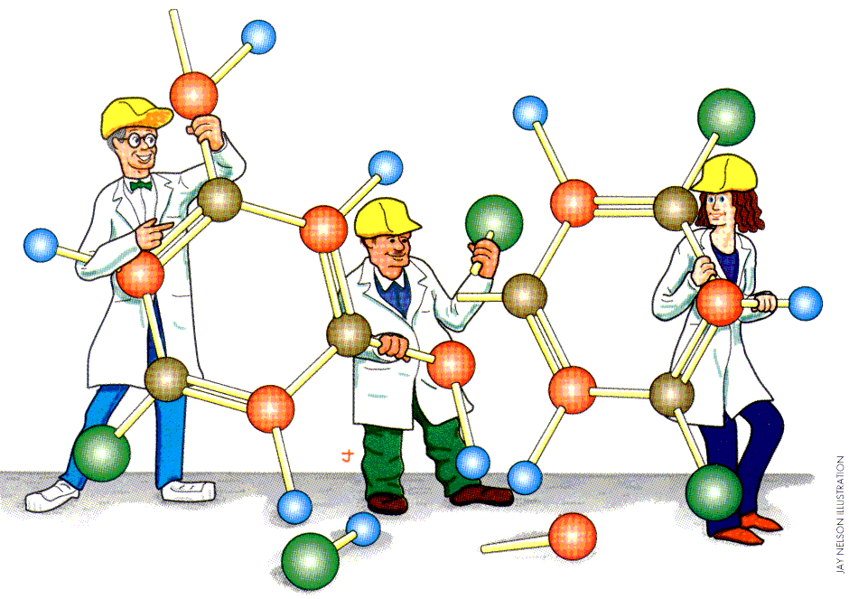
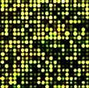


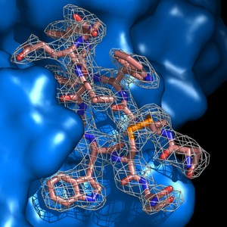


Bio + Chem informatics
Bio::Sequence
Bio::GenBank,
Bio::EMBL etc.
RefSeq
EMBL
GenPept
LIGAND
GenBank
GENES
ENZYME
COM
POUND
Sequence DBs
UniProt
PubChem
UCSC
KEGG
DAS
OBDA
Ensembl
Bio::Flat(BDB)
Bio::Fetch(HTTP)
Bio::SQL(RDB)
Compound DBs
Various format
Bio::Reference
Bio::DAS
(REST CGI)
Bio::KEGG::API
(SOAP/WSDL)
PubMed
PATHWAY
Literatures
E-Utils
(CGI)
Bio::Pathway
PDB
Softwares
Bio::BLAST,
Bio::HMMER etc.
TINKER
3D structures
HMMER
Gene expressions
Softwares
Notes:
Our short term goal is to make Bio and Chem Ruby better,
but in the end, we hope to integrate bioinformatics and cheminformatics with Ruby and KEGG.
Both areas have a lot of databases and applications separately and
they will be linked by pathways.

Slide 7
in KEGG lab,
Katayama：developing KEGG API, KEGG DAS etc.
Tanaka：developing algorithms for structure search etc.
ChemRuby
Connect
seamlessly..
BioRuby + KEGG API
korg = "bsu"
serv = Bio::KEGG::API.new
list = serv.list_pathways(korg)
list.each do |path|
pathway = path.entry_id
fg_list = Array.new
bg_list = Array.new
genes = serv.get_genes_by_pathway(pathway)
genes.each do |gene|
fg_list << "#000000"
bg_list << exp2rgb(gene) || "#cccccc"
end
url = serv.color_pathway_by_objects(pathway, genes, fg_list, bg_list)
serv.save_image(url)
end
Notes:
and they will be linked by pathways.
We hope to connect them seamlessly.

Slide 8
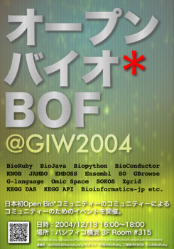
Open Bio Japan
Promoting Open Bio* in Japan
  Tutorials, documentations, mailing lists
Japanese bioinfo developer's meeting
  G-language, KNOB, BioRuby etc. ..
http://open-bio.jp/
  (http://open-bio.sourceforge.jp/)
Notes:
One more thing, we have started Open Bio Japan, which is a Japanese user group
of the Open Bio* software.
In Japan, Open Bio products isn't utilized sufficiently._x0001_
So, we held a developer's camp and tutorial sessions in Japan and
we will write some Japanese documentations.

Slide 9
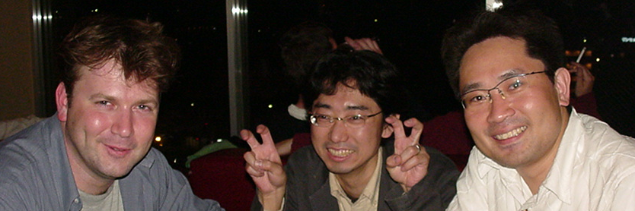
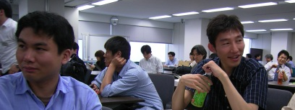
More info?
http://bioruby.org/
staff@bioruby.org
  Toshiaki Katayama
  Mitsuteru Nakao
  Naohisa Goto
  Nobuya Tanaka
BioPerl
BioRuby
BioRuby
BioRuby
ChemRuby
Notes:
That's it.
Thank you for your attention.

