Slide 1
BioRuby.project("introduction")
Toshiaki Katayama
<k@bioruby.org>
http:// bioruby.org/
Bioinformatics Center, Kyoto University, JAPAN

Slide 2

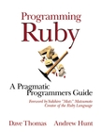

What is Ruby
Purely object oriented scripting language (made in Japan...)
Interpreter
Perl
Python
Ruby
Compile
C
Java
Object oriented

Slide 3
Why BioRuby
Bioinformatics subjects
Open Source Biome (Bio*)
Sequence
Bioperl
We love Ruby
We wanted to support Japanese resources including KEGG
  We are trying to focus on the pathway computation in KEGG
KEGG :
  Kyoto Encyclopedia of Genes and Genomes
  http://genome.jp/kegg/
Networking –
SOAP/CORBA/DAS …
BioJava
Biopython
BioRuby
Structure
Pathway

Slide 4
What objects BioRuby has
Sequence (translation, splicing, window search etc.)
  Bio::Sequence::NA, AA, Bio::Location
Data I/O (DBGET system, local flatfile, WWW etc.)
  Bio::DBGET, Bio::FlatFile, Bio::PubMed
Database parsers and entry objects
  Bio::GenBank, Bio::KEGG::GENES etc. (supports >20)
Applications (homology search – local/remote)
  Bio::Blast, Bio::Fasta
Bibliography, Graphs, Binary relations etc.
  Bio::Reference, Bio::Pathway, Bio::Relation

Slide 5
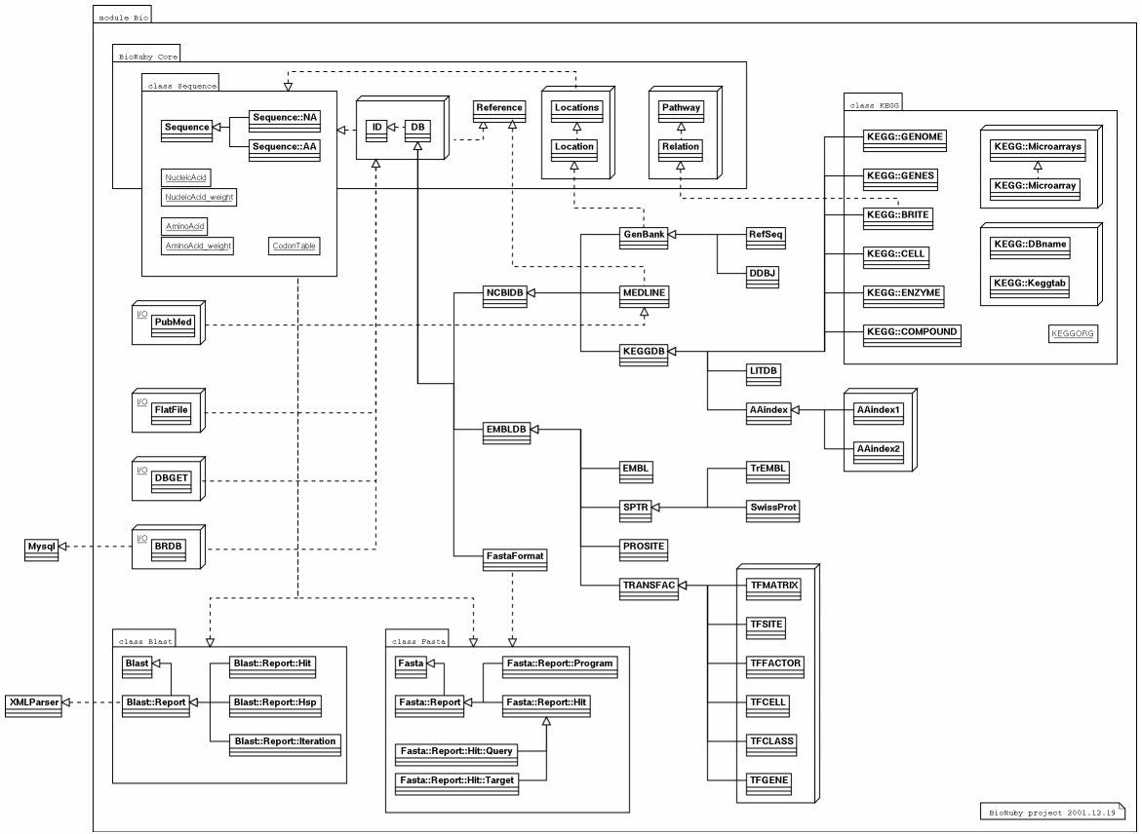
BioRuby class hierarchy (pseudo UML:)

Slide 6
Sequence
Bio::Sequence ::NA → nucleotide, ::AA → peptide
  seq = Bio::Sequence::NA.new("atgcatgcatgc") # DNA
  puts seq # → "atgcatgcatgc"
  puts seq.complement.translate # → "ACMH" Protein
  seq.window_search(10) do |subseq|
  puts subseq.gc # → GC% on 10nt window
  end
  puts seq.randomize # → "atcgctggcaat"
  puts seq.pikachu # → "pikapikapika" (sorry:)

Slide 7
Database I/O (1/3)
Bio::DBGET <http://genome.jp/dbget/>
  Client/Server (or WWW based) entry retrieval system
  Supports
    GenBank/RefSeq, EMBL, SwissProt, PIR, PRF, PDB, EPD, TRANSFAC, PROSITE, BLOCKS, ProDom, PRINTS, Pfam, OMIM, LITDB, PMD etc.
    KEGG (GENOME, GENES), LIGAND (COMPOUND, ENZYME), BRITE, PATHWAY, AAindex etc.
  Search
    Bio::DBGET.bfind("<db_name> <keyword>")
  Get
    Bio::DBGET.bget("<db_name>:<entry_id>")

Slide 8
Database I/O (2/3)
Bio::FlatFile (not indexed)
  #!/usr/bin/env ruby
  require 'bio'
  ff = Bio::FlatFile.open(Bio::GenBank, "gbest1.seq")
  ff.each_entry do |gb|
  puts ">#{gb.entry_id} #{gb.definition}"
  puts gb.naseq
  end

Slide 9
Database I/O (3/3)
Bio::BRDB
  Trying to store parsed entry in MySQL
    not only seqence databases
  Restore BioRuby object from RDB ?
    Bio::BRDB.get(Bio::GenBank, "AF139016")
SOAP / CORBA / DAS / dRuby ... more APIs
  We need to work with Bio*
  /etc/bioinformatics/
  Ruby has
    "distributed Ruby", SOAP4R, XMLparser, REXML, Ruby-Orbit libraries etc.

Slide 10
Database parsers (= entry obj)
Bio::DB
  1 entry 1 object
  parse flatfile entry
    Bio::GenBank.new(entry)
  fetch BRDB ?
    Bio::GenBank.brdb(id)
  Currently supports:
    Bio::GenBank, Bio::RefSeq, Bio::DDBJ, Bio::EMBL, Bio::TrEMBL, Bio::SwissProt, Bio::TRANSFAC, Bio::PROSITE, Bio::MEDLINE, Bio::LITDB, etc.
    KEGG (Bio::KEGG::GENOME, Bio::KEGG::GENES), LIGAND (Bio::KEGG::COMPOUND, Bio::KEGG::ENZYME), Bio::KEGG::BRITE, Bio::KEGG::CELL, Bio::AAindex etc.

Slide 11
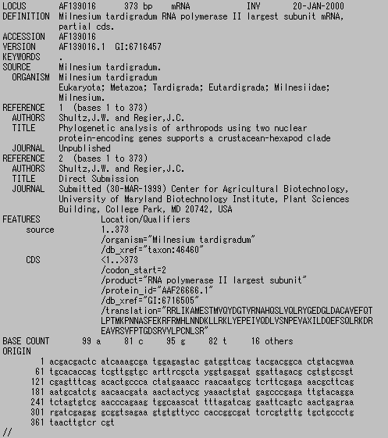
GenBank entry

Slide 12
GenBank object
#!/usr/bin/env ruby
require 'bio'
entry = ARGF.read
gb = Bio::GenBank.new(entry)
#!/usr/bin/env ruby
require 'bio'
entry = Bio::DBGET.bget("gb:AF139016")
gb = Bio::GenBank.new(entry)
#!/usr/bin/env ruby
require 'bio'
ff = Bio::FlatFile.open(Bio::GenBank, "gbest1.seq")
ff.each_entry do |gb|
# do something on 'gb' object
end

Slide 13
GenBank parse
On-demand parsing
1. parse roughly
↓method call
2. parse in detail
3. cache parsed result

Slide 14
GenBank parse
gb.definition
gb.date
gb.nalen
gb.entry_id
# → "AF139016"
gb.division
gb.natype
gb.taxonomy
gb.common_name
gb.basecount

Slide 15
GenBank parse
refs = gb.references
# → Array of Reference objs
refs.each do |ref|
puts ref.bibitem
end

Slide 16
GenBank parse
gb.features # → Array of Feature
gb.each_cds do |cds|
puts cds['product']
puts cds['translation']
# =~ gb.naseq.splicing(cds['position']).translate
end

Slide 17
GenBank parse
seq = gb. naseq # → Bio::Sequence::NA obj
pos = "<1..>373" # ← position string
seq.splicing(pos) # → spliced sequence
# internally uses Bio::Locations.new(pos) to splice
Various position strings :
join((8298.8300)..10206,1..855)
complement((1700.1708)..(1715.1721))
8050..one-of(10731,10758,10905,11242)

Slide 18
Applications
Bio::Blast, Bio::Fasta
  #!/usr/bin/env ruby
  require 'bio'
  include Bio
  factory = Fasta.local('fasta34', "mytarget.f")
  queries = FlatFile.open(FastaFormat, "myquery.f")
  queries.each do |query|
  puts query.definition
  fasta_report = query.fasta(factory)
  fasta_report.each do |hit|
  puts hit.evalue # do something on each 'hit'
  end
  end

Slide 19
References
Bio::PubMed
  entry = Bio::PubMed.query(id) # → fetch MEDLINE entry
Bio::MEDLINE
  med = Bio::MEDLINE.new(entry) # → MEDLINE obj
Bio::Reference
  ref = med.reference # → Bio::Reference obj
  puts ref.bibitem # → format as TeX bibitem
c.f. puts Bio::MEDLINE.new(Bio::PubMed.query(id)).reference.bibitem

Slide 20
Graph
Bio::Relation
  r1 = Bio::Relation.new('b', 'a', '+p')
  r2 = Bio::Relation.new('c', 'a', '-p')
Bio::Pathway
  list = [ r1, r2, r3, … ]
  p1 = Bio::Pathway.new(list)
  p1.dfs_topological_sort # one of various graph algos.
  p1.subgraph(mark) # extract subgraph by labeled nodes
  p1.to_matrix # linked list to matrix

Slide 21
BioRuby roadmap
Jan 2002
  Release stable version BioRuby 0.4
  Start dev branch BioRuby 0.5
Feb 2002
  Hackathon
TODO
  BRDB (BioRuby DB) implementation
  SOAP / DAS / CORBA ... APIs
  PDB structure
  Pathway application
  GUI factory
  etc...

Slide 22
staff@bioruby.org
Toshiaki Katayama -k （project leader)
Yoshinori Okuji -o
Mitsuteru Nakao -n
Shuichi Kawashima -s
Happy Hacking!

Slide 23
Let's install
% lftpget ftp://ftp.ruby-lang.org/pub/ruby/ruby-1.6.6.tar.gz
% tar zxvf ruby-1.6.6.tar.gz
% cd ruby-1.6.6
% ./configure
% make
# make install
% lftpget http://bioruby.org/ftp/src/bioruby-0.4.0.tar.gz
% tar zxvf bioruby-0.4.0.tar.gz
% cd bioruby-0.4.0
% ruby install.rb config
% ruby install.rb setup
# ruby install.rb install

