Slide 1
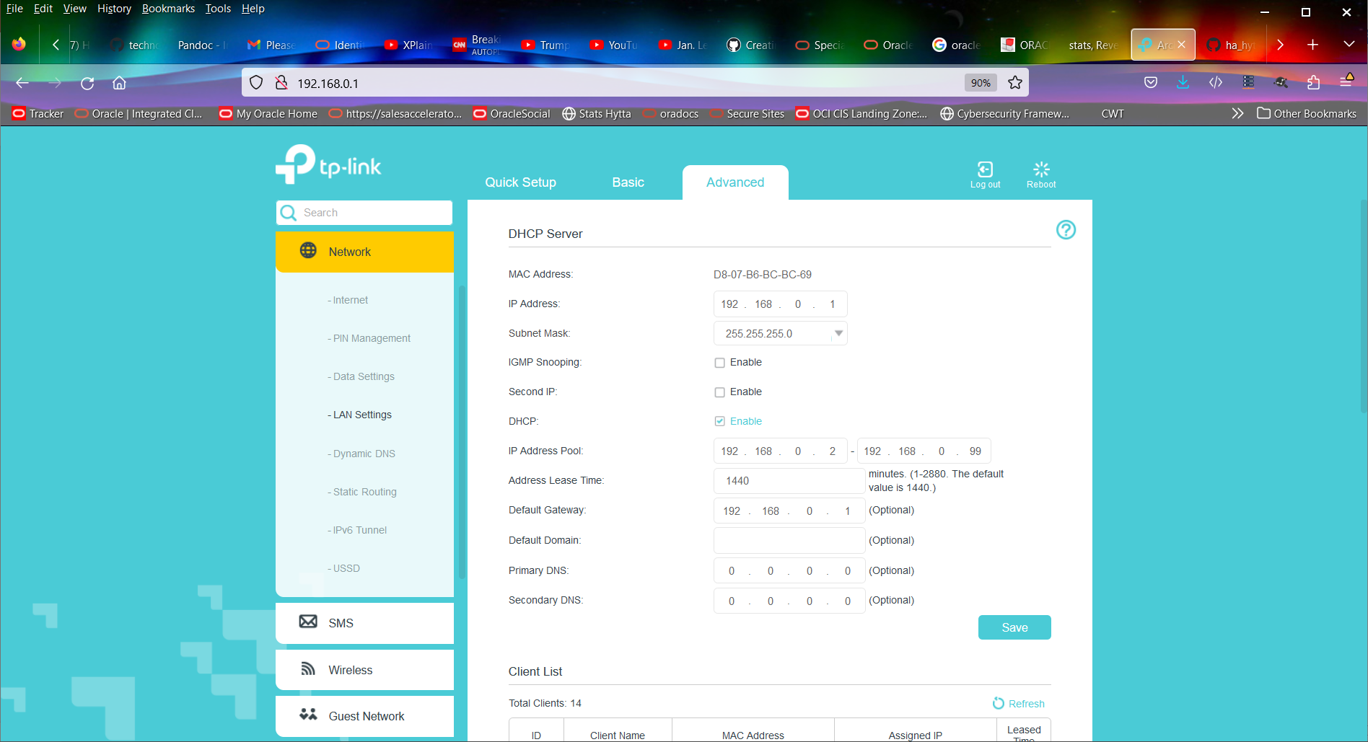

Slide 2
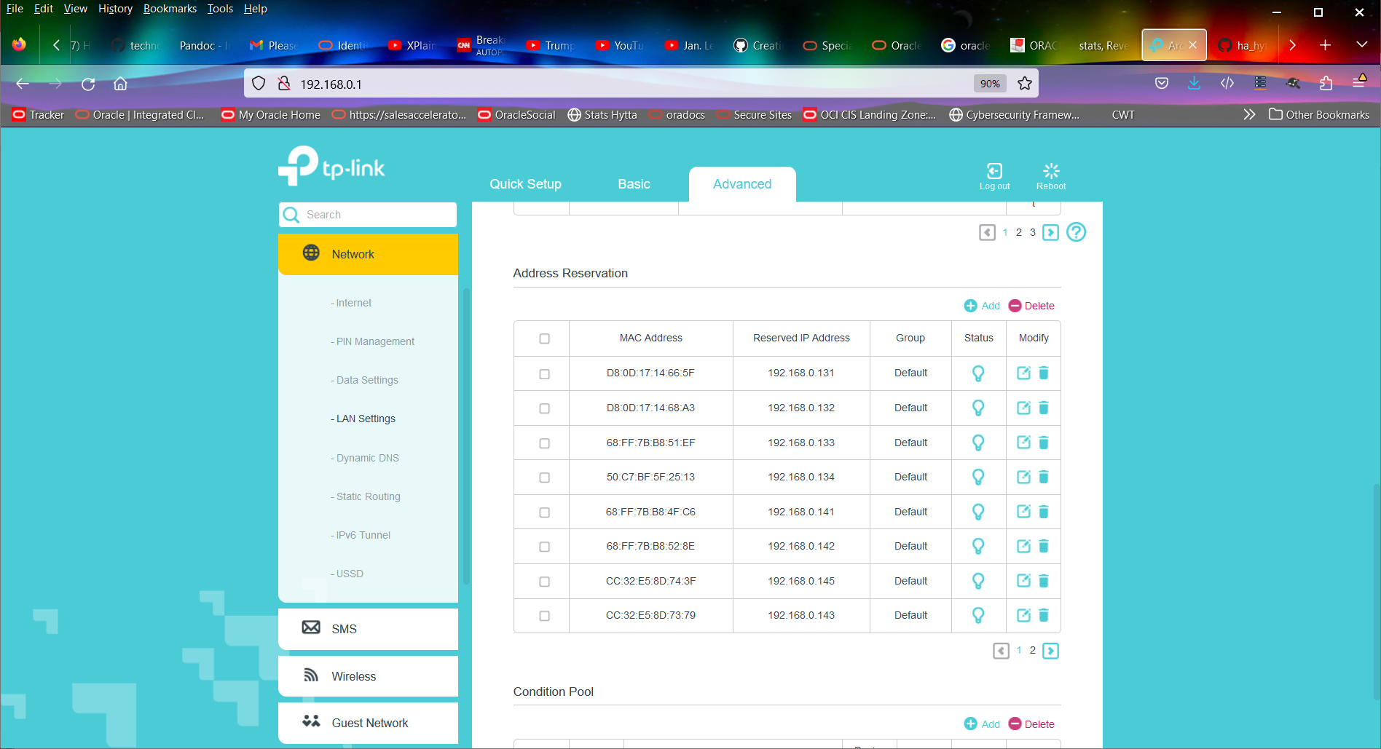

Slide 3
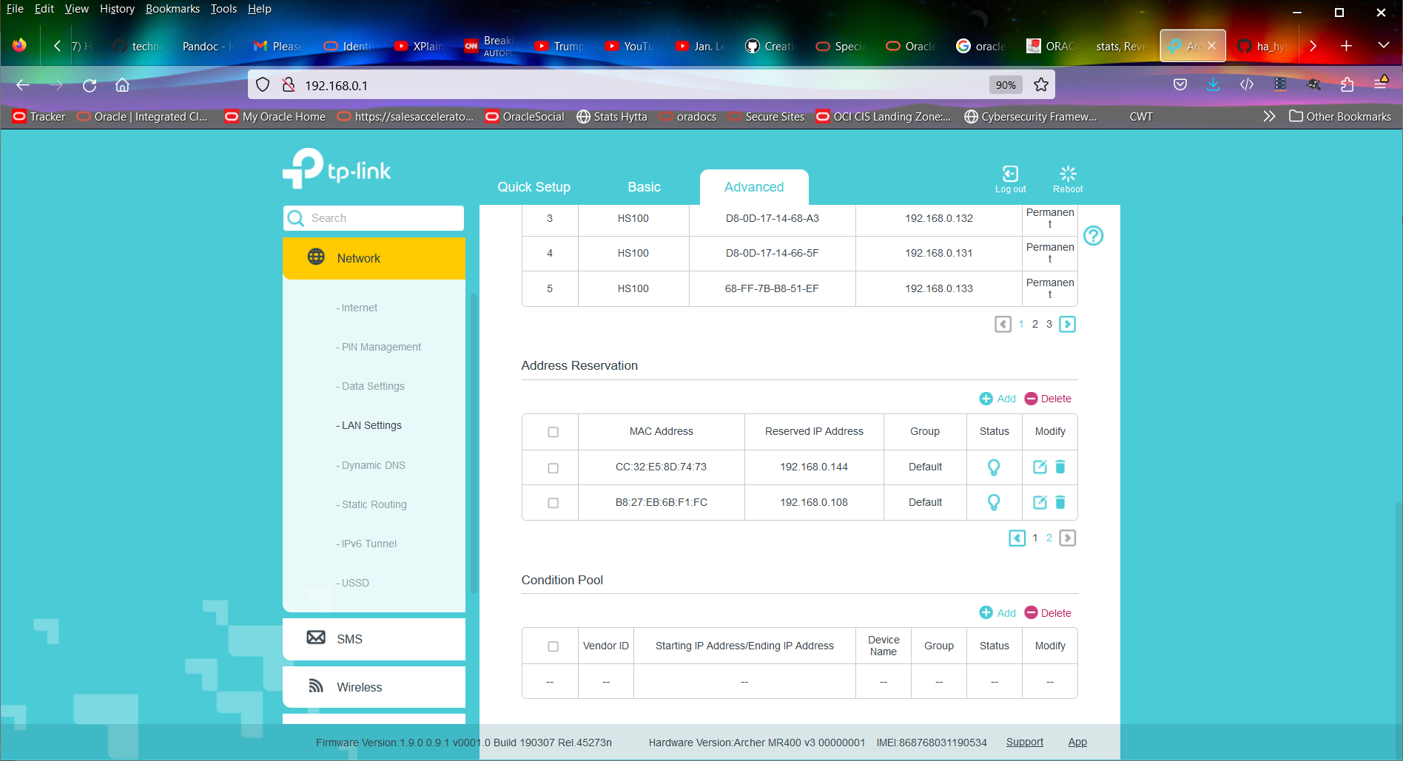

Slide 4
D8:0D:17:14:66:5F | 192.168.0.131 | Default
 | D8:0D:17:14:68:A3 | 192.168.0.132
 | 68:FF:7B:B8:51:EF | 192.168.0.133
 | 50:C7:BF:5F:25:13 | 192.168.0.134
 | 68:FF:7B:B8:4F:C6 | 192.168.0.141
 | 68:FF:7B:B8:52:8E | 192.168.0.142
 | CC:32:E5:8D:74:3F | 192.168.0.145
 | CC:32:E5:8D:73:79 | 192.168.0.143
D8:0D:17:14:66:5F | 192.168.0.131 | Default
CC:32:E5:8D:74:73 | 192.168.0.144 | Default
 | B8:27:EB:6B:F1:FC | 192.168.0.108
B8-27-EB-04-70-30

