Slide 1
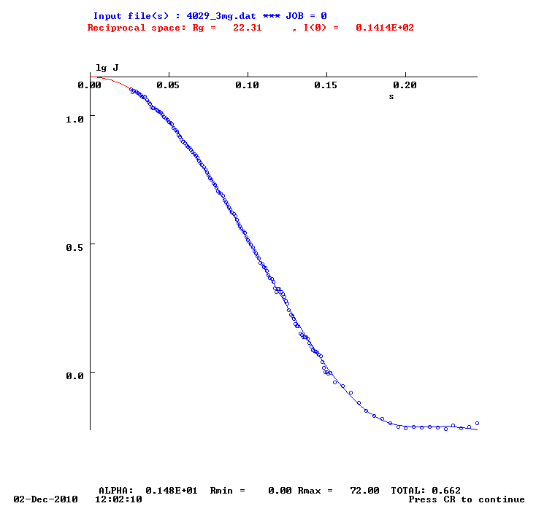
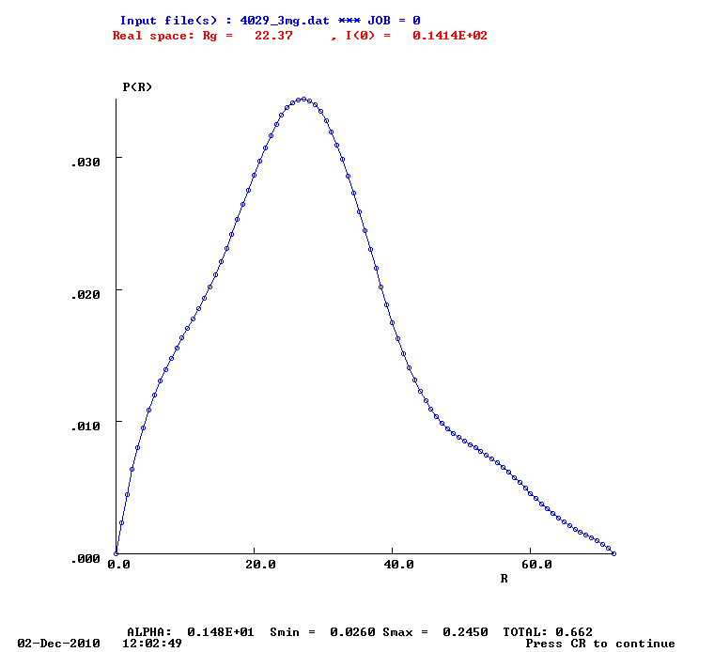
Fig1
Points 15-320 (0.0260-0.25)
Rmax=60
Rg=22.37 I(0)=14.14
Rg=22.31 I(0)=14.14

Slide 2
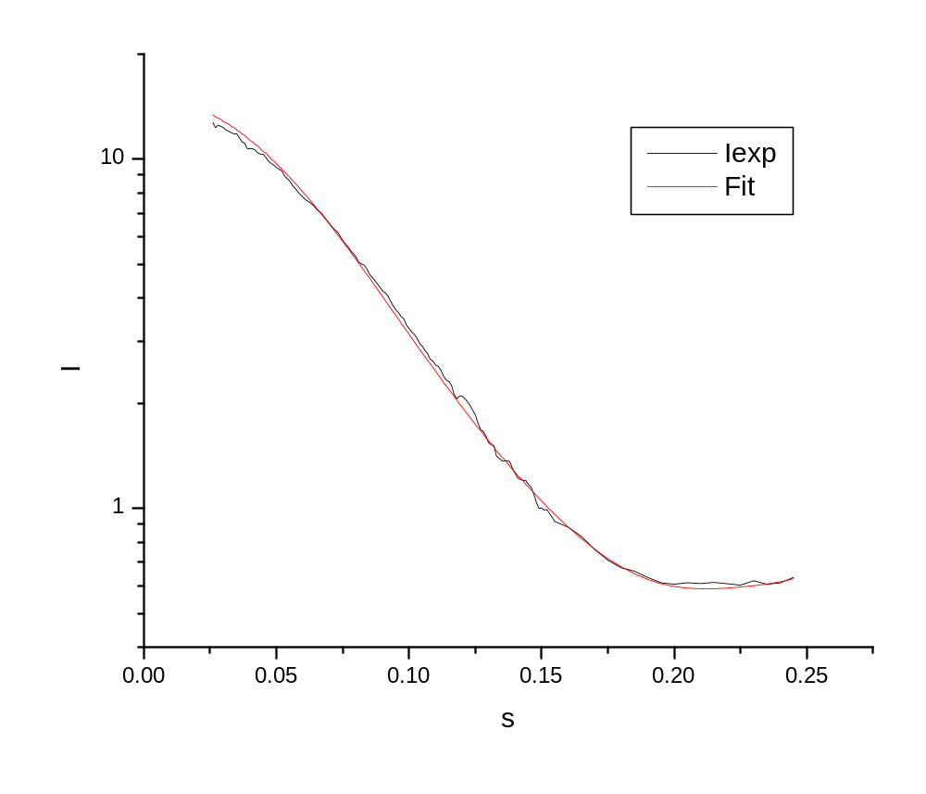
Gasbor 2.2i
Χ =3.8

