Slide 1
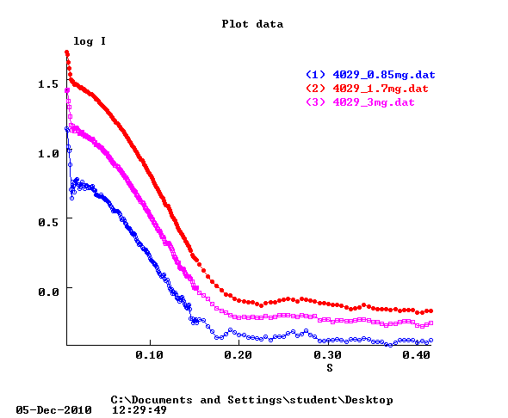

Slide 2
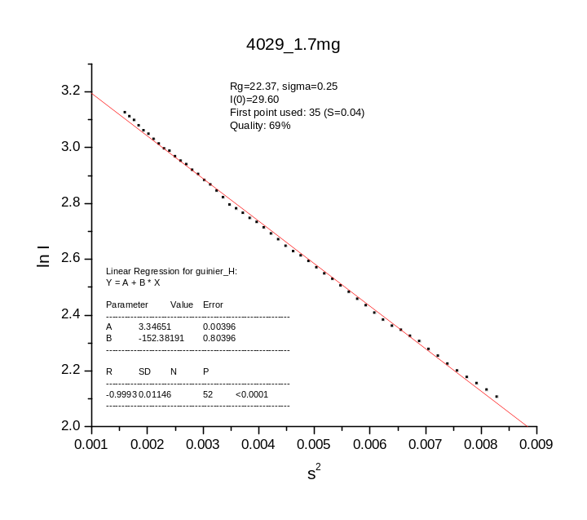
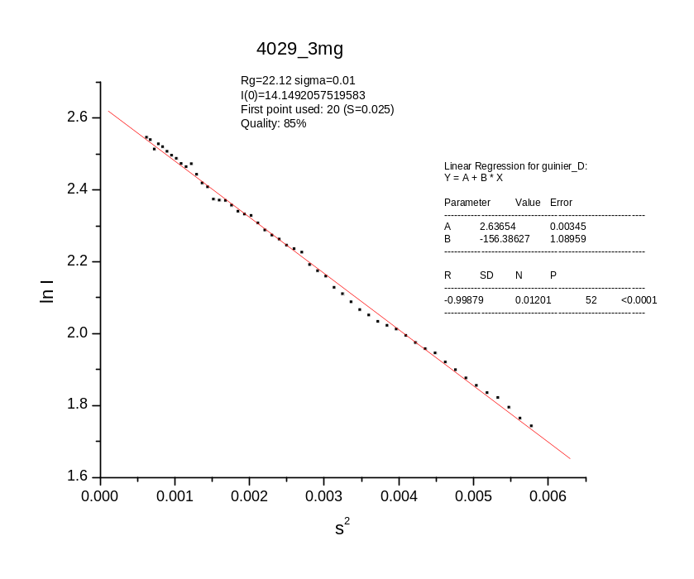
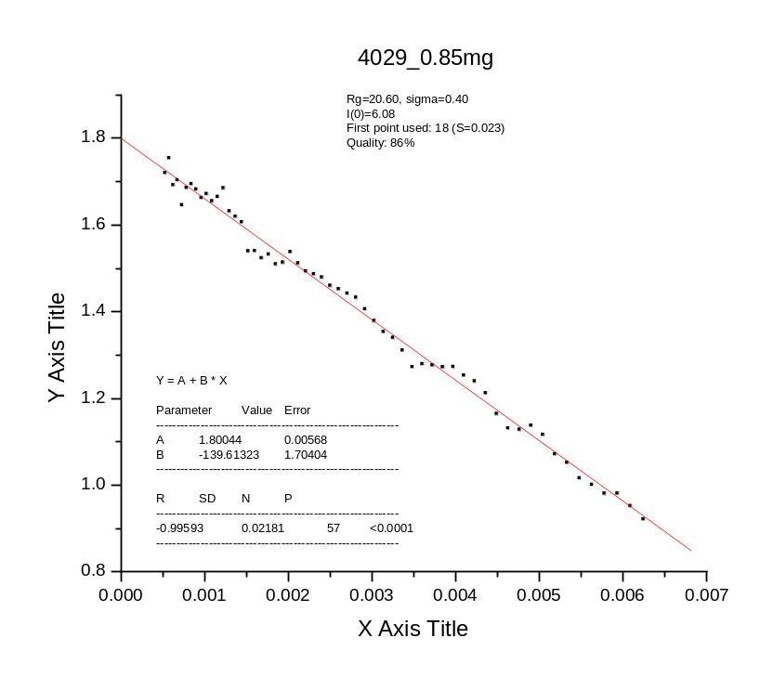
Protein | Rg | I(0) | I(0)/c
4029 3mg | 22.12 | 14.15 | 4.72
4029 1.7mg | 22.37 | 29.60 | 17.41
4029 0.85mg | 20.60 | 6.08 | 7.15

Slide 3
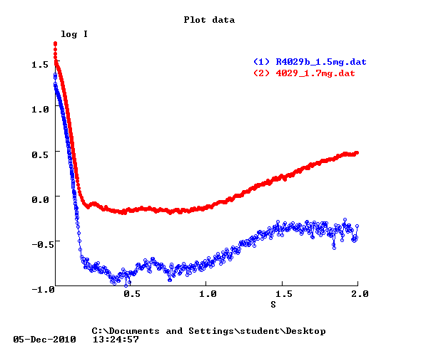
Same sample
Measured in different days
Protein | Rg | I(0) | I(0)/c
4029 1.7mg | 22.37 (.25) | 29.60 | 17.41
4029 1.7mg | 24.43 (4.22) | 15.55 | 9.15

