Slide 1
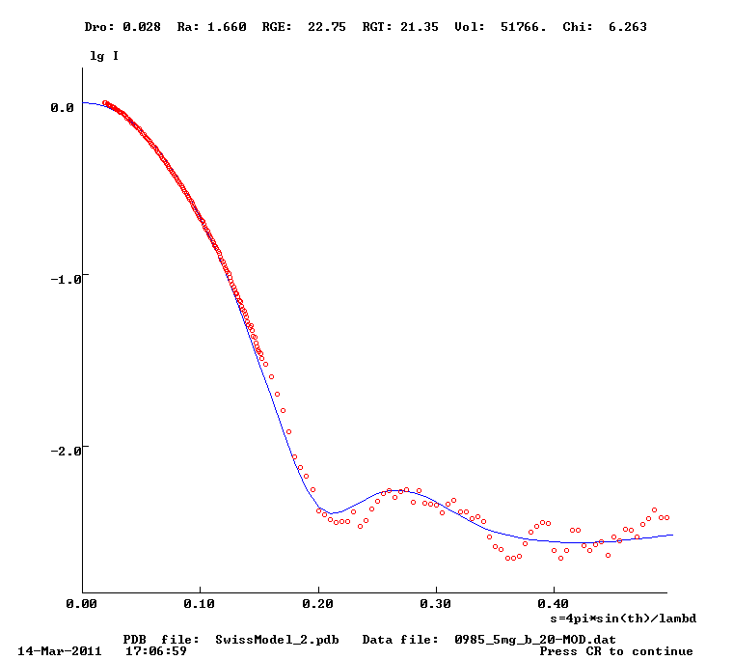
Swiss model 1 with constant subtraction
Frist 13 points omitted

Slide 2

Phyre model2 with constant subtraction
Frist 13 points omitted

Slide 3
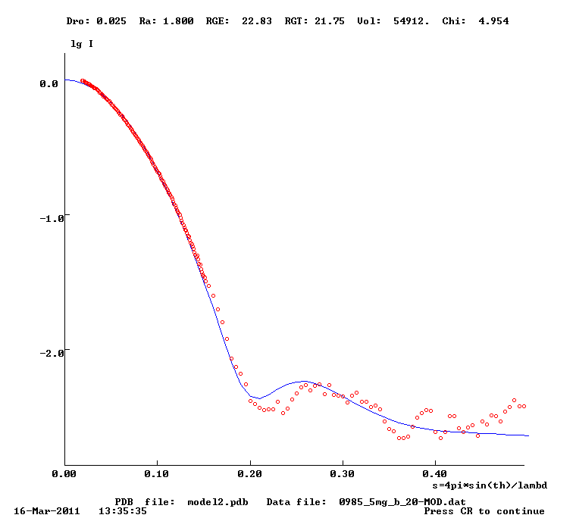
I-Tasser model 2 with constant subtraction Frist 13 points omitted

Slide 4
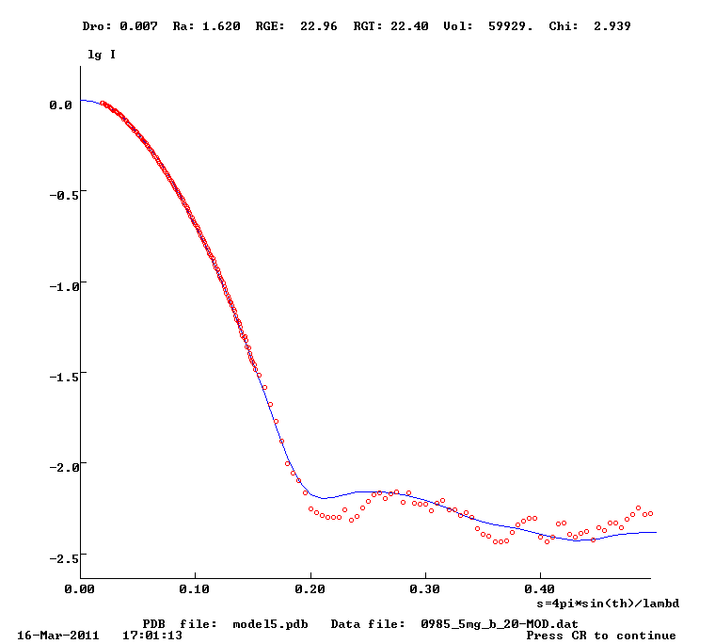
I-Tasser model 5 with constant subtraction Frist 13 points omitted

