Slide 1
Business Delivery and Opex Optimization
January 2025

Slide 2
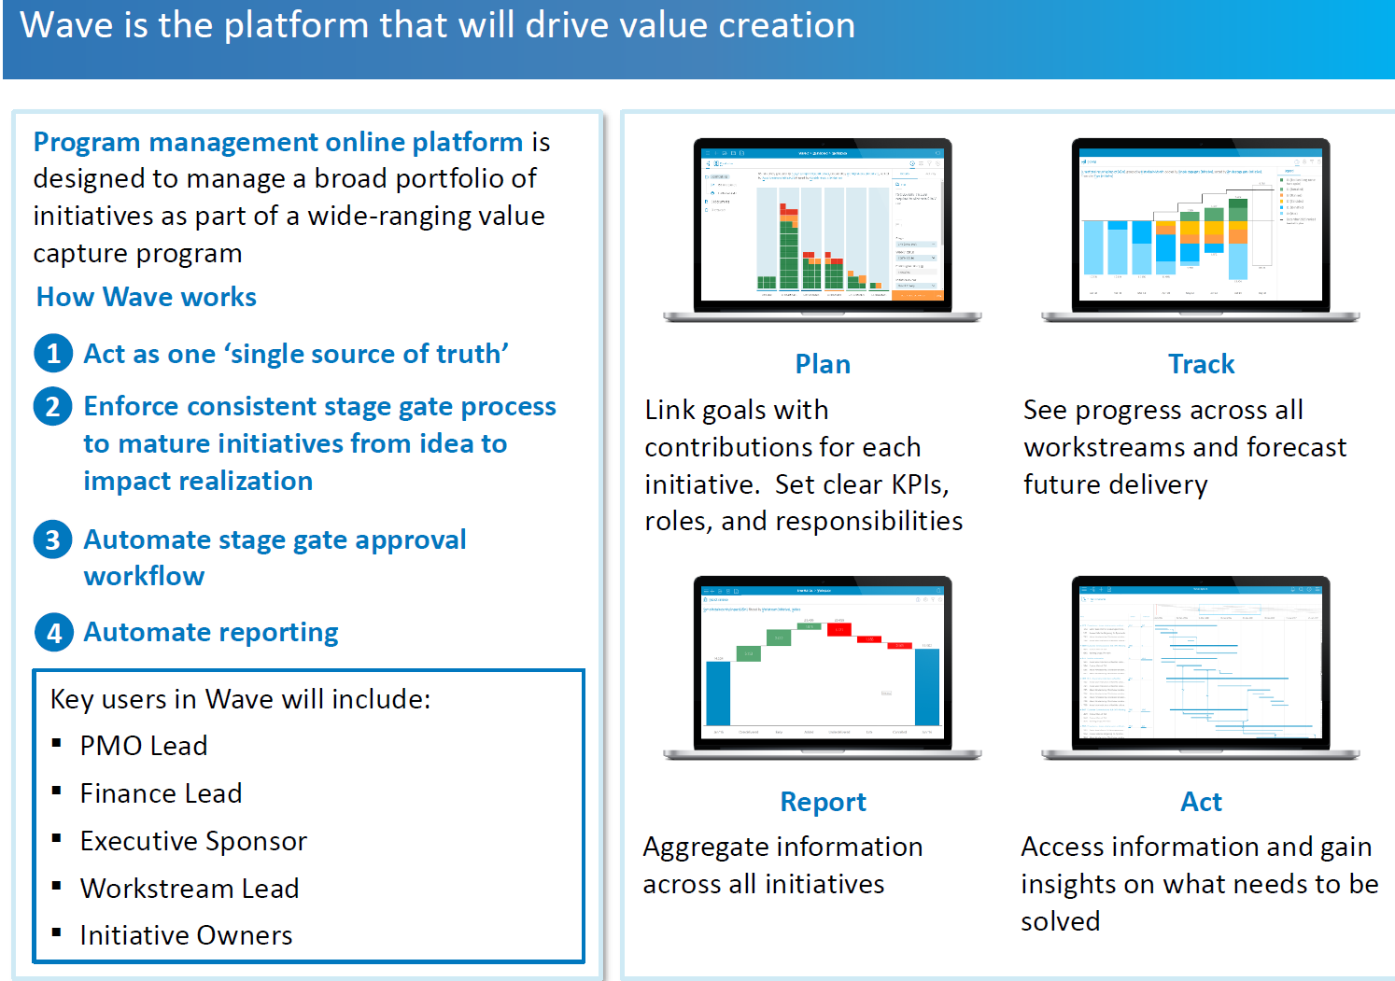
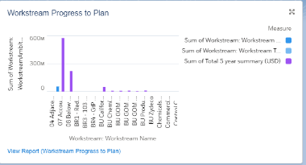
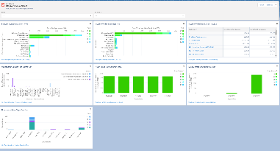
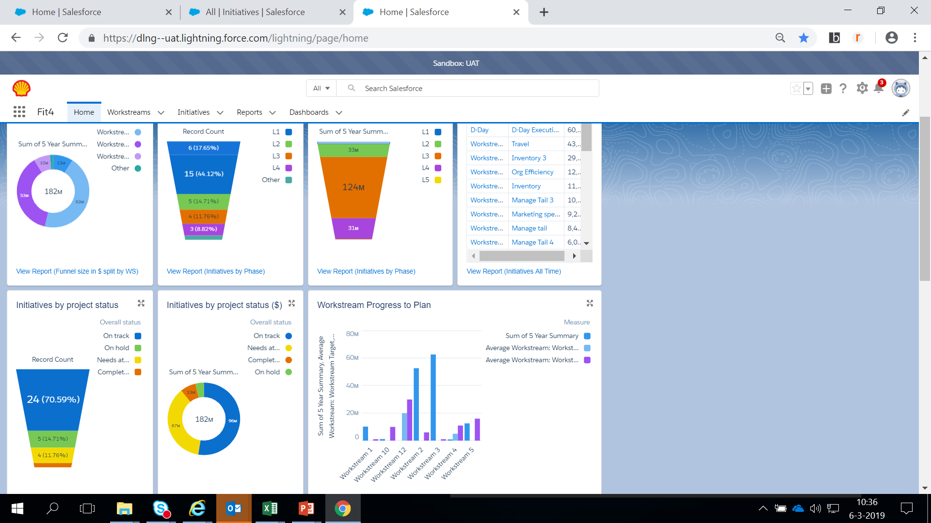
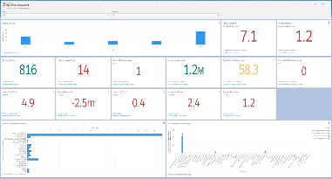
Fit4 – In Shell environment (Not Available to Renaissance)
Fit4 online platform is designed to manage a broad portfolio of initiatives as part of a wide-ranging value capture program
How Fit4 works
Acts as one ‘single source of truth’ as a digital platform providing a consolidated view of all workstreams, eliminating version control issues
Enforces consistent L0-L5 phase maturation process from idea to impact realization
Automates L0-L5 phase approval workflow from specific approvers at each phase
Automates reporting and real-time status on initiatives
Plan
Link goals with contributions for each initiative. Set clear actions (milestones), roles and responsibilities
Track
See progress across all workstreams and forecast future delivery
Key users to include
Workstream Sponsors
Workstream Leads
Finance Leads
initiative Owners
Report
Aggregate information across all initiatives
Act
Access information and gain insights on what needs to be solved

Slide 3
DIY Alternative for Business Continuity
FIT4 Alternative DIY tool: The application, Business Optimization mimics the features in Fit4 and is developed using Python and Django framework. This will ensure business continuity in OPEX management and optimisation.
How the DIY tool will work
A ‘single source of truth’ to provide a single view of all workstreams and initiatives under the workstream
L0-L5 L-Gate maturation from idea to impact realization
L0-L5 phase approval workflow is automated approvers at each L Gate flows across the designated approver for each workstream
Reporting real-time status of initiatives are displayed on the dashboard
Timeline:
Feb
Mar
Install Python 3.11 and above on a server (IDT)
Install Django version (IDT)
Install MSSQL to a database server (IDT)
The Data Analysis of report, with different graphs
Move the application code to the server
Connect the application to the Database
Supply all users' details (Fit4 team)
Supply all SPDC specific data (Fit4 team)
Migrate all SPDC data supplied to the DIY tool
User Acceptance Test
Provide User support during UAT
Go live date ?

Slide 4
Alternative tools being sourced by IDT
1. WAVE: A tool used in Shell before Fit4

Slide 5
Business Transformation (BCP) for Program Management Business Delivery and Opex Optimization
Temporary workaround for business continuity in the event of unavailability of IT applications:
Manual Operations: If IT systems are down, revert to paper-based or offline workflows where possible.
Develop Project Charter for each Initiative.
Print out project charters which contains clear actions (milestones), roles and responsibilities and store manually in a hard copy folder.
Track progress and forecast future delivery (On desktop, excel, power point or manually on paper).
When the system is available, Business Transformation will notify functions using standard network communication channels
Initiative owners make the entries into the tool.
Alternative Communication Channels: If internal email and messaging are down:
Use mobile networks (SMS, phone calls).
Use WhatsApp group channel for nonbusiness communication, only to notify the team of the breach.

