Slide 1
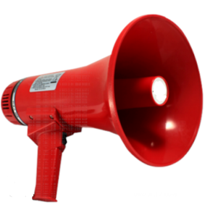
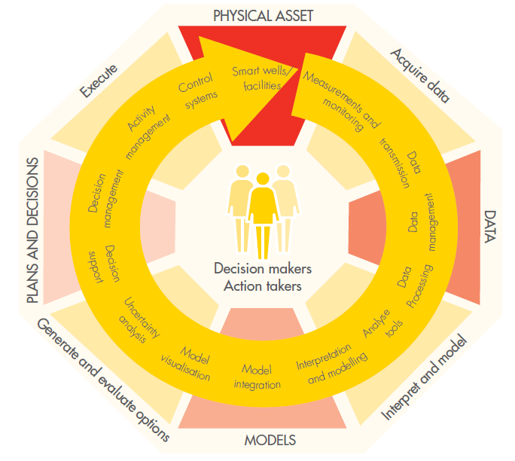
IMOR Gas Lift Health Check & Optimization Workshop -- REPORT OUT --
Date & Time of Workshop:
14th February 2018; 0900hrs to 1530hrs
Land Asset Team

Slide 2
Workshop Participants
S/N | Name | Role
1 | Akporuno, Mamoke SPDC-UPO/G/PSSH | Snr Programmer
2 | Amos, Martins SPDC-UPO/G/PSSH | Smart field Lead
3 | Anyanwu, Chinedu SPDC-UPO/G/PSSH | Smart field Engr
4 | Aribisala, Ayodeji A SPDC-UPO/G/PLI | Operations
5 | Attoni, Success D SPDC-UPO/G/DNL | Reservoir Engineer
6 | Erivona, Gloria O SPDC-UPO/G/DNL | IMOR FMT / Production Technologist
7 | Ezugworie, Chibogwu S SPDC-UPO/G/PL | Asset Mgr
8 | Famofo-Idowu, Olasunkanmi J SPDC-PTP/O/NA | Engineering
9 | Jamabo, Ibinabo SPDC-UPO/G/PL | WRFM Support
10 | Nongo, Boniface T SPDC-UPO/G/PL | WRFM Lead
11 | Oamen, Christopher A SPDC-UPO/G/PLI | PUM
12 | Obong, Benjamin U SPDC-UPO/G/PLI | Production
13 | Oboro, Richardson O SPDC-UPO/G/PLI | Production
14 | Offurum, Nmamkoche A SPDC-PTE/EUPE | Process WRFM
15 | Oginni, Abiodun I SPDC-UPO/G/PLI | Ops Supv
16 | Okpubuluku, Kevwe B SPDC-UPO/G/PSSH | Head PMC
17 | Oruambo, Tamunomiete J SPDC-UPO/G/DNL | Production Technologist
18 | Otoakhia, Iroboudu R SPDC-UPO/G/PSSH | Smart field Engr
19 | Salisu, Hassan S SPDC-UPO/G/PLI | Operations
20 | Uche, Nduka J SPDC-UPO/G/PLI | OPS
21 | Udo, Uzochukwu SPDC-UPO/G/PLI | PACO

Slide 3

Opportunity Statement from Workshop
.
There is an opportunity to increase production in Imo River field by approx. 2,700 ~ 3,400 bopd by end 2018; through the execution of WH, GLL, FL replacement/repair, Surveillance data acquisition and GLOP/GLVCO activities on 25 Gas Lifted conduits and the overhauling of the GL metering and automation system in the field.

Slide 4



Why? What? Next
What happened at the Workshop?
6
Assess Level 1 cost of project execution [TBA]
GoTo
SLIDE 9
[Plan/Roadmap/Actions]
SLIDE 8
[Reward Staircase - Optional Candidates]
SLIDE 7
[Reward Staircase - Firm Candidates]
SLIDE 6
[Full Candidate List]
5
Why?
Developed a phased implementation plan, identify clear actions, responsibilities and accountabilities
Next ⇨ Execution
Most wells producing at HWCT (ca 70% >)
Aged gaslift hardware (Mandrels, valves, GLL, automated measuring and injection system, etc)
System not SMART
Few wells presently on GL
Opportunity exists to increase overall GL system performance and improve production due to GL
4
Execution of Workshop Outcome.
[Work the Plan]
Assessed the reward of revamping/installing components identified in 2 and implementing GLOP/GLVI in candidates identified in 3
3
Identified GL optimization and new Installation Candidate Conduits
2
Identified areas of improvement in field GL hardware and software (metering, piping automation system, etc)
GoTo
SLIDE 5
1
Assessed status of Gaslift System

Slide 5
GL System Status Assessment and Improvement Identification
LEGEND
Item OK
Item being improved upon
Item not in place
Competent hand within CWI, O&M Contractor + Operations
Good Dev – CW Interface
Good Operations-Development interface
Installation of GLV, unloading and kick-off of wells with/without mandrels.
Compressor station availability/uptime at 95% ok
Manning level and lack of staff continuity in gaslift system operations.
GL competence and staff motivation
Competencies in gaslift optimization.
Availability of Wireline units for GLVCO activities
Security situation impacting on operations
GLL, FL, WHE availability (Some items require replacement/repairs)
CAO SCADA unavailability hampering real time monitoring
No updated gaslift system operating envelope for optimization
Gaslift manifold in place (planned to maintain FCVsr)
Lift gas metering on individual wells available
Adequate no of pumps
Gaslift lines to wells in place; some vandalized lines to be repaired.
Vmonitor/CAO/SCADA not functional.
Gas metering Facility(No integrators)
Optimization of dual string completion.
Gaslift manifold flushing to remove restrictions
BHP surveys ( SG) done regularly .
Gauges are regularly calibrated
Test separator availability
Data gathering plan in place
USM available in flowstations.
Metering & Production allocation
Time lag btw sample acquisition and analysis at the lab & prod. Prog.
Concurrent well test not always done with sampling & BHP acquisition. GOR measurement suspect
CAO SCADA not available Real Time BS&W
BSW probes not available on test separators
No Capability for real time data capture and analysis
EC available and in use (welltest data)
Availability of up-to-date well status diagram
Availability of temperature data.
Accuracy of data in the corporate BHP database
Quality of BSW data
Wellhead Pressure data (feedback not regular)
Injected Gas, measurement and optimization
Kick-off gaslift in Imor field
Gas lift valves and GL lines installation plans
Integrated Asset Activity Plan available
Real time systems implementation plan
Prosper modelling course readily available for PT’s
Automated gaslift system plan in place
Plan & process in place to build WinGlue models
CAO SCADA plan in place
Procurement & Storage of parts and materials.
Updated Asset Reference Plan
Maintained focus on the corporate WRM initiative
Optimization/rationalization strategy for GL
Lift gas metering for individual wells.
Competent PTs for building Prosper models
Competence in analyzing BHP surveys
Skills development
Programming & operations
Prosper
Field ware, PU-RTO, etc.
Real-time monitoring of gas lifted wells
GL System is at 50 - 60% of the standard the team desires
Key items in place were identified (in green font)
Key items being improved (in amber font)
Key items not in place (in red font)
Actions and responsible party to address issues listed in 5 (of “The purpose”)
Prosper training for PT
Determine the size of the prize (impact of gas lift in the Asset)
Ranked list of opportunities
Kick off gas lift in wells with mandrels
Planning and selection of data acquisition candidates
Real time acquisition of production data
Gaslift training for operations, maintenance and PTs
Contractors for GL optimization activities
PROSPER models available
Winglue models (Not applicable).
UNISIM Models available for the flowstation
Gap/IPSM model available
MBAL available (Available)
Back To Why? What? Next

Slide 6
Identified GL Optimization and New Installation Candidate Conduits
Legend
Total
Group
43
Conduit Count
GL Gain (bopd)
2775 - 3418
[+ X from Options]
Firm: Mainly conduits that have been on GL in the past where well modelling suggests GL optimization gains are possible.
Option: Conduits identified producing/produced at HWCT, that require additional work (such as CIWR, well modelling study, GLVI, etc) to mature
Firm
Option
25
18
2775 - 3418
TBD
Optimization
New Installation
Optimization
New Installation
24
0
10
8
2775 - 3418
Nil
TBD
TBD
Not in Plan for 2018
Full Candidate Listing
Back To Why? What? Next

Slide 7
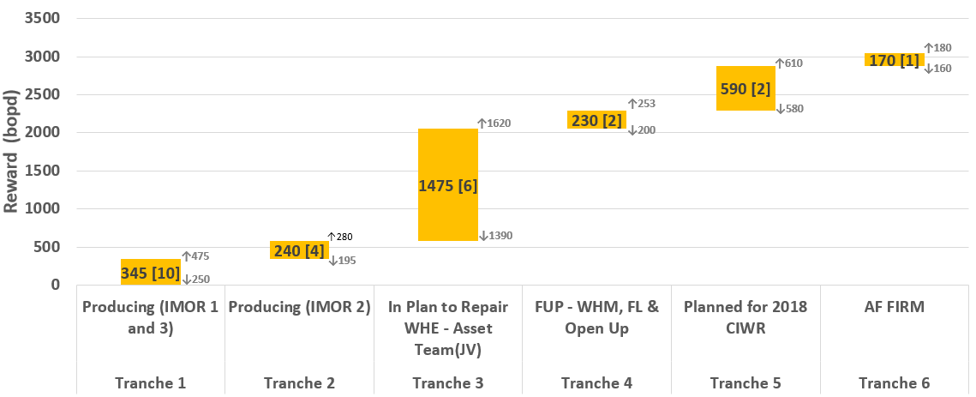

Reward Staircase and Implementation Timeline [FIRM CANDIDATES]
Tranche 1
IMOR001T:D2000X
IMOR013L:D6000A
IMOR019S:D2000X
IMOR021L:D2000X
IMOR025S:D1000X
IMOR026S:D2000X
IMOR032L:D2000X
IMOR032S:D1000X
IMOR037L:D2000X
IMOR063T:D2000X
All candidates in Firm Category has GL Mandrel and has been on GL in the past, and are selected GL Optimization
Well down on WHE/FL vandalization, AF Funded
Already identified in Strategy Workshop. WHM proposal preparation ongoing
Currently on GL, MRT required to optimize lift rate
STAIRCASE LEGEND
Tranche 2
Base Case Potential
High Case Potential
IMOR010L:D2000X
IMOR021S:D1000X
IMOR025L:D2000X
IMOR058T:D2000X
Pending Ejection from AF
Tranche 3
Conduit Count
Low Case Potential
IMOR005S:D1000X
IMOR030L:D8000N
IMOR036S:D4000X
IMOR044S:D9000N
IMOR055S:D1000X
IMOR057L:D6000P
Tranche 4
IMOR044L:E4000N
IMOR048S:D2000X
Tranche 5
Delivery Timeline (Mnths) →
14 Feb 2018 – 14 May 2018
15 May 2018 – 15 Aug 2018
16 Aug 2018 - Nov 2018
IMOR012S:D2000X
IMOR060T:D2000X
Requires FL & GLL Availability Check
Tranche 6
Range of reward (L/B/H): 2775/3050/3418 bopd
IMOR033L:D2000X
Note:
For the producing wells (i.e. Tranche 1&2): The gain is incremental due to GLOP and GLVCO (if necessary)
For non-producing conduits (i.e. Tranche 3 - 6): The reward is the expected potential of executing all activities (including GLOP) necessary to restore the conduits. These conduits flow sub-optimally without gas lift, and in some cases cannot sustain flow on NF.
Back To Why? What? Next

Slide 8
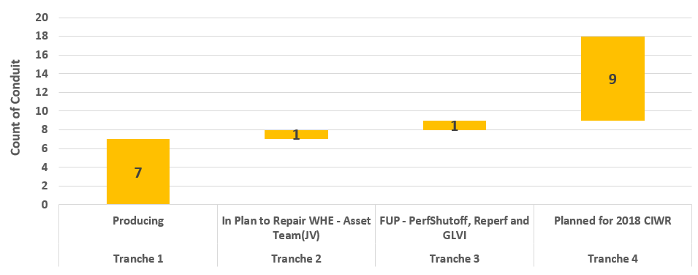
Reward Staircase and Implementation Timeline [OPTIONAL CANDIDATES]
Tranche 1
IMOR013S:D3200X
IMOR018L:D8000A
IMOR018S:D2000X
IMOR022L:D3000X
IMOR023L:D2000X
IMOR026L:D3000X
IMOR064L:D2000X
Tranche 2
IMOR002T:D3000X
Tranche 3
IMOR006L:D6000A
Tranche 4
IMOR003L:D2000X
IMOR003S:D1000X
IMOR005L:D2000X
IMOR006S:D2000X
IMOR012L:D3000X
IMOR024S:D2000X
IMOR033S:D1000X
IMOR037S:D1000X
IMOR064S:D2000X
No GL Mandrel – New Installation Candidates
Mandrel Exists – Optimization Candidates
Notional Delivery Timeline
2019
Range of reward (L/B/H): To Be Assessed
Back To Why? What? Next

Slide 9
Level 1 Implementation Plan Summary, Action and Accountabilities [Firm Candidates]
Firm Candidate Field Implementation Complete
Access Success and cumulative gain, compare with Baseline.
Run System health-check and compare with pre-project status
[Re-routing prj complete] Commence optz study of Tranche 2 conduits
Share Optz Results/Recommendation and kick start field implementation
MRT, Choke Removal, GLVCO sand and WCT monitoring
[Tranche 3 - Restoration complete] – Optz Study
Tranche 4 - WHM, GLL& FL Proposal & Job exec complete. – Optz study
Field implementation of Tranche 3 and 4
Troubleshoot implementation issues
Record gains
6 Mnths Milestone Check (plan vs Actual)
Develop recovery plan if necessary (source fillers from Options Category if necessary to replace unsuccessful candidates)
Field implementation of Tranche 5 & 6
Troubleshoot implementation issues
Record gains
9 Mnths Milestone Check (plan vs Actual)
Develop recovery plan if necessary (source fillers from Options Category if necessary to replace unsuccessful candidates)
Tranche 1 – Complete Study, share Results/Recommendation and kick start field implementation
MRT, Choke Removal, GLVCO sand and WCT monitoring
Troubleshoot implementation issues
Record gains
Integrate Delta V and SMART System for Well Test volume measurement
3 Mnths Milestone Check (plan vs Actual)
Develop recovery plan if necessary (source fillers from Options Category if necessary to replace unsuccessful candidates)
Tranche 5 – CIWR, Proposal Complete. WHM, FL, GLL repairs/replacement done
Tranche 6 – Ejected from AF
Opt Study of Tranche 5 & 6 Complete
Record (Baseline) Prodn from wells producing on GL at 14.Feb.2018.
Firm up candidate wells for GL Installt’n/Opt
Create maint’ce plan for FL manifold Flow control loop (FCVs, transmitters, etc.).
Initiate GL Project in CADENCE.
CAO/SCADA reinstatement status assessment (material and costing).
GL Manifold line flushing
Check GLL and FL integrity for all wells that can be Gas lifted.
Revamping of GL automation system: ensure that 22 FCVs are functional.
Commence optimization study of Tranche 1 conduits
ACTION LOG
Back To Why? What? Next

