Slide 1
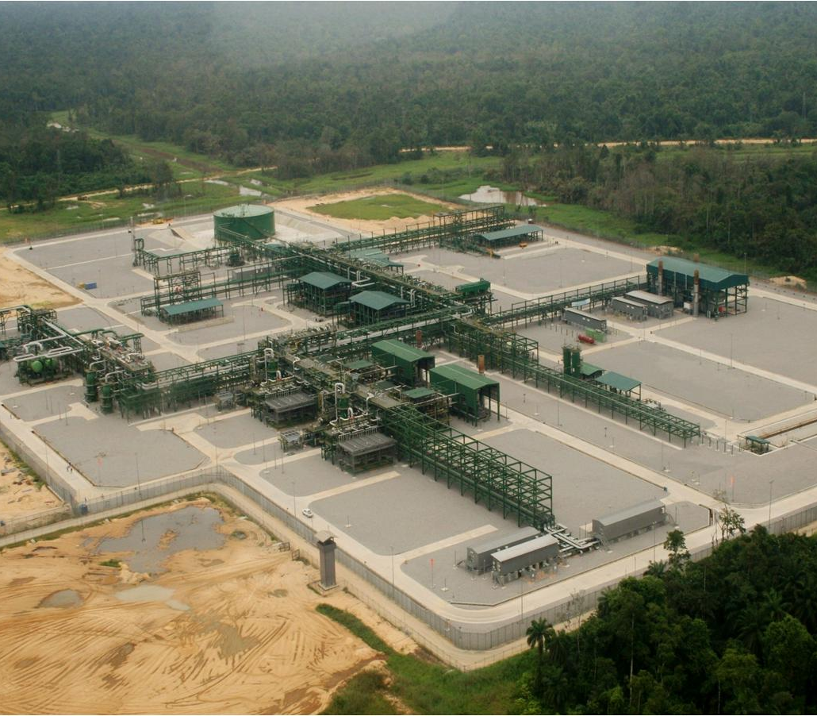
Nodal Water-Cut Determination using Decantation Technique. Using the Decantation Technique
Chimdike IHE & Ekine Ogbokuma
Production Operations, Gbaran-Ubie

Slide 2
Agenda
Gas well Testing
Sampling challenges
Decantation approach
Process/procedure
Concerns/Support

Slide 3
Gas well Testing
Two conventional approaches exist for NAG WELL test;
Through a dedicated test separator.
Schlumberger well test module.
Provision is not made for NAG well testing in the Gbaran CPF,
Well testing is done through testing difference
Testing by elimination.
Testing by difference
In this technique, all the wells flowing into the nominated slug catcher opened to their maximum advised potentials.

Slide 4
Gas well Testing cont’d
The wells are allowed to flow at their maximum potentials for a pre-determined time for stability.
The total condensate flow from the slug catcher is then measured and recorded.
Flow is reduced from in steps of 20MMSCFD (Highest to lowest) from the well to be tested while other wells on the node are kept at maximum flowrates.
The total condensate from the slug catcher is measured and recorded at each reduced rate of the well being tested.
The drop in the total condensate is attributed to the reduced flow from the well being tested.
Condensate samples are taken at reduced flow rate of the well being tested to corroborate the reading from the Coriolis meter.

Slide 5
Gas well Testing cont’d
Testing by elimination.
In this method all other wells flowing into the slug catcher are closed in leaving only the well being tested.
The gas flowrate of the well is increased stepwise.
The condensate flowrate leaving the slug catcher is measured and recorded.
The level in the slug catcher is maintained at a particular level throughout the test duration.
The measured condensate leaving the slug catcher is taken as the condensate production of the well at the particular flowrate.
The reduction in the water load in the condensate is taken as the water cut of the well at the particular flowrate.

Slide 6
Sampling challenges
A major challenge associated with methods is determination of the right CGR from the slug catcher as a result of the following reasons;
Tapping point of Walker sampling unit is at the 9 o’clock position of the pipeline.
No form of agitation before Coriolis meter or sample point
condensate flow

Slide 7
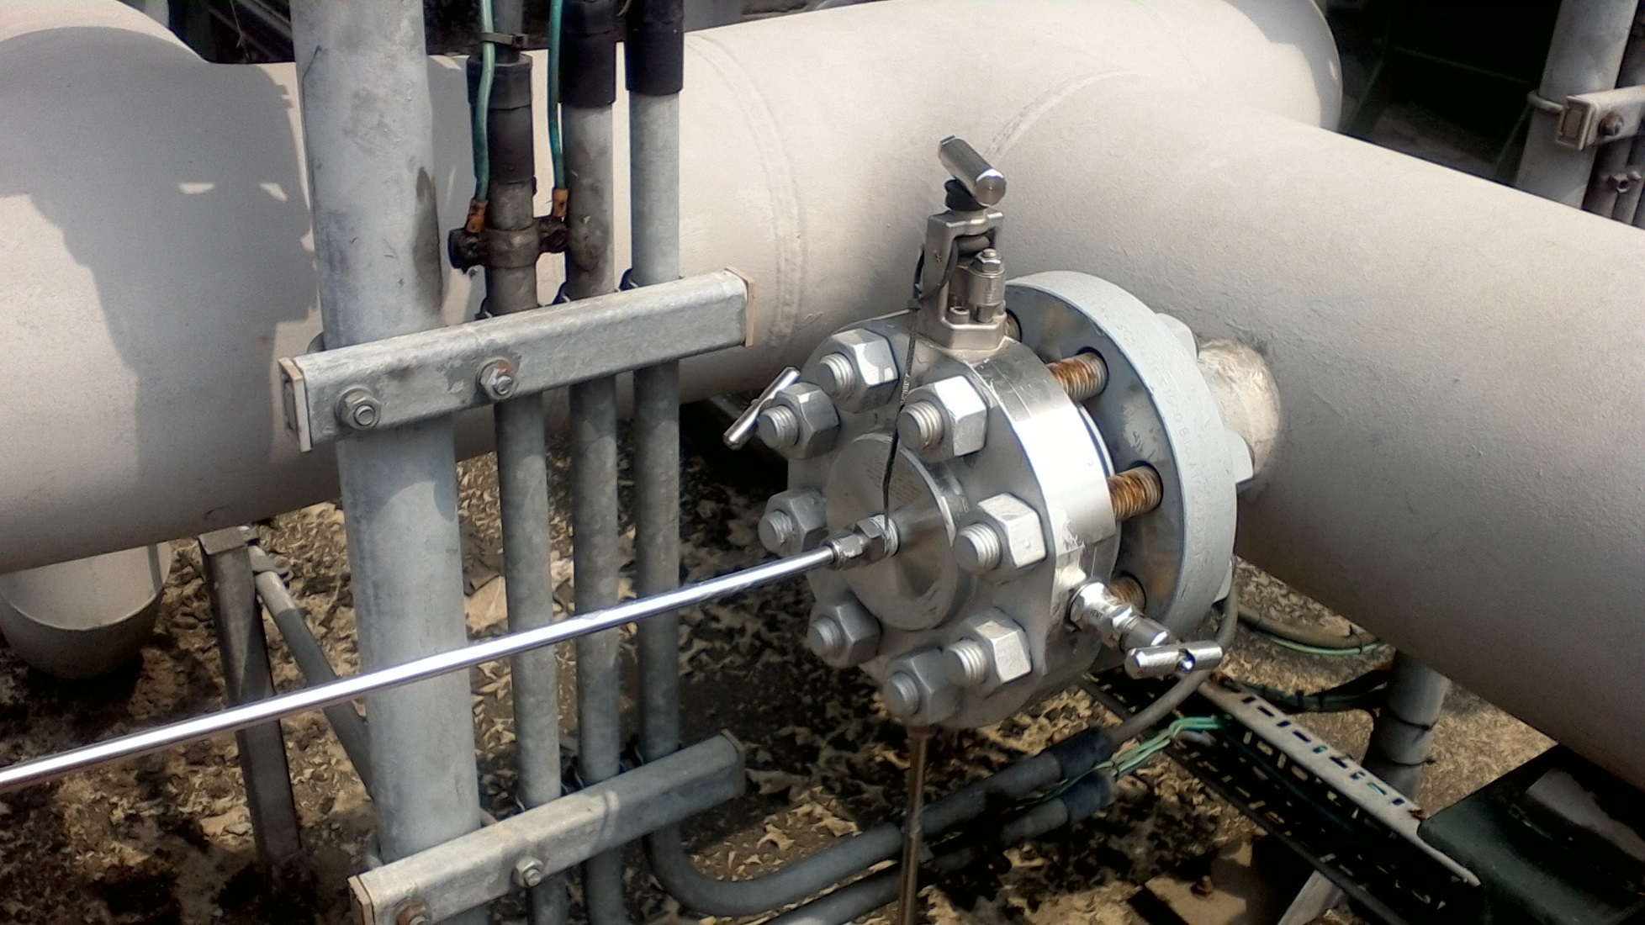
Condensate outlet
Sampling point tapping

Slide 8
PIPE ‘’HOLD UP’’ ANALYSIS
Pipe cross-sectional area not occupied by the fluid
Pipe cross-sectional area occupied by the condensate
Sample instrument tapping point
Pipe cross-sectional area occupied by water.

Slide 9
PIPE ‘’HOLD UP’’ ANALYSIS Cont’d
The fluid occupies only a cross-sectional area of the pipe called the ‘’Hold up’’ and not the entire diameter of pipe.
Sampling point at the middle of the pipe.
Flow through the pipe is laminar
By gravity the condensate ‘floats’ on the water.
Sampling challenges.
There is a measure of separation by gravity and because of this the sampling point tapping, most times the sample is consist mainly of water.
It therefore becomes almost impossible to get a representative sample.
Also there is no form of agitation before the sampling point to help mix the two fluids.

Slide 10
Decantation approach
Gas Out
Gas in
Condensate
Water
Liquid out
Sampling point

Slide 11
Process/procedure
In other to get a representative sample the following procedure will be followed;
Manually close the liquid outlet valve to the nominated slug catcher.
Build level in the slug catcher to 95%.
Closed in all wells producing wells to the nominated slug catcher
Allow for a settling time of 3 to 4 hour.
Take sample from the liquid leaving the slug catcher.
Gradually drain the vessel to 80%
Drain further to 60% and sample
Continue step 7 to 40%, 20%, 10% and 5%
Analyse condensate and use properties to compute density, Coriolis correction factor and Algorithm.

Slide 12
Establish density trends real time monitoring on PAS.
Simultaneously monitor density from Coriolis to corroborate with sample analysis
Concerns/Support
PACO to support ; provide a faceplate for density trends from the Coriolis meter.
PC lab to support with time-stamped sample analysis of codensate.
Obtain IAP deferment approvals for nominated node to be tested.
Obtain override for the level shutdown instruments.
PACO to check the level instruments on the nominated slug catcher in preparation for this exercise.

Slide 13
Questions and Answers

