Slide 1
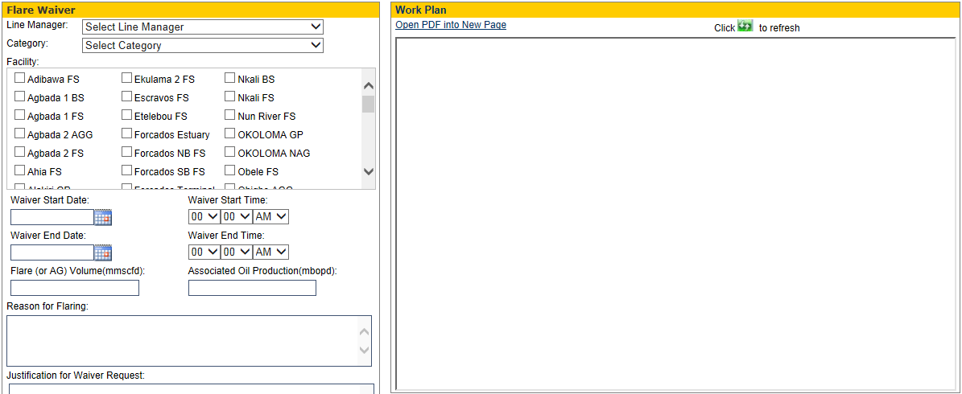
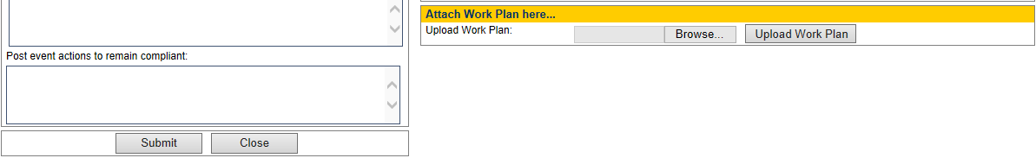
UIO-G Flaring/GOR Control Waiver
How to raise flare waiver request
To Raise flare waiver request:
Click “Request Flare Waiver” on the Menu by the left hand side
Fill the form accordingly.
*Attach work plan-
You can attach work plan if required.
*Click Browse button,
*Select your work plan
Note: work plan must be in PDF format.
*Click Upload Work Plan button
Then click Submit.

Slide 2
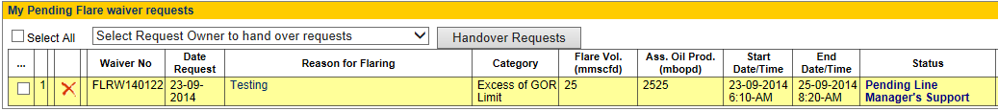
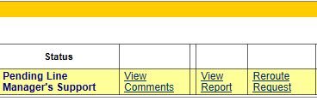
UIO-G Flaring/GOR Control Waiver
My Pending Flare Waiver Requests
ALWAYS:
*GO SEE
When you submit your flare waiver request, an email goes to the Line Manager you selected when filling the form and you will get a copy of the mail also.
The list of Flare waiver you requested will be listed as shown above.
The status of the flare waiver shows who is yet to support/or approve the request
You can cancel the request if no longer required.
You can view comments made by the support/approvers.
You can generate a report from your request entry.
You can reroute the request if the person to whom the request was initially forwarded no longer available.

Slide 3
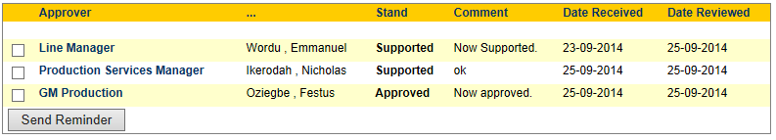
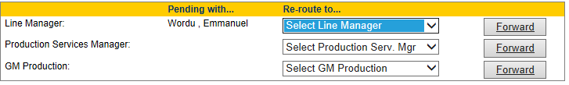
UIO-G Flaring/GOR Control Waiver

Slide 4
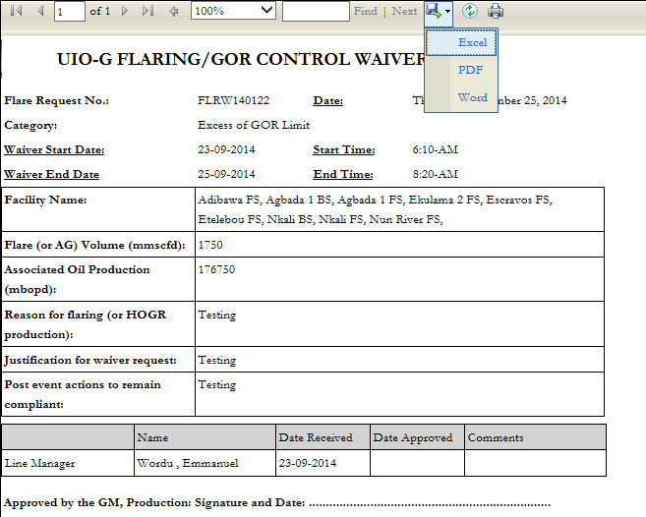
UIO-G Flaring/GOR Control Waiver

Slide 5
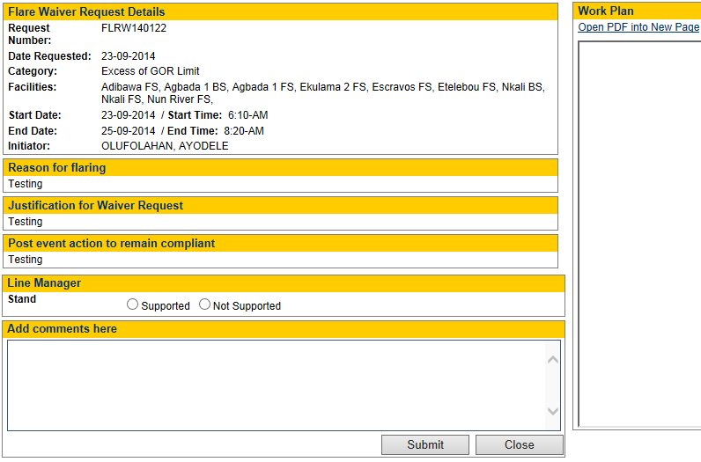
UIO-G Flaring/GOR Control Waiver

Slide 6
UIO-G Flaring/GOR Control Waiver

Slide 7
UIO-G Flaring/GOR Control Waiver

