Slide 1
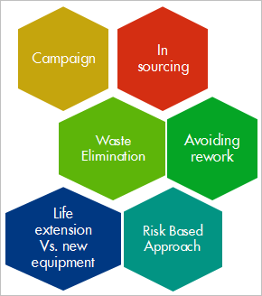
Cost & Efficiency Improvement (Land East)
DIY Campaign
Background/Business Case
Following funding constraints across the business, there is need to ensure Capital Efficiency, doing more with less
Aim: Champion Do-it-Yourself (DIY) campaign across the various facilities within the Asset
INITIAL GOALS
Capital efficiency – Optimise use of the limited available resources, utilise in-house expertise rather than contracting external vendor services, encourage DIYs by O&M team, and embedding Continuous Improvement culture in eliminating waste.
Current Conditions/Opportunity
YTD Current Cost Savings/Gains from DIY Campaign - $0.99m
In-house Major equipment overhaul – $400k
In-house resource in restoring crashed Metering Validation Workstation - $60k
Optimize AGO consumption (savings 2015 YTD) - $50k
Integrated team approach in replacing KRCK Power cable - $100k
DIY to restore GTG1 UPS batteries - $60k
In-house resource for GTG/AGC mechanical repair works and
EPF Electrical repair works - $100k
Applying 5S to PACO Workshop - $70k

Slide 2
Cost & Efficiency Improvement (Land East)
Waste Elimination
Background/Business Case
Gbaran JTF Camp powered by 2 X 100KVA Diesel generators since plant commissioning in 2010
Increased OPEX from diesel consumption and high maintenance cost due to frequent failures of the generators; also adds to the GHG emissions associated with operating the Asset.
Aim: Power JTF camp from Gbaran FLB Switchboard
INITIAL GOALS
Capital Efficiency - supply power to the JTF camp from the FLB Switchboard and eliminate need for the diesel generators thereby eliminating OPEX costs for diesel consumption and generator maintenance
Make available redundant 2x100KVA diesel generators for use in other SPDC facilities
Reduce GHG emissions to the environment
External Stakeholder management - Improve relationship with JTF personnel as inconveniences from frequent power outages due to diesel genset failures are eliminated.
Current Conditions/Opportunity (Connection Completed)
Gains from powering JTF camp from FLB Switchboard are as follows:
Current Yearly OPEX cost from diesel consumption and maintenance of the 2 diesel generators: $0
Expected cost savings/year: $103K
Expected savings in 10years $1.3m
GHG emissions savings
>99% Power availability at Gbaran JTF Camp (since January 2015)

Slide 3
Cost & Efficiency Improvement (Land East)
Integrated Team approach
Background/Business Case
Hydrocarbon hiss from cracked nozzle weld joint on ¾” branch connection along 10” blowdown line of the Gbaran Tr2 XHP Separator vessel
Incident leading to isolation and depressurization of vessel and all associated lines; also led to close-in of all hydrocarbon feed to the vessel. 44,000 bbl of Oil and 124.7 MMScf of Gas deferred.
Aim: Prevent oil and gas production deferment of circa 240kboed through timely and safe execution of repairs by an Integrated team.
INITIAL GOALS
Risk management – risk assessment and robust mitigations in place.
Timely and Safe execution of emergency hot-work repairs to restore production
Execute work at no additional operating cost, eliminating time delay and associated cost for Contractor scoping, mobilization, intervention & de-mobilization through an Integrated Team approach involving Asset Team, NLNG Supplies Project team, and their Contractors.
Current Conditions/Opportunity
Gains from Integrated Team approach to resolve issue: assuming 10days required to engage external vendor services for repair work
Potential deferment cost of 240kboed @$59/bbl for 10days – $141.6m
Actual deferment costs of 64,750boe: $3.82m
Deferment cost savings: $137.78m
Additional costs incurred $0

Slide 4
Cost & Efficiency Improvement (Land East)
In sourcing
Background/Business Case
There is need to restore and make operational the failed Supervisory computer (SVCA) in order to eliminate the huge financial, reputational, disputes/potential litigation and associated operational exposures with OKGP export metering system for billing, archiving and recording of produced and sales gas to customers.
Left unattended since 2010 due to high cost of restoration by OEM
INITIAL GOALS
Get it restored by the OEM – System repairs/ replacement at competitive rate within budget
Save cost of inspection, repairs, replacement & licensing (vendor services) while safe guarding integrity
Achieve Asset Integrity Compliance
Current Conditions/Opportunity
SVCA restored, commissioned, operational & Functional
The repair and commissioning of OKGP SVCA presented an opportunity to take off some maintenance cost, using one of SPDC approved local vendor with experience on metering systems
Historical Cost (FSEs, inspection /installation of new system, license) $90K
Cost with collaboration with SPDC personnel $ 9K
Valued saved: $81K
Follow up by identifying other jobs that are otherwise done by OEM that can be done in-house, with a view to drive down cost without compromising on Asset and Technical integrity (TI).

Slide 5
Cost & Efficiency Improvement (Bonga)
In sourcing
Background/Business Case
Bonga DCS servers shall be using current Microsoft platform and shall comply to IT security standard
Availability of servers shall be increased by making them less vulnerable to cyber security risks
Cost of maintenance to sustain IT security compliance shall be reduced
Maintenance tasks shall be reduced/simplified and where possible automated.
INITIAL GOALS
Get latest DCS software and platform that support Shell IT security requirements fully . Use Microsoft Windows 7 and 2008 server. Remove all obsolete components
Ensure compliance to Shell IT security DEP and IRM standard
Use multicore microprossesor technology to improve performance of servers
Current Conditions/Savings
DCS upgrade proposal is building on Bonga As-Is architecture and implemented security mitigations
Duplications identified and unnecessary low benefit features identified and removed from scope
Contingency in manpower estimate identified and removed to reduce total price
Price has dropped from initial USD 258k down to 85k
Security compliancy will be maintained as required without need for additional manpower capacity.

Slide 6

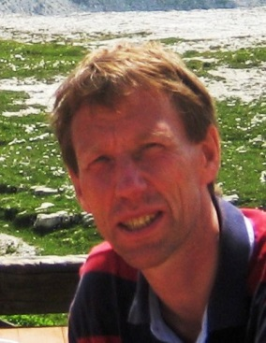
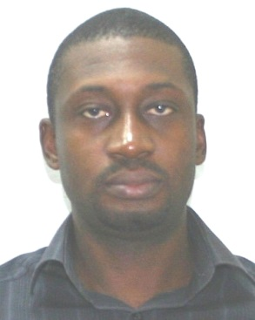
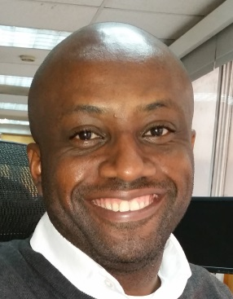
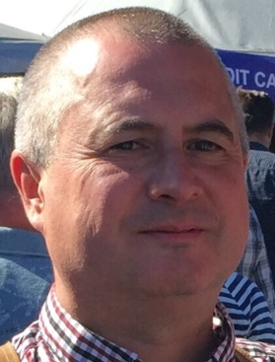
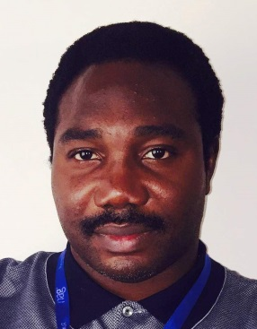
PACO team involved
Chiedu Okoye
Jules Vos
Victor Onoja
Andrew Ebenuwah
Chris Kilburn
Seun Akinyemi

