Slide 1
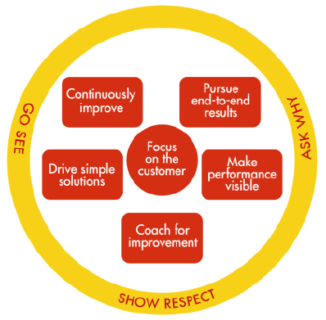
CONTINUOUS IMPROVEMENT (CI) WAYS OF WORKING
Are you working the CI Way? …Then initiate an improvement in your work area
FOCUS ON THE CUSTOMER - Who's the customer and what do they value?
PURSUE END -TO -END RESULTS - Do I understand the whole process, not just my part?
MAKE PERFROMANCE VISIBLE - How do we know how our process is performing?
COACH FOR IMPROVEMENT - How do I enable others through shared learning?
DRIVE SIMPLE SOLUTIONS - Are we over-engineering our solutions?
CONTINOUSLY IMPROVE - Is Continuous Improvement Everybody Everyday?

Slide 2
CONTINUOUS IMPROVEMENT (CI) WAYS OF WORKING
You can identify improvement initiatives in your area through Go See at the Gemba
Go See Guide
WHAT IS IT: To go see the actual process to understand the real situation through direct observation
WHERE IS IT DONE? At the "actual place" (aka the Gemba) where the process is taking place. This cannot be done away from the process and its performers
WHY DO IT: To observe for yourself and Identify Opportunities & best practice, investigate a problem, monitor performance, coach for improvement
WHO DOES IT? Anyone who needs to understand the process, from senior manager to team leaders and process performers
WHAT TO ASK (Examples)
Is this a safe and convenient time to talk?
Can you show me your process?
How do you know when you are doing this right?
How do you measure performance
Who's the customer of this work?
Do you have ideas of how to improve the process?
What do you do if you find a problem?
Remember to always Show Respect: Be hard on the process not the people.
ALWAYS:
*GO SEE
See guide
*SHOW RESPECT - Remember that the process performer is the true expert
*ASK WHY - Demonstrate curiosity, dig into the detail in order to determine the real root cause of the problem
At the Gemba

Slide 3
CONTINUOUS IMPROVEMENT (CI) WAYS OF WORKING
For additional information, support and Coaching, see below
Lagos:
Lanre Ogunsakin - +234 80703 65201
Greg Esangbedo – +234 8070363195
Akeem Adepoju – +234 80 703 62093
Port Harcourt:
Mustapha Adetoun - +234 8070324337
Chuks Bisike-Ojiako - +2348070321929
Ben Odeh – +234 8070342634
Omu Ugborugbo - +234 80702 39633
Chinyere Akuegbonwu - +2348070222461
Links to additional information:
UIOG CI/Lean website – additional information
UIOG CI/Lean Projects Dashboard – Register a CI project & monitor status
CI Newsletters
Bright Ideas – Register an improvement idea

