Slide 1
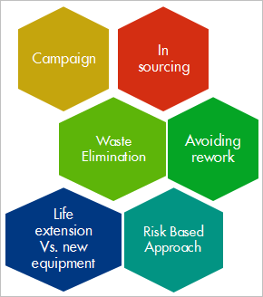
Cost & Efficiency Improvement (Swamp West)
Waste Elimination
Background/Business Case
A number of Marine equipment's are kept on stand by and paid for daily by the Asset Team.
The equipment's are used very frequently but there is the need to optimize their usage
Aim is to derive greater operational value from the equipment's with reduced daily rate paid
INITIAL GOALS
Optimize the frequency of use of the relevant marine equipment to a maximum of 70% in the year, thereby reducing the cost by a minimum of 30%.
Reduce HSSE exposure due to marine operations
Current Conditions/Opportunity
Gains from the Marine logistic equipment’s optimization are as follows.
Current Yearly Cost of Dedicated Barges: $676K
Expected Cost after Optimization: $355K
Expected Saving: $321K
2) Pilotage chargeback back $3,200k
Expected cost after Optimization: $2,200k
Expected Savings: $1,000k

Slide 2
Cost & Efficiency Improvement (Swamp East)
In sourcing
Background/Business Case
INITIAL GOALS
Current Conditions/Opportunity

