Slide 1

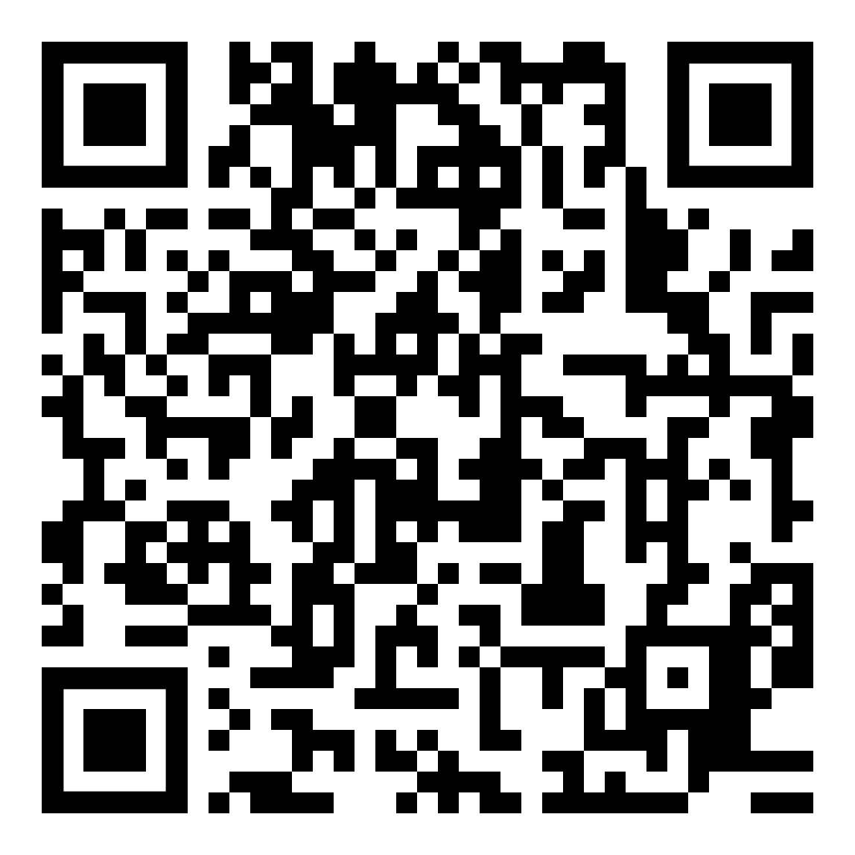
An IPR seminar series supported by
WPI-PRIMe and ASPiRE
BioSim Talk #1
22th May 2026 (Friday)
3.30 – 5.00 pm
Institute for Protein Research
University of Osaka (Suita Campus)
4th floor Seminar room
Rodolfo Sebastian Allendes Osorio
Specially-appointed assistant professor,
The University of Osaka, WPI-PRIMe
Untangling Mixed Samples: A Practical Framework for Multiplexed scRNA-seq Experiments
Pooling cells from multiple donors into a single scRNA-seq experiment is a powerful strategy to increase scale, reduce batch effects, and lower costs. However, success depends critically on "demultiplexing"—accurately assigning each sequenced cell back to its correct donor of origin. Without clear guidelines, researchers often proceed blindly, risking expensive failures and catastrophic data loss. This time, I will talk about this problem and the steps we are taking towards helping in its solution (and how that could potentially help you solve your own entangle).
Link for online participation via Zoom:
Please inform us if you will be participating online or
joining our Slack channel
sandhyatiwari@protein.osaka-u.ac.jp, shinobu.ai.prime@osaka-u.ac.jp
Notes:
https://www.qrcode-monkey.com/#about

