Slide 1

++++++++[>++++[>++>+++>+++>+<<<<-]>+>+>->>+[<]<-]>>.>---.+++++++..+++.>>.<-.<.+++.------.--------.>>+.>++.

Slide 2
Why the brainfuck benchmark?
Simple to understand
Expressive D example
Intermediate

Slide 3
Let's break it up
What does each line mean?
What does it do?
What are the benchmarks?
How does it compare to other languages?

Slide 4
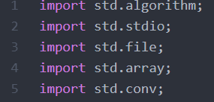
Imports

Slide 5
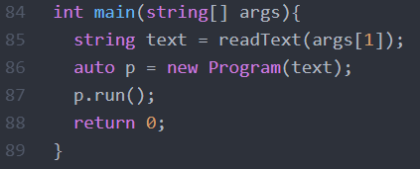
Entry Point

Slide 6
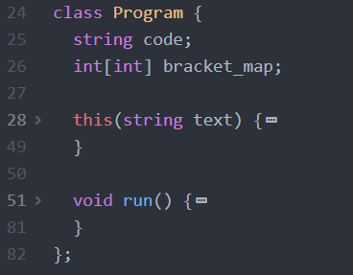
The “Program” Class

Slide 7
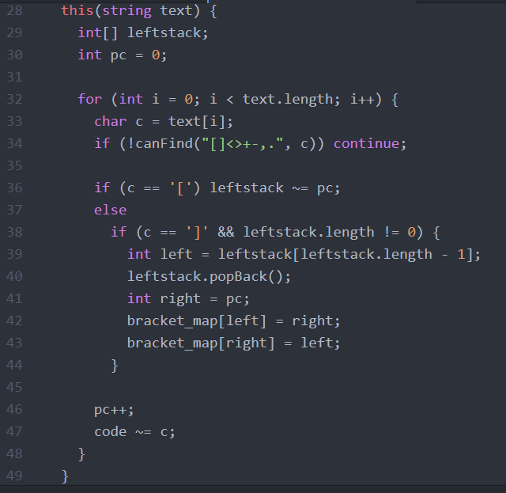
The “Program” Constructor

Slide 8
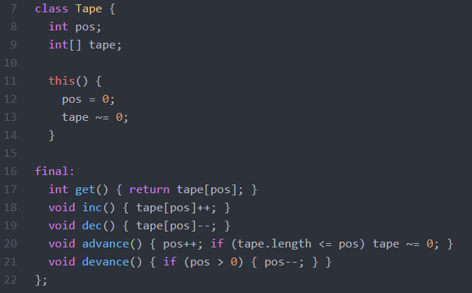
The “Tape” Class

Slide 9
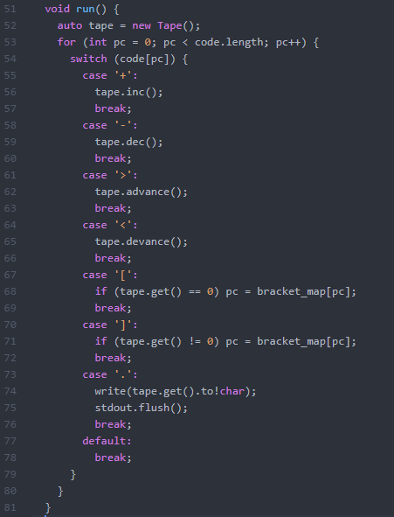
The “Program.run” function

Slide 10


Benchmarks

Slide 11
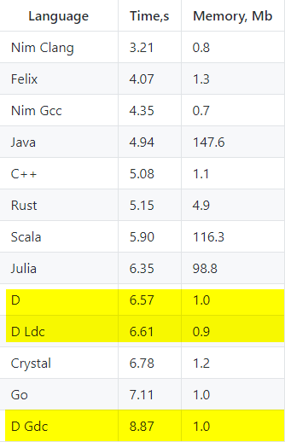
Language Comparisons

Slide 12
Conclusion
D is in the top 10
D matches with other high-performance languages
Benchmarks are not ideal code

