Slide 1
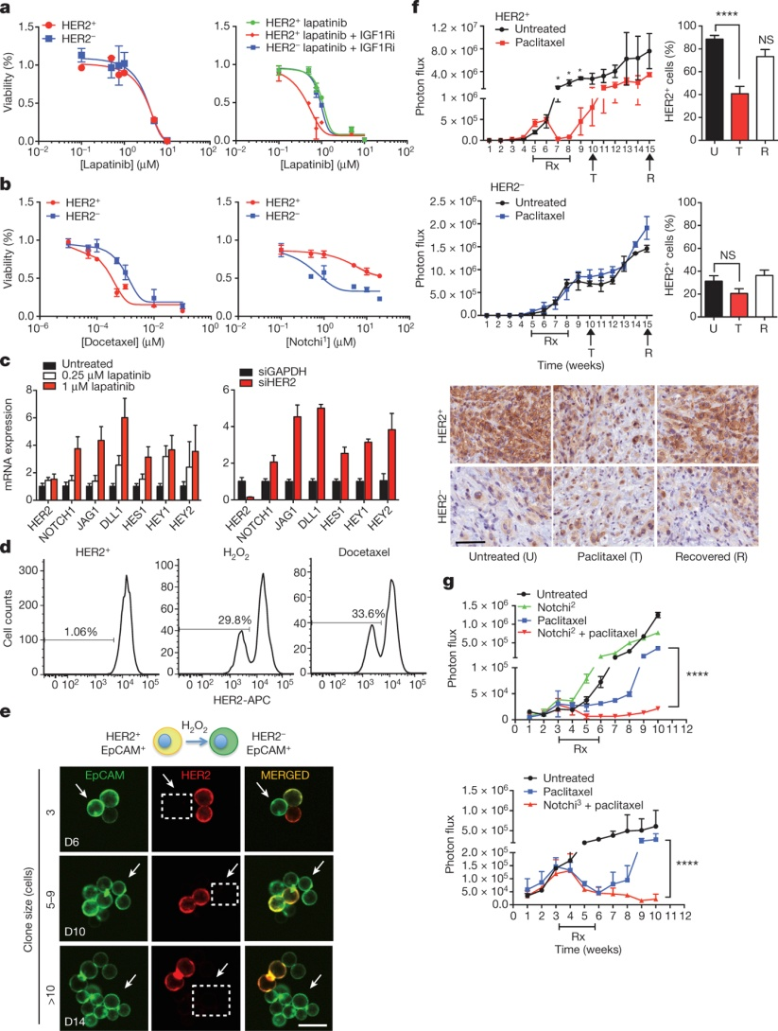
Cooperative targeting of HER2⁺ and HER2⁻ CTC subpopulations suppresses tumour growth
N V Jordan et al. Nature 1–5 (2016) doi:10.1038/nature19328

