Slide 1
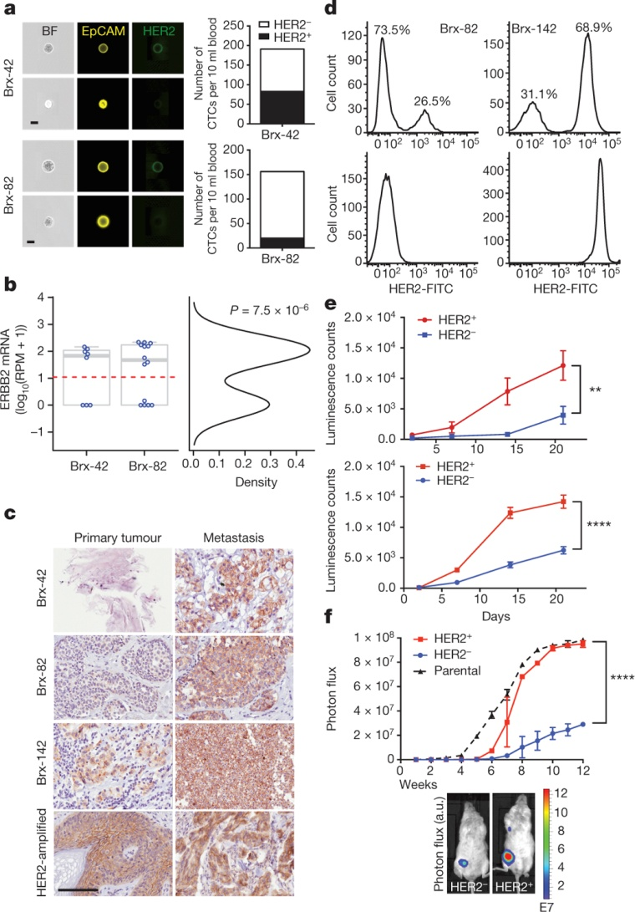
Distinct properties of HER2⁺ and HER2⁻ CTC subpopulations from patients with advanced ER⁺/HER2⁻ breast cancer
N V Jordan et al. Nature 1–5 (2016) doi:10.1038/nature19328

