Slide 1
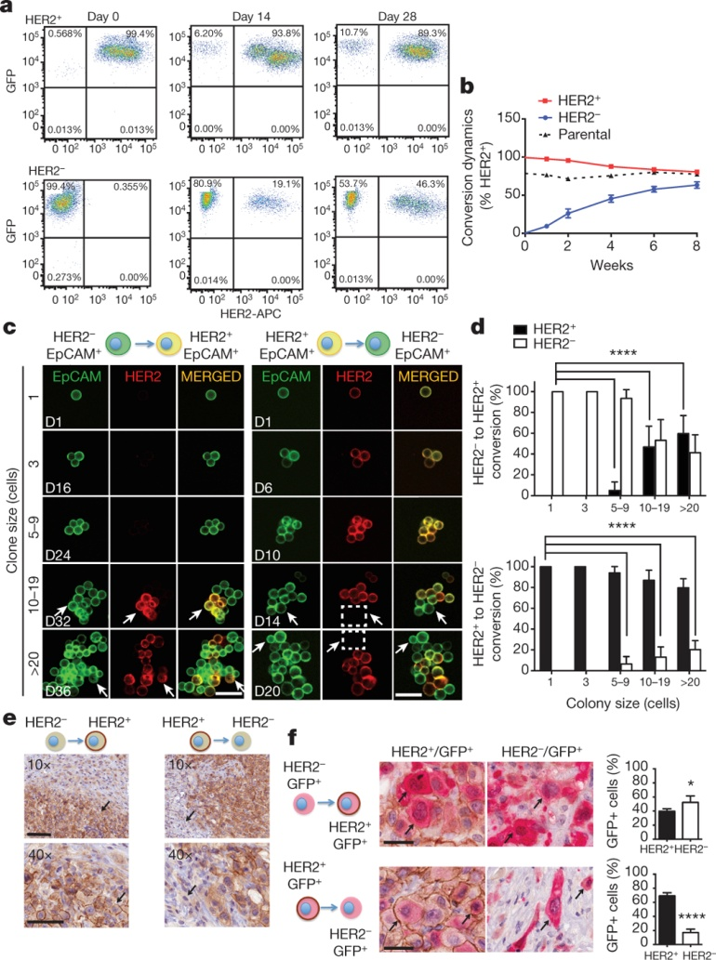
Interconversion of HER2⁺ and HER2⁻ phenotypes
N V Jordan et al. Nature 1–5 (2016) doi:10.1038/nature19328

