Slide 1
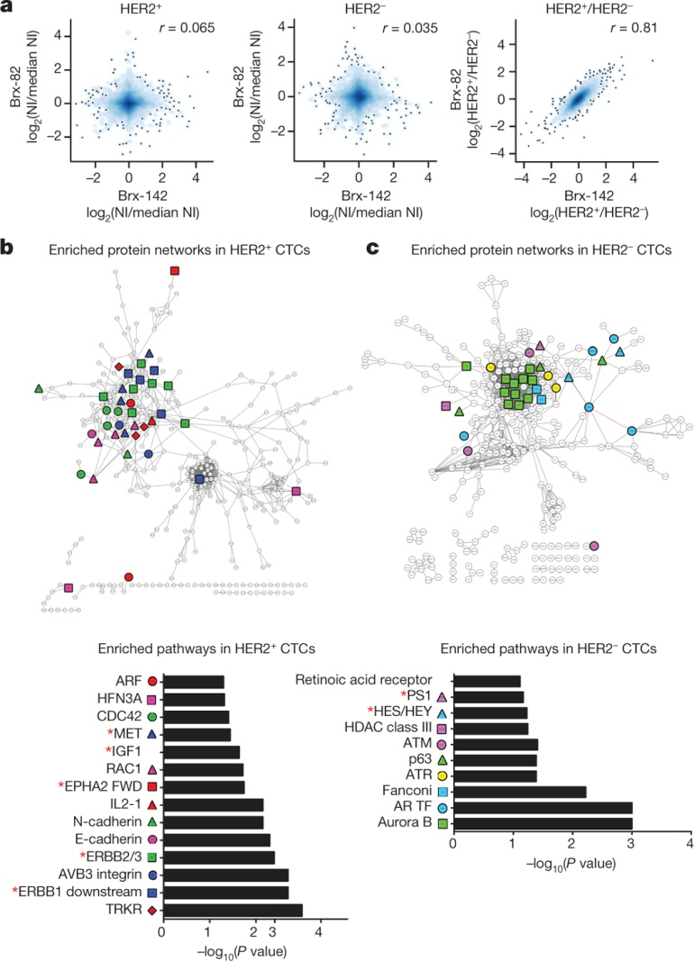
Molecular pathways differentially activated in HER2⁻ versus HER2⁺ cultured CTCs
N V Jordan et al. Nature 1–5 (2016) doi:10.1038/nature19328

