Slide 1

Retrieving and Visualizing Data
Charles Severance

Slide 2
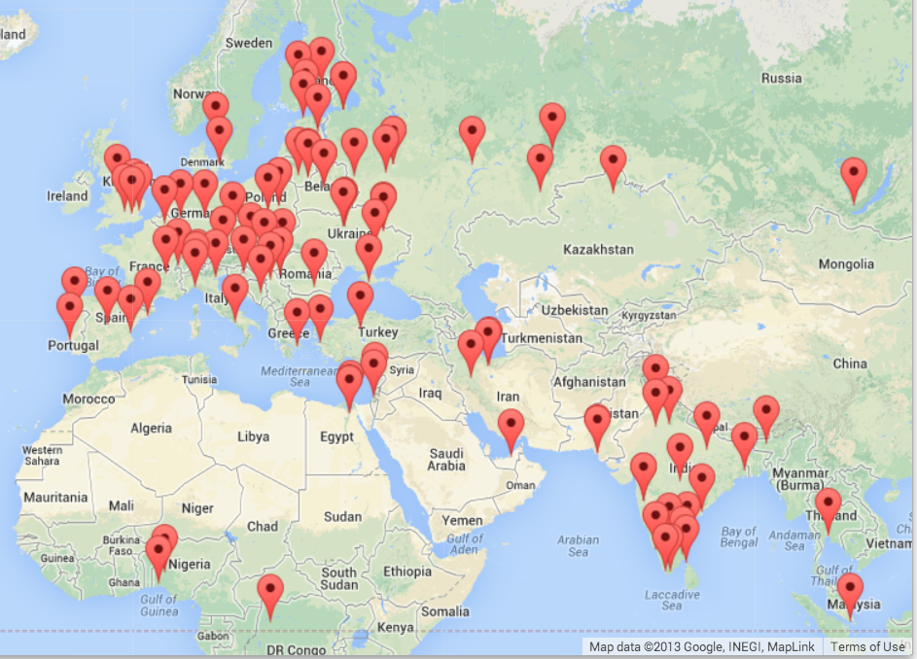


Multi-Step Data Analysis
Data
Source
Gather
Visualize
Clean/Process
(5, 1.0, 0.985, 3, u'http://www.dr..')
(3, 1.0, 2.135, 4, u'http://www.dr..')
(1, 1.0, 0.659, 2, u'http://www.dr..')
(1, 1.0, 0.659, 5, u'http://www.dr..')
....
Analyze

Slide 3
Many Data Mining Technologies
^{https://hadoop.apache.org/}
^{http://spark.apache.org/}
https://aws.amazon.com/redshift/
^{http://community.pentaho.com/}
....
Notes:
We will call my approach "Personal Data Mining" – mostly focused on getting better as Python Programmers.

Slide 4
"Personal Data Mining"
Our goal is to make you better programmers – not to make you data mining experts

Slide 5
GeoData
Makes a Google Map from user entered data
Uses the Google Geodata API
Caches data in a database to avoid rate limiting and allow restarting
Visualized in a browser using the Google Maps API
http://www.pythonlearn.com/code/geodata.zip

Slide 6
where.html
where.data
Google
geodata
geoload.py
geodata.sqlite
where.js
geodump.py
Northeastern University, ... Boston, MA 02115, USA 42.3396998 -71.08975
Bradley University, 1501 ... Peoria, IL 61625, USA 40.6963857 -89.6160811
...
Technion, Viazman 87, Kesalsaba, 32000, Israel 32.7775 35.0216667
Monash University Clayton ... VIC 3800, Australia -37.9152113 145.134682
Kokshetau, Kazakhstan 53.2833333 69.3833333
...
12 records written to where.js
Open where.html to view the data in a browser
http://www.pythonlearn.com/code/geodata.zip

Slide 7
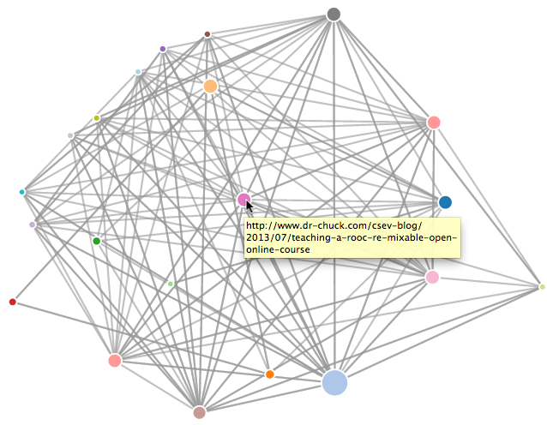
Page Rank
Write a simple web page crawler
Compute a simple version of Google's Page Rank algorithm
Visualize the resulting network
http://www.pythonlearn.com/code/pagerank.zip

Slide 8
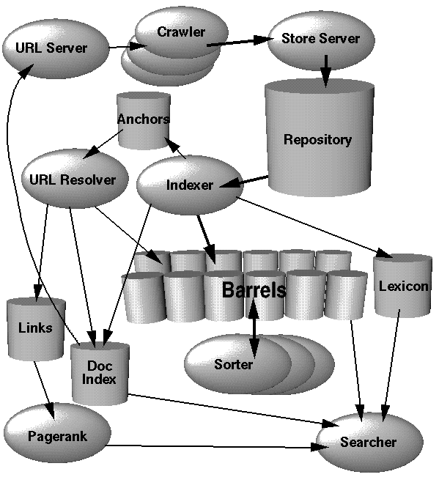
Search Engine Architecture
Web Crawling
Index Building
Searching
http://infolab.stanford.edu/~backrub/google.html

Slide 9
Web Crawler
A Web crawler is a computer program that browses the World Wide Web in a methodical, automated manner. Web crawlers are mainly used to create a copy of all the visited pages for later processing by a search engine that will index the downloaded pages to provide fast searches.
http://en.wikipedia.org/wiki/Web_crawler

Slide 10
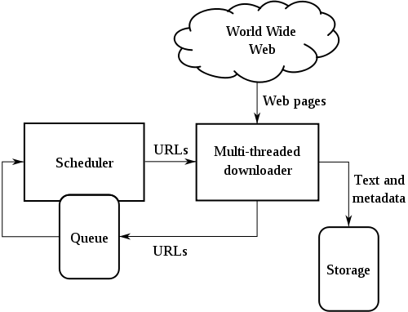
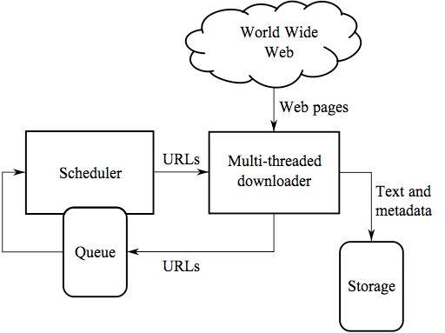
Web Crawler
Retrieve a page
Look through the page for links
Add the links to a list of “to be retrieved” sites
Repeat...
http://en.wikipedia.org/wiki/Web_crawler

Slide 11
Web Crawling Policy
a selection policy that states which pages to download,
a re-visit policy that states when to check for changes to the pages,
a politeness policy that states how to avoid overloading Web sites, and
a parallelization policy that states how to coordinate distributed Web crawlers
http://en.wikipedia.org/wiki/Web_crawler

Slide 12
robots.txt
A way for a web site to communicate with web crawlers
An informal and voluntary standard
Sometimes folks make a “Spider Trap” to catch “bad” spiders
User-agent: *
Disallow: /cgi-bin/
Disallow: /images/
Disallow: /tmp/
Disallow: /private/
http://en.wikipedia.org/wiki/Robots_Exclusion_Standard
http://en.wikipedia.org/wiki/Spider_trap

Slide 13
Google Architecture
Web Crawling
Index Building
Searching
http://infolab.stanford.edu/~backrub/google.html

Slide 14
Search Indexing
Search engine indexing collects, parses, and stores data to facilitate fast and accurate information retrieval. The purpose of storing an index is to optimize speed and performance in finding relevant documents for a search query. Without an index, the search engine would scan every document in the corpus, which would require considerable time and computing power.
http://en.wikipedia.org/wiki/Index_(search_engine)

Slide 15
force.html
d3.js
spreset.py
sprank.py
The
Web
spider.py
spider.sqlite
spjson.py
spdump.py
force.js
(5, None, 1.0, 3, u'http://www.dr-chuck.com/csev-blog')
(3, None, 1.0, 4, u'http://www.dr-chuck.com/dr-chuck/resume/speaking.htm')
(1, None, 1.0, 2, u'http://www.dr-chuck.com/csev-blog/')
(1, None, 1.0, 5, u'http://www.dr-chuck.com/dr-chuck/resume/index.htm')
4 rows.
http://www.pythonlearn.com/code/pagerank.zip

Slide 16
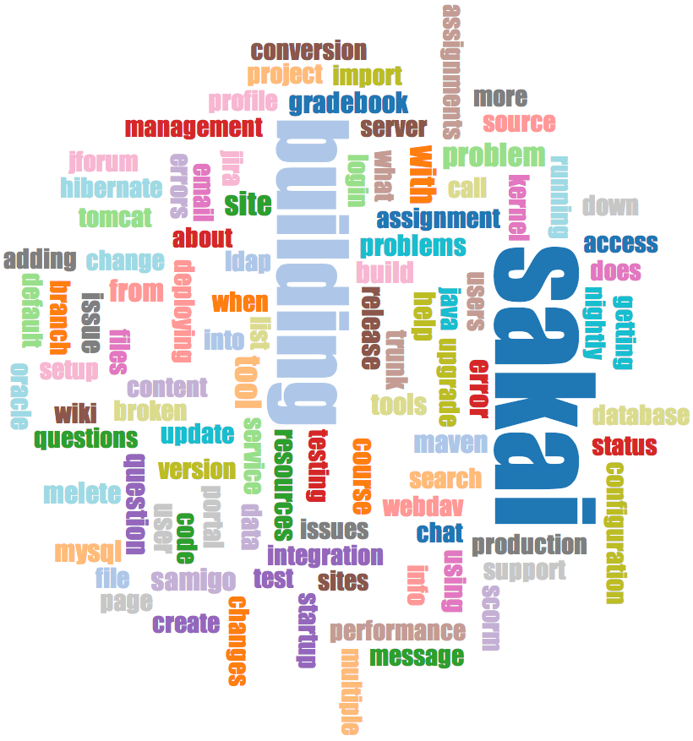
Mailing Lists - Gmane
Crawl the archive of a mailing list
Do some analysis / cleanup
Visualize the data as word cloud and lines
http://www.pythonlearn.com/code/gmane.zip

Slide 17
Warning: This Dataset is > 1GB
Do not just point this application at gmane.org and let it run all night
There is no rate limits – these are cool folks
Don't ruin it for the rest of us
Please use my non-rate-limited copy of this data for your testing
http://gmane.dr-chuck.net//gmane.comp.cms.sakai.devel/4/5

Slide 18
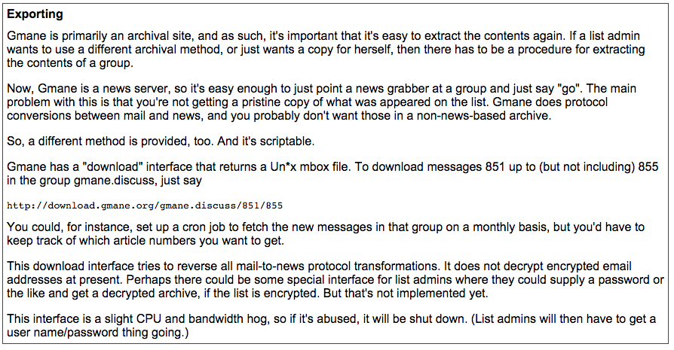
http://gmane.org/export.php

Slide 19
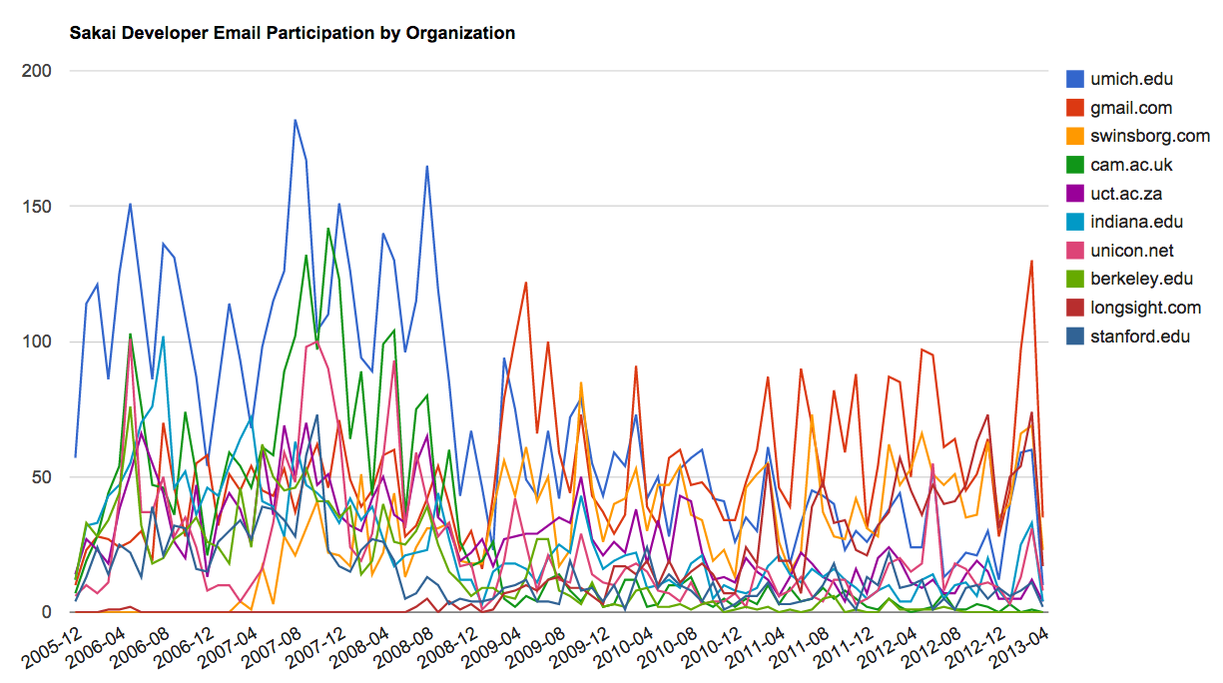
gword.htm
d3.js
gmane.org
gmane.py
content.sqlite
gmodel.py
gword.js
content.sqlite
gword.py
gbasic.py
gline.py
How many to dump? 5
Loaded messages= 51330 subjects= 25033 senders= 1584
Top 5 Email list participants
steve.swinsburg@gmail.com 2657
azeckoski@unicon.net 1742
ieb@tfd.co.uk 1591
csev@umich.edu 1304
david.horwitz@uct.ac.za 1184
...
gline.js
gline.htm
d3.js
http://www.pythonlearn.com/code/gmane.zip

Slide 20


Acknowledgements / Contributions
Thes slide are Copyright 2010- Charles R. Severance (www.dr-chuck.com) of the University of Michigan School of Information and open.umich.edu and made available under a Creative Commons Attribution 4.0 License. Please maintain this last slide in all copies of the document to comply with the attribution requirements of the license. If you make a change, feel free to add your name and organization to the list of contributors on this page as you republish the materials.
Initial Development: Charles Severance, University of Michigan School of Information
… Insert new Contributors here
...

