Slide 1
Part III. Genetic Association Analysis

Slide 2
Chapter 13. Classification of Phenotype and Strategies for Disease Gene Identification

Slide 3
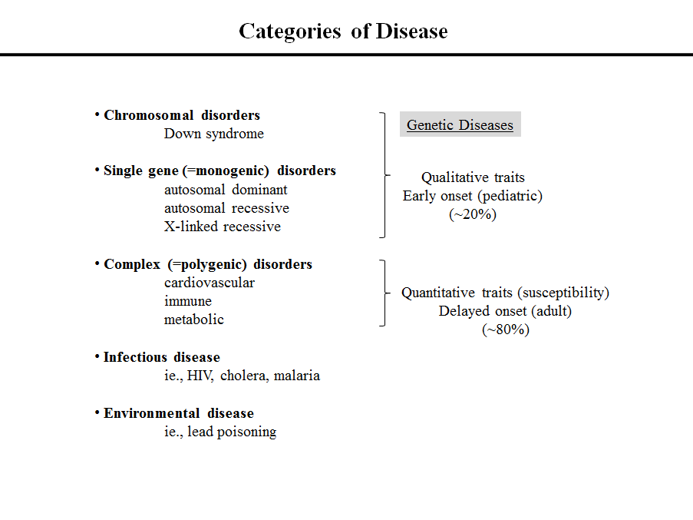

Slide 4
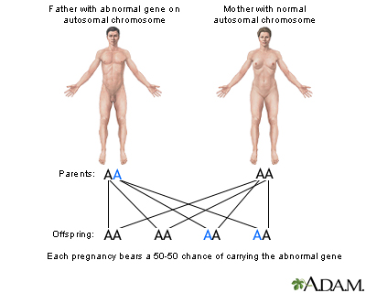
Autosomal dominant
In the case of autosomal dominant genes, a single abnormal gene on one of the autosomal chromosomes from either parent can cause the disease.
Ref> U.S National library of Medicine

Slide 5
Autosomal recessive
A
A
AA
If you are born to parents who carry the same autosomal recessive change (mutation), you have a 1 in 4 chance of inheriting the abnormal gene from both parents and developing the disease. You have a 50% (1 in 2) chance of inheriting one abnormal gene. This would make you a carrier.
Ref> U.S National library of Medicine

Slide 6
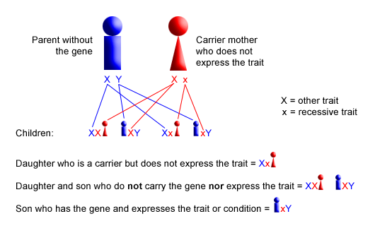
X-linked recessive
Ref> https://www.urmc.rochester.edu

Slide 7
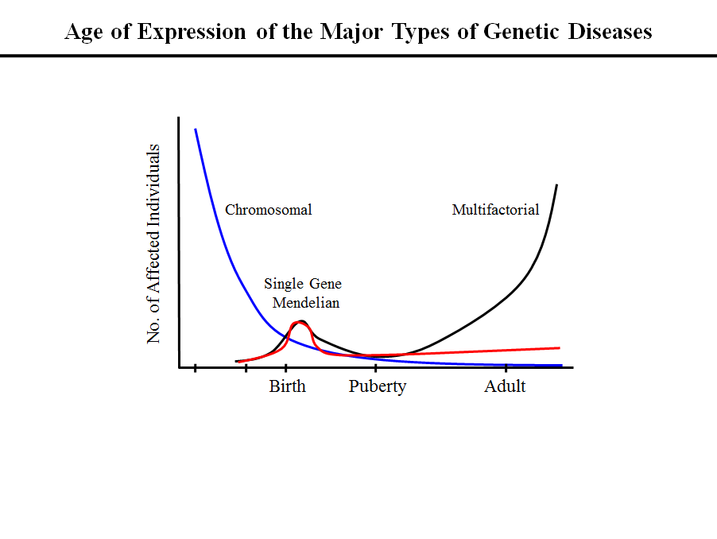

Slide 8
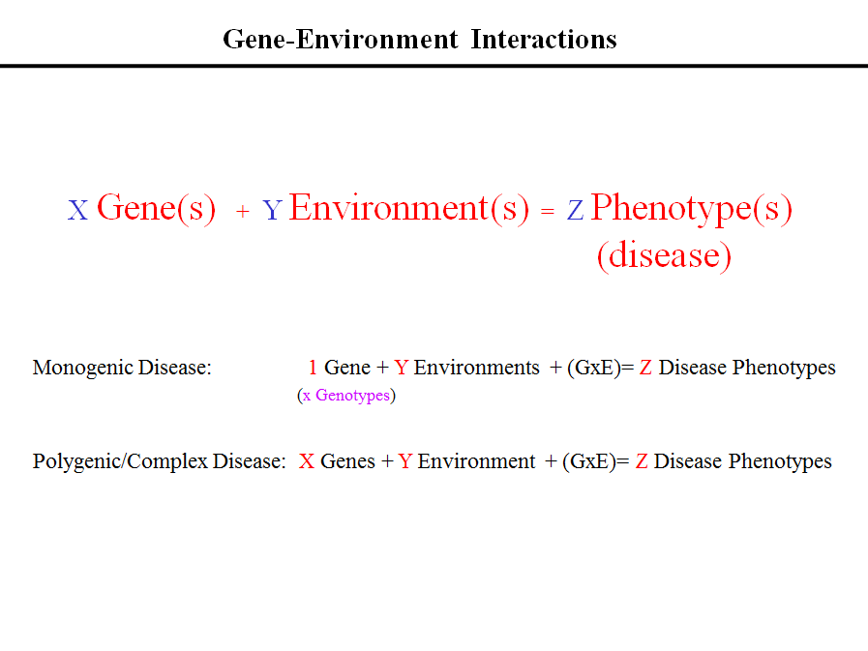

Slide 9
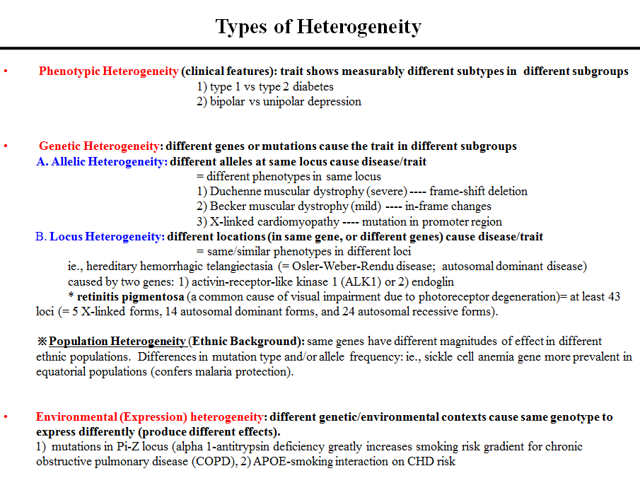

Slide 10
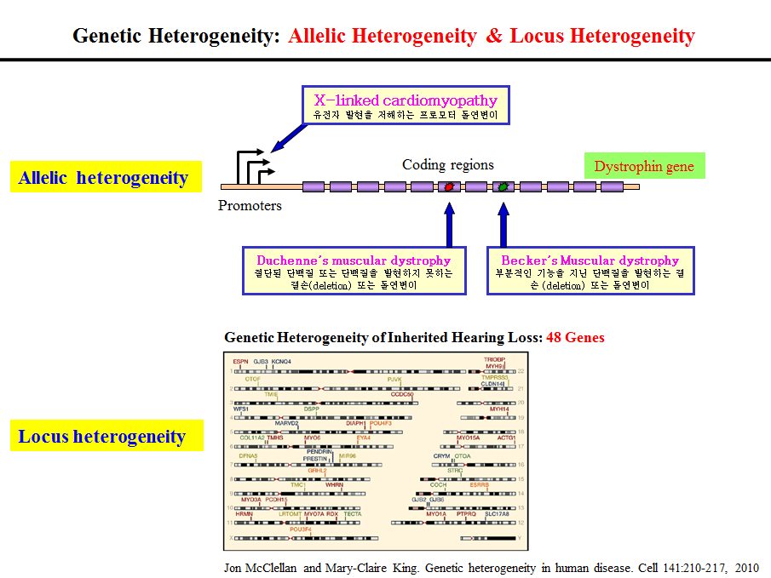

Slide 11
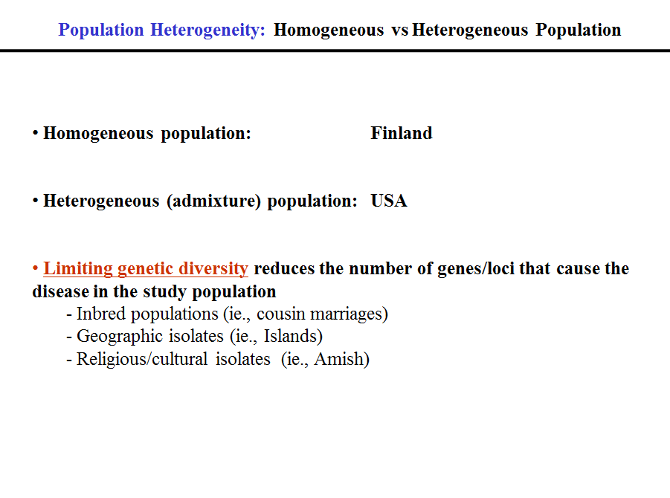

Slide 12
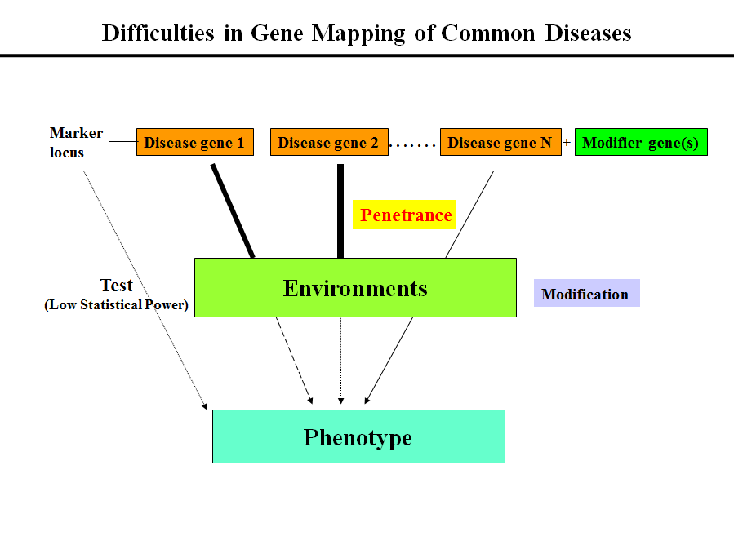

Slide 13
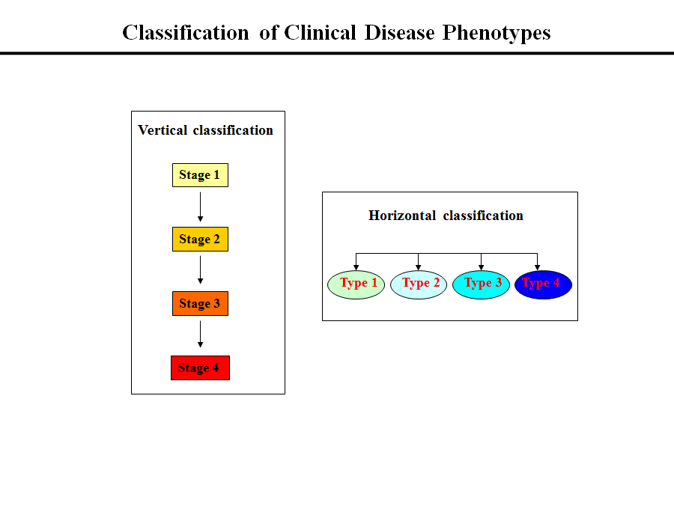

Slide 14
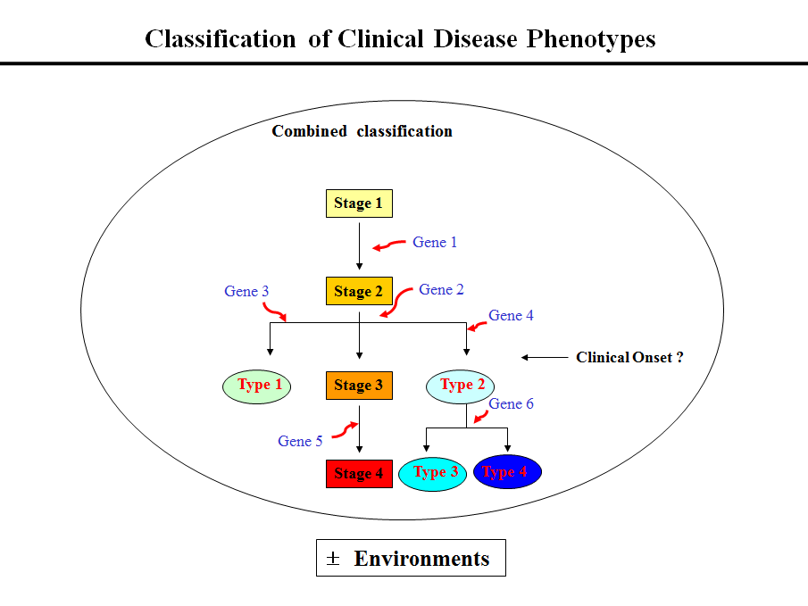

Slide 15
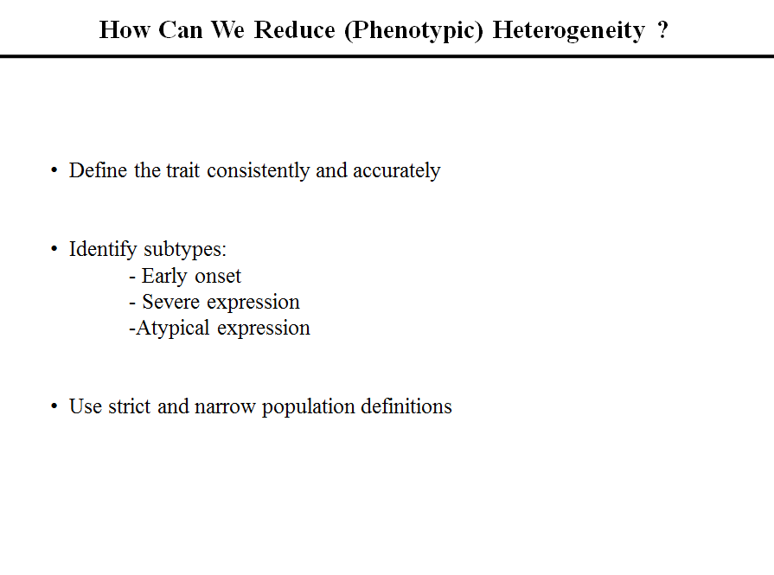

Slide 16
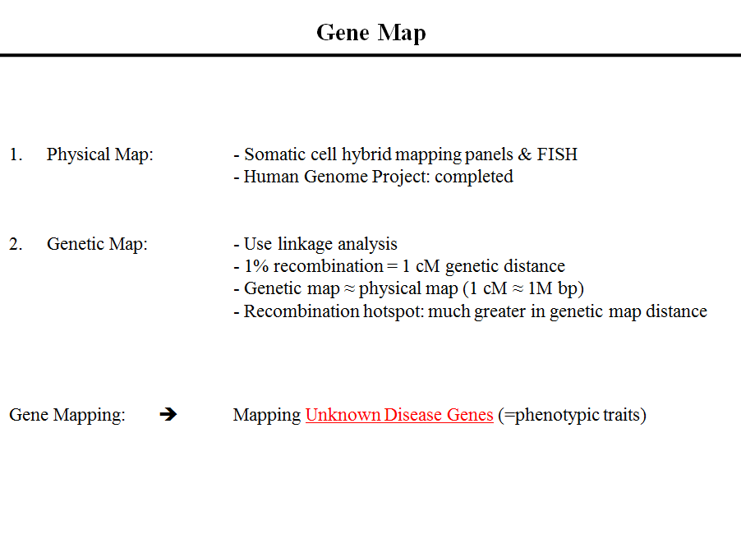

Slide 17
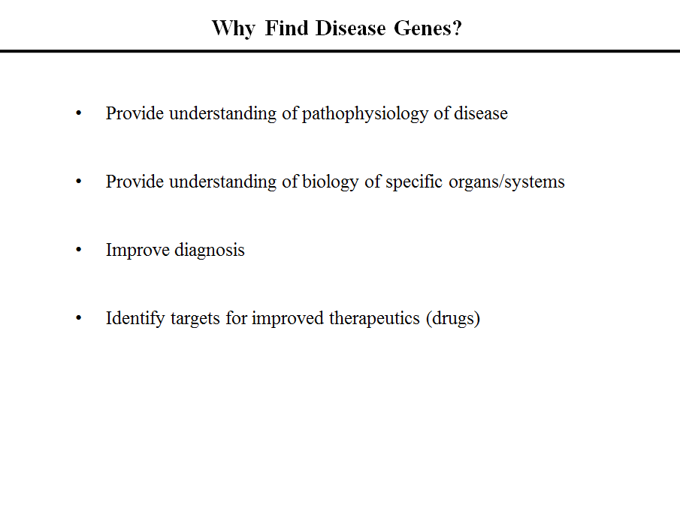

Slide 18
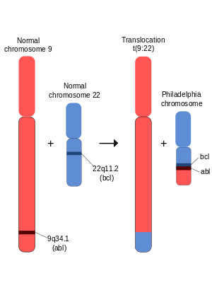
Philadelphia chromosome
The Abl gene expresses a membrane-associated protein, a tyrosine kinase, and the BCR-Abl transcript is also translated into a tyrosine kinase. The activity of tyrosine kinases is typically controlled by other molecules, but the mutant tyrosine kinase of the BCR-Abl transcript codes for a protein that is "always on" or continuously activated, which results in unregulated cell division (i.e. cancer).
Ref> Wikipedia (https://www.wikipedia.org)

Slide 19
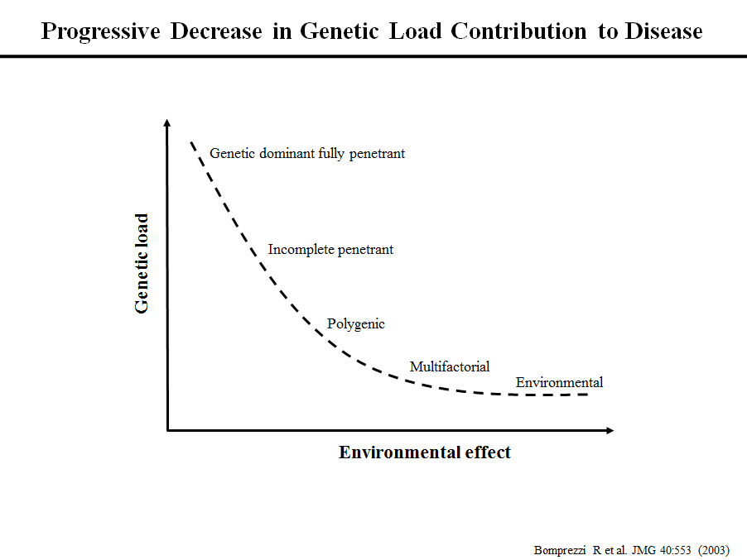

Slide 20
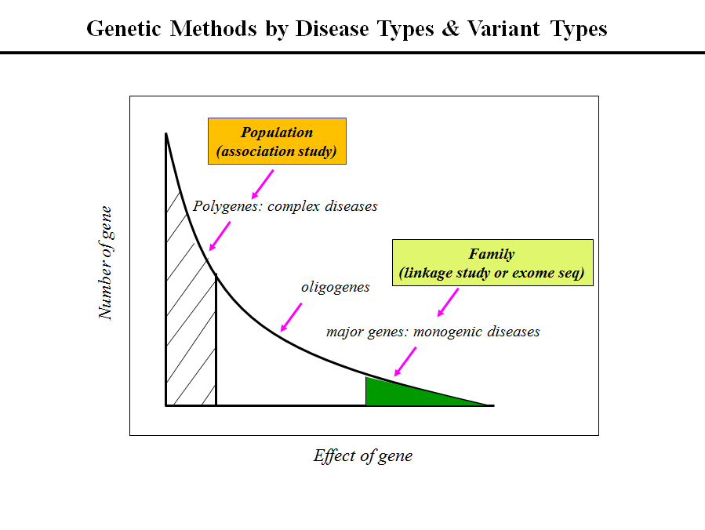

Slide 21
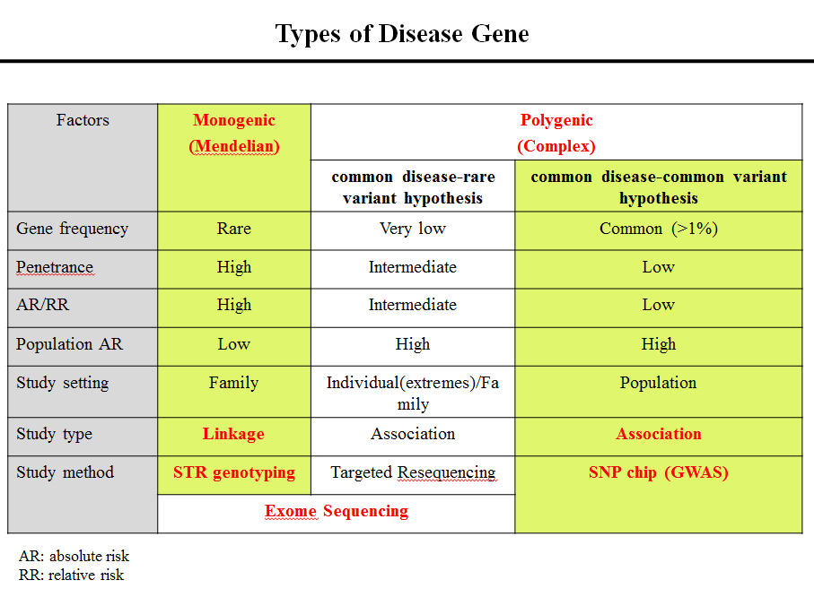

Slide 22
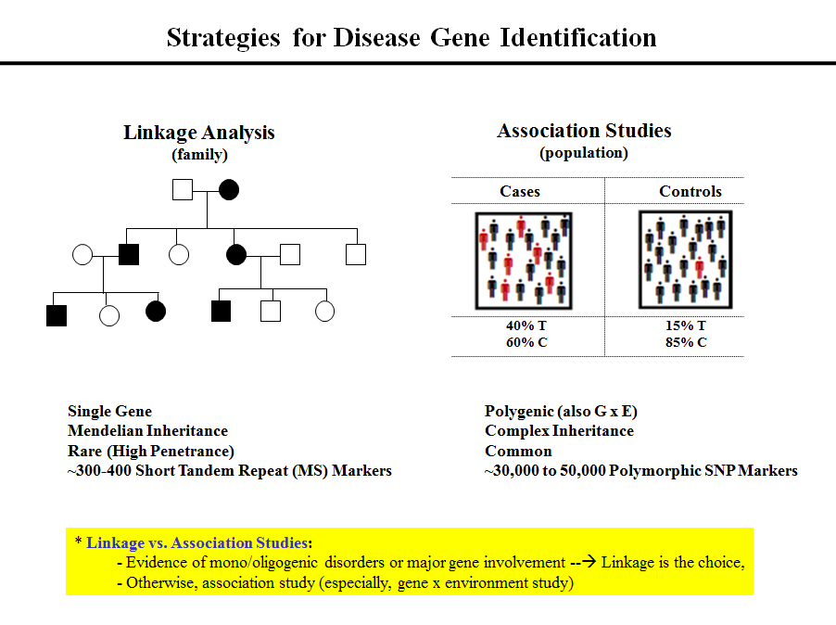

Slide 23
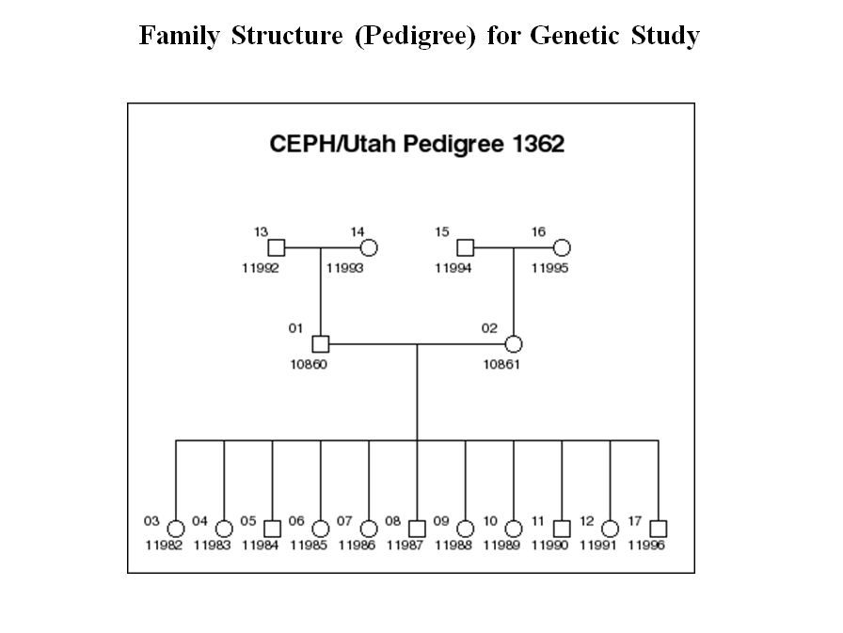

Slide 24
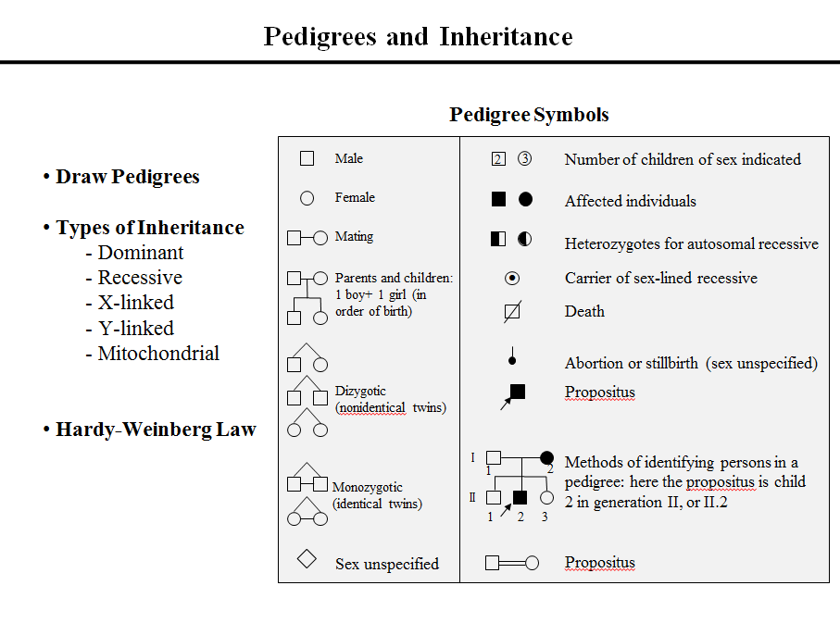

Slide 25
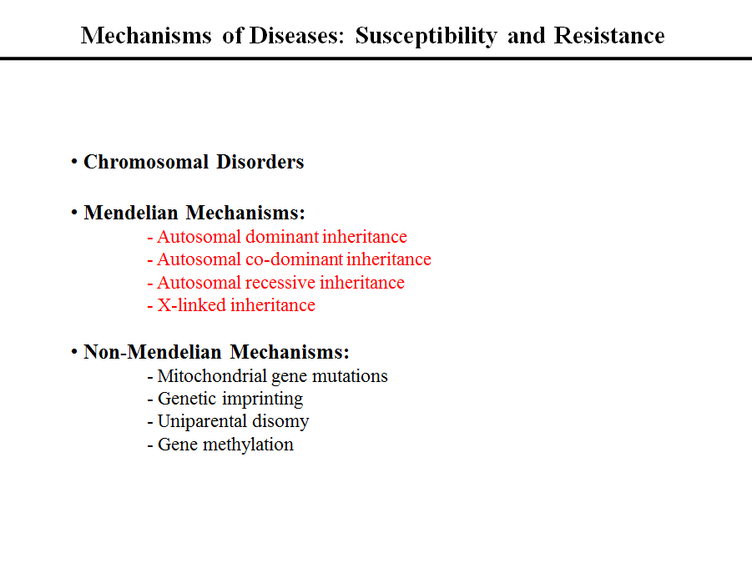

Slide 26
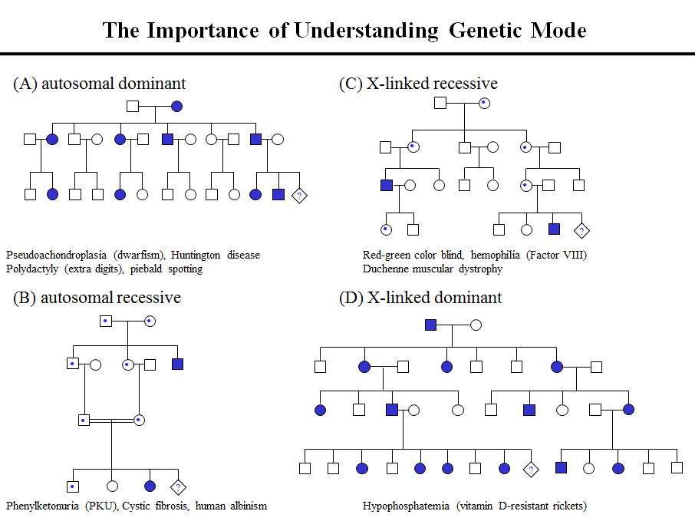

Slide 27
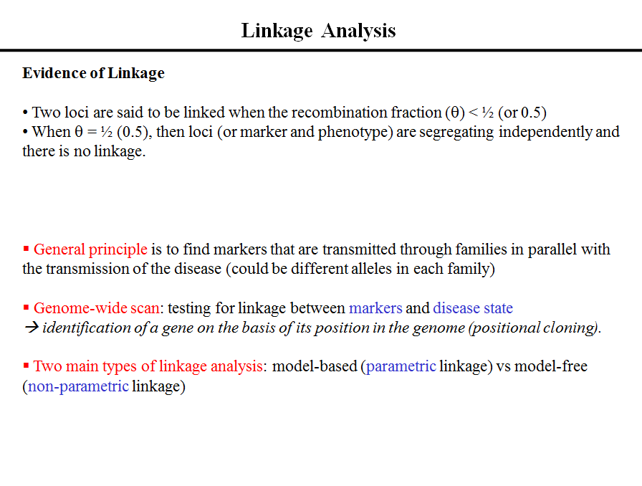

Slide 28
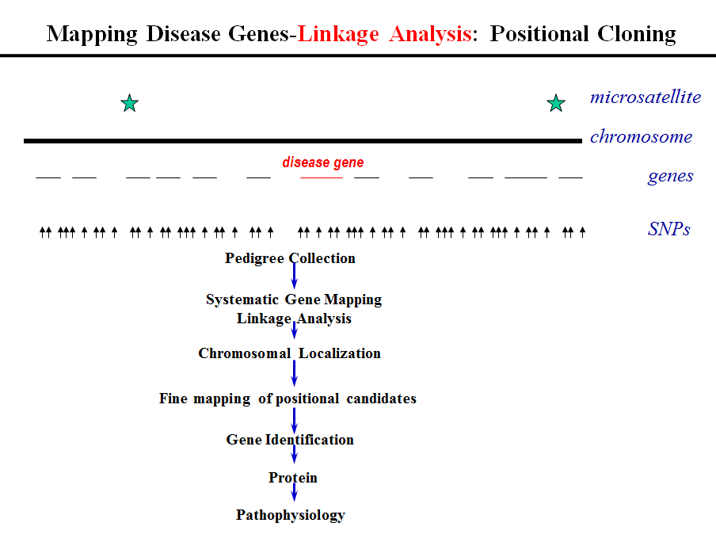

Slide 29
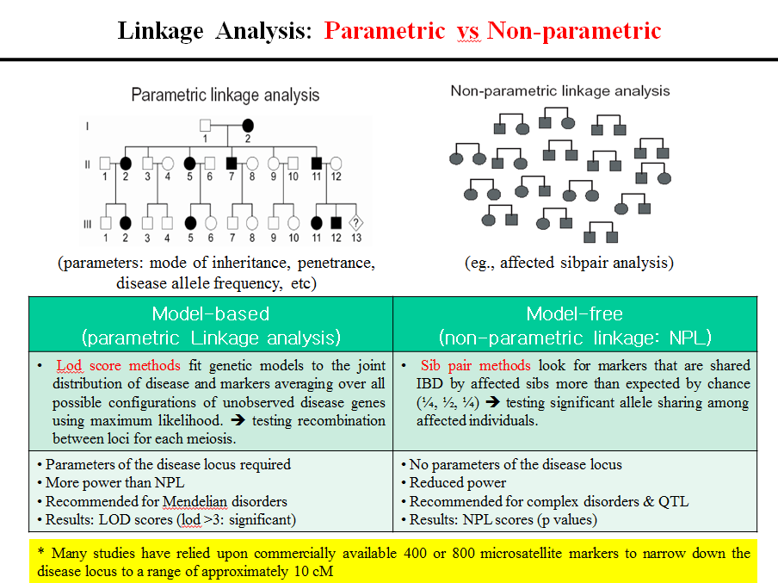

Slide 30
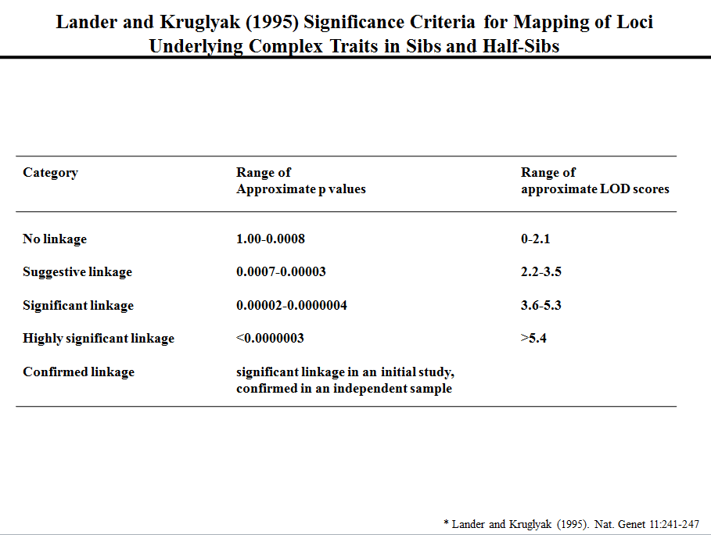

Slide 31
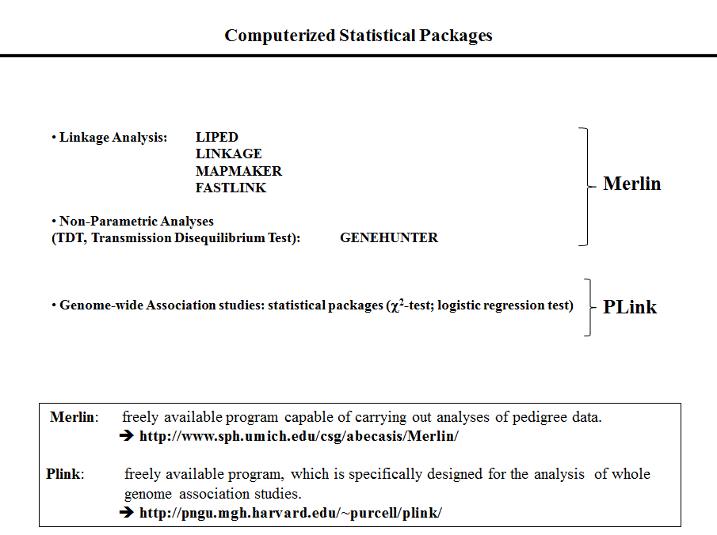

Slide 32
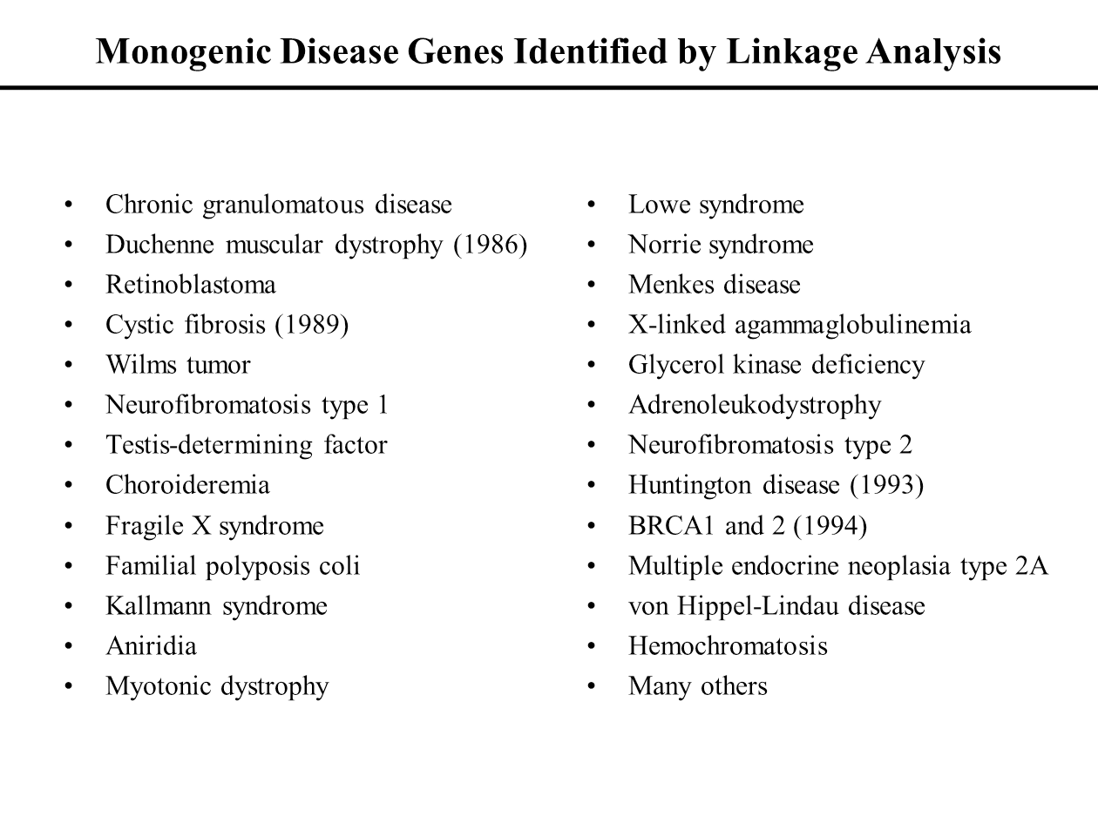

Slide 33
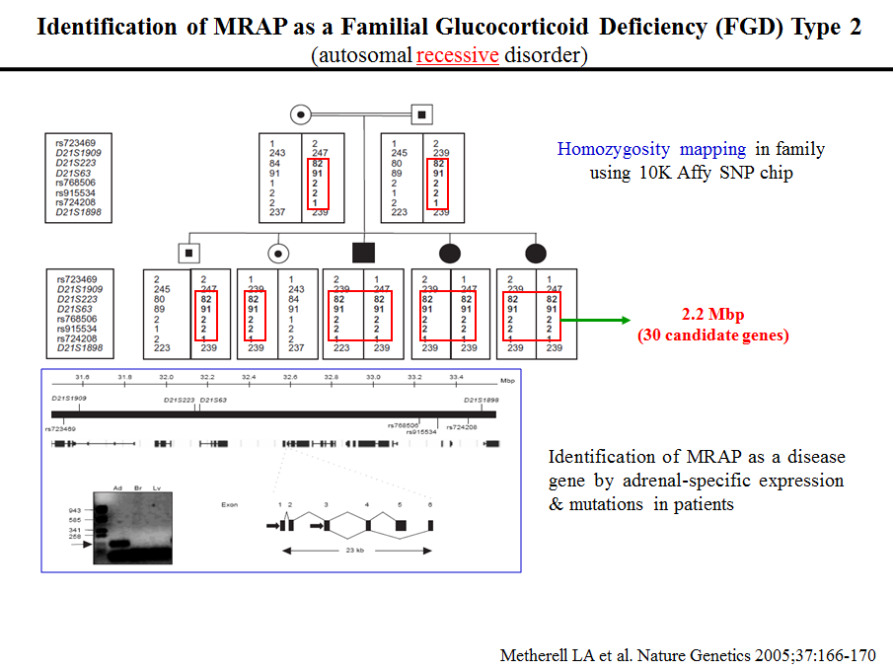

Slide 34
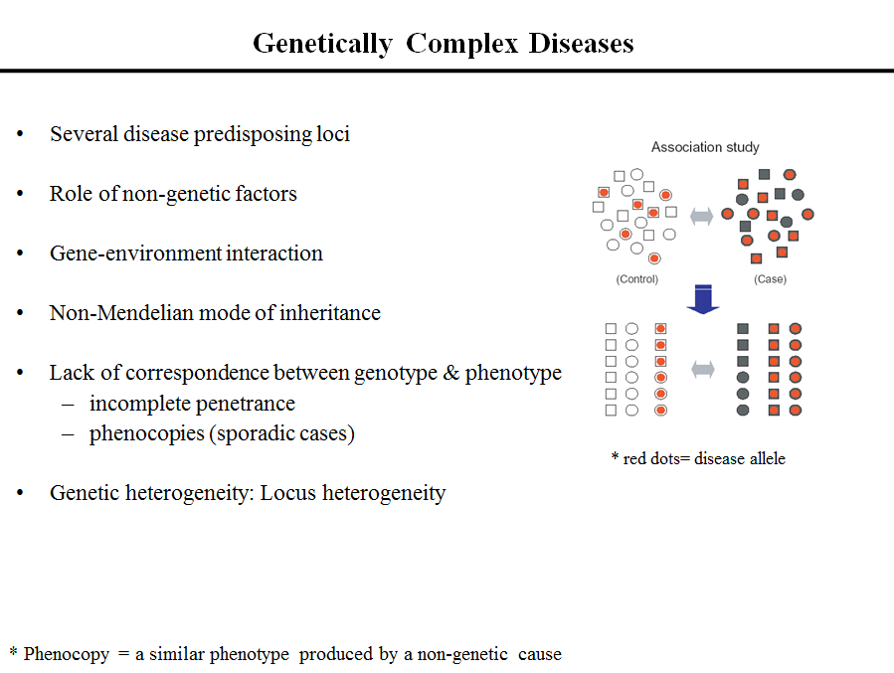

Slide 35
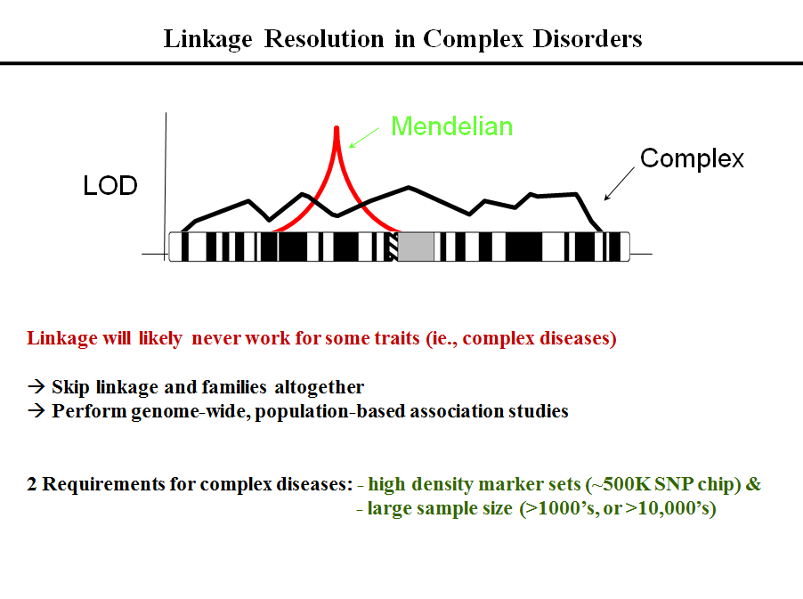

Slide 36
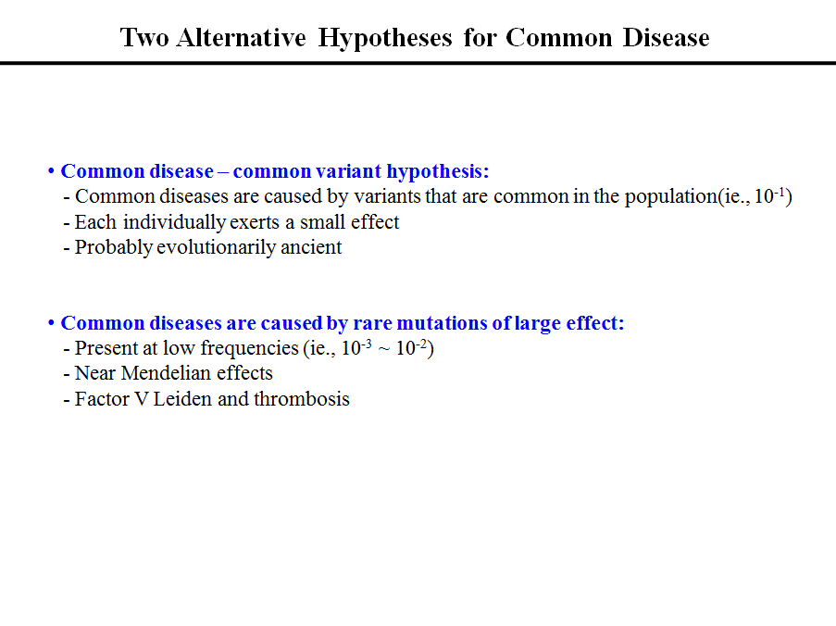

Slide 37
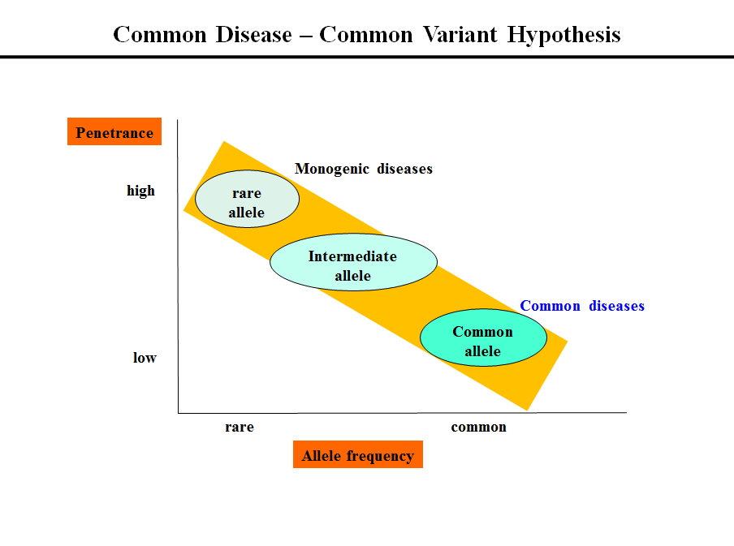

Slide 38
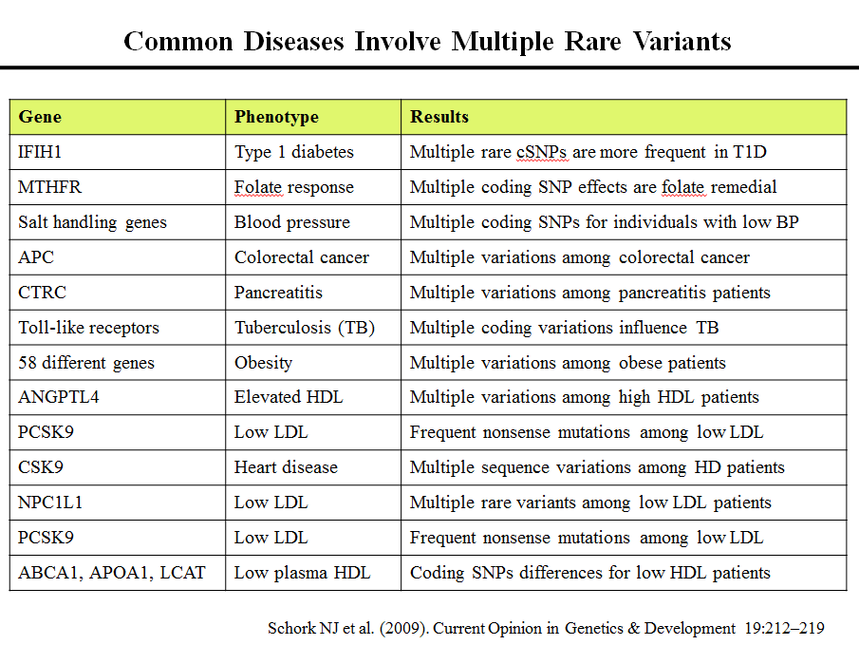

Slide 39
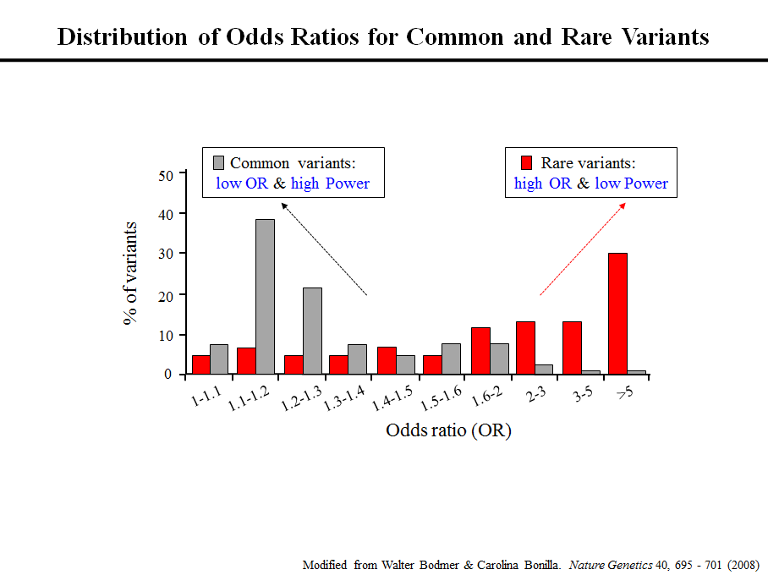

Slide 40
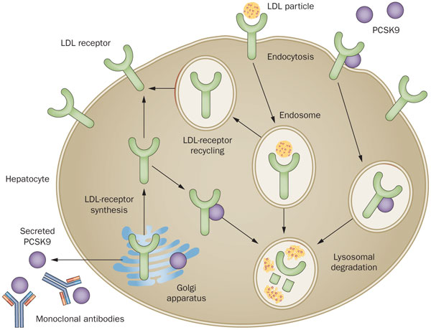
PCSK9(Proprotein convertase subtilisin/kexin type 9 ): Nabil Seidah, a scientist at the Clinical Research Institute of Montreal in Canada, discovered, in 2003.
Ref> Davidson, Dyslipidaemia: PCSK9 antibodies: a dividend of the genomics revolution, Nature Reviews Cardiology, 2013

Slide 41
FH3: mutations in PCSK9
PCSK9 is a protease which binds to LDL-R and directs them to lysosomes for degradation, rather than recycling to cell surface
Loss of function (non-sense and some mis-sense) mutations of PCSK9 lead to ↓LDL levels
2.6% of US blacks, LDL ↓28%, CHD ↓88%
3.2% of US whites, LDL ↓15%, CHD ↓47%
Familial hypercholesterolemia (FH)
Autosomal dominant inheritance
Heterozygous (HeFH): prevalence 1/500 (LDL 250-500)
Homozygous: often die <20yo (LDL >600-1000)
Genetic defect at the LDL receptor
Premature vascular disease: untreated CHD risk is 30% by age 40, 50% by 50yo
Not responsive to diet or exercise
Ref> Cohen et al. NEJM 2006;354:1264
Notes:
95% CI very wide for reduction in CHD (Blacks 0.02-0.81, Whites 0.32-0.79).
Chromosome 1.
ARH is needed for PCSK9 to reduce LDLR activity. In its absence neither protein is internalised. ?it is secreted PCSK9 which is active in degrading LDLR. Is this why ARH is milder than HoFH – because PCSK9 cannot degrade any residual LDLR activity?

Slide 42

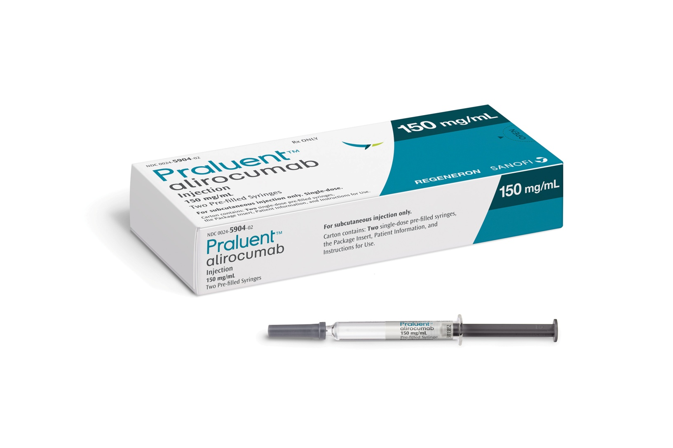

Slide 43
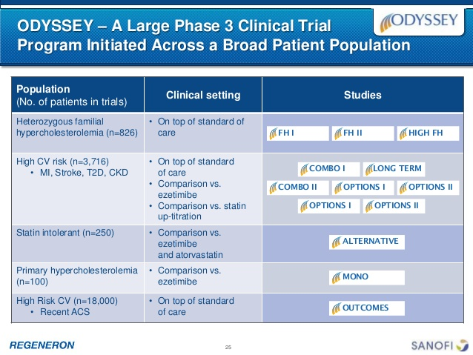

Slide 44
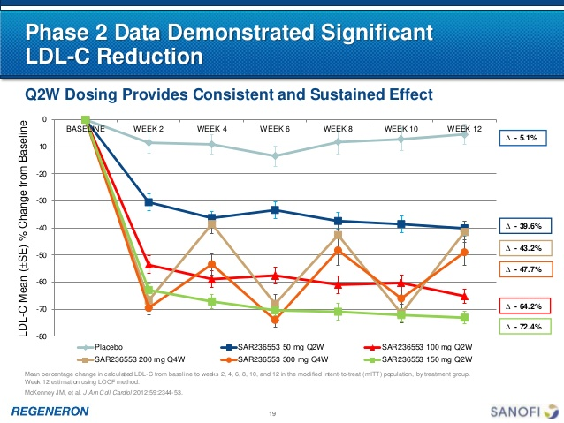

Slide 45
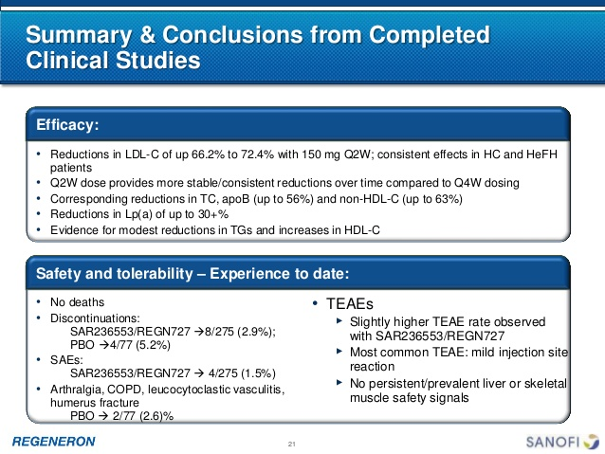

Slide 46
PCSK9 관련 기사
2015. 7: ‘알리로쿠맙’(alirocumab)이 PCSK9억제제로는 처음으로 미 FDA로부터 승인을 획득
2015. 8: 암젠은 경쟁사인 사노피와 리제네론의 프랄루엔트(Praluent, alirocumab)가 미국 최초의 PCSK9 저해제로 승인된 지 한 달 만에 미국 FDA로부터 항콜레스테롤 약물 레파타(Repatha, evolocumab)를 승인받음
“알리로쿠맙은 PCSK9의 유전자 기반의 발견을 혁신적인 의약품으로 변모시키기 위한 지칠 줄 모르는 오랜 작업의 결정체”
NYT에 따르면 스탠퍼드대학 심장병 전문의인 조슈아 놀스 박사는 유전학 연구에서 개발 아이디어를 얻은 이 약에 대해 “현대 유전 혁명의 승리”라고 평가

