Slide 1
Chapter 22. Discovery of Drug Response Genes (Pharmacogenomics)

Slide 2
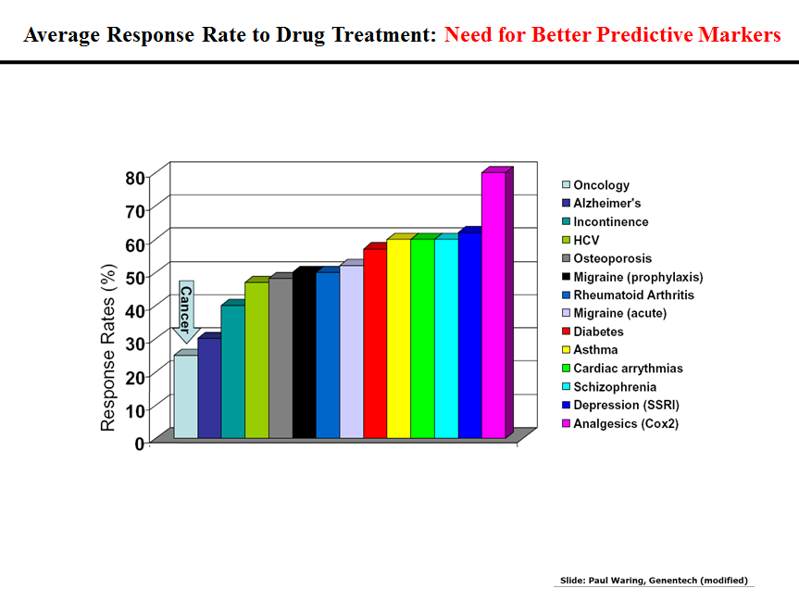

Slide 3
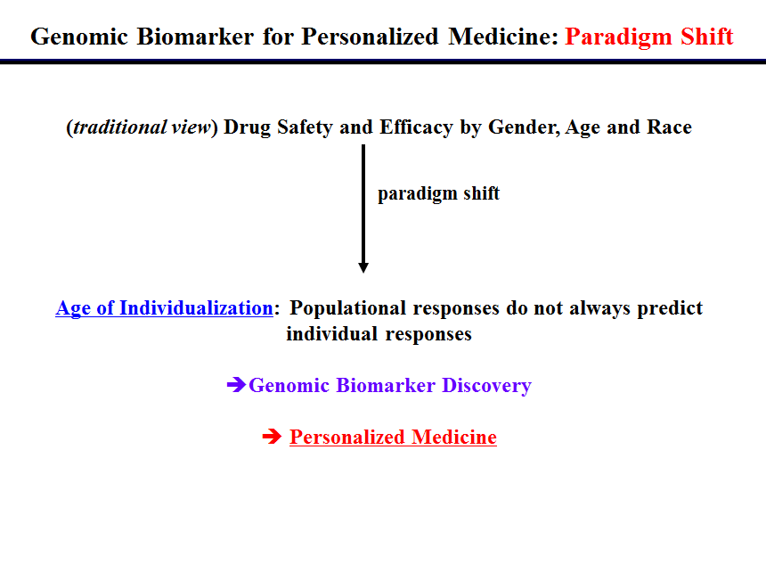

Slide 4
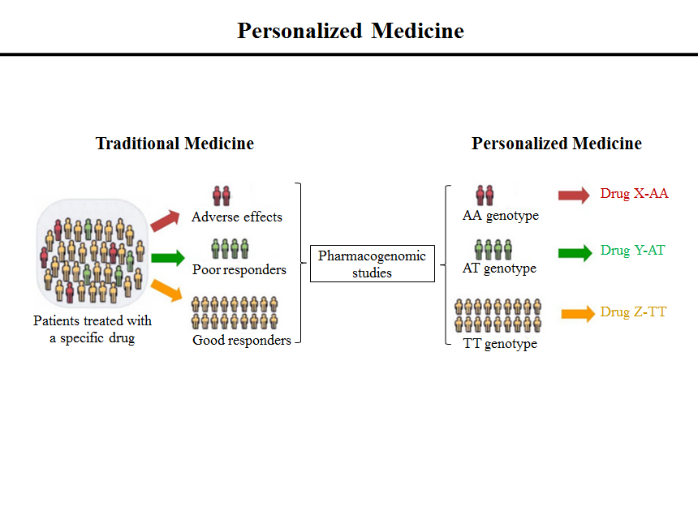

Slide 5
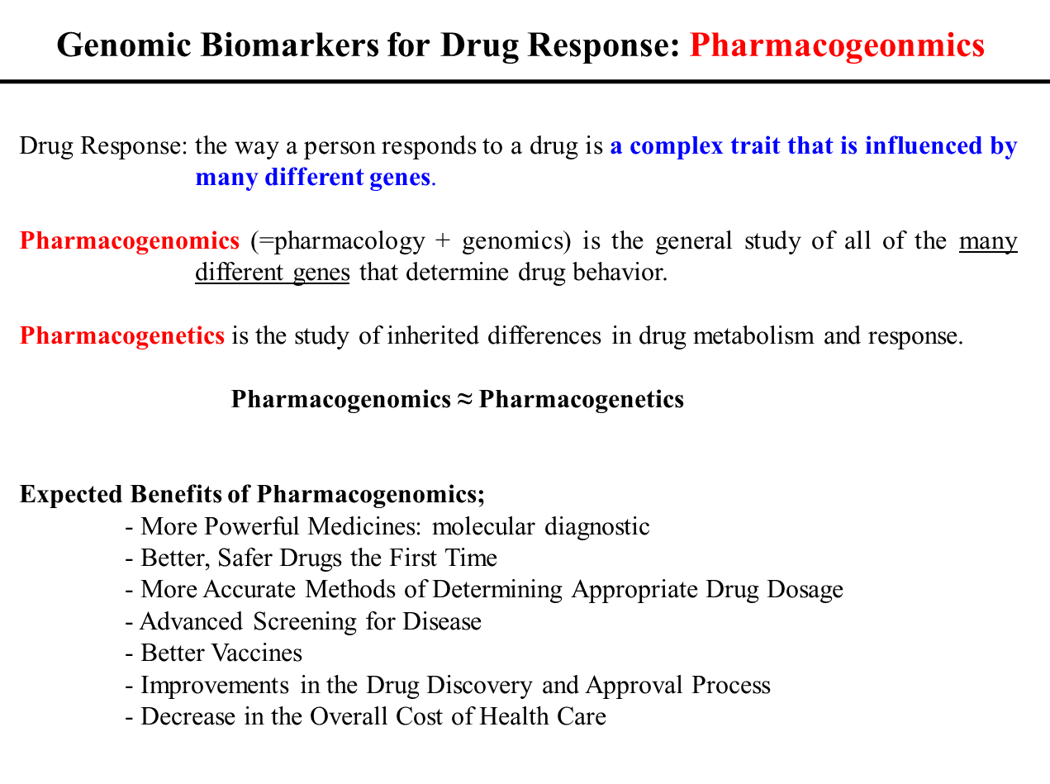

Slide 6
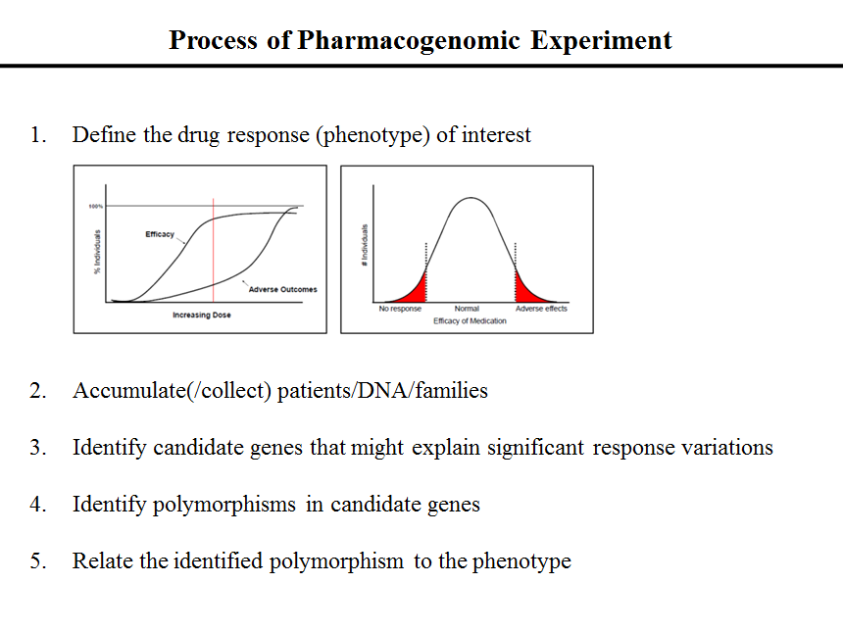

Slide 7
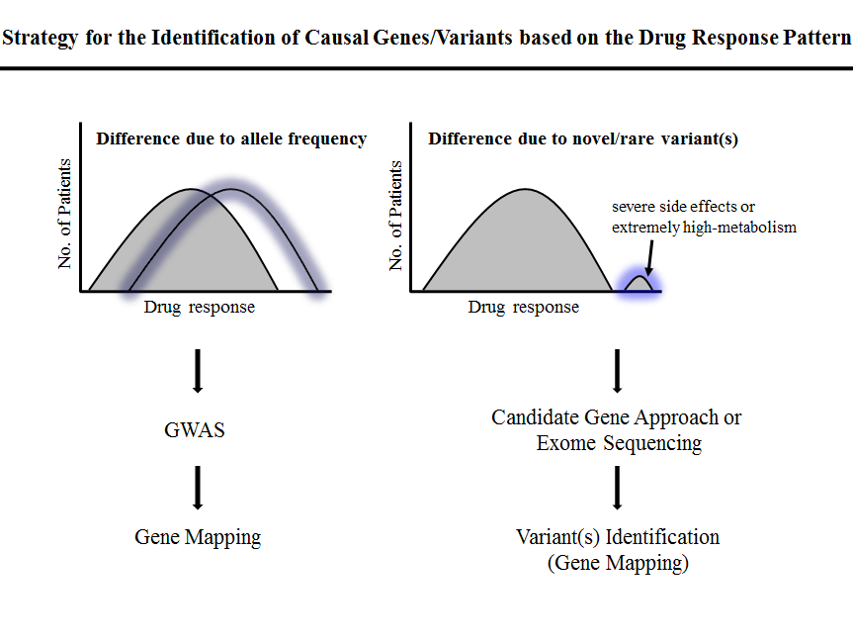

Slide 8
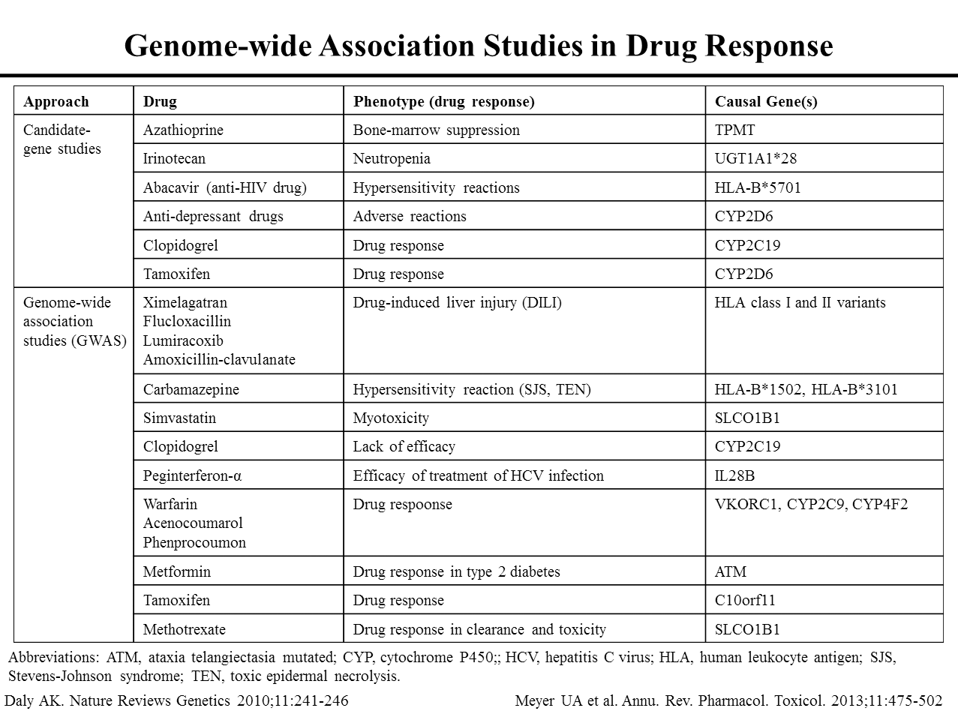

Slide 9
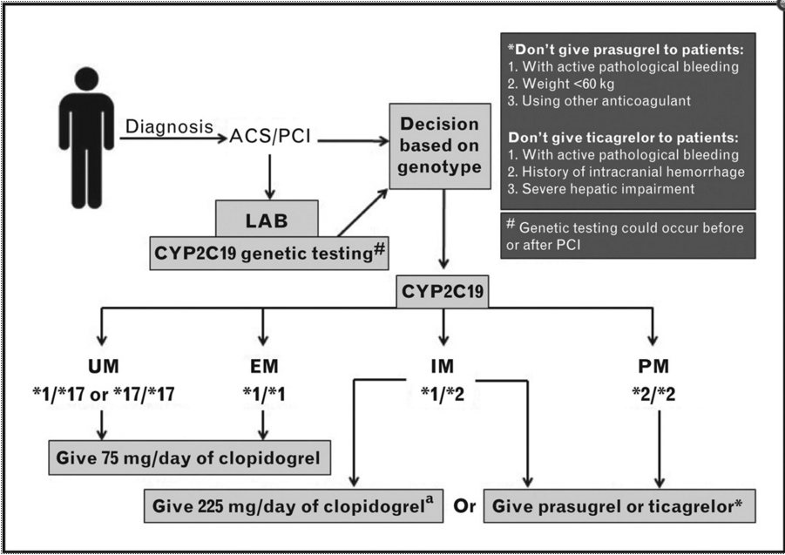
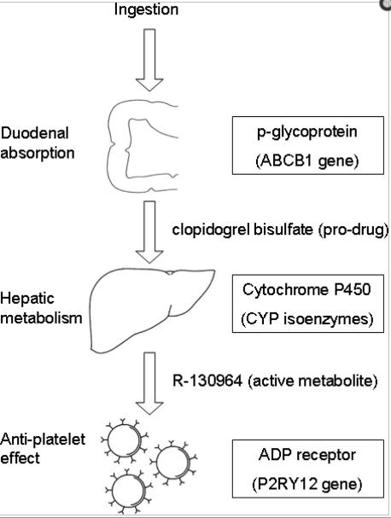
Curr Opin Cardiol. 2013 May; 28(3): 305–314
Clopidogrel metabolism
Stroke. 2010 Dec; 41(12): 2997–3002

Slide 10
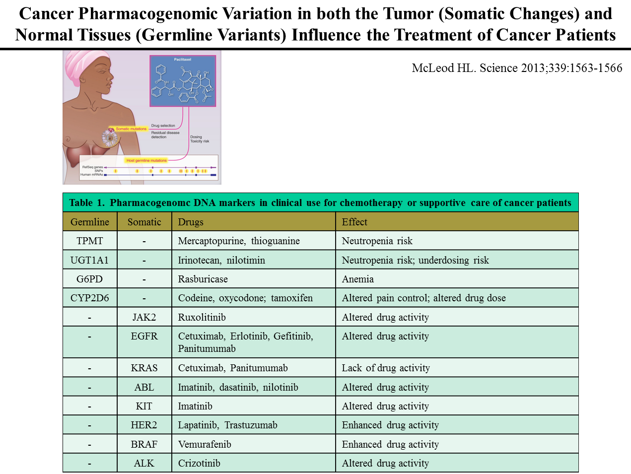

Slide 11
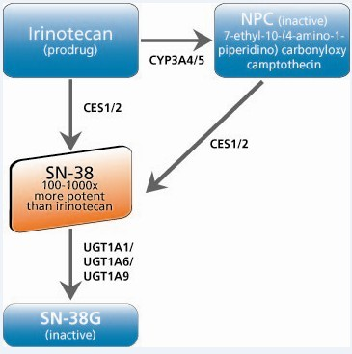
Association between UGT1A1 variant alleles and irinotecan-induced severe neutropenia.

Slide 12
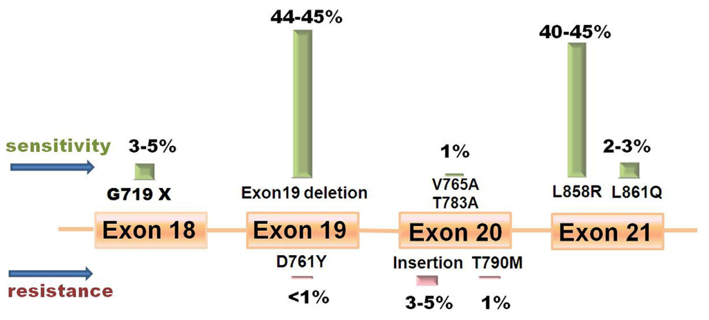
The basic mechanism of EGFR, the predictive biomarkers
and the mechanism of resistance
Int. J. Mol. Sci. 2012, 13(9), 11471-11496

Slide 13
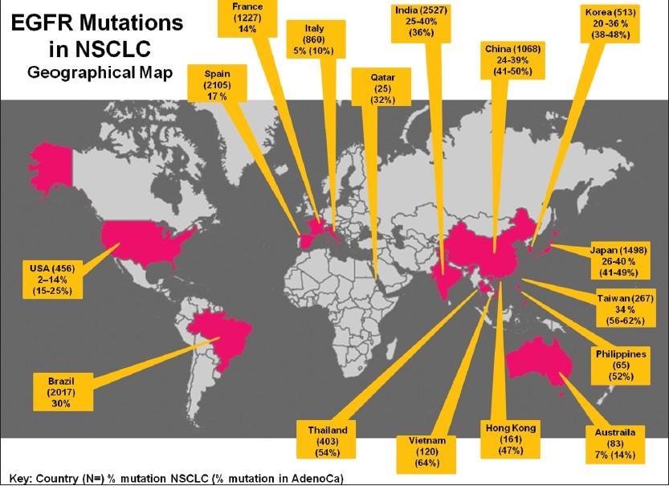
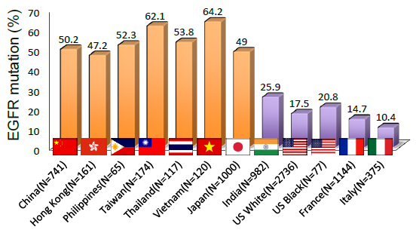
TLCR, Vol 3, No 4 (August 2014)

Slide 14
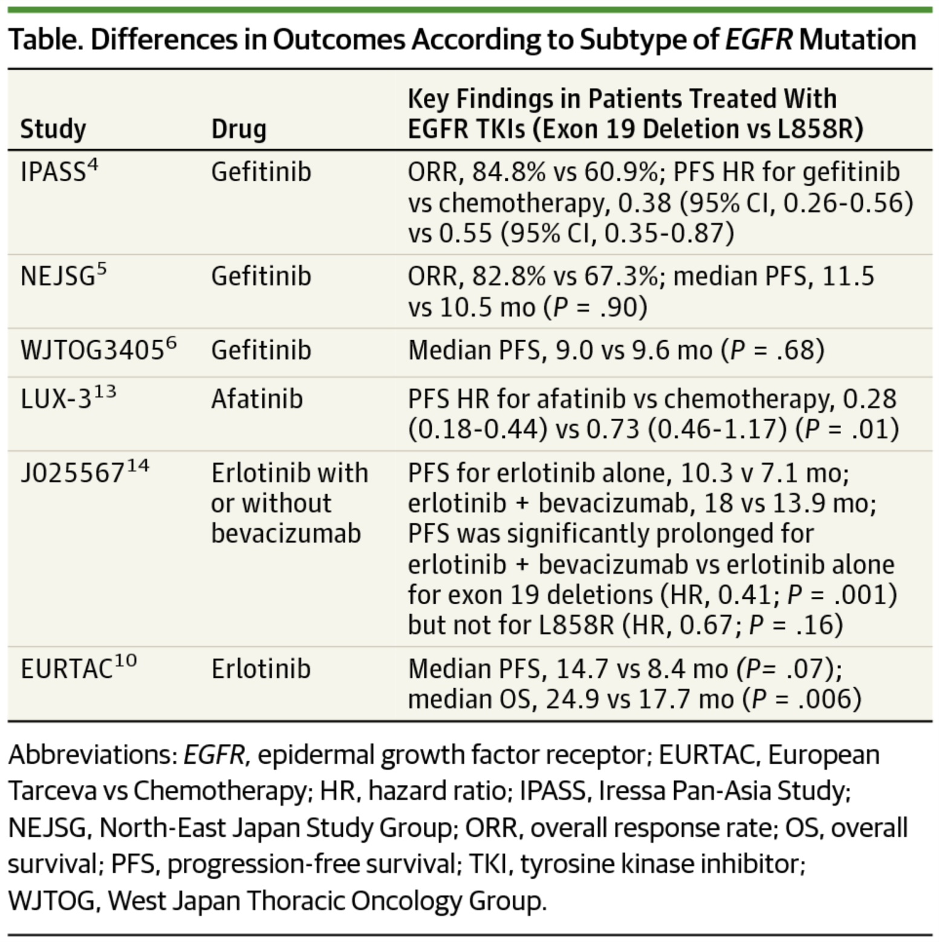
EGFR mutation(+), 선암, 여성환자, 비흡연자, 아시아인
JAMA Oncol. 2015;1(2)
:146-148.

Slide 15
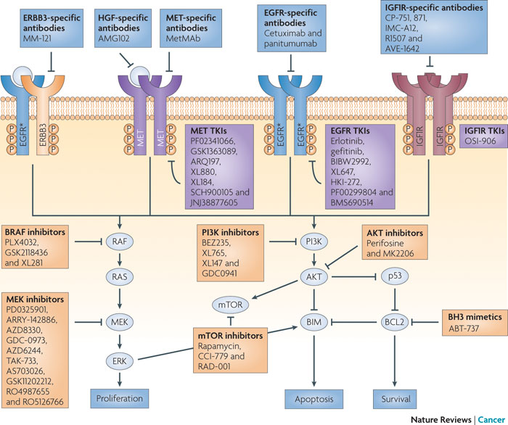
Afatinib
Nature Reviews cancer, 13, 663 - 673 (2013)

Slide 16
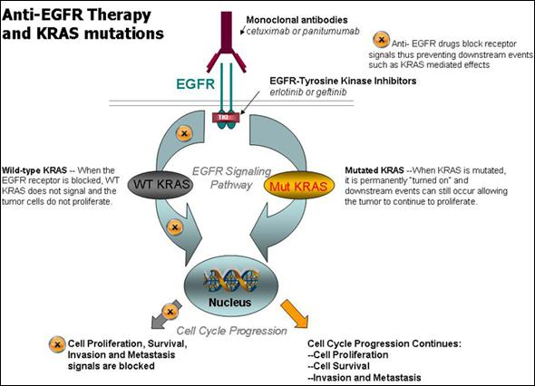

Slide 17
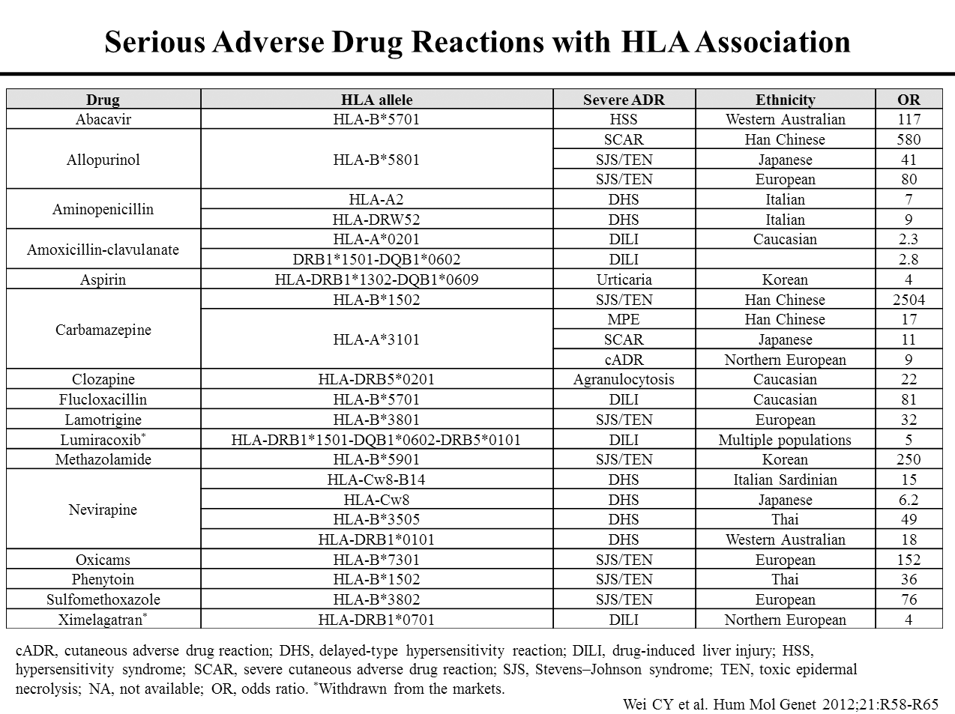

Slide 18
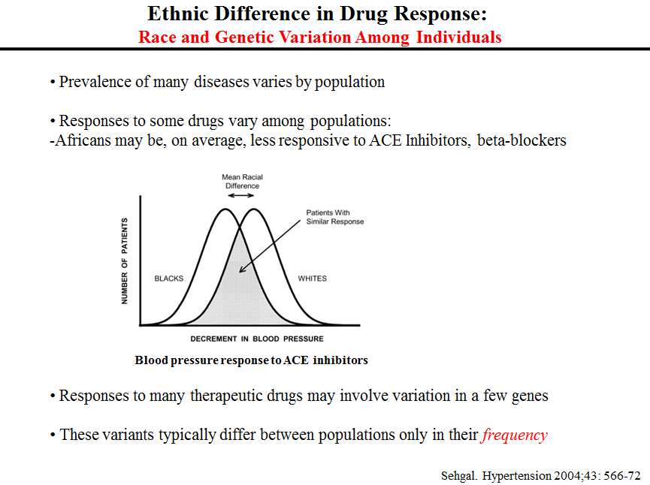

Slide 19
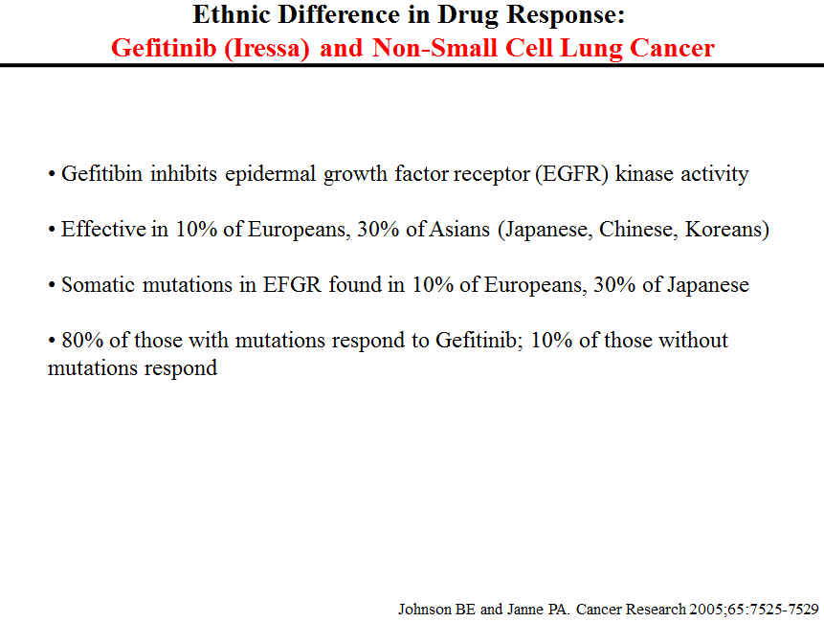

Slide 20
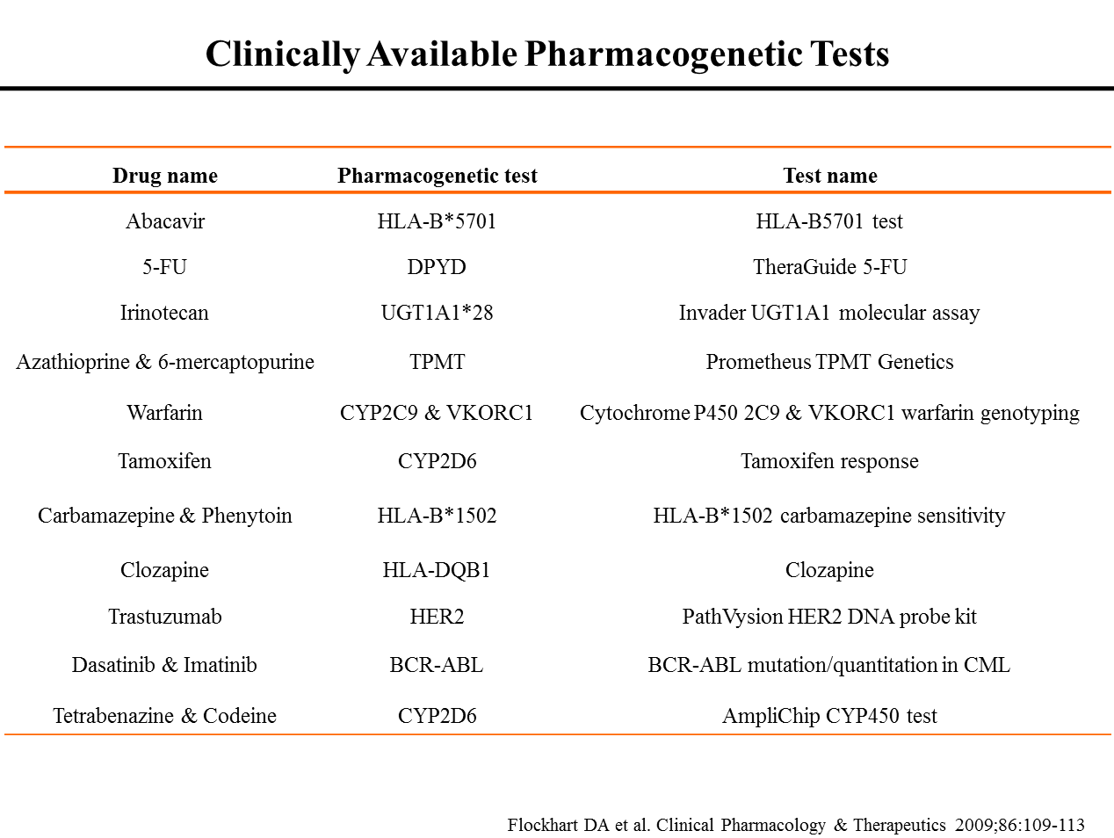

Slide 21
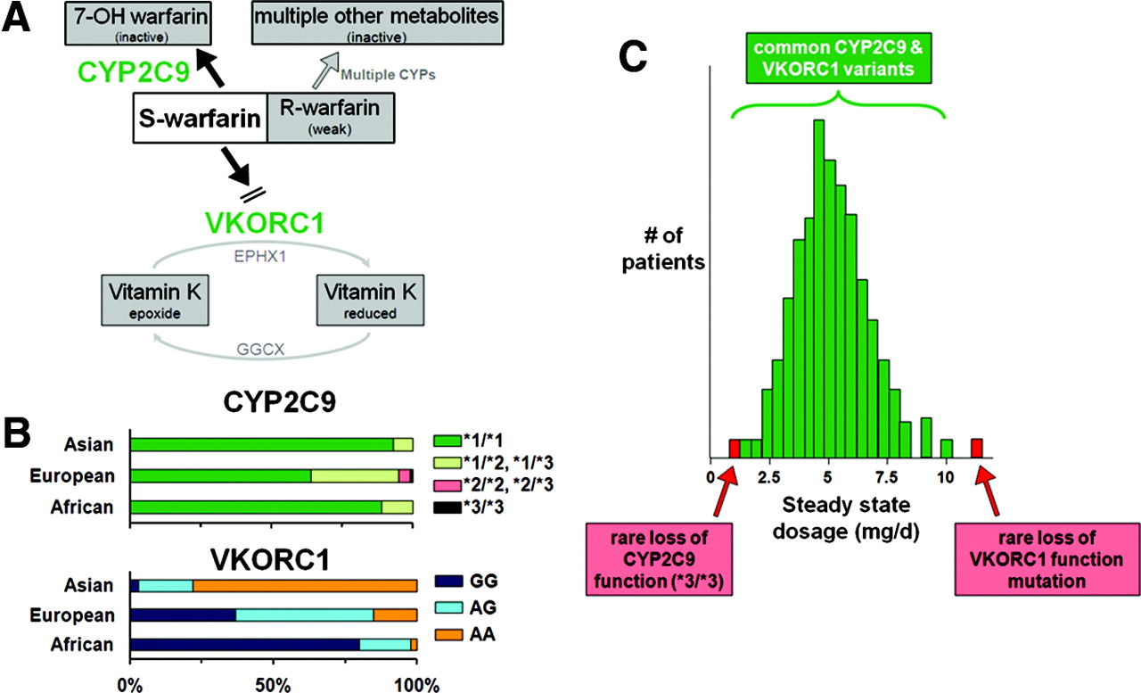
Warfarin Therapy and the Genotypes CYP2C9 and VKORC1
1639A carriers require lower initial doses of the drug than 1639G carriers
Genetics Primer for the General Cardiologist,
Circulation, 2011 ,123 ,15,1661-1670

Slide 22
