Slide 1



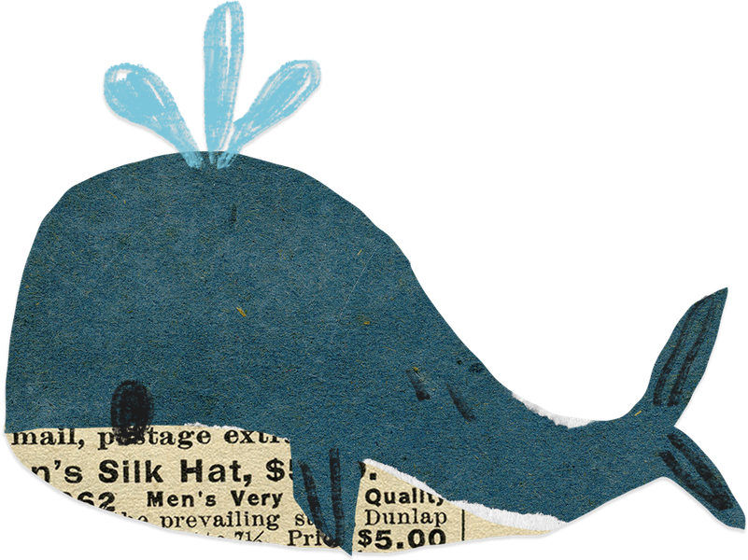
Now, Let’s act.
Global Citizenship Project

Slide 2


We can choose.
Our choice changes the Earth.
When will we start?

Slide 3
WHO is in trouble?
WHY are they suffering?
WHAT should we do?
NOW, Let’s act.

Slide 4
Let’s make a 4-cut photo story.
WHO - WHY - WHAT - NOW

Slide 5
I want to help a(n) ( ).
I will reduce (p ).
I promise to help the (E ).
We will protect the (e ).

Slide 6
One World
One Friendship

