Slide 1



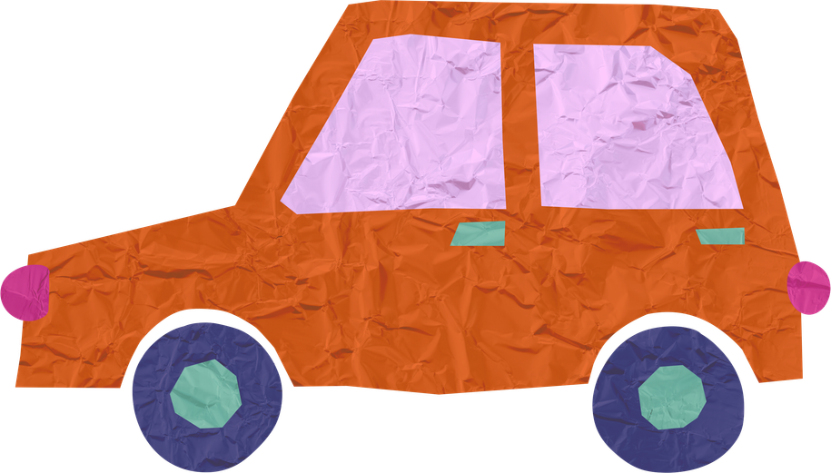
Why are they suffering?

Slide 2
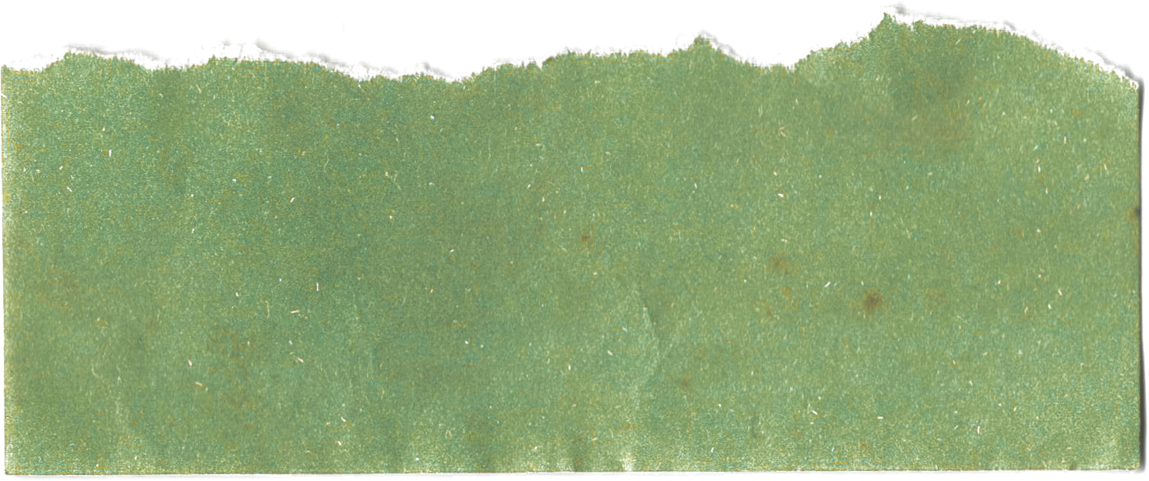
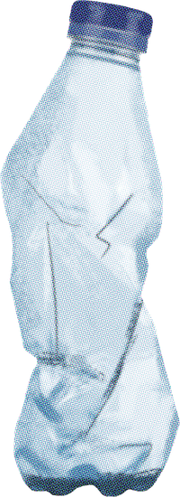
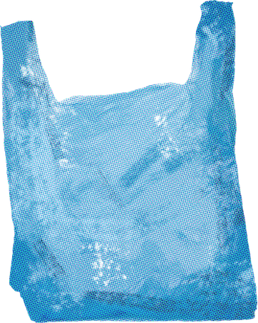

What do you see?
Is this natural,
or
is this made by people?
(P ) made it.
Notes:
“In Korea, we have air pollution.”
“In Thailand, we have plastic waste.”

Slide 3
plastic in the ocean
people throw trash
too much plastic
human behavior

Slide 4
The trash doesn’t (d ).
It stays in the (o ).
Sometimes, it becomes something else.
Notes:
“In Korea, we have air pollution.”
“In Thailand, we have plastic waste.”

Slide 5
This is s glass.
It was t .
Notes:
“In Korea, we have air pollution.”
“In Thailand, we have plastic waste.”

Slide 6
What can we do?
How can we help the Earth?
Notes:
“In Korea, we have air pollution.”
“In Thailand, we have plastic waste.”

Slide 7
Let’s make a keyring
with sea glass.
Notes:
“In Korea, we have air pollution.”
“In Thailand, we have plastic waste.”

Slide 8
How do you feel?
Why are they suffering?
Why is there so much trash?
Notes:
“In Korea, we have air pollution.”
“In Thailand, we have plastic waste.”

Slide 9
Next time
What can we do?

