Slide 1
Introduction to Google Gemini
Lisa Avery

Slide 2
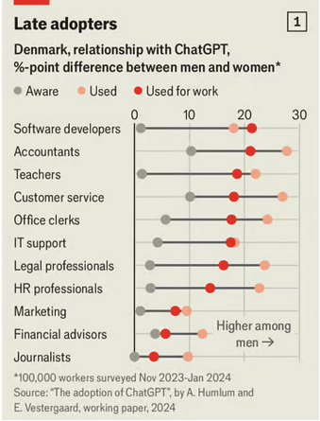
Use of ChatGPT
From The Economist, Why don’t women use artificial intelligence? 21 Aug,2024

Slide 3
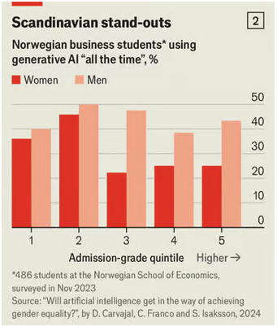
Why aren’t educated women using chatGPT?
The Economist attributed the behaviour to “good-girl” thinking, that high achieving women believe they need to
“do it on my own and I shouldn’t cheat and take short-cuts”
This is misguided!
The researchers did a follow-up survey and found that hiring managers put an 8% premium on high-performing women with AI experience.

Slide 4
Available AI Tools
chatGPT
new free version is pretty good
keeps a conversation history
can’t be used for anything private
Copilot
Microsoft Copilot login with your UHN email
has a notebook feature, but nothing is saved - you need to save as you go
has a degree of commercial data protection info here
… but that doesn’t ensure PHIPA compliant
Google Gemini
three ways to engage with Gemini
now has a paid version as well
easier to interactively code

Slide 5
Introduction to Gemini
What is it?
A large language model– capable of understanding, generating, and responding to text
Requires a validated Google Account
The AI model can be used three ways:
1. as a stand alone chat (like ChatGPT)
2. within Google Colab
3. using the API

Slide 6
Gemini can write code in all the major languages
The default language tends to be Python, but you can ask it to provide code in R
I haven’t tried SAS code – has anyone else?
The benefit is code that is created very quickly, and well commented
But it is rarely fully useful out of the box – you need to code the final 20%
Beware: You will probably not get the same results if you re-issue the prompt
Prompt:
I have a CSV file with patient data containing columns for age, gender, height, weight, and blood pressure. Some values are missing, others are inconsistent (e.g., age as text instead of numbers, height in inches and centimeters). How can I clean this data?

Slide 7
Data Cleaning Code
# Load required library library(tidyverse) # Sample data (replace with your data) patient_data <- data.frame( age = c(25, "30", 42, NA, 51), gender = c("Male", "Female", "Male", "Female", "Male"), height = c(175, 162, NA, 180, 178), weight = c(70, 55, 68, 72, 80), blood_pressure = c("120/80", "130/90", "115/75", NA, "140/95"), stringsAsFactors = FALSE ) # Data cleaning clean_data <- patient_data %>% mutate( age = as.numeric(age), height = as.numeric(height), blood_pressure = gsub("/", ".", blood_pressure) ) %>% separate(blood_pressure, into = c("systolic", "diastolic"), sep = "\\.") %>% mutate( systolic = as.numeric(systolic), diastolic = as.numeric(diastolic) ) %>% drop_na() # Handle outliers (example for age) Q1 <- quantile(clean_data$age, 0.25) Q3 <- quantile(clean_data$age, 0.75) IQR <- Q3 - Q1 clean_data <- clean_data[clean_data$age > (Q1 - 1.5 - IQR) & clean_data$age < (Q3 + 1.5 - IQR), ]

Slide 8
The result
head(clean_data)
age gender height weight systolic diastolic 1 25 Male 175 70 120 80
Not quite what we want (only one line of data!!)– but close – and quick!

Slide 9
Writing a Function in R
Problem: need to extract all the references in a markdown document and store these in a separate bib file.
Prompt:
I require an R function that will find all the citations in a document (in the form [@citationkey]) and read in the contents of a bibtex file (you can find examples on the web of how these are formatted) and then extract the citations from the bibtex file and store in a new file
Example Citation: [@szymanski2010]

Slide 10
Gemini Response
find_and_extract_citations <- function(doc_file, bib_file, output_file) { # Read the document file doc_text <- readLines(doc_file) # Extract citation keys from the document citation_keys <- stringr::str_extract_all(doc_text, pattern = "\\[@([^]]+)\\]")[[1]] # Read the BibTeX file bib_data <- readLines(bib_file) # Parse the BibTeX data using bibutils bib_parsed <- bibutils::parse_bib(bib_data) # Extract the citations based on the keys extracted_citations <- lapply(citation_keys, function(key) { citation <- bib_parsed[[key]] if (!is.null(citation)) { return(citation) } else { return(paste0("Citation not found for key: ", key)) } }) # Write the extracted citations to a new file writeLines(unlist(extracted_citations), output_file) }

Slide 11
> I need the code to read in the bibtex file without using an external package
read_bibtex <- function(bib_file) { bib_data <- readLines(bib_file) # Remove comments and empty lines bib_data <- bib_data[!grepl("^%", bib_data)] bib_data <- bib_data[nzchar(bib_data)] # Split the BibTeX data into individual entries entry_start_indices <- grep("^@", bib_data) entry_end_indices <- c(entry_start_indices[-1] - 1, length(bib_data)) entries <- lapply(seq_along(entry_start_indices), function(i) { bib_data[entry_start_indices[i]:entry_end_indices[i]] }) # Parse each entry parsed_entries <- lapply(entries, parse_bibtex_entry) # Combine parsed entries into a list names(parsed_entries) <- sapply(parsed_entries, function(entry) entry$key) return(parsed_entries) }

Slide 12
And a function that we don’t actually need at all! This we will just ignore
parse_bibtex_entry <- function(entry) { # Split the entry into lines lines <- strsplit(entry, "\n")[[1]] # Find the key line key_line <- grep("^@", lines)[1] key <- sub("@([^}]+)", "\\1", lines[key_line]) # Extract fields and values fields <- gsub("\\s*={\\s*", "=", lines[-key_line]) fields <- gsub("\\s*\\}\\s*", "", fields) field_values <- strsplit(fields, "=") fields <- sapply(field_values, "[", 1) values <- sapply(field_values, "[", 2) # Create the parsed entry entry <- list(key = key, fields = fields, values = values) return(entry) }

Slide 13
Final Product
A bit of trial and error, and combining the functions gives a useful solution
createBibFile <- function(markdown_file, bib_file, output_file="bibfile.bib") { # Extract citation keys from markdown file citations <- unique(unlist(stringr::str_extract_all(readLines(markdown_file), "@\\w+"))) # Read the master BibTeX file bib_text <- readLines(bib_file) # Identify BibTeX entries based on citation keys entry_starts <- grep("^@", bib_text) entry_ends <- c(entry_starts[-1],length(bib_text))-1 cited_entries <- lapply(seq_along(citations), function(i) { citation_pattern <- paste0("^@", ".*", "\\{", gsub("@","",citations[i]), ",") entry_idx <- which(grepl(citation_pattern, bib_text[entry_starts])) if (length(entry_idx) > 0) { start <- entry_starts[entry_idx] end <- entry_ends[entry_idx] return(bib_text[start:end]) } else { return(NULL) } }) if (any(unlist(lapply(cited_entries,is.null)))){ message(paste0("The following citations were not found in the bib_file:\n", paste(citations[unlist(lapply(cited_entries,is.null))],collapse=", "))) } cited_bib <- unlist(cited_entries[!unlist(lapply(cited_entries,is.null))]) # Write the extracted BibTeX entries to a new file writeLines(cited_bib, output_file) }

Slide 14

Strategies for function writing
start with a concise problem (break complex problems into pieces)
test the code line by line (unless the function just works!)
look at the output - what needs to change?
ask the AI for help with problematic lines/packages
ensure you understand and test the code!
Not perfect $≠$ Not Useful
Don’t blindly trust the AI!
I asked chatGPT for Euclidean distances and it gave me a function for regression residuals!

Slide 15
Gemini API
What is an API?
Application Programming Interface for software communication.
How to use the Gemini API:
get an API Key (need a Google login)
Prepare a prompt and pass the API the prompt and the data
Google Colab
Free Jupyter notebook environment– with cloud-based resources.
Seamless integration with Gemini API–.
Benefits: easy to use, powerful computing, collaboration features.
Example files available on gitHub

Slide 16
Updates to reportRmd
New Function: rm_compactsum
Temporary Functions: rm_uvsum2 , rm_mvsum2
-> These will be removed when testing is complete
# To install the latest changes devtools::install_github("biostatsPMH/reportRmd", ref="summer2024")

Slide 17
Compact Table One
Similar to rm_covsum, but a more compact presentation. The guidance was taken from Lancet Oncology
library(reportRmd) data("pembrolizumab") rm_compactsum(data = pembrolizumab, xvars = c("age","change_ctdna_group", "l_size", "pdl1","cohort"), grp = "sex", use_mean = "age", digits = c("age" = 2, "l_size" = 3), digits.cat = 1)
library(reportRmd) data("pembrolizumab") rm_compactsum(data = pembrolizumab, xvars = c("age","change_ctdna_group", "l_size", "pdl1","cohort"), grp = "sex", use_mean = "age", digits = c("age" = 2, "l_size" = 3), digits.cat = 1)
Descriptive statistics were calculated as mean (sd) for age, counts (%) for change_ctdna_group and cohort,
and median (IQR) for l_size and pdl1. Between group comparisons were made using independent t-test for age,
chi-square test for change_ctdna_group, Wilcoxon rank sum test for l_size and pdl1, and Fisher's Exact Test for cohort.
 | Full Sample (n=94) | Female (n=58) | Male (n=36) | p-value | Missing
age | 57.86 (12.75) | 56.95 (12.59) | 59.32 (13.05) | 0.39 | 0
change ctdna group - Increase from baseline | 40 (54.8%) | 21 (52.5%) | 19 (57.6%) | 0.84 | 21
l size | 73.500 (49.250-108.750) | 68.000 (44.250-97.750) | 93.000 (65.500-121.000) | 0.066 | 0
pdl1 | 0.0 (0.0-10.0) | 0.5 (0.0-13.8) | 0.0 (0.0-4.5) | 0.76 | 1
cohort |  |  |  | <0.001 | 0
A | 16 (17.0%) | 3 (5.2%) | 13 (36.1%)
B | 18 (19.1%) | 18 (31.0%) | 0 (0.0%)
C | 18 (19.1%) | 18 (31.0%) | 0 (0.0%)
D | 12 (12.8%) | 7 (12.1%) | 5 (13.9%)
E | 30 (31.9%) | 12 (20.7%) | 18 (50.0%)

Slide 18
New Features
For the lousy typists amongst us, the functions are now pipeable
pembrolizumab |> rm_compactsum(xvars = c(age,change_ctdna_group,cohort),grp=sex)
The description is stored in the “description” attribute
tab <- pembrolizumab |> rm_compactsum(xvars = c(age,change_ctdna_group,cohort),grp=sex)
attr(tab,"description")
[1] "Descriptive statistics were calculated as median (IQR) for age and counts (%) for change_ctdna_group and cohort. Between group comparisons were made using Wilcoxon rank sum test for age, chi-square test for change_ctdna_group, and Fisher's Exact Test for cohort."

Slide 19
Effect Sizes
Effect sizes are calculated with 95% bootstrap CIs
pembrolizumab |> rm_compactsum(xvars = c(age,change_ctdna_group,cohort),
grp=sex,effSize = T)
Descriptive statistics were calculated as median (IQR) for age and counts (%) for
change_ctdna_group and cohort. Between group comparisons were made using Wilcoxon rank sum test for age, chi-square test for change_ctdna_group, and Fisher's Exact Test for cohort. Reported effect sizes are Wilcoxon R for age and Cramer's V for change_ctdna_group and cohort. 1000 bootstrap samples were used to calculate effect size confidence intervals.
 | Full Sample (n=94) | Female (n=58) | Male (n=36) | p-value | Effect Size (95% CI) | Missing
age | 59.1 (49.5-68.7) | 56.6 (45.8-67.8) | 61.2 (52.0-69.4) | 0.30 | 0.11 (-0.09, 0.21) | 0
change ctdna group - Increase from baseline | 40 (55%) | 21 (52%) | 19 (58%) | 0.84 | 0.02 (-0.19, 0.05) | 21
cohort |  |  |  | <0.001 | 0.66 (0.97, 1.24) | 0
A | 16 (17%) | 3 (5%) | 13 (36%)
B | 18 (19%) | 18 (31%) | 0 (0%)
C | 18 (19%) | 18 (31%) | 0 (0%)
D | 12 (13%) | 7 (12%) | 5 (14%)
E | 30 (32%) | 12 (21%) | 18 (50%)

Slide 20
Regression Summaries
There are two new functions: rm_uvsum2 and rm_mvsum2, which duplicate the original functions
rm_uvsum("age", covs = c("sex", "l_size"), data = pembrolizumab)
 | Estimate(95%CI) | p-value | N
sex |  | 0.38 | 94
Female | Reference |  | 58
Male | 2.37 (-3.01, 7.75) |  | 36
l size | -0.03 (-0.07, 0.02) | 0.23 | 94
rm_uvsum2("age", covs = c("sex", "l_size"), data = pembrolizumab)
 | Estimate(95%CI) | p-value | N
sex |  |  | 94
Female | Reference |  | 58
Male | 2.37 (-3.01, 7.75) | 0.38 | 36
l size | -0.03 (-0.07, 0.02) | 0.23 | 94

Slide 21
rm_uvsum2 is also pipeable
pembrolizumab |> rm_uvsum2(response=age,covs=c(sex,cohort,change_ctdna_group))
 | Estimate(95%CI) | p-value | N
sex |  |  | 94
Female | Reference |  | 58
Male | 2.37 (-3.01, 7.75) | 0.38 | 36
cohort |  |  | 94
A | Reference |  | 16
B | -6.58 (-Inf, 1.90) | 0.13 | 18
C | -4.98 (-Inf, 3.50) | 0.25 | 18
D | 0.97 (-8.46, 10.39) | 0.84 | 12
E | -9.18 (-Inf, -1.54) | 0.019 | 30
change ctdna group |  |  | 73
Decrease from baseline | Reference |  | 33
Increase from baseline | -5.99 (-Inf, 0.18) | 0.057 | 40
New Functions are Temporary!
Once testing is complete rm_mvsum2 will replace rm_mvsum and rm_uvsum2 will replace rm_uvsum

Slide 22
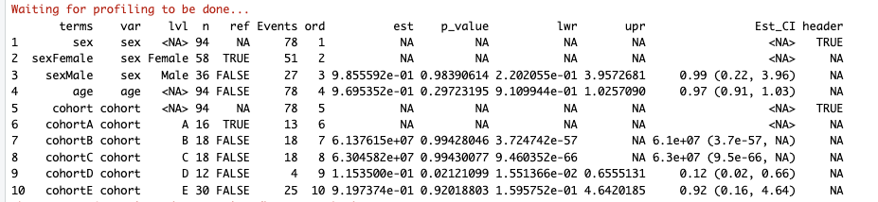
Extending reportRmd
There is an internal function, m_summary which summarises diverse model types into a single common format
fit_binom<- glm(formula=as.formula(orr~sex+age+cohort),
data=pembrolizumab,
family="binomial")
reportRmd:::m_summary(fit_binom,for_plot = T)

