Slide 1

Standard deviation, standard error, and measures of variability
Rebecca Jaszczak (rebecca.jaszczak@ucsf.edu)
Laird Lab, BMS Graduate Program
01/17/2019 Biostats Club
statisticshowto.datasciencecentral.com

Slide 2
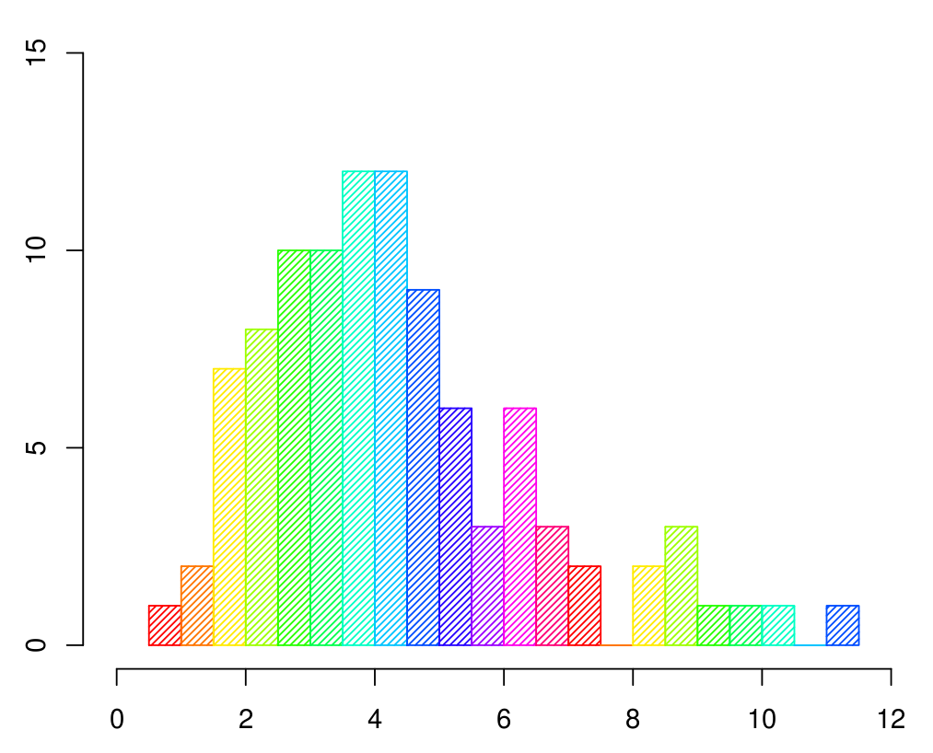
Data distributions
Frequency / Counts
bins
Notes:
frequency histogram is something that I use every time I analyze a single cell RNA seq dataset.
count observations and put them in bins.
histograms are used to summarize data distribution and spread
provide a lot of nuance to visualization of data

Slide 3
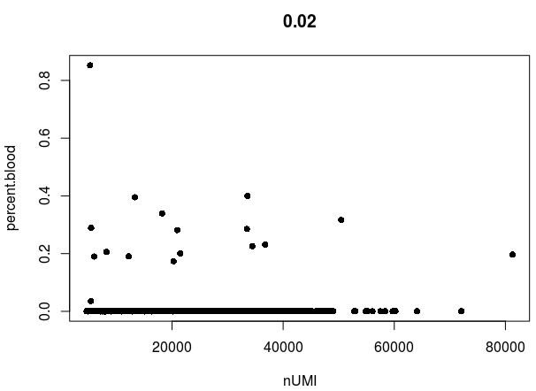
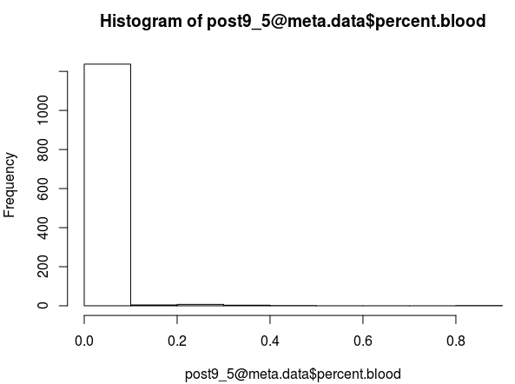
Data visualizations and distributions

Slide 4
Variance - some definitions
numerical measure of dispersion of data values around the mean
conveys spread with a single number
Notes:
Why think about variance?
click
A single number that preserves a lot of information about the data. Also reduces clutter - you don’t have to look at every single datapoint.

Slide 5
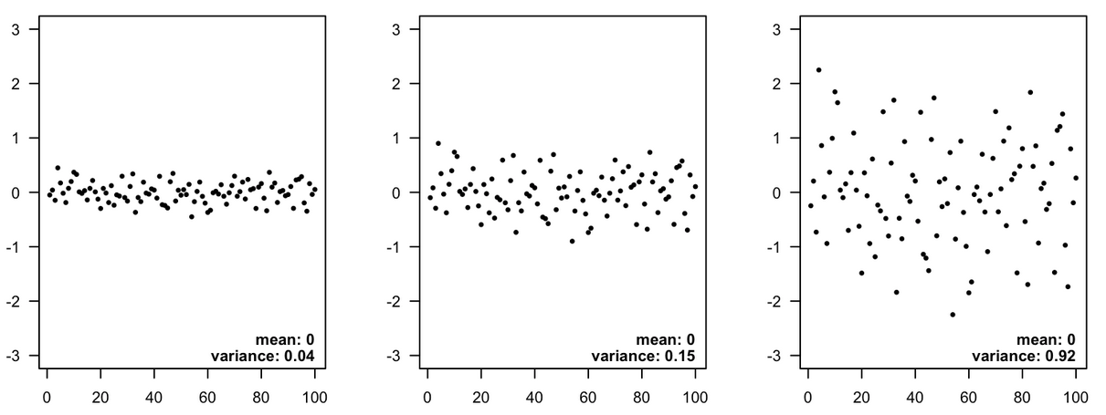
Variance - some pictures
summarizes the spread (dispersion)
variance: 0.04
variance: 0.15
variance: 0.92
David Quigley, UCSF
Notes:
a way of talking about how much variation overall there is in the dataset
increasing variance for datasets which all have a mean of 0

Slide 6
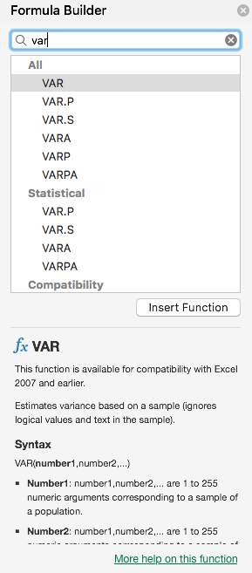
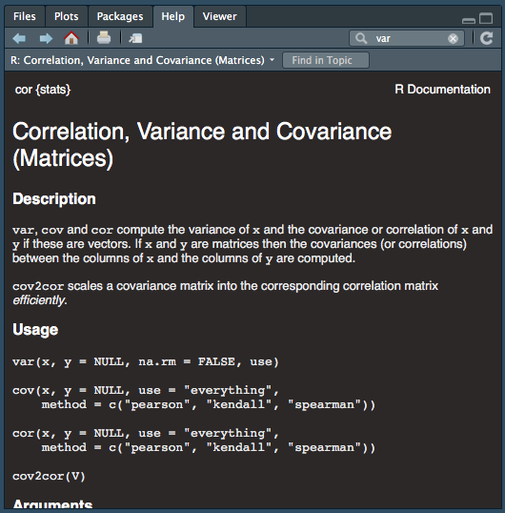
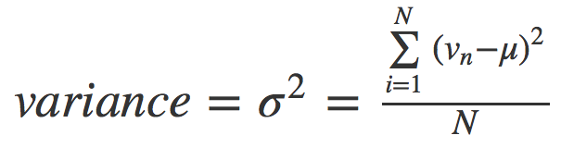
Variance - some math
Notes:
means squared difference of every point from the mean
1) calculate distance from each point to mean
2) square the distances
3) sum the distances and divide by the number of points
I hate math

Slide 7
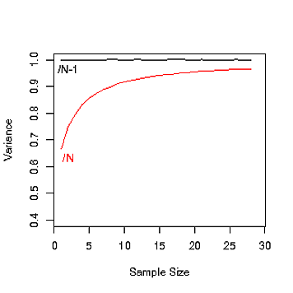
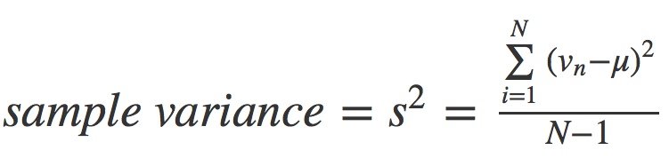
Kinds of variance
population variance (σ²)
vs
sample variance (s²)
(In this example, the variance should be close to 1)
stackoverflow
Notes:
most experiments use a sample of conditions, rather than knowing all conditions ever
As sample size decreases N-1 is a pretty good correction for the fact that the sample variance gets lower (you're just more likely to sample near the peak of the distribution---see figure). If sample size is really big then it doesn't matter any meaningful amount.
if we calculate s² by dividing just by n, (which is intuitive) our estimation of s² will be an underestimate. To compensate, we divide by n−1.

Slide 8

Using variance in your data - you already do it
Units² is annoying and a different scale than your data is already in
Taking the square root of variance gives standard deviation!
Notes:
it’s nice to have the spread in the same scale than the mean

Slide 9
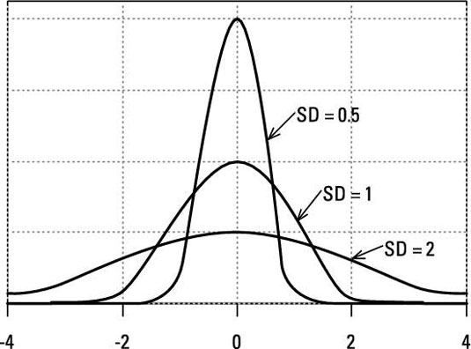
Standard deviation - width of data
dummies.com
Notes:
The figure shows three normal distributions. They all have a mean of zero, but they have different standard deviations and, therefore, different widths.

Slide 10
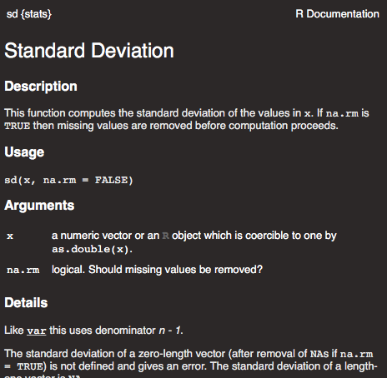
Standard deviation
Notes:
work smarter

Slide 11
So, what about standard error?

Slide 12
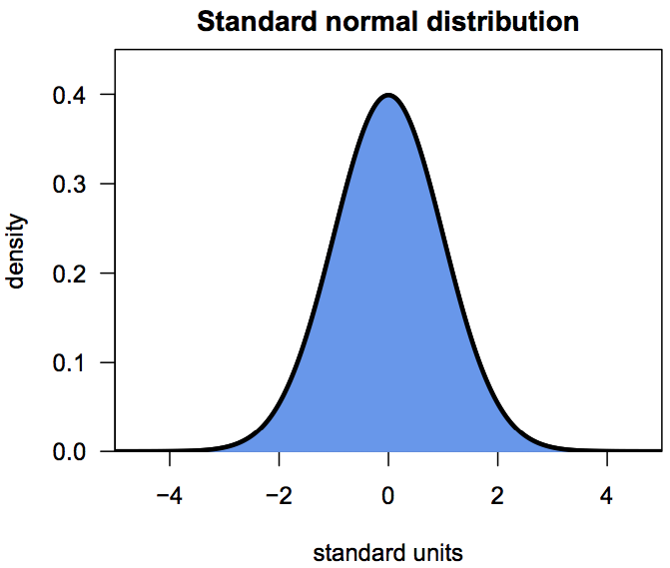
Normal Distributions
data not normal?
power transforms or box-cox transform…
a story for another day
David Quigley, UCSF
Notes:
some data generated by sampling properties of living things follow a common frequency distribution: most values are near the mean value, and more extreme values appear much less frequently
real data will never be identical to a particular distribution, the frequency distribution of real data will often be close enough to a distribution that we can use the distribution as a stand-in for the observed data; normal data is always symmetrical around the mean, an kind of ideal histogram.

Slide 13
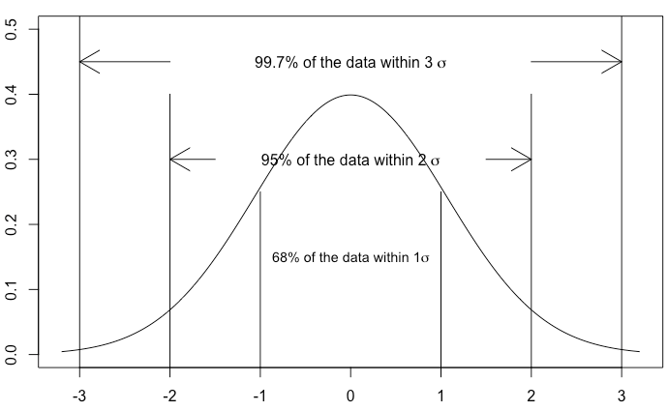
Normal Distributions

Slide 14
Standard error
The standard deviation describes variation in a sample or population.
The standard error of the mean describes confidence in the estimate of the sample mean.

Slide 15
Standard error
Often reported as “confidence intervals” or “error bars”
Depends on variance - increased variance = more difficulty getting a sample to model the population
Depends on size - larger samples are more representative than smaller

Slide 16
Standard error = some maths
SE = SD_{(sample)} / √N
sample mean and SE can be used to estimate the probability that population mean lies within given bounds, given the assumption that the population has approximately normal distribution

Slide 17
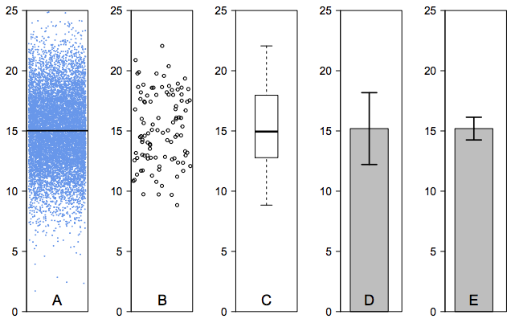
In totality
Figure 3: Presenting the variation using SEM and SD. 3A shows the entire dataset, with random noise on the X-axis to make the data easier to see. 3B shows the sample from the dataset. 3C shows a box and whiskers plot of the sample data. 3D shows a bar plot of sample mean +/- one SD. 3E shows a bar plot of sample mean +/- one SEM.
David Quigley, UCSF

Slide 18
When to use

Slide 19
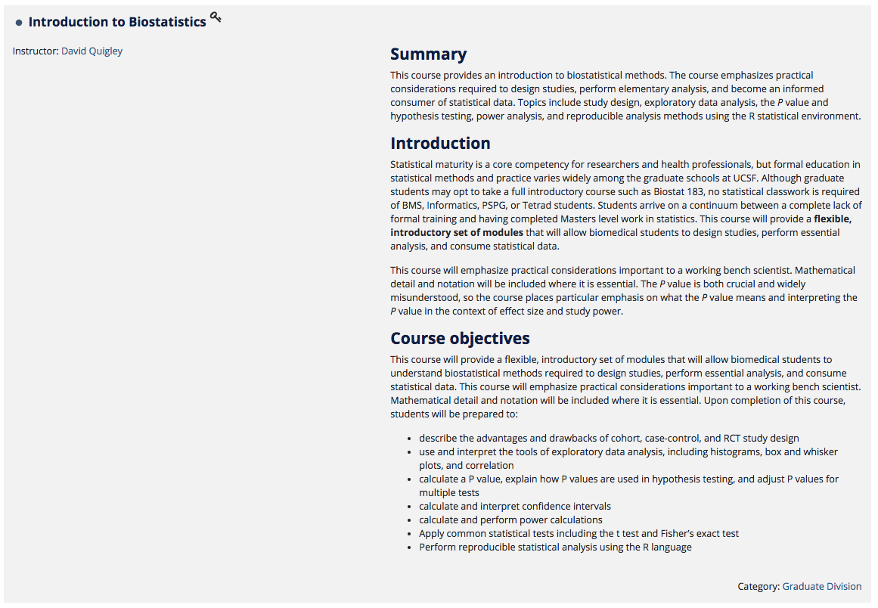
On the CLE!

Slide 20
R Code!

