Slide 1
Introduction to Next-Gen Sequencing Data Processing Through Unix/Command Line
Biostats Journal Club
Steven Cincotta
April 19th, 2018

Slide 2
Outline
Next-gen sequencing techniques: planning and execution
Intro to Unix commands
Navigating the file system
FASTQ file viewing and structure
Fastqc program for read quality
Adapter trimming
How to alter Unix commands with options
Genome aligners
SAM file format, flag and MAPQ scores
BAM file format

Slide 3
Types of NGS techniques
All based on the idea of sequencing small nucleotide fragments, and then aligning to a reference sequence to determine their origin and abundance
Examples of common techniques:
RNA-seq – measures transcript levels
ChIP-seq – measures transcription factor binding to DNA
ATAC-seq – measures DNA accessibility (openness)
Whole genome bisulfite sequencing – measures DNA methylation
Massive up-to-date list of sequencing-related techniques:
https://liorpachter.wordpress.com/seq/
Notes:
Currently 97 on the list

Slide 4
What do I need to consider before my NGS experiment?
What’s the question? Will the experiment address that question?
Data in = data out!
Library preparation:
Paired-end vs single-end?
Poly-A vs ribosome depletion (RNA-seq)?
Strand-specific?
How many replicates needed? (←pssst, power analysis JC anyone?)
Notes:
Most of the time you want a clear question, easier to analyze rather than wide screen
Bioinformatics cannot magically make shitty data better
Many decisions to be made about how you want to prep your library, can lead to differences in what information you can extract from data
Power analysis to ensure you can perform proper statistics

Slide 5
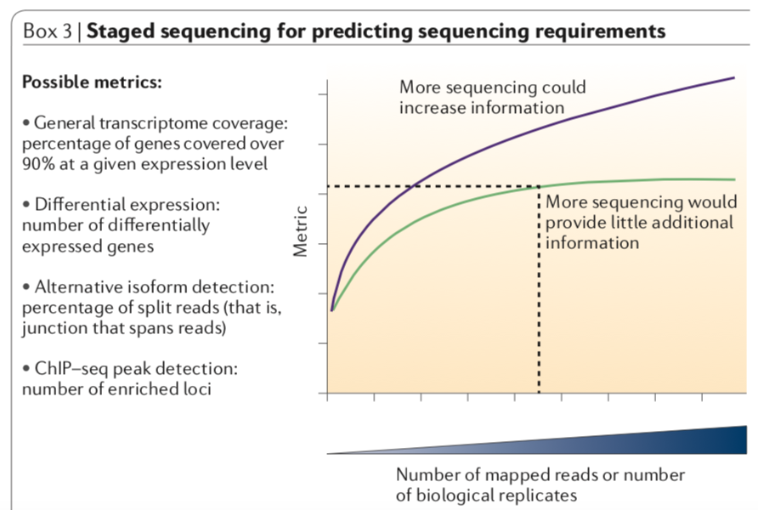
What do I need to consider before my NGS experiment?
Sequencing depth requirements:
Sims et al 2014
Nat Rev genetics
https://rtsf.natsci.msu.edu/_rtsf/assets/File/depth%20and%20coverage.pdf

Slide 6
Simple workflow for an NGS experiment
RNA-seq
ChIP-seq
Adapter ligation
RNA extraction
Crosslink protein and DNA
Signal amplification by PCR
Product: “library”
Rev transc to cDNA
Sequence
IP and rev crosslinks
Data Analysis:
Read filtering/trimming
Genome alignment
Fragment DNA
Fragment chromatin
(Enzymatic or mechanical)
Transcript assembly
Differential gene expr
Etc…
Peak calling
Motiff analysis
Etc…

Slide 7
Let’s look at the file I gave you
Download the files I sent:
Examplefile1.fastq
Examplefile2.fastq
Save these files to your desktop
Open up a terminal window

Slide 8
Our first three crucial Unix commands:
pwd – “print working directory”
ls – “list”
cd – “change directory”
Allow us to navigate through the file tree system.
→ What’s that?

Slide 9
😀
(home directory)
/User/scincotta
pwd --> /User/scincotta
/Desktop
/Apps
/Documents

Slide 10
(home directory)
/User/scincotta
cd Documents
😀
/Desktop
/Apps
/Documents
pwd --> /User/scincotta/Documents
ls -->
File1.txt
File2.docx
File3.fastq
Etc…

Slide 11
Exercise 1
Take two minutes to navigate your file system,
Can you figure out what these variations do?
cd ~/
cd ../
ls –a
ls -l
Change into your Desktop directory and confirm you can see your test.fastq file before we move on

Slide 12
Exercise 2: Ways to view a file
Let’s try three different commands, what do they do?:
cat examplefile1.fastq
head examplefile1.fastq
tail examplefile1.fastq
How do I know what these programs do before running them?
man (command)

Slide 13
Additional essential Unix commands:
mkdir (directoryname)
– generates new empty directory (folder)
mv ~/location1 ~/location2
- moves file from location1 to location2
- can also be used to rename a file!
cp ~/location1 ~/location2
- generates copy of file in new location
rm (filename)
- deletes file: PLEASE BE CAREFUL USING THIS, YOU CANNOT UNDO THIS IN ANY WAY.

Slide 14
FASTQ file
Composed of repeating units of four lines (per read)
@ERR022485.24 IL3_4946:6:1:8203:1041/1
NTTTGGTGCTGCATTCCTTTTCTTGGTCGAACAAGTGTGG……
+
!814403632<<<<;;;;;9;;;;;;;<<<9;;;;;;9;;……
Notes:
I shortened a bit of the first read from the examplefile1.fastq

Slide 15
FASTQ file
Composed of repeating units of four lines (per read)
@ERR022485.24 IL3_4946:6:1:8203:1041/1
NTTTGGTGCTGCATTCCTTTTCTTGGTCGAACAAGTGTGG……
+
!814403632<<<<;;;;;9;;;;;;;<<<9;;;;;;9;;……
Individual read name
Sequence
Quality Score
aka Phred Score

Slide 16

FASTQ file
@ERR022485.24 IL3_4946:6:1:8203:1041/1
NTTTGGTGCTGCATTCCTTTTCTTGGTCGAACAAGTGTGG……
+
!814403632<<<<;;;;;9;;;;;;;<<<9;;;;;;9;;……
Phred scores are represented as symbols, which have corresponding numeric values
Probability base call is incorrect
$$={10}^{−PhredScore/10}$$
Good link for deciphering phred symbols and scores: https://www.drive5.com/usearch/manual/quality_score.html

Slide 17
How do I check the quality of my fastq file?
Standard in the field is to use the program “fastqc”
To download fastqc:
Download the magical program Homebrew 🍺:
https://brew.sh
Run this command: /usr/bin/ruby -e "$(curl -fsSL https://raw.githubusercontent.com/Homebrew/install/master/install)”
When finished, run: brew install fastqc

Slide 18
Exercise 3: Let’s run fastqc
fastqc examplefile2.fastq
Should get two files:
examplefile2_fastqc.html
examplefile2_fastqc.zip
From finder window, open the .html file. What info do we get?
Notes:
Notice the file we got had no adapters, but did have some poor quality.

Slide 19
Why do I need to process my reads before aligning???
PCR primer
PCR primer
index
P5
sequence of read
P7
P5 and P7 are the ends of the adapters, which allow binding to the flow cell
PCR primers are used during library amplification
Index sequences are part of reverse PCR primer, used for multiplexing
Notes:
To remove adapters and/or barcodes
To trim low quality bases
If you don’t remove all of this, alignment won’t work

Slide 20
Downloading cutadapt
Useful program for trimming adapters
brew install brewsci/science/cutadapt
Let’s look how this program is used:
cutadapt -help

Slide 21
Side note: What are options of Unix commands?
Start with either “-” or “--”
Used to:
Specify format of input or output
Adjust functionality of a program
(lots of other things!)
To see available options of program, try either:
<program> or man <program> or <program> --help

Slide 22
Exercise 4: Running cutadapt
Usage:
cutadapt -a ADAPTER [options] [-o output.fastq] input.fastq
“-a” specifies that your adapters are on the 3’ end of your reads, tells cutadapt to trim adapter and everything after it.
ADAPTER is the actual known sequence of your adapter entered directly into command line
[other additional options]
“-o” specifies the name of your output file (make sure .fastq !)
Let’s run fastqc again to confirm they’re gone
Notes:
My fake adapter sequence: CTGAGTAGCAGTAGC

Slide 23
Types of aligners
There are lots of aligners out there, how do I know which to use?
Things to consider:
Do you need a splice-aware aligner?
Do you have single-end or paired-end reads?
Speed vs accuracy?
What size reads do you have?
Some popular aligners: Bowtie2, STAR, BWA, kallisto

Slide 24
SAM file format – output of alignment
SRR3689759.32.1 73 chr13 40376348 42 76M = 40376348 0 GTACAAG… AAAA<EE… AS:i:0 XN:i:0 XM:i:0 XO:i:0 XG:i:0 NM:i:0 MD:Z:76 YT:Z:UP
Notes:
Look up what SAM abbrev stands for

Slide 25
SAM file format – output of alignment
SRR3689759.32.1 73 chr13 40376348 42 76M = 40376348 0 GTACAAG… AAAA<EE… AS:i:0 XN:i:0 XM:i:0 XO:i:0 XG:i:0 NM:i:0 MD:Z:76 YT:Z:UP
QNAME: Read name
FLAG: Bitwise SAM FLAG
RNAME: Name of reference sequence mapped to (in this case chrom #)
POS: Leftmost mapping position
MAPQ: Mapping quality score
SEQ: read sequence (which I shortened here)
QUAL: read quality phred score (which I shortened here)
Excellent page that explains this all in excruciating detail: https://samtools.github.io/hts-specs/SAMv1.pdf

Slide 26
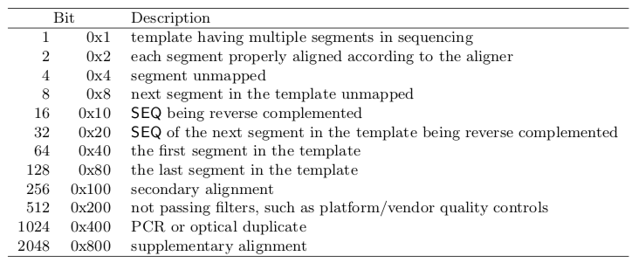
What can we use SAM flags for?
SAM flags are a bitwise score that contain information about the mapping characteristics of a read.
These can be used to filter reads for certain characteristics!
Awesome tool for deciphering what your flag scores mean:
https://broadinstitute.github.io/picard/explain-flags.html
Notes:
Biostars thread on this: https://www.biostars.org/p/52657/

Slide 27
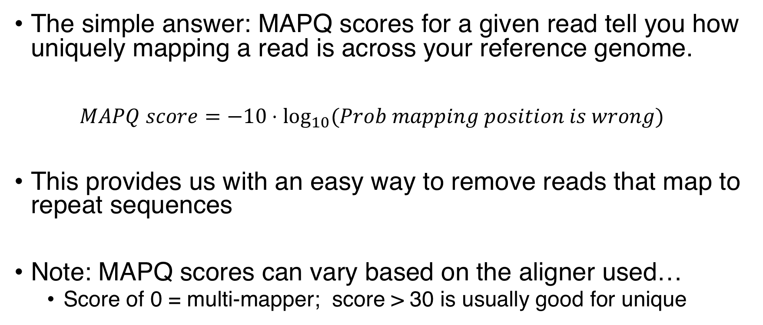
What’s the MAPQ score for?
The simple answer: MAPQ scores for a given read tell you how uniquely mapping a read is across your reference genome.
$MAPQ score=−10⋅\log_{10}{(Prob mapping position is wrong)}$
This provides us with an easy way to remove reads that map to repeat sequences
Note: MAPQ scores can vary based on the aligner used…
Score of 0 = multi-mapper; score > 30 is usually good for unique

Slide 28
Wait, so what’s a BAM file?
BAM files are simply a binary-converted version of a SAM file.
They take up considerably less space than SAM files, but are NOT human readable, meaning we need special tools to view
One popular set of tools is “samtools” (which can be downloaded with Homebrew)
Need to be sorted and indexed (w/samtools) before using the BAM file for any downstream analysis

Slide 29
(Other unix things to go over if we have time)
Directing input and output
“>” to direct output to a file
“|” known as a “pipe,” takes output from program on left side and “pipes” or directs it as input into the command on the right side
Very helpful unix commands:
awk
grep
sed

Slide 30
Unix resources
Simple and straightforward course for understanding how to work with the command line and the essential Unix commands (this is where I started with everything!):
https://www.codecademy.com/learn/learn-the-command-line
Another online course that looks great (not yet tested!):
https://www.coursera.org/learn/unix

