Slide 1
Analyses of Variance
Biostatistics Journal Club
10 May 2018
Alexis Leigh Krup

Slide 2
Analyses of Variance
t-Test
ANOVA = Analysis of Variance
MANOVA = Multivariant Analysis of Variance

Slide 3
Players in an Analysis of Variance
Factor = different variable
Independent variable in t-test
Level = value you are comparing for those factors
Dependent variable in t-test
Null hypothesis = there is no significant difference or effect

Slide 4
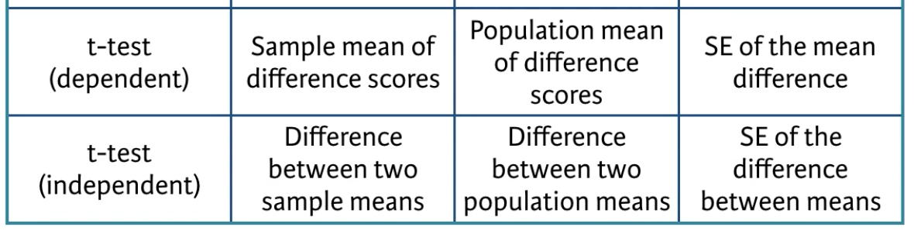
t-Test
Observed
Expected
Standard Error

Slide 5


Dependent t-Test
Mm_A
Mm_A
 | Mm_A | Mm_B | Mm_C | Mm_D | Mm_E
pre Tx
post Tx
Pre-Tx
Post-Tx
Notes:
Independent Variable = treatment (Tx)
Dependent Variable = sample taken from Mm_A either before treatment or after treatment
Comparison = Mm_A sample pre-treatment and post treatment → The effect of treatment

Slide 6
Independent t-Test
Mm_A
Mm_B
 | sample 1 | sample 2 | sample 3 | sample 4 | sample 5
Mm_A
Mm_B
Notes:
Independent Variables = Mm_A and Mm_B (maybe something genetically different about these mice and measuring their blood for a biomarker)
Depdendent Variables = samples taken from these mice
Comparison = MmA and MmB

Slide 7
Practical Exercise #1
Effect of training program on 100m running times
 | Runner01 | Runner02 | Runner03 | Runner04 | Runner05 | Runner06 | Runner07 | Runner08 | Runner09 | Runner10
Before Training | 12.9 | 13.5 | 12.8 | 15.6 | 17.2 | 19.2 | 12.6 | 15.3 | 14.4 | 11.3
After Training | 12.7 | 13.6 | 12 | 15.2 | 16.8 | 20 | 12 | 15.9 | 16 | 11.1
https://www.r-bloggers.com/paired-students-t-test/
Notes:
Indepdendent Variables = training
Depdenent Variables = runner’s 100m times

Slide 8
ANOVA
Analysis of Variance
One way ANOVA = Comparisons of effect of multiple levels of one factor
Two way ANOVA = Comparisons of effect of multiple factors on one dependent variable
Treatment1, dose1
Treatment1, dose2
Treatment1, dose3
 | Mm_A blood
treatment1, dose1
treatment1, dose2
treatment1, dose3
Notes:
Factor = treatment 1
Levels = dosage
Depdendent variable = MmA blood biomarker
Comparison = level of MmA biomarker as a result of the different dosages of the treatment
One-way ANOVA (Because multiple levels of one factor)

Slide 9
Practical Exercise #2
A drug company tested three formulations of a pain relief medicine for migraine headache sufferers
Subjects report their pain on a scale of 1 to 10
 | Patient01 | Patient02 | Patient03 | Patient04 | Patient05 | Patient06 | Patient07 | Patient08 | Patient09
Drug A | 4 | 5 | 4 | 3 | 2 | 4 | 3 | 4 | 4
Drug B | 6 | 8 | 4 | 5 | 4 | 6 | 5 | 8 | 6
Drug C | 6 | 7 | 6 | 6 | 7 | 5 | 6 | 5 | 5
http://www.stat.columbia.edu/~martin/W2024/R3.pdf
Notes:
Factor = migraine drug
Levels = dosage A,B,C
Depdendent variable = reported pain
Coparison = dosage effects on migraine relief

Slide 10
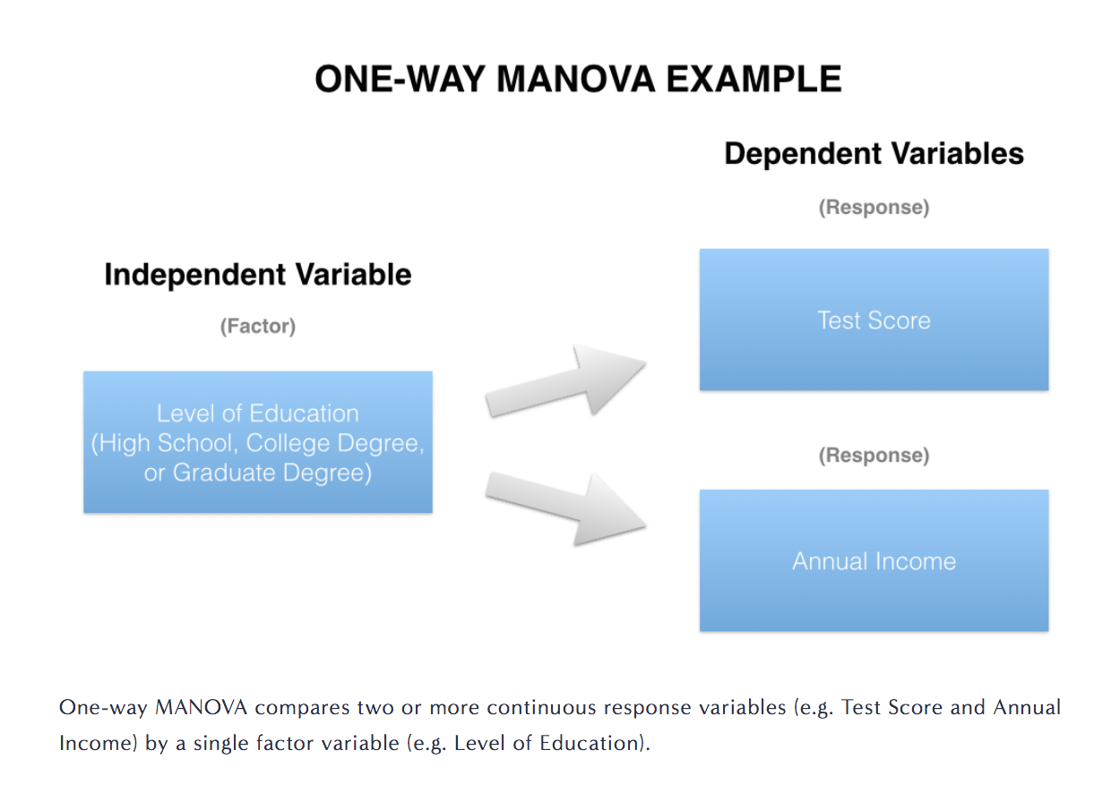
MANOVA
statsmakemecry.com

Slide 11
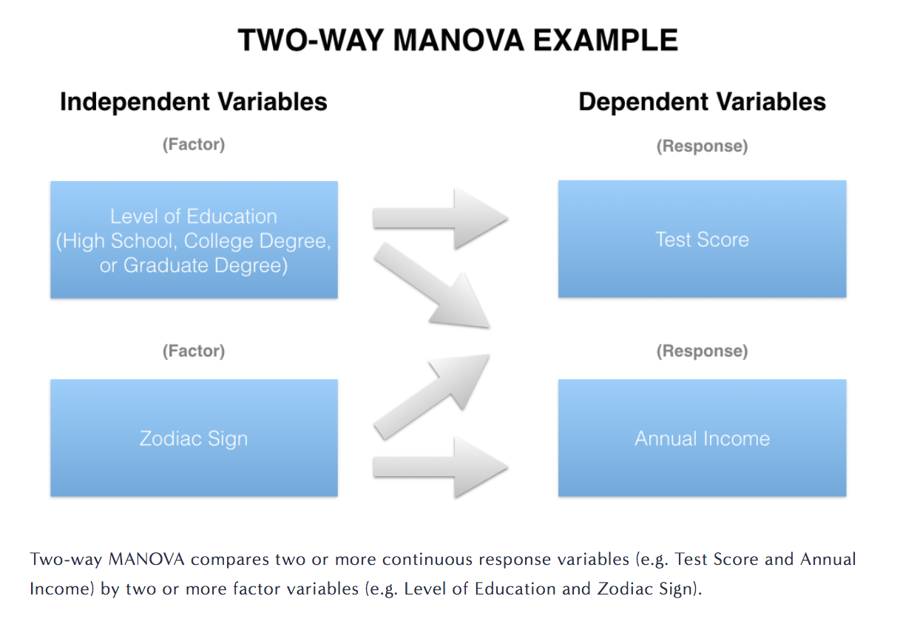
MANOVA
statsmakemecry.com

Slide 12

Practical Exercise #3
Analyzing the growth of six different apple tree rootstocks from 1918 – 1934 (Andrews and Herzberg, Data, Springer Series in Statistics, 1985)
Six Independent Variables/Factors
Four Dependent Variables:
Trunk girth at 4 years (mm X 100)
Extension growth at 4 years (m)
Trunk girth at 15 years (mm X 100)
Weight of tree above ground at 15 years (lb X 100)
https://rpubs.com/aaronsc32/manova
Rencher, Methods of Multivariate Analysis, 1995

Slide 13

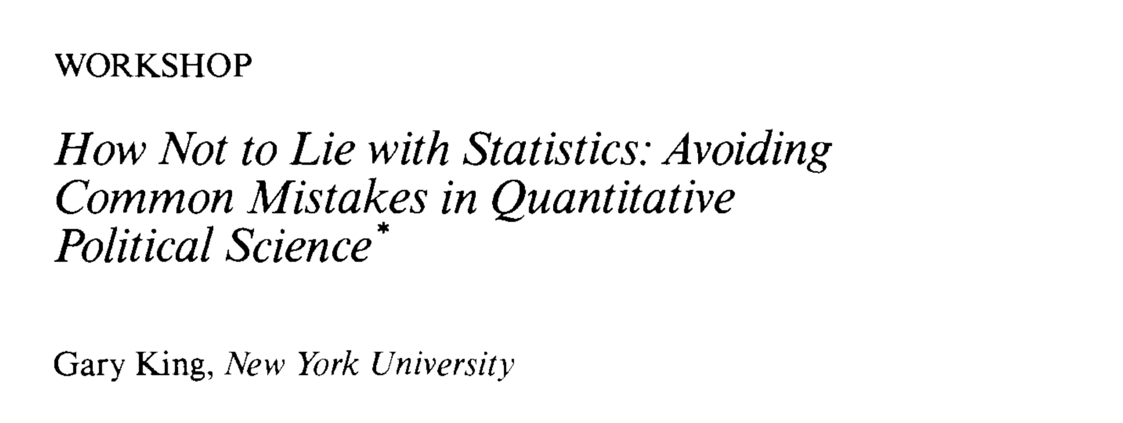

be careful & consult with experts

Slide 14
Want More?
Related articles courtesy of Nature Methods
Krzywinski and Altman “Points of significance: Analysis of variance and blocking” https://www.nature.com/articles/nmeth.3005
Krzywinksi and Altman “Points of Significance: Designing comparative experiments” https://www.nature.com/articles/nmeth.2974
Help with definitions
http://www.statsmakemecry.com/smmctheblog/stats-soup-anova-ancova-manova-mancova
Guided Practice
https://www.statmethods.net/stats/anova.html
Practice with larger, more complicated data sets and graphical depictions
https://richardlent.github.io/post/multivariate-analysis-with-r/

