Slide 1
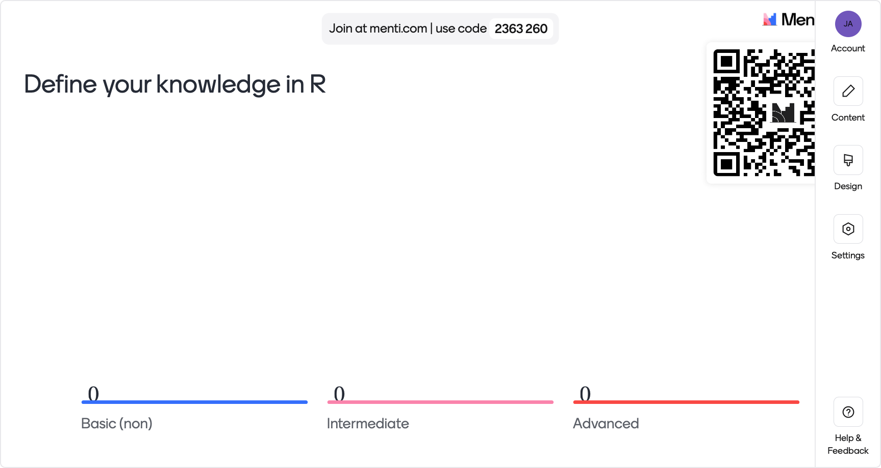

Slide 2


Slide 3


Slide 4
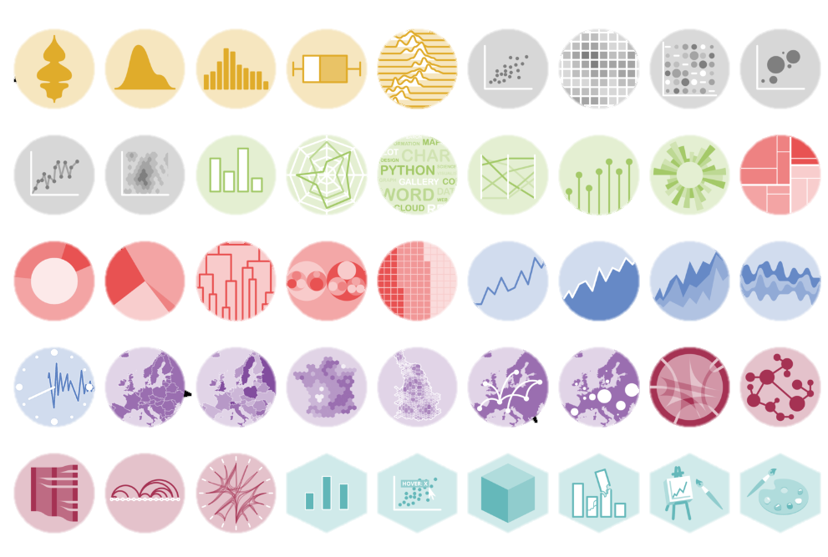
What is Data Visualization?
It is the graphical representation of data or information

Slide 5
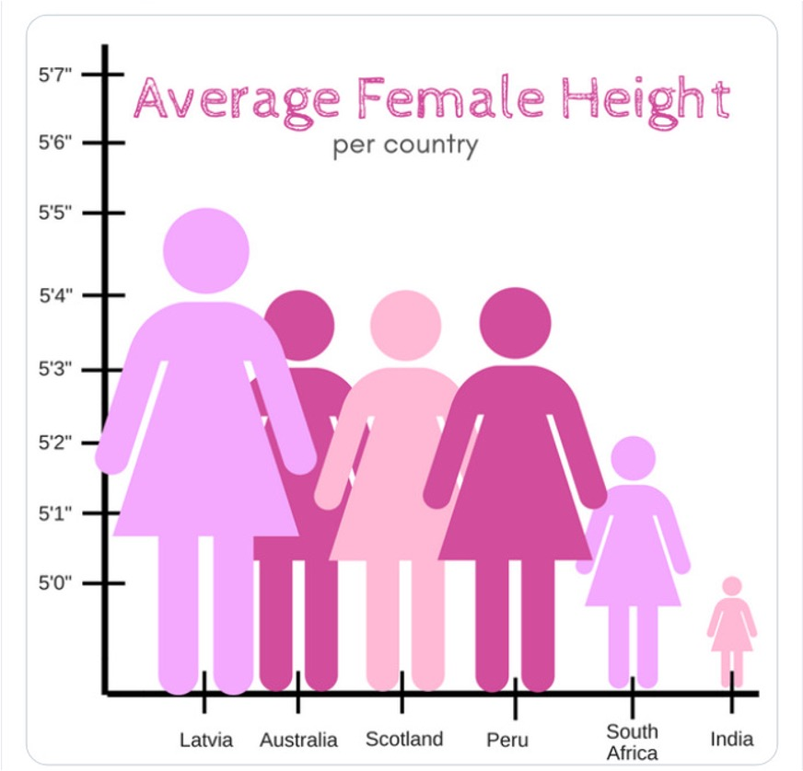
Principles of Good Visualization

Slide 6
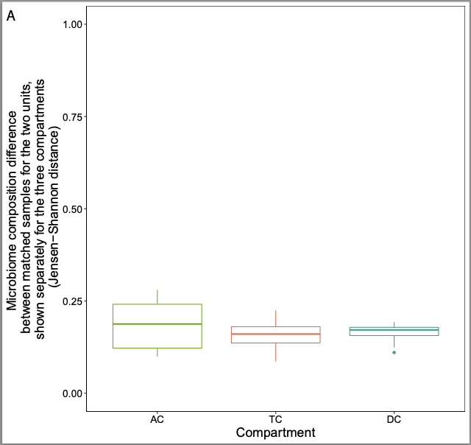
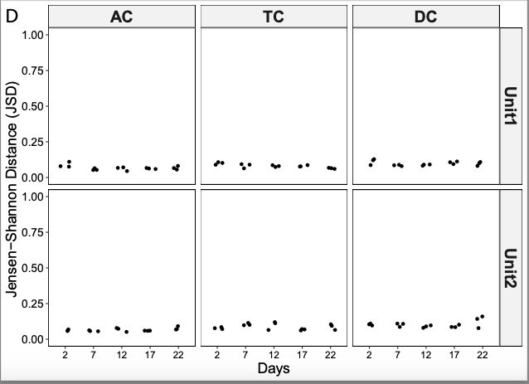

Principles of Good Visualization

Slide 7

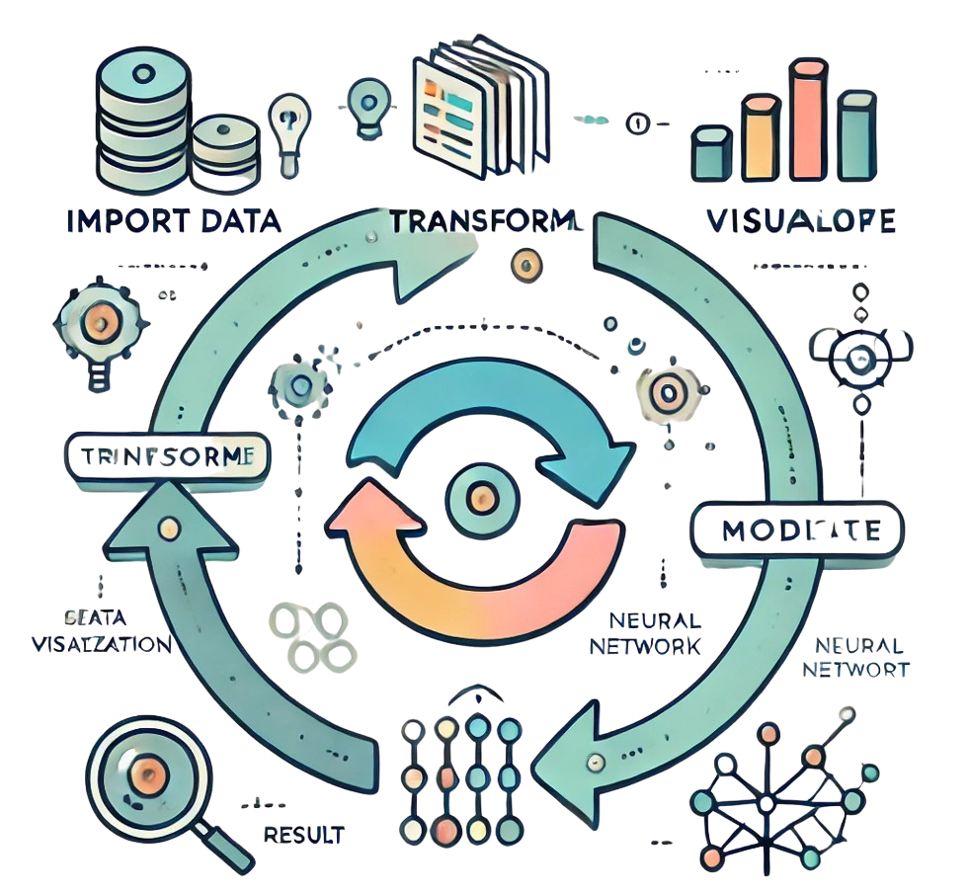
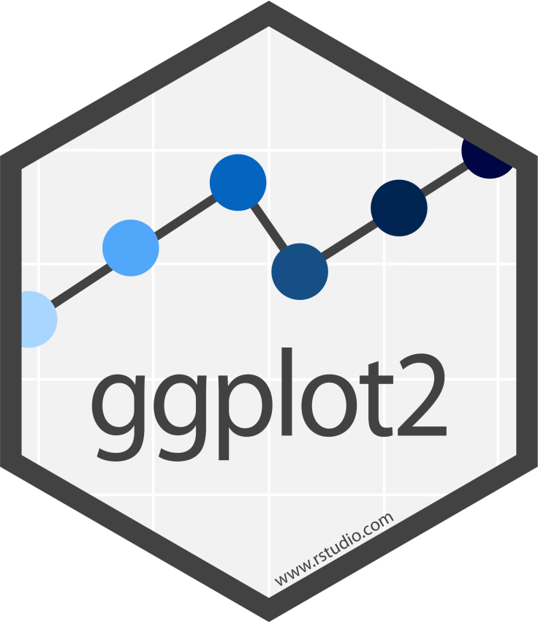


My real life in DataViz
Import
Transform
Visualize
Communicate

Slide 8
Grammar of Graphics: the importance of layering in visualizations:
Data: The foundation of your plot.
Aesthetics: Mapping data to visual properties like color, shape, or size.
Geometries: The visual marks (points, lines, bars) used to display data.
Scales: Translating data to visual dimensions.
Facets: Dividing data into subplots for clarity.
This approach ensures systematic, consistent, and reproducible visuals.
Exploration and Communication: Visualizations serve two purposes:
Exploration: To discover trends and outliers during data analysis.
Communication: To present findings in a compelling way.
Hadley Wickham
Notes:
Gemometric object

Slide 9
Making Coding Easier
Pipe: pronounced “then”
Reverse assignment operator: “creates”
alpha_info_tab %>%
filter(Study == "Exp1") ->
Exp1
Variable

Slide 10
You can’t do a good Plot without doing a bad Plot

Slide 11


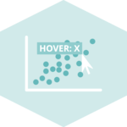


Slide 13
Hadley Wickham:
Grammar of Graphics: Data visualization is a structured process. In Wickham's work, particularly with tools like ggplot2, he emphasizes the importance of layering in visualizations:
Data: The foundation of your plot.
Aesthetics: Mapping data to visual properties like color, shape, or size.
Geometries: The visual marks (points, lines, bars) used to display data.
Scales: Translating data to visual dimensions.
Facets: Dividing data into subplots for clarity.
This approach ensures systematic, consistent, and reproducible visuals.
Exploration and Communication: Visualizations serve two purposes:
Exploration: To discover trends and outliers during data analysis.
Communication: To present findings in a compelling way.

