Slide 1


Processing of shotgun metagenomics samples
nf-core/taxprofiler together with Metaphlan v4 database
Genome-level marker gene based taxonomic classifier
Data Science platform
BRIGHT
Spring Data-type Courses
6th May 2026

Slide 2
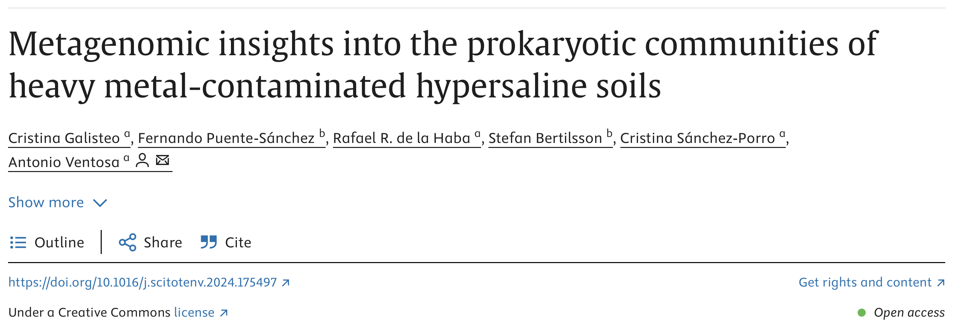
https://www.sciencedirect.com/science/article/pii/S004896972405647X
Saline soils and their microbial communities have recently been studied in response to ongoing desertification of agricultural soils caused by anthropogenic impacts and climate change.
In this study, they describe the prokaryotic microbiota of hypersaline soils in the Odiel Saltmarshes Natural Area of Southwest Spain.
This region has been strongly affected by mining and industrial activity and feature high levels of certain heavy metals.
18 shotgun metagenomes sequenced with Illumina NovaSeq from three different areas in 2020 and 2021.
Notes:
For our hands on part we are going to use the dataset presented in the following metagenomics study: Metagenomic insights into the prokaryotic communities of heavy metal-contaminated hypersaline soils.
Saline soils and their microbial communities have recently been studied in response to ongoing desertification of agricultural soils caused by anthropogenic impacts and climate change
Here they describe the prokaryotic microbiota of hypersaline soils in the Odiel Saltmarshes Natural Area of Southwest Spain.
This region has been strongly affected by mining and industrial activity and feature high levels of certain heavy metals.

Slide 3
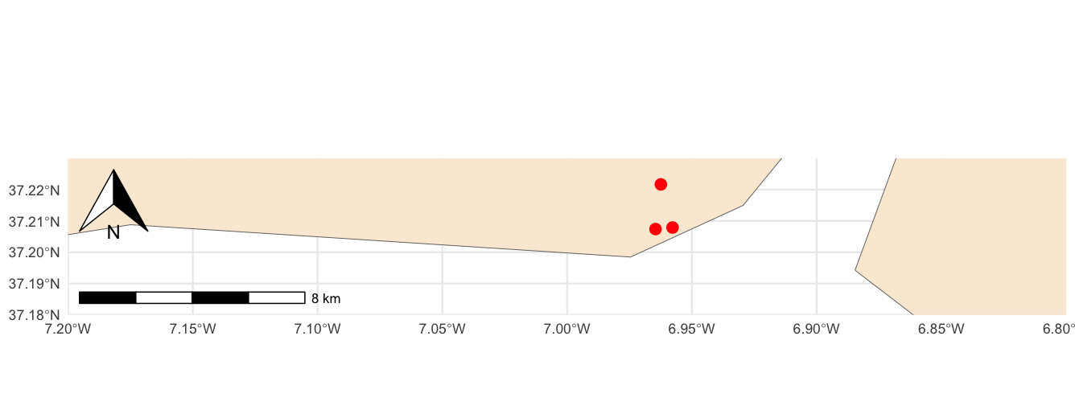
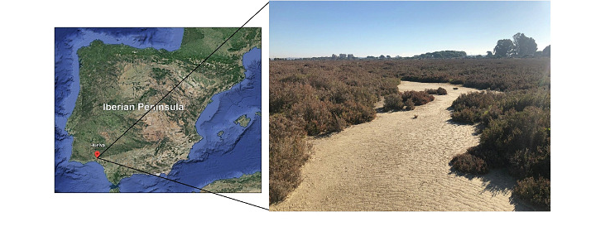
Sampling sites
Three sampling sites (1, 2 and 3) were selected in order to obtain a representative subset of the prokaryotic community of the soils from the Odiel Saltmarshes Natural Area

Slide 4
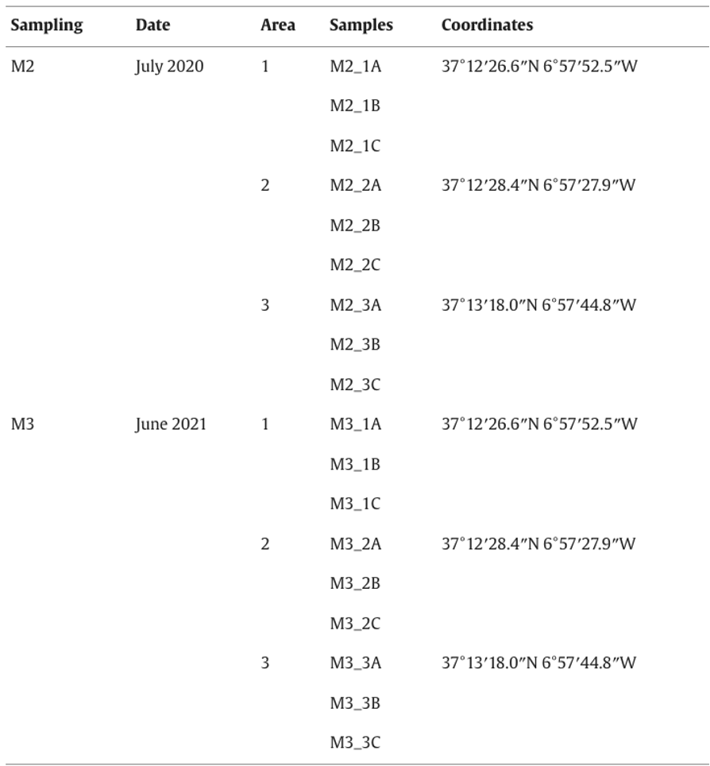
Sample table with some metadata:
Sampling dates (2)
Areas (3)
Coordinates
Sample names (n = 18)

Slide 5
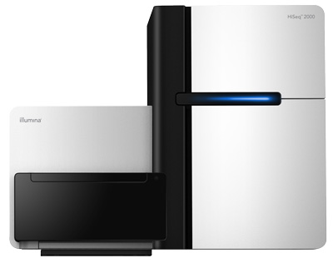
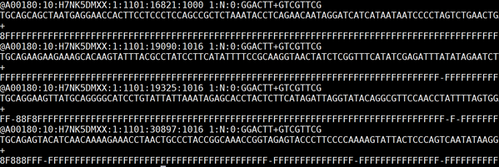
Processing metagenomics data – a fastq file
A00180 → instrument name
10 → run id
H7NK5DMXX → flowcell id
1 → flowcell lane
1101 → tile number within the flow cell line
16821 → x-coordinate of the cluster within the tile
1000 → y-coordinate of the cluster within the tile
SPACE
1 → member of the pair (if paired-end)
N → N if read is not filtered, Y if it is filtered
0 → when none of the control bit are on
GGACTT, GTCGTTCG → barcodes are used for demultiplexing
and assign reads to the correct sample
Four lines for each read:
identifier (starting with @)
Read sequence
a line starting with + (sometimes id gets repeated)
Phred quality scores representing the base-caller’s confidence – equal in length to the read sequence

Slide 6
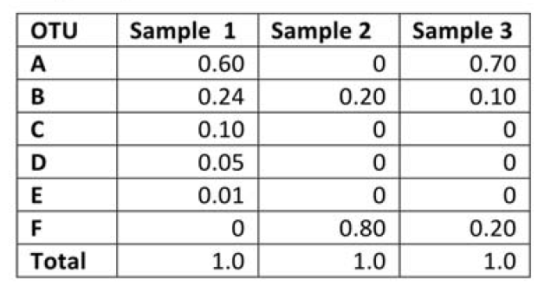

Repeating steps too many times? – find yourself a pipeline!
Abundance table for downstream analysis
Series of steps in an specific order
Nextflow is a language to build workflows and a software to orchestrate workflows execution.
Different steps to run manually in an order (QC, host removal, mapping to a database, etc…)
Workflow that contains all the processes needed and have them chained
Strong community behind with various bioinformaticians joining forces to build each of the pipelines
Support for other technologies

Slide 7

Nextflow’s core features
Reproducible between runs
integration with code management tools
all packages downloaded, organized in containers, and control over computing environment
Portable between systems
you can write the code in your laptop and can run everywhere (HPC, cloud)
works with most of computing environments
Scalable
it can run for 10 samples on your laptop or thousands in the cloud
Integration of existing tools, systems, and industry standards

Slide 8

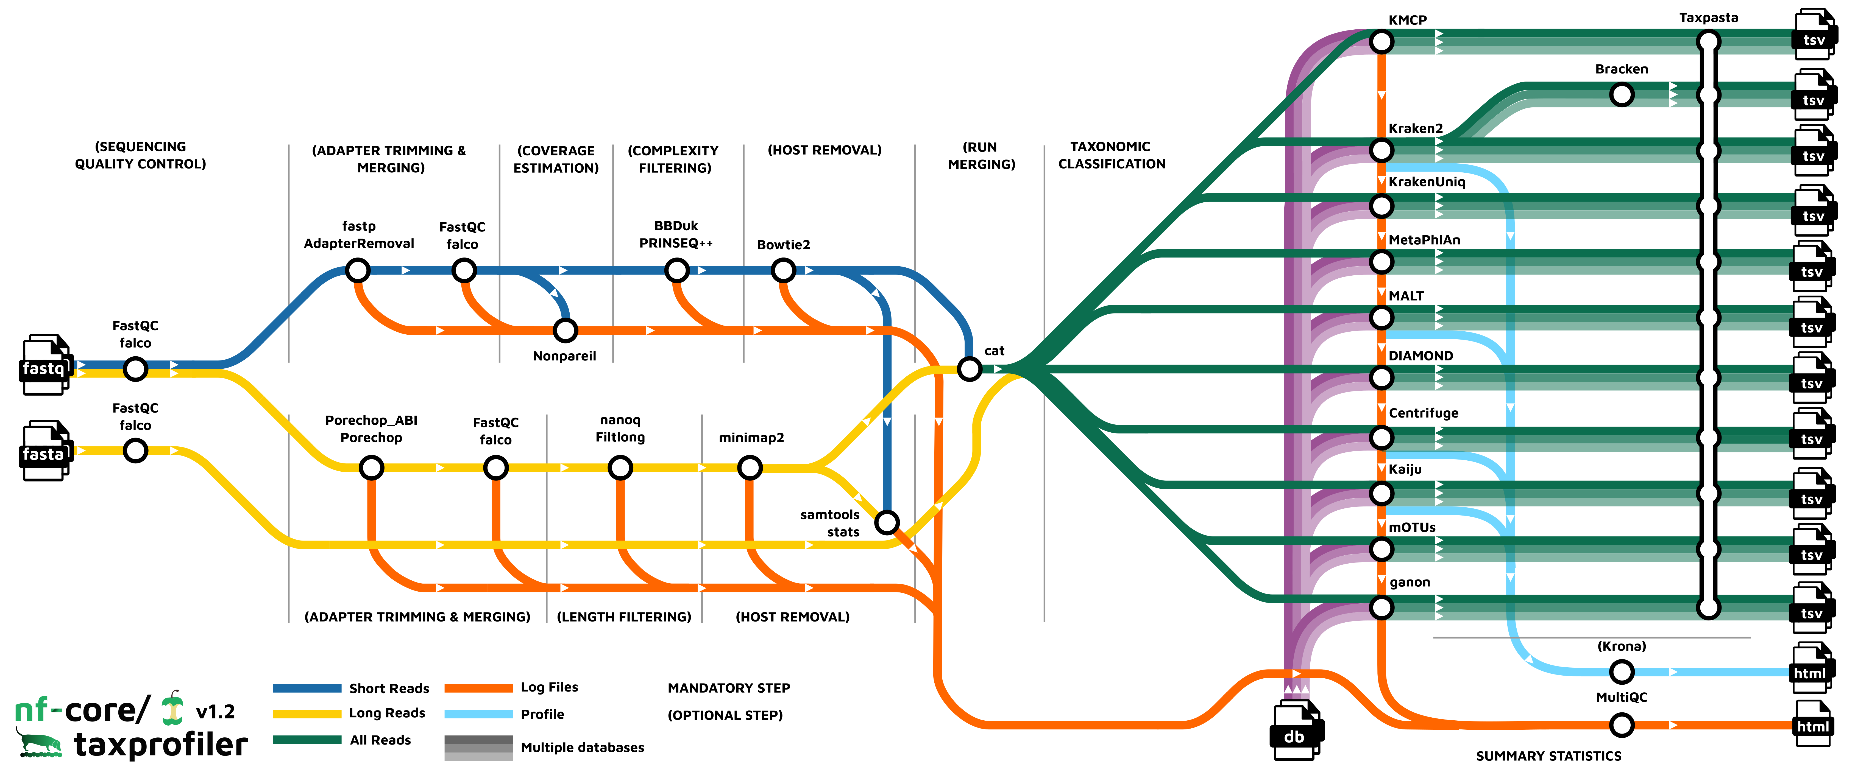
A global community effort to collect a curated set of open‑source analysis pipelines built using Nextflow. https://nf-co.re/
https://www.nature.com/articles/s41587-020-0439-x
149 pipelines available (2nd May 2026)
for 149 different bioinformatic analysis
Modules: 1,811 reusable components that can be integrated into pipelines
Subworkflows: 117 pre-assembled combinations of modules aimed at streamlining commonly used workflows

Slide 9
nf-core/taxprofiler
Reference-based taxonomical profiling

Slide 10
Command line to run the pipeline
nextflow run nf-core/taxprofiler -profile test,docker --outdir processed_data
nf-core/taxprofiler → nf-core pipeline downloaded from here: https://github.com/nf-core/taxprofiler/tree/2.0.0
“test” → running for demonstration few reduced samples, each pipeline has a test dataset (in a github repo, so we do not have to specify the input files this time)
“docker” → using Docker containers for reproducibility
--outdir → our results folder
Wanna know more about Nextflow: https://biosustain.github.io/dsp_nextflow_training/

