Slide 1
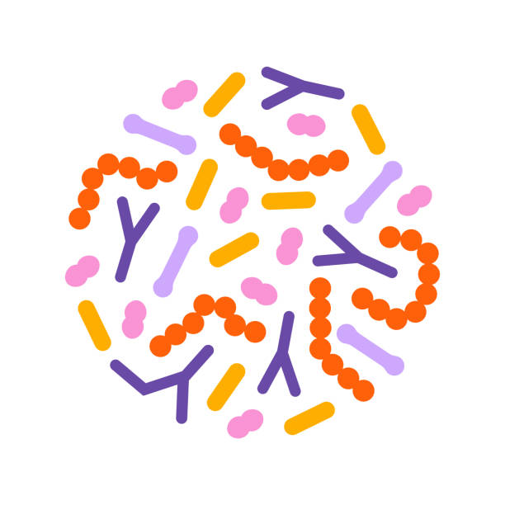

Introduction to Metagenomics
Data Science platform
BRIGHT
Spring Data-type Courses
6th May 2026

Slide 2
Impact of microbiome studies in medical and planetary health
Notes:
In these first slides I am going to give examples of the impact of microbiome studies on the fields of medical health and planetary health

Slide 3
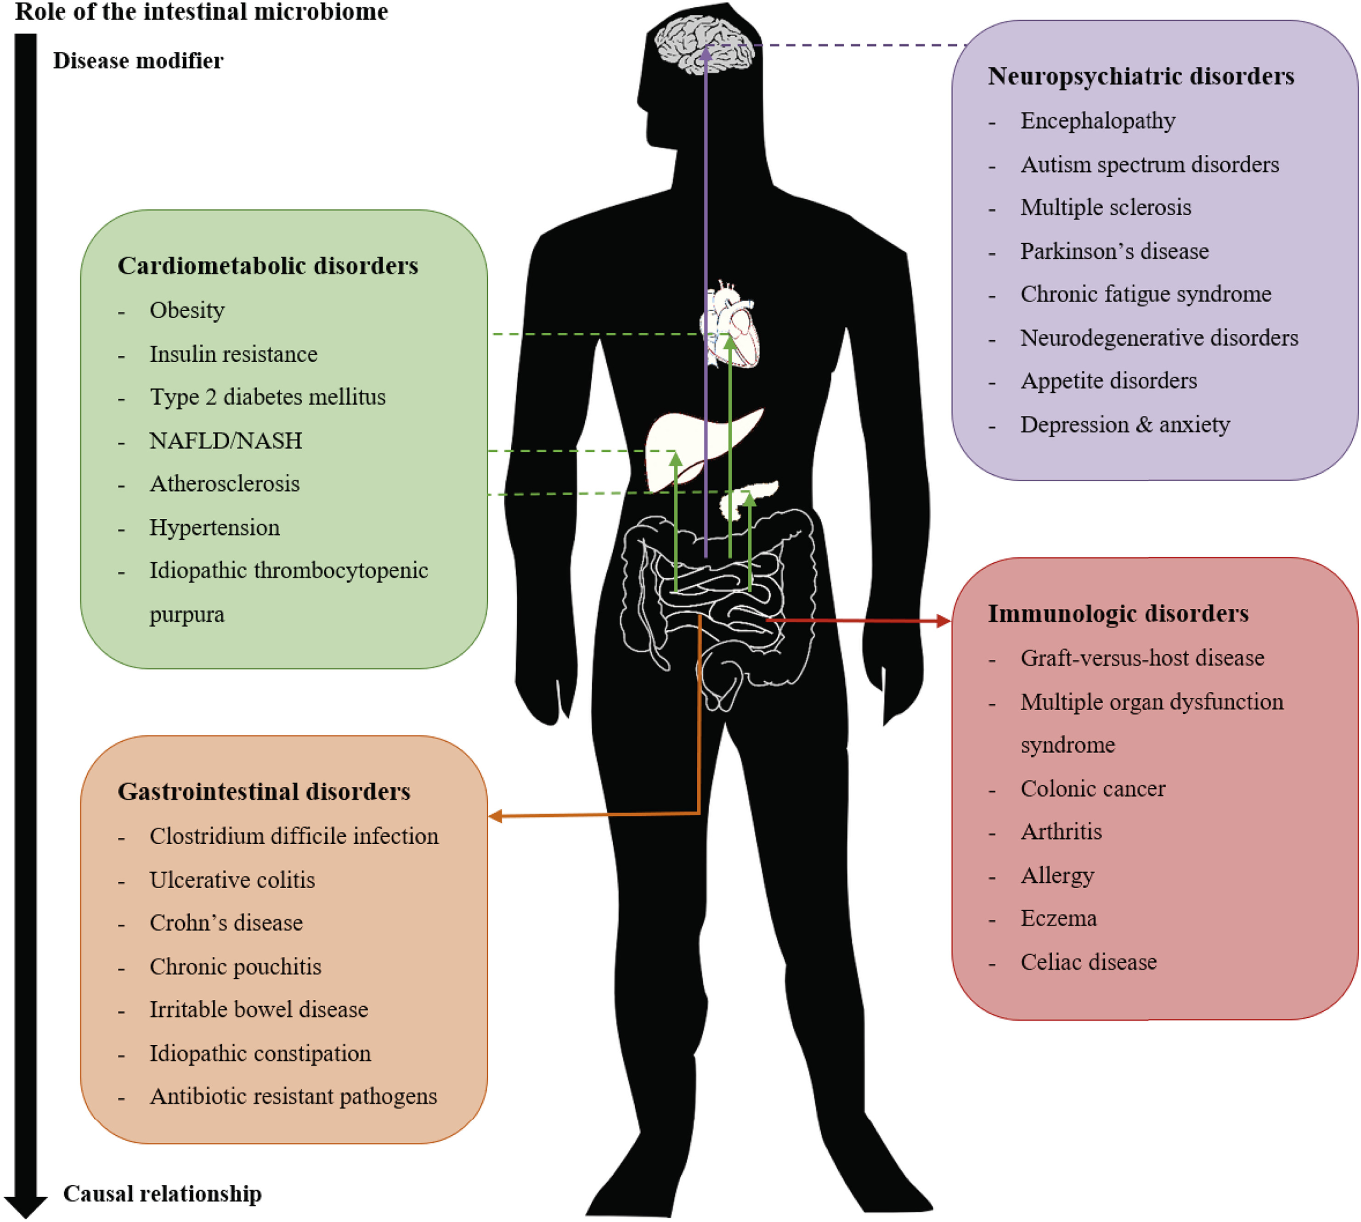
Microbiome has been associated with a variety of diseases
Microbiota: cause or consequence of the disease?
For some diseases it may also be a disease modifier or may metabolize the drugs administered to the diseased individuals
Notes:
Over more than a decade microbiome has been associated to a variety of disease becoming a really hot topic in science as it could be the target for disease treatments
Examples
For most of the diseases it is not known whether the microbiota is the cause or the consequence of the disease
For some diseases it may also be a disease modifier or may metabolize the drugs administered to the diseased individuals

Slide 4
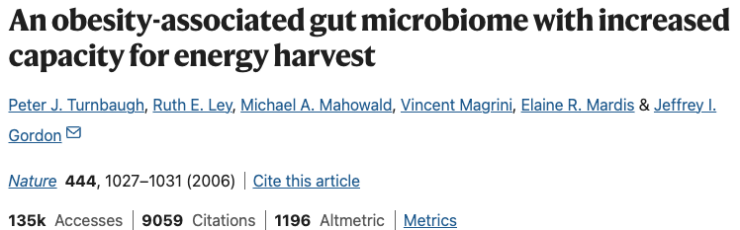
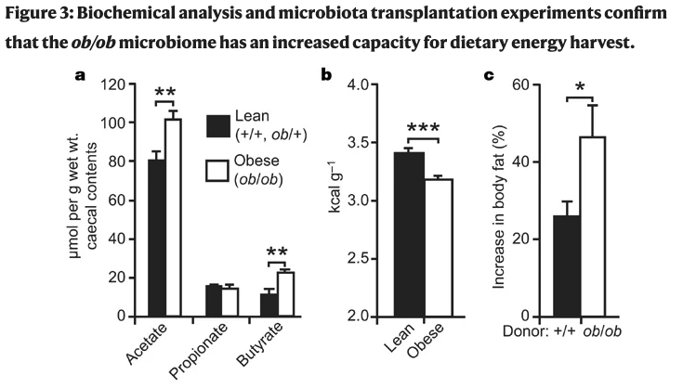
Obesity associated gut microbiome – a transmissible trait
https://doi.org/10.1038/nature05414
Obese mice had an increased capacity to harvest energy from the diet
The trait is transmissible! Colonization of germ-free mice with an ‘obese microbiota’ resulted in a significantly greater increase in total body fat than colonization with a ‘lean microbiota’
Genetically obese mice had an increased concentration of the major fermentation end-products: butyrate and acetate
They also had significantly less energy remaining in their faeces
Germ-free mice colonized with an obese mice microbiota exhibited significantly greater increase in body fat
Notes:
In one of the pioneering studies, P. Turnbaugh and Ruth Ley showed that obesity was associated to gut microbiome. Microbiome from obese mice had higher capacity to harvest energy from the diet, and less energy left in their feces
They also showed that the trait was transmissible! Colonization of germ-free mice with an ‘obese microbiota’ results in a significantly greater increase in total body fat than colonization with a ‘lean microbiota’

Slide 5
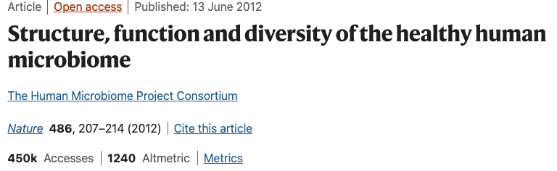
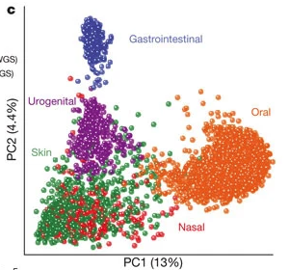
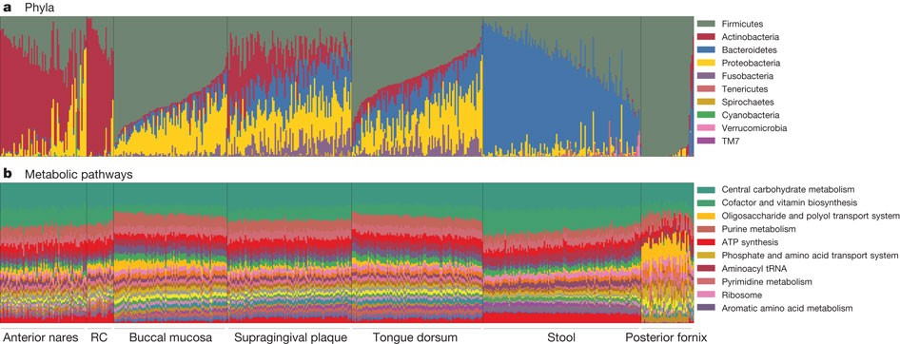
The Human Microbiome Project (HMP)
https://doi.org/10.1038/nature11234
Great initial resource to study the microbiome (based on thousands of samples)
Diversity of the human microbiome is concordant among measures, unique to each individual, and strongly determined by microbial habitat
Carriage of microbial taxa varies while metabolic pathways remain stable within a healthy population
Notes:
Few years later the Human Microbiome Project from US published their data based on thousands of samples which constituted a great resource to study the microbiome
They showed that diversity of the human microbiome is concordant among measures, unique to each individual and strongly influenced by habitat.
They also reported that carriage of different taxa varies among individuals while metabolic pathways remain more stable within a healthy population

Slide 6
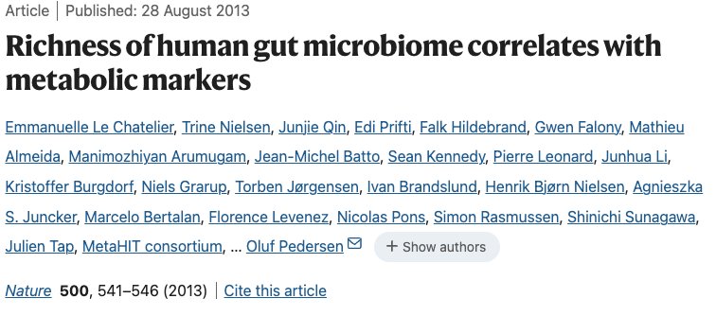
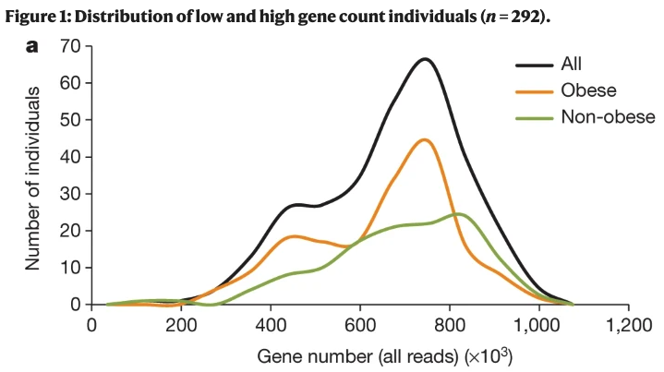
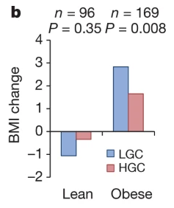
Richness of human gut microbiome correlates with metabolic markers (lessons of MetaHIT study)
10.1038/nature12506
Individuals with a lower bacterial gene richness were characterized by more marked overall adiposity, insulin resistance and dyslipidaemia and a more pronounced inflammatory phenotype
Individuals with lower number of genes (gene richness) and higher BMI had less efficient weight loss when following a diet
Notes:
Meanwhile the analogous European initiative called MetaHIT consortium published their data showing that bacterial richness correlated with metabolic markers
More precisely, individuals with a low bacterial gene richness are characterized by more marked overall adiposity, insulin resistance and dyslipidaemia and a more pronounced inflammatory phenotype when compared with high bacterial richness individuals
Individuals with lower number of genes (gene richness) and higher BMI had less efficient weight loss when following a diet
So diversity could be related to health markers!

Slide 7
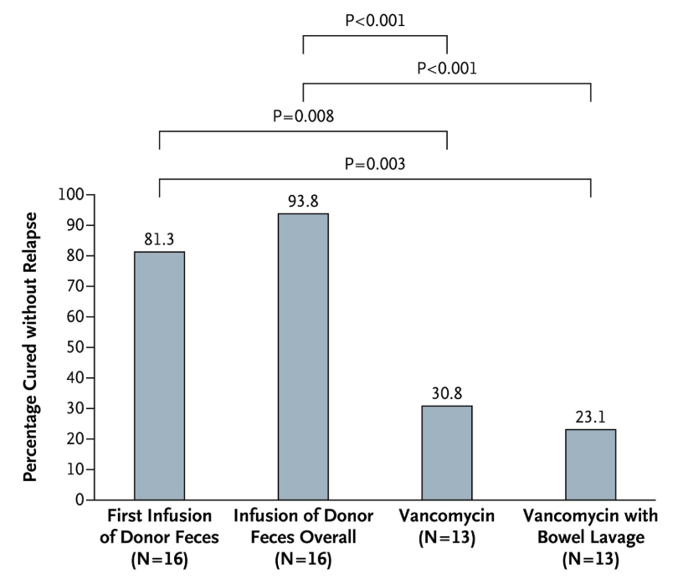
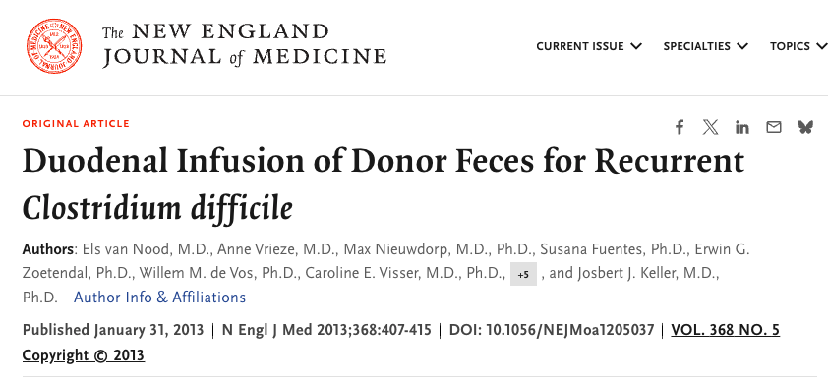
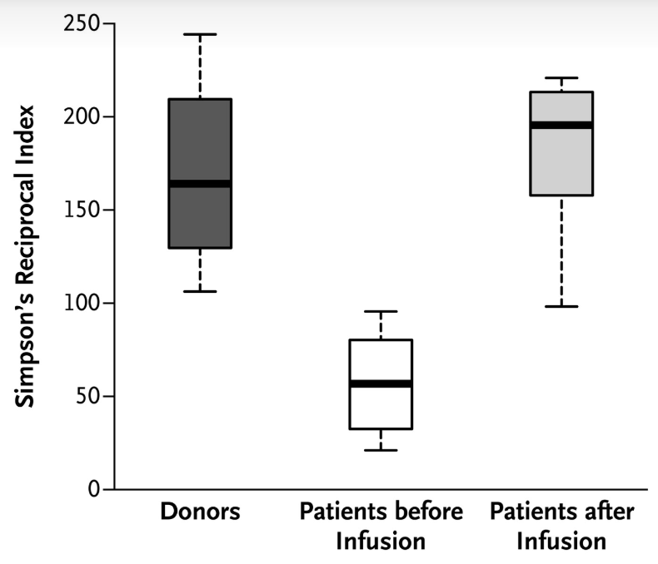
Fecal material transplantation (FMT) as experimental cure for Clostridioides difficile
10.1056/NEJMoa1205037
FMT succesfully used to cure Clostridioides difficile infection with higher percentages of cured patients without relapse compared to the standard treatment (vancomycin)
Diversity (Simpson’s index) of patients after FMT resemble more the donors diversity
Notes:
Probably you have heard about microbial therapies? Probiotics, prebiotics, … and one of the most promising ones is a fecal material transplantation where the microbiota of a healthy donor is encapsulated in a pill that is given to a sick patient (the recipient) to restore the patient microbiome and cure the disease or alleviate symptoms This has been succesfully used to cure Clostridioides difficile infection with higher percentages of cured patients without relapse compared to the standard treatment (vancomycin).
Diversity (Simpson’s index) of patients after FMT resemble more the donors diversity
It has been tried in other disesases like IBD and cancer with different rates of success.

Slide 8
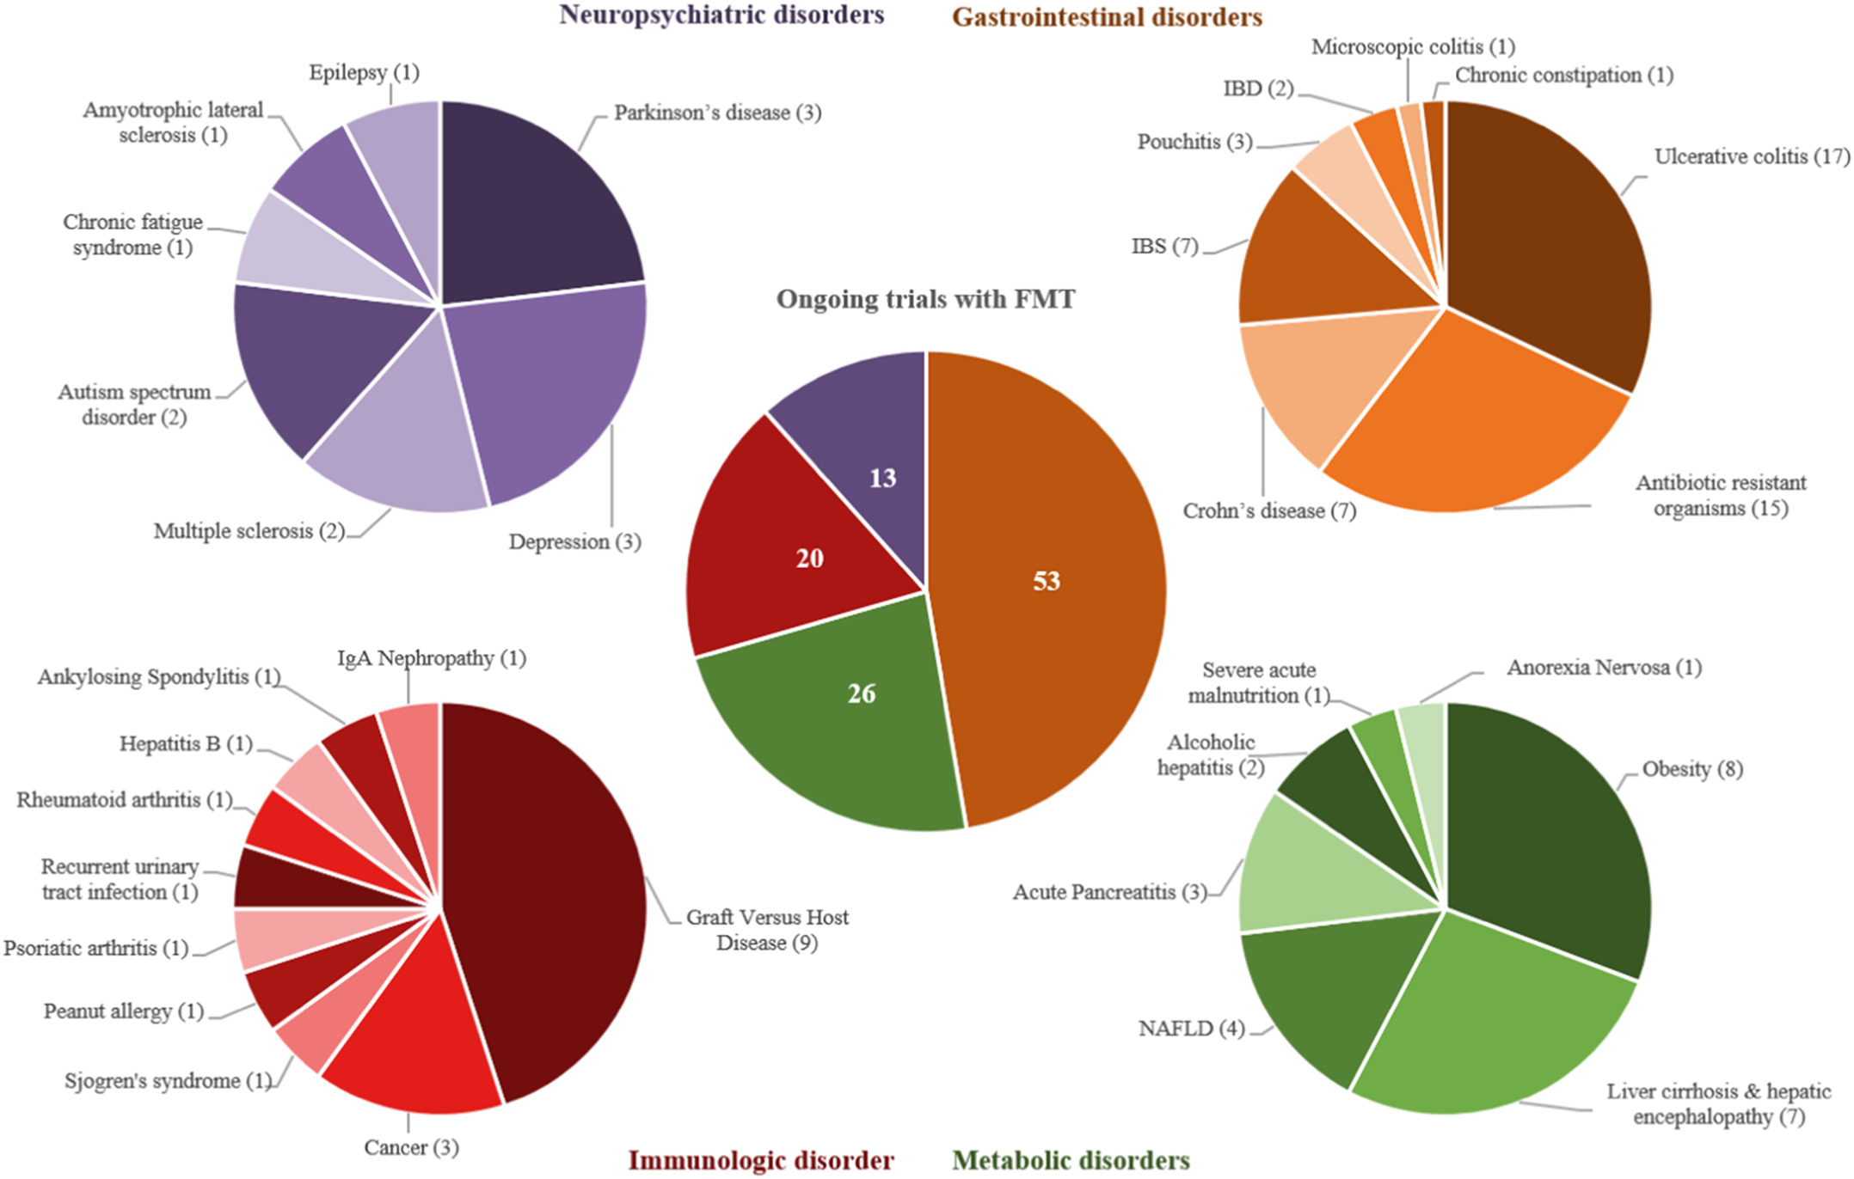
Notes:
So for you to get an idea of how promising is this therapy here is an overview of ongoing clinical trials in which the efficacy of FMT is tested for a range of different diseases

Slide 9
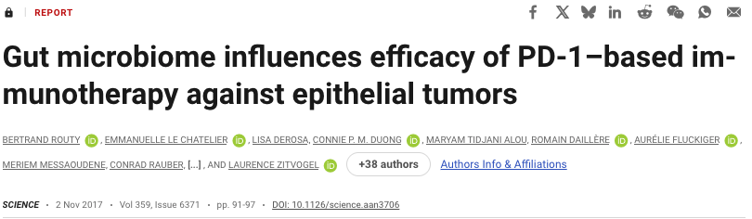
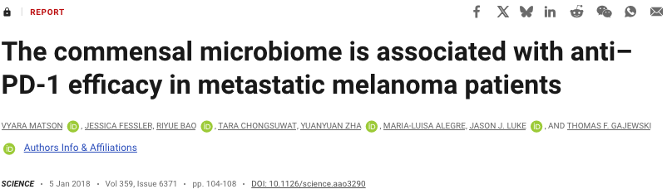
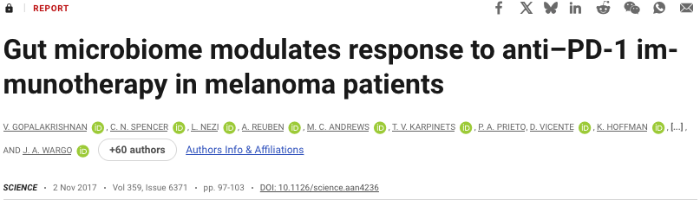
Resident gut bacteria can affect patient responses to cancer immunotherapy
In a series of back-to-back papers in Science:
Routy et al. showed that higher abx consumption --> poorer response to cancer immunotherapy (immunotherapeutic PD1 blockade)
Observed low levels of Akkermansia muciniphila in lung and kidney cancer patients → oral supplementation of this bacteria to abx-treated mice restored response to immunotherapy
Matson et al. and Gopalakrishnan et al. studied melanoma patients receiving PD-1 blockade and found a greater abundance of “good” bacteria in the guts of responding patients.
Non-responders had an imbalance in gut microbiota composition, which correlated with impaired immune cell activity.
DOI: 10.1126/science.aan3706
DOI: 10.1126/science.aao3290
DOI: 10.1126/science.aan4236
Notes:
Finally to conclude the papers related to medical health, I wanted to highlight a series of back to back papers in Science showing how gut bacteria can affect patient responses to cancer immunotherapy
Basically these papers demonstrated better reponse to cancer immunotherapy on patients with higher gut microbiome diversity or presence of good key bacteria in their guts and worse responses on lower diversity or imbalanced microbiomes.

Slide 10
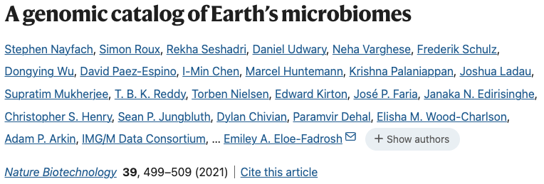
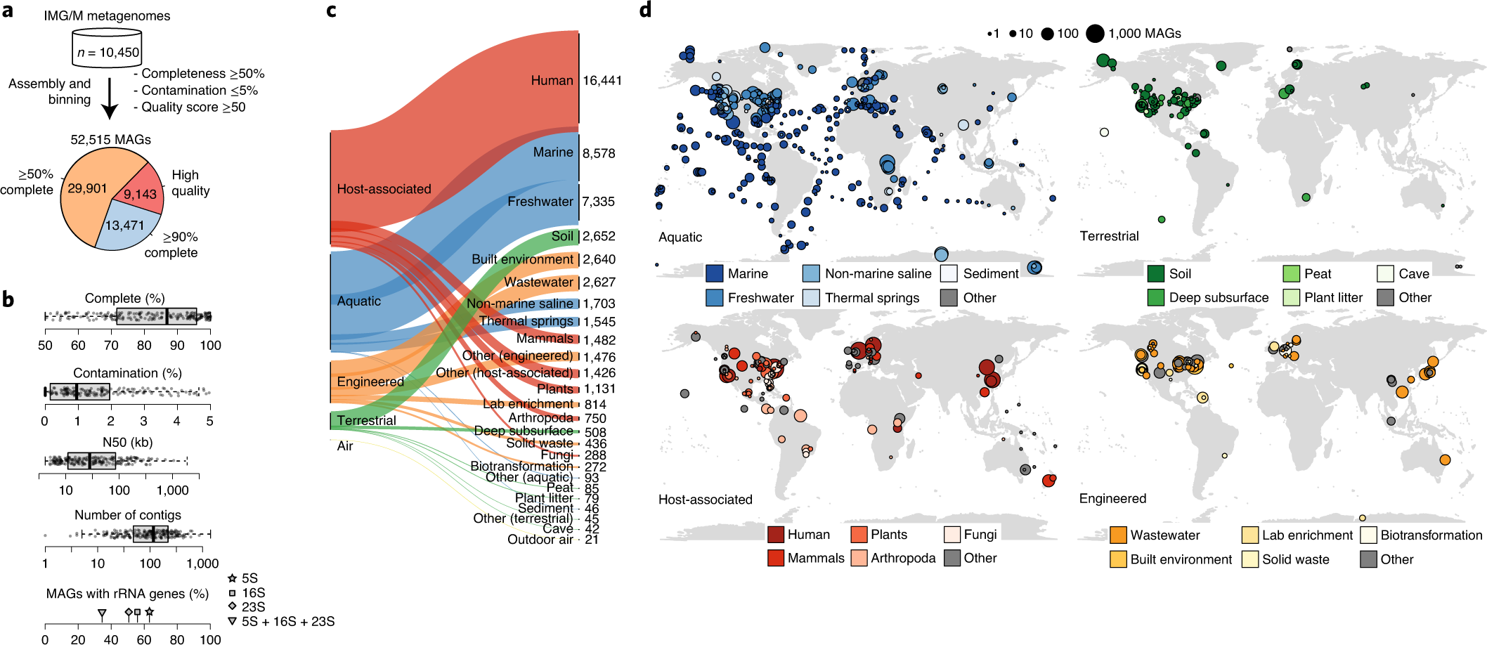
A genomic catalog of Earth’s microbiome
>10,000 metagenomes collected from diverse habitats comprising host associated, aquatic, terrestrials, air and engineered microbiomes
52,515 metagenome-assembled genomes representing 12,556 novel candidate species from 135 different phyla
The catalog allows metabolic modelling, understanding secondary-metabolite biosynthetic potential and resolving thousands of new host linkages to uncultivated viruses
https://doi.org/10.1038/s41587-020-0718-6
Notes:
Now let’s have a look to impactful microbiome studies in planetary health. Few years ago, it was published the first genomic catalog of the Earth’s microbiome with more than 10,000 samples collected from diverse habitats comprising host associated, aquatic, terrestrials, air and engineered microbiomes
To give an idea of the volume of data reported:
52,515 metagenome-assembled genomes representing 12,556 novel candidate species from 135 different phyla
The catalog allows metabolic modelling, understanding secondary-metabolite biosynthetic potential and resolving thousands of new host linkages to uncultivated viruses

Slide 11
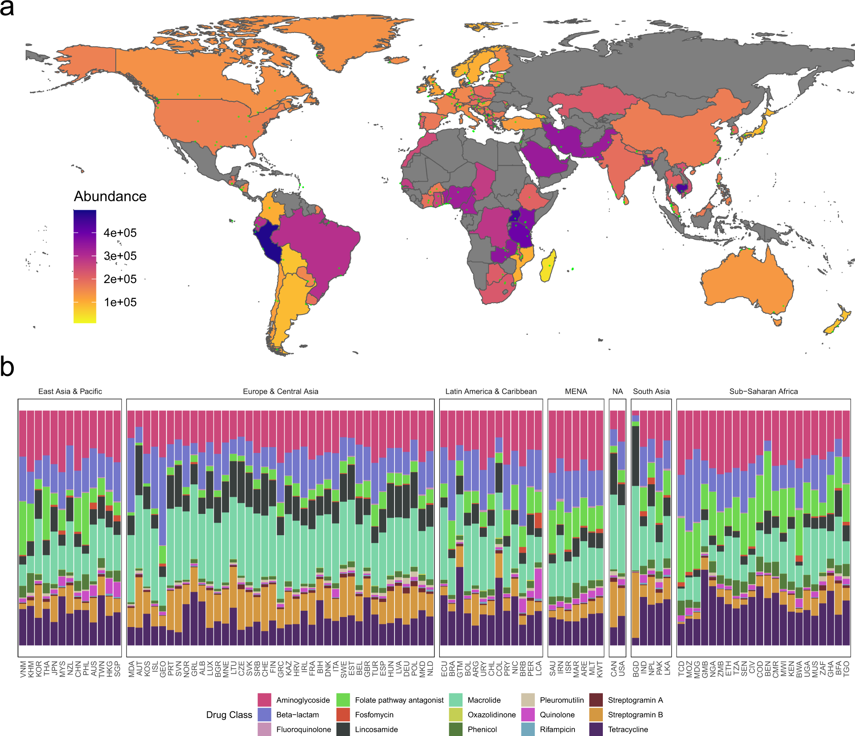
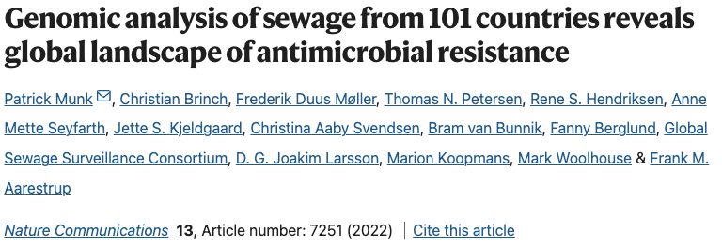
Antimicrobial resistance is a major threat to global health!
https://doi.org/10.1038/s41467-022-34312-7
The global resistome based on sewage-based monitoring
Metagenomic samples revealed regional patterns reflecting taxonomical changes
Understanding the emergence, evolution, and transmission of individual antibiotic resistance genes (ARGs) is essential to develop sustainable strategies to fight this threat
Notes:
Another type of microbial study, resistome analysis. I am sure you must have heard that Antimicrobial resistance is a major threat to global health mostly due to the abuse of antibiotic prescription and the utilization of antibiotics on agriculture and farming
Our colleagues from DTU Food in collaboration with The Global Sewage Surveillance consortium worked on a global resistome based on sewage-based monitoring, where they could describe the ARG abundance around the world revealing regional patterns reflecting taxonomical changes
Understanding the emergence, evolution, and transmission of individual antibiotic resistance genes (ARGs) is essential to develop sustainable strategies to fight this threat
Fig b. Stacked bar chart of relative abundances per drug class per country. Each panel represent countries in a World Bank region and is ordered by the Shannon diversity of class-level AMR.

Slide 12
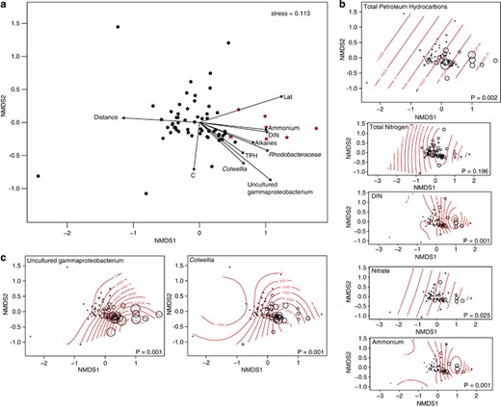
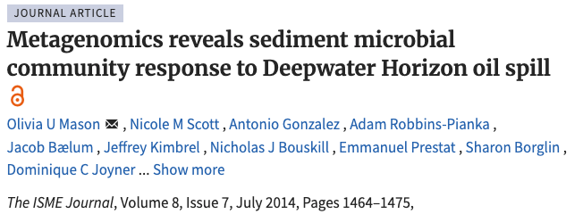
Microbial community at the Deepwater Horizon oil spill site
https://doi.org/10.1038/ismej.2013.254
Metagenomic Analysis of sediment samples from 64 sites in the Gulf of Mexico, characterizing microbial community's response to the oil spill
Uncultured Gammaproteobacterium and Colwellia species were enriched in oil-impacted sediments (hydrocarbon degradation)
An increase in genes associated with hydrocarbon degradation pathways (aliphatic and aromatic hydrocarbon breakdown), indicating adaptive microbial response to oil contamination
The study emphasized the importance of microbial communities in natural bioremediation processes.
Notes:
Another very interesting study was the study of microbial communities at the Deepwater Horizon oil spill site In this Metagenomic Analysis of sediment samples from 64 sites in the Gulf of Mexico, characteryzing the microbial community's response to the oil spill.
They found that Uncultured Gammaproteobacterium and Colwellia species, that were enriched in oil-impacted sediments, highlighting their roles in hydrocarbon degradation
Also an increase on the abundance of genes associated with hydrocarbon degradation pathways, including those involved in aliphatic and aromatic hydrocarbon breakdown, indicating an adaptive microbial response to oil contamination.
The study emphasized the importance of microbial communities in natural bioremediation processes.

Slide 13
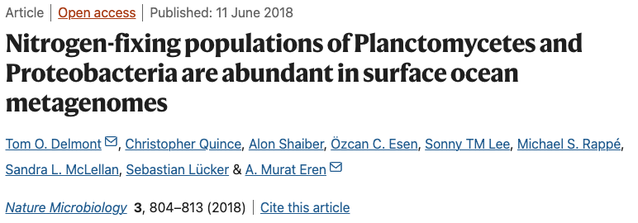
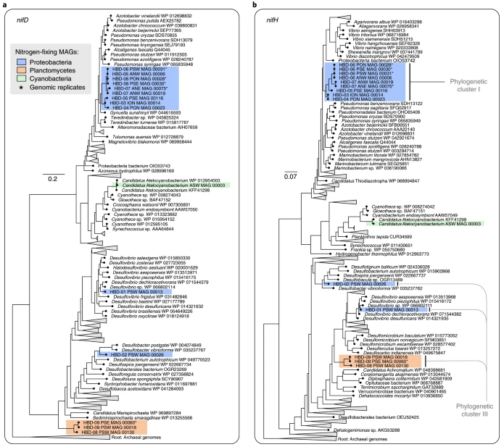
Global ocean microbiome (Tara oceans)
https://doi.org/10.1038/s41564-018-0176-9
Characteryzed ~1,000 non-redundant microbial genomes from the TARA Oceans sites
Nitrogen fixation in the surface ocean impacts global marine nitrogen bioavailability and therefore the microbial primary productivity
Usually done by cyanobacteria, but non-cyanobacterial diazotrophs inhabiting surface waters of the open ocean (lineages within the Proteobacteria and Planctomycetes) have also the functional potential (nifD, nifH)
Notes:
And the final example of this section is the Global ocean microbiome within the Tara Oceans initiative
They Characteryzed ~1,000 non-redundant microbial genomes from the TARA Oceans metagenomes
Nitrogen fixation in the surface ocean impacts global marine nitrogen bioavailability and thus microbial primary productivity Usually this is done by cyanobacteria but in this study they described Non-cyanobacterial diazotrophs inhabiting surface waters of the open ocean, which correspond to lineages within the Proteobacteria and Planctomycetes have also the functional potential (nifD, nifH)

Slide 14
What is metagenomics?
Notes:
Now we are going to define what is metagenomics

Slide 15
Microbiome definition
Notes:
WHO do you expecto to find in a microbiome? WHERE do you expect to find microbe communities?
What other products you can find in a microbiome sample?

Slide 16
Microbiome definition
Microbiome refers to an microbial community in an specific environment
Organism products:
Genes
Proteins
Pathways
Metabolites
Inhabitants:
Bacteria
Archaea
Fungi
Viruses
Protozoa
…
Environment:
Soil
Ocean
Wastewater plant
Gut
Skin
…
In contrast to a monoculture (all cells belong to one organism), in a microbiome we have cells of many different organisms → microbial community

Slide 17

What a microbiome study usually answer?

Slide 18
What a microbiome study usually answer
Who is living in this habitat?
What is the relative proportion of the different members
What is the total abundace (number of cells) (by absolute abundace)
How abundant are bacteria, archaea, protozoa, virus,…
How diverse is the microbial community (diversity indices)
How evenly distributed is it?
What are these organisms doing?
What functions potentially do they perform?
What substrates they consume?
What metabolites they produce?
How do they perform their activities?
Which genes and/or pathways are present?

Slide 19
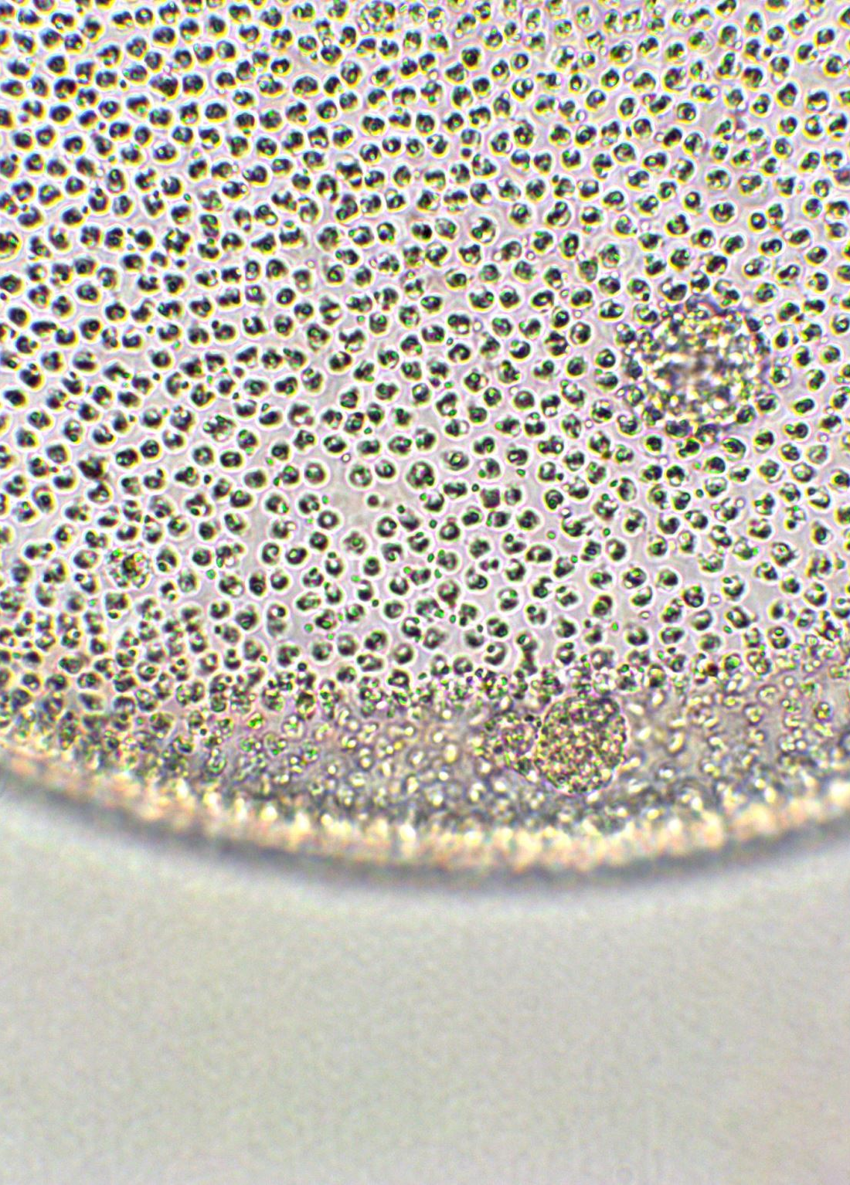
What is Metagenomics?
Study of the genetic material sampled directly from the environment (fecal, skin, soil, marine,… samples)
No need of culturing organisms – many of the organisms that we characterize can not even be cultured – we can study all the organisms in the microbial community
Based on high-throughput DNA sequencing technology to analyze microbial diversity, taxonomic and functional profiles, and microbial interactions
Notes:
Study of the genetic material sampled directly from the environment (fecal, skin, soil, marine,… samples)
No need of culturing organisms – many of the organisms that we characterize can not even be cultured –
we can study all the organisms in the microbial community
Uses high-throughput DNA sequencing technology to analyze microbial diversity, taxonomical and functional profiles, and microbial interactions

Slide 20
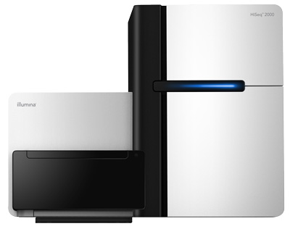
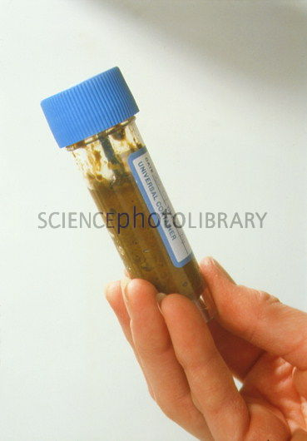
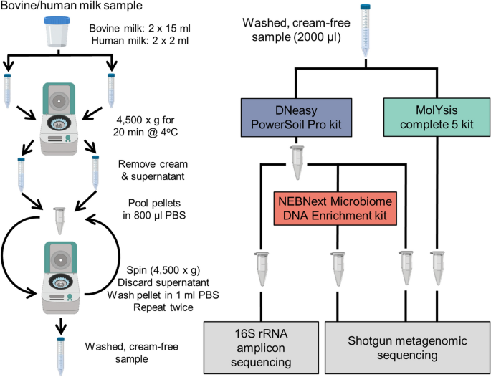
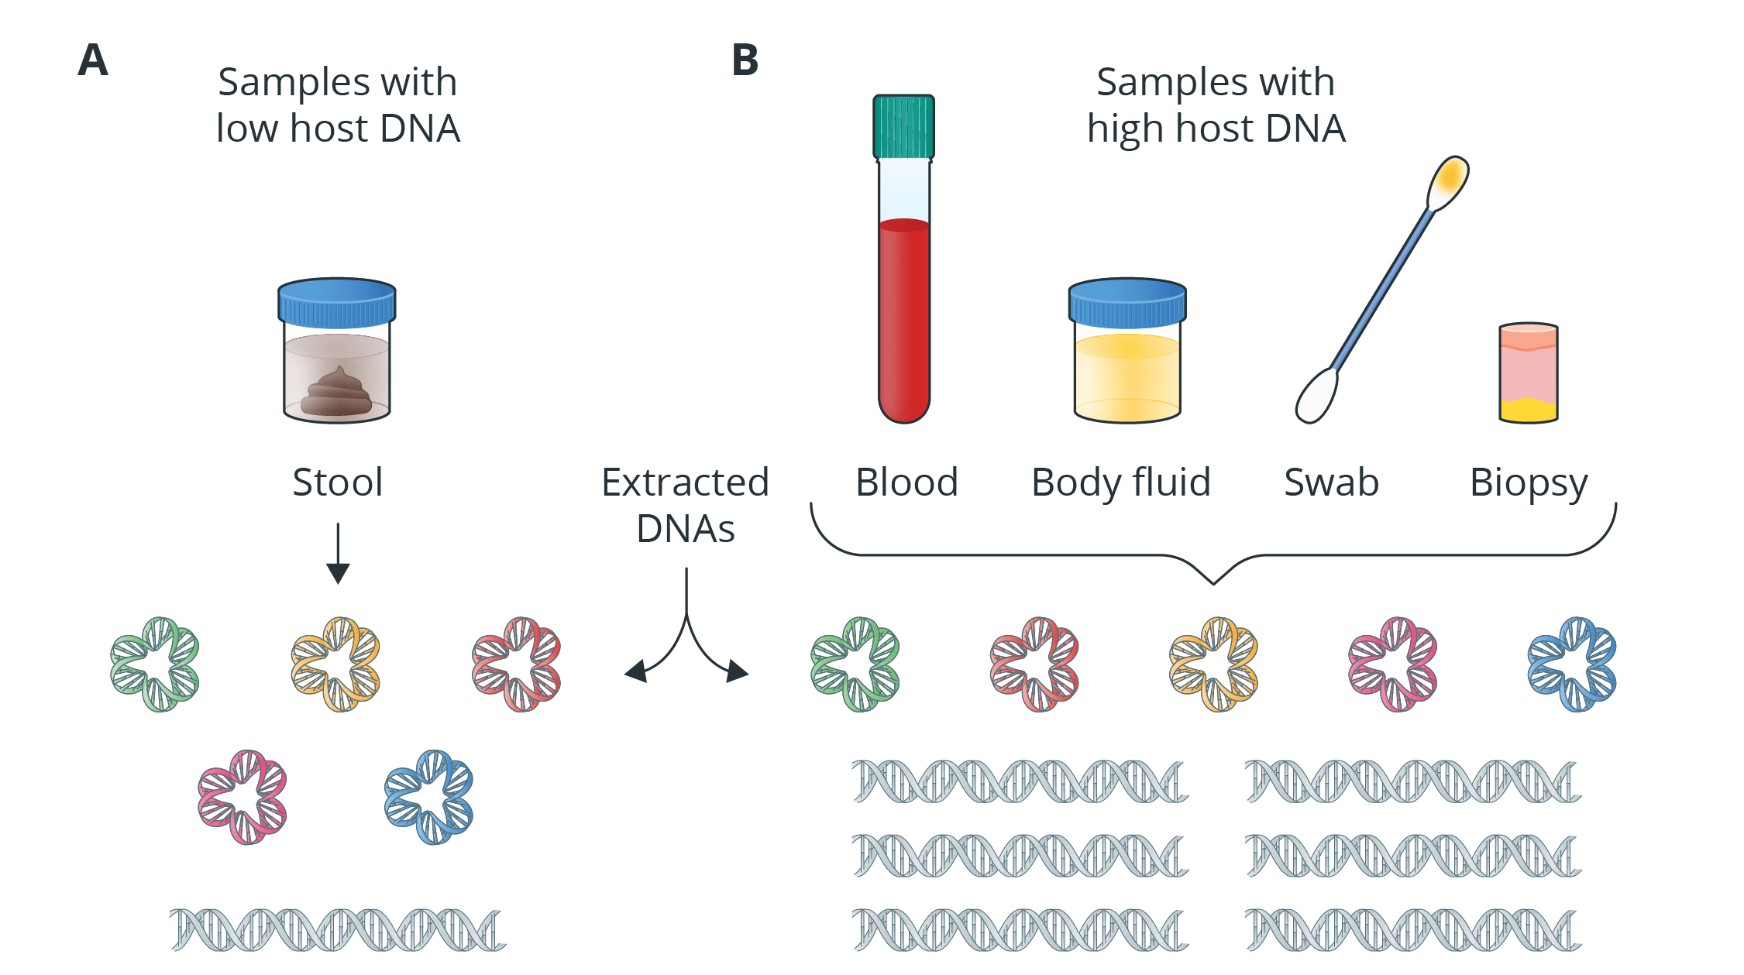
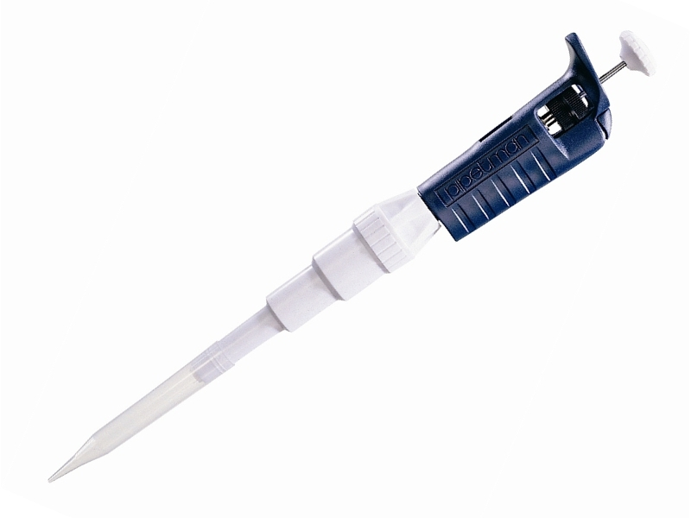
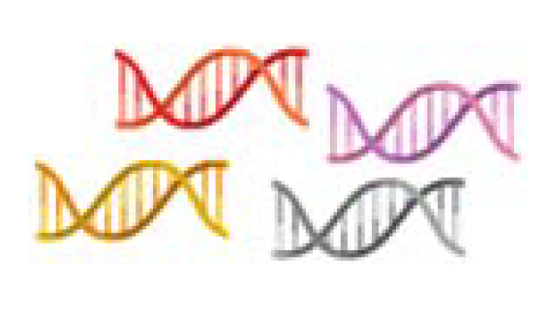

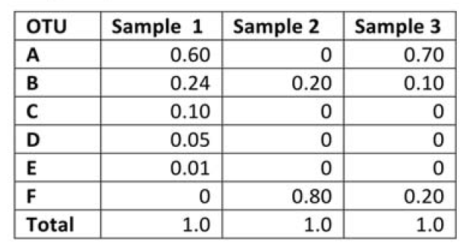

Experimental design
DNA Sequencing
library prep: fragmentation, end repair, adapter ligation
DNA Sampling
spatula, swabs, filtration units, soil cores,…
DNA Storage
freezing, preservation buffers,…
DNA Extraction
Kits to lyse the cells and release the DNA
Microbiome abundances
Taxonomical and functional characterization of the sequenced reads (fastQ files)
Data Analysis
Notes:
The usual experimental design in metagenomics:
First sampling of DNA. DNA sampling tools vary depending on the source material and the application
After DNA storage is important, the best thing you can do is freeze the DNA as soon as possible, otherwise you can use preserving buffers
Then it will come the DNA Extraction, where different kits are commonly used.
Then prior to DNA sequencing in the library preparation the Dna is fragmented into small reads of the same length, end are repaired and adapters are ligated. Then sequencing starts!
Once is finished the sequencer provider or our colleagues will pass us the fastq files containing the reads and we can do the taxonomical and functional characterization to get an abundance table
Here taxa will be in the rows and samples in the columns
And this is the starting point of our downstream analysis

Slide 21
Sample collection
To obtain a representative and uncontaminated snapshot of a microbial community in a specific environment (e.g., gut, soil, water, skin,…)
Sterile tools and containers need to be used
Microbial DNA can degrade rapidly. A good preservation ensures the microbial community structure remains as close to in situ as possible.
Freezing (-20 to -80C) for long-term storage
Preservation buffers if freezing is delayed
For sample transportation use cold chain logistics (ice packs, dry ice, liquid nitrogen)
Label clearly with metadata: time, location, environmental conditions, etc.
Important for downstream analysis and reproducibility

Slide 22
DNA Extraction
To obtain high-quality, unbiased, and inhibitor-free DNA from a complex matrix (e.g., soil, feces, water)
Isolate total microbial DNA from all organisms in a sample (bacteria, archaea, fungi, viruses—depending on context)
Steps:
Cell Lysis: The goal is to lyse all types of microbes, including tough ones like Gram-positive bacteria or spores.
Mechanical disruption (Bead beating)
Chemical/enzymatic lysis (detergent/enzyms (lysozyme, proteinase K, Rnase)
Kits are preferred in metagenomics for consistency, ease, and reduced contamination risk (e.g., Qiagen, Zymo, MoBio/DNeasy)
Contaminant Removal: Use specialized kits with inhibitor removal steps (e.g., PowerSoil DNA Kit)
DNA Purification: remove proteins, RNA, lipids, and inhibitors
Quantification & Quality Check
Common DNA extraction kits:
QIAGEN DNeasy PowerSoil Pro Kit
QIAGEN QIAamp PowerFecal Pro DNA Kit
ZymoBIOMICS DNA Miniprep Kit

Slide 23
Sequencing
To read the nucleotide sequences of DNA fragments extracted from a microbial community — enabling identification of who is present and what they can do
Library preparation: DNA must be fragmented and tagged with adapters for compatibility with sequencing platforms.
Include negative and positive controls (e.g., mock communities)
Choose depth wisely: deeper for complex samples or analysis (e.g., soil, strain resolution, single nucleotide variants(SNVs)), shallower for simpler ones
Paired-end sequencing from Illumina (Sequencing by Synthesis):
https://www.youtube.com/watch?v=HMyCqWhwB8E

Slide 24
Platforms
Platform | Features | Read Length | Use Case
Illumina | High accuracy, short reads | ~150–300 bp | Most common for shotgun & amplicon
Oxford Nanopore | Long reads, portable | up to 100 kb+ | Assembly, rare taxa detection
PacBio HiFi | Long + accurate reads | ~10–25 kb | Functional profiling, assembly
Ion Torrent | Medium throughput | ~200–400 bp | Less common but used in clinical
Notes:
Here I let you what are common sequencing platform nowadays and their common use cases for your revision. WE will talk today only about Illumina which produces short reads with high accuracy and is mostly used for amplicon and shotgun metagenomics

Slide 25
Taxonomical profiling

Slide 26
Taxonomical profiling
Process of identifying and quantifying the microbial taxa present in a sample - this can be bacteria, archaea, viruses, fungi, …
Typically from metagenomic or amplicon sequencing data (metabarcoding).
The most common taxonomical profiling methods can be grouped based on the type of sequencing data used:
Amplicon based profiling: 16S, 18S, ITS rRNA sequencing – e.g. 16S rRNA gene is used to profile bacteria and archaea
Whole-genome shotgun (WGS) metagenomics involves random sequencing of all genetic material in a sample:
Reference-based methods: direct mapping of reads to genes, proteins or genomes
Assembly-based methods: assemble reads into contigs and bin them into metagenome/assembled genomes

Slide 27
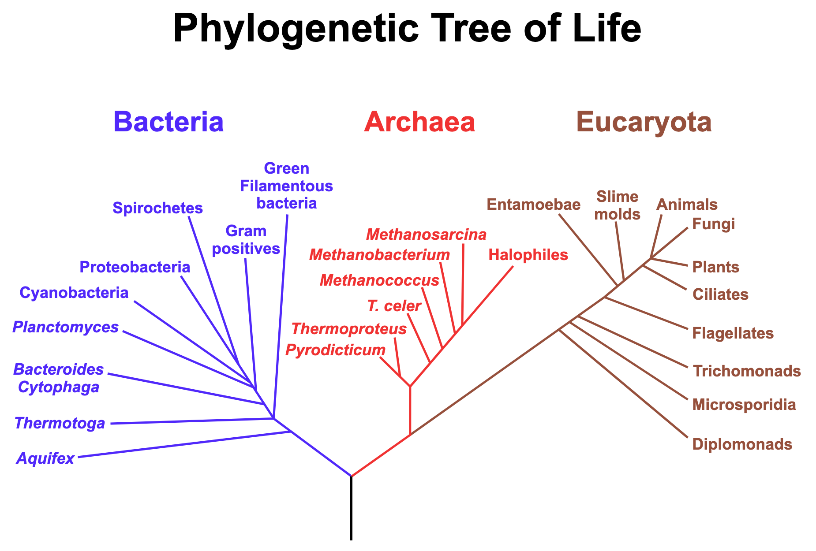
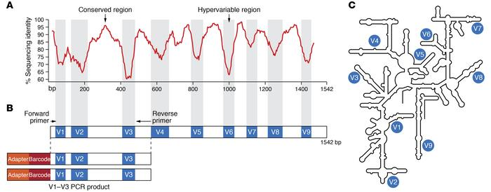
16S amplicon sequencing
16S rRNA gene is an ancient gene that encodes the RNA component of the small (30S) subunit of the prokaryotic ribosome
As it is conserved in many organisms, traditionally used to infer phylogenetic trees to figure out species evolution (Present also in mitochondria and chloroplasts of eukaryotes)
16s gene has
conserved regions: spread around all organisms and easy to amplify
variable unique regions: to tag specifically species
Universal phylogenetic tree based on the 16S rRNA gene sequence comparisons. Pace, N. A molecular view of microbial diversity and the biosphere.
Science276:734-740. 1997.
J Clin Invest. 2022;132(7):e154944.
https://doi.org/10.1172/JCI154944.
Notes:
- 16S rRNA gene is an ancient gene that encodes the RNA component of the small (30S) subunit of the prokaryotic ribosome
As it is conserved in many organisms, traditionally used to infer phylogenetic trees to figure out species evolution
16s gene has
conserved region: spread around all organisms and easy to amplify
variable unique regions: to tag specifically species

Slide 28



16S amplicon sequencing
Traditionally cluster the sequences (97% similarity) into operational taxonomic units (OTUs) and compare to known 16S databases
16S
16S
TTCAACCGAGATATGC
16S
TTCAACCGAGATATGC
assign taxonomy directly to the denoised amplicon sequence variants therefore allowing more precise taxonomic placement than OTUs
16S
16S
TTCAACCGAGATATGC
16S
16S
TTTAACCGATATATGC
16S
TTTAACCGATATATGC
Samples
16S
16S
TTTAACCGATATATGC
OTUs/ASVs
16S
TTTAACAGAGATATGC
16S
16S
16S
TTTAACAGAGATATGC
16S
TTTAACCGAGATATAC
Abundance table of operational taxonomic units (OTUs) or amplicon sequence variants (ASVs) – resolution up to Genus and no functional annotation
PCR amplification of 16S rRNA gene to produce a pool of DNA containing only 16S genes
Sequencing all fragments
Microbial genomes in our sample carrying 16S rRNA gene
Notes:
SO in our samples we have microbial genomes carrying the 16S rRNA gene,
we amplify out this gene with PCR amplification and we sequence all these 16S genes
and we can align them to each other and find out the differences - in this example different single nucleotide variants, that can uniquely identify to which species this gene belongs
Computationally we would cluster all similar sequences into operational taxonomic units that are compared to 16S gene databases like silva or green genes to assign them taxonomy
Or we can use DADA2, my favorite one, which assign taxonomy directly to the amplicon sequence variants therefore allowing more precise taxonomic placement than OTUs
In the end we are going to get an OTUs or ASVs abundance table but we get only to genus resolution
and we do not have functional annotation unless we predict it from taxonomical compositional (PICRUST).
Many assumptions, for example Close phylogenetic neighbors have similar gene content and functional potential, does not capture HGT or strain level functionality,…

Slide 29
Reference-based methods
Read mapping to know genomes, specific marker genes (BLAST, bowtie2, DIAMOND)
Genome (Kraken 2, Centrifuge, GTDB)
AACAACCGAGATATCC
TTCAACGGAGATATGC
AACAACCGAGATATCC
TTCAACGGAGATATGC
Clade-specific Marker genes (Metahphlan v4)
TTCAACCGAGATATGC
TTCAACCGAGATATGC
ATCAACA
ATCTTCA
AGACGCAGATATGC
TTCAACCGAGATATGC
ATCAACA
TTCAACCGAGATATGC
…
GAACGGAGAAATCC
…
AACAACCGAGATATGC
Abundance estimation:
- gene/genome counts
- gene/genome length and sample depth normalization
TTCAACCGAGATATGC
ATCAACGGAGATATGC
TTCAACCGAGATATGC
TACAACCGAGATGC
ATCAACACCGAGATATGC
Samples
ATCAACACATATGC
TTCTTCGGAGATTTGC
GACTCGAGTTTTCC
GAACGGAGATATGC
Taxa
Randomly shattering them into fragments of relatively equal length (e.g 150 bps) - no PCR amplification
AGACGGAGATATGC
Microbial genomes in your sample from different organisms
Sequence all fragments (millions per sample)
Abundance table
Notes:
Microbial genomes in your sample from different organisms (here represented with different colors)
Randomly shattering them into fragments of relatively equal length (150-300 bps) - no PCR amplification
Sequence all these small fragments of DNA (in the order of millions per sample)
and we map them with different tools to genomes or to clade-specfic marker genes
When we know all the gene/genome counts (reads mapping) we can divide those by gene or genome length and by sample depth (number of reads detected in a sample) to estimate the final abundance of our taxa.

Slide 30
Amplicon and read-based shotgun metagenomics tools
Method | Tools | Databases
16S Amplicon-based Profiling | QIIME 2: A popular pipeline supporting DADA2, Deblur, and multiple classifiers (Naive Bayes, etc.). DADA2: High-resolution method that infers amplicon sequence variants (ASVs). USEARCH / VSEARCH: Clustering-based OTU picking methods. Mothur: OTU-based method using different clustering and alignment strategies. RDP Classifier: Naive Bayesian classifier for assigning taxonomy. | SILVA Greengenes (deprecated but still used) RDP UNITE (for fungi)
Shotgun Metagenomics-based Reference-based profiling | MetaPhlAn4: Uses clade-specific marker genes for fast, accurate profiling. Kraken2 / KrakenUniq: K-mer based, ultra-fast classification against a database of genomes. Centrifuge: K-mer based, designed for large reference databases and low-memory use. HUMAnN / HUMAnN3: Often used alongside MetaPhlAn for functional and taxonomic profiling. StrainPhlAn: Extension of MetaPhlAn for strain-level profiling. | ChocoPhlAn (used by MetaPhlAn) RefSeq / GenBank (used by Kraken/Centrifuge) GTDB (Genome-based taxonomic reference)
Choice depending on:
Speed vs. Accuracy: Kraken2 is fast; MetaPhlAn is more accurate for species-level identification.
Resolution: DADA2 and MetaPhlAn can provide high-resolution profiling.
Data Type: Amplicon (16S) vs. shotgun metagenomics.
Resource Requirements: Kraken needs large memory for big databases; MetaPhlAn is lighter.
Notes:
Here I just added table describing tools and databases used the 16S amplicon sequencing and in the Reference-based profiling for your revision.
I highlighted in red my preferred methods, both in my opinion with higher resolution.
Choice depending on your needs:
Speed vs. Accuracy: Kraken2 is fast; MetaPhlAn is more accurate for species-level identification.
Resolution: DADA2 and MetaPhlAn can provide high-resolution profiling.
Data Type: Amplicon (16S) vs. shotgun metagenomics.
Resource Requirements: Kraken needs large memory for big databases; MetaPhlAn is lighter.

Slide 31
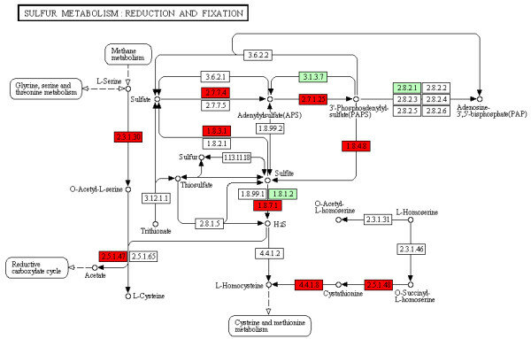
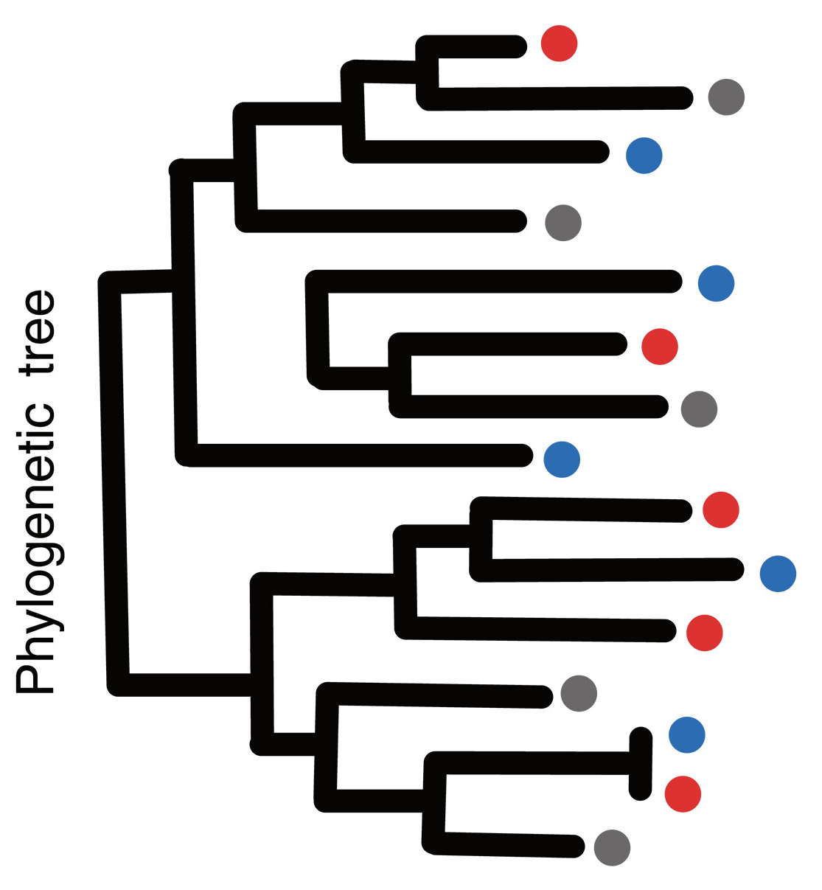
Assembly-based methods: Metagenome-assembled genomes (MAG)
C1
Contig 1
C2
GC content
tetranuclotide frequencies
coverage depth across samples
QC
Assembly
Binning
MAG1
Contig 2
Contig 23
C23
Contig 12
MAG30
Contig 77
C77
C12
MAG49
Contig 44
High quality host removed reads
C44
FastQ files
Low quality or host reads
Assembled contigs
Metagenome-assembled genomes (MAG)
g1
Bin refinement
C1
g2
g3
g4
g1
Quality assessment (completeness and contamination)
C2
g2
g3
g4
Functional annotation
Phylogenomic analysis
Taxonomic classification
C23
C1
C23
C1
C2
C2
MAG30
C12
C12
MAG49
MAG1
MAG30
MAG49
MAG1
C44
C44
Medium-quality MAG: >50% completeness, <10% contamination
High-quality MAG: >90% completeness, <5% contamination
Pseudomonas putida
Bacillus subtilis
Escherichia coli K12
Notes:
Reference-based methods rely on what is known in the databases (human commensals, pathogens or enzyms and species used in the industry better characterized in the databases) The next method I am gonna present is an assemble based method called metagenome assembled genomes.
Let’s go step by step:
We have fastQ files with our reads and we perform QC to remove low quality, low complexity and host reads (if there are)
we stitch together sequenced reads to reproduce the original genome from where they came. If we had easy communitires and lots of reds we could reproduce the whole genome, otherwise we get these large DNA chunks called contigs.
These contigs can be clustered into different bins according to their composition (GC content, tetranucleotide frequencies) or coverage depth across samples (require to remap all the reads to the contigs – more samples higher accuracy).
The bins go through refinment and quality assessment. In many MAG collections they divide the MAGs on High quality and medium quality based on the completeness and contamination levels (how many marker genes of this species can be found in the bin, how many marker genes from other species)
We assign taxonomy therefore to the bins and we can then with the clean bins do phylogenomic analysis or do functional annotation (call genes in the contigs assigned to the bins and map them to pathways, etc.. and estimate their abundances by mapping reads to the functional features)

Slide 32
MAG construction tools
https://pubmed.ncbi.nlm.nih.gov/28898207/
Step | Goal | Tools | Notes
Quality Control | Remove low-quality reads, adapters, and contaminants (e.g. host reads) | fastp, adapterremoval, Trimmomatic, BBduk | Output: Clean reads
Assembly | Assemble short reads into longer contigs. | MEGAHIT, metaSPAdes | Output: Assembled contigs
Binning | Group contigs that belong to the same genome | MetaBAT2, MaxBin2, CONCOCT, VAMB | Output: bins of contigs belonging to the same genome Using coverage profiles and sequence composition (GC content, tetranucleotide frequency).
Bin refinment | Improve bin quality and merge results from different binning tools | DASTool, metaWRAP | Output: Refined bins
Quality Assessment | Assess completeness and contamination of bins (MAGs) | CheckM, BUSCO | Metrics usually used: High-quality MAG: >90% completeness, <5% contamination. Medium-quality MAG: >50% completeness, <10% contamination.
Taxonomic classification | Assign taxonomy to MAGs | GTDB-Tk, Kraken2, CAT/BAT | Output: taxonomically annotated MAGs
Functional annotation | Predict genes and metabolic functions | Prokka, EggNOG-mapper | Out put: functionally annotated MAGs
Phylogenomic analysis | Compare MAGs evolutionarily | PhyloPhlAn, Anvi’o, IQ-TREE | Output: Phylogenetic trees based on MAGs
Notes:
Here I left you a table with all the tools related to the different steps on building MAGs. As you can see it is a very complex process and it requires of many softwares that need to be run in a chained way.
Maybe in another course we can cover only that methodology.

Slide 33
Comparing the three methods
 | Amplicon/16S sequencing | Shotgun metagenomics
 |  | Reference - based | Assembly - based
Pros | Can handle low biomass / non-bacterial contamination Rough taxonomy of novel species Less expensive | High resolution (subspecies, genes SNVs) Can detect all DNA in the sample (also virus, fungus, protozoa,…) Fast and scales well Finds rare entities | High resolution (subspecies, genes SNVs) Can detect all DNA in the sample (also virus, fungus, protozoa,…) Can identify novel genomes, genes and synteny patterns
Cons | Low resolution Limited to bacteria or archaea No subspecies or strains resolution Biases due to PCR amplification / amplicon copy number variation | Does not work well for low biomass More expensive than 16S Limited to what is known in the databases | Does not work well for low biomass More expensive than 16S Misses rare entities Computationally very intensive
Notes:
And finally I wanted to compare the three different methods that we have described.
TABLE

Slide 34
Functional profiling

Slide 35
Building a microbial gene catalog
To do functional annotation you can always map reads to genes (read/reference-based annotation)
A common resource used in functional annotation is building a gene catalog The beginning of the process is the same as the assembly method
Contig 1
Clusters
Contig 2
C1
Gene calling
Gene clustering
Assembly
C2
Contig 12
Contig 44
C3
High quality host removed reads
C4
Contig 23
…
…
Contig 77
CD-HIT
95% identity
90% coverage
Non-redundant gene catalog
…
…
Notes:
To do functional annotation you can always map reads to genes (read/reference-based annotation)
A common resource used in functional annotation is building a microbial gene catalog
We have high quality reads that were stitched into contigs, and the genes are called up on in these contigs.
With softwares like CD-HIT, a quite used one, we can cluster these genes based on sequence similarity and asking for a % identity and a % of coverage.
The longest sequences of these clusters are then taken as representatives of each gene cluster and a non-redundant gene catalog is then ready.

Slide 36
Annotating the gene catalog and getting functional abundance
Reads can be mapped to the catalog genes to infer gene abudance and those genes can be mapped to several functional information databases (e.g KEGG database, PATRIC Database, CARD or Resfams antibiotic resistance gene databases,…)
eggNOG
mapper
Functional annotation tool using orthology-based inference
Functional information databases
Gene Ontology (GO) terms
KEGG pathways
COG categories
CAZY categories
Pfam domains
Enzyme Commission (EC) numbers
Protein names and descriptions
…
eggNOG orthologous
Descend from a single gene in the last common ancestor and typically perform the same function across species
…
Non-redundant gene catalog
Samples
Genes
gene length
sample depth normalization
Functional abundance table
Notes:
When we have this gene catalog we can maps reads to the genes to figure out the gene abundance (normalized by gene length and sample depth)
Parallelly, catalog genes can be mapped to several functional information databases (e.g KEGG database)
This is usually done by eggNOG mapper which is a tool that map the genes to orthologous groups. An ortholog group is a collection of genes that Descend from a single gene in the last common ancestor and typically perform the same function across species
Once we have this mapping we can transfer all the information know to these orthologous to the genes and then we have them mapped to KEGG pathways, CAZY, … Then in the end we can collapse the gene abundaces into the different feature that these genes map to and get different features abundance.
But why to build a gene catalog?
-

Slide 37
Why building a gene catalog?
Annotation of genes across all metagenome (not only the known ones – novel or uncharacterized functions - new biochemical functions, pathways, or resistance mechanisms)
Cross-sample comparability - All samples are quantified against the same gene set, then cleaner statistics and fewer biases.
Computational efficiency (downstream) - Annotation and indexing are done once instead of per sample.
Better detection of shared vs unique genes - You can easily identify core vs accessory genes across samples.
Reduce redundancy - Many microbes share similar genes. Clustering genes removes duplicates and simplifies downstream analysis
Reusable resource - valuable resource for upcoming large-scale projects

Slide 38
Microbiome data

Slide 39
Microbiome data
Relative abundace (%)
Area
1 | 2 | 3 | 1 | 2 | 3 | 1 | 2 | 3
X | X | X | Y | Y | Y | Z | Z | Z
10 | 11 | 20 | 12 | 14 | 16 | 25 | 34 | 22
70 | 49 | 56 | 0.9 | 0.5 | 0 | 0 | 0.1 | 0
0 | 0 | 0 | 0.4 | 0.1 | 0 | 0 | 0 | 0
0.3 | 0.4 | 0.45 | 0 | 0.1 | 1 | 2 | 3 | 4
2 | 2 | 3 | 0 | 0 | 0.01 | 1 | 1 | 2
Condition
Sparsity
Dinamic range
Usually expressed as Relative, not Absolute abundance
Compositional data
Relative abundance
Taxa or functional feature
Samples
Notes:
How does it look the microbiome data?
Microbiome data shows sparsity and a dinamic range
Here we have a relative abundace table fo taxa or functional features in rows and samples in columns. I added the metadata which is area and condition measured
As you can see the abundance
First row evenly distributed
Highly dinamic range
- Some fetures drop 0

Slide 40
Microbiome data
Microbiome data is compositional:
Sampling of a fraction of the total genomic DNA
Different sequencing depth between samples
Both sampling depth and sequencing depth can vary several orders of magnitude between samples
Absolute abundances are normally not known – abundances are relative and constraint to sum to 1 (or 100%)
Proportions or percentages of total reads per sample — not true cell counts.
Relative abundances are susceptible to compositional effects
Sparsity
Dinamic range
Usually expressed as Relative, not Absolute abundance
Compositional data
https://pubmed.ncbi.nlm.nih.gov/27306058/
Notes:
Microbiome data is usually expressed as relatives abundance, which makes this data compostional
What compositional data means:
Sampling of a fraction of the total genomic DNA
Different sequencing depth between samples
Both sampling depth and sequencing depth can vary several orders of magnitude between samples
Absolute abundances are normally not known – abundances are relative and constraint to sum to 1 (or 100%)
Proportions or percentages of total reads per sample — not true cell counts.
Relative abundances are susceptible to compositional effects.
----
Metagenomic studies of microbial communities sample a fraction of the total genomic content (sampling depth), which are then sequenced at a certain sequencing depth. Both sampling depth and sequencing depth can vary several orders of magnitude between samples. As absolute microbial counts (abundances) are normally not known, and measurements depend on sampling and sequencing depths, community compositions are represented using relative abundances. Since relative abundances are constrained (they sum to 1 in a given community), they are susceptible to compositional effects, where an increase in relative abundance of one component leads to a compositional decrease in the relative abundance of other components. Differential analysis based on relative abundances thus needs careful interpretation as compositional effect can introduce spurious differences in relative abundances while the absolute abundances are not different.

Slide 41
Compositional data
Consider read counts as a proxy for cell abundance (not perfect as 16S gene can have multiple gene copies in some genomes, and in shotgun metagenomics we have different genome sizes – larger genomes contributing with more reads per cell, extraction efficiency, library prep bias, etc ...)
 | S1 cells | S1 Rel ab % | S2 cells | S2 Rel ab %
Taxa 1 | 250 | 25 | 250 | 33.33
Taxa 2 | 250 | 25 | 250 | 33.33
Taxa 3 | 300 | 30 | 50 | 6.67
Taxa 4 | 200 | 20 | 200 | 26.67
Total | 1000 | 100 | 750 | 100
Only Taxon 3 reduced its abundance after antibiotic treament, but 1,2, and 4 seem that they increase
Affects downstream analysis and interpretations
e.g. correlations or regression assume independent variables
analysis alternatives and data transformations have been proposed: center-log-ration transformation (clr), ALDEx2, ANCOM
however, they introduce practical limitations — especially with zero handling, computational cost, and difficult interpretation
Notes:
Here I prepared an example to illustrate the compositionality issue.
Consider read counts as a proxy for cell abundance (not perfect as in 16S gene we have multiple gene copies in some genomes, and in shotgun metagenomics we have different genome sizes – larger genomes contributing with more reads per cell, extraction efficiency, library prep bias, etc ...)
Then we have in the tablæe cell counts and relative abundace for S1 before an antibiotic treatment and fro sample 2 after the antibiotic treatment.
TABLE
Only Taxon 3 reduced its abundance after antibiotic treament, but 1,2, and 4 seem that they increase. Their number of cells have not changed but due to the decrease of one taxon the orther 3 seem to have increased abundances.
This affects downstream analysis and specially interpretations.
e.g correlations or regression assume independent variables
analysis alternatives and data transformations have been proposed: center-log-ration transformation (clr), ALDEx2, ANCOM
however, they introduce practical limitations — especially with zero handling, computational cost, and difficult interpretation
Best thing you can do after your analysis is plotting your data, perhaps also as an exploratory step plotting your data is advisable!

Slide 42
Ideal scenario: absolute abundances
If we want to know true cell counts, we need to:
Add internal spike-in controls (known amounts of reference DNA).
Use qPCR or flow cytometry to estimate total bacterial load.
This allows you to correct read counts to reflect absolute abundance, not just proportions.
Notes:
The ideal scenario it would be measure absolute abundances, something that different groups and companies are starting to do.
This way we have true cell counts
to obtain absolute abundances, you can
Add internal spike-in controls (known amounts of reference DNA). Then. you can calculate the other taxa abundance on respect to that reference
Use qPCR or flow cytometry to estimate total bacterial load. Then normalize your data accordingly
This allows you to correct read counts to reflect absolute abundance, not just proportions.

Slide 43
Diversity measures

Slide 44

Diversity measures: Alpha diversity
Shannon index:
S = total number of species
pi = proportion of species i in the sample
Diversity within a sample
Richness: number of unique taxa found in a sample (species, OTUs, ASVs,…)
Shannon Index: Accounts for both richness and evenness (how balanced the community is)
Higher values = More diverse and evenly distributed community
Other indices: Simpson, Chao1, Faith’s PD (for phylogenetic diversity)
https://pubmed.ncbi.nlm.nih.gov/30349083/
Notes:
There are several ways how microbiome ecologist describe microbiome data:
For example Microbiome alpha div which is the diversity within a sample
Two common measures of diversity are
- Richness: number of unique taxa found in a sample (species, OTUs, ASVs,…)
Shannon Index: Accounts for both richness and evenness (how balanced the community is)
Higher values indicate More diverse and evenly distributed community
There are other indices used but here we will focus on these two, up there you have the Shannon formula
PLOT – here we studied the diversity after an antibiotic treatment in young humans and you can see that after an initial decrease of both richness and Shannon index both recovered diversity within half a year.

Slide 45
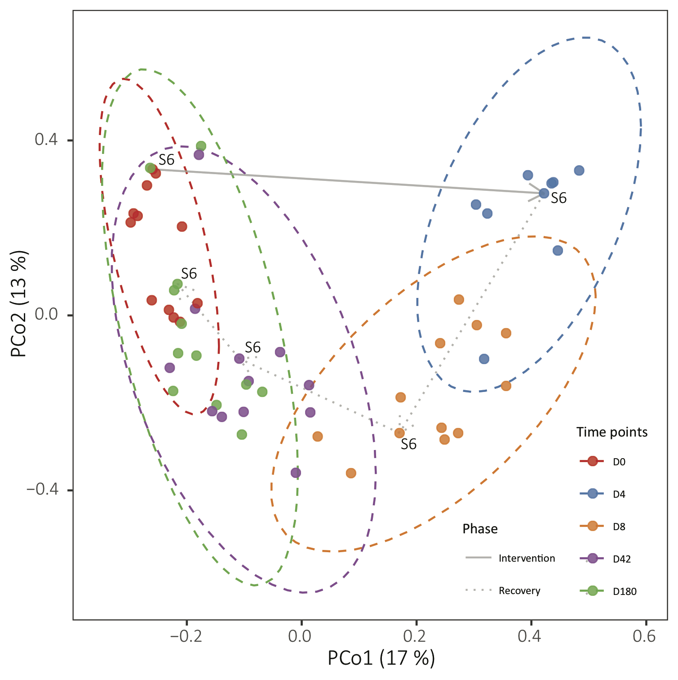
Diversity measures: Beta diversity
Diversity between samples (community composition dissimilarity)
For example:
Bray-Curtis dissimilarity (presence/absence + abundance-weighted)
Jaccard distance (presence/absence)
UniFrac (phylogenetic distances: weighted/unweighted)
These distances between samples are calculated based on the abundance and projected on the two first dimensions of a PCoA.
other ordination methods are also used: NMDS, tSNE or simply PCA,…)
https://pubmed.ncbi.nlm.nih.gov/30349083/
Notes:
Another diversity measure is beta diversity which is diversity between samples
This one is measured by ecological distances or dissimilarities based on the species abundance table. Few of the most known and used are:
Bray-Curtis dissimilarity (presence/absence + abundance-weighted)
Jaccard distance (presence/absence)
UniFrac (phylogenetic distances: weighted/unweighted)
These distances between samples are calculated based on the taxa abundance table and projected on the two first dimensions of a PCoA.
other ordination methods are also used: NMDS, tSNE or simply PCA,…)
In this example is about the dataset that I talked in the previous slide and as you can see the microbial composition changes dramatically after an antibiotic treatment and looks more and more similar to the baseline composition when the time passes and the gut microbiotat recovers.
Same you could have in environmental studies, you change a condition in a microbial community and it changes drastically and perhaps with the time it comes back to the original composition once the new resource is consumed or dervies into a totally different composition, then samples will be placed further away in the PCoA.

Slide 46
Challenges and limitations

Slide 47
Challenges and limitations of metagenomics studies
Shotgun metagenomics have higher cost than 16S amplicon, but you get higher taxonomical resolution and functional information
Sampling biases can occur when collecting environmental samples which can also lead to misrepresentation of the microbial community
It is also challenging to extract microbes DNA from low biomass samples - highly dependant on the sampling method and its accuracy
Microbial genomes available and deposited in reference databases are biased towards model organisms, pathogens, species with industrial potential and cultivable bacteria
Metagenomic sequencing can detect the presence of microorganisms but cannot easily determine if they are pathogenic (Do they carry their toxins? Are they active?)
https://pubmed.ncbi.nlm.nih.gov/28898207/

Slide 48
Challenges and limitations of metagenomics studies
Functional profiling is hindered by the lack of annotation for many genes
“Microbial dark matter” – microbes not yet characterized can be recovered by assemble-based methods, but still many reads are not used in the assembly – sequencing noise, DNA contamination, and bacteria and plasmids that remain obscure even after some parts of their genomes are assembled
“Live or dead” dilemma – DNA persists in the environment after the death of the host cell, sequencing results may not be representative of the active microbial population
Snapshot of the microbiome - many metagenomics studies are cross-sectional and can not assess intra- vs inter-subject variation – more longitudinal studies are needed
Disentangling the cause from the effect – follow ups, longitudinal and prospective studies needed
Metagenomics have not yet reached the level of standardization of other high-throughput techniques
https://pubmed.ncbi.nlm.nih.gov/28898207/

