Slide 1
Processing of shotgun metagenomics samples
Using a reference-based method
nf-core/taxprofiler together with Metaphlan v4 database

Slide 2
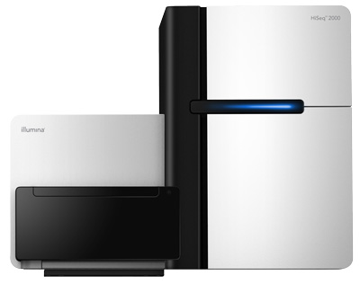
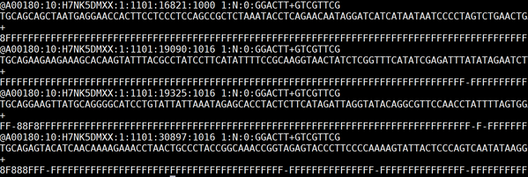
Processing metagenomics data – a fastq file
A00180 → instrument name
10 → run id
H7NK5DMXX → flowcell id
1 → flowcell lane
1101 → tile number within the flow cell line
16821 → x-coordinate of the cluster within the tile
1000 → y-coordinate of the cluster within the tile
SPACE
1 → member of the pair (if paired-end)
N → N if read is not filtered, Y if it is filtered
0 → ) when none of the control bit are on
GGACTT, GTCGTTCG →
Every entry consists of 4 lines:
identifier (starting with @)
Read sequence
a line starting with + (sometimes id gets repeated)
quality scores per nucleotide (Phred score)

Slide 3
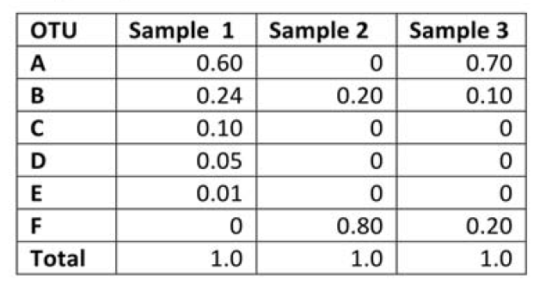

Repeating steps too many times? – find yourself a pipeline!
Series of steps in an specific order
Nextflow is a language to build workflows and a software to orchestrate workflows execution.
Different steps to run manually in an order (QC, host removal, mapping to a database, etc…)
Workflow that contains all the processes needed and have them chained
Strong community behind with various bioinformaticians joining forces to build each of the pipelines
Support for other technologies

Slide 4



Nextflow’s core features
Reproducible between runs
integration with code management tools
all packages downloaded, organized in containers, and control over computing environment
Portable between systems
you can write the code in your laptop and can run everywhere (HPC, cloud)
works with most of computing environments
Scalable
it can run for 10 samples on your laptop or thousands in the cloud
Integration of existing tools, systems, and industry standards

Slide 5


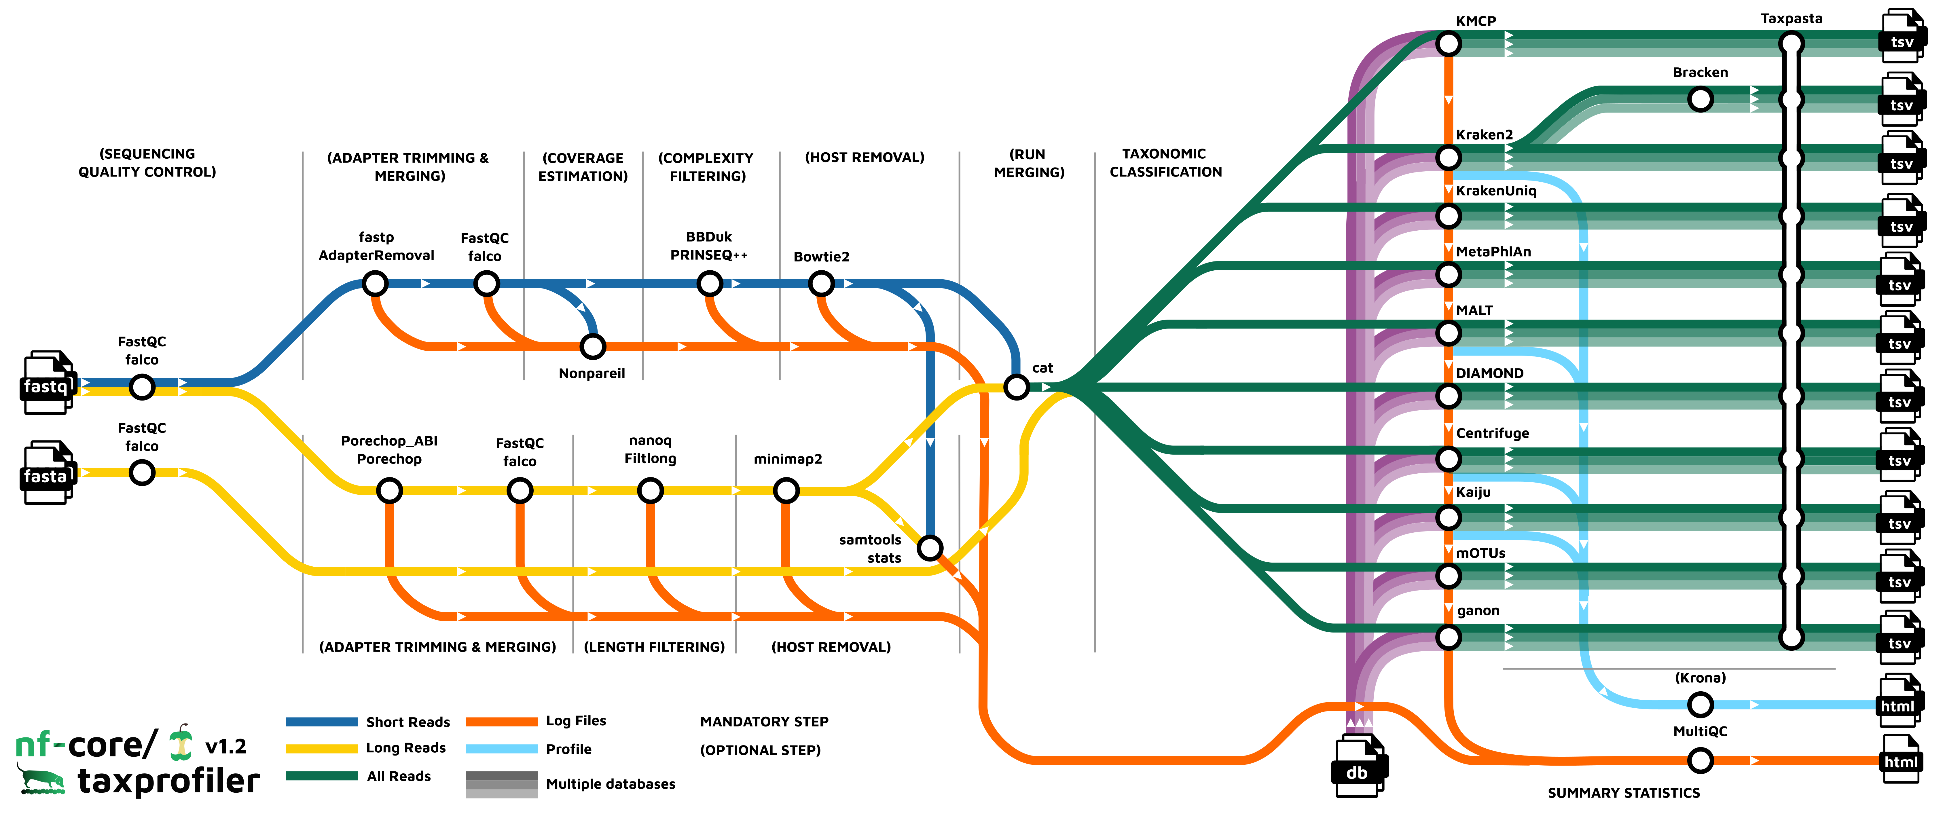
A global community effort to collect a curated set of open‑source analysis pipelines built using Nextflow. https://nf-co.re/
130 pipelines available (22th May 2025)
to process and analyse many different data types
Modules: 1,163 reusable components that can be integrated into pipelines
Subworkflows: 72 pre-assembled combinations of modules aimed at streamlining commonly used workflows

Slide 6
nf-core/taxprofiler
Reference-based taxonomical profiling

Slide 7
samplesheet.csv
sample,run_accession,instrument_platform,fastq_1,fastq_2,fasta2612,run1,ILLUMINA,2612_run1_R1.fq.gz,,2612,run2,ILLUMINA,2612_run2_R1.fq.gz,,2612,run3,ILLUMINA,2612_run3_R1.fq.gz,2612_run3_R2.fq.gz,

Slide 8
databases.csv
tool,db_name,db_params,db_pathkraken2,db2,--quick,/<path>/<to>/kraken2/testdb-kraken2.tar.gzmetaphlan,db1,,/<path>/<to>/metaphlan/metaphlan_database/

Slide 9
config file

Slide 10
Command line to run the pipeline
nextflow run nf-core/taxprofiler \ -profile <docker/singularity/.../institute> \ --input samplesheet.csv \ --databases databases.csv \ --outdir <OUTDIR> \ --run_kraken2 --run_metaphlan

