Slide 1
Biological Complexity: Network-Based Approaches for Multi-Omics Integration
Integrating serum proteomics and metabolomics in a sepsis cohort
Danish Bioinformatics Conference · Odense · 27–28 October 2026
protein
metabolite
Multiomics Analytics Group · DTU Biosustain
Notes:
Welcome to the workshop.
In two hours we go from one real clinical cohort to a cross-omics hypothesis.

Slide 2
The next two hours
0:00
0:25
0:35
1:10
1:20
1:55
Context
Multi-omics
Hands-on I
Network biology
Hands-on II
Wrap-up
Dataset, nf-core processing, single-omics results, data integration basics
Short reading: why and how to integrate multiomics data
Data Integration — Similarity Network Fusion (SNF) and Multiomics factor analysis (MOFA)
Short reading: graphs, nodes, edges, hubs, modules
Networks, joint pathways, the methionine cycle
Conclusions
(Colab)
(Colab)
Hands-on blocks are highlighted in green — about 95 of the 120 minutes are for you to read some theory at your own tempo and to get hands-on the data integration.
Notes:
SO a plan for the next two hours:
I will give you About 20/25 minutes of context, then you can work at your own pace in the notebooks. Notebooks run in Google Colab – no need of installations.
You can also run it locally if you want to deal with the installations or already have the tools/libraries installed
Before each hands/on you can read in 10/15 min of theory from the slide decks.
Timings are a guide. If Colab installs are slow, start Hands-on I while reading the material.

Slide 3
1 · One cohort, data from two instruments
He J, Luo S, Xu W, Chen Y, Liu G, Tang J, Yang Y, Zhao B, Ma L, Sheng H, Mao E. Serum proteomic profiling of sepsis patients reveals a protein-based diagnostic model, with metabolomic insights into carbapenem-resistant Klebsiella pneumoniae infection. Front Immunol. 2026;17:1818068. doi:10.3389/fimmu.2026.1818068 · open access, CC BY 4.0
Notes:
About the study, we have a cohort that has data from two instruments, so we have proteomics and metabolomics data
See the reference here if you want to scheme through the paper or read after the course.

Slide 4
The clinical question: can serum profiles tell a resistant from a susceptible Klebsiella pneumoniae infection on day 0 (time of sepsis diagnosis)?
Sepsis is a dysregulated host response to infection; K. pneumoniae is a common cause of sepsis
20–>40 %
1–3 days
Day 0
mortality of carbapenem-resistant K. pneumoniae (CRKP) sepsis — about twice that of carbapenem susceptible strains
for blood culture and susceptibility testing — treatment cannot wait that long
can the host's own serum molecules tell a resistant from a susceptible infection?
Carbapenems are antibiotics of last resort. A host-response test would guide empirical therapy before microbiology returns.
Notes:
There is a clinical problem in this paper was whether serum profiles tell a resistant from a susceptible Klebsiella pneumoniae infection on day 0 (time of sepsis diagnosis)?
Sepsis is a dysregulated host response; K. pneumoniae is a common cause of sepsis;
resistant strains of this bacteria roughly double mortality.
Blood culture and susceptibility testing take about 1-3 days and sometimes treatment can wait that long
So it would be great if serum proteins or metabolites could inform early, targeted antimicrobial decisions prior to the availability of culture and susceptibility results!

Slide 5

45 septic patients, three groups of 15
Con
Culture-negative (on all microbiology tests) sepsis
sample IDs Con1 … Con15
Why this is hard
Every patient is septic — the contrast is susceptible and resistant, not sick vs healthy
Expected pathogenicity effects are small; severity dominates the variance
Small sample size = 15 per group: supervised models overfit easily
CSKP
Carbapenem-susceptible K. pneumoniae
sample IDs KP1 … KP15
CRKP
Carbapenem-resistant K. pneumoniae
sample IDs CRKP1 … CRKP15
Serum at diagnosis, four Shanghai hospitals, April–December 2025. A separate 45-patient validation cohort was measured by targeted parallel reaction monitoring (PRM) and used for validation of the protein biomarkers.​
Notes:
This is an study of 45 septic patients divided on three pathogenicity groups of 15 patients each
Culture negative sepsis (on all microbiology tests)
Carbapenem-susceptible K. pneumoniae sepsis
Carbapenem-resistant K. pneumoniae sepsis
Why this analysis is hard?
Notice that all patients are sick, so the contrasts here are between susceptible and resistant
Expect that infection severity will dominate the variance, resistance effect should be a small one compared to severity
Sample size 15 per group supervised methods will tend to overfit

Slide 6

The same 45 samples, measured twice
Two very different technologies: untargeted DIA proteomics with many missing values, and targeted MRM metabolomics with few missing.
Both deposited publicly.
 | Proteomics | Metabolomics
Repository | PXD075261 (ProteomeXchange / iProX) | MTBLS14016 (MetaboLights)
Instrument | timsTOF Pro (Bruker) | QTRAP 6500 (SCIEX)
Acquisition | diaPASEF — data-independent | MRM — widely targeted, ± ionisation
Processing | DIA-NN 1.9.2, library-free, MaxLFQ | Vendor MRM peak integration
Features | 1 458 protein groups | 1 073 named metabolites
Pooled QC | 3 injections | 6 injections
Missing values | ≈ 27 % | ≈ 5 %
Pairing is the point
Each patient has two descriptions of the same physiology. That is what makes integration possible — rather than decorative.
Curated tables in the workshop repository https://github.com/biosustain/dsp_multiomics_workshop
in data/: protein_groups_matrix.tsv · metabolite_matrix.tsv · metabolite_annotation.tsv · sample_metadata.tsv
Notes:
From the 45 samples we measured proteomics and metabolomics with two different technologies:
untargeted-ish DIA proteomics with many missing values,
and targeted MRM metabolomics with few.
Both datasets were deposited publicly. We tank the authors!
Today you are not going to process the data again, The notebooks read small curated tables straight from GitHub.
The patients have two descriptions of the same physiology which makes integration possible and exciting.

Slide 7
2 · From raw files to feature intensity matrices
Reproducible processing with Nextflow and nf-core pipelines
Notes:
Let’s talk briefly about the processing
How we go from raw files to feature intensity matrices

Slide 8





Why a pipeline, not a dozen tools by hand
Pinned versions
Anatomy of a run
-r v1.8.1 fixes every tool version the run used
nextflow run bigbio/quantmsdiann -r v1.8.1 \
-profile docker \
--input PXD075261.sdrf.tsv \
--database uniprot_human.fasta \
--outdir results/PXD075261 \
-resume
Containers
Docker / Apptainer ship the exact software stack
Resume
-resume reuses finished steps after a failure
Standard metadata
single dash = Nextflow option · double dash = pipeline parameter
SDRF / samplesheet describe every file and sample
Full cohort is a cluster job: 45 × 2.4 GB .d.zip, several CPU-hours per file, ≥ 32 GB RAM.
Notes:
We tend to use curated pipelines instead of many tools one after another
At BRIGHT we are setting a collection of Nextflow pipelines as default to work with different omics.
It is recommendable as we have pinned versions with a clear map of what versions were used of each tool in each pipeline version
We ensure reproducibility by using containers (Docker/apptainer) shipped together with the software
Nextflow offers the possibility of resume pipelines from wherever they stopped/fail
And we can use standards defined by the Nextflow community or other communities , f eg proteomics standards use sdrf format for samplesheets

Slide 9

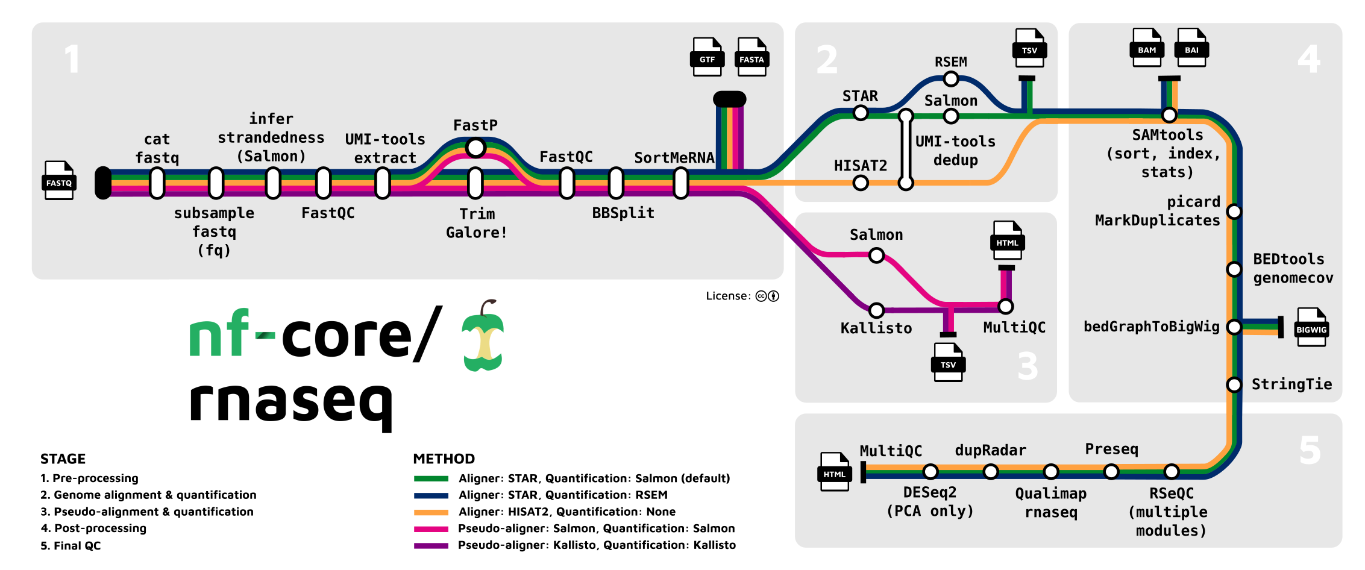

Nextflow’s core features
  Reproducible between runs
    integration with code management tools
    all packages downloaded, organized in containers, and control over computing environment
  Portable between systems
    you can write the code in your laptop and can run everywhere (HPC, cloud)
    works with most of computing environments
  Scalable
    it can be run for 10 on your laptop or thousands of samples in an HPC or the cloud
  Integration of existing tools, systems, and industry standards
Nextflow is a software - Workflow orchestrator engine
Nextflow is a Domain-specific language (DSL) built on top of Groovy
Notes:
Briefly Nextflow is a workflow orchestrator engine and a workflow programming language
It allows us to have reproducible runs
Portable and scalable pipelines between different platforms
And it integrates with existing tools and industry standards
Nf-core initiative is a collection of curated Nextflow pipelines that you can use to process many different data types (about 158 different pipeline nowadays) built in a modular way so that you can reuse the modules to build yours

Slide 10
Proteomics: bigbio/quantmsdiann (DIA-NN)
The pipeline takes SDRF metadata (must use the .sdrf.tsv extension) and mass spectrometry data files (.raw, .mzML, .d, .dia, .wiff) as input and performs:
Input validation — SDRF parsing and validation via sdrf-pipelines
File preparation — RAW to mzML conversion (ThermoRawFileParser), indexing. WIFF to mzML conversion (WiffConverter, ghcr.io/bigbio/wiffconverter:0.10)
In-silico spectral library generation — deep learning-based prediction, or use a user-provided library (--speclib)
Preliminary analysis — per-file calibration and mass accuracy estimation (parallelized)
Empirical library assembly — consensus library from preliminary results with RT profiling
Individual analysis — per-file search with the empirical library (parallelized)
Final quantification — protein/peptide/gene group matrices with cross-run normalization
MSstats conversion — DIA-NN report to MSstats-compatible format
Quality control — interactive QC report via pmultiqc
Notes:
For the proteomics data we use quantmsdiann is the DIA-NN branch of quantms, built to nf-core standards by bigbio at EMBL-EBI.
What the pipeline does.
The SDRF is generated by bin/build_sdrf.py; pooled QCs are excluded from it so they do not enter the differential design.

Slide 11
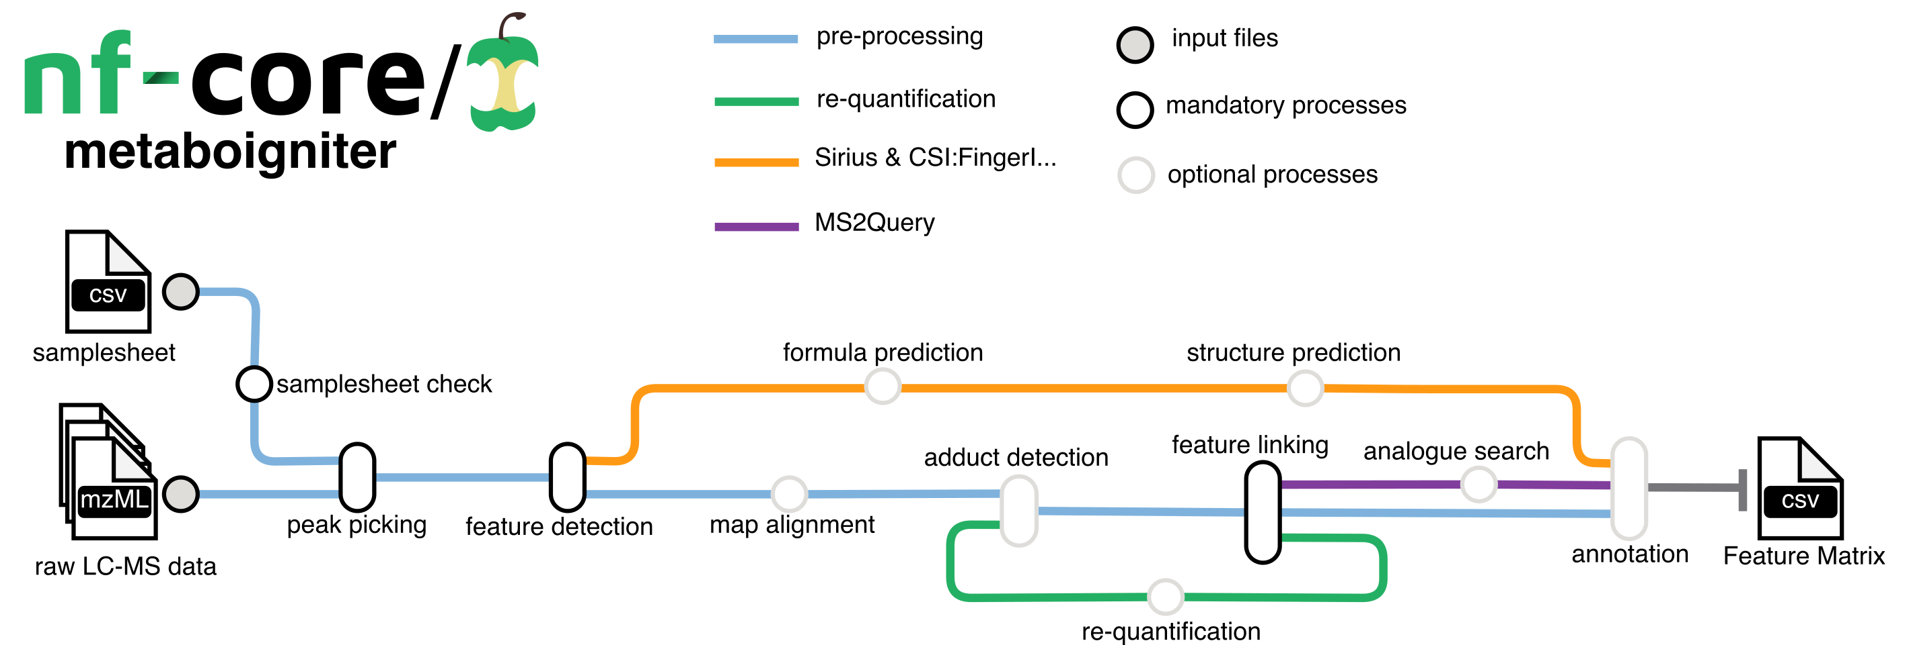
Metabolomics: nf-core/metaboigniter (OpenMS)
Centroiding: Converts the continuous mass spectra into a series of discrete points.
Feature Detection: Identifies unique signals or ‘features’ in the spectra.
Adduct Detection: Identifies adduct ions, which are formed by the interaction of the sample with the ion source.
Alignment: Ensures that the same features across different samples are matched together.
Linking: Establishes connections between features across different ionization modes or adducts.
Requantification: Fills in missing values in the data set for a more complete analysis.
Identification: Uses MS2Query and SIRIUS to identify compounds based on their MS2 spectral data.
Output Generation: Produces a comprehensive list of detected and potentially identified metabolites.
Notes:
For metabolomics we are integrationg in our structure metaboigniter which is based on OpenMS tools
What the pipeline does.

Slide 12

Metabolomics: nf-core/metaboigniter (OpenMS)
To keep in mind if you run the original course another day
1
Peak picking
Our cohort cannot go through it
2
Feature detection
3
Adduct grouping
metaboigniter is untargeted: it picks peaks from full-scan spectra
MTBLS14016 is targeted MRM: each mzML holds ~1 550 SRM chromatograms and zero spectra
Course solution: show where an MRM peak area comes from, then run metaboigniter on a small untargeted study (MTBLS8735)
The cohort matrix = vendor-integrated MRM peak areas
4
RT alignment
5
Link across samples
6
Requantify
7
Identify (SIRIUS, MS2Query)
→ feature table: m/z · RT · adduct · intensity per sample
Notes:
If you run the original course one day just keep in mind that metaboigniter is for untargeted metabolics, and in the paper they used targeted MRM metabolomics.
Untargeted and targeted strategies have different acquisition methods and answer different questions.
So in the original course they used another untargeted dataset to show how to process the data
Here today, in the repo you have the feature intensities already processed and ready for the multiomics integration

Slide 13




Traps that come with real public data
Sample names differ
QC samples are not patients
DIA-NN headers say CPKP1–15, everything else CRKP1–15. Join on the wrong string and 15 patients vanish silently.
QC_pool1–3 vs QC01–06 — exclude before integrating. The notebooks assert 45 shared patients.
Broken metadata
Run order = group
The two MetaboLights MAF files are byte-identical; assay tables pair samples with the wrong files.
All Con, then all CSKP, then all CRKP. In Proteomics dataset the instrument drift is inseparable from biology; no injection order communicated for metabolomics.
Design lesson that costs nothing at the bench: randomise or interleave injection order — and deposit it.
Notes:
With the use of public data we should be aware of few traps.
Sample names sometimes differ and they need to be harmonise before the analysis
Sometimes the metadata is broken or missing
We need to rememeber to remove QC samples, they are not patients!
We need to be aware that we should randomise or interleave injection order — and deposit these orders in the archives together with the samples
In the paper, for Proteomics they injected the samples as in the same order as in the groups, therefore instrument drift is inseparable from biology; no injection order was communicated for metabolomics.; keep it in mind when any result looks too good.

Slide 14
3 · What each layer says on its own
Main comparison: CRKP vs CSKP — same bacterium, different resistance
Notes:
Let’s talk a bit about the paper findings for each data type
Keep in mind that the most important contrast is susceptible vs resistant infection

Slide 15
Proteomics: six decisions from matrix to list
Filter
log2
Impute
Test
Enrich
filtered out proteins missing in ≥ 70 % of patients
multiplicative → additive
down-shifted normal
(missing = low)
ANOVA, t-test
CRKP vs CSKP
GO / KEGG,
measured background
1458
85
51
AUC = 0.92
LASSO regression with CV: key differential proteins; Logistic Regression, Random Forest, and XGBoost: predictive 4-protein panel: IGHV1-8, ITGA2, PKP1, IGFBP6
(discovery cohort)
protein groups
published differential expressed proteins, CRKP vs CSKP (68 up · 17 down regulated)
proteins rising stepwise
Con → CSKP → CRKP
Paper's DEP rule: unadjusted p < 0.05 and |log2FC| ≥ 0.58 — far fewer proteins survive 5 % FDR. Hypothesis-generating, then validated by PRM.
Notes:
In data analysis each decision that you take influences the results.
In Proteomics, they log2 transformed the data, filter proteins out proteins missing in more than 70%, imputed from a down+shifted normal distribution, normalized by the median and tested the differences with ANOVA and t+test and performed an enrichment analysis using KEGG database.
From 1458 proteins considered they found 85 differentially regulated proteins when comparing susceptible vs resistant with 51 proteins increasing ins stepwise con susceptible and resistant. They used a classifier to find a panel of four proteins that can predict the pathogenicity group with an AUC 0.92 and validated in an external cohort.

Slide 16
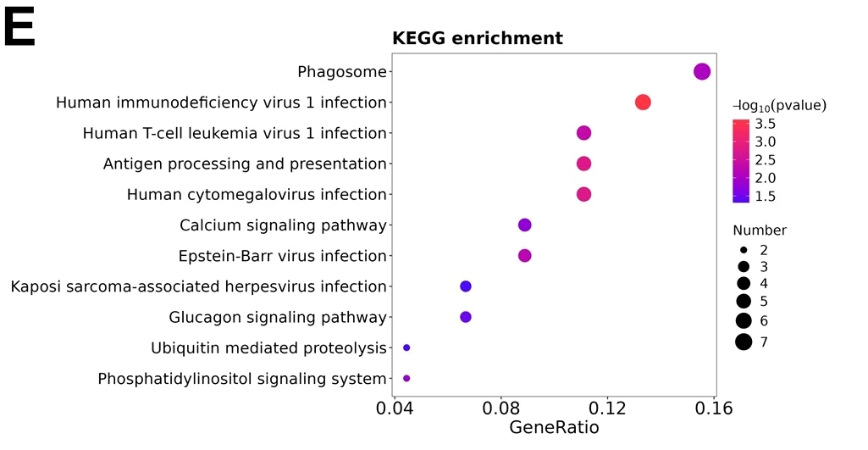
Proteomics: antigen presentation and a 4-protein panel
Immune recognition
HLA-C, B2M, CALR, CANX, CTSL — MHC class I antigen presentation shifts with resistance
Diagnostic panel
IGHV1-8 · ITGA2 · PKP1 · IGFBP6 — AUC 0.920 (LASSO, 70/30 split), confirmed by PRM in a second cohort
Network hubs
CD44 and B2M; coagulation (VWF) among stepwise-rising proteins
enriched in viral infection-related pathways, immune processes such as antigen processing, and presentation and phagosome, as well as fundamental cellular signaling pathways including the phosphatidylinositol signaling system and calcium signaling pathway
Notes:
When they run enrichment analysis they found enriched viral+infection related pathways, antigen presentation, and phagosome function
The panel AUC comes from a single split chosen on test performance, so read it as optimistic; the PRM validation cohort is the stronger evidence.
The viral-infection KEGG terms are generic: they contain the antigen-presentation genes.

Slide 17
Metabolomics: the QC samples become the ruler
80 % rule
CV filter
D-ratio ≤ 0.5
1/5 of the minimum
ANCOVA
KEGG
measured in ≥ 80 % of patients
QC CV < patient CV
near 0 is biology, near 1 is measurement noise
technical / biological
dispersion (MAD)
missing = below LOQ
group effect,
adjusted for age
compound → pathway
1073
128
VIP > 1
No
named metabolites
+ 6 pooled QC injections
published differentially expressed metabolites, CRKP vs CSKP (71 up · 57 down regulated)
OPLS-DA + t-test p < 0.05
(paper's rule)
drift correction possible —
injection order never deposited
Three steps differ from proteomics: QC-based filtering, a different meaning of 'missing', and a covariate in the test.
Notes:
IN the metabolomics part again decisions that can affect the results
They took metabolites measured in ≥ 80 % of patients
Different way of filtering the metabolites: CV of the qc samples had to be lower than the CV of patients
Technical biological dispersion < 0.5
They run an ancova to figure out the effect of the group but here they adjusted for age
For enrichment they used KEGG also
Here they considered 1073 metabolites and found 128 differentially regulated between susceptible and resistant group
D-ratio = sigma_QC / sigma_biological; near 0 is biology, near 1 is measurement noise. QC CVs were low (median about 0.14) and samples ran in one batch, which reduces but does not remove the drift risk.

Slide 18
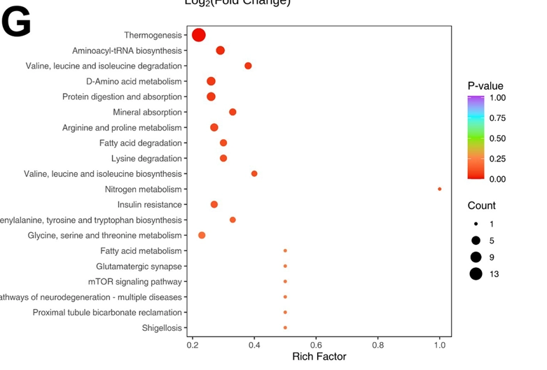
Metabolomics: lipid fuel and amino-acid metabolism
Fatty-acid fuel
Acylcarnitines (C16-OH, C17:0) and free fatty acids higher in CRKP — a shift in mitochondrial fuel use
Amino acids
Lysine up; amino-acid biosynthesis, D-amino-acid and arginine/proline pathways enriched
Methionine cycle
Integrated pathway analysis of proteomic and metabolomic data highlighted dysregulation in cysteine/methionine metabolism and the folate-mediated one-carbon pool, with MAT2B as a key connecting protein.
thermogenesis as the most significantly enriched pathway, alongside pronounced alterations in amino acid metabolism (valine, leucine, isoleucine degradation; arginine and proline metabolism) and fatty acid degradation pathways
Notes:
When they did enrichment analysis they found thermogenesis and aminoacid and fatty acid degradation pathways enriched in resistant group
And the most interesting finding was about the methionine cycle. Integrated pathway analysis of proteomic and metabolomic data highlighted dysregulation in cysteine/methionine metabolism and the folate-mediated one-carbon pool, with MAT2B as a key connecting protein. Keep that one in mind for later in our integration exercises.
Bars are numbers of significant compounds per pathway from the paper's supplementary table 8. Pathway hits rest on few compounds; treat them as leads.

Slide 19


Two lessons before we integrate
Sepsis Severity dominates
A list = data + choices
The largest variance is how ill each patient is — the resistance signal is a small perturbation on top.
Re-analysing the same matrix reproduces the published effect sizes closely, but not the same list. Filtering, imputation and thresholds change membership.
So the question for integration is not 'do the groups separate?' but 'what structure is shared, and where does mechanism cross layers?'
Notes:
Two lessons before we integrate
Sepsis severity dominates, the largest variance is about how ill a patient is, the resistance effect is probably a small perturbation in the top
Also a results list of proteins and metabolites is a product of the data plus our data analysis choices
These two points set expectations for the hands-on: our methods will probably not recover the three groups cleanly, and that is a result, not a failure.
So the question for integration is not 'do the groups separate?’ is more 'what structure is shared between layers, and where does a mechanism cross layers?'

Slide 20
4 · Integration in few minutes
Just enough to start the notebooks
Notes:
Finally few slides about integration and the methods you are going to see in the hands-on

Slide 21



Why is Multi-Omics Integration Key?
Discover Mechanisms
Uncover complex molecular pathways and regulatory networks that are hidden to single-omic analysis.
Refine Phenotypic Subtypes
Identify new, more precise subgroups based on their complete molecular profile, leading to more accurate analyses.
Find Better Biomarkers
Discover robust biomarkers for disease diagnosis, prognosis, and prediction of treatment response.
Notes:
First of all why is multiomics integration key?
Discover mechanisms that were hidden on single omics analysis
Refine phenotypic subtypes: for example disease severity, disease stages, inflammation profiles….besides our study groups
Find better biomarkers for across layers mechanisms that improve disease diagnosis, prognosis, etc…

Slide 22
Data Integration
Horizontal Integration
Study 1
Study 2
Study n
Omics 1
Omics 2
Vertical Integration
Omics n
Notes:
There are two types of data integration:
1 horizontal where we integrate different studies of the same omics
2 vertical where we integrate different omics on the same study (what we have in out integration of today’s workshop)
Both types are tackled with different methods and approaches.

Slide 23
Step zero: two physiology views of the same patients
The same recipe applied symmetrically to both layers
1
Intersect IDs
assert 45 shared patients
shared = [s for s in metadata.index
if s in proteins and s in metabolites]
assert len(shared) == 45, \
"layers no longer describe one cohort"
2
log2
both are multiplicative
3
Filter
≤ 35 % missing
Silent sample mismatches are the most common way multi-omics produces confident nonsense: shapes still match, code still runs.
z-scoring stops one feature dominating by units and one layer dominating by dynamic range.
4
Impute
feature minimum
5
z-score normalization
per feature
Notes:
Before integration there is a step 0 very important!
We have two physiology views of the same patients
The same recipe needs to be applied symmetrically to both layers for them to be comparable
In both layers we are going to check that the IDs are the same – silent sample mismatches is a common cause of producing no sense results
log2 transform the data so that we can observe changes among high and among low abundant features
we are going to filter out low prevalent features
and impute data with the lowest value for each feature – usually in label free MS studies they consider that inf a value is not observed it is because it is low below limit of detection
and finally we z-score per feature and that stops one feature dominating by units and one layer dominating by dynamic range

Slide 24
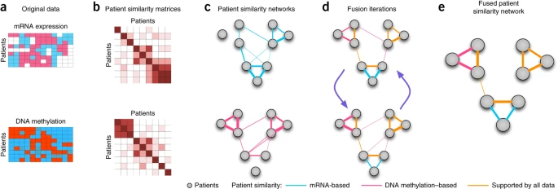
Method: Similarity Network Fusion (SNF)
A network-based method to find sample subtypes (compares patients, not variables)
Step 1 Builds a patient similarity network for each omic data type (e.g based on gene expression, DNA methylation, proteome and metabolome intensities, etc… ).
Step 2 Iteratively fuses these networks into a single, comprehensive patient network.
The fusion process keeps strong similarities found in multiple omics layers and filters out weak, "noisy" connections.
The final fused network represents a robust measure of patient similarity which is then used for clustering and comparison with clinical groups.
https://www.nature.com/articles/nmeth.2810
Notes:
First method that you will see is Similarity network fusion

Slide 25

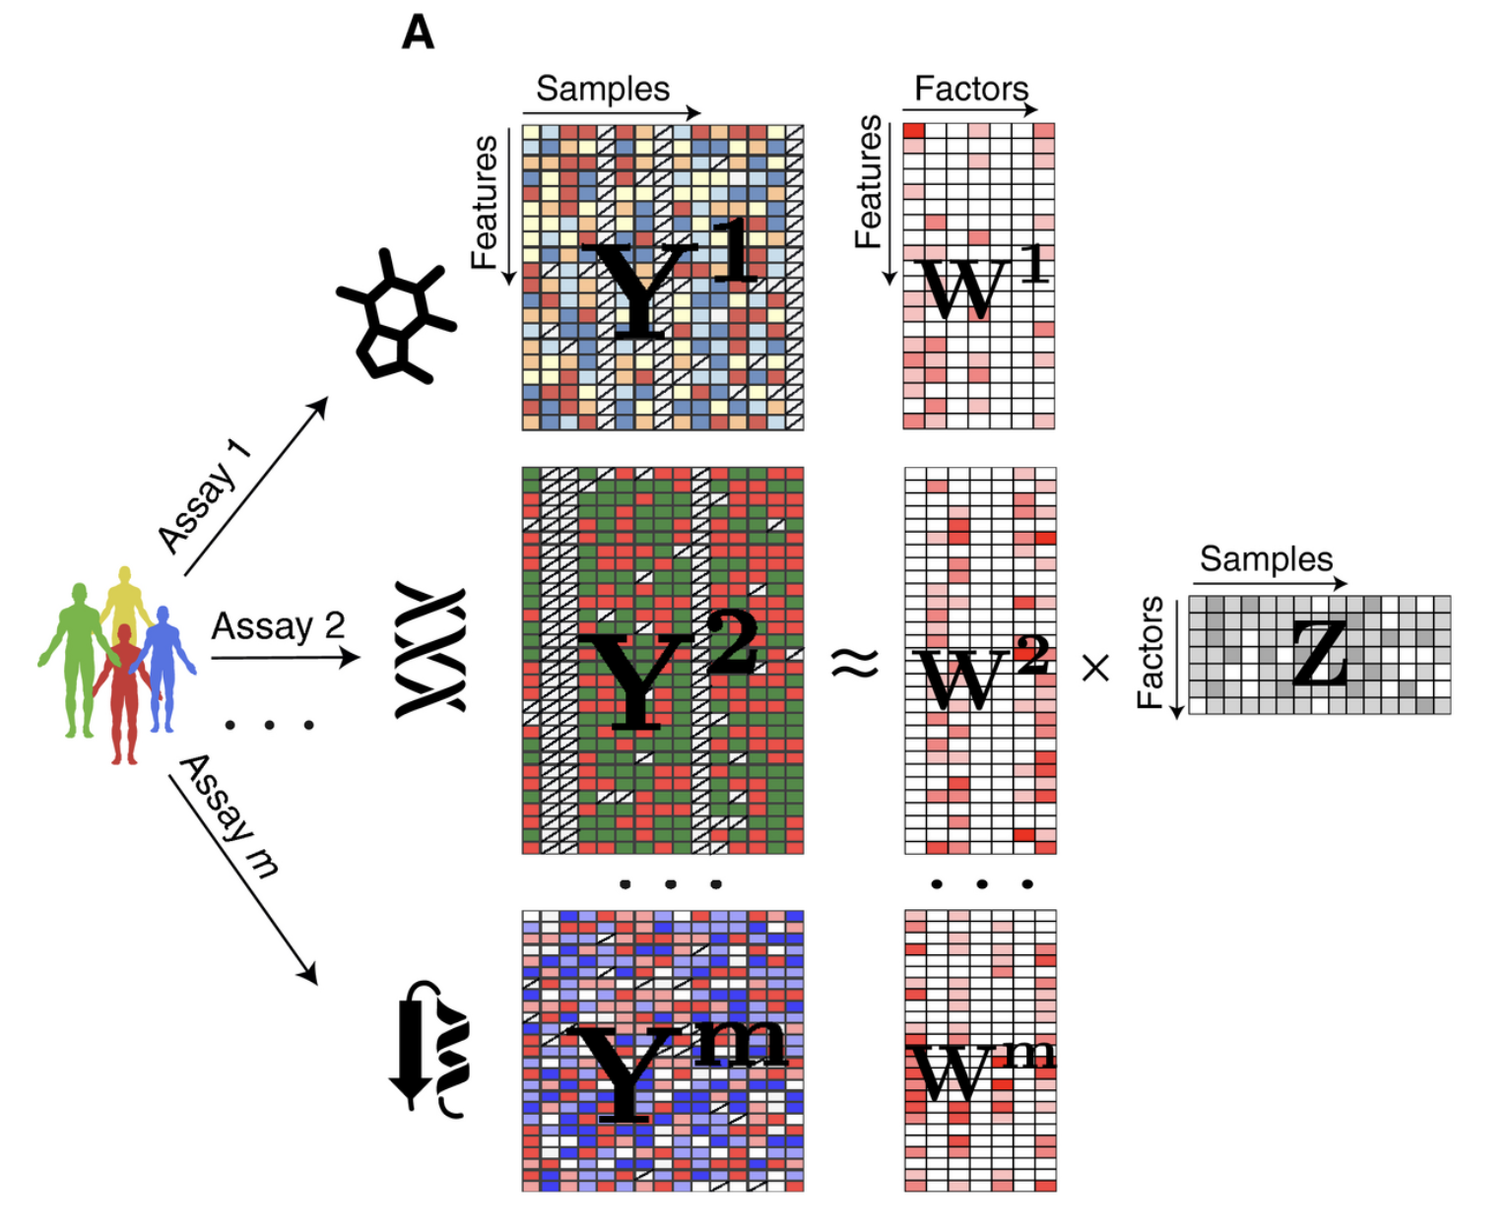
Method: Multi-Omics Factor Analysis (MOFA)
Unsupervised integration method
To find the sources of variation
Generalization of PCA for multi-omics (dimensionality reduction tool)
Main difference integration of probabilistic structure and sparsity priors.
It decomposes all omics data into a set of hidden factors
which factors are shared (capture variance across all omics) and which are specific (capture variance in only one omic)
These factors can then be visualized, correlated with clinical data, or used for clustering and imputation.
https://www.embopress.org/doi/full/10.15252/msb.20178124
Notes:
Example of the switches turning on/off features

Slide 26
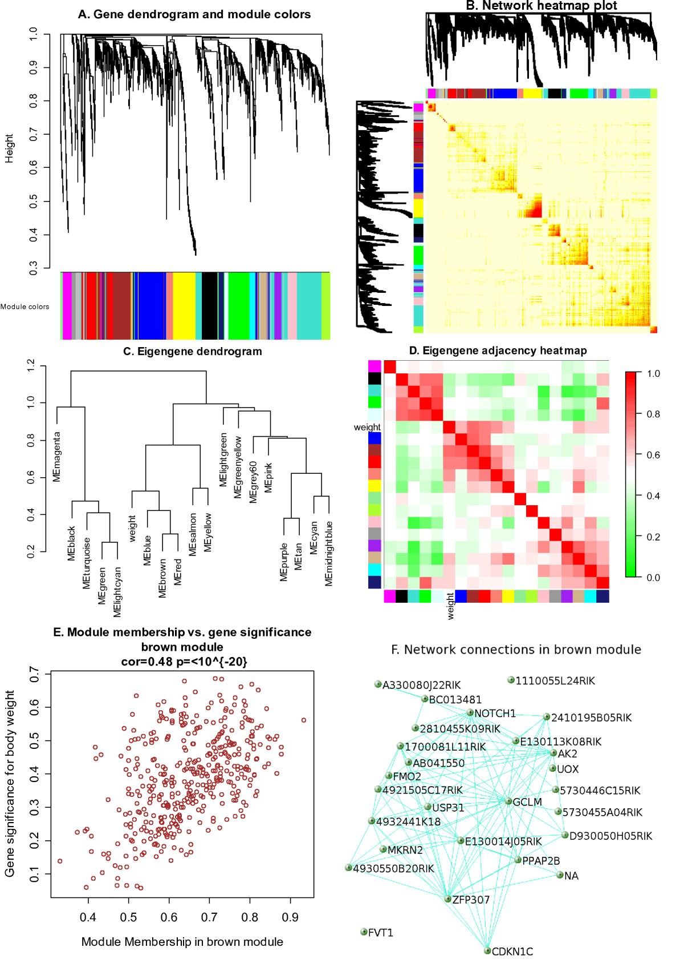
Network Biology Analysis
In network biology the primary goal is to find modules of highly correlated features (e.g., co-expressed genes, correlated proteins and metabolites).
We build multi-omic correlation networks to identify for instance modules of proteins (from proteomics) that are highly correlated with modules of metabolites (from metabolomics).
This allows researchers to find key proteins that may be regulators of specific metabolic pathways.
https://bmcbioinformatics.biomedcentral.com/articles/10.1186/1471-2105-9-559

Slide 27



Your turn: two notebooks in Google Colab
https://tinyurl.com/bddaap8r
Multi-omics I — Data layers Integration
~35 min
Multi-omics II — Networks & pathways
~35 min
notebooks/01_multiomics_integration.ipynb
notebooks/02_multiomics_networks(_with_AUC).ipynb
Questions to answer
Questions to answer
Is the Mantel correlation positive? Shared or complementary signal?
Do SNF clusters match the groups — or the clinical variables?
Which MOFA factor tracks group, which tracks CRP / creatinine?
How many protein–metabolite edges survive FDR 5 % vs 20 %?
Who are the hubs — controllers or markers of global state?
Does MAT2B correlate with SAM? Would you believe it?
github.com/biosustain/dsp_multiomics_workshop · open each notebook from the README · Runtime → Run all first
Notes:
Ok so now it is your turn to get hands on data integration.
As I said there are two slide decks to read before the hands-on if you want, otherwise you jump directly to the hands on notebook in google colab.
Both notebooks are self-contained: they download the curated tables from the workshop repository on GitHub and need no output from earlier sessions.
Cytoscape export is optional; skip it if Cytoscape is not installed.
Focus on having a general idea of what we do instead of getting stuck on each single detail. The material is open and you can get back to it later whenever you want to consolidate your understanding.
When there are 5 min left we will wrap up and answer together these questions.

Slide 28
Take home
Preprocessing is a chain of decisions — pin pipelines, record metadata, randomise run order
A differential list is the data plus the analyst's choices
Integration pays off where mechanism crosses layers, not where groups separate
Networks generate hypotheses; validation needs another cohort
Notes:
Close with the biology: in CRKP sepsis the serum shows antigen-presentation and coagulation changes and, where the layers meet, one-carbon and methionine metabolism. A hypothesis with a specific mechanism and a specific way to be wrong.

Slide 29
Answers to the questions
Multi-omics I — Integration
1. Is the Mantel correlation between the two layers positive? Is the signal shared or complementary?
The correlation is slightly positive (rho=0.058), but almost zero and statistically non-significant (p = 0.491). This indicates that the global structures of the proteome and the metabolome in this cohort do not strongly mirror each other. Therefore, the signal is highly complementary rather than shared; each layer captures unique biological dimensions of the host response.
2. Do the SNF clusters match the pathogenicity groups — or the clinical variables?
The clusters do not match the pathogen resistance groups (CSKP vs. CRKP). Instead, they match clinical variables representing the severity of the inflammatory host response. Cluster 1 is characterized by a significantly higher systemic inflammatory profile, while cluster 0 and 2 contain mostly culture negative samples / less severe sepsis.
3. Which MOFA factor tracks group, and which tracks CRP, procalcitonin or creatinine?
Factor 2 is associated with pathogenicity/clinical groups (Kruskal-Wallis p = 0.0000219) – quite clean signal of the clinical groups.
Factor 1 has the strongest relationship with systemic inflammatory markers, showing Spearman correlation with Procalcitonin (rho = 0.452) and CRP (rho = 0.26) and creatinine (rho = 0.232 – renal function). We did not choose the factor 4 because it explains ~8% less of the variance.

Slide 30
Answers to the questions
Multi-omics II — Networks and pathways
1. How many protein–metabolite edges survive FDR 5 %, and how many FDR 20 %?
At FDR 5% only 8 edges survive (with a Spearman rho > 0.45.
At FDR 20% 492 edges survive (331 positive, 161 negative). This gives us enough network structure to map out metabolic communities, but with the warning that about 1 in 5 edges (around 98 of them) are expected to be false positives.
2. Who are the hubs — metabolic controllers, or markers of a global state?
Mostly markers of a global state. For example, the top protein hub F7 (Coagulation Factor VII) and immunoglobulins like IGKV2-29 (which has 31 partners) correlate with many metabolites because they all independently track the systemic collapse, vascular damage, and immune exhaustion of severe CRKP sepsis.
3. Does MAT2B correlate with S-adenosylmethionine (SAM)? Would you believe it?
Yes, they correlate: rho = 0.38; p = 0.0358
I would believe it with strong skepticism. Why?
- Very Small Sample Size: MAT2B is only measured in 30 out of 45 patients.
- Leakage vs. Activity: MAT2B is an intracellular enzyme. Finding it in the serum likely means cell death and tissue damage rather than active serum enzyme kinetics.
- Circular Reasoning: We specifically zoomed in on the methionine cycle because the paper's pathway analysis (with FDR = 0.57) pointed us there. Finding a correlation here is a coherence check, not independent biological confirmation.

