Slide 1



Multi-omics
Alberto Santos & Yesid Cuesta-Astroz

Slide 2
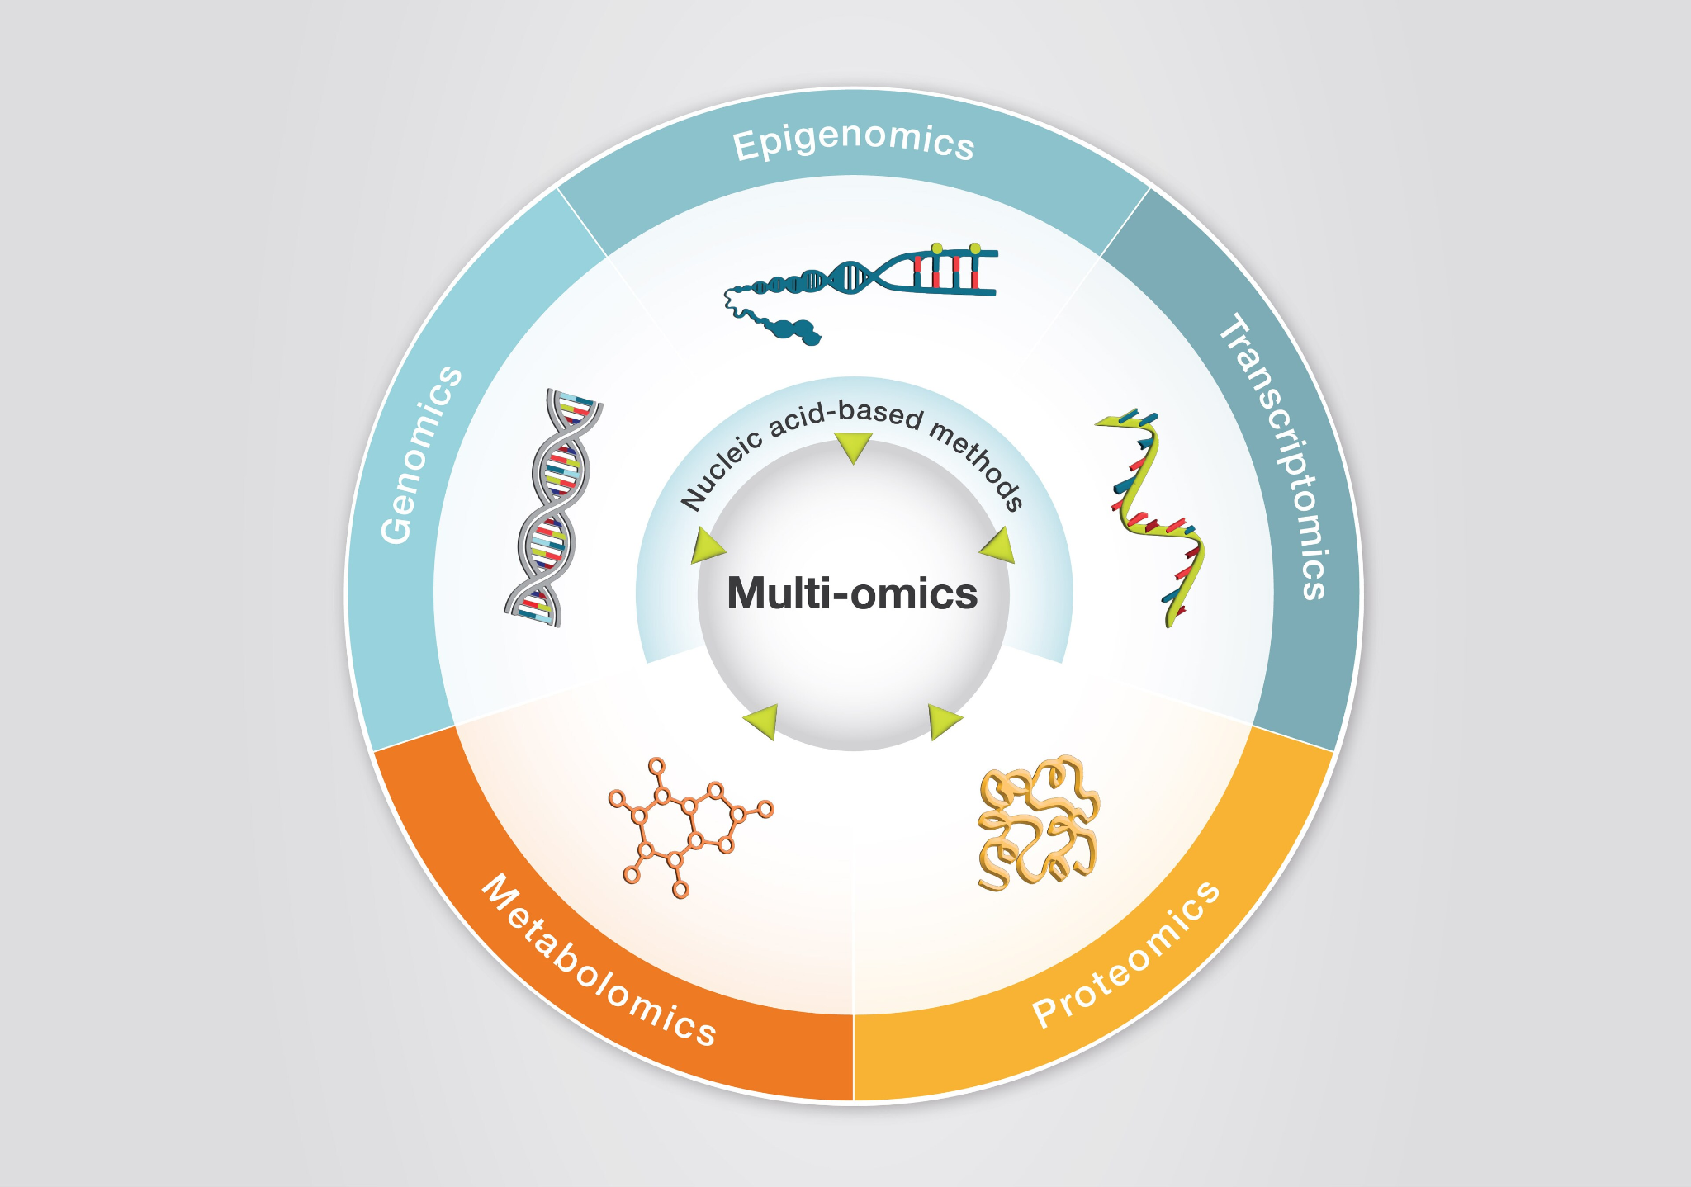
Multi-omics
Multi-omics integration refers to the computational methods used to combine and analyze data from two or more different 'omic' layers (e.g., genomics, transcriptomics, proteomics, metabolomics).
The goal is to gain a comprehensive, systems-level understanding of a biological process or disease.
It helps uncover the complex interactions and information flow from one layer to the phenotype.

Slide 3



Why is Multi-Omics Integration Key?
Discover Mechanisms
Uncover complex molecular pathways and regulatory networks that are hidden to single-omic analysis.
Refine Phenotypic Subtypes
Identify new, more precise subgroups based on their complete molecular profile, leading to more accurate analyses.
Find Better Biomarkers
Discover robust biomarkers for disease diagnosis, prognosis, and prediction of treatment response.

Slide 4
Key Challenges
High Dimensionality The "curse of dimensionality" (p >> n), where the number of features (genes, proteins) vastly exceeds the number of samples.
Data Heterogeneity Integrating data of different types, scales, and statistical distributions (e.g., counts, binary, continuous).
Noise & Batch Effects Each omic layer introduces its own technical noise and batch effects that must be corrected.
Missing Data Datasets are often incomplete, with different omics measured on only partially overlapping sets of samples.
Interpretability Building models that are not just predictive but also biologically interpretable.

Slide 5
Data Integration
Horizontal Integration
Study 1
Study 2
Study n
Omics 1
Omics 2
Vertical Integration
Omics n

Slide 6
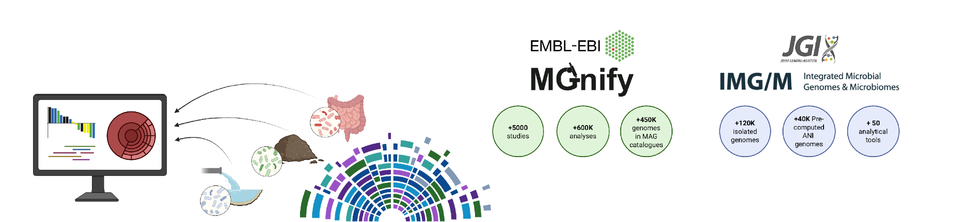
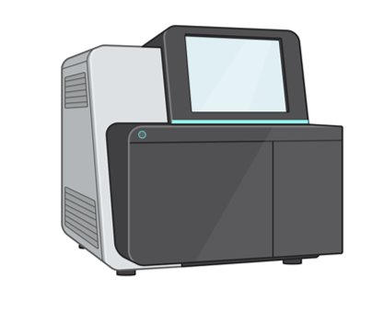
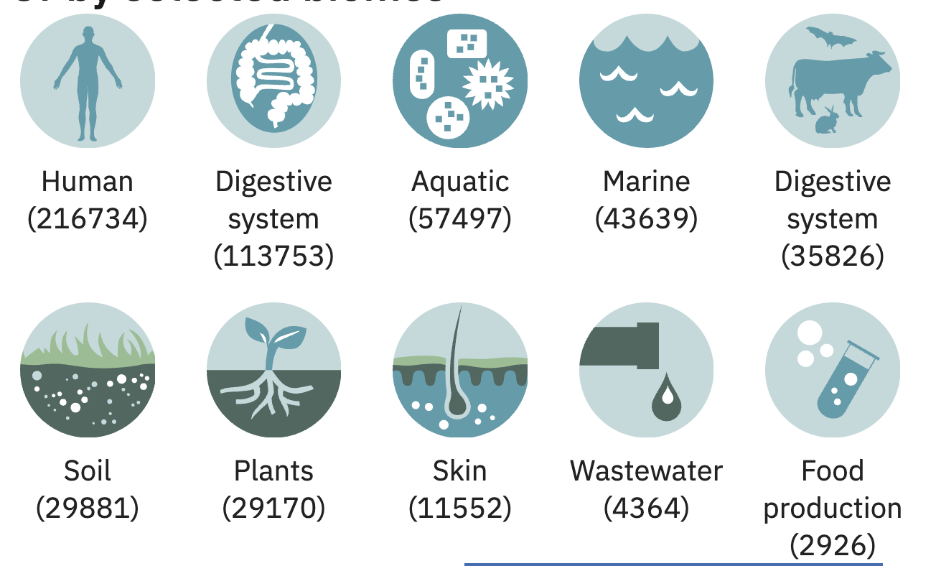
Horizontal Data Integration
Publicly Available Data

Slide 7
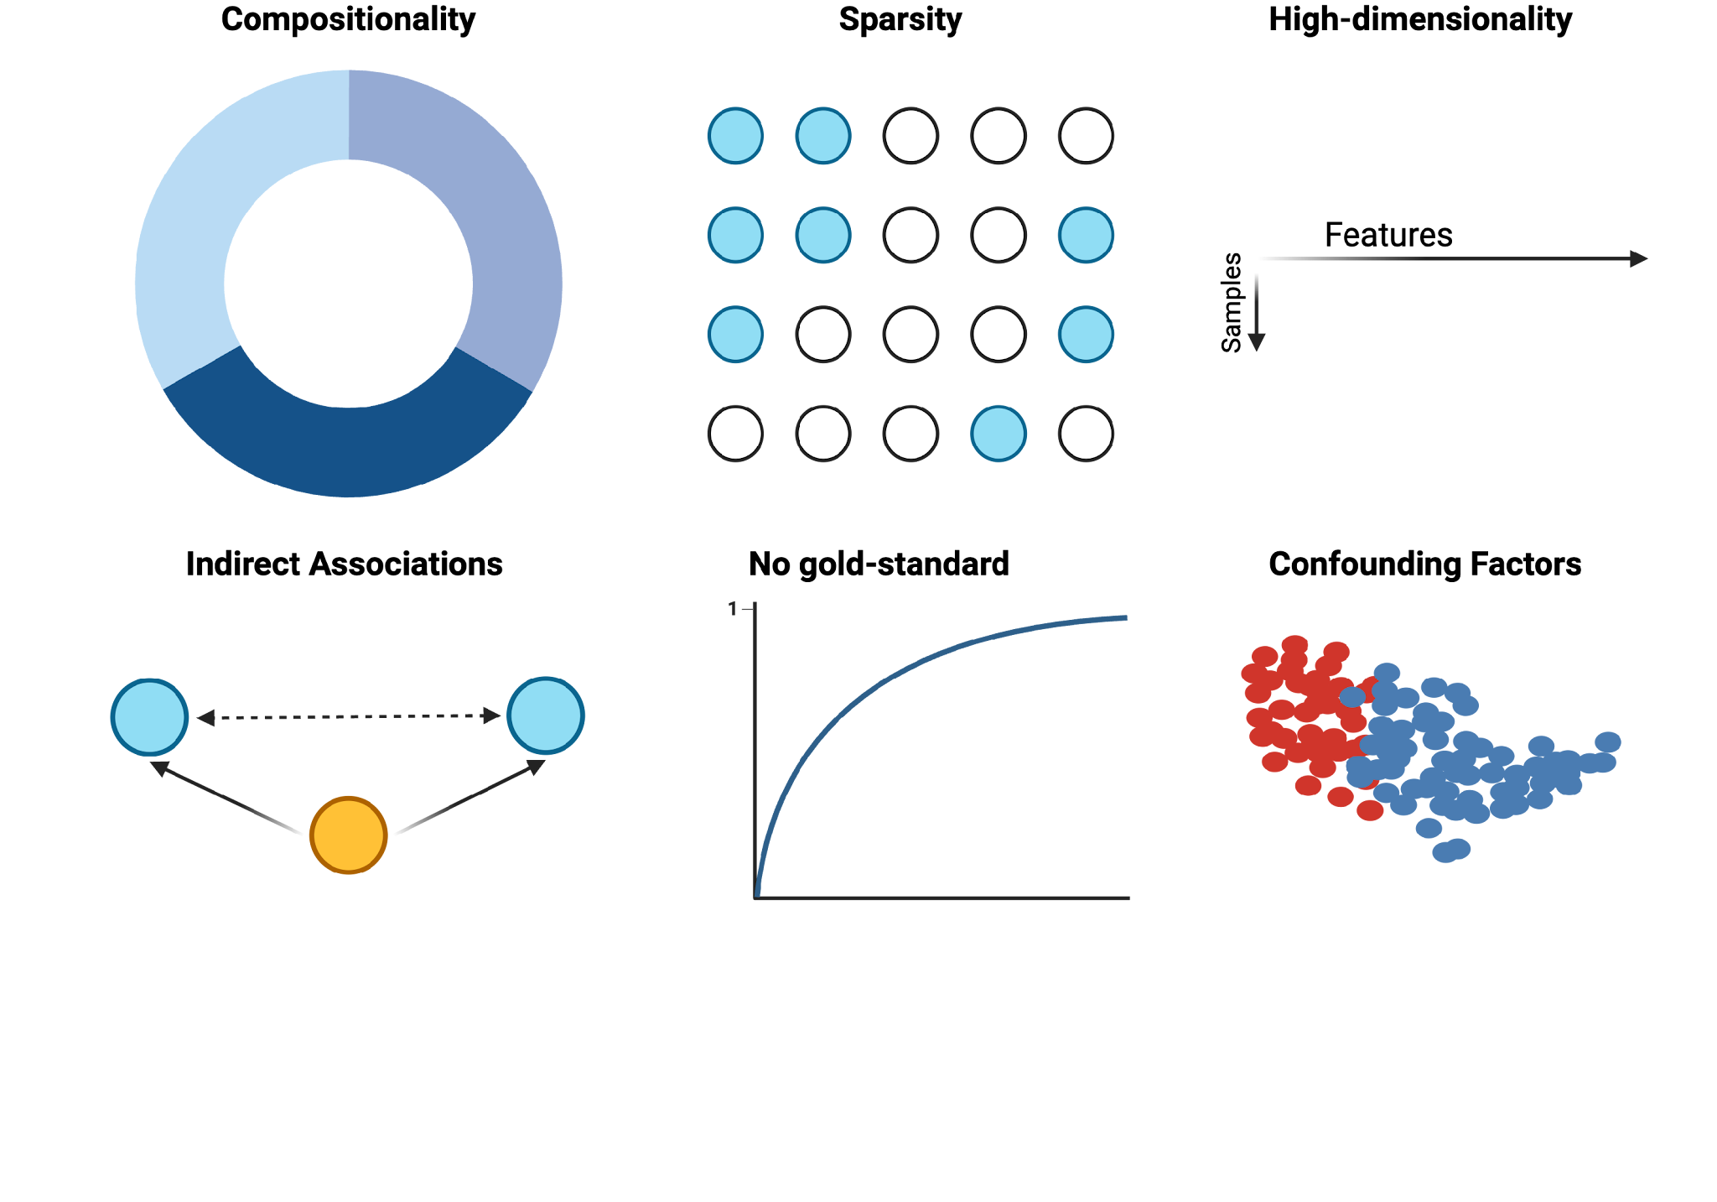
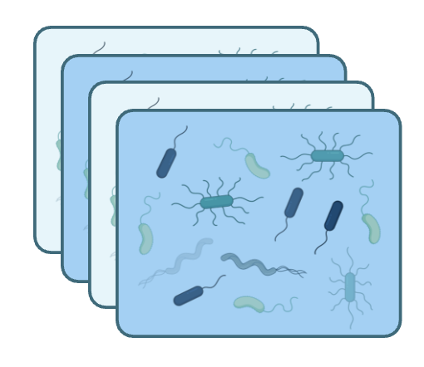
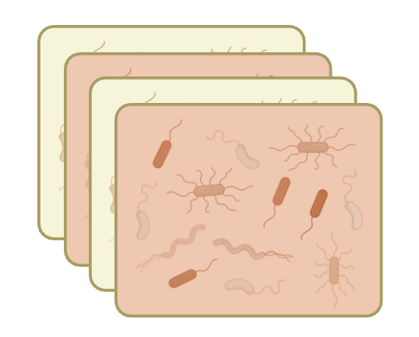
Horizontal Data Integration
study 1
study n

Slide 8
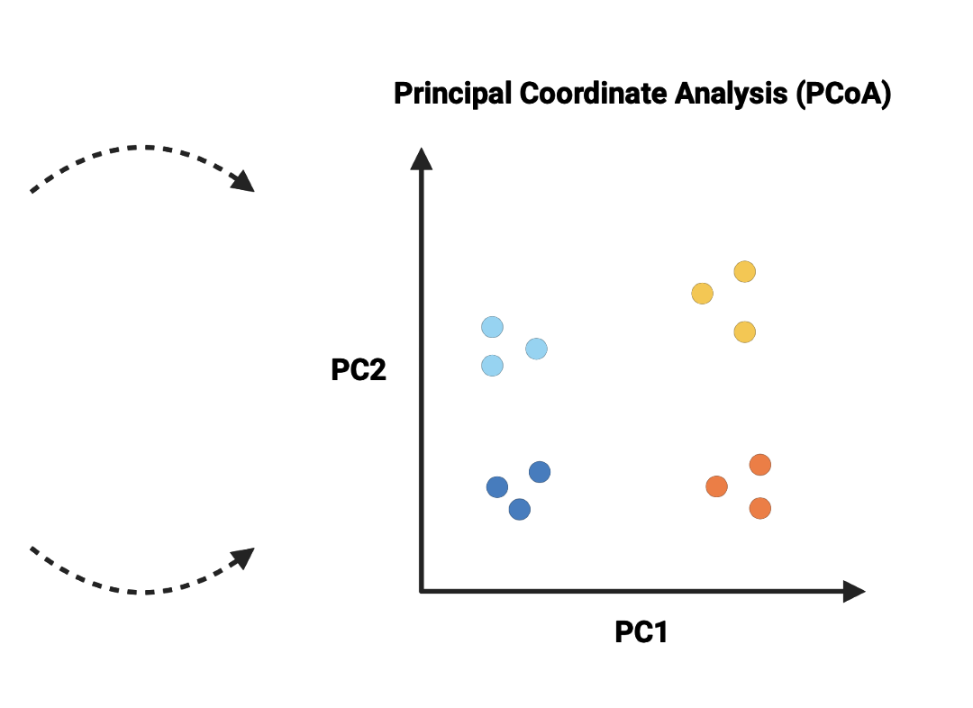
Horizontal Data Integration
study 1
study n

Slide 9
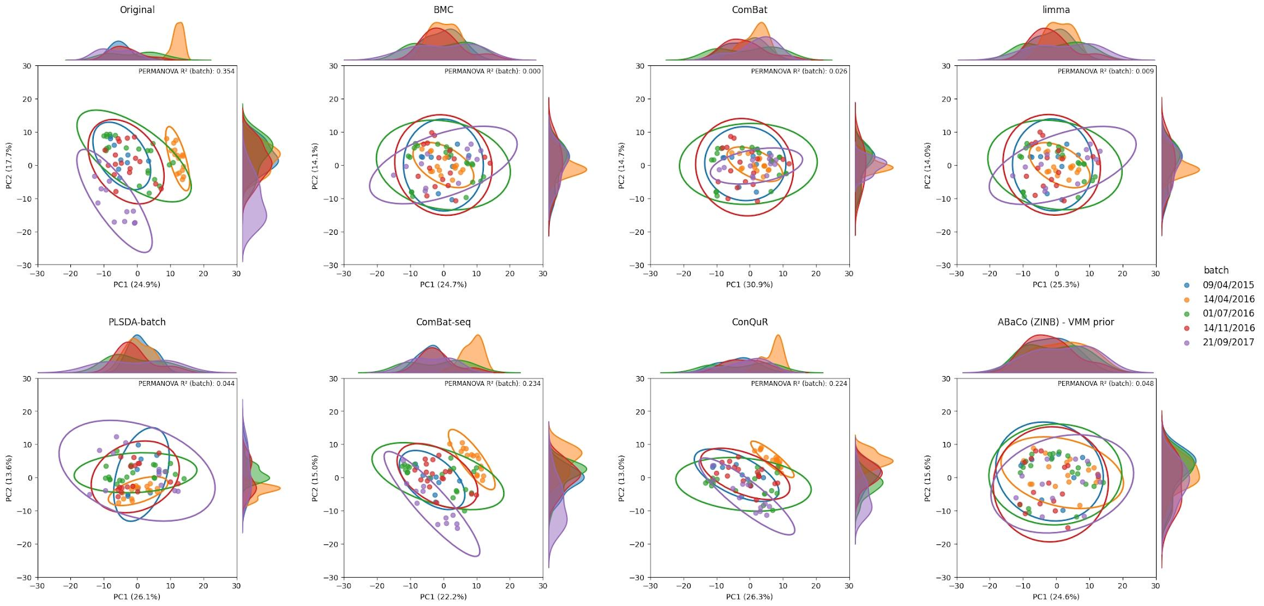
Study Effect

Slide 10
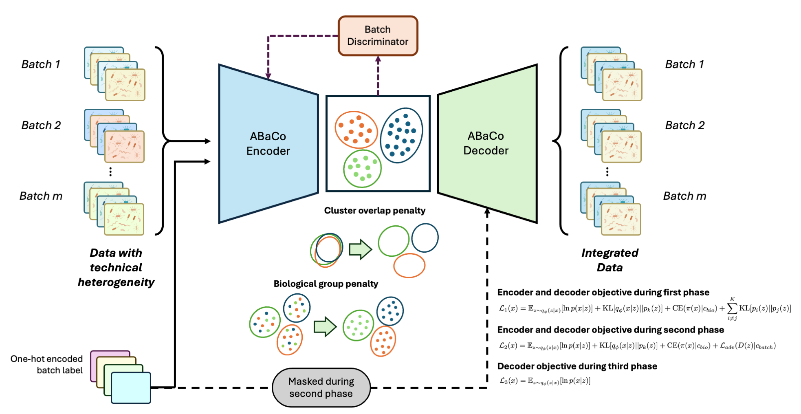
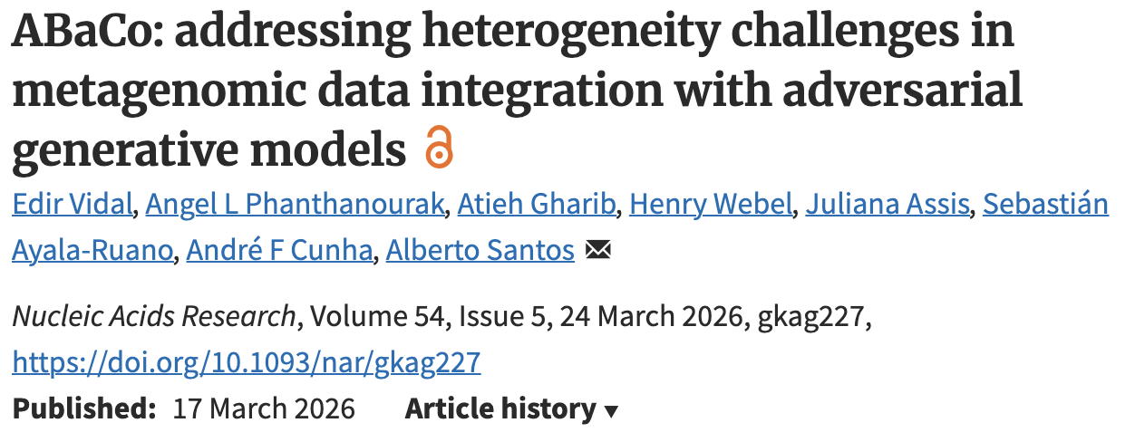
ABaCo: Autoencoder-based Batch Correction

Slide 11
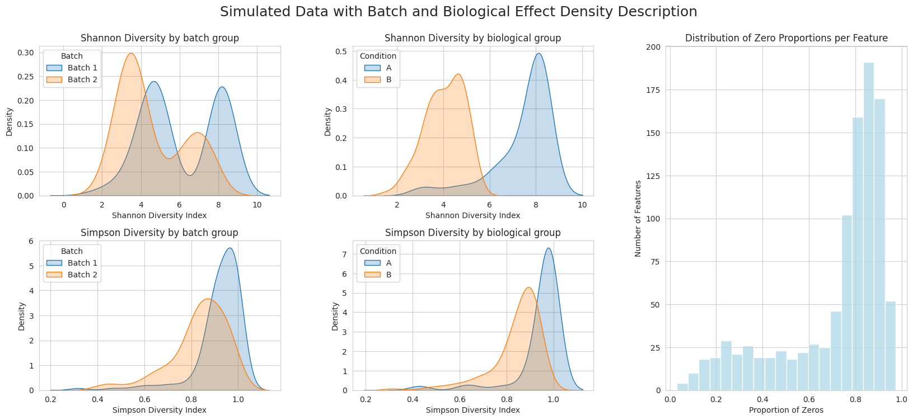
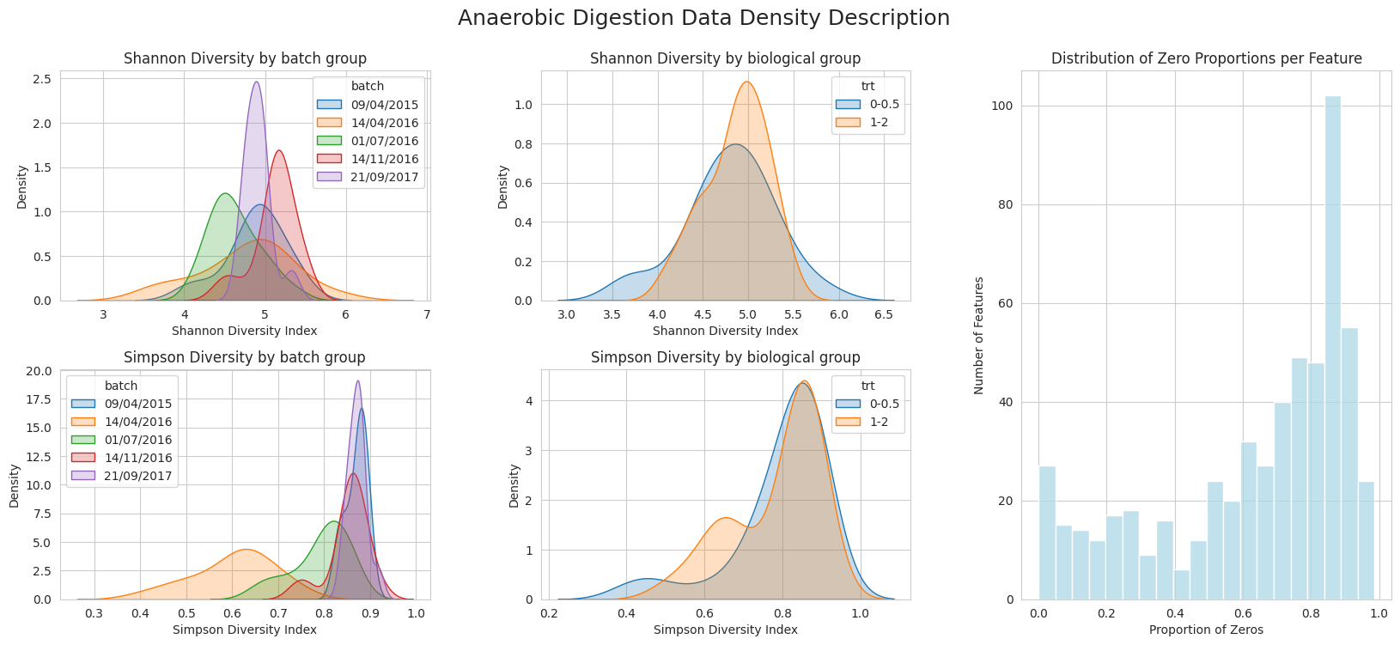
Benchmark
Datasets
2 x Simulated Dataset
3 x Real Dataset

Slide 12
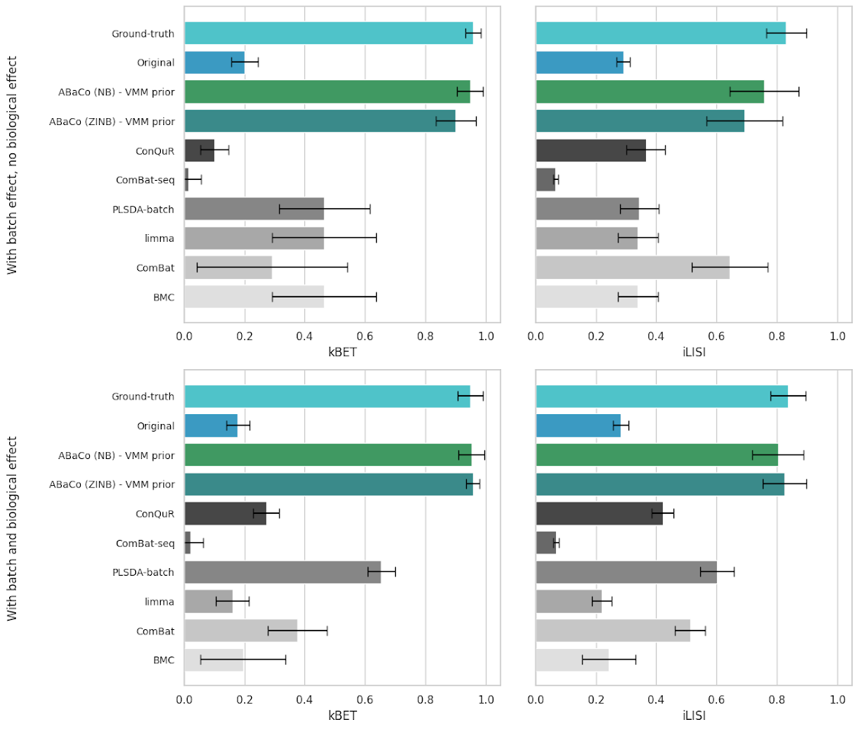
Benchmark Results
Biological groups
Batches

Slide 13
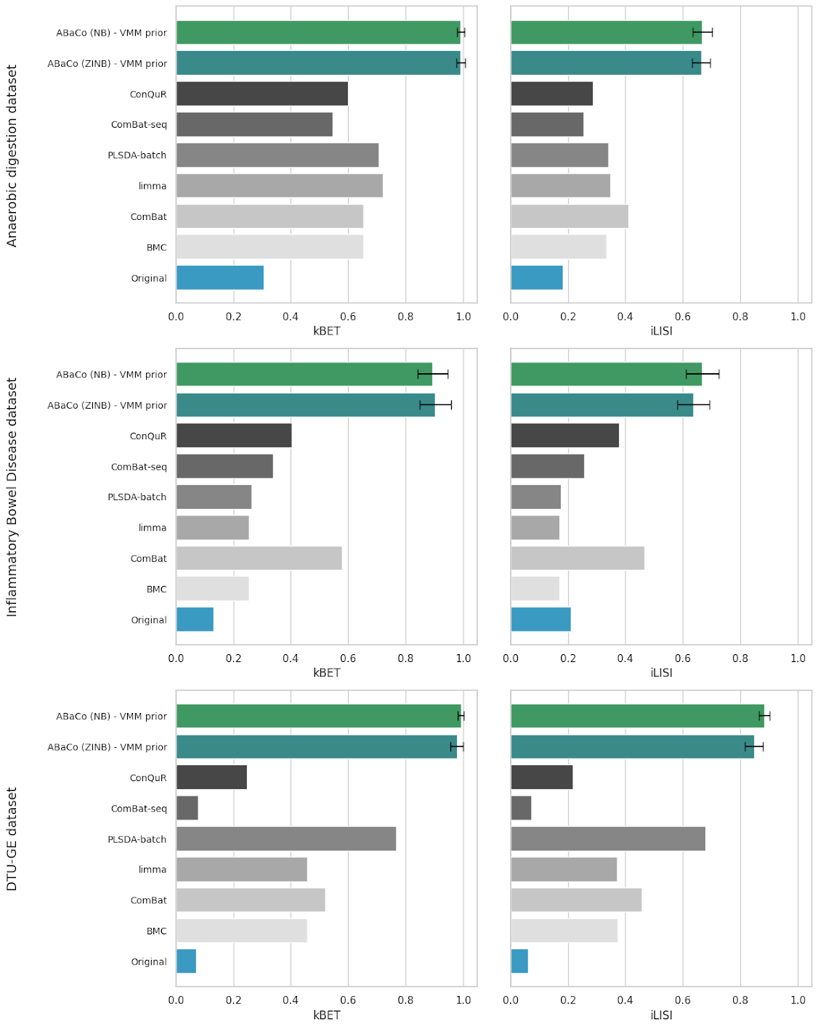
Benchmark Results

Slide 14
Benchmark Results

Slide 15
Ready for Integration
Before
After

Slide 16
Vertical Integration

Slide 17
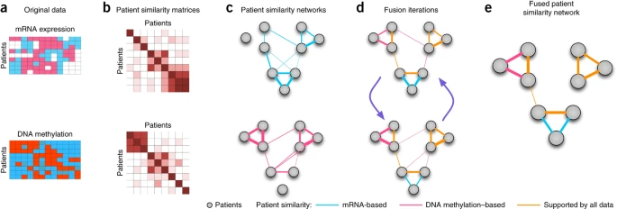
Method: Similarity Network Fusion (SNF)
A network-based method to find sample subtypes
Step 1 Builds a patient similarity network for each omic data type (e.g., a gene expression network, a methylation network).
Step 2 Iteratively fuses these networks into a single, comprehensive patient network.
https://www.nature.com/articles/nmeth.2810

Slide 18
Method: Similarity Network Fusion (SNF)
The fusion process finds strong similarities found in multiple omics layers and filters out weak, "noisy" connections.
The final fused network represents a robust measure of patient similarity which is then used for clustering.
Pro Tolerates noise and data heterogeneity well.
Con Does not identify the specific features (genes) driving the clusters.

Slide 19

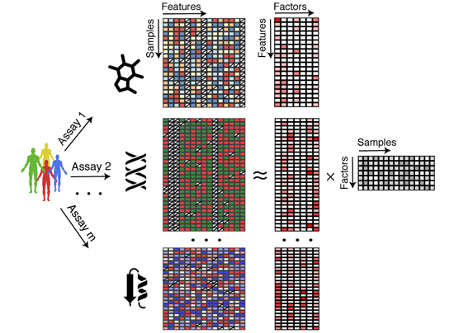
Method: Multi-Omics Factor Analysis (MOFA)
An unsupervised integration method, often described as a generalization of PCA for multi-omics. The primary difference is the integration of probabilistic structure and sparsity priors.
It decomposes all omics data into a set of hidden factors (a latent space).
It shows which factors are shared (capture variance across all omics) and which are specific (capture variance in only one omic).
These factors can then be visualized, correlated with clinical data, or used for clustering and imputation.
MOFA achieves a structured dimensionality reduction that is both statistically rigorous and interpretable.
https://www.embopress.org/doi/full/10.15252/msb.20178124

Slide 20
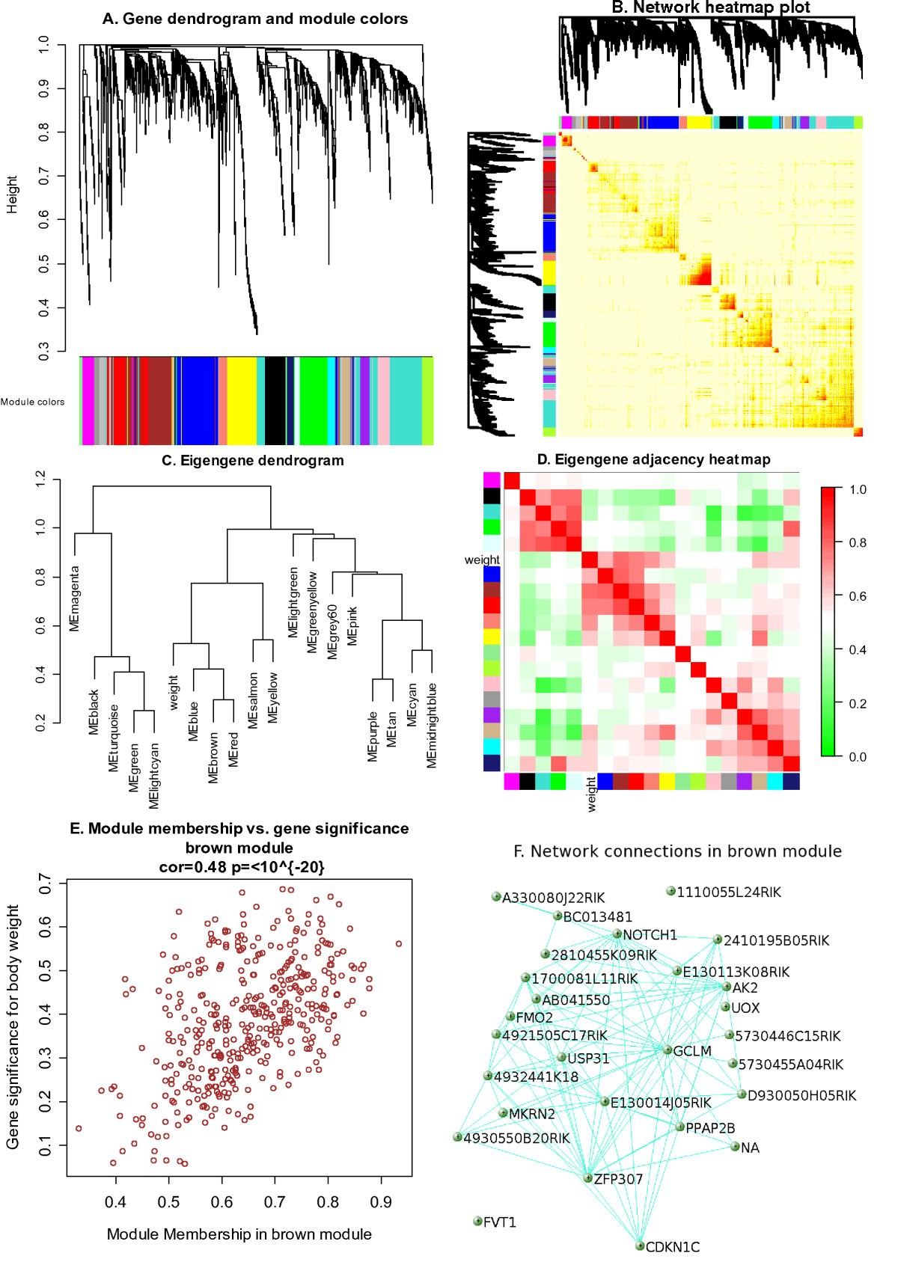
Method: Weighted Gene Coexpression Network Analysis
WGCNA’s primary goal is to find modules of highly correlated features (e.g., co-expressed genes).
WGCNA is used to build multi-omic correlation networks to identify for instance modules of genes (from transcriptomics) that are highly correlated with modules of metabolites (from metabolomics).
This allows researchers to find key genes that may be regulators of specific metabolic pathways.
https://bmcbioinformatics.biomedcentral.com/articles/10.1186/1471-2105-9-559

Slide 21
Other Integration Methods
DIABLO (mixOmics)
A supervised method (based on PLS/CCA) that finds correlated features between omic layers.
iCluster
A latent variable model (matrix factorization) that simultaneously clusters samples based on multiple data types.
MOVE (Multi-Omics Variational autoEncoder)
Variational Autoencoder model that learns a compressed, non-linear representation of omics and clinical data.

Slide 22
When to Add Another 'Omic' Layer?
When your research question cannot be answered by a single omic layer.
To increase predictive power and provide a more complete, systems-level view.
The Trade-Off (The "Cost")
Adding layers is not always better. It increases costs, computational complexity, and data storage needs.
Introduces more challenges with batch effects, noise, and missing data.
Decision must be a strategic, hypothesis-driven choice where the potential for deeper insight outweighs the costs and challenges

Slide 23
Multi-omics integration is moving biology from a reductionist to a systems-level perspective. While computationally challenging, it offers unprecedented power to understand the complexity of life and disease.

Slide 24


