Slide 1

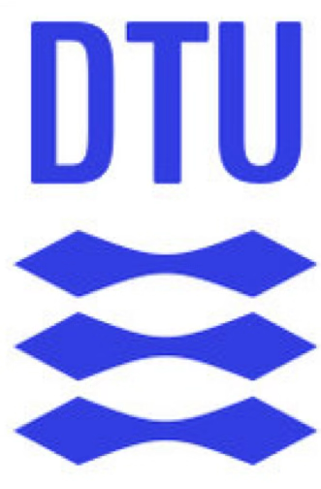

Network Biology
Alberto Santos & Yesid Cuesta-Astroz

Slide 2
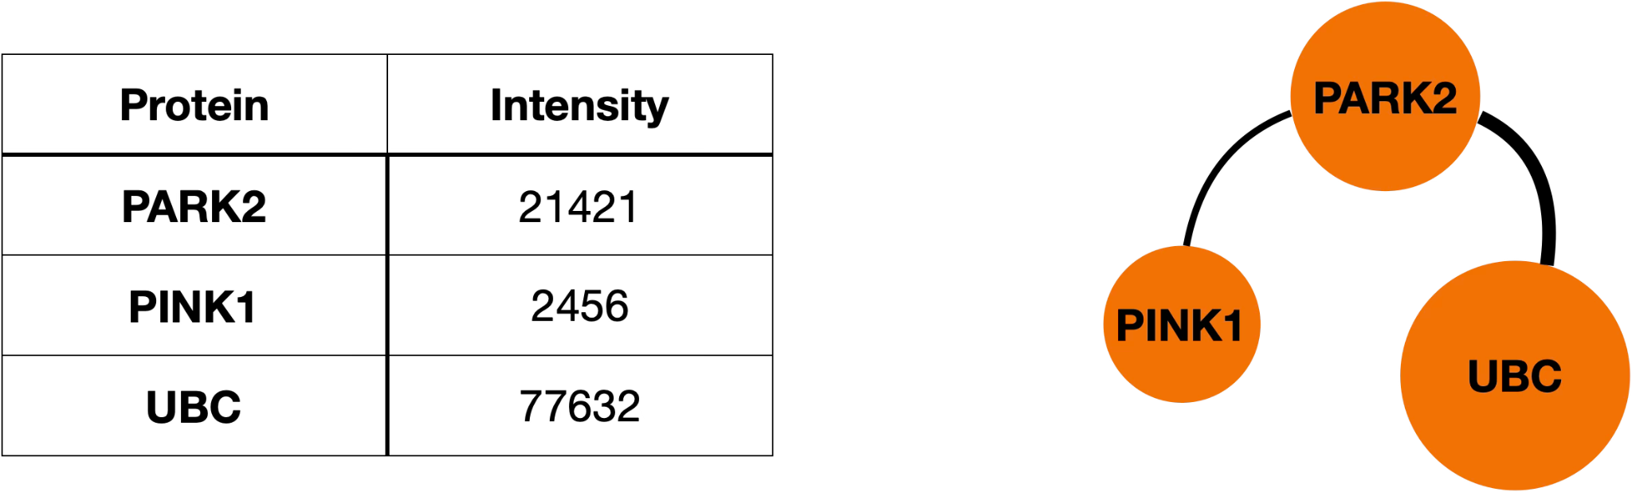
Biology as a System
Understanding biology holistically and integratively — structures, functions, and interactions.
Biological systems are complex systems difficult to model and predict their responses to perturbations or interventions.

Slide 3
Modelling Biological Systems
Not walking away from complexity
Holistic understanding — Studying biology as systems allows us to understand the complex interactions and dependencies among biological components, beyond isolated parts
Integrative approach — Aggregating data from multiple disciplines and technologies helps to better understand life processes
Emergent properties analysis — Many biological phenomena cannot be understood by studying components individually but emerge from their interactions
Real-world applications — A systems perspective aims to model complex global challenges

Slide 4
Network Biology
Helps us to visualise and analyse complex biological systems as networks of interactions (e.g., protein-protein, gene regulatory, or metabolic pathways), aiding in understanding their structure and function
Networks model diverse biological datasets into interpretable frameworks, enabling researchers to uncover patterns that might be overlooked otherwise (e.g., multi-omics data — genomics, proteomics, etc.)
Researchers can use network properties to identify critical nodes or pathways disrupted in specific conditions like disease or define how biological systems maintain function, guiding strategies to enhance resilience or address fragility
Computational models using network structures allow prediction of outcomes, reducing reliance on trial-and-error experiments

Slide 5
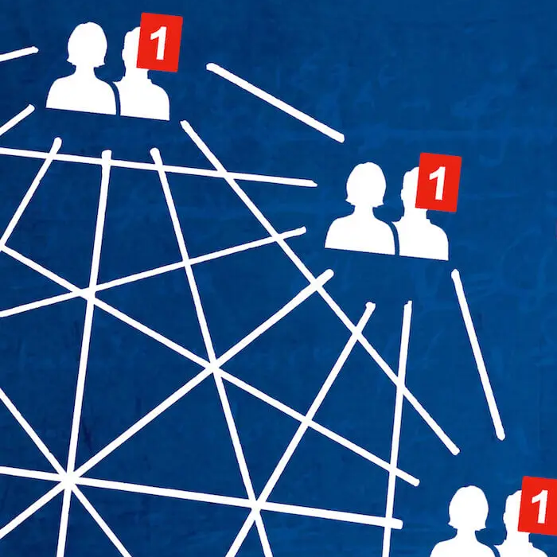

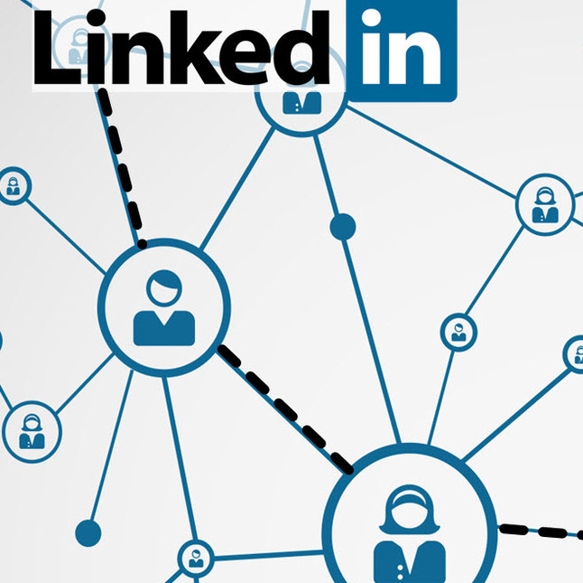
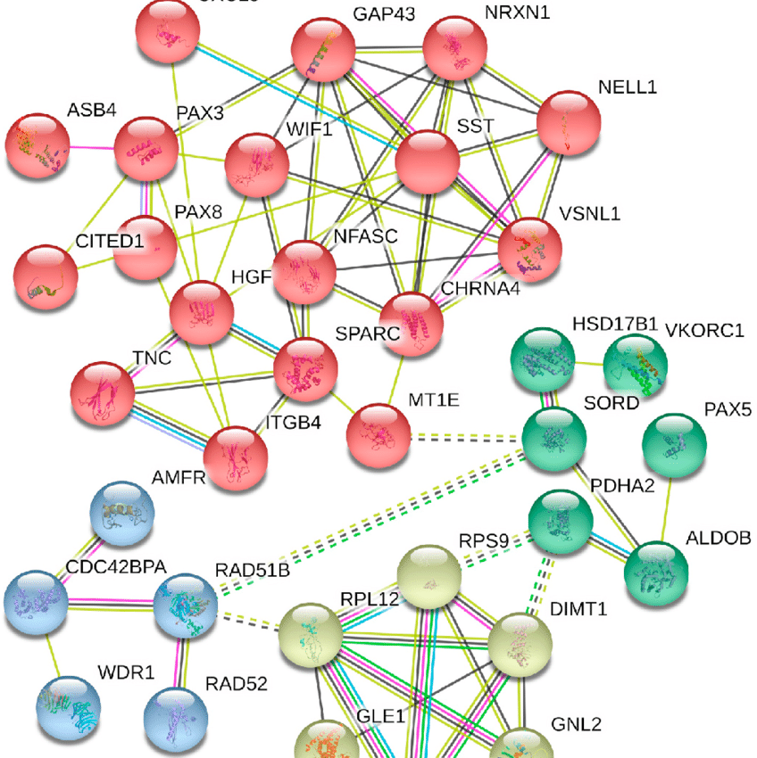
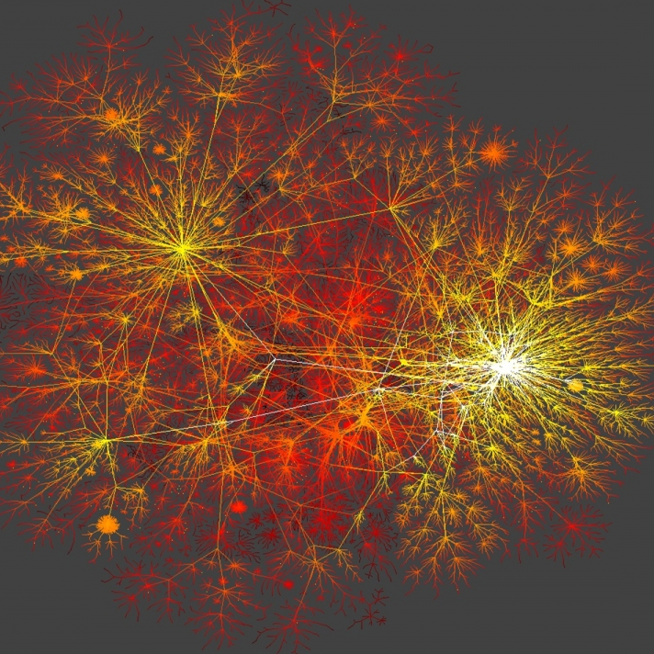
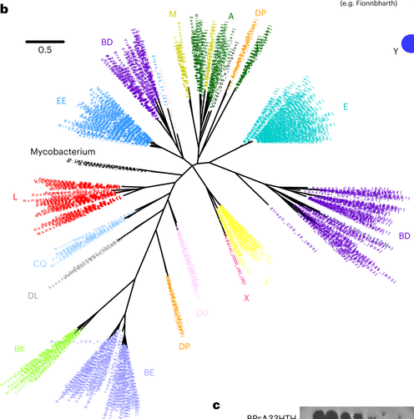
What is a Graph/Network?
Data structures of components (nodes) connected by relationships (edges)
Social networks
Biological networks

Slide 6
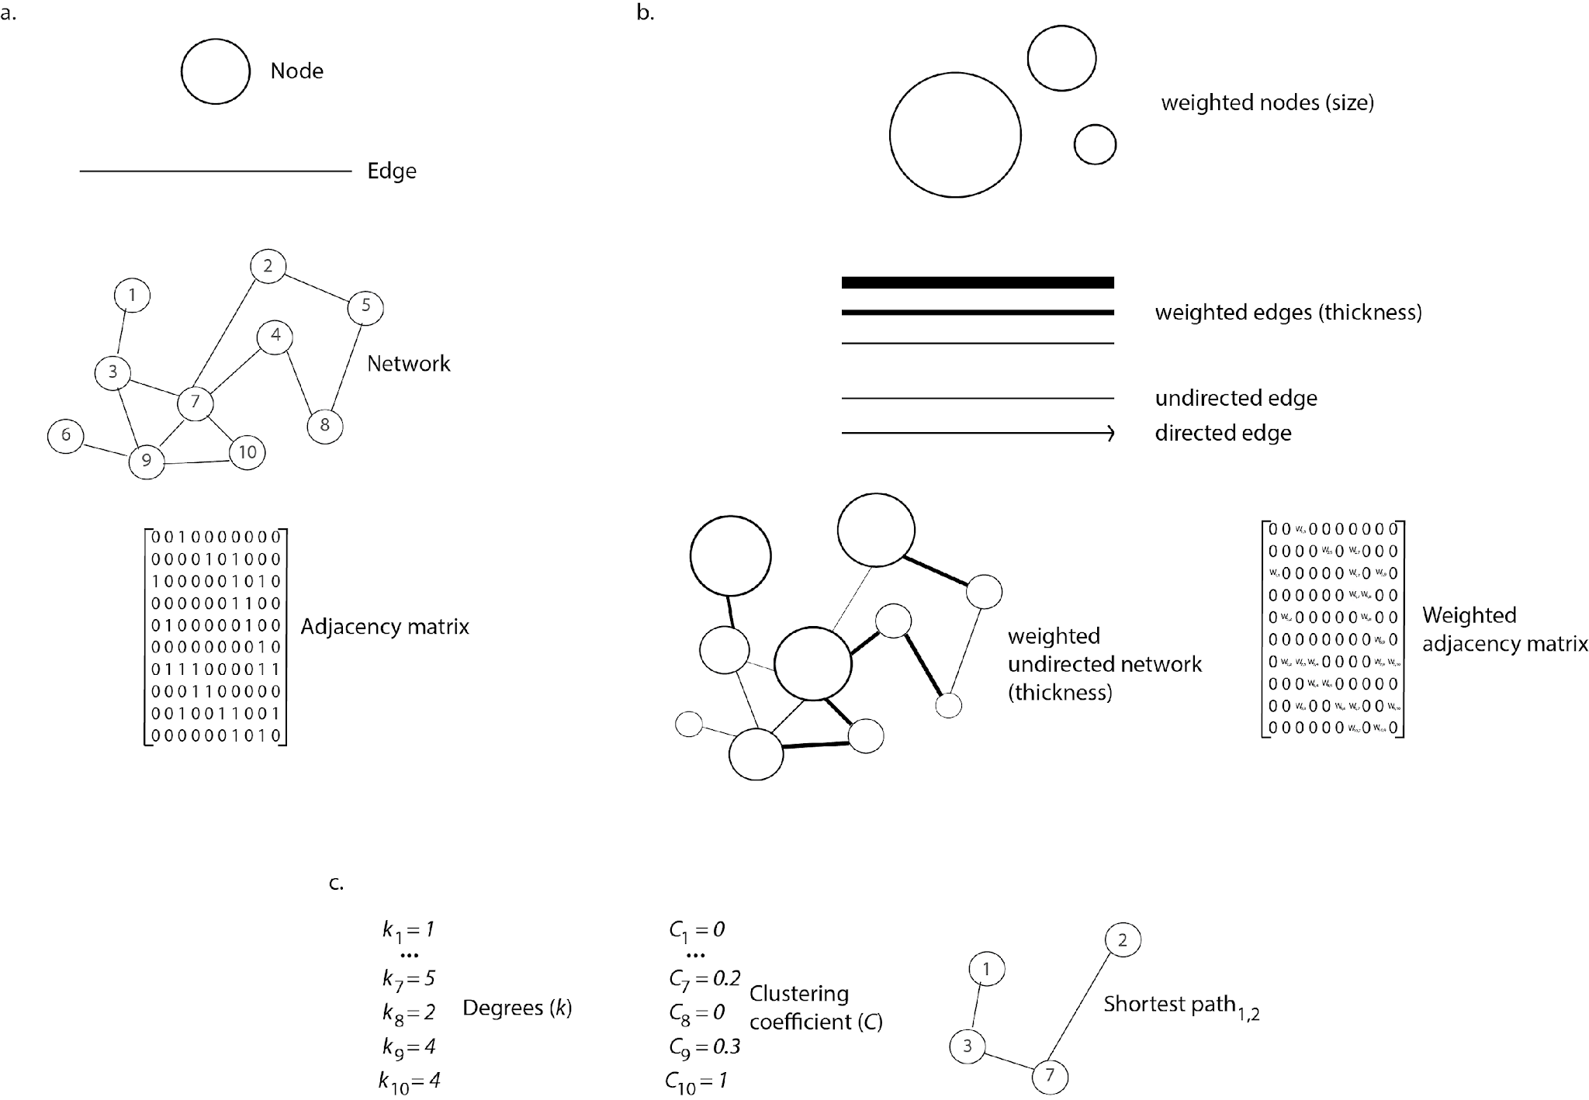
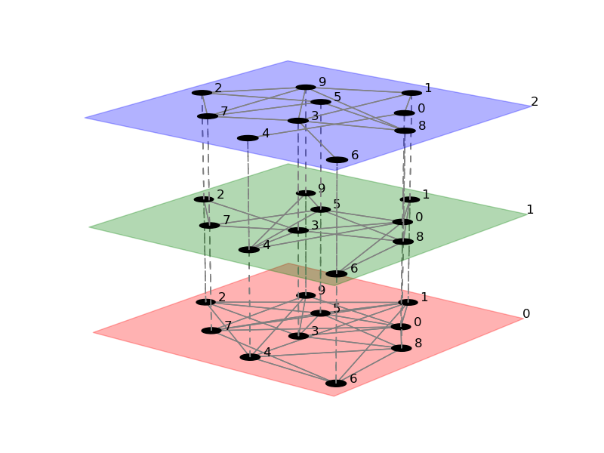
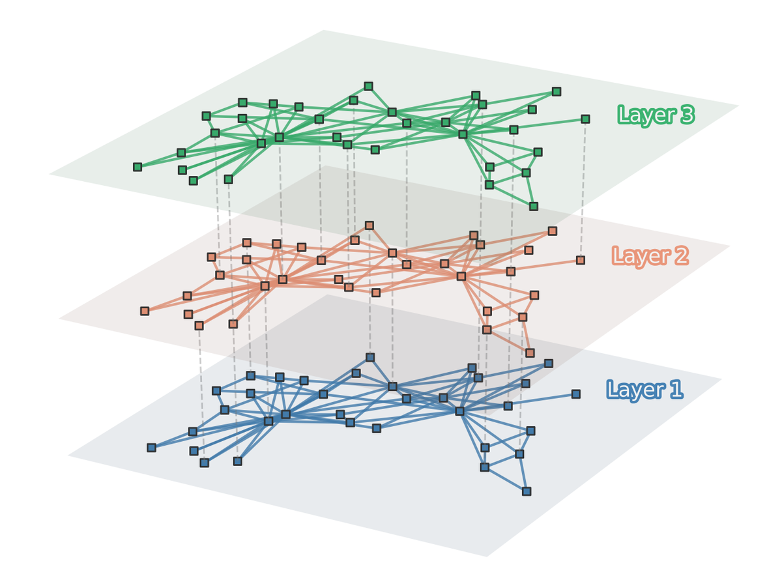
Graphs

Slide 7
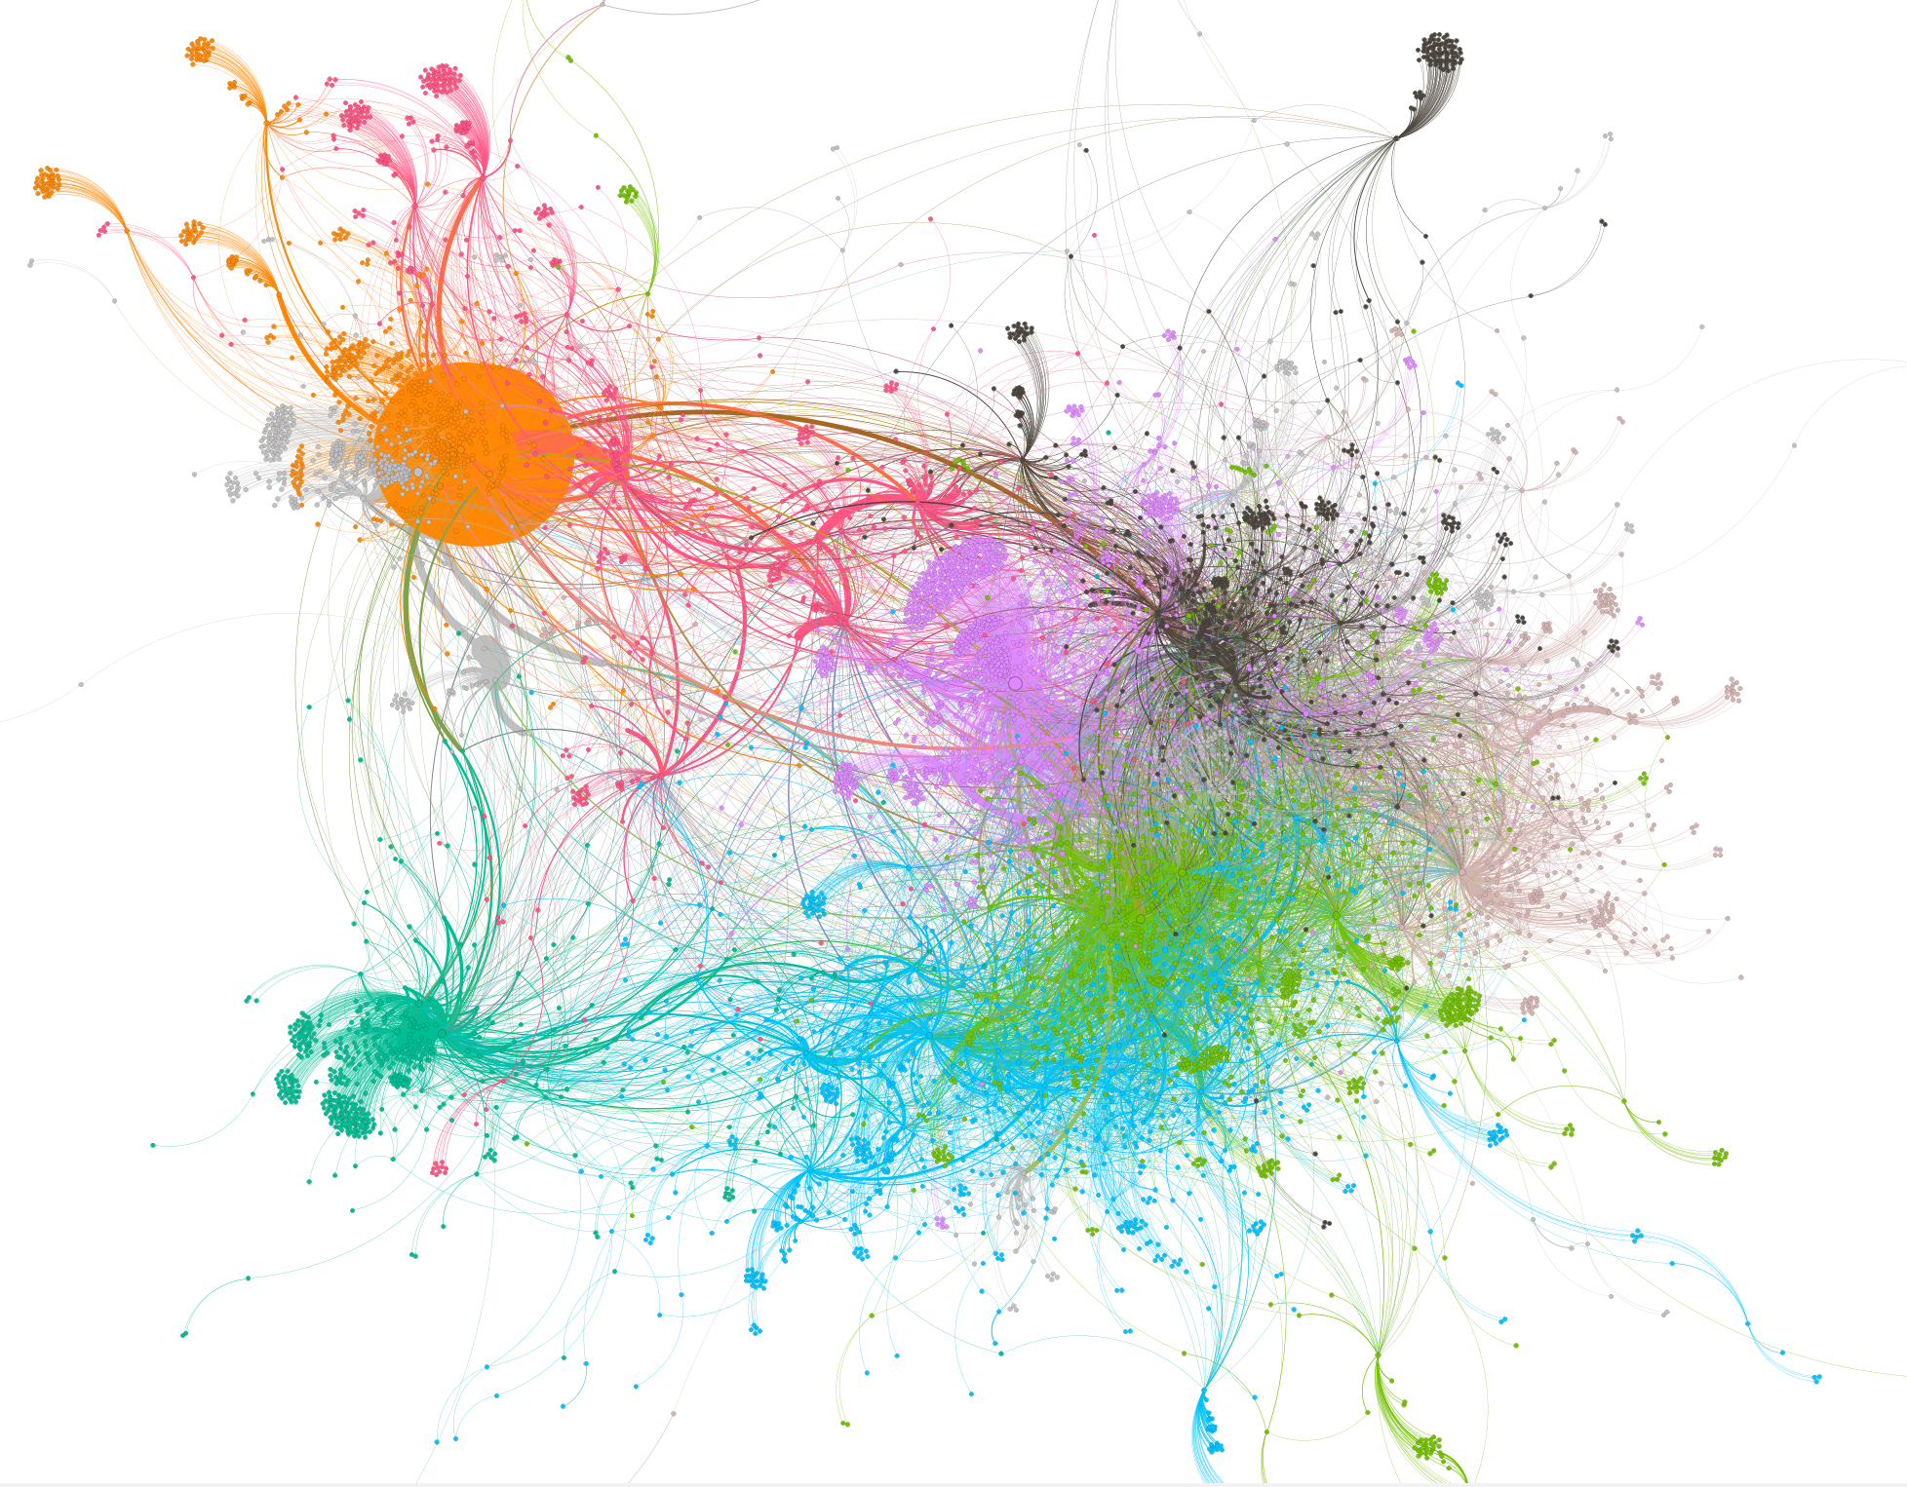
Why Graphs?
These structures allow:
  Quick integration of heterogeneous data based on relationships
  Graph theory methods can be used to analyse and interpret data, e.g., topological properties can be used to explain:
    The possible role of specific components
    The flow of information
    The robustness of the system
Visualize data

Slide 8
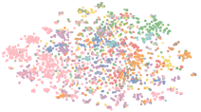
How to Analyse Graph Structures
Using and Analysing Relationships
Graph Theory: algorithms that allow you to extract relevant information from the topology of the graph.
  Topological Features: Centrality, degree, clustering, etc.
Graph Machine Learning:
  Embeddings
  Graph Neural Networks
https://huggingface.co/blog/intro-graphml

Slide 9
Graph Theory — Some Topological Properties
Topological properties can help extract meaningful information and identify relevant structures within the network
1
Degree — Measures the number of connections (edges) a node has in the network. Identifies highly connected nodes (hubs) that often represent critical molecules or interactions, such as essential proteins or highly expressed genes.
Path length — Average shortest path between all pairs of nodes. Indicates the signal flow across the network, relevant for instance in signaling pathways.
Shortest Path — The minimum number of edges required to traverse between two nodes. Essential for studying signal transduction, metabolic fluxes, and the efficiency of molecular or ecological interactions. Nodes with many shortest paths passing through them often have critical roles in the system.
Clustering Coefficient — Measures the tendency of nodes to form tightly knit groups. High clustering often signifies functional specialization, such as protein-protein interaction clusters in cellular compartments.
1
1
5
1
2
2
B
A
https://timbr.ai/community-detection-algorithm/
Graph Theory Measures and Their Application to Neurosurgical Eloquence. Cancers 2023

Slide 10
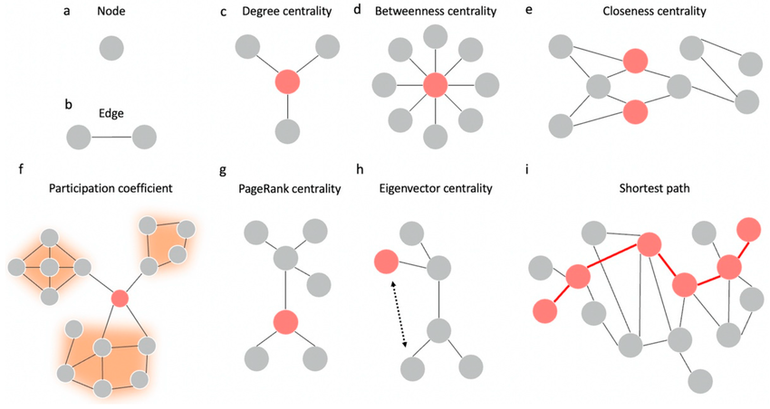
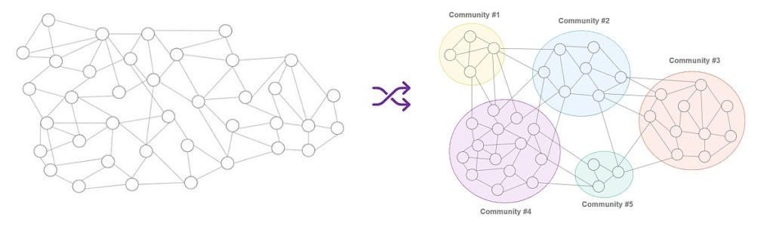
Some Topological Features
Centrality — set of metrics that determine the importance or influence of a node within a network. Different centrality measures highlight different aspects of importance based on the network’s structure
  Betweenness Centrality: Reflects the frequency with which a node appears on the shortest paths between other nodes. Important for identifying key regulators or bottlenecks in pathways.
  Closeness Centrality: Measures how close a node is to all other nodes, indicating its ability to quickly interact or influence others.
  Degree Centrality: Identifies the most connected nodes, which may play pivotal roles in stability or robustness.
  Eigenvector Centrality: Considers the influence of a node based on the importance of its neighbors, helping locate influential components in signaling or metabolic networks.
Community — clusters or groups of nodes within a network that are more densely connected to each other than to nodes outside the group. These clusters, or communities, are also known as modules or sub-networks
https://timbr.ai/community-detection-algorithm/
Graph Theory Measures and Their Application to Neurosurgical Eloquence. Cancers 2023

Slide 11
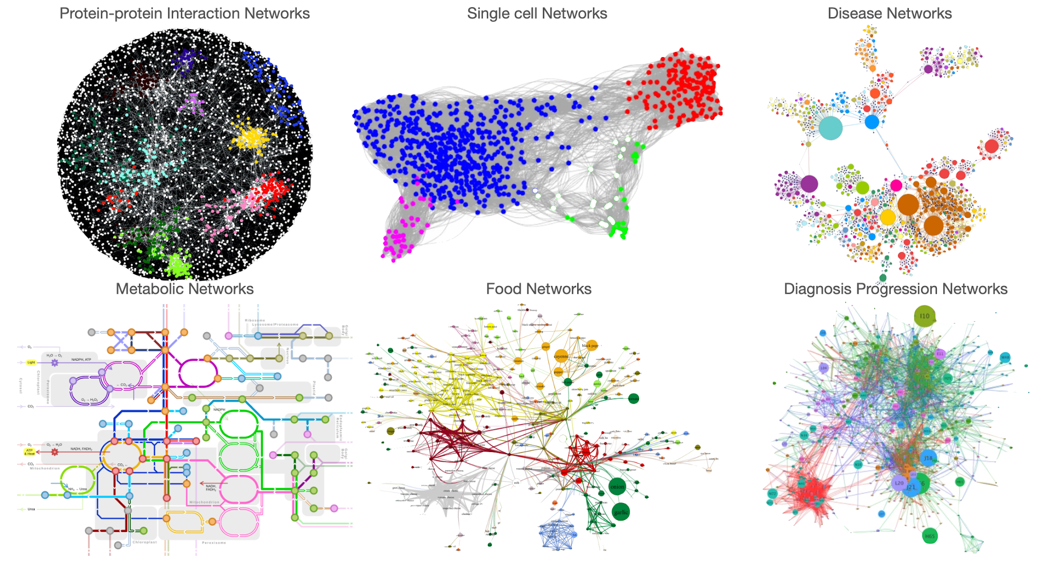
Graphs in Biology
https://towardsdatascience.com/umap-for-data-integration-50b5cfa4cdcd
http://snap.stanford.edu/deepnetbio-ismb/ipynb/Human+Disease+Network.html
https://cytoscape.org/cytoscape-tutorials/presentations/ppi-tools1-2017-mpi.html#/
https://en.wikipedia.org/wiki/Metabolic_network
https://www.scienceandfood.org/the-flavor-network/

Slide 12
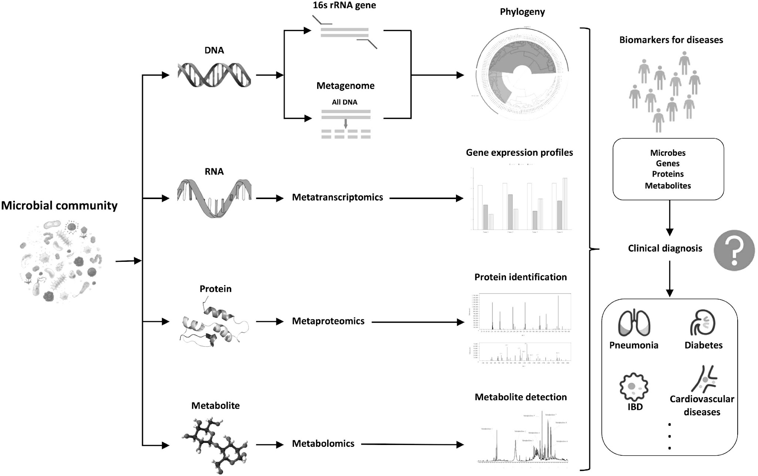
Omics Networks

Slide 13
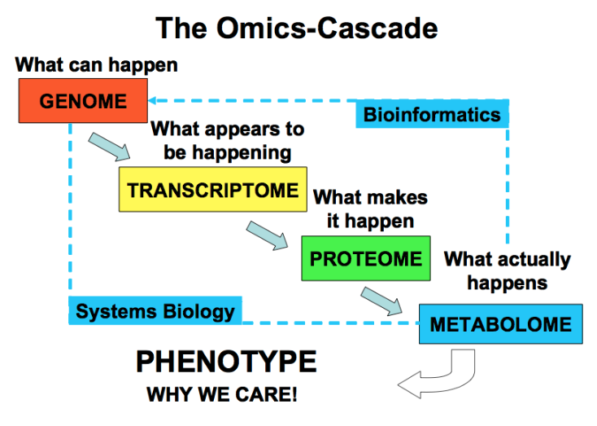
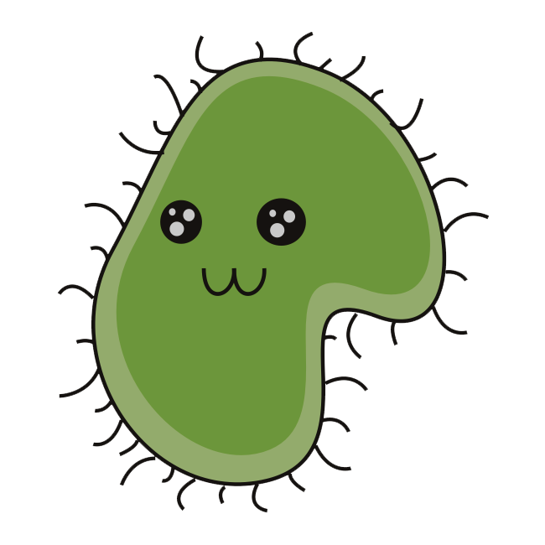
Types of Omics
Genomics Study of the genome, which includes all DNA within an organism
  Sequence, structure, and function of genes
  Key technology — Next-generation sequencing (NGS)
Transcriptomics Study of the transcriptome, which is the complete set of RNA transcripts
  Gene expression and regulation
  Key technology — RNA sequencing (RNA-seq)
Proteomics Study of the proteome, or the complete set of proteins in a cell or organism
  Protein structure, function, interactions, and modifications
  Key technology — Mass spectrometry (MS)
Metabolomics Study of the metabolome, which includes all small-molecule metabolites in a cell or biological system
  Cellular processes and metabolic pathways
  Key technology — Mass spectrometry (MS)
Metaomics Studies the collective genetic material, proteins, metabolites, and other molecular components from entire communities of organisms in a specific environment, without needing to isolate or culture individual species.
Genome
Transcriptome
Proteome
Metabolome

Slide 14
Omics Data
genes
Analytics
transcripts
Visualisation
samples
proteins
Reporting
metabolites
API
Web
Doc

Slide 15
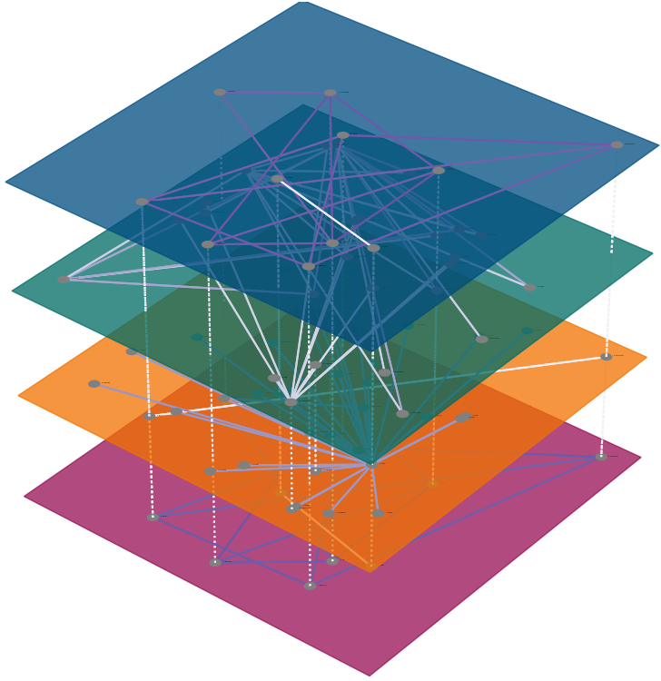
Omics Data
genes
Graphs
transcripts
samples
proteins
metabolites

Slide 16
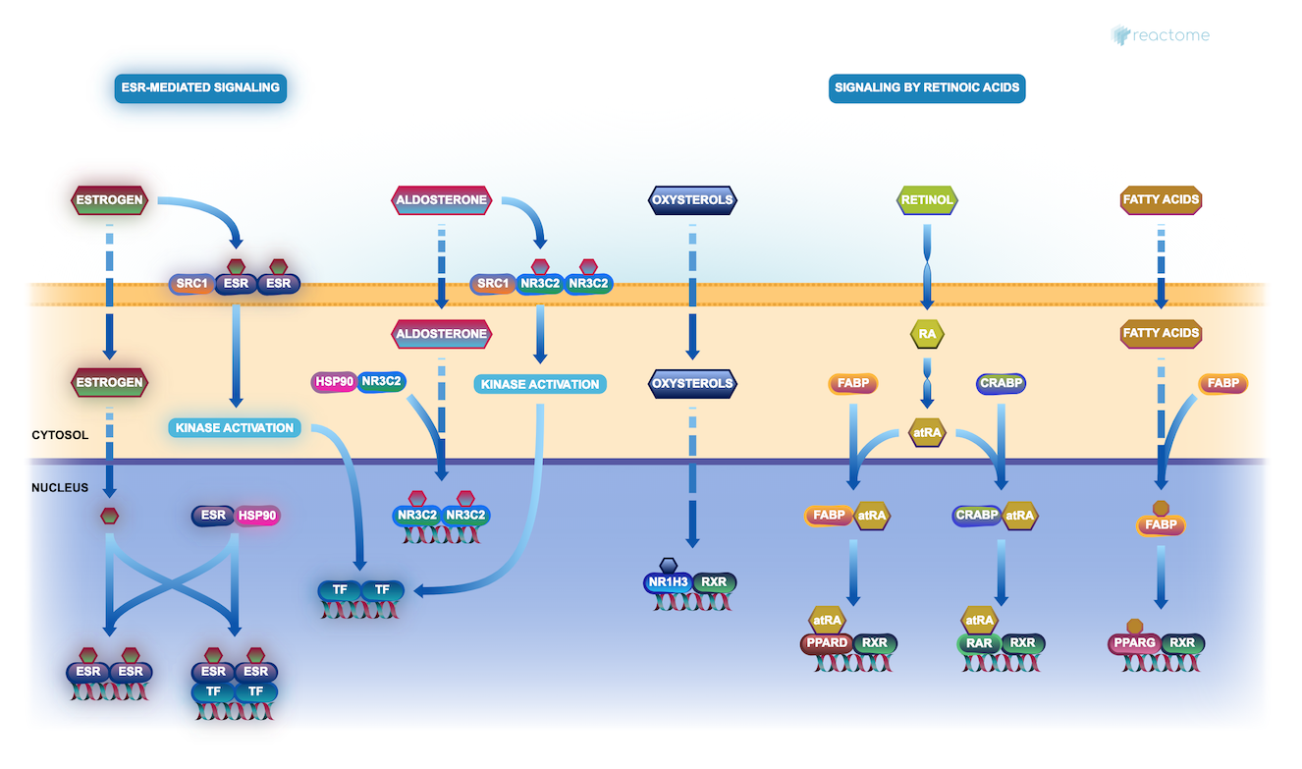
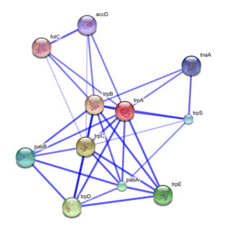
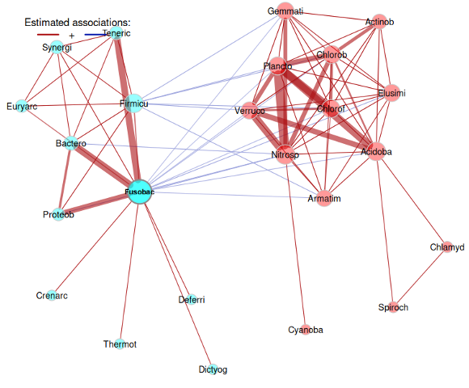
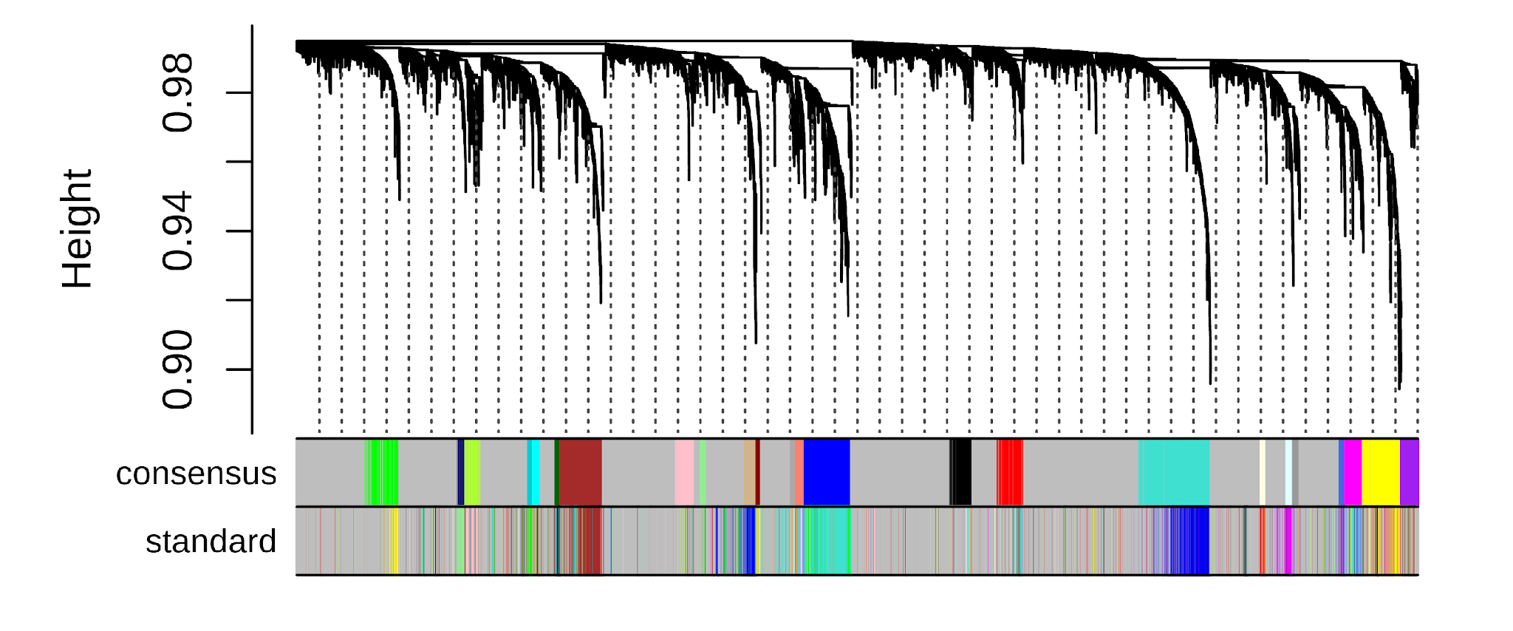
How to Build a Network
Data to Graph
Data sources
  STRING — https://string-db.org/
  BioGRID — https://thebiogrid.org/
  IntAct — https://www.ebi.ac.uk/intact
  REACTOME — https://reactome.org/
  KEGG — https://www.genome.jp/kegg/
  MINT — https://mint.bio.uniroma2.it/
Correlation-based networks — constructed by calculating pairwise correlations between entities based on their expression profiles across multiple conditions, time points, or samples (Weighted gene co-expression network analysis (WGCNA), co-abundance networks)
Knowledge-base approaches — also called knowledge graphs and built by integrating heterogeneous data from multiple sources —> Knowledge Graphs

Slide 17
How to Build a Network
Starting point
proteins
proteins
knowledge graph
correlation analysis
correlation network
samples
proteins
Protein-protein Interaction network
proteins
proteins
differential regulation analysis
samples
functions
functional enrichment network
functional enrichment
proteins

Slide 18
Knowledge Graphs

Slide 19
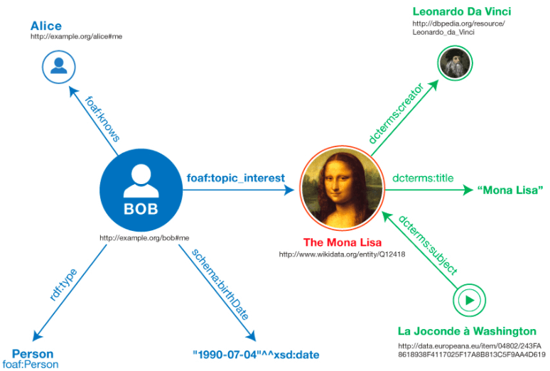
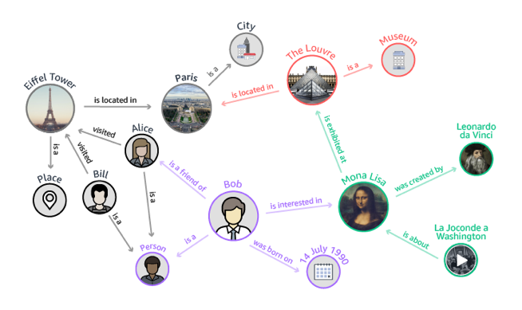
What is a Knowledge Graph (KG)
Relationships firsts everything else second
A way to organise knowledge/information by defining associations or relationships
These relationships facilitate integration, management and enrichment of data
The objective when setting up a KG:
  Standardisation / FAIRification
  Reusability
  Interpretability
  Automation
  Representation/Visualisation
The Knowledge Graph Cookbook. Andreas Blumauer and Helmut Nagy. 2020

Slide 20
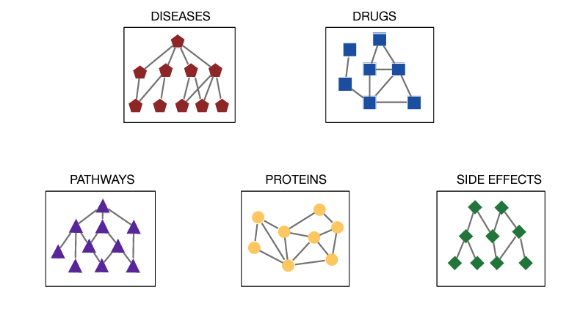
Knowledge Graph vs Graph Database
https://snap.stanford.edu/graphlearning-workshop/slides/stanford_graph_learning_Biomedicine.pdf

Slide 21
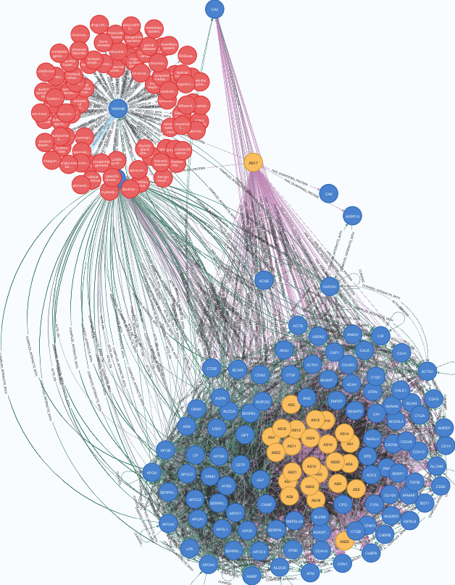
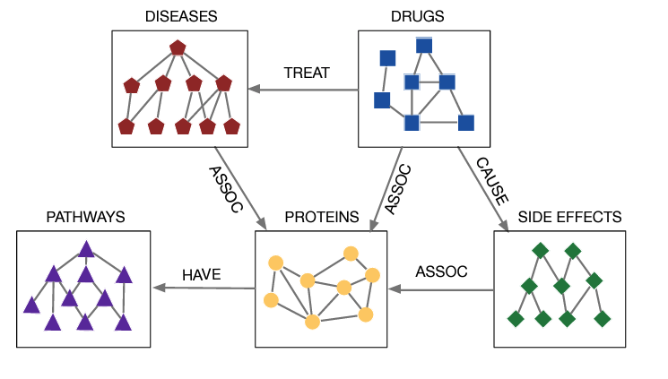
Knowledge Graph vs Graph Database
Focus on data integration to represent complex biological systems and be able to reason over them
https://snap.stanford.edu/graphlearning-workshop/slides/stanford_graph_learning_Biomedicine.pdf

Slide 22
Building a Knowledge Graph
Define the questions you want to answer
Define what data can be used to answer these questions and how it is linked — Data model
Find where to get these data
Get the data, standardise it and format it
Generate the graph
Query the graph to answer the questions

Slide 23
Building a Knowledge Graph
1 and 2

Slide 24
Building a Knowledge Graph
1 and 2
Exercise
Create a data model that allows us to answer the question:
What drugs related to our disease of interest target some of the proteins identified in our experiment or relevant protein complexes and pathways?

Slide 25
Graph Databases
Knowledge Graphs became popular in 2012 thanks to Google (proprietary graphs)
What made them accessible was the development of open-source Graph Databases
Graph Databases are NoSQL databases that use graph structures to represent and store data
Data is represented as Nodes, Relationships and properties
They use their own querying languages: Cypher, SPARQL, GraphQL, Gremlin, etc.
property
node
node
relationship
property
https://en.wikipedia.org/wiki/Graph_database

Slide 26
Graph Data Models
Semantics vs Programmers
Semantic Graphs or Triple-stores
  The network represents meaning through semantic relationships, which simplifies reasoning
  Follows the Resource Description Framework (RDF) data model
  Properties need to be represented as nodes
  Allows n-array relationships —>
  Uses Uniform Resource Identifiers (URIs) to identify concepts
  Used for Ontologies —> cancer — is_a — disease
  The query language used is SPARQL
  Vendors (I know):
    STARDOG (https://www.stardog.com/)
    PoolParty (https://www.poolparty.biz/)
  subject —predicate — object
:item

Slide 27
Graph Data Models
Semantics vs Programmers
Labelled Property Graphs (LPG)
  The network represents relationships between pairs of nodes, and they have labels describing id, type, class and other properties
  The number nodes is reduced by using properties instead
  Does not allow n-array relationships, instead properties —>
  The query language used is Cypher (not a standard but widely adopted)
  Vendors (I know):
    Neo4j (https://neo4j.com/)
    TypeDB (https://vaticle.com/)
    Memgraph (https://memgraph.com/)
    FalkorDB (https://www.falkordb.com/)
    NebulaGraph (https://www.nebula-graph.io/)
property
node
node
relationship
property
from=librarian_id
https://www.oxfordsemantic.tech/fundamentals/what-is-a-labeled-property-graph

Slide 28
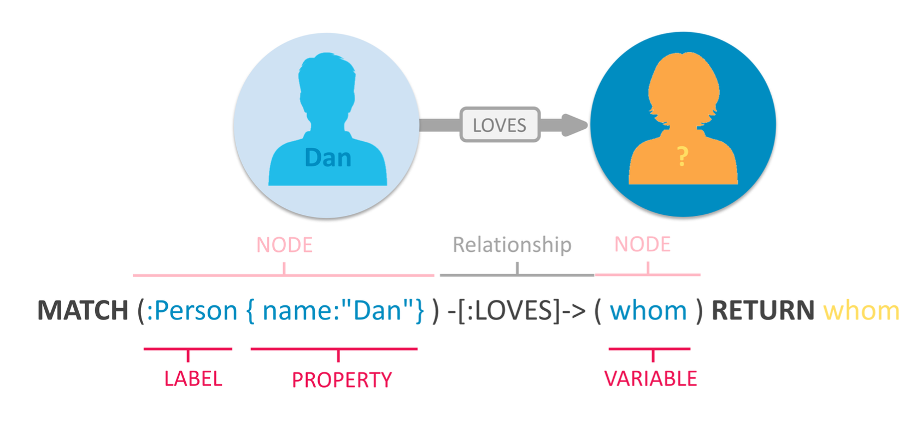
Cypher Query Language
5 and 6
Cypher is a graph query language that provides a visual way of matching patterns and relationships
(property graphs)
https://neo4j.com/developer/cypher/

Slide 29
Querying a Knowledge Graph
Common Exercise
Create a cypher query for the data model we created

Slide 30
Questions?

