Slide 1
Úvod do MLOPS MLflow workšop
Milan Straka
FRI UNIZA
KEGA 008ŽU-4/2024 SCORE4AI: Slovenský kolaboratívny otvorený výskumný a vzdelávací ekosystém pre umelú inteligenciu

Slide 2
MLOPS
Machine Learning Operations (originated from DEVOPS)
Set of practices to design, deploy and maintain machine learning in production continuously, reliably and efficiently
Process automatization
Problem definition & requirements
Exploratory data analysis
Implementation design
Feature engineering
Experiment design
Model training & evaluation
Setup CI/CD pipeline
Deploy model
Monitoring
Design
Development
Operations

Slide 3
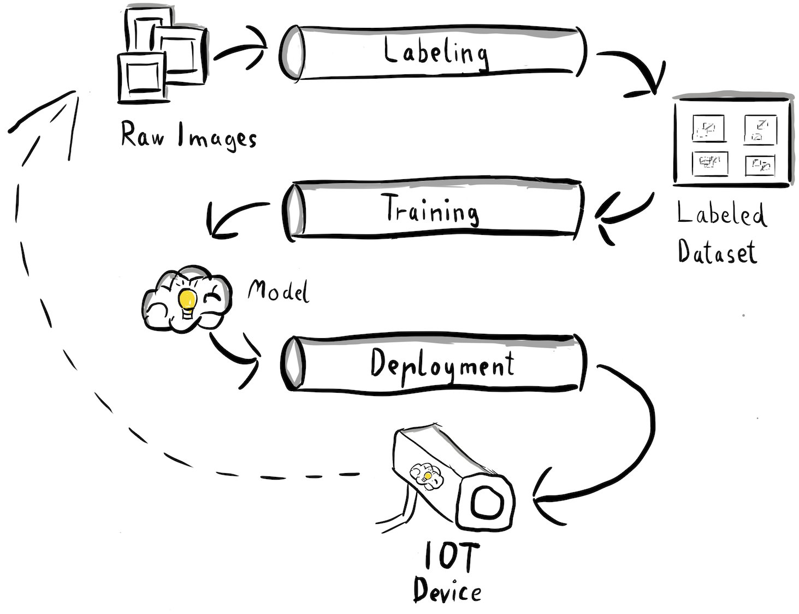
MLOPS process
https://aws.amazon.com/blogs/machine-learning/build-an-end-to-end-mlops-pipeline-for-visual-quality-inspection-at-the-edge-part-1/

Slide 4
Main applications of MLOPS for research
Doing “true” models – knowing how to realistically evaluate models
Avoiding biased models
People often do magic with models and data to produce reliable result
Avoid data leakage, peeking
Tidier handling of experiments
Data version control – DVC – data versioning – integrated with Git
Experiment tracking with MLFlow
Using AI to tune hyperparameters
Better utilization of cloud services – e.g. when no local machines are available
Certain parts as dockerization, CI/CD are more related to business

Slide 5
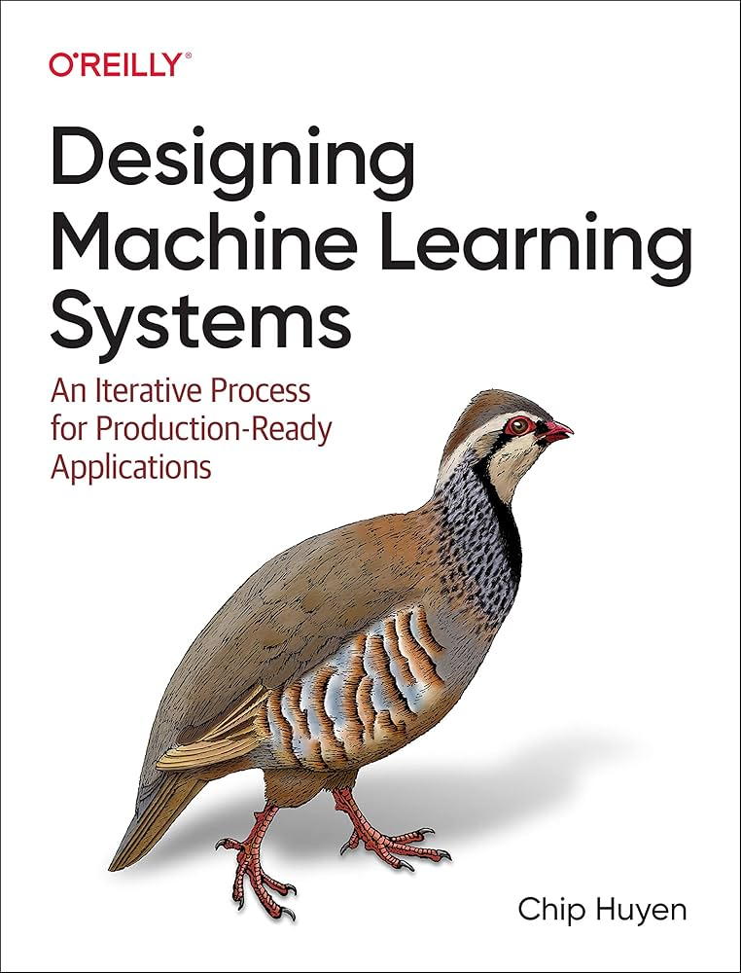
What to read

Slide 6
Why to teach MLOPS?
Most courses related to “standard machine learning”
Talking about math / model, maybe a little implementation
OFC math is important but in reality …
School assignments: Train a few variants of models, use maybe a single dataset and never see/need the model again
Graduates do mostly engineering with/around ML/DL models
Not much taught about real-life implementations and maintenance of such models

Slide 7
Content of MLOPS course at FRI UNIZA
Data Management — ETL/ELT, data versioning with DVC, schema validation, batch and streaming pipelines.
Model Development — Hyperparameter tuning, experiment tracking with MLflow, model comparison and versioning.
Evaluation & Testing — Offline/online evaluation, A/B testing, unit tests, and evaluation pipeline implementation.
Deployment — Docker, Kubernetes, REST APIs, auto-scaling, and blue-green/canary deployment patterns.
CI/CD — Automated testing and delivery pipelines via GitHub Actions, GitOps, and pipeline orchestration.
Monitoring & Ethics — Drift detection, Prometheus/Grafana alerting, automated retraining, and fairness considerations.

Slide 8
Experiment tracking and versioning
We experiment with many architectures and models
Some models are similar, yet may have different performance
Need to track the models arises
We need to track artifacts
File generated during experiment (loss curve…)
Comparing experiments helps understanding the models

Slide 9
Experiment tracking
Process of tracking progress and results of an experiment
Important to know what happens in your model during training
Does my model learn anything useful?
As often are many things tracked, it requires a system
Most of the tracked we check only if something happens
Enables comparison across experiments
Simple tracking - branch for each experiment with logs?

Slide 10
Versioning
Process of logging all the details of an experiment to recreate it or compare with other experiments
You have a nice model results, however after some time you can’t replicate them (you changed some code …)
Hope everybody uses code versioning
What about data versioning?
Data can be very large compared to code
Challenges in data versioning
merge conflicts – two models trained in two different data versions wont merge into the same
GDPR

Slide 11


Slide 12
MLflow
MLflow was created by Databricks, the company founded by the original creators of Apache Spark, first announced in 2018
Open-source platform for managing end-to-end machine learning lifecycle
4 key components:
MLflow Tracking
MLflow Models
Model Registry
Mlflow Projects
Run locally or self-hosted
Notes:
From experimentation to deployment

Slide 13
MLflow tracking
Experiments
A top-level container grouping related runs — typically one per prediction problem.
Created/reused via mlflow.set_experiment("name").
compare metrics and params across many runs in the UI.
Runs
A single training attempt with one specific model and hyperparameter configuration.
Started with mlflow.start_run(), nested inside an experiment.
Logs params, metrics, and artifacts

Slide 14
MLflow tracking - Example
You need to track electricity price predictions
Create an experiment for the predictions
As run use models and parameters settings, e.g.:
run_1: XGBoost, 0.1 learning rate
run_2: XGBoost, 0.2 learning rate
run_3: Random Forest, 100 trees
For other types of predictions, e.g., prediction of salaries, create different experiments

Slide 15
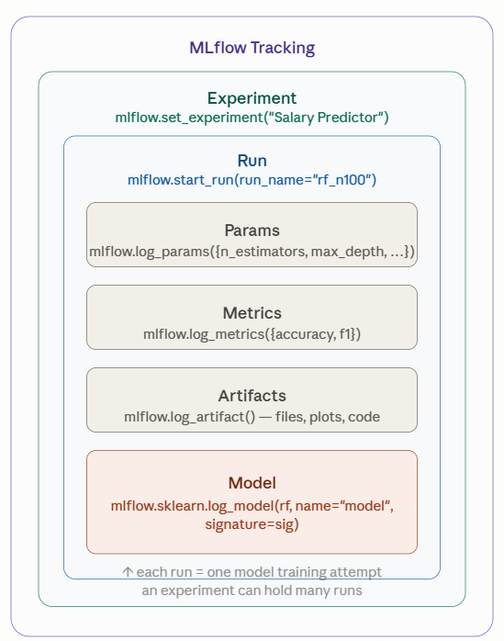
MLflow tracking
Parent run
groups several related child runs together, useful for hyperparameter sweeps or multi-step pipelines.
Logs:
log_params
log_metrics
log_artifact
log_model
Tags – key-value labels, used for search, e.g. model family: linear

Slide 16
MLflow models
Consistent format for packaging models from different frameworks
Flavors – lets the same model used by different tools – for most common ML & DL packages already implemented
import mlflow.sklearn
Saved model can be easily replicated
Bridging the gap between training and deployment by giving every model a common portable format regardless of the underlying ML framework.
You can implement to your library it via Custom Python Models

Slide 17
MLflow models – log_models
1. Serialize the model cloudpickle → model.pkl
2. Capture the environment requirements.txt, python_env.yaml
3. Write the MLmodel manifest flavors, loader module, run_id
4. Upload as a run artifact
tied to the active run
5. Register as new model version
Serializes the model object to disk (e.g. model.pkl via cloudpickle for sklearn).
Captures the environment — requirements.txt and python_env.yaml.
Writes the MLmodel manifest describing flavors, loader, and metadata.
Uploads the whole directory (above files) as an artifact tied to the active run.
Optionally registers it as a new model version if registered_model_name is set.
If is the name of registered model set

Slide 18
MLflow model API
log – store the model in run
autolog – autocapture parameters, framework defined
save – write to file system (less details as run)
load – retrieve the model (inference/deployment)
Serving models
Automatically creates REST API endpoint serving the model
Just send the data and obtain predictions
For multiple models different ports
Example request:
curl http://127.0.0.1:5001/invocations \
-H 'Content-Type: application/json' \
-d '{
"dataframe_split": {
"columns": ["sex", "age", "weight"],
"data": [["male", 23, 160], ["female", 33, 120]]
}
}'

Slide 19
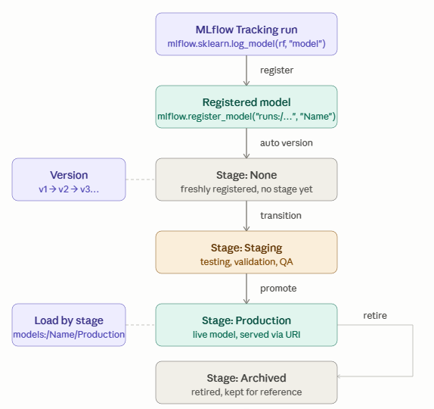
MLflow model registry
Centralized store for managing the full lifecycle of your models
From logged run to production
First, you register a model
Versions - automatically incremented

Slide 20
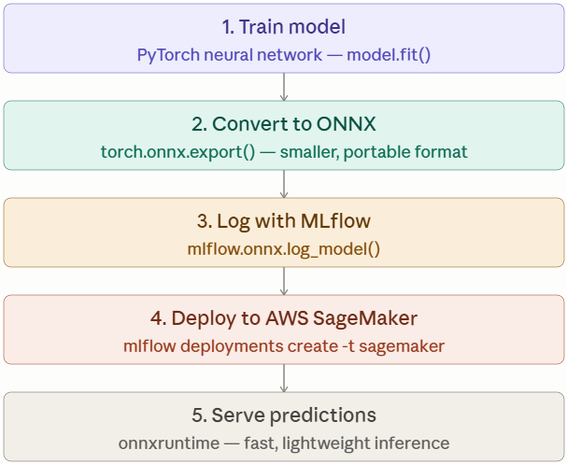
Custom model serving example

Slide 21
MLflow projects
MLflow Projects package ML code into a reproducible, shareable format that can run anywhere — locally, remotely, or via Docker.
MLproject file — a YAML config defining entry points, parameters, and the environment to use.
Run a project with mlflow run (CLI)
Projects support multiple entry points (e.g. train, test, step_1, step_2)
The environment is reproducible via python_env.yaml and requirements.txt, ensuring the same code runs consistently across machines.
Notes:
tests

Slide 22
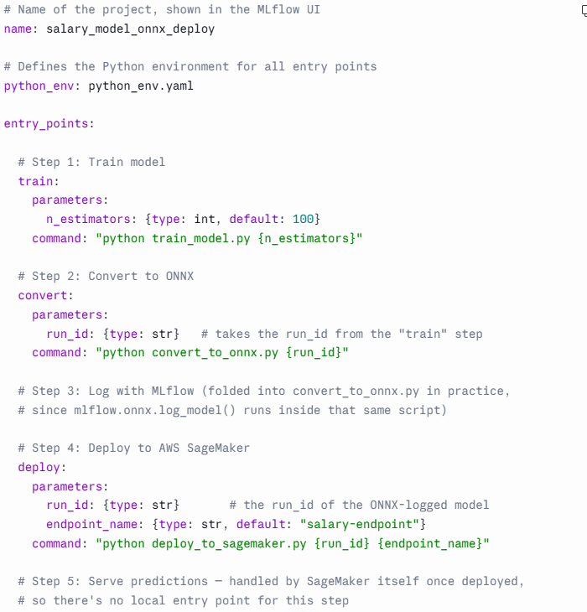

Slide 23
Thanks for attention

