Slide 1
Detecting Weakly Simply Polygon
Hsien-Chih Chang, Jeff Erickson, Chao Xu
University of Illinois Urbana-Champaign
Department of Computer Science

Slide 2
Motivation
Many algorithms that works for simple polygons could work for degenerate cases.
We define weakly simple polygon, which intuitively means the polygon overlaps but doesn’t cross itself.
Moreover, we provide an efficient algorithm to decide if a polygon is weakly simple.
Notes:
Eg. Linear time convex hull algorithm for simple polygons.

Slide 3

Definition
A closed curve $P$ on the plane is weakly simple if for any $ε>0$ , there is a simple closed curve $P′$ whose Fréchet distance from $P$ is at most $ε.$

Slide 4
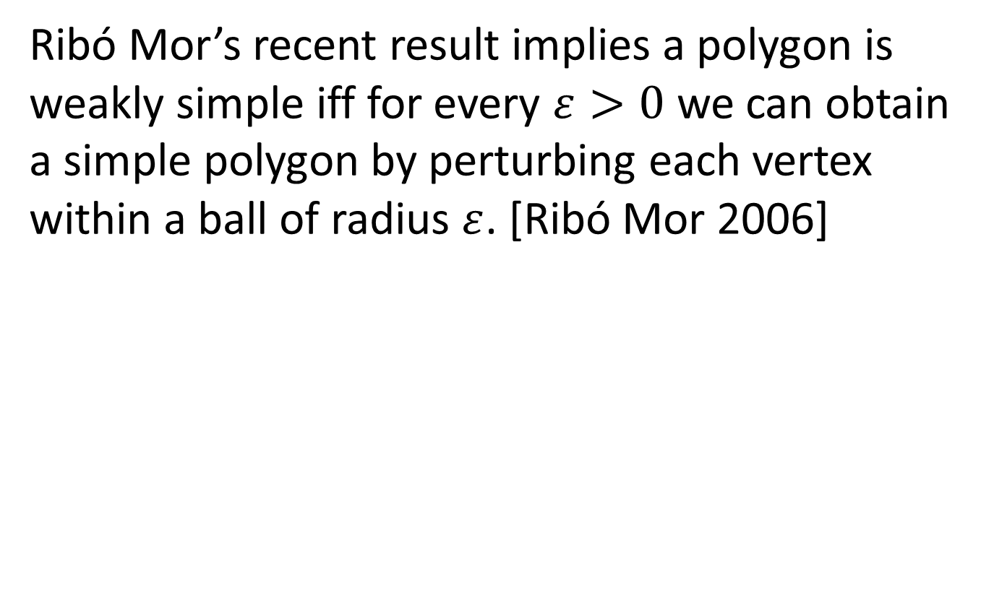
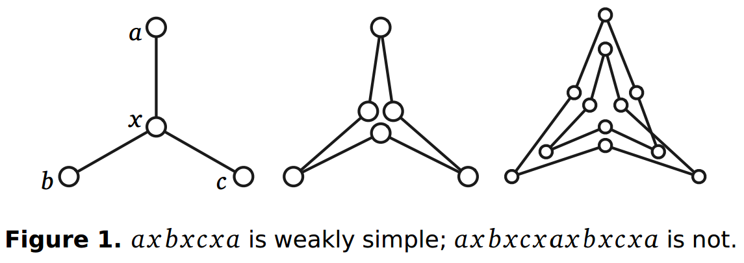
A useful Characterization

Slide 5





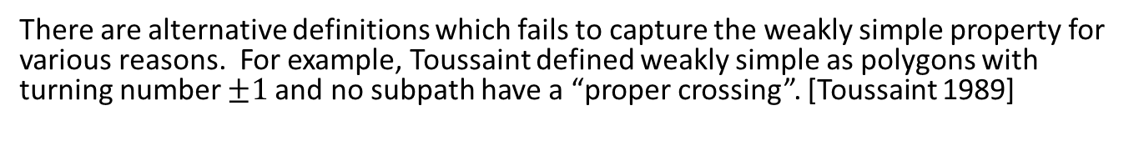



There are alternative definitions which fails to capture the weakly simple property for various reasons. For example, Toussaint defined weakly simple as polygons with turning number $±1$and no subpath have a “proper crossing”. [Toussaint 1989]
$$a$$
$$b$$
A proper crossing
$$abcdefdca$$
$$abcdfedca$$
The right side is a “zoomed in view”. Each large disk is one node,
and the line segments between the same large disks overlaps.

Slide 6
Spurs: vertices whose two incident edges overlap.
Toussaint’s definition fails because turning numbers are not well defined.
A spur
Notes:
Winding numbers are not well defined for polygon with spurs
Hsien: Also for a different reason; on cstheory.se Jeff post an example with no spurs, winding number 1 and no proper path crossing, but the polygon is not weakly simple. Need a definition for proper walk crossing.

Slide 7








Forks: A vertex is a fork if it is contained in the interior of some edges.
$$abcdefa$$
$$b$$
$$e$$
$$c$$
$$d$$
Forks: $c$ and $d$ are contained inside the edge $af.$
Notes:
A vertex is a fork if it is contained in the interior of some edges.

Slide 8
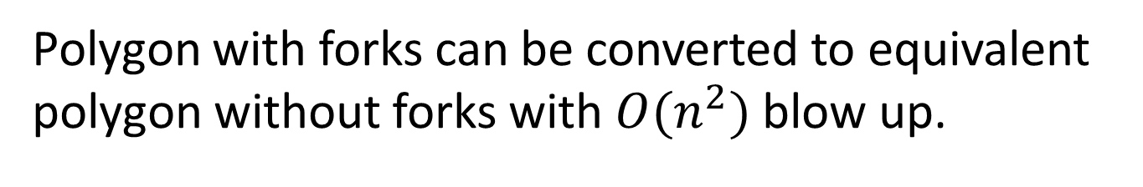
Polygon with forks can be converted to equivalent polygon without forks with $O(n^{2})$ blow up.
$O\left(f\left(n\right)\right)$algorithm (without forks) $⇒$ $O\left(f\left(n^{2}\right)\right)$algorithm (with forks)
Notes:
By equivalent, I mean they are the same curve on the plane.
Using a sweep line algorithm, we can reduce a polygon with forks to polygon without forks.
The rest of the talk focus only on polygon without forks.

Slide 9
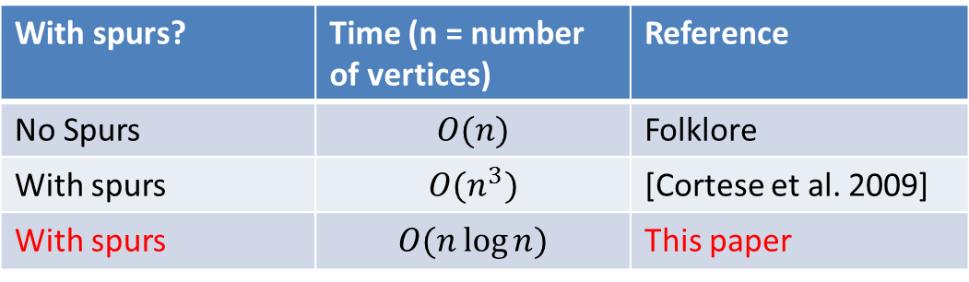
Detecting weakly simple polygon without forks
With spurs? | Time (n = number of vertices) | Reference
No Spurs | $$O(n)$$ | Folklore
With spurs | $$O(n^{3})$$ | [Cortese et al. 2009]
With spurs | $$O(n\log{n)}$$ | This paper

Slide 10
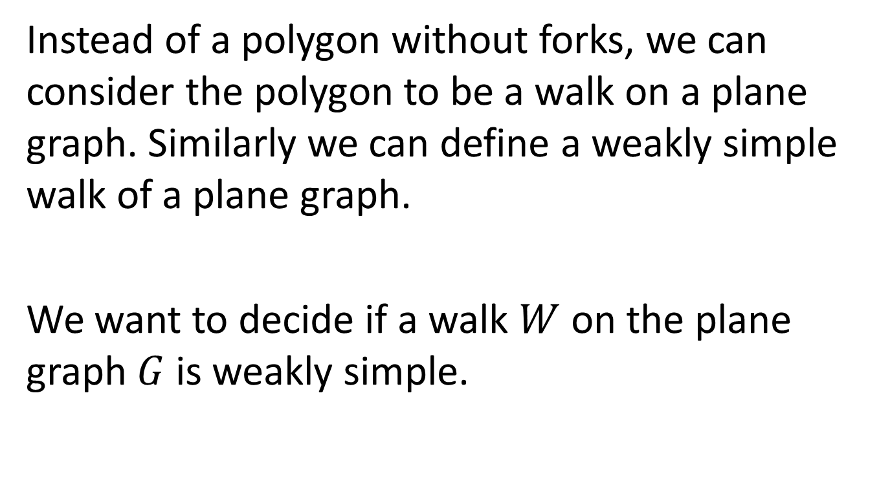
Instead of a polygon without forks, we can consider the polygon to be a walk on a plane graph. Similarly we can define a weakly simple walk of a plane graph.
We want to decide if a walk $W$ on the plane graph $G$ is weakly simple.

Slide 11

An edge $uv$is a base for $v$ if each occurrence of $v$ in the walk $W$ is immediately preceded or followed by the other endpoint $u$.

Slide 12

An edge $uv$ is expandable if
1. $uv$is a base for both $u$ and $v$.
2. $uv$is the unique base either $u$or $v$.
Notes:
It will be clear later the second requirement is there for efficiency.

Slide 13
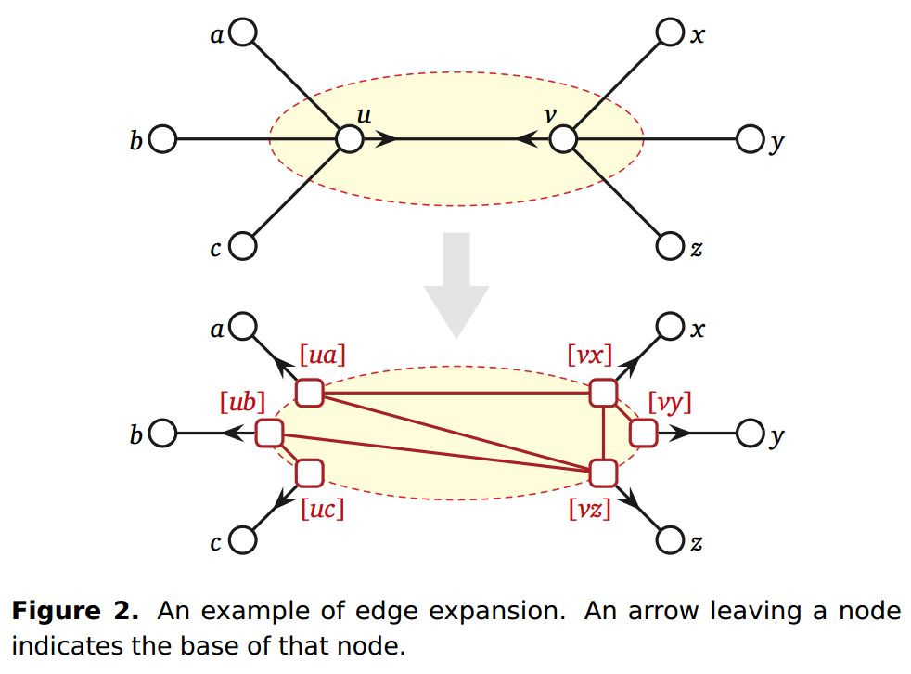
Notes:
The expansion of an expandable edge uv can be deﬁned
geometrically as follows. Consider an ellipse C with u and v
inside and all other nodes outside, that intersects precisely
the edges incident to either u or v but not both. Because
edges of G are straight line segments, C intersects each edge
at most once. We subdivide each edge up (where p 6= v)
with a new node [up] at the intersection point up ∩ C; we
similarly subdivide edges incident to v. Finally, we modify
both G and W by replacing each subwalk of W that lies
within the region surrounded by C and starts and ends on C
with a straight line segment. In particular, we contract any
subwalk that starts and ends at the same point of C to that
point; otherwise, these new segments become new edges
of G. If any of these new edges cross, the original walk W
is not weakly simple; otherwise, all necessary invariants
are maintained.

Slide 14
The walk is weakly simple iff the walk after the expansion is weakly simple.
The expansion might introduces local non-planarity.

Slide 15
The algorithm:
A linear time preprocessing stage, after preprocessing every vertex has an base.
Pick an expandable edge, expand it. Repeat this step until there is no more expandable edge. Reject if any expansion introduce local non-planarity.
The graph is either a cycle or a empty graph, and it’s easy to check if it’s weakly simple.
Notes:
In fact, in the final state, plane graph is either a trivial graph or a cycle.

Slide 16
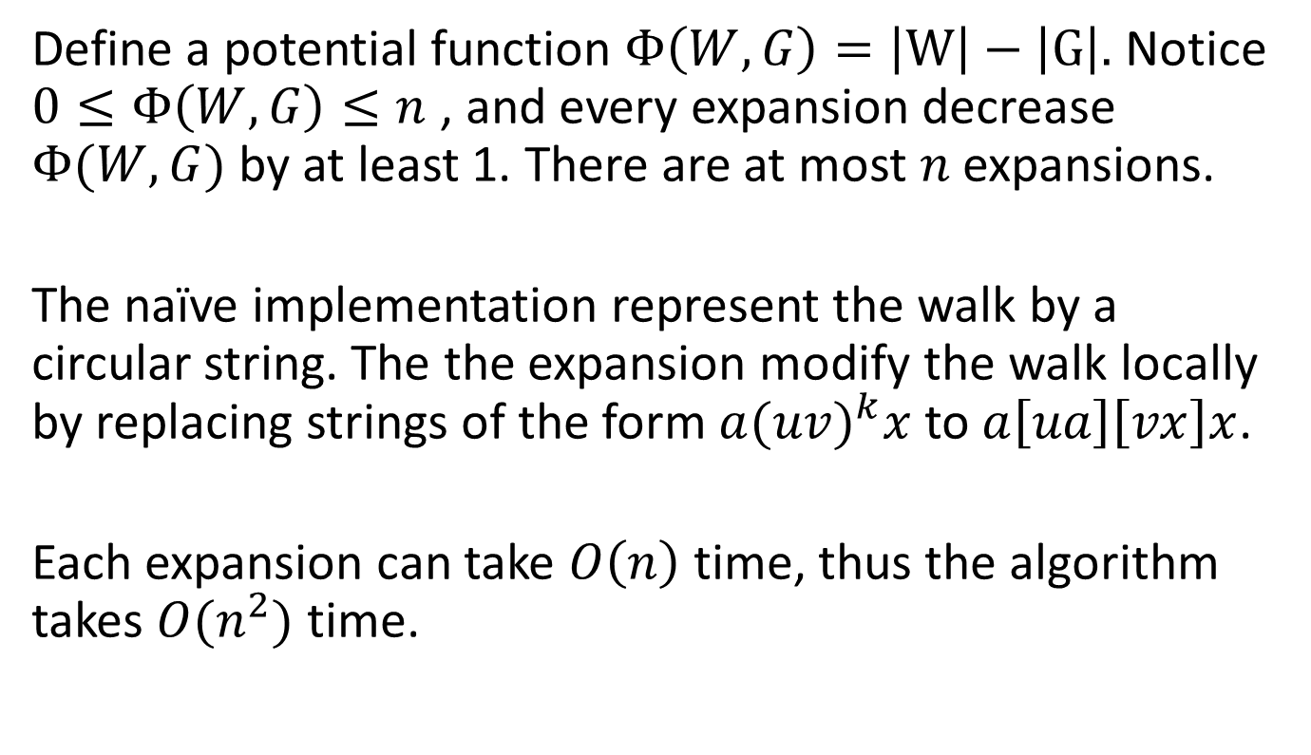
Analysis
Define a potential function $Φ\left(W,G\right)=\left|W\right|−\left|G\right|.$Notice $0≤Φ\left(W,G\right)≤n$ , and every expansion decrease $Φ(W,G)$ by at least 1. There are at most $n$ expansions.
The naïve implementation represent the walk by a circular string. The the expansion modify the walk locally by replacing strings of the form $a{(uv)}^{k}x$ to$a\left[ua\right]\left[vx\right]x$.
Each expansion can take $O\left(n\right)$time, thus the algorithm takes $O(n^{2})$ time.

Slide 17

We can reuse the nodes instead of delete them. Namely we let $\left[ua\right]=u$ and $\left[vx\right]=v$for some $a$and $x$.

Slide 18
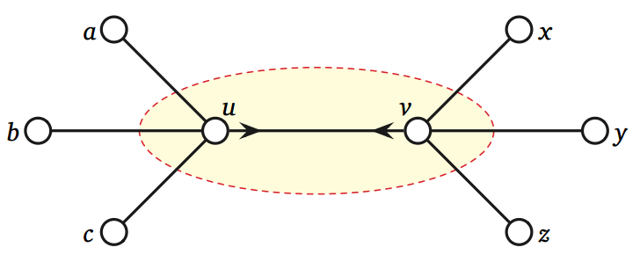
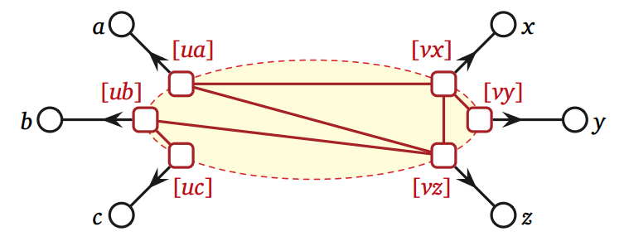


a x*
*b
y
c
z
u v
$$v$$
$$u$$

Slide 19
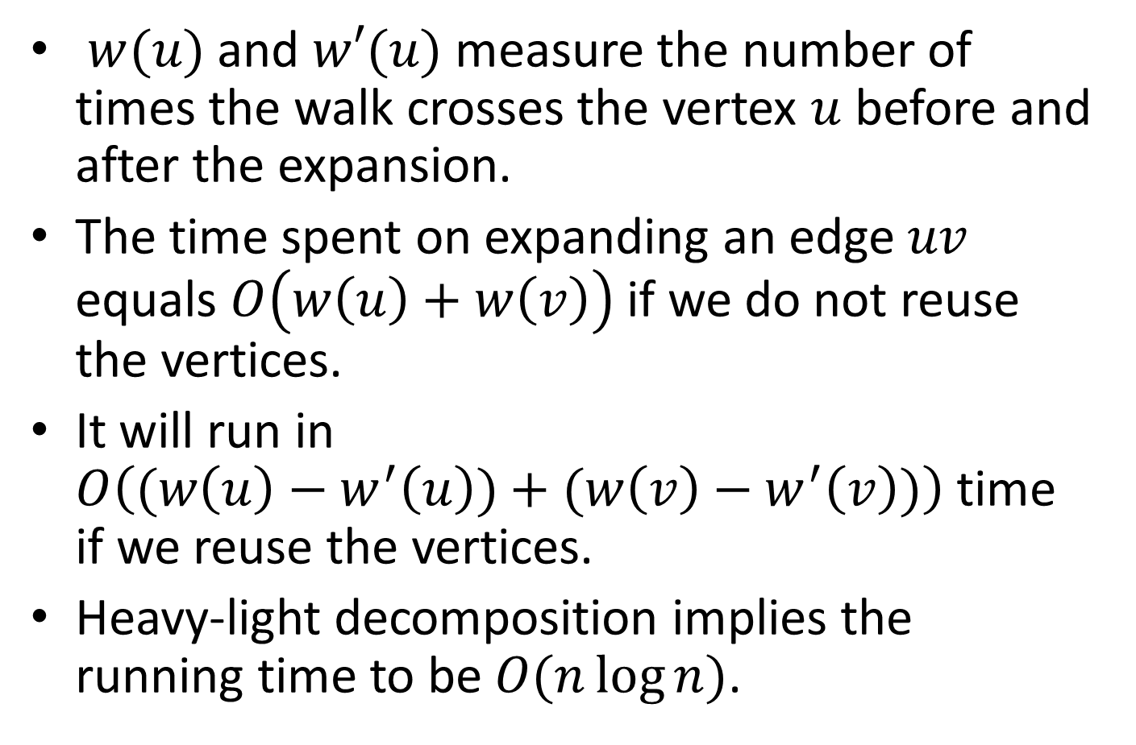
$w(u)$ and $w′(u)$ measure the number of times the walk crosses the vertex $u$ before and after the expansion.
The time spent on expanding an edge $uv$ equals $O\left(w\left(u\right)+w\left(v\right)\right)$ if we do not reuse the vertices.
It will run in $O\left((w\left(u\right)−w^{′}\left(u\right))+(w\left(v\right)−w^{′}\left(v\right))\right)$ time if we reuse the vertices.
Heavy-light decomposition implies the running time to be $O(n\log{n)}$.

Slide 20








$$u$$
$$v$$
$$u$$
$$[ua]$$
$$[uc]$$
$$v$$
$$[vy]$$
$$[vz]$$

Slide 21
References
Pier Francesco Cortese, Giuseppe Di Battista, Maurizio Patrignani, and Maurizio Pizzonia. On embedding a cycle in a plane graph. Discrete Mathematics 309(7):1856–1869, 2009.
Ares Ribó Mor. Realization and Counting Problems for Planar Structures: Trees and Linkages, Polytopes and Polyominoes. Ph.D. thesis, Freie Universität Berlin, 2006.
Godfried T. Toussaint. Computing geodesic properties insidea simple polygon. Revue d’Intelligence Artificielle 3(2):9–42, 1989.

