Slide 1
MSstats is an open-source R-based package for statistical relative quantification of peptides and proteins in mass spectrometry-based proteomic experiments.
MSstats is applicable to multiple types of sample preparation, including label-free workflows, workflows that use stable isotope labeled reference proteins and peptides, and workflows that use fractionation.
It is applicable to targeted Selected Reaction Monitoring (SRM), Data-Dependent Acquisition (DDA or shotgun), and Data-Independent Acquisition (DIA or SWATH-MS).
It is applicable to experiments that make arbitrary complex comparisons of experimental conditions or times.
MSstats is not applicable to experiments that compare multiple metabolically labeled endogenous samples within a same run, such as experiments with iTRAQ labeling or TMT labeling. These experiments are supported by MSstatsTMT, which is a sibling package.

Slide 2
MSstats performs three analysis steps.
The first step, data processing, visualization, and run-level summarization, transforms, normalizes and summarizes the intensities of the peaks per MS run and per protein, and generates workflow-specific and customizable numeric summaries for data visualization and quality control.
The second step, statistical modeling and inference, automatically detects the experimental design from the data. It then reflects the experimental design and the type of spectral acquisition strategy, and fits an appropriate linear mixed model by means of lm and lmer functionalities in R. The model is used to detect differentially abundant proteins or peptides, or to summarize the protein or peptide abundance in a single biological replicate or condition (that can be used, e.g. as input to clustering or classification).
The third step, statistical experimental design, views the dataset being analyzed as a pilot study of a future experiment, utilizes the variance components of the current dataset, and calculates the minimal number of replicates necessary in the future experiment to achieve a pre-specified statistical power.

Slide 3
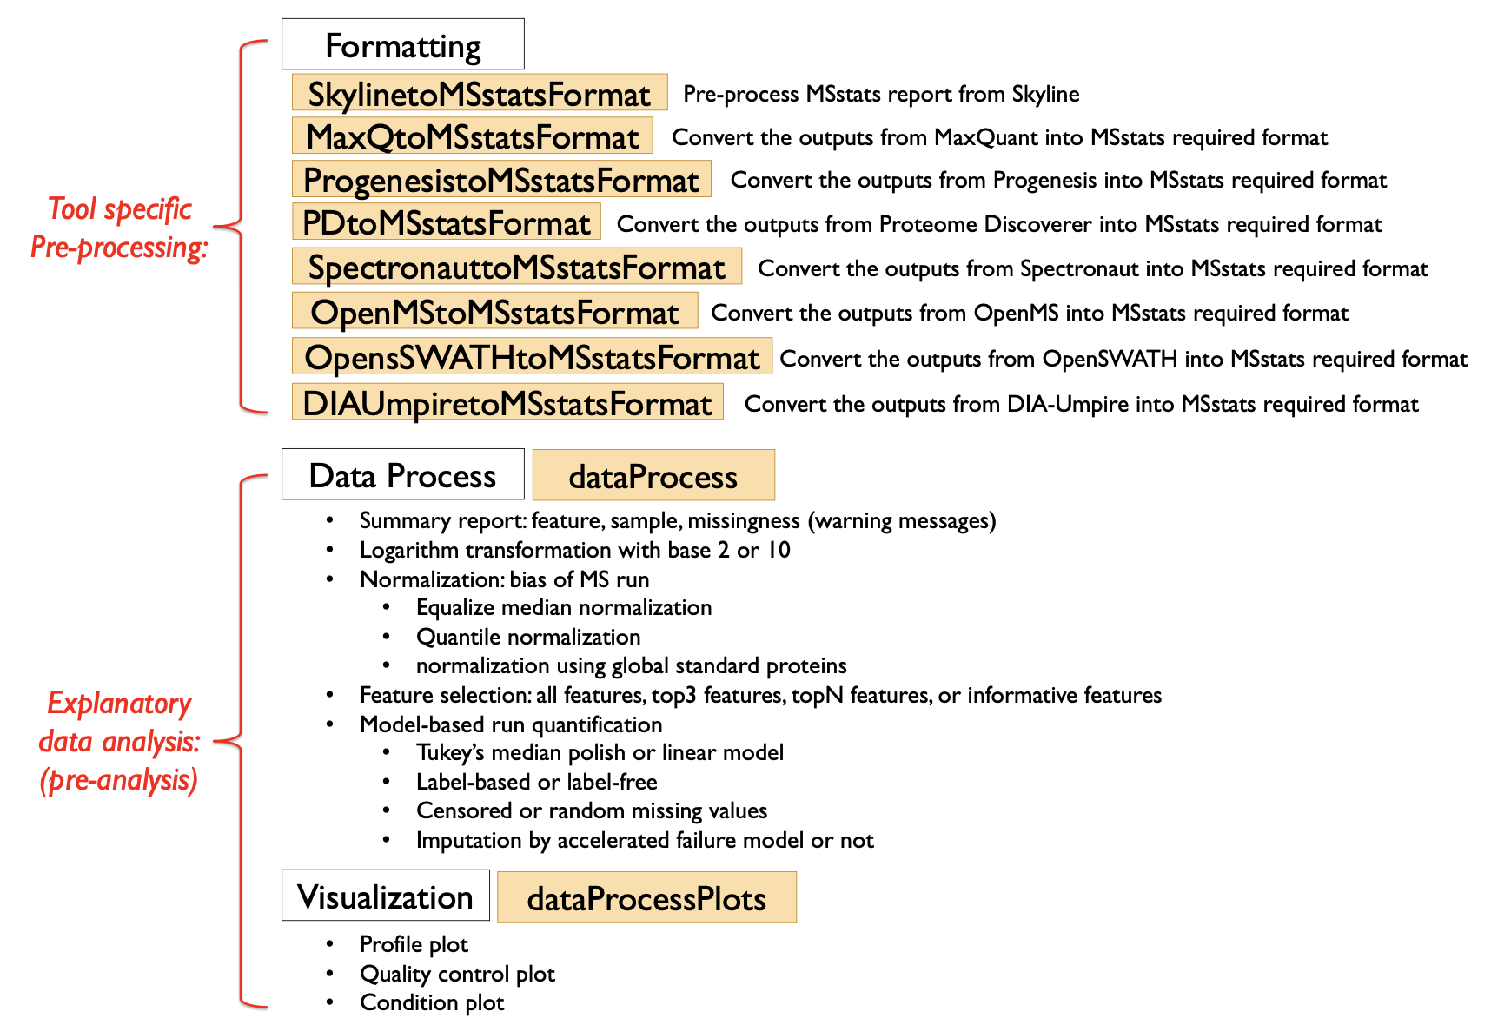
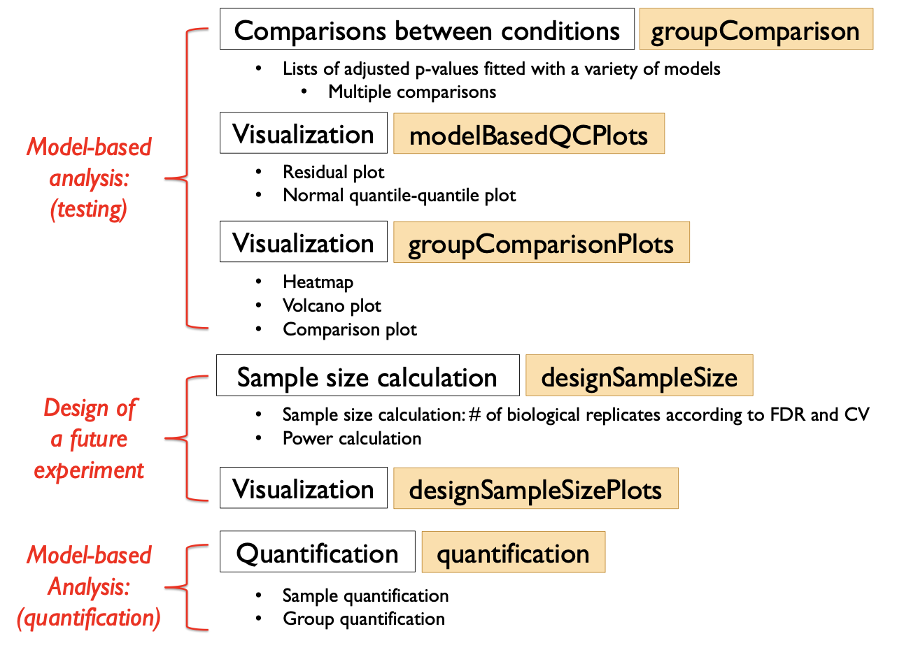
Overview of the functionalities

Slide 4
MSstats data formats
Input to MSstats is the output of other software tools (such as MultiQuant) that read raw spectral files and identify and quantify spectral peaks.
The preferred structure of data for use in MSstats is a .csv file in a “long” format with 10 columns representing the following variables: ProteinName, PeptideSequence, PrecursorCharge, FragmentIon, ProductCharge, IsotopeLabelType, Condition, BioReplicate, Run, Intensity.
(1) ProteinName: This column needs information about Protein id. Statistical analysis will be done separately for each unique label in this column. For peptide-level modeling and analysis, use peptide id in this column.
(2)-(5) PeptideSequence, PrecursorCharge, FragmentIon, ProductCharge: The combination of these 4 columns defines a feature of a protein (in SRM experiments, it is a transition that is identified and quantified across runs). If the information for one or several of these columns is not available, please do not discard these columns but use a single fixed value across the entire dataset. For example, if the original raw data does not contain the information of ProductCharge, assign the value 0 to the entries in the column ProductCharge for the entire dataset. If the peptide sequences should be distinguished based on post-translational modifications, this column can be renamed to PeptideModifiedSequence.
(6) IsotopeLabelType: This column indicates whether this measurement is based on the endogenous peptides (use “L”) or labeled reference peptides (use “H”).

Slide 5
MSstats data formats
(7) Condition: For group comparison experiments, this column indicates groups of interest (such as “Disease” or “Control”). For time-course experiments, this column indicates time points (such as “T1”, “T2”, etc). If the experimental design contains both distinct groups of subjects and multiple time points per subject, this column should indicate a combination of these values (such as “Disease_T1”, “Disease_T2”, “Control_T1”, “Control_T2”, etc.).
(8) BioReplicate: This column should contain a unique identifier for each biological replicate in the experiment. For example, in a clinical proteomic investigation this should be a unique patient id. Patients from distinct groups should have distinct ids. If the technical replicates are present, all samples or runs from a same biological replicate should have a same id. MSstats automatically detects the presence of technical replicates and accounts for them in the model-based analysis.
(9) Run: This column contains the identifier of a mass spectrometry run. Each mass spectrometry run should have a unique identifier, regardless of the origin of the biological sample. It is possible to use the actual input file names as values in the column Run.
(10) Intensity: This column should contain the quantified signal of a feature in a run without any transformation (in particular, no logarithm transform). The signals can be quantified as the peak height or the peak of area under curve. Any other quantitative representation of abundance can also be used.

Slide 6
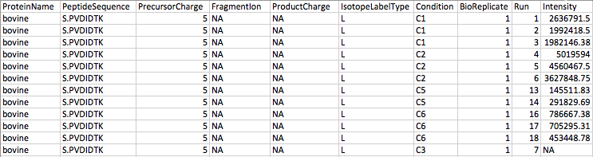
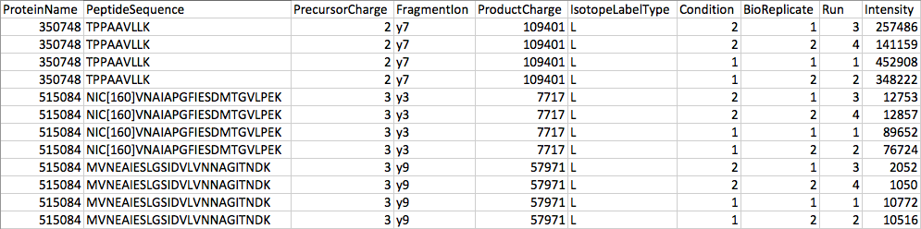
MSstats data formats
Since for label-free DDA experiments some of the columns PeptideSequence, PrecursorCharge, FragmentIon, and ProductCharge are not relevant, these columns will have a constant fixed value (such as NA) across the entire dataset. Furthermore, the column IsotopeLabelType will be set to “L” for the entire dataset.
For label-free DIA experiments, the combination of the values in the columns PeptideSequence, PrecursorCharge, FragmentIon, ProductCharge uniquely identifies each spectral feature. Furthermore, the column IsotopeLabelType is set to “L” for the entire dataset.

Slide 7
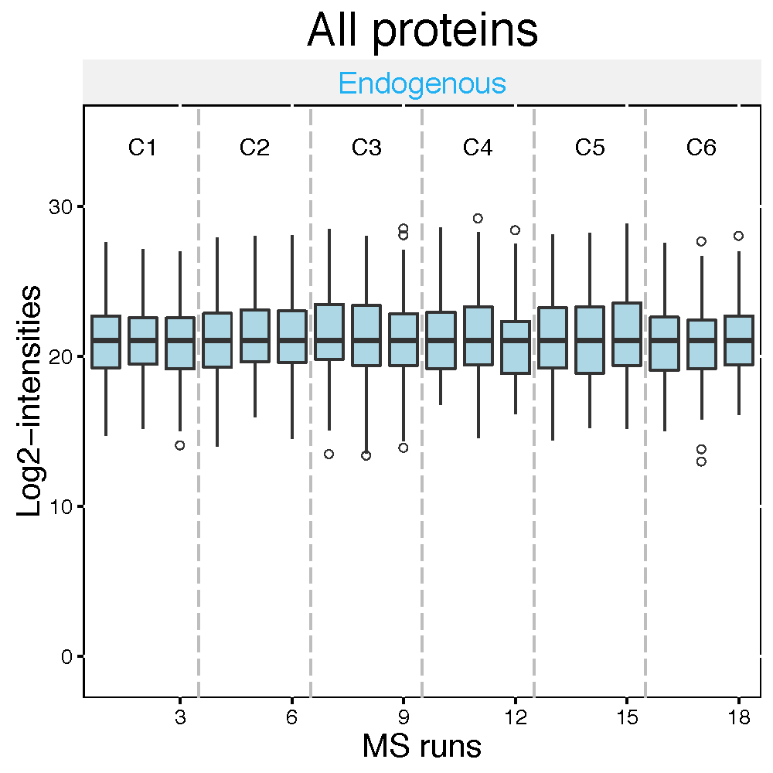
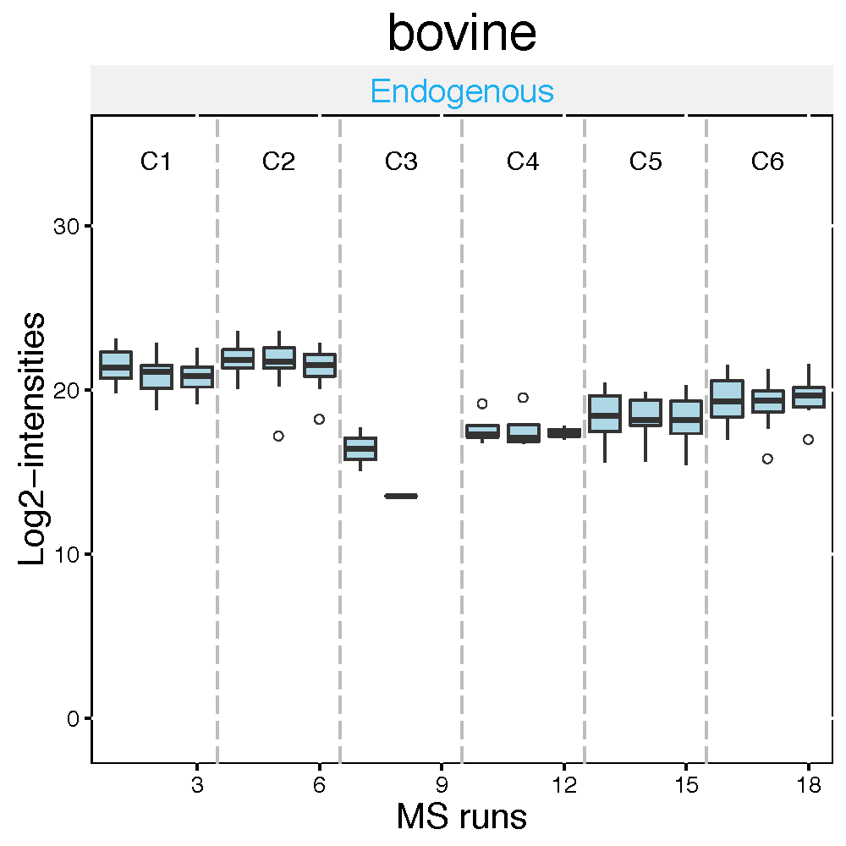
Visualization of processed data
QC plot visualizes potential systematic biases between mass spectrometry runs.
It can be used to assess the effects of the normalization step. After constant normalization, the median intensities of reference transitions across all proteins should be equal between runs. After quantile normalization, the distribution of reference intensities across all proteins should be equal between runs.
This step generates two types of QC plots: one for all the proteins combined, and the other separately for each protein.

Slide 8
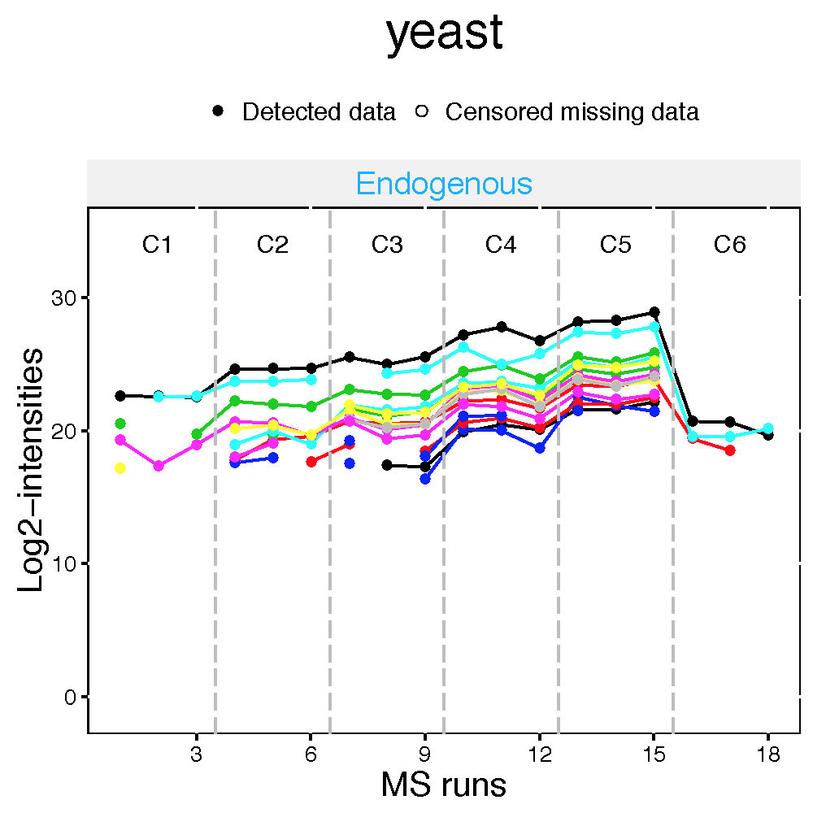
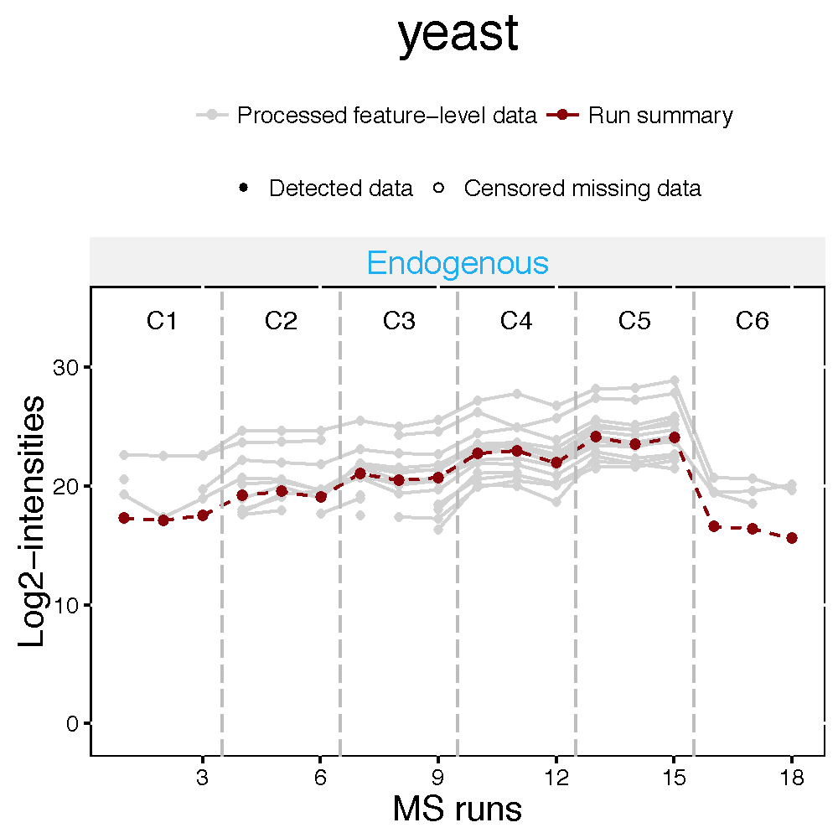
Visualization of processed data
Profile plot helps identify potential sources of variation for each protein.
Profile plots with summarization present the effects of the summarization step by showing all individual measurements of a protein and their summarized intensity.
The first plot shows individual measurement for each peptide (peptide for DDA, transition for SRM or DIA) across runs, grouped per condition. Each peptide has a different color/type layout. Disconnected lines show that there are missing value (NA).
The second plot shows run-level summarized data per protein. The same peptides (or transition) in the first plot are presented in grey, with the summarized values (by TMP, in this example) overlaid in red.

Slide 9
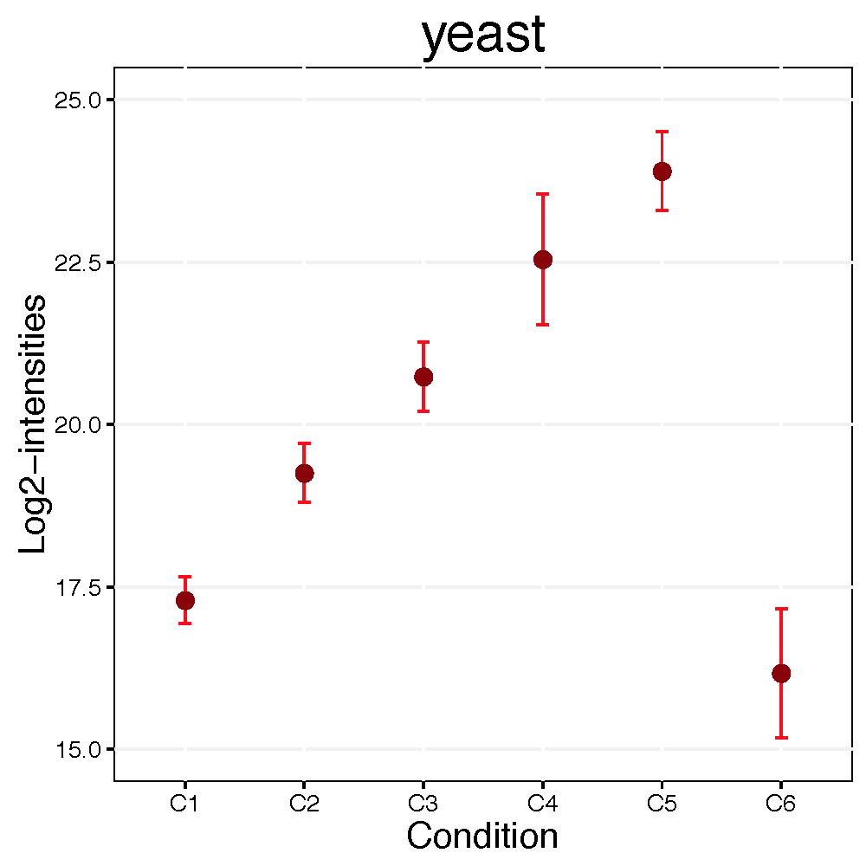
Visualization of processed data
Condition plot visualizes potential systematic differences in protein intensities between conditions. Dots indicate the mean of log2 intensities for each condition. With the option interval='CI'(default), error bars indicate the confidence interval with 0.95 significant level for each condition. With the option interval='SD', error bars indicate the standard deviation among all feature intensities for each condition.

Slide 10
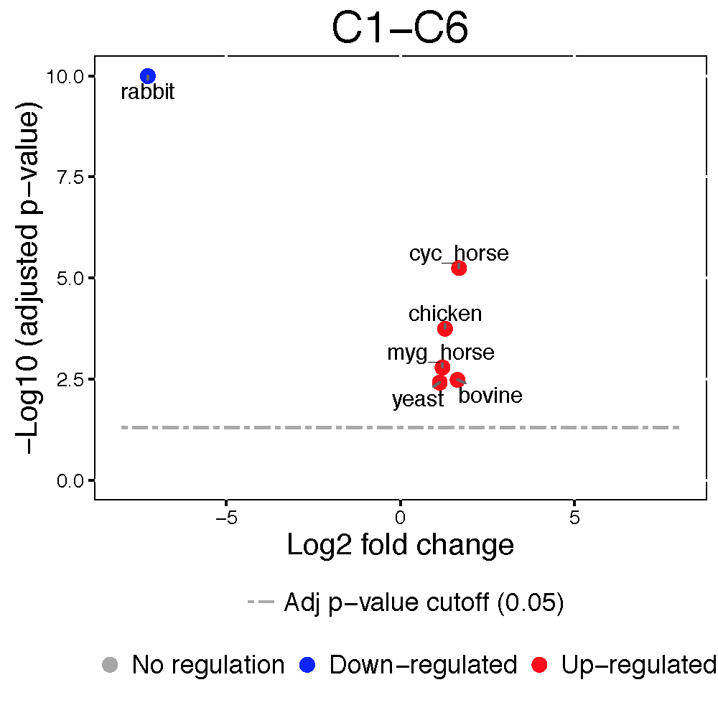
Visualization of differentially abundant proteins
Volcano plots visualize the outcome of one comparison between conditions for all the proteins.
The y-axis displays the FDR-adjusted p-values on the negative log10 scale, representing statistical significance. The horizontal dashed line shows the FDR cutoff.
The points above the FDR cutoff line are statistically significant proteins that are differentially abundant across conditions. These points are colored in red and blue for upregulated and downregulated proteins, respectively.
The x-axis is the model-based estimate of fold change on log scale, and represents practical significance.
If the fold change cutoff is specified, the points above the horizontal cutoff line but within the vertical cutoff line will be considered as not differentially abundant (and will be colored in black).

Slide 11
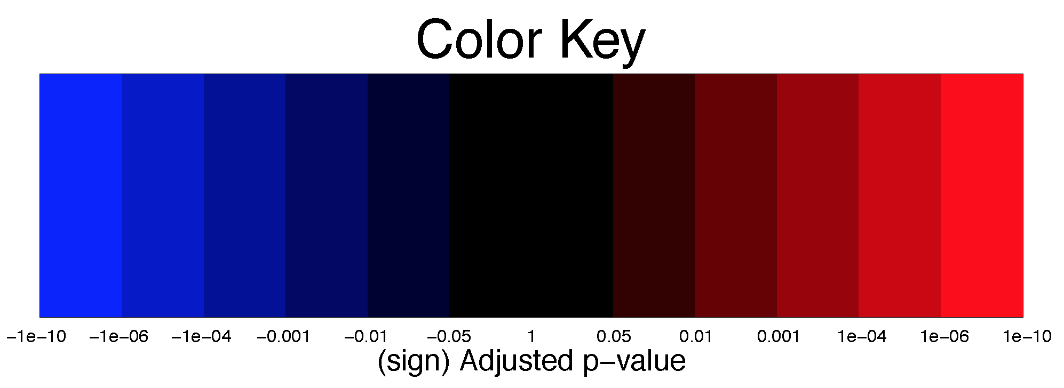
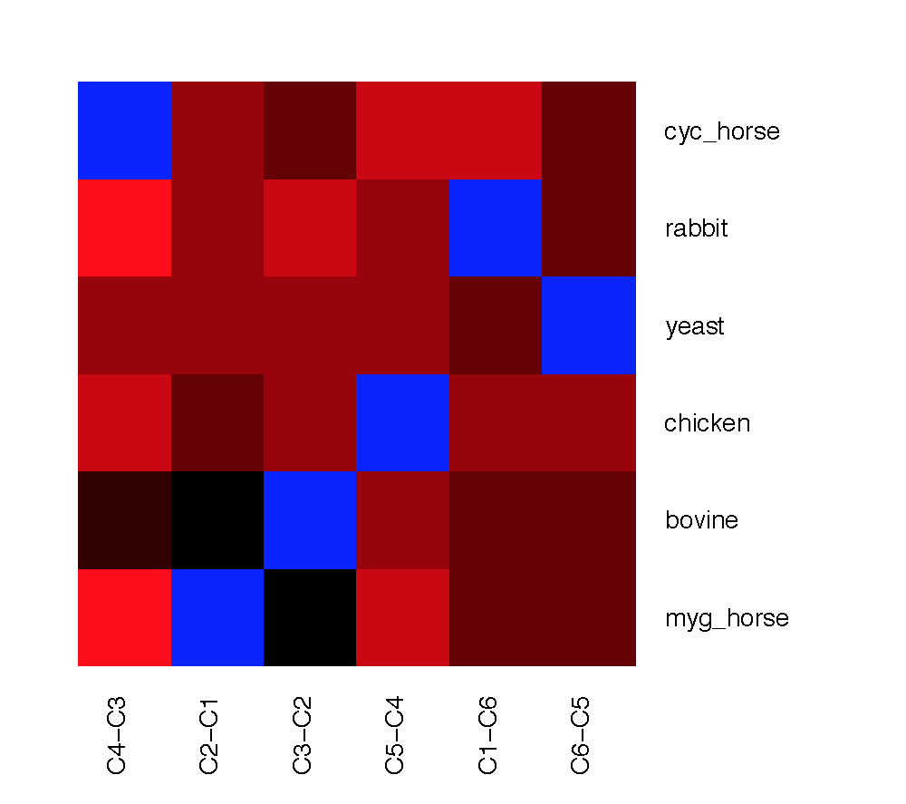
Visualization of differentially abundant proteins
Heatmaps illustrate the patterns of up- and down-regulation of proteins in several comparisons.
Columns in the heatmaps are comparison of conditions assigned in contrast.matrix, and rows are proteins.
The heatmaps display signed FDR-adjusted p-values of the tests, colored in red/blue for significantly up- /down-regulated proteins. Brighter colors indicate stronger evidence in favor of differential abundance. Black color represents proteins that are not significantly differentially abundant.
The rows and columns of the heatmaps can be ordered with the option clustering, which performs hierarchical clustering with the Ward method (minimum variance).

Slide 12
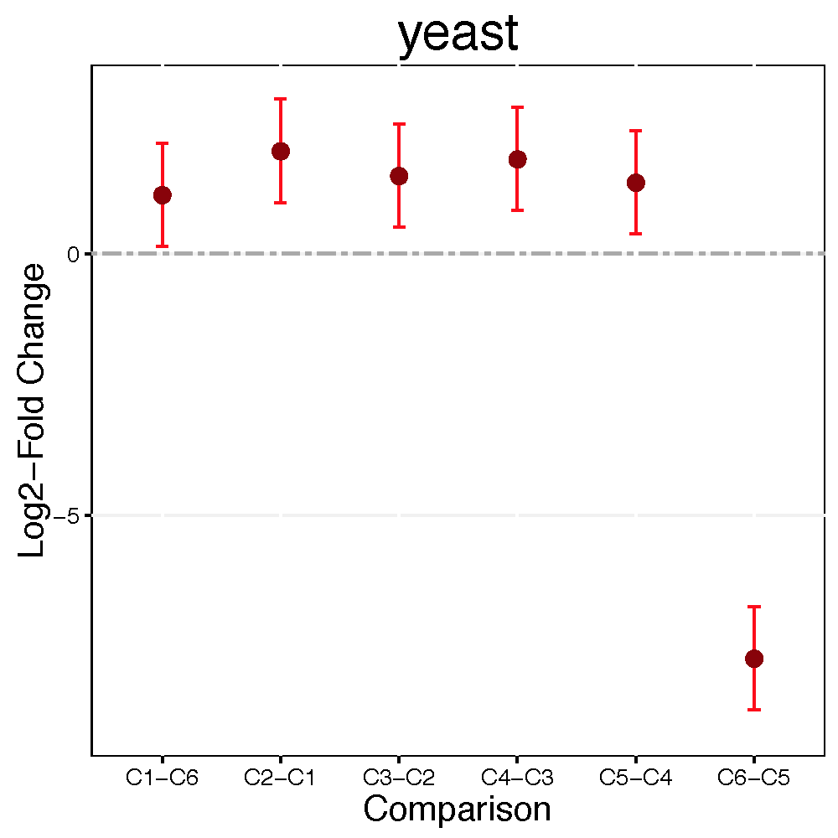
Visualization of differentially abundant proteins
Comparison plots illustrate model-based estimates of log-fold changes, and the associated uncertainty, in several comparisons of conditions for one protein.
X-axis is the comparison of interest. Y-axis is the log fold change. The dots are the model-based estimates of log-fold change, and the error bars are the model-based 95% confidence intervals (the option sig can be used to change the significance level of significance).
For simplicity, the confidence intervals are adjusted for multiple comparisons within protein only, using the Bonferroni approach. For proteins with N comparisons, the individual confidence intervals are at the level of 1-sig/N.

Slide 13
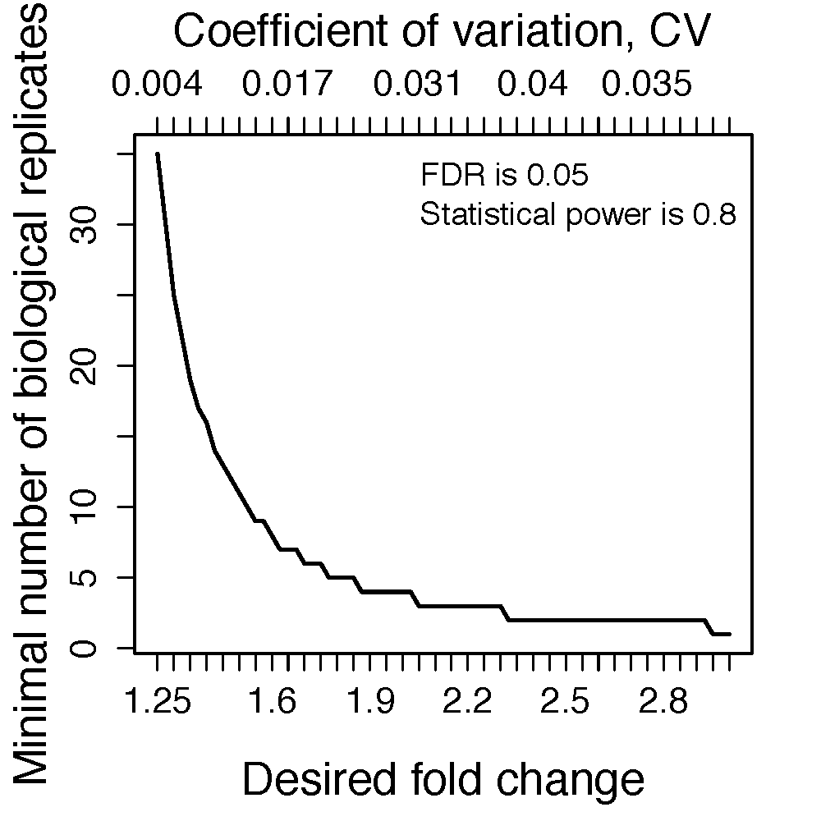
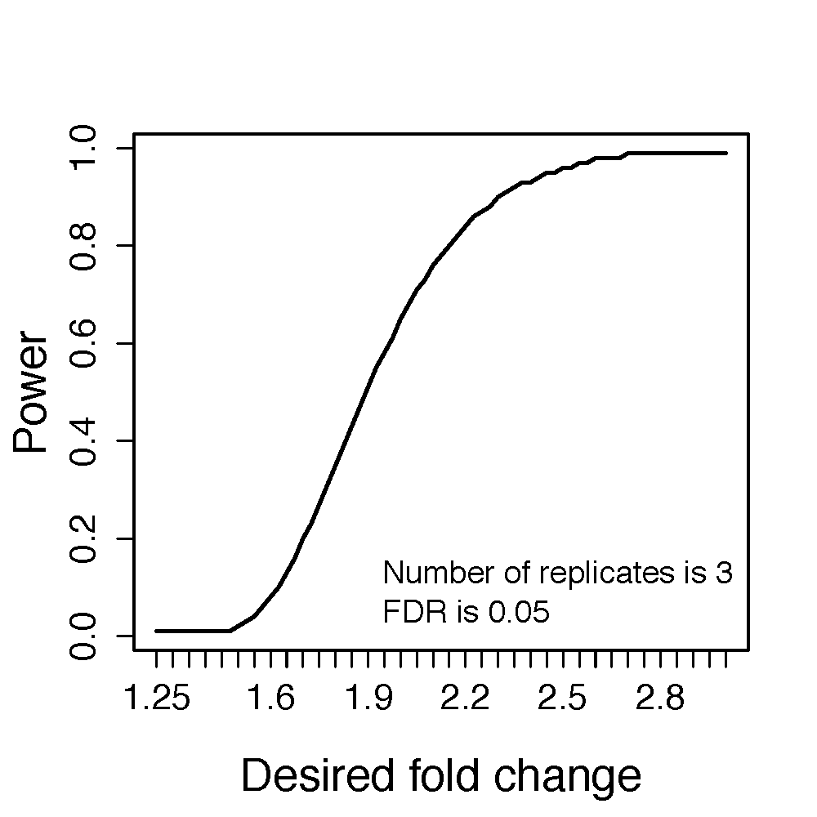
Visualization of sample size calculations
The calculated relationship between the number of biological replicates per condition (numSample), average statistical power across all the proteins (power), minimal fold change that we would like to detect (desiredFC), and the False Discovery Rate (FDR) can be visualized using the function designSampleSizePlots. The function takes as input the output of designSampleSize.

Slide 14
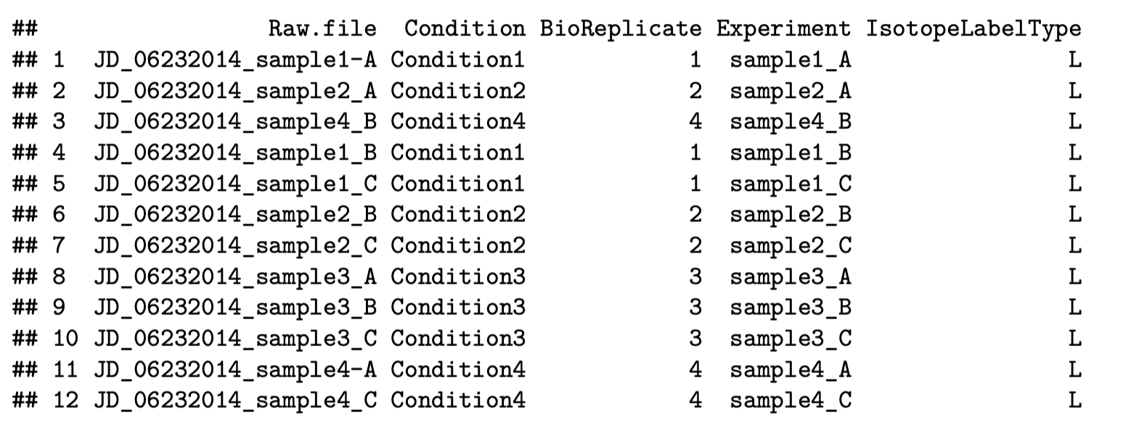
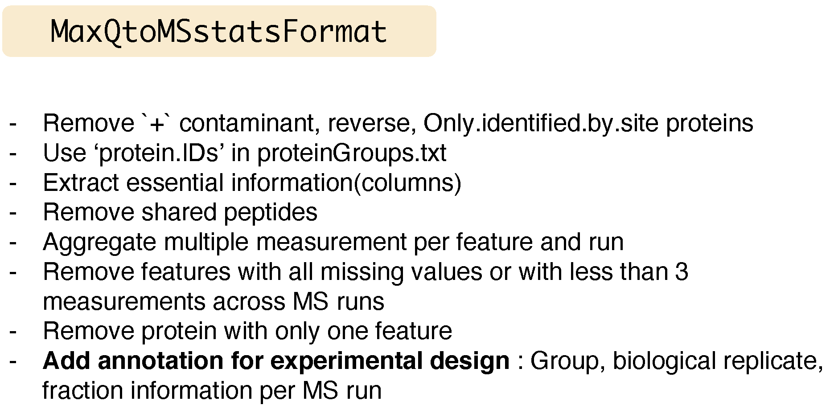
Load MaxQuant outputs
Three files should be prepared before MSstats. Two files, ‘proteinGroups.txt’ and ‘evidence.txt’ are outputs from MaxQuant. One file is for annotation information, required to fill in Condition and BioReplicate for corresponding Run information.
MaxQtoMSstatsFormat function helps pre-processing for making right format of MSstats input from MaxQuant output. Basically, this function gets peptide ion intensity from ‘evidence.txt’ file. In addition, there are several steps to filter out or to modify the data in order to get required information.

