Slide 1
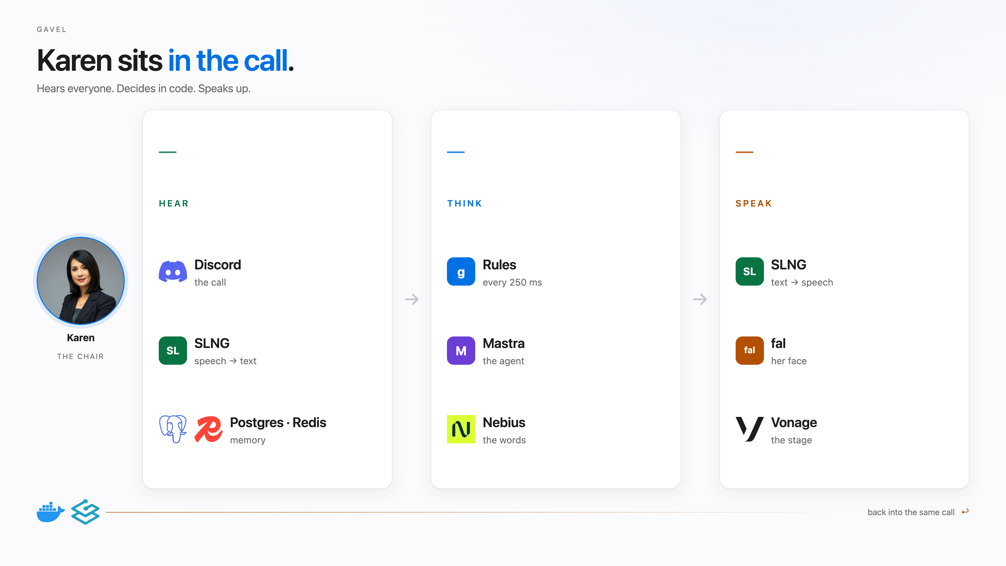
Notes:
Karen sits in the call. Hear: Discord, SLNG speech-to-text, Postgres and Redis. Think: rules four times a second, Mastra orchestration, Nebius for the words. Speak: SLNG back into the call, fal moves her face, Vonage for the stage.

Slide 2
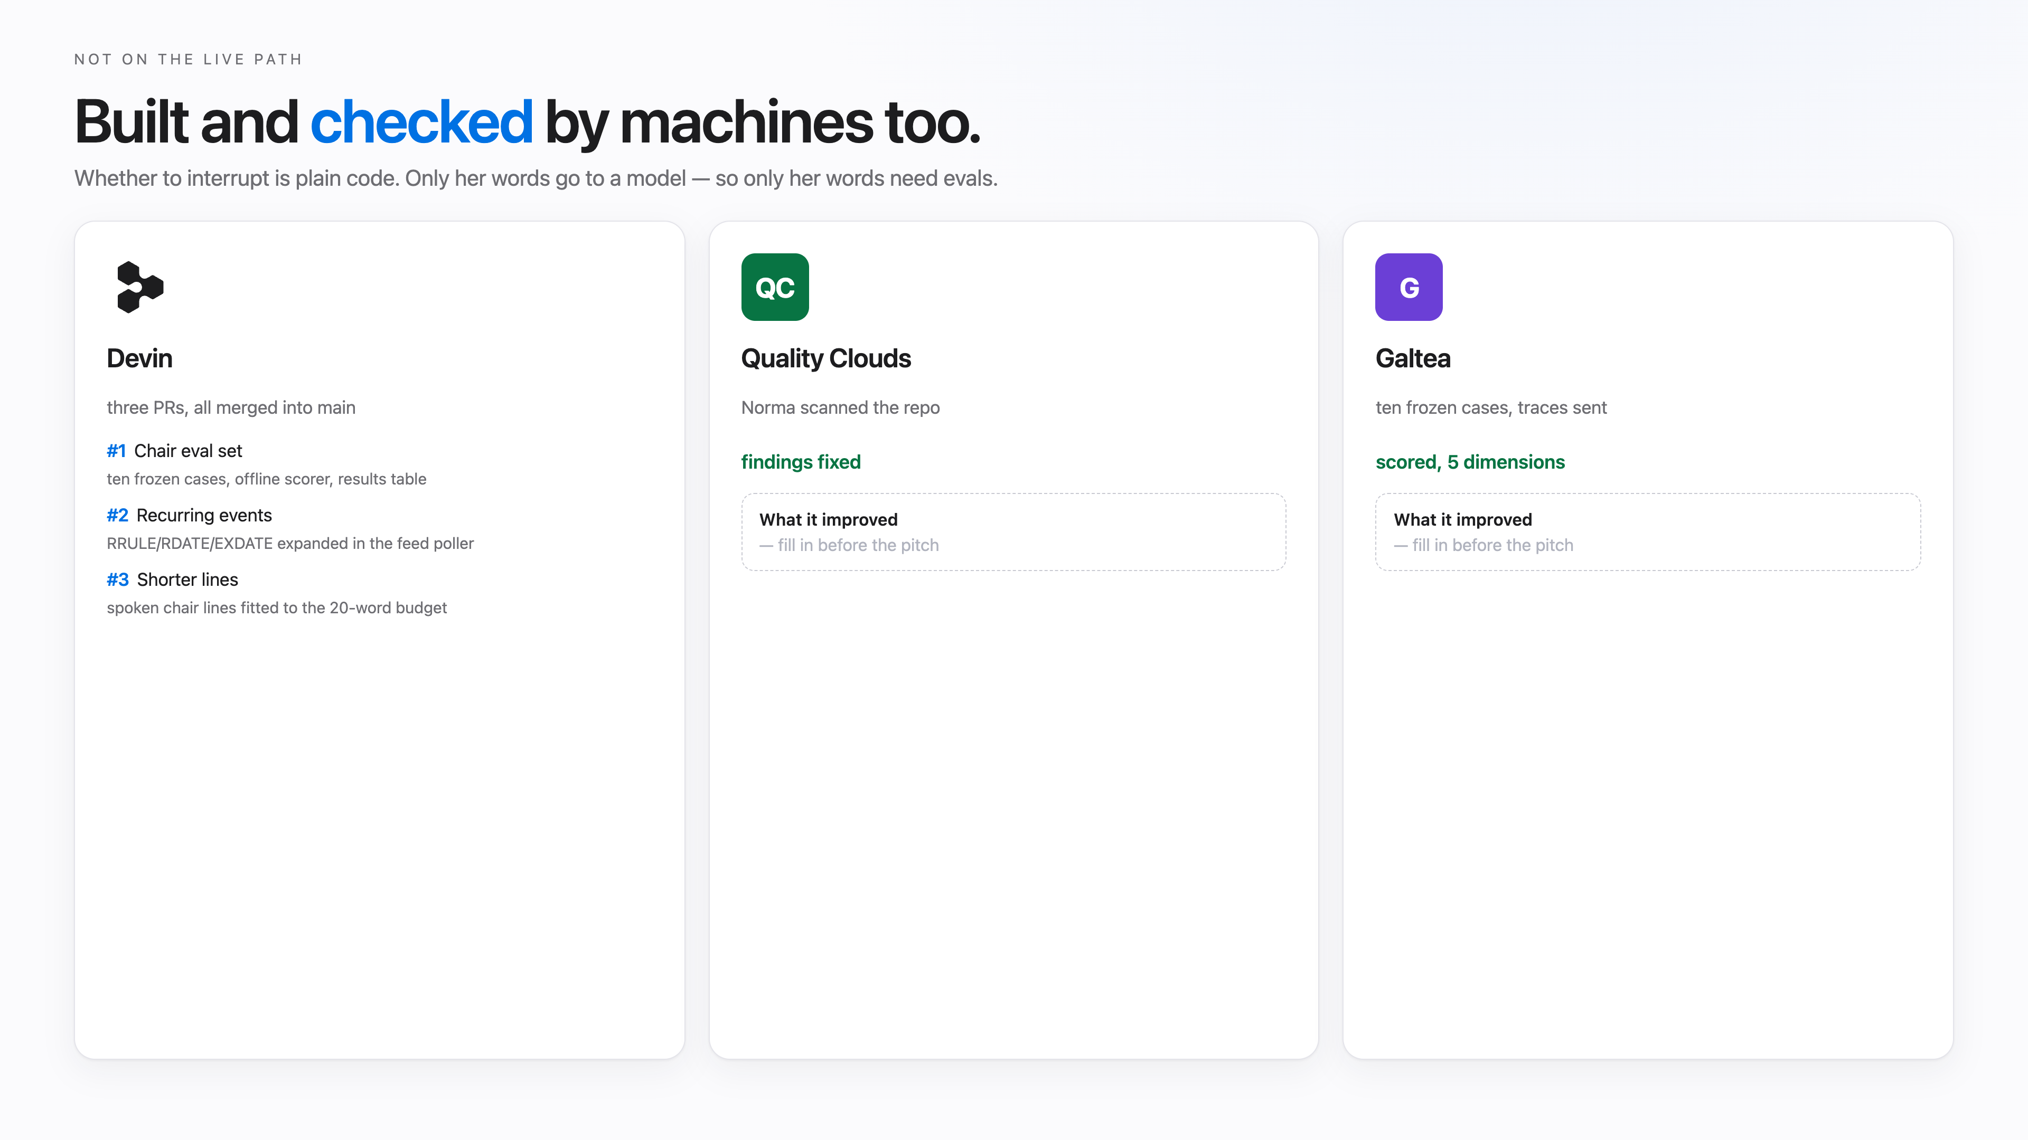
Notes:
Built and checked by machines too. Devin wrote PRs, Quality Clouds scanned the repo, Galtea scored the chair across five dimensions, Langfuse traced every model call.

Slide 3
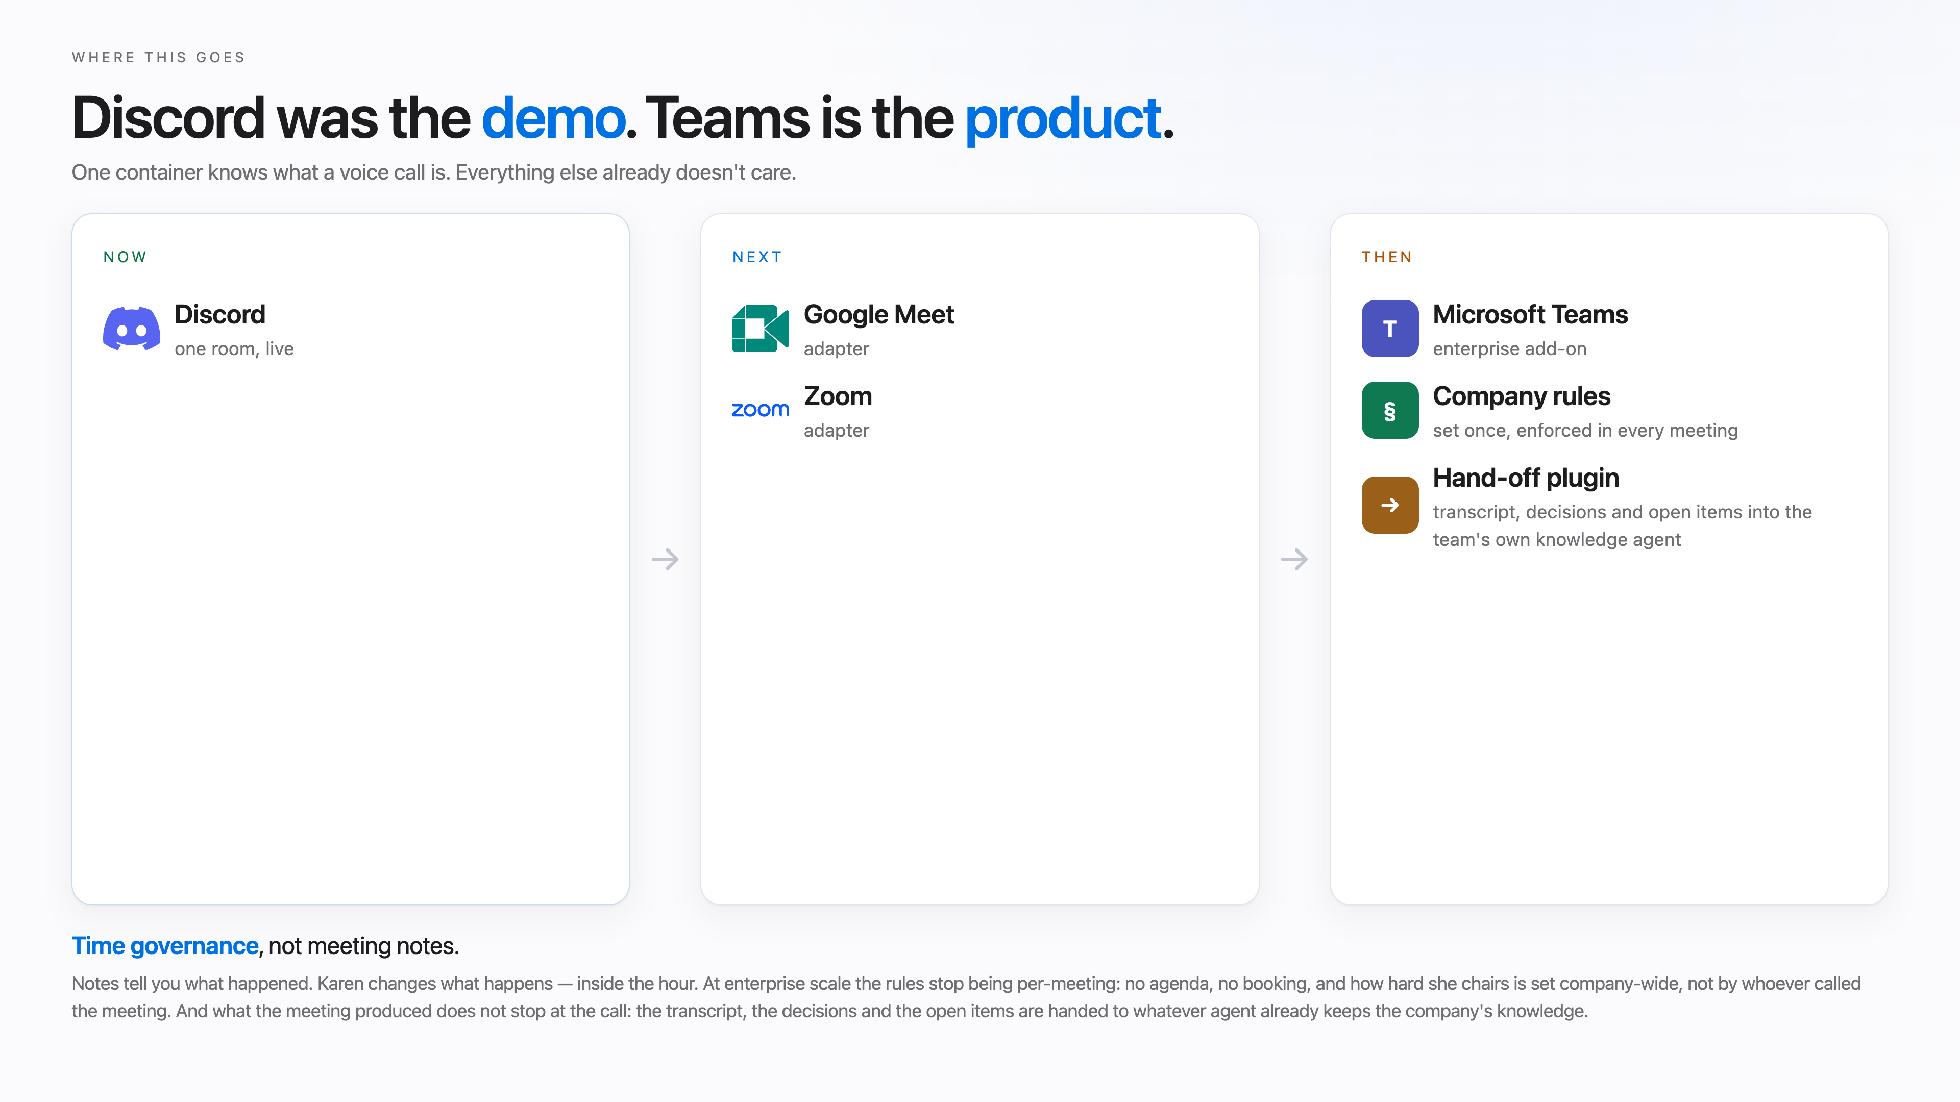
Notes:
Discord was the demo. Teams is the product. One container knows what a voice call is. Company rules set once and enforced everywhere, and a hand-off plugin that pushes the transcript, decisions and open items into the team's own knowledge agent.

