Slide 1
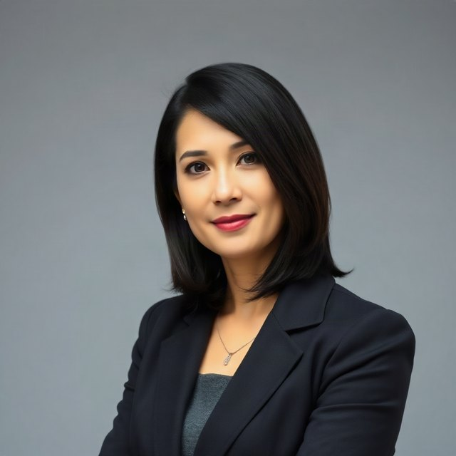
GAVEL
Karen sits in the call.
Hears everyone. Decides in code. Speaks up.
HEAR
THINK
SPEAK
DC
Discord
g
Rules
SL
SLNG
the call
every 250 ms
text → speech
SL
SLNG
→
M
Mastra
→
fal
fal
Karen
speech → text
the agent
her face
the chair
Postgres · Redis
Nebius
Vonage
PG
memory
N
the words
V
the stage
↩ back into the same call — Vonage · Discord

Slide 2
NOT ON THE LIVE PATH
Built and checked by machines too.
Whether to interrupt is plain code. Only her words go to a model — so only her words need evals.
D
QC
G
Devin
Quality Clouds
Galtea
three PRs, all merged into main
Norma scanned the repo
ten frozen cases, traces sent
#1 Chair eval set
findings fixed
scored, 5 dimensions
ten frozen cases, offline scorer, results table
#2 Recurring events
What it improved
What it improved
RRULE/RDATE/EXDATE expanded in the feed poller
— fill in before the pitch
— fill in before the pitch
#3 Shorter lines
spoken chair lines fitted to the 20-word budget

Slide 3
WHERE THIS GOES
Discord was the demo. Teams is the product.
One container knows what a voice call is. Everything else already doesn't care.
NOW
NEXT
THEN
DC
Discord
GM
Google Meet
T
Microsoft Teams
one room, live
adapter
enterprise add-on
→
Zoom
→
Company rules
Z
adapter
§
set once, enforced in every meeting
→
Hand-off plugin
transcript, decisions and open items into the team's knowledge agent
Time governance, not meeting notes. Notes tell you what happened. Karen changes what happens — inside the hour. At enterprise scale the rules stop being per-meeting: no agenda, no booking, and how hard she chairs is set company-wide, not by whoever called the meeting. And what the meeting produced does not stop at the call: the transcript, the decisions and the open items are handed to whatever agent already keeps the company's knowledge.

