Slide 1
AI-Assisted Software Testing Practice Platform
Team Members:
Bipan Dhakal (CIHE251088)
Santosh Chapagain(CIHE251055)
Keshav Raj Poudel(CIHE251100)
Susil Kumar Shrestha(CIHE251075)
Manjil Khanal(CIHE250109)

Slide 2
Introduction
A web application where students practice ISTQB Foundation Level (CTFL v4.0) certification-style questions.
AI-generated reasoning for each answer via Google Gemini API.
Domain-level analytics dashboard—monitor progress and highlight weak areas.
Tech stack: React, Python Flask, PostgreSQL, and Google Gemini API.
Will develop in collaboration with industry partner Bottot Pty Ltd.

Slide 3
Problem Statement
Only 60% of candidates pass the ISTQB Foundation Level exam on their first attempt
No AI feedback on wrong answers — candidates must manually search the syllabus
No domain-level analytics — candidates cannot identify and target their weak areas

Slide 4
Goals and Objectives
Goal: Build a product that allows ISTQB Foundation Level students to practice with AI-generated explanations and domain-level performance metrics.
Objective 1: Build a secure web prototype with CTFL v4.0 practice questions and Google Gemini AI answer explanations.
Objective 2: Implement a learner analytics dashboard showing domain-level performance and weak area recommendations.

Slide 5
Project Scope
In Scope:
React + Next.js frontend, Python Flask REST API, PostgreSQL database.
150+ original questions across all 6 CTFL v4.0 domains.
Google Gemini AI explanations and domain analytics dashboard.
Out of Scope:
Production cloud deployment, native mobile app.
Advanced/Expert ISTQB levels.
Payment systems and multi-language support.

Slide 6
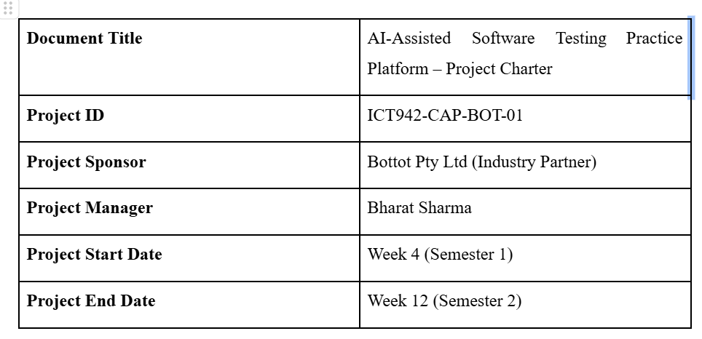
Project Charter

Slide 7
Purpose
60% pass rate in ISTQB exam
No free AI-based learning tool
Build AI-powered test prep platform (Gemini)
Stakeholders
Bottot Pty Ltd, ICT942 Coordinator
Team: Frontend, Backend, Testing, PM

Slide 8
Formal Acceptance Criteria
Working prototype fully installed
Question system + AI explanations functional
Analytics dashboard operational
Minimum 150+ questions across all 6 domains
Security check: No high severity issues (OWASP ZAP)
Test coverage ≥ 80%

Slide 9
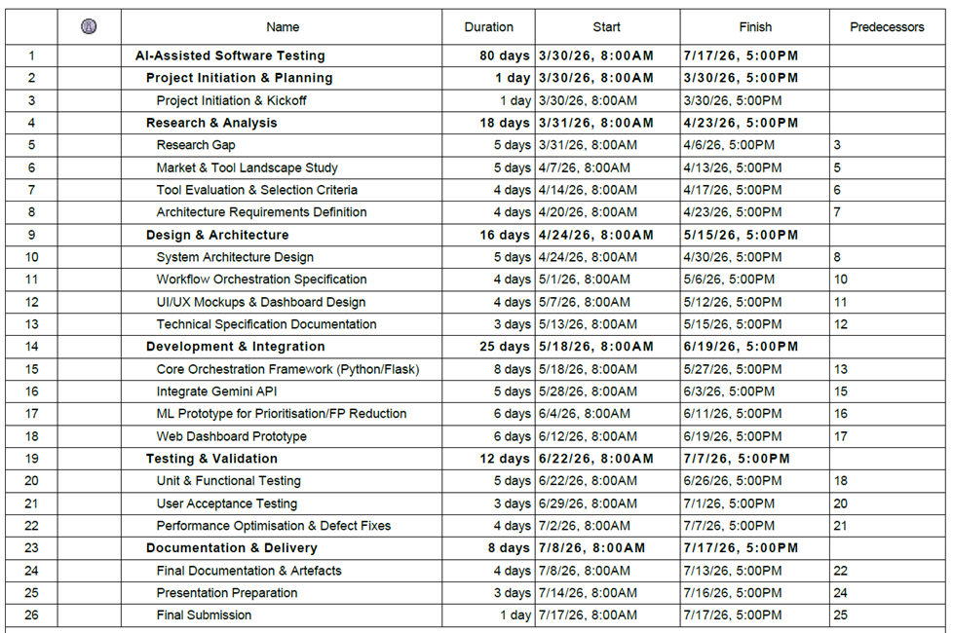
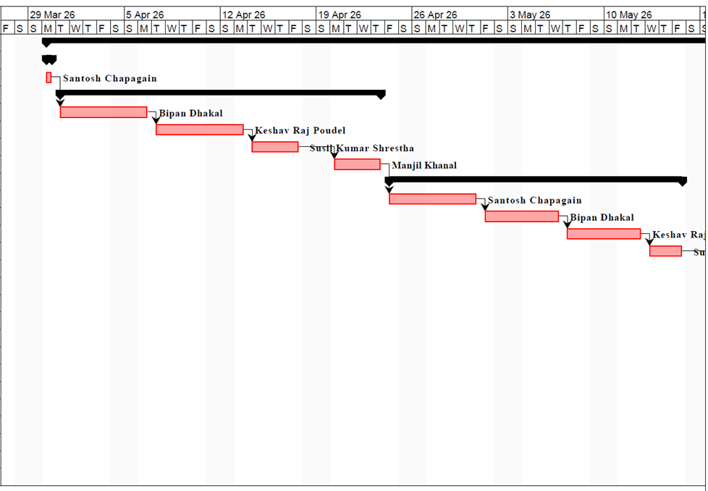
Gantt chart

Slide 10
Team Roles & Responsibilities
Bipan Dhakal (Frontend): UI design, React components, Tailwind, dashboard integration
Susil Shrestha (Frontend): Admin panel, routing, responsive design
Santosh Chapagain (Backend): Flask API, PostgreSQL, ORM, analytics, API docs
Manzil Khanal (Testing Lead): Testing, OWASP ZAP, bug tracking, UAT
Keshav Raj Poudel (Backend/PM): Gemini API, backend, sprint planning, coordination

Slide 11
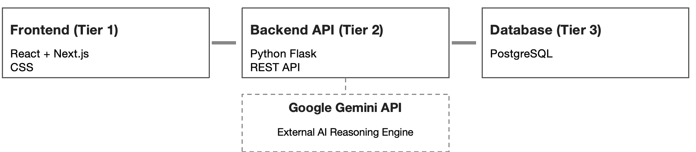
System Architecture
The platform is implemented as a three-tier web application.

Slide 12
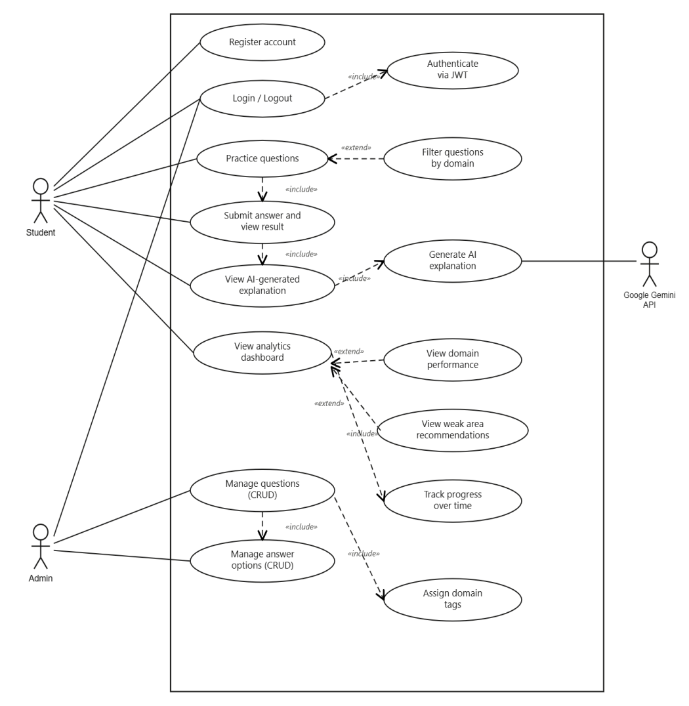
Use case diagram

Slide 13
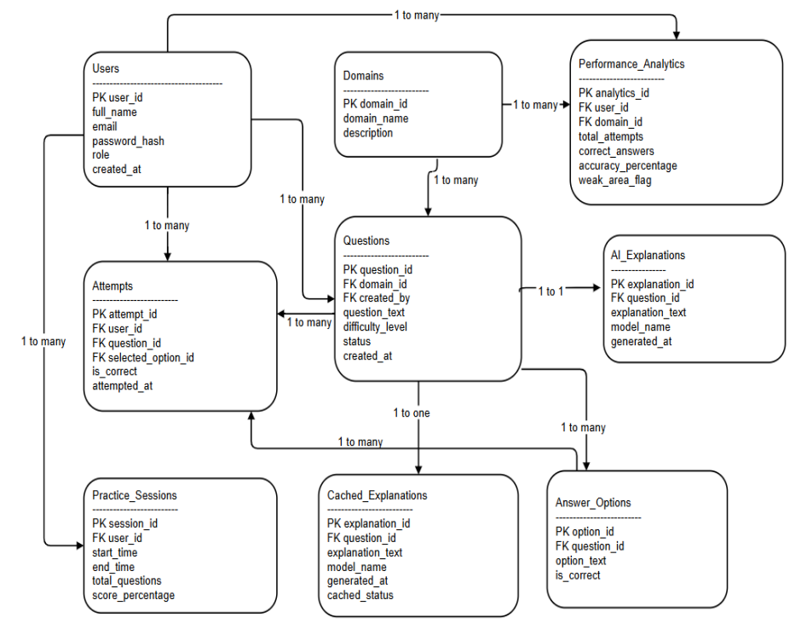
ERD Diagram

Slide 14
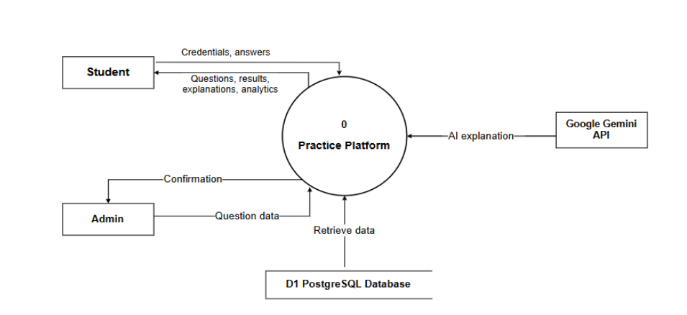
Data Flow Diagram (Level 0)

Slide 15
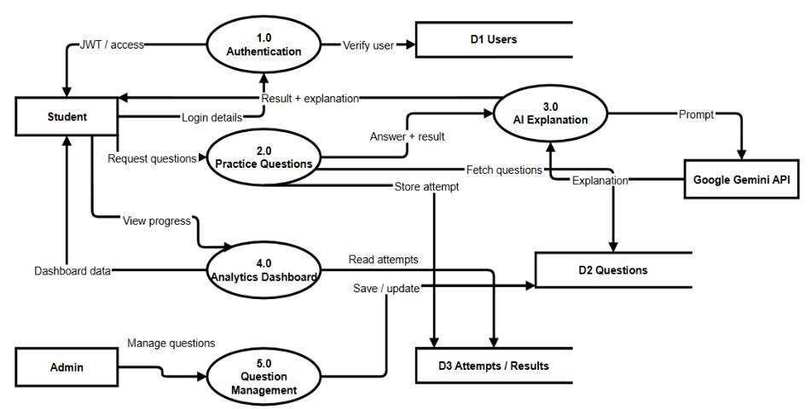
Data Flow Diagram (Level 1)

Slide 16
Technology Stack Overview
Frontend: React + Tailwind CSS
Backend: Python Flask (REST API)
Database: PostgreSQL (Supabase)
AI Engine: Google Gemini API
Visualization: Python (server-side analytics)

Slide 17
Key Justifications
Frontend (React & Tailwind) : Building UI quickly with reusable components
Backend (Flask): Simple, lightweight, flexible framework for API building
Database (PostgreSQL): Robust, scalable SQL database
AI Engine (Gemini API): Free tier + powerful AI reasoning
Data Science (Python): Accurate, consistent data processing

Slide 18
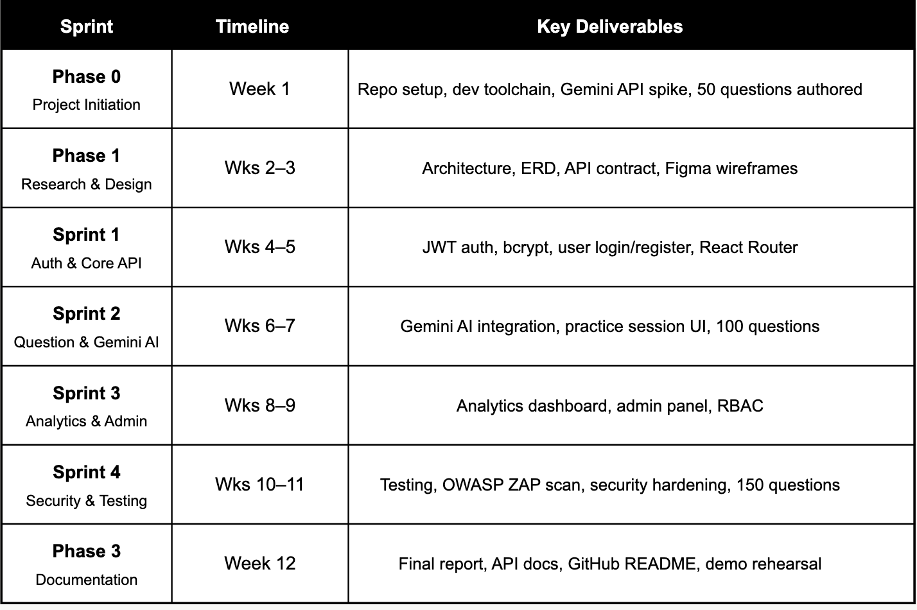
Implementation/Sprint Plan

Slide 19
Conclusion
Nearly 60% of ISTQB candidates fail their first attempt due to lack of smart, affordable prep tools.
The platform offers AI-powered explanations, domain analytics, and 150+ practice questions — all free.
Build on React, Flask, and PostgreSQL with OWASP Top 10 security standards.
All feasibility dimensions validated with a clear 12-week Agile-Waterfall delivery plan.
A strong proof of concept for AI-enhanced learning, aligned with Bottot Pty Ltd's EdTech goals.

