Slide 1
CompTIA Network+
Day 3 — Network Operations
Document • Monitor • Recover • Operate
CompTIA Network+ • Day 3 • Network Operations • 1
Notes:
Today we move from building networks to operating them reliably.

Slide 2
Day 3 Objectives
Network Operations
• Explain documentation, life-cycle, change and configuration management.
• Use monitoring methods and interpret evidence.
• Explain RPO, RTO, MTTR, MTBF, DR sites and high availability.
• Implement/verify DHCP, DNS, IPv6 and time services.
• Explain VPNs, jump hosts, and in-band vs. out-of-band management.
CompTIA Network+ • Day 3 • Network Operations • 2

Slide 3
Network Operations — The Big Picture
DISCOVER
DOCUMENT
BASELINE
CHANGE
MONITOR
VERIFY
RECOVER
DOCUMENT
Mental model
Good operations make the network easier to understand today — and easier to troubleshoot tomorrow.
CompTIA Network+ • Day 3 • Network Operations • 3
Notes:
Let’s look at Network Operations as one continuous cycle.
Imagine we are managing a small company network.
First, we discover what devices we have — switches, routers, access points and servers.
Then we document everything: where each device is, which port connects where, and what IP addresses are being used.
Next, we create a baseline. For example, we know that normally the internet response time is around 20 milliseconds.
Now suppose we need to make a change — maybe we move a department to a new VLAN. Before changing anything, we record the current configuration.
After the change, we monitor the network and verify that users can still access their applications.
If something goes wrong, we recover — perhaps by rolling back the change or switching to a backup system.
And finally, we document what happened.
So remember this simple story:
Know it → Record it → Measure it → Change it → Watch it → Check it → Recover it → Record it again.
That is the basic mindset of Network Operations. We don't just configure a network and walk away — we continuously operate and maintain it.

Slide 4
3.1 Organizational Processes
Why processes matter
Documentation
Life-cycle
Change
Configuration
What exists?
Where is it?
How is it connected?
Plan → deploy → operate → maintain → retire
What? Why? Impact?
Rollback?
What settings are active?
What changed?
CompTIA Network+ • Day 3 • Network Operations • 4
Notes:
Now let’s understand why organizational processes are important in networking.
Imagine you are managing the network of a small office.
First — Documentation. We need to know what devices we have, where they are, and how they are connected. For example, we should know: Which switch connects to the router? Which port is connected to the server?
Second — Life-cycle. Every network device has a life-cycle: Plan → Deploy → Operate → Maintain → Retire. For example, we install a new switch, use it for several years, maintain it, and eventually replace it.
Third — Change. Suppose we want to move users to a new VLAN. We should ask: What are we changing? Why are we changing it? What could be affected? And most importantly, What will we do if something goes wrong? That is our rollback plan.
Fourth — Configuration. We need to know what settings are actually active on the device and what has changed.
For example, if a user suddenly loses network access, we can check whether someone recently changed the VLAN or port configuration.
So the simple idea is:
Document it → Manage its life → Control changes → Check configuration.
Good processes make troubleshooting much easier because we know what we have, what changed, and what the network should look like

Slide 5
Network Documentation
Topology
Inventory
Records
Logical/physical diagram
Links & interfaces
VLANs & subnets
Device
Hostname
Role
Management IP
Ports
Labels
Addressing
Services
Changes
CompTIA Network+ • Day 3 • Network Operations • 5
Notes:
Network documentation is basically the network’s notebook.
First, we have Topology. This shows us how devices are connected — switches, routers, VLANs and links.
Second, we have Inventory. This tells us what devices we have and important details like hostname, role and management IP.
Third, we have Records. These tell us things like which ports are used, IP addresses, services and changes.
For example, imagine a user cannot connect to the network.
Instead of checking everything randomly, we can look at our documentation:
Where is the PC connected? → Which switch port? → Which VLAN? → Which IP network? → What changed recently?
So remember:
Topology = How it is connected Inventory = What we have Records = What is configured and what changed
Good documentation turns troubleshooting from guessing into checking.

Slide 6
Baseline — Know the Normal
• Baseline = a recorded picture of normal behavior.
• Capture reachability, latency, interface state and service status.
• Compare future measurements with the baseline.
• Without a baseline, 'unusual' is difficult to prove.
Example
Gateway ping: ~2 ms
Remote ping: ~25 ms
Interface: UP
DNS: resolves
CompTIA Network+ • Day 3 • Network Operations • 6

Slide 7
Change Management — Controlled Change
REQUEST
ASSESS
APPROVE
CHANGE
VERIFY
ROLLBACK
Before the change
Record current state • expected result • impact • rollback plan
CompTIA Network+ • Day 3 • Network Operations • 7
Notes:
Now let’s understand change management with a very simple example.
Imagine our company wants to replace a network switch.
We don't just unplug the old switch and connect the new one. We follow a controlled process.
First, we request the change. Then we assess it — what could be affected?
Next, someone approves the change.
We then perform the change during the planned maintenance time.
After that, we verify — is the network working correctly?
And finally, we keep a rollback plan. If something goes wrong, we can return to the previous configuration.
For example, before replacing a switch, we record its current configuration, expected result, possible impact, and rollback plan.
The simple idea is:
Plan → Approve → Change → Verify → Roll back if needed.
This prevents a small network change from becoming a big network outage.

Slide 8
Configuration Management
Current State
Known Good
Drift
What configuration is active now?
What configuration should be active?
What changed unexpectedly?
CompTIA Network+ • Day 3 • Network Operations • 8
Notes:
Configuration management is basically about knowing what the network should look like and what it actually looks like.
Let’s take a simple example.
Imagine we have a company switch. The approved configuration says VLAN 10 should be on port 5.
First, we check the Current State — what is configured on the switch right now?
Then we compare it with our Known Good configuration — what configuration do we expect?
Now suppose someone changes port 5 to VLAN 20 without telling us. That unexpected difference is called configuration drift.
So remember three simple questions:
Current State → What is there now?
Known Good → What should be there?
Drift → What changed unexpectedly?
This is very useful when troubleshooting because sometimes the network problem is simply caused by a configuration change that nobody documented.

Slide 9
Change vs Configuration Management
Change Management
Configuration Management
Focus: the change event
Example: move a port from VLAN 10 to VLAN 20.
Was it planned, approved and verified?
Focus: configuration state
Example: track VLAN membership and interface settings.
Does current state match intended state?
CompTIA Network+ • Day 3 • Network Operations • 9
Notes:
“Let’s make the difference very simple.
Think about our switch port.
Change Management is about the change event.
For example, we want to move Port 5 from VLAN 10 to VLAN 20.
We ask: Was this change requested, approved, performed, and verified?
Configuration Management is about the configuration itself.
After the change, we check: Is Port 5 actually in VLAN 20? Is that the configuration we expect?
So the easiest way to remember is:
👉 Change Management = What changed? 👉 Configuration Management = What is configured now?
For example, if someone changes Port 5 to VLAN 20 without approval, Change Management tells us that the change was unauthorized, while Configuration Management helps us detect that the port is no longer in its expected VLAN.
In short: Change tracks the journey; Configuration tracks the state.”

Slide 10
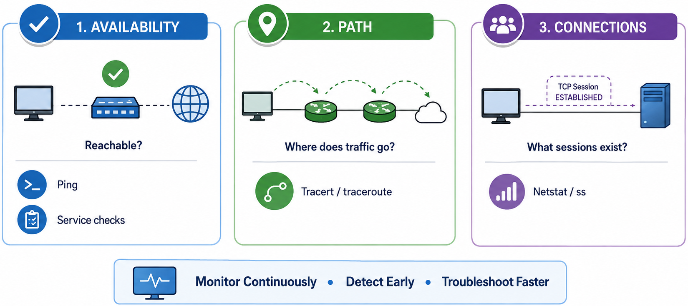
3.2 Network Monitoring
Monitoring turns symptoms into evidence
CompTIA Network+ • Day 3 • Network Operations • 10

Slide 11
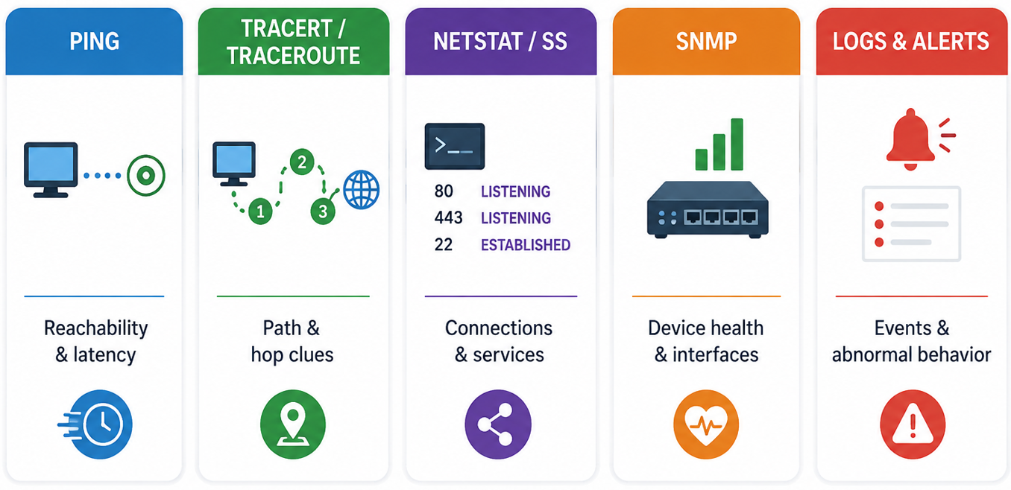
Monitoring Methods — Simple Toolkit
• Ping → reachability and basic latency.
• Tracert / traceroute → path and hop clues.
• Netstat / ss → local connections and listening services.
• SNMP → device health and interface information in managed environments.
• Logs and alerts → events and abnormal behavior.
CompTIA Network+ • Day 3 • Network Operations • 11

Slide 12
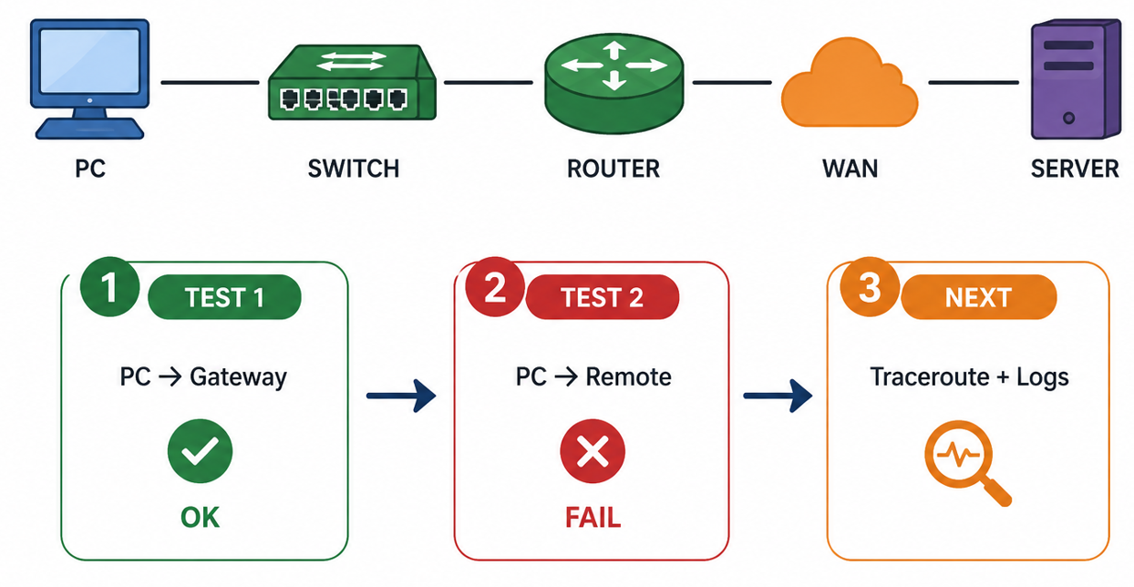
Monitoring Example — Find the Fault Domain
CompTIA Network+ • Day 3 • Network Operations • 12

Slide 13
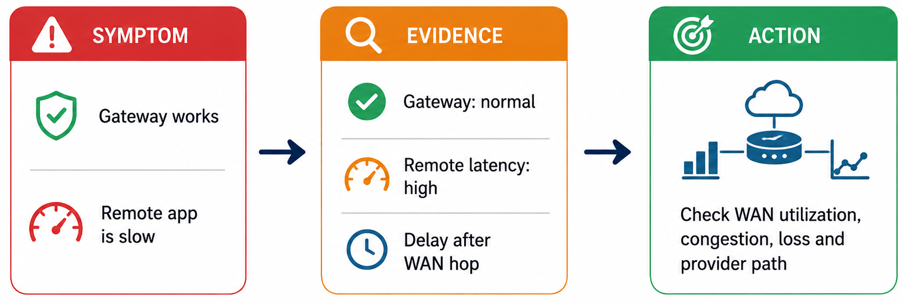
Monitoring Scenario
CompTIA Network+ • Day 3 • Network Operations • 13
Notes:
Let’s take a very simple example.
Imagine a user says, ‘The company application is very slow.’ That is our symptom. We don't immediately blame the server or the Internet.
First, we collect evidence.
We check the gateway — it is working normally. Then we use a tool like traceroute and notice that the delay starts after the traffic leaves our network and reaches the WAN.
Now we have a much better idea of the fault domain.
So our next action is to investigate the WAN — things like utilization, congestion, packet loss, or the provider path.
The important lesson is: don't guess the problem; use monitoring evidence to narrow it down.
Think of the process as:
Symptom → Evidence → Fault Domain → Action

Slide 14
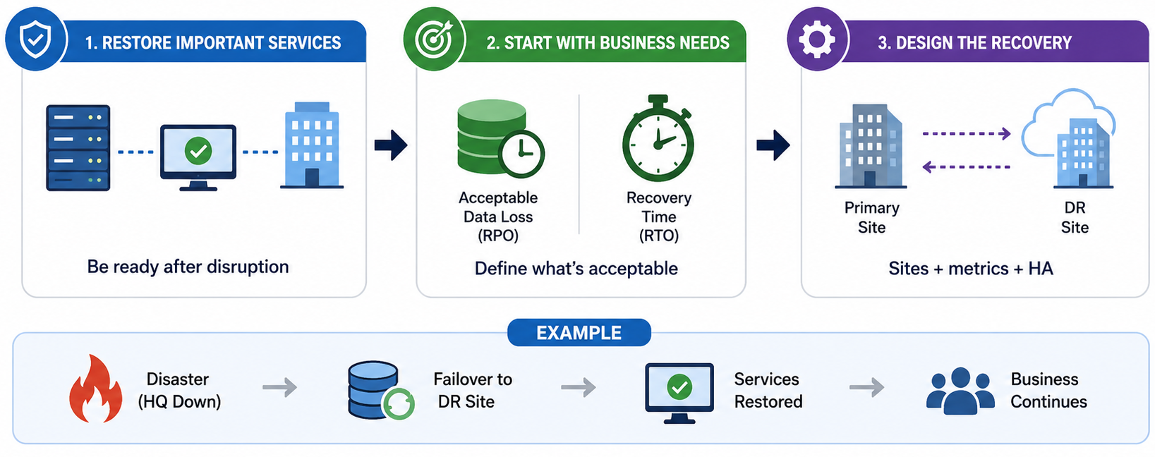
3.3 Disaster Recovery
Why prepare?
• DR prepares the organization to restore important services after disruption.
• Start with business needs: acceptable data loss and recovery time.
• Recovery design includes metrics, sites and high-availability approaches.
CompTIA Network+ • Day 3 • Network Operations • 14
Notes:
• DR prepares the organization to restore important services after disruption.
• Start with business needs: acceptable data loss and recovery time.
• Recovery design includes metrics, sites and high-availability approaches.

Slide 15
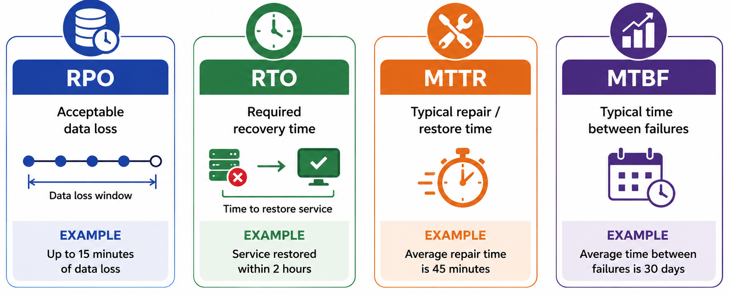
DR Metrics — RPO • RTO • MTTR • MTBF
CompTIA Network+ • Day 3 • Network Operations • 15
Notes:
Now let’s look at four important Disaster Recovery metrics: RPO, RTO, MTTR, and MTBF.
Let’s take a simple example. Imagine our company’s online shopping system suddenly goes down.
RPO asks: How much data can we afford to lose? For example, if our RPO is 15 minutes, we can accept losing up to 15 minutes of recent transactions.
RTO asks: How quickly must we bring the service back? For example, an RTO of 2 hours means the shopping system should be restored within two hours.
MTTR means Mean Time to Repair. It tells us how long it normally takes to fix or restore something after it fails. For example, if repairs normally take 45 minutes, our MTTR is 45 minutes.
Finally, MTBF means Mean Time Between Failures. It tells us how often something fails. For example, if a server normally runs for 30 days before a failure, its MTBF is 30 days.
So, an easy way to remember them is:
RPO → How much data can we lose? RTO → How fast must we recover? MTTR → How fast do we fix it? MTBF → How often does it fail?
These metrics help the organization decide how much protection and recovery capability it really needs.

Slide 16
DR Metrics — Easy Example
Online order database
Customer portal
RPO = 15 minutes
→ Up to 15 minutes of data loss is acceptable.
RTO = 1 hour
→ Service should return within 1 hour.
CompTIA Network+ • Day 3 • Network Operations • 16

Slide 17
DR Sites — Hot vs Warm vs Cold
Hot Site
Warm Site
Cold Site
Ready quickly
Systems/data available
Higher cost
Partially ready
Some setup required
Medium cost
Space/basic infrastructure
More recovery work
Lower cost
CompTIA Network+ • Day 3 • Network Operations • 17

Slide 18
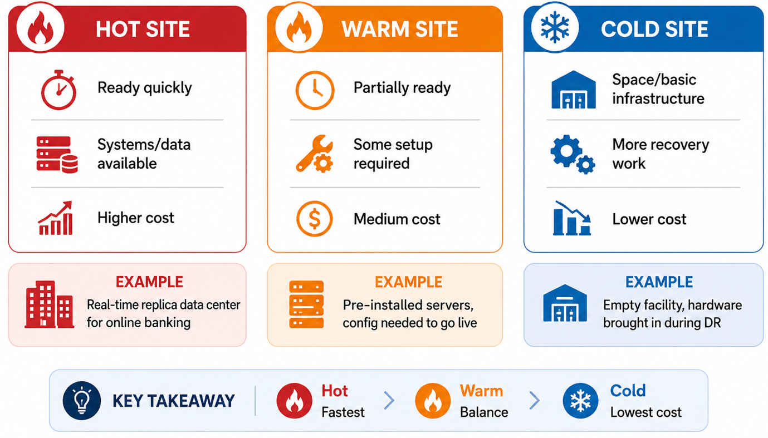

Slide 19
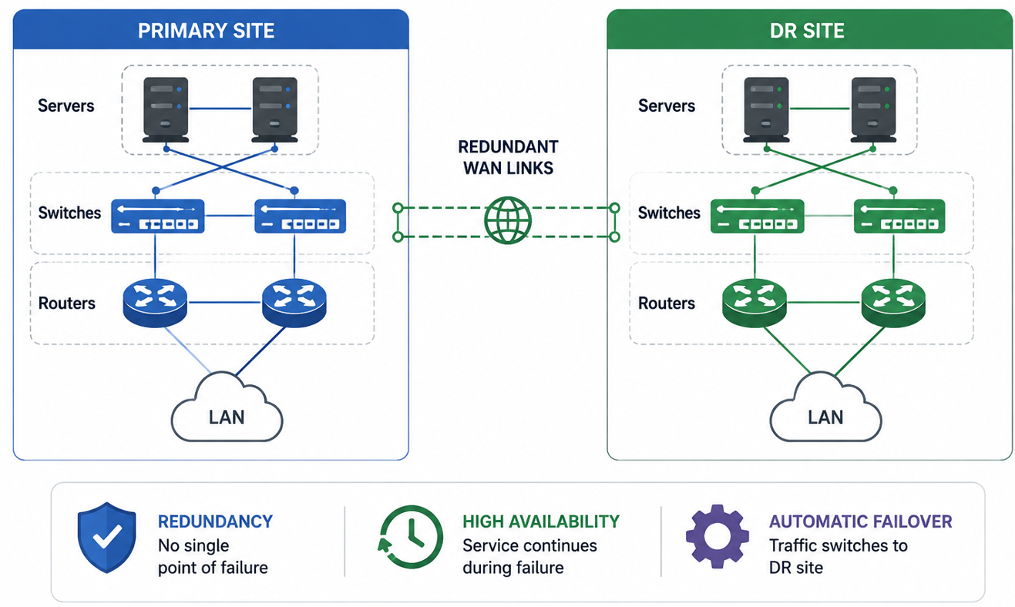
High Availability — Reduce Downtime
PRIMARY
REDUNDANT PATH
SERVICE
CompTIA Network+ • Day 3 • Network Operations • 18
Notes:
• Redundancy reduces single points of failure.
• Examples: redundant links, devices, power and gateway services.
• Goal: keep service available while a failed component is repaired.

Slide 20
3.4 IPv4 Network Services
Dynamic addressing
DHCP
Why?
Verify
Automatically provides
IP • mask • gateway • DNS
Faster deployment
Fewer manual errors
Centralized addressing
Check lease
Ping gateway
Confirm DNS
CompTIA Network+ • Day 3 • Network Operations • 20

Slide 21
DHCP — Simple Flow
CLIENT
DISCOVER
OFFER
REQUEST
ACK
Example
A new laptop joins office Wi‑Fi and receives an IP automatically.
CompTIA Network+ • Day 3 • Network Operations • 21

Slide 22
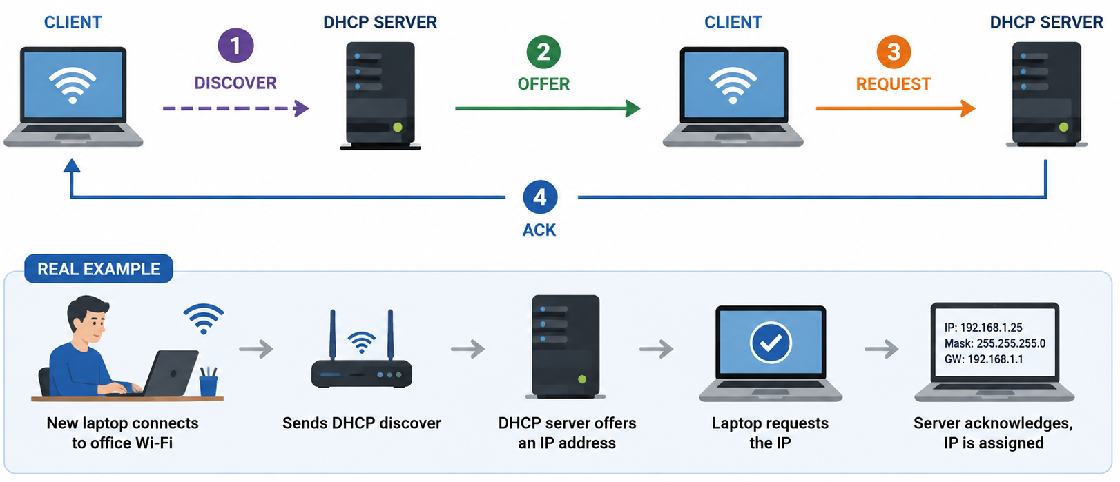

Slide 23
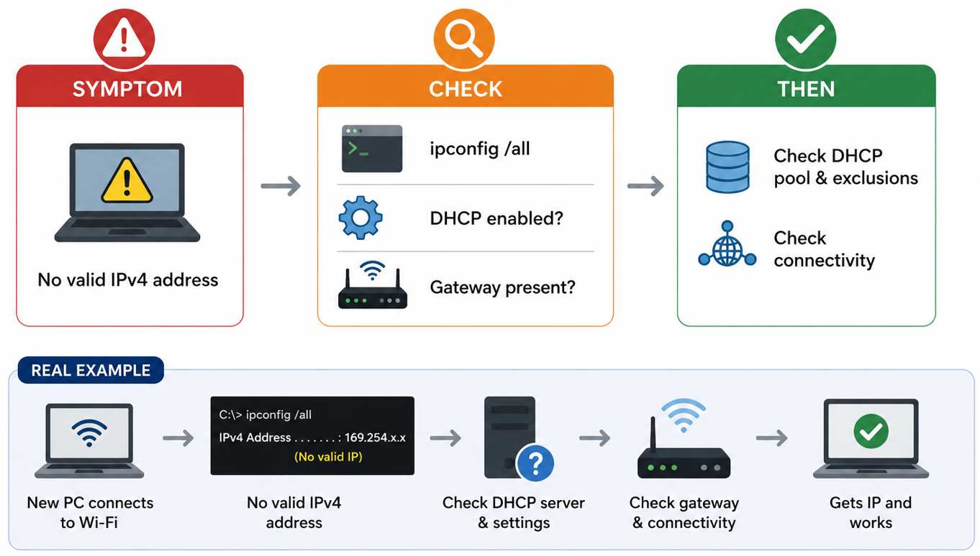
DHCP Troubleshooting Clue
CompTIA Network+ • Day 3 • Network Operations • 22

Slide 24
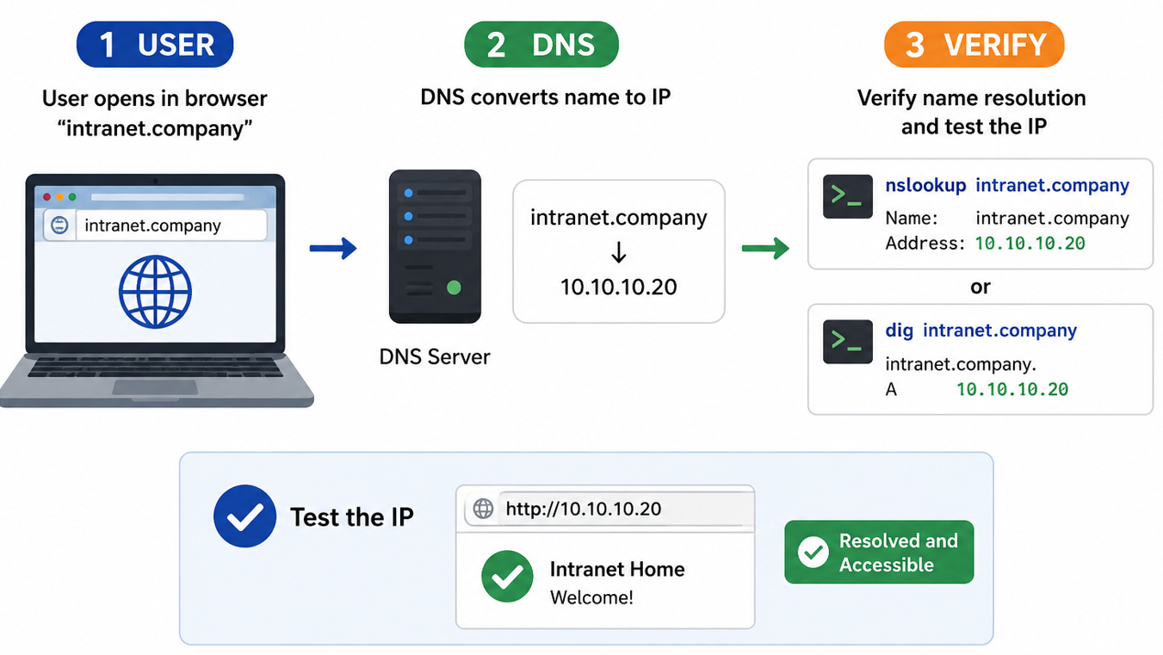
Name Resolution — DNS
CompTIA Network+ • Day 3 • Network Operations • 23

Slide 25
Time Services — Why Time Matters
NTP / Time
Operations
Example
Keeps systems aligned to a common time source.
Accurate timestamps make logs easier to correlate.
Server A: 10:02
Server B: 10:17
Timeline becomes confusing.
CompTIA Network+ • Day 3 • Network Operations • 24

Slide 26
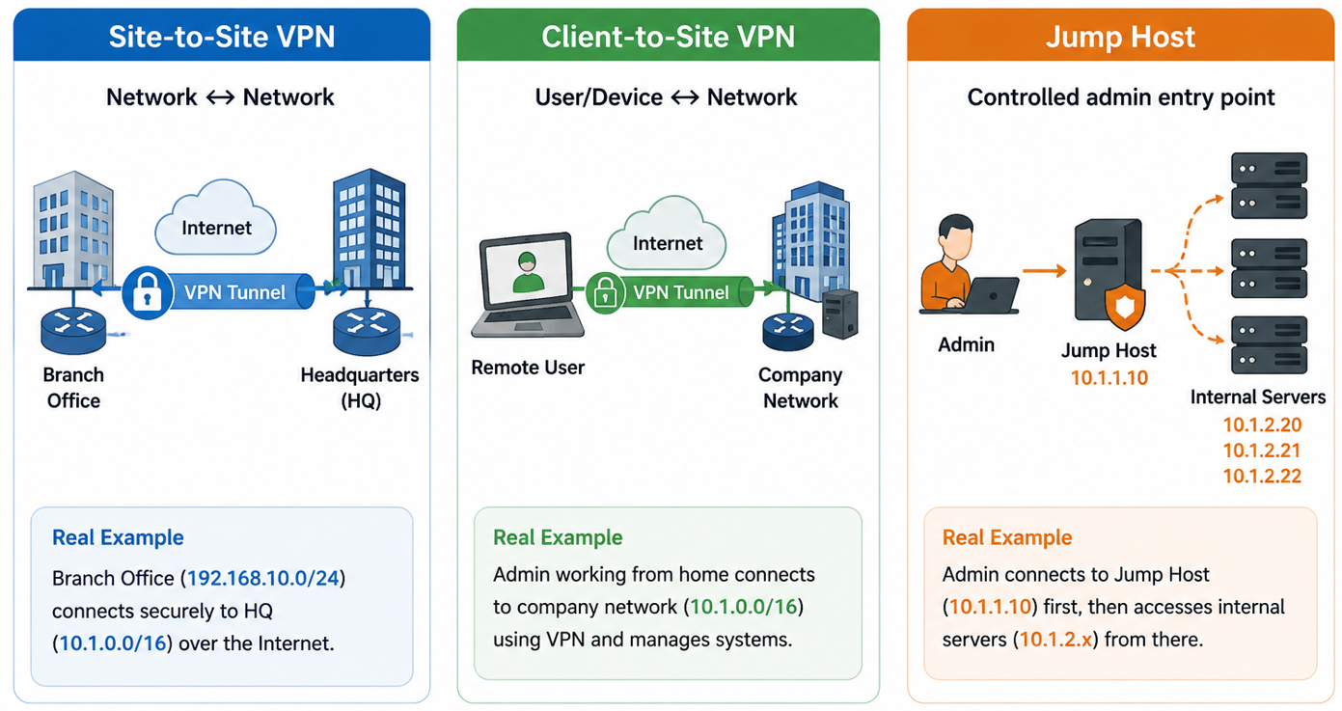
3.5 Secure Management Access
CompTIA Network+ • Day 3 • Network Operations • 26

Slide 27
Operational Evidence — What to Record?
• Topology and device inventory
• IP addresses, VLANs, interfaces and gateways
• Normal performance / baseline measurements
• DHCP, DNS and time-service evidence
• Monitoring alerts, logs and test results
• Changes, approvals, verification and rollback
• DR metrics and recovery design
CompTIA Network+ • Day 3 • Network Operations • 30

Slide 28
Scenario — Small Office Operations
USERS
SWITCH
ROUTER
INTERNET
CLOUD APP
• Document topology and addressing.
• Establish normal gateway and cloud-app tests.
• Monitor reachability and latency.
• Use DHCP/DNS evidence when users report access problems.
CompTIA Network+ • Day 3 • Network Operations • 31
Notes:
Let’s put everything we have learned into a small office example.
Imagine a company with 20 employees. All the users connect to a switch. The switch connects to the router, and the router provides Internet access to a cloud application.
Now, as the network administrator, what do we need to do?
First, we document the network — which devices exist, their IP addresses, and how they are connected.
Next, we establish some normal tests. For example, can a PC reach its gateway? Can it reach the company’s cloud application?
Then we monitor the network. We can check whether users are experiencing high latency or losing connectivity.
Now imagine one employee says, ‘I can't access the cloud application.’
Instead of immediately blaming the cloud application, we check the basics:
Does the PC have a valid IP? → Is DHCP working? → Is DNS resolving the application name? → Can the PC reach the gateway? → Can it reach the Internet?
If the gateway works but the cloud application does not, we have narrowed down where to investigate.
So the big operational lesson is:
Document → Test → Monitor → Troubleshoot using evidence.
Good network operations are not just about fixing problems — they are about knowing what normal looks like so we can quickly recognize what has changed.

Slide 29
Scenario — Change with Rollback
1. Baseline
2. Change
3. Verify
4. Rollback
Record current state.
Apply approved config.
Check state + reachability.
If verification fails.
CompTIA Network+ • Day 3 • Network Operations • 32

Slide 30
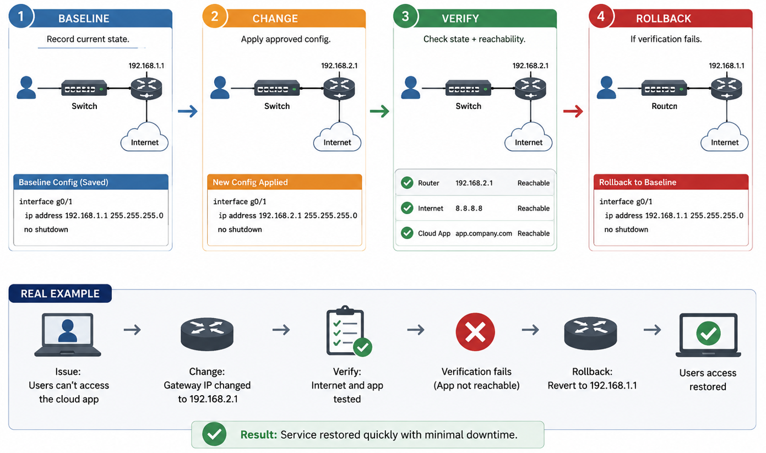

Slide 31
Scenario — Monitoring Evidence
Gateway
Remote
Decision
Ping succeeds
Low latency
Ping slow
Traceroute shows delay
Investigate WAN path / congestion before changing LAN.
CompTIA Network+ • Day 3 • Network Operations • 33

Slide 32
Scenario — DHCP + DNS
Client
Check
After Fix
No normal DHCP lease
DHCP enabled?
Pool exhausted?
Connectivity?
Confirm IP + mask + gateway + DNS.
Test hostname.
CompTIA Network+ • Day 3 • Network Operations • 34

Slide 33
Knowledge Check
• 1. What is a network baseline?
• 2. Change management vs configuration management?
• 3. What does ping tell you?
• 4. What does traceroute reveal?
• 5. What does RPO measure?
• 6. What does RTO measure?
• 7. Hot vs warm vs cold site?
• 8. What does DHCP provide?
• 9. What does DNS provide?
• 10. Why is out-of-band management useful?
CompTIA Network+ • Day 3 • Network Operations • 35

Slide 34
Day 3 Lab Preview
• 01 Documentation & Network Baseline
• 02 Change & Configuration Management
• 03 Network Monitoring
• 04 Monitoring Scenario
• 05 Disaster Recovery Metrics
• 06 DR Sites & High Availability
• 07 IPv4 Network Services — DHCP
• 08 IPv6 + DNS + Time
• 09 VPN & Management Access
• 10 Integrated Network Operations Challenge
CompTIA Network+ • Day 3 • Network Operations • 36

Slide 35
Lab Environment & Safety
• Cisco Packet Tracer → routing, DHCP and operational simulations.
• Windows/Linux VM → ping, tracert/traceroute, nslookup/dig, netstat/ss.
• Wireshark → only authorized captures.
• Never make changes to production.
• Before every change: record current state, expected result and rollback.
CompTIA Network+ • Day 3 • Network Operations • 37

Slide 36
Integrated Challenge — Network Operations
DOCUMENT
BASELINE
TEST
CHANGE
VERIFY
DR PLAN
MANAGE
Final challenge
Collect evidence → make an approved change → verify service → document the result.
CompTIA Network+ • Day 3 • Network Operations • 38
Notes:
Now we are going to put everything from today together.
Imagine you are the network administrator for a small company. Users are complaining that they cannot reliably access a cloud application.
Your job is not to immediately change something. First, you need evidence.
Start by documenting the current network — devices, IP addresses, VLANs and connections.
Next, establish a baseline. Check what normally works: gateway connectivity, DNS, Internet access and application reachability.
Then test the problem. Use tools such as ping, tracert, ipconfig, nslookup, and connection information to find where the problem occurs.
Suppose you discover that a switch port was accidentally placed in the wrong VLAN.
Now comes the important part: don't just change it. Make sure the change is approved, record the current configuration, make the change, and then verify the result.
If everything works, document what you changed.
But what if the application still doesn't work?
That's where the DR and rollback plan becomes important. Restore the known-good configuration and verify that the service is working again.
So I want you to remember this complete flow:
Document → Baseline → Test → Change → Verify → Recover → Manage
You are no longer just troubleshooting one device. You are managing the network as an operational system.”
🧪 Give learners this scenario
Company: ABC Office Users: 20 Problem: Cloud application is unreachable for some users
Give them this task:
Step
Learner must do
1. DocumentIdentify devices, IPs, VLANs and links
2. BaselineRecord normal gateway/DNS/Internet results
3. TestFind where connectivity fails
4. ChangeCorrect the suspected VLAN/configuration issue
5. VerifyTest gateway → Internet → cloud app
6. DR PlanDecide what to restore if the change fails
7. ManageRecord the final change and result
💡 Trainer tip
Tell learners:
“I don't want the answer first. I want your evidence first.”
That makes this a much better Network+ practical assessment, because students practice the mindset of a real network administrator rather than simply memorizing commands.

Slide 37
Day 3 Takeaways
• Documentation makes the network understandable.
• Baselines make 'normal' measurable.
• Change/configuration management reduce uncontrolled change.
• Monitoring provides evidence instead of guesses.
• RPO/RTO/MTTR/MTBF describe recovery and reliability needs.
• DHCP, DNS and time are operational building blocks.
• VPNs, jump hosts and out-of-band access provide controlled management paths.
CompTIA Network+ • Day 3 • Network Operations • 39

Slide 38
Bridge to Day 4 — Network Security
Day 3
Day 4
Connection
Operate
Monitor
Recover
Protect
Segment
Harden
Good operations create evidence for secure networks and troubleshooting.
CompTIA Network+ • Day 3 • Network Operations • 40

