Slide 1
CompTIA Network+
Day 1 — Networking Concepts
Module 1.0 • Models • Devices • Protocols • Media • Topologies • IPv4 • Cloud • Modern Networking
Notes:
Day 1 establishes the vocabulary and mental models used throughout Network+. The uploaded course outline is the source of truth for today's topics.

Slide 2
Day 1 Learning Objectives
Explain the OSI reference model.
Compare networking appliances, applications and functions.
Summarize cloud concepts and connectivity options.
Explain common ports, protocols, services and traffic types.
Compare transmission media and transceivers.
Compare network topologies, architectures and traffic flows.
Use appropriate IPv4 network addressing and subnetting.
Summarize SDN, SD-WAN, VXLAN, ZTA, SASE/SSE, IaC and IPv6.
CompTIA Network+ • Day 1 • Networking Concepts • 2
Notes:
Walk through the day's outcomes and connect them to the later implementation, operations, security and troubleshooting days.

Slide 3
1.0 Networking Concepts
OSI model → devices → protocols → media → topology → addressing → modern networks

Slide 4
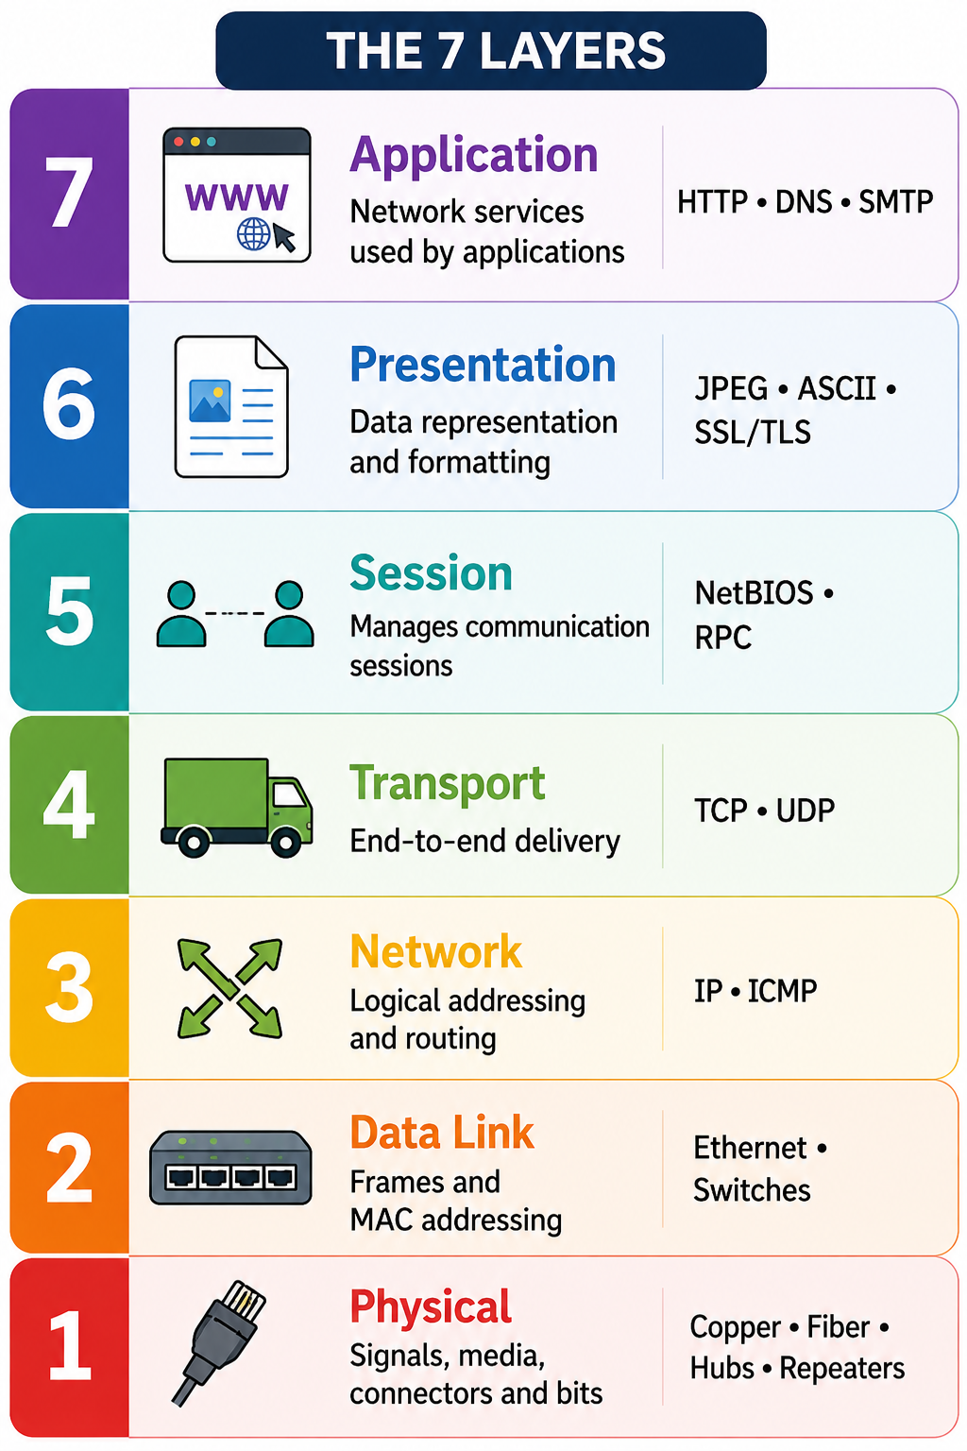
OSI Reference Model — 7 Layers
Notes:
Use OSI as a troubleshooting map. Focus on what each layer does, then reinforce the layer numbers.

Slide 5
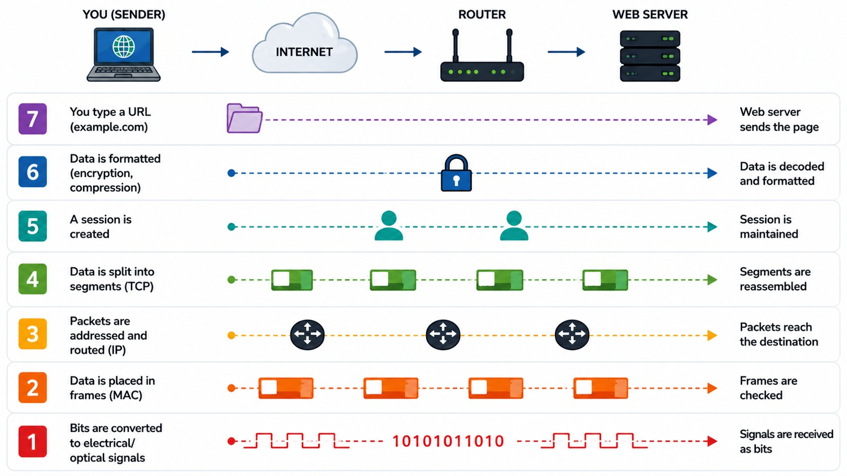
OSI Layers — Network to Physical
Notes:
Let’s understand the OSI model with one simple example — opening a web page.
Imagine I am sitting on my laptop and I type example.com.
At Layer 7, Application, I am using a network service such as HTTP. This is where my application, like a web browser, starts the communication.
At Layer 6, Presentation, the data is prepared in a format that both sides can understand. It can also involve encryption or compression.
At Layer 5, Session, a communication session is created and maintained between my computer and the server.
Now we come to Layer 4, Transport. Here, TCP can break the data into smaller pieces called segments and make sure they are delivered properly.
At Layer 3, Network, the data becomes packets. IP addressing is added, and routers decide where the packets should go.
At Layer 2, Data Link, the packets are placed into frames. MAC addresses are used for communication on the local network.
Finally, at Layer 1, Physical, those frames are converted into bits and signals. These signals travel through copper cable, fiber, or another physical medium.
When the data reaches the web server, the process happens in the opposite direction. The server receives the signals, processes each layer, rebuilds the data, and finally sends the web page back to us.
So remember the simple flow:
Application → Presentation → Session → Transport → Network → Data Link → Physical.
And when troubleshooting, we can think from the bottom up:
Physical → Data Link → Network → Transport → Application.
For example, if there is no cable connection, there is no point checking DNS first. Start at the lower layer and move upward until you find where the problem is.

Slide 6
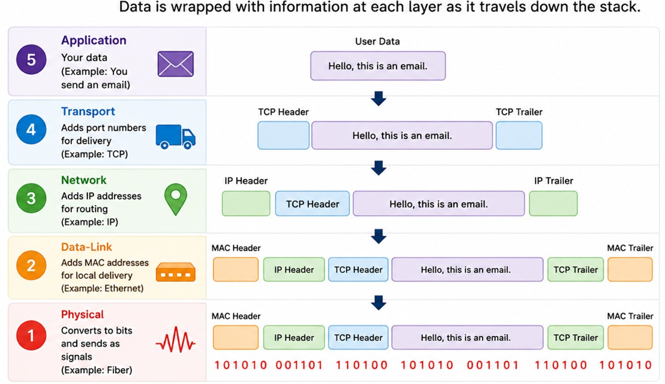
Encapsulation
CompTIA Network+ • Day 1 • Networking Concepts • 6
Notes:
Application data → Transport segment/datagram → IP packet → Data-Link frame → Physical bits.
Each layer adds information needed for its job.
At the destination, the process is reversed: decapsulation.

Slide 7
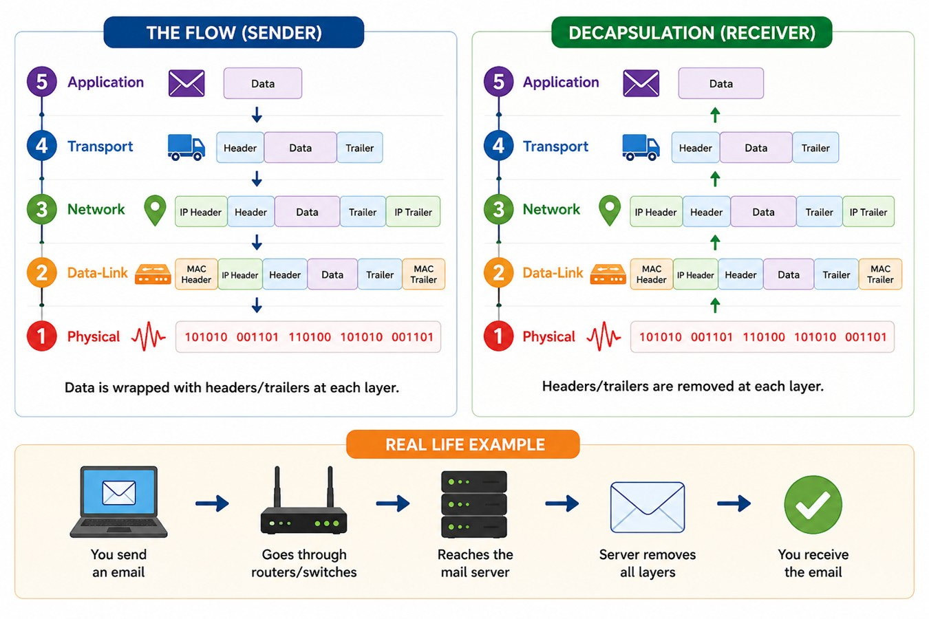

Slide 8
Networking Appliances & Functions
Physical and virtual appliances

Slide 9
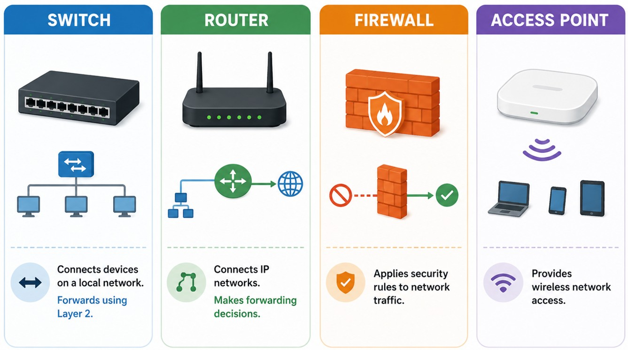
Network Devices — Core Functions
CompTIA Network+ • Day 1 • Networking Concepts • 8
Notes:
The outline asks learners to compare networking appliances, applications and functions. Focus on purpose.

Slide 10
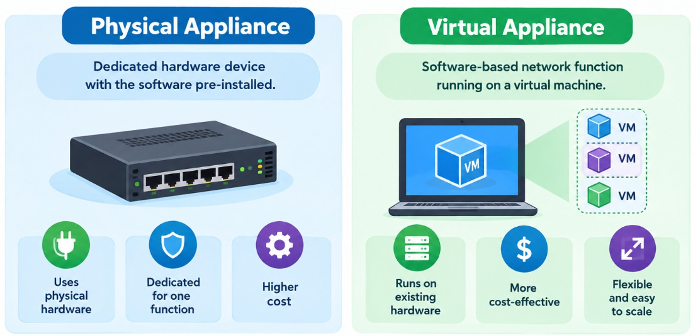
Physical vs Virtual Appliances
CompTIA Network+ • Day 1 • Networking Concepts • 9
Notes:
Physical appliance → dedicated hardware.
Virtual appliance → software-based network function.
Virtualization changes implementation, not the network function.
Think: What function does this appliance provide?

Slide 11
Cloud Networking
VPC • security controls • gateways • VPN • Direct Connect

Slide 12
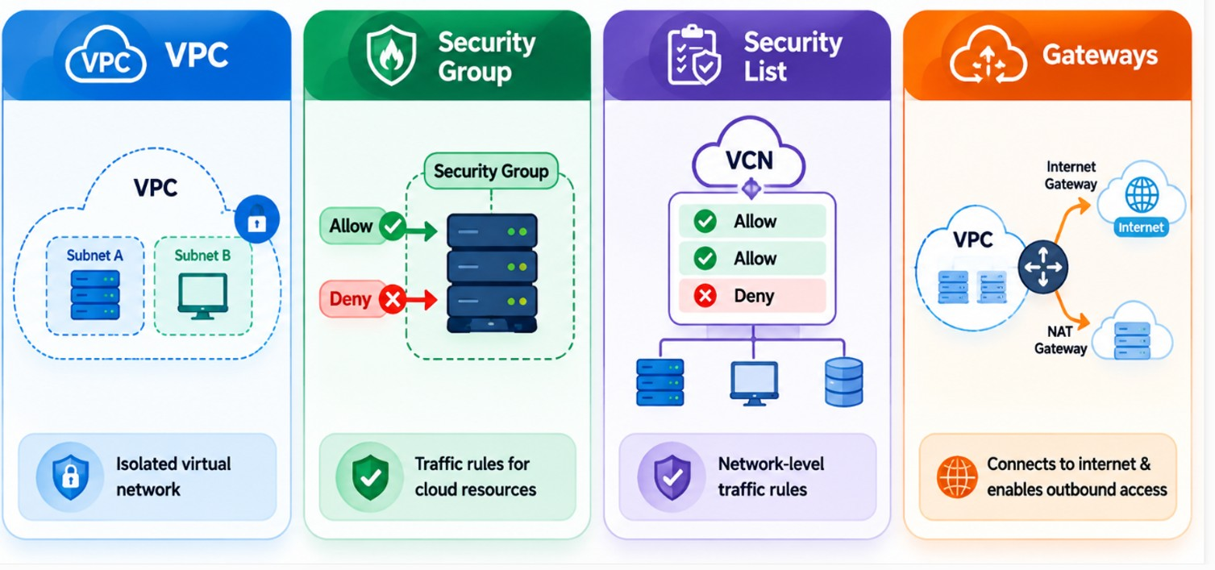
Cloud Networking Building Blocks
CompTIA Network+ • Day 1 • Networking Concepts • 11
Notes:
Keep cloud security terminology aligned with the outline.

Slide 13
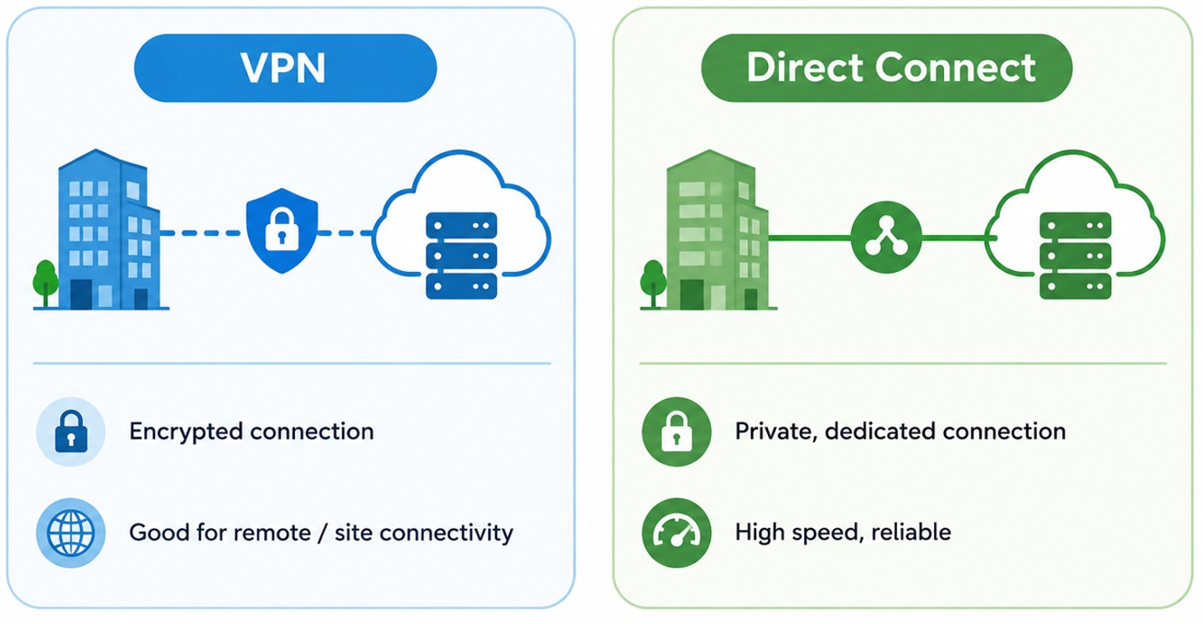
Cloud Connectivity
CompTIA Network+ • Day 1 • Networking Concepts • 12
Notes:
Distinguish VPN from dedicated connectivity; they solve different connectivity requirements.

Slide 14
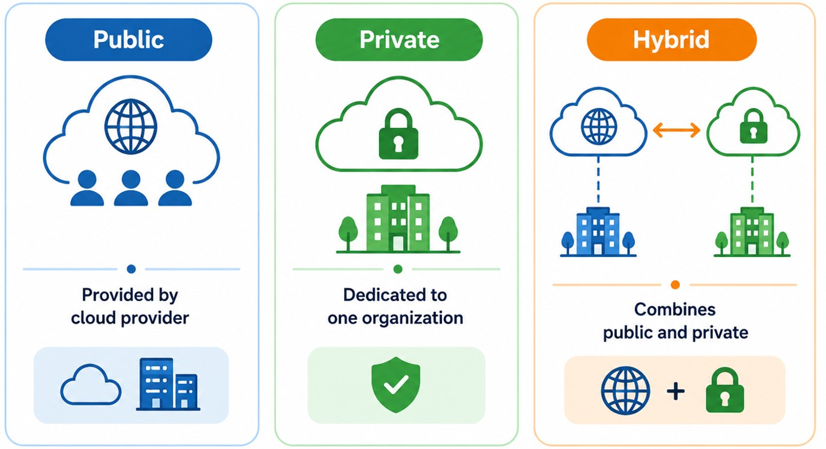
Cloud Deployment Models
CompTIA Network+ • Day 1 • Networking Concepts • 13
Notes:
Public cloud does not mean public data. It describes the deployment model.

Slide 15
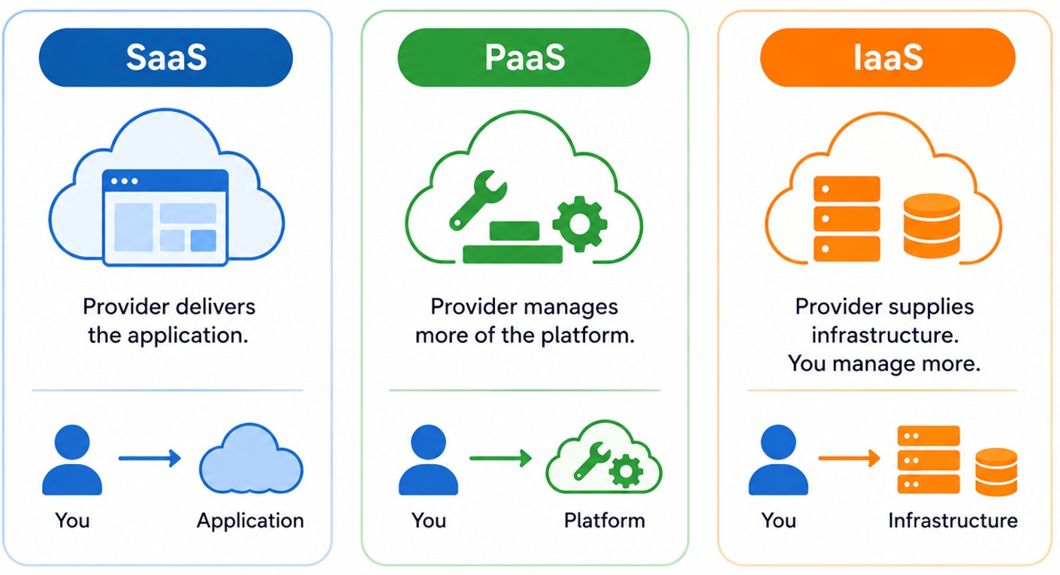
Cloud Service Models
CompTIA Network+ • Day 1 • Networking Concepts • 14
Notes:
Use a responsibility spectrum: SaaS → more provider-managed; IaaS → more customer-managed.

Slide 16
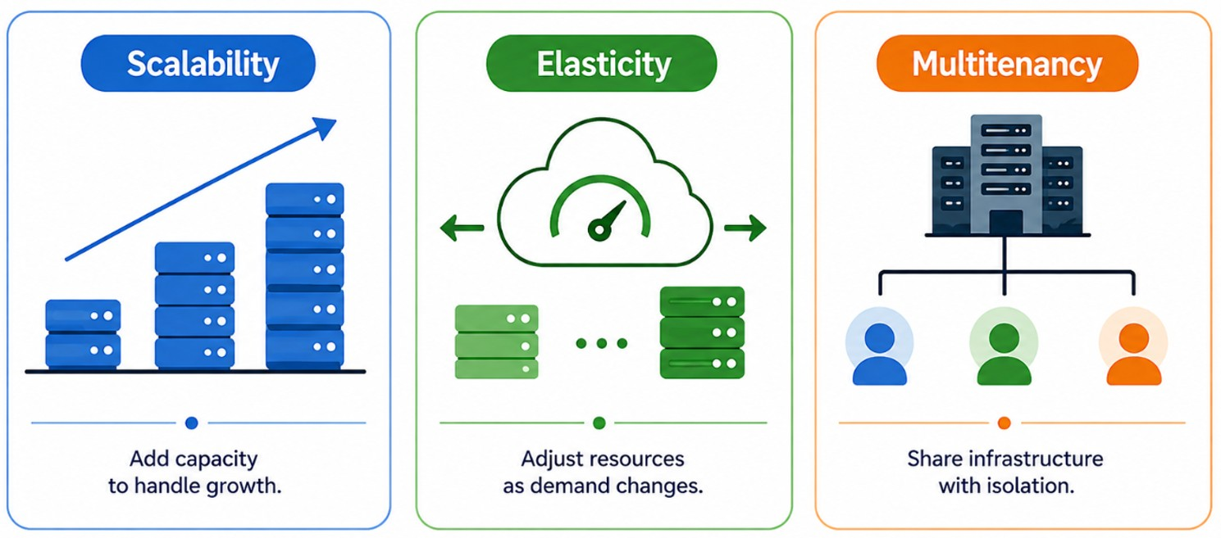
Scalability • Elasticity • Multitenancy
CompTIA Network+ • Day 1 • Networking Concepts • 15
Notes:
Give simple examples of growing capacity, adjusting capacity, and shared infrastructure.

Slide 17
Ports, Protocols & Traffic
Protocol + service + port

Slide 18
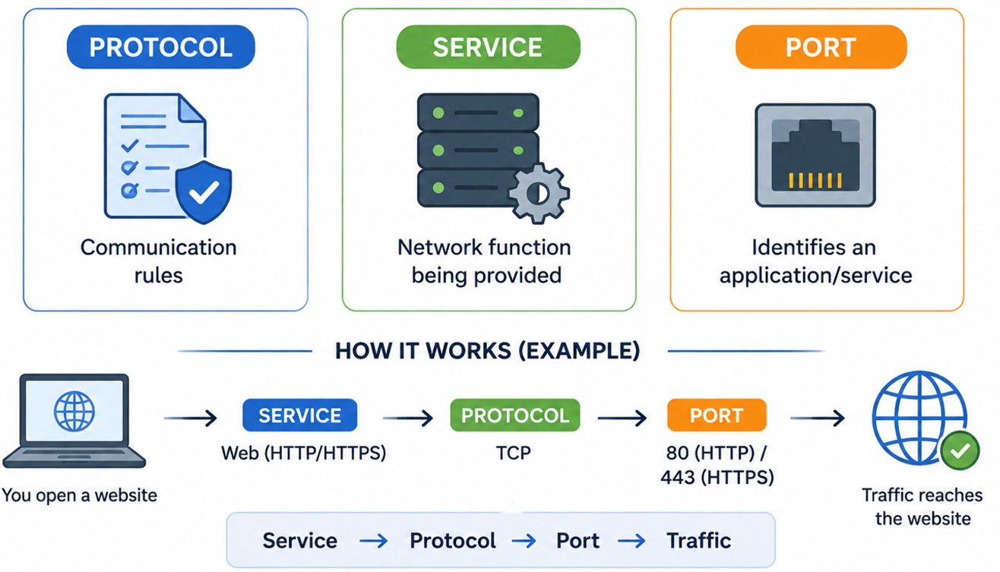
Protocol • Service • Port
CompTIA Network+ • Day 1 • Networking Concepts • 17
Notes:
Do not treat port numbers as the protocol itself.
Protocol = communication rules.
Service = network function being provided.
Port = logical transport-layer endpoint used to identify an application/service.
Think: service → protocol → port → traffic.

Slide 19
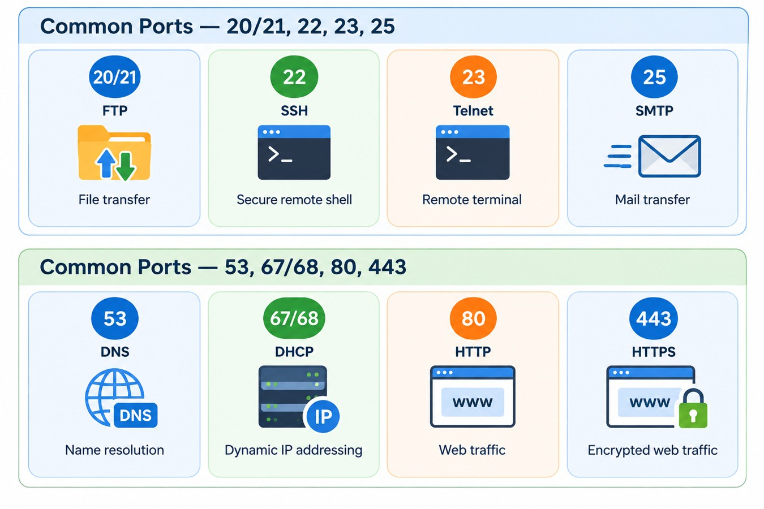
Common Ports — 20/21, 22, 23, 25
CompTIA Network+ • Day 1 • Networking Concepts • 18
Notes:
Reinforce service purpose first, port second.

Slide 20
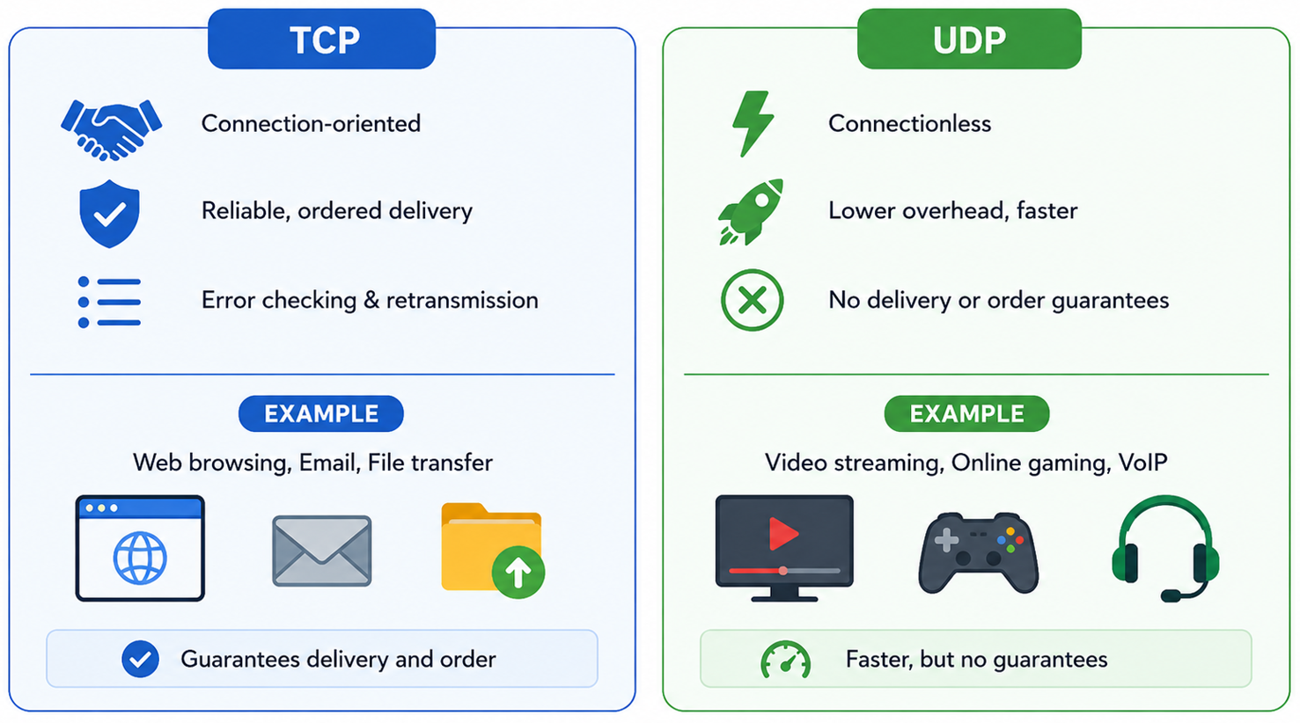
TCP vs UDP
CompTIA Network+ • Day 1 • Networking Concepts • 20
Notes:
UDP is not 'bad'; applications choose it for appropriate requirements.

Slide 21
Transmission Media & Transceivers
Wireless • wired • connectors

Slide 22
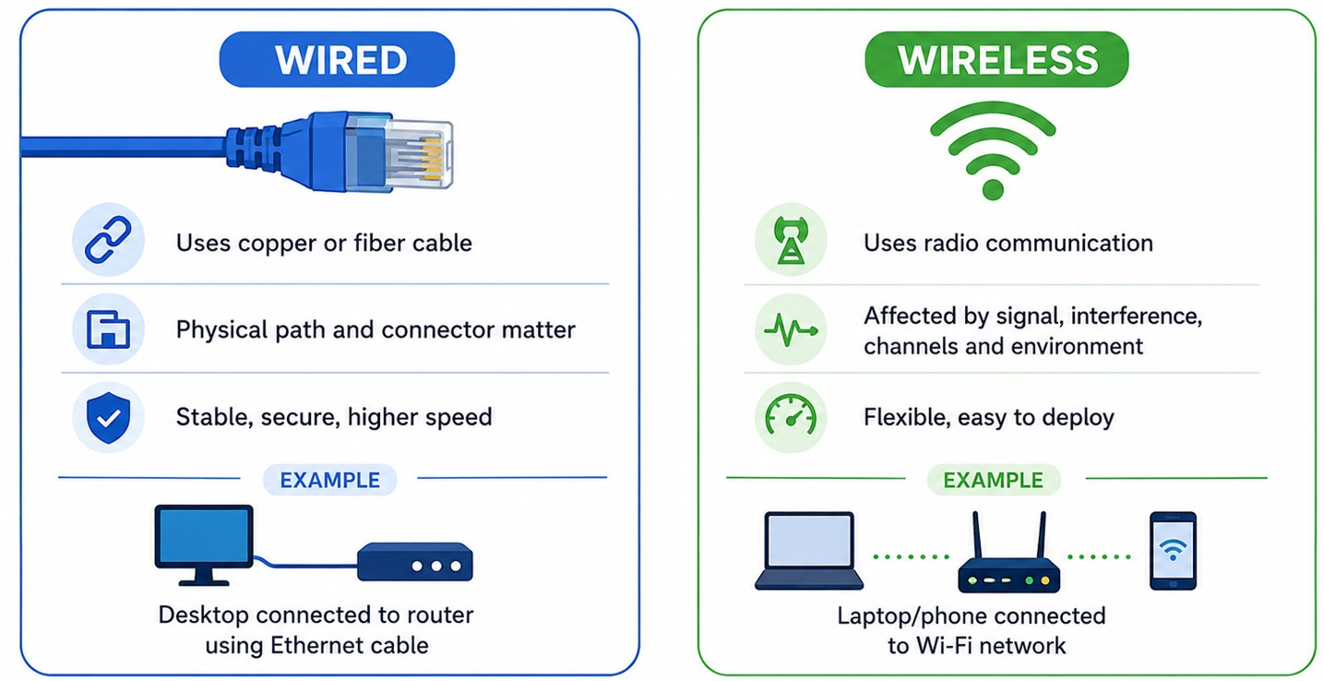
Wired vs Wireless
CompTIA Network+ • Day 1 • Networking Concepts • 22
Notes:
Connect media choice to later implementation and troubleshooting.

Slide 23
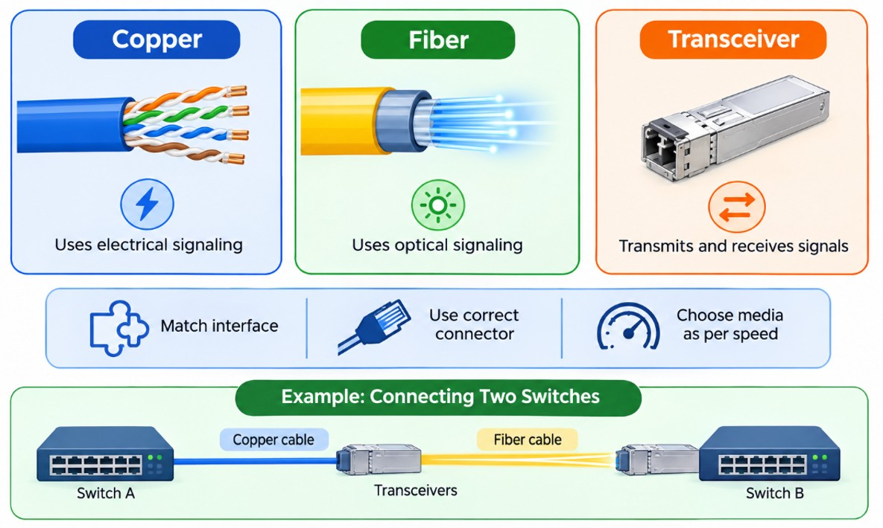
Copper • Fiber • Transceivers
CompTIA Network+ • Day 1 • Networking Concepts • 23
Notes:
Copper → electrical signaling.
Fiber → optical signaling.
Transceiver → transmits and receives signals.
Match interface, connector, media and speed requirements.

Slide 24
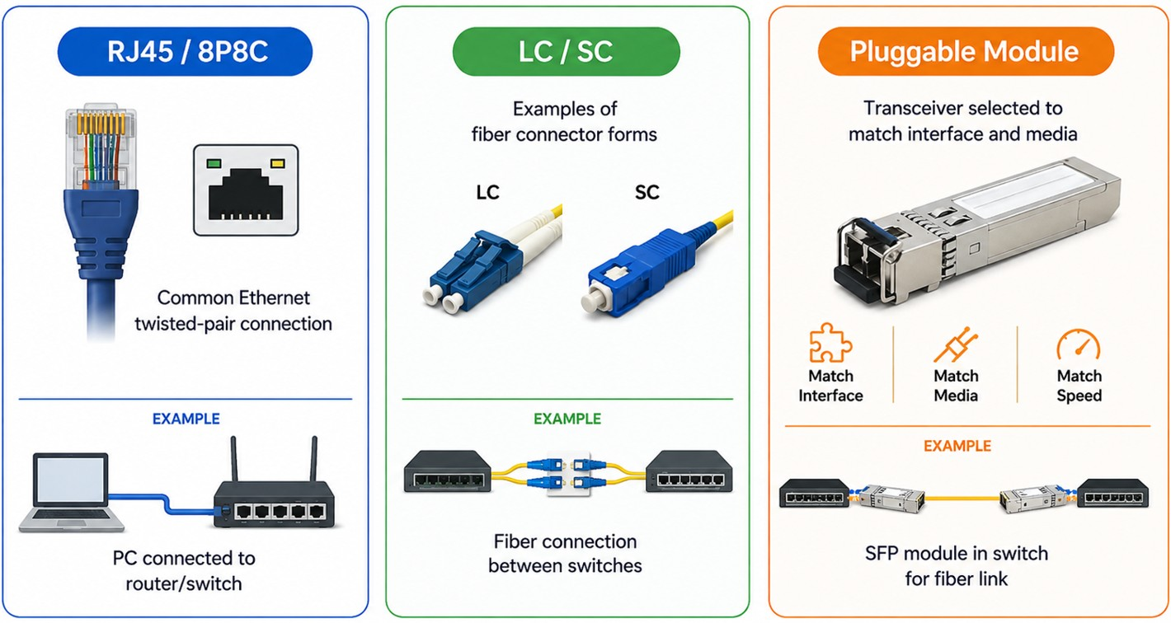
Connector Awareness
CompTIA Network+ • Day 1 • Networking Concepts • 24
Notes:
Recognition-level discussion is sufficient here.

Slide 25
Topologies & Architectures
How networks are organized and how traffic flows

Slide 26
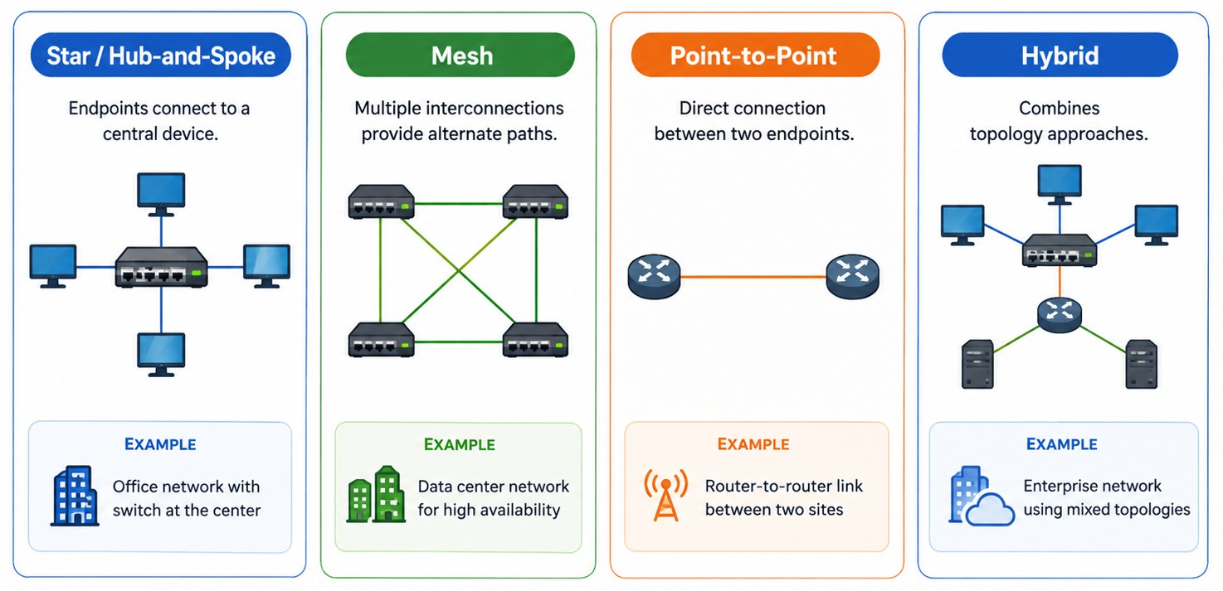
Common Topologies
CompTIA Network+ • Day 1 • Networking Concepts • 26
Notes:
Ask learners for an advantage/trade-off for each.

Slide 27
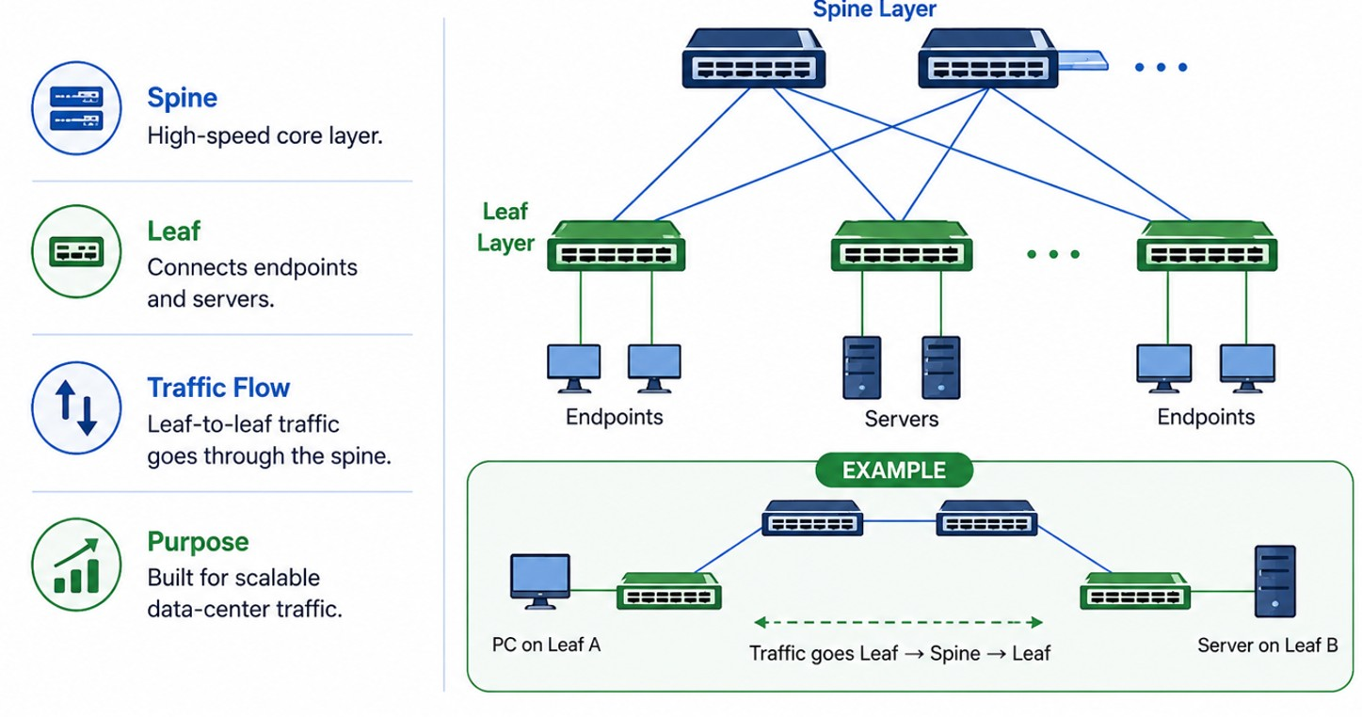
Spine-and-Leaf
CompTIA Network+ • Day 1 • Networking Concepts • 27
Notes:
Spine switches form the central high-speed layer.
Leaf switches connect endpoints/servers.
Leaf-to-leaf traffic commonly travels through the spine.
Designed for scalable data-center traffic patterns.

Slide 28
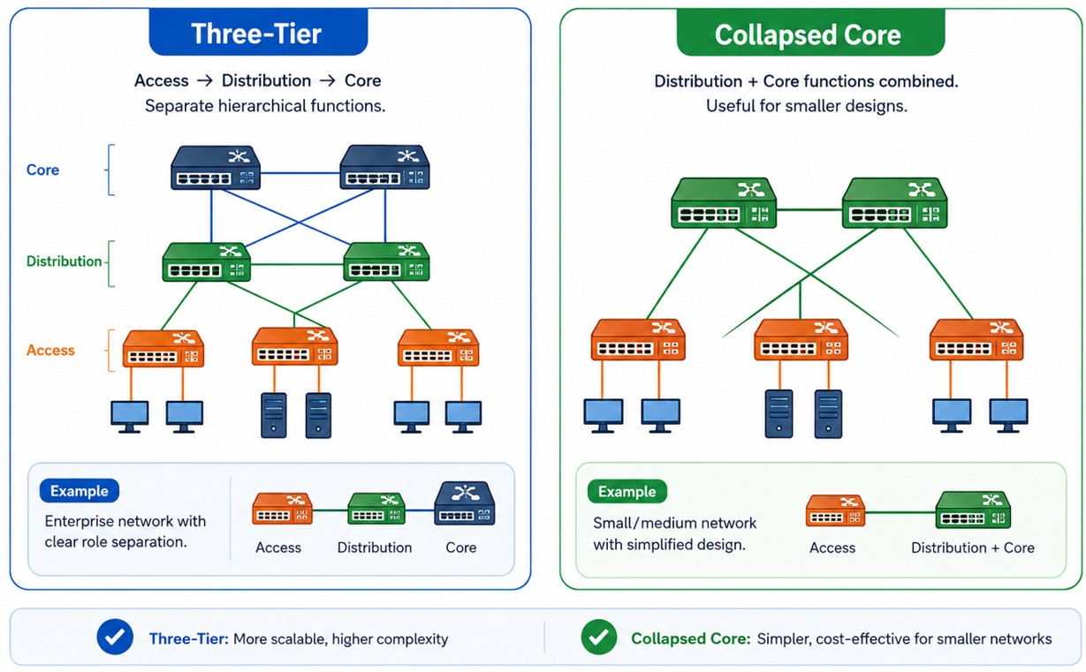
Three-Tier vs Collapsed Core
CompTIA Network+ • Day 1 • Networking Concepts • 28
Notes:
Neither design is universally better; selection depends on requirements.

Slide 29
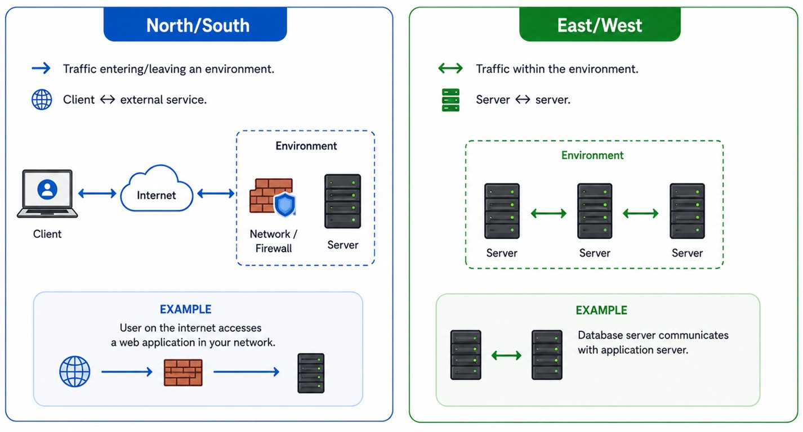
Traffic Flows
CompTIA Network+ • Day 1 • Networking Concepts • 29
Notes:
Use these concepts when discussing modern architectures.

Slide 30
IPv4 Network Addressing
Public/private • classes • subnetting

Slide 31
IPv4 Address Basics
32 Total Bits
The complete IPv4 address length
24 Network Bits
Bits identifying the network
8 Host Bits
Bits identifying the specific host
CompTIA Network+ • Day 1 • Networking Concepts • 31
Notes:
IPv4 uses 32-bit addresses written as four decimal octets.
Subnet mask/prefix separates network bits from host bits.
Default gateway provides a next hop outside the local subnet.
Example notation: 192.168.10.25/24.

Slide 32
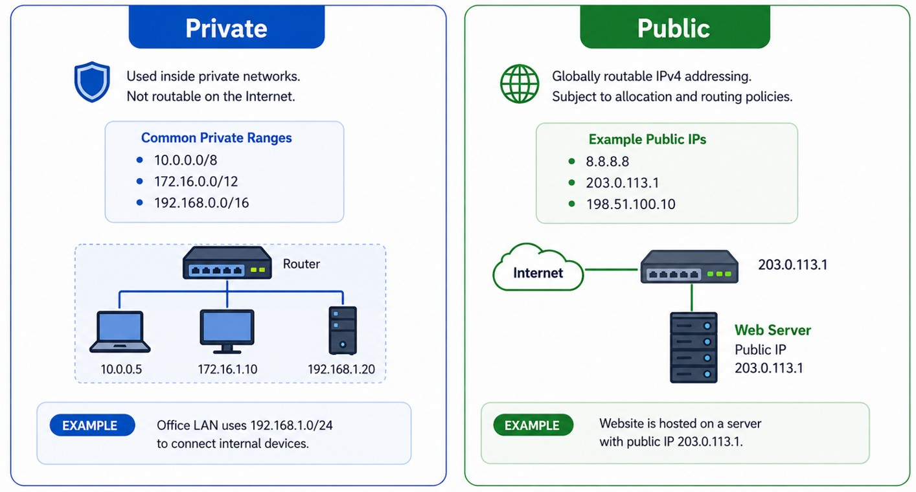
Public vs Private IPv4
CompTIA Network+ • Day 1 • Networking Concepts • 32
Notes:
Explain that NAT commonly allows private-addressed systems to communicate externally.

Slide 33
IPv4 Classes — Historical
Class A
1–126 First Octet
Class B
128–191
Class C
192–223
IPv4 Address
Classes
Class D
Multicast
Class E
Experimental/Reserved
CIDR/Prefix Notation
Modern Networks
CompTIA Network+ • Day 1 • Networking Concepts • 33
Notes:
The outline includes IPv4 classes. Clearly label classful addressing as historical.
Class A → 1–126 first octet.
Class B → 128–191.
Class C → 192–223.
Class D → multicast.
Class E → experimental/reserved historical category.
Modern networks use CIDR/prefix notation.

Slide 34
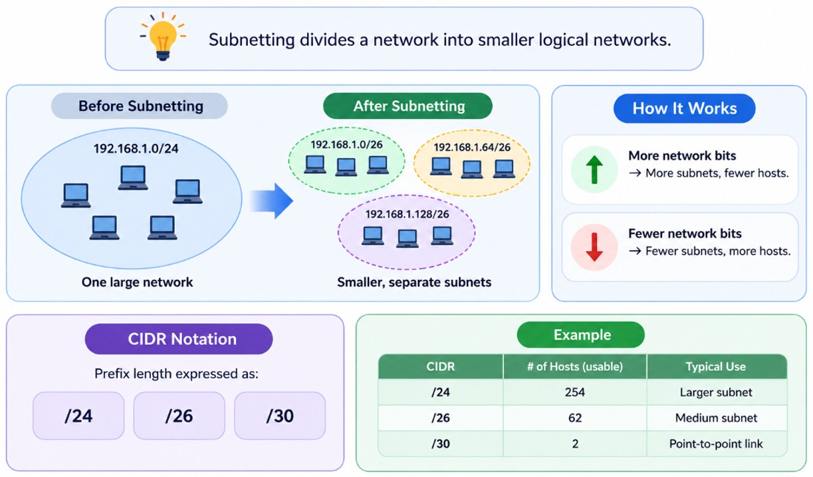
Subnetting — Core Idea
CompTIA Network+ • Day 1 • Networking Concepts • 34
Notes:
Subnetting divides a network into smaller logical networks.
More network bits → more subnets, fewer hosts per subnet.
Fewer network bits → fewer subnets, more hosts per subnet.
CIDR notation expresses the prefix: /24, /26, /30.

Slide 35
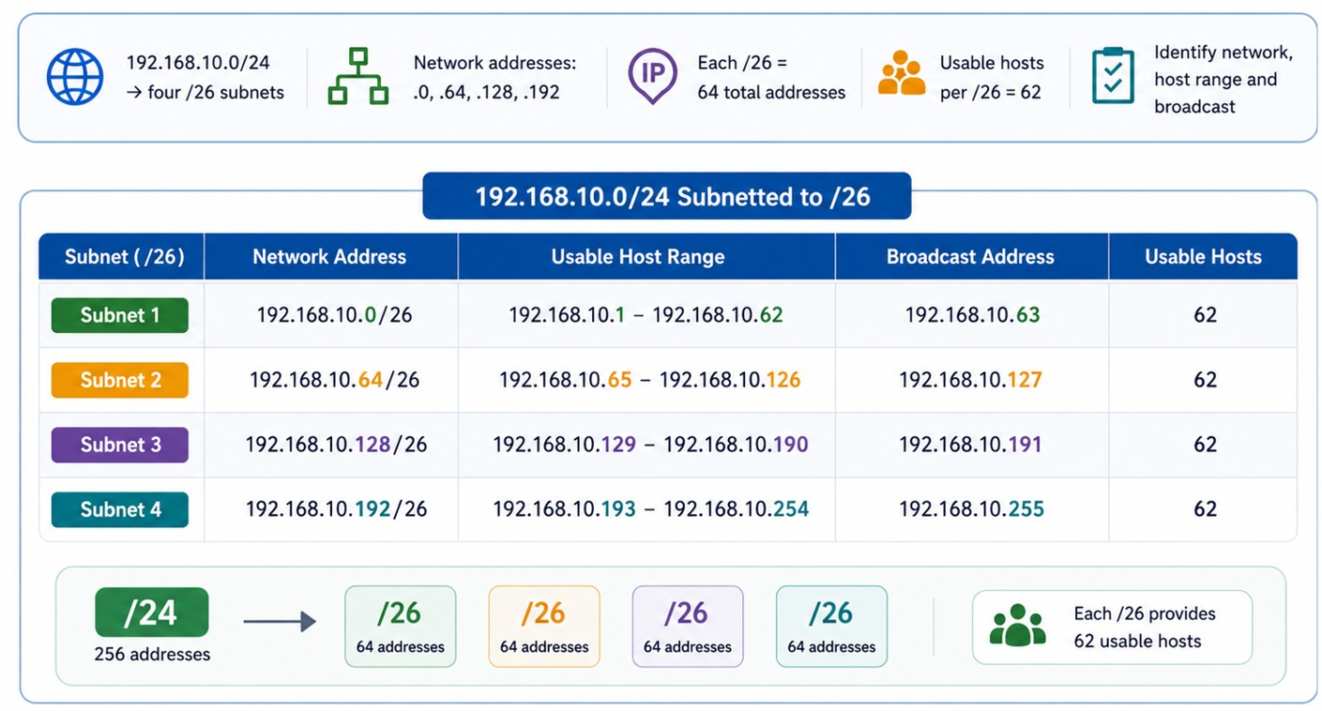
Subnetting Example — /24 → /26
CompTIA Network+ • Day 1 • Networking Concepts • 35
Notes:
192.168.10.0/24 → four /26 subnets.
Network addresses: .0, .64, .128, .192
Each /26 = 64 total addresses.
Traditional usable hosts per /26 = 62.
Identify network, host range and broadcast.

Slide 36
Evolving Network Environments
SDN • SD-WAN • VXLAN • ZTA • SASE/SSE • IaC • IPv6

Slide 37
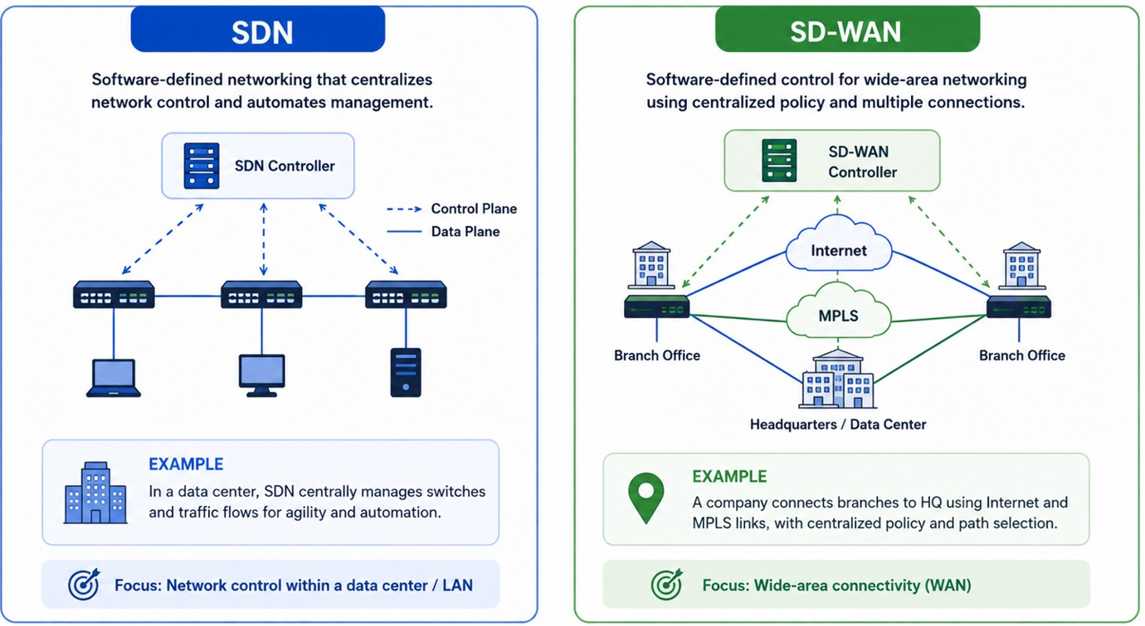
SDN vs SD-WAN
CompTIA Network+ • Day 1 • Networking Concepts • 37
Notes:
Keep the distinction conceptual.

Slide 38
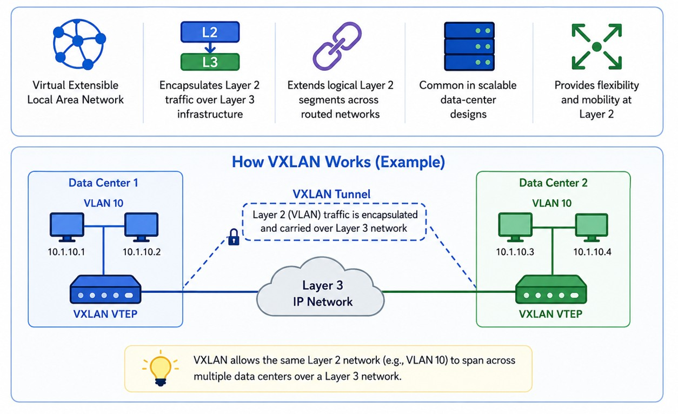
VXLAN
CompTIA Network+ • Day 1 • Networking Concepts • 38
Notes:
Let’s understand VXLAN with a very simple example.
Imagine we have two data centers. In Data Center 1, we have computers in VLAN 10, and in Data Center 2, we also have computers in VLAN 10.
Normally, a VLAN is limited to a local network. But what if we want these two VLAN 10 networks to behave as one logical network, even though they are in different locations?
This is where VXLAN helps.
The devices called VTEPs take the Layer 2 traffic and encapsulate it inside Layer 3 IP traffic.
Think of it like putting a small envelope inside a larger envelope.
The original VLAN frame is the small envelope. VXLAN adds an outer IP packet, and that packet can travel across the Layer 3 network between the two data centers.
When it reaches the other side, the VTEP removes that outer information and delivers the original Layer 2 traffic.
So, the simple flow is:
VLAN traffic → VXLAN encapsulation → IP network → VXLAN VTEP → original VLAN traffic
The key idea to remember is:
👉 VXLAN allows Layer 2 networks to stretch across a Layer 3 network.
For example, a server in Data Center 1 and a server in Data Center 2 can both belong to VLAN 10, even though they are connected through a routed IP network.
That is why VXLAN is very useful in large and scalable data centers.

Slide 39
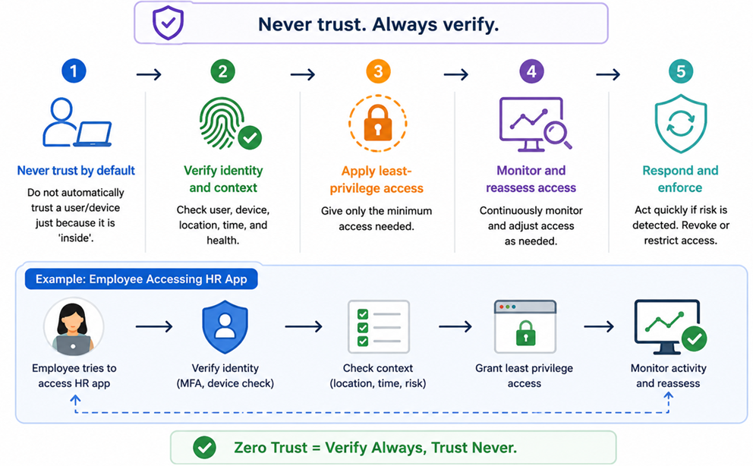
Zero Trust Architecture
CompTIA Network+ • Day 1 • Networking Concepts • 39
Notes:
Do not automatically trust a user/device because it is 'inside'.
Verify identity and context.
Apply least-privilege access.
Monitor and reassess access.

Slide 40
Putting It Together
User → access → switching → routing → security → service

Slide 41
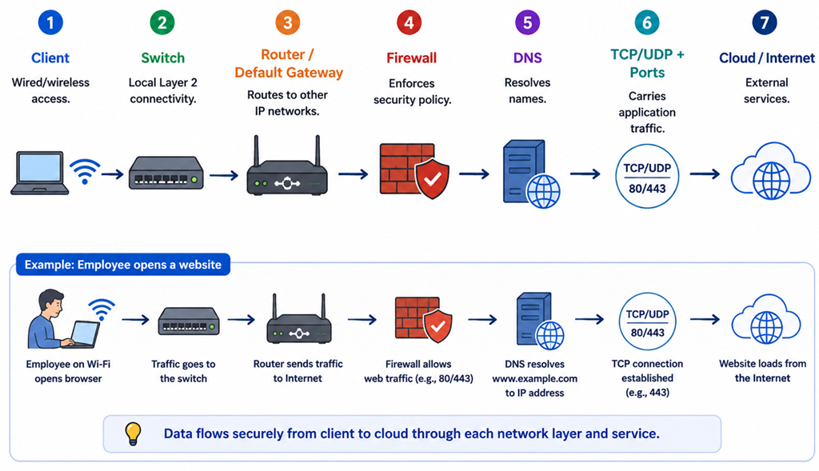
Simple End-to-End Network
CompTIA Network+ • Day 1 • Networking Concepts • 43
Notes:
Client → wired/wireless access.
Switch → local Layer 2 connectivity.
Router/default gateway → other IP networks.
Firewall → security policy.
DNS → name resolution.
TCP/UDP + ports → application traffic.
Cloud/Internet → external services.

Slide 42
Day 1 Knowledge Check
1. Which OSI layer handles routing?
2. Switch vs router — what is the key difference?
3. What is a VPC?
4. Scalability vs elasticity?
5. Which transport protocol provides TCP-style reliable delivery?
6. What is the purpose of a port?
7. What is a private IPv4 address?
8. What does subnetting accomplish?
9. SDN vs SD-WAN?
10. What major addressing problem does IPv6 address?
CompTIA Network+ • Day 1 • Networking Concepts • 45
Notes:
Use as verbal or written review.

Slide 43
Day 1 Takeaways
OSI provides a structured way to understand communication.
Devices perform specific network functions.
Protocols and ports support application communication.
Media and connectors determine physical transmission.
Topology and architecture shape traffic flow.
IPv4 addressing and subnetting define network boundaries.
Modern networks increasingly use cloud, software-defined control, automation and IPv6.
Tomorrow → routing, switching, VLANs, wireless and physical implementation.
CompTIA Network+ • Day 1 • Networking Concepts • 47
Notes:
Close Day 1 and preview Day 2.

