Slide 1
CompTIA Network+
Day 2 — Network Implementation
Module 2.0 • Routing • Switching • VLANs • STP • MTU • Wireless • Physical Installation
Notes:
Day 2 moves from networking concepts into implementation. The uploaded course outline is the source of truth for Module 2.0.

Slide 2
Day 2 Learning Objectives
Explain characteristics of routing technologies.
Compare static and dynamic routing.
Understand route selection, address translation, FHRP, VIPs and subinterfaces.
Configure switching technologies including VLANs, interfaces, spanning tree and MTU.
Select and configure wireless technologies: channels, frequencies, SSIDs, networks, guest access and authentication.
Explain antennas and autonomous vs lightweight access points.
Explain important physical installation implications, power and environmental factors.
CompTIA Network+ • Day 2 • Network Implementation • 2
Notes:
Preview the day. Emphasize that students will use Packet Tracer heavily for routing, switching and VLAN work.

Slide 3
2.1 Routing Technologies
Move packets between networks

Slide 4
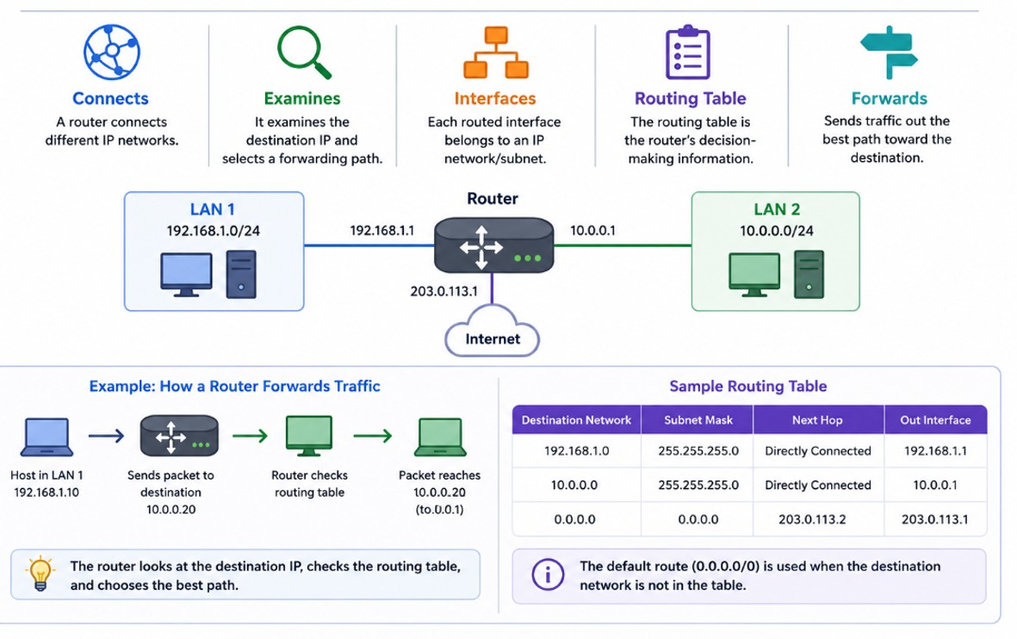
What Does a Router Do?
CompTIA Network+ • Day 2 • Network Implementation • 4
Notes:
Use a simple example: LAN A → router → LAN B. A switch alone cannot route between different IP networks.
A router connects different IP networks.
It examines the destination IP and selects a forwarding path.
Each routed interface belongs to an IP network/subnet.
The routing table is the router's decision-making information.

Slide 5
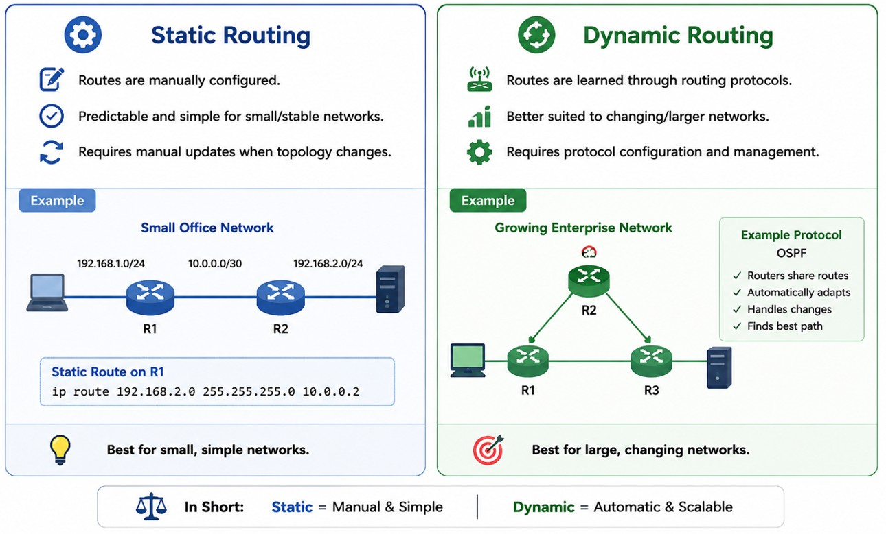
Static vs Dynamic Routing
CompTIA Network+ • Day 2 • Network Implementation • 5
Notes:
Do not imply dynamic routing is always better. Match the method to network size, stability and operational requirements.

Slide 6
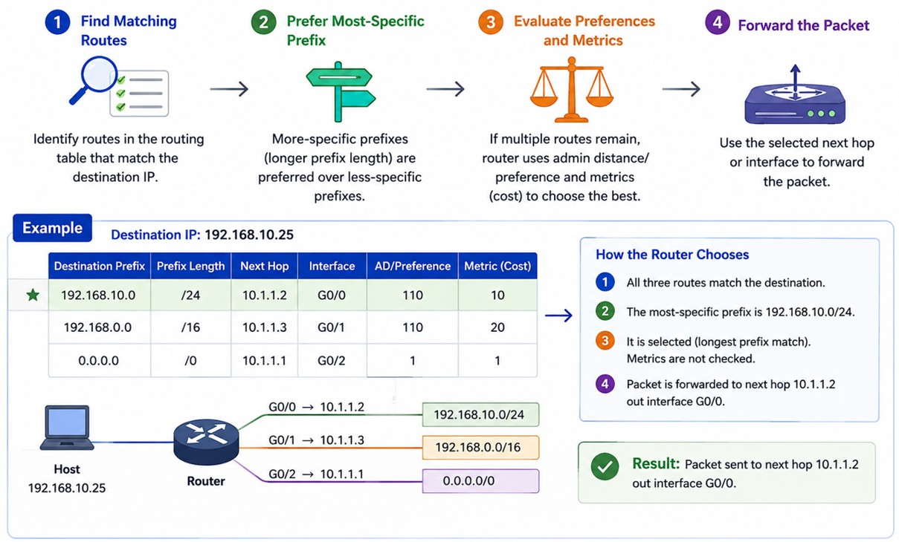
Route Selection — How Does the Router Choose?
CompTIA Network+ • Day 2 • Network Implementation • 6
Notes:
First, identify routes that match the destination.
More-specific prefixes are generally preferred over less-specific prefixes.
If multiple routes are candidates, routing protocol/administrative preference and route metrics can influence selection.
The selected next hop/interface is used to forward the packet.

Slide 7
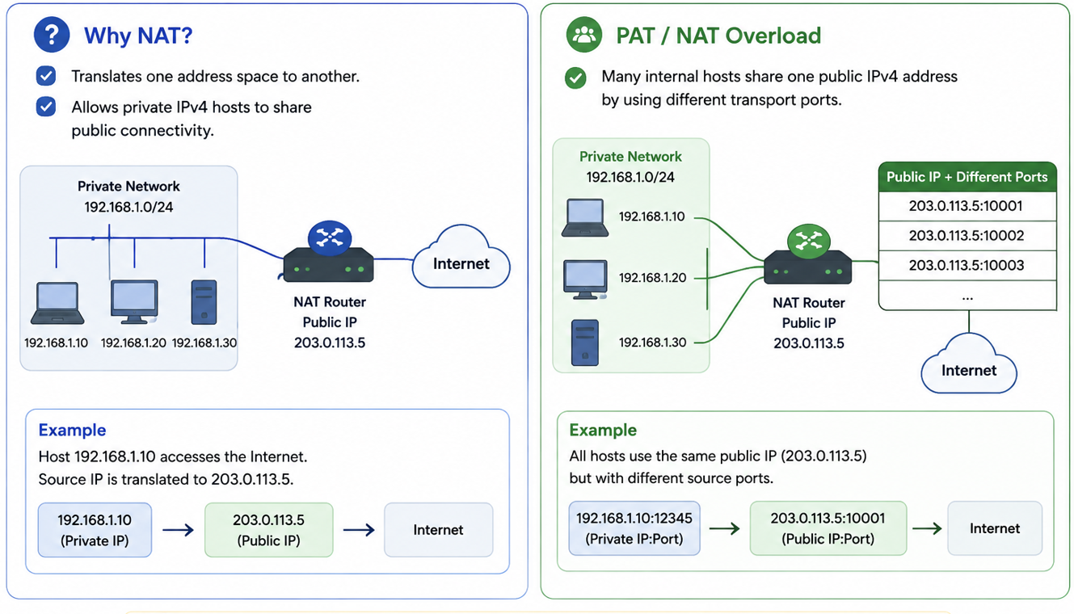
Address Translation — NAT
CompTIA Network+ • Day 2 • Network Implementation • 7
Notes:
Tie NAT back to Day 1 private/public IPv4 and cloud NAT Gateway concepts.

Slide 8
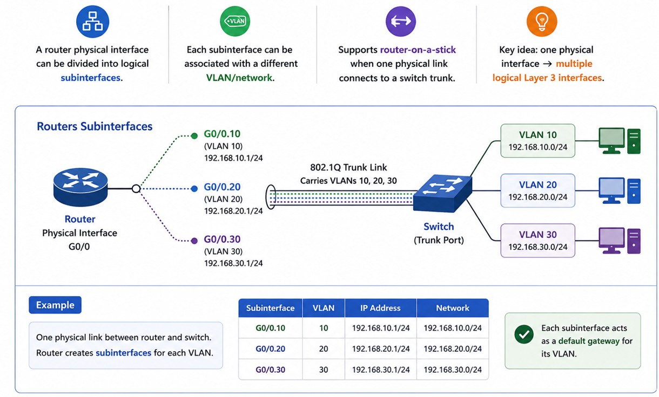
Sub Interfaces
CompTIA Network+ • Day 2 • Network Implementation • 9
Notes:
Draw switch trunk → router physical interface → subinterface for VLAN 10 and VLAN 20.
A router physical interface can be divided into logical subinterfaces.
Each subinterface can be associated with a different VLAN/network.
This supports router-on-a-stick designs when one physical router link connects to a switch trunk.
Key idea: one physical interface → multiple logical Layer 3 interfaces

Slide 9
2.2 Switching Technologies
VLANs • interfaces • STP • MTU

Slide 10
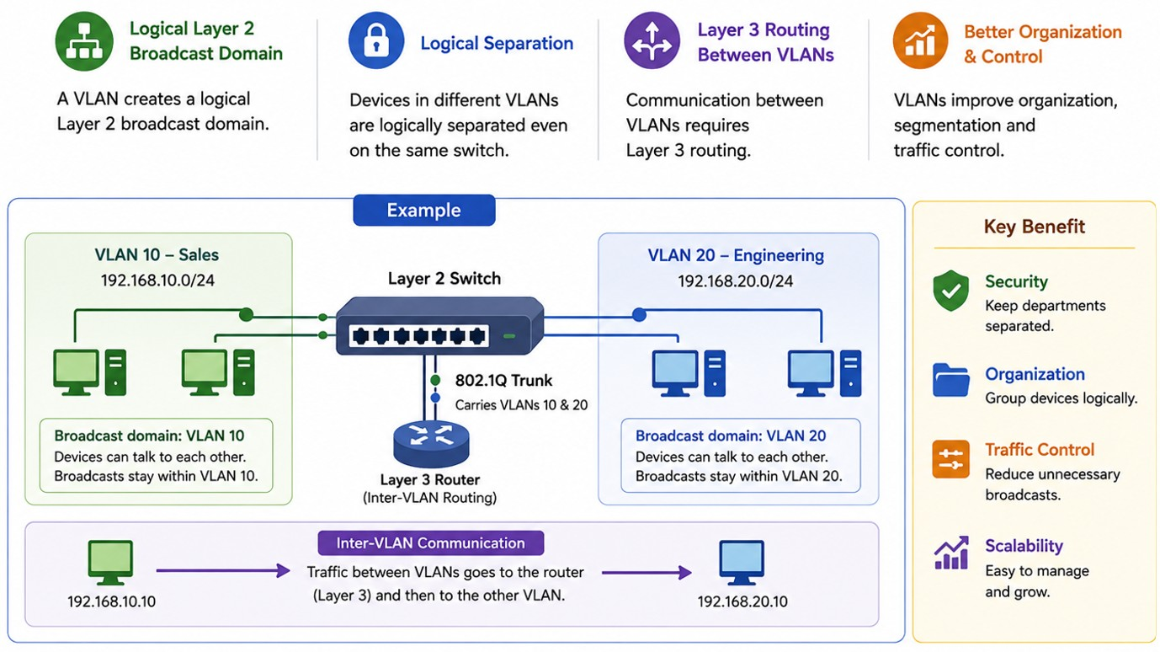
VLAN — Logical Network Segmentation
CompTIA Network+ • Day 2 • Network Implementation • 11
Notes:
Use an office example: VLAN 10 Users, VLAN 20 Voice, VLAN 30 Guest.
A VLAN creates a logical Layer 2 broadcast domain.
Devices in different VLANs are logically separated even when they use the same physical switch.
Communication between VLANs requires Layer 3 routing.
VLANs improve organization, segmentation and traffic control.

Slide 11
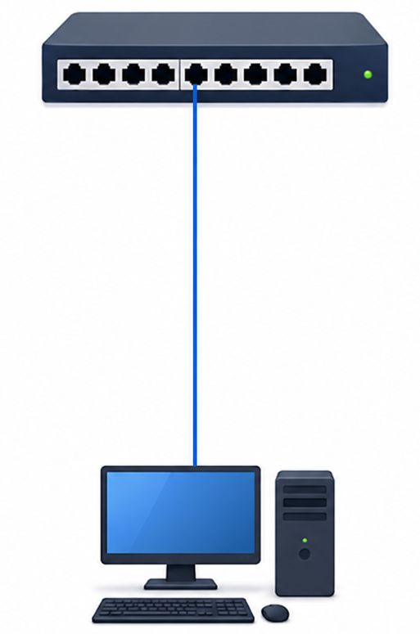
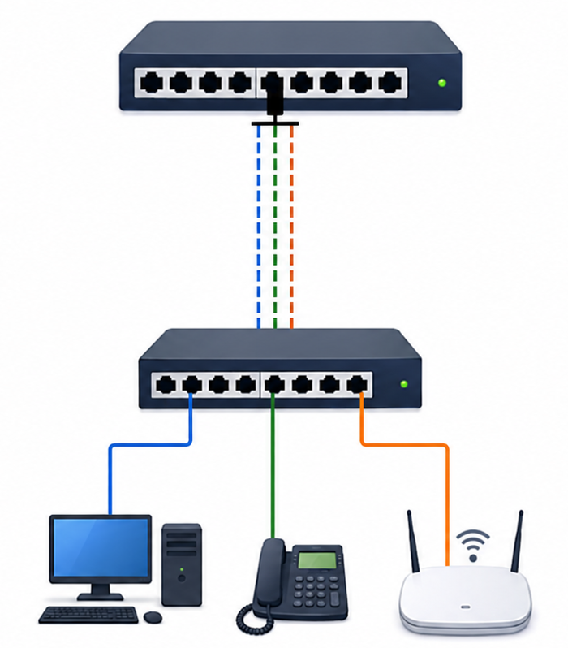
Access Port vs Trunk Port
Access Port
Trunk Port
Typically carries traffic for one VLAN to an endpoint such as a PC.
Carries traffic for multiple VLANs between network devices using VLAN tagging.
CompTIA Network+ • Day 2 • Network Implementation • 12
Notes:
Important distinction for Packet Tracer. Endpoint port = access; switch-to-switch or switch-to-router VLAN link often = trunk.

Slide 12
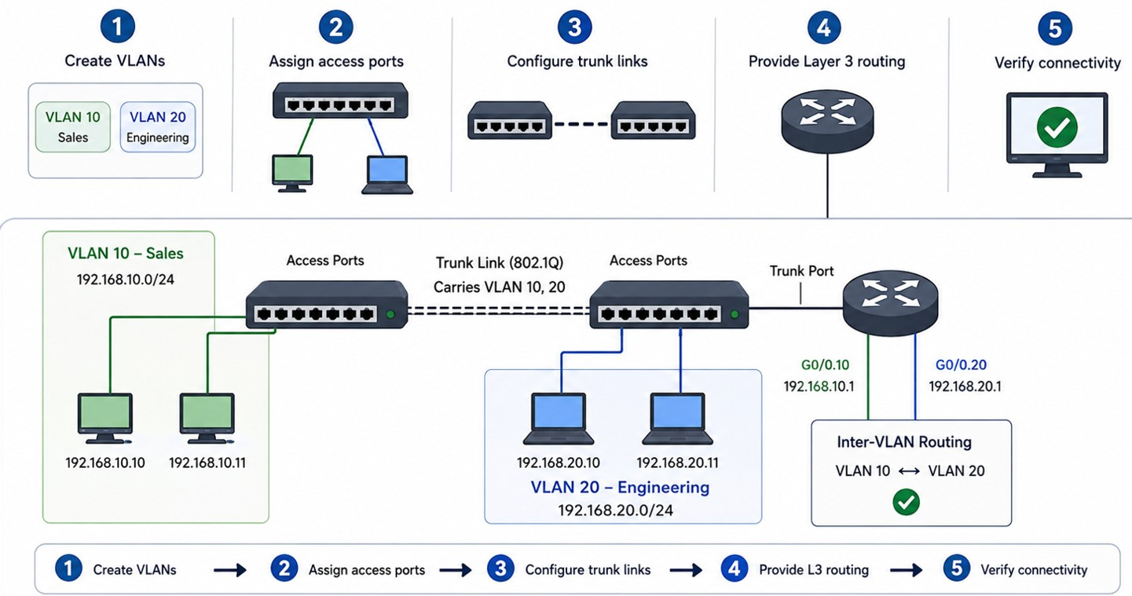
Basic VLAN Design
CompTIA Network+ • Day 2 • Network Implementation • 13
Notes:
Create VLANs.
Assign access ports to the correct VLAN.
Configure trunk links where multiple VLANs must cross one link.
Provide Layer 3 routing when VLANs need to communicate.
Verify VLAN membership and connectivity.

Slide 13
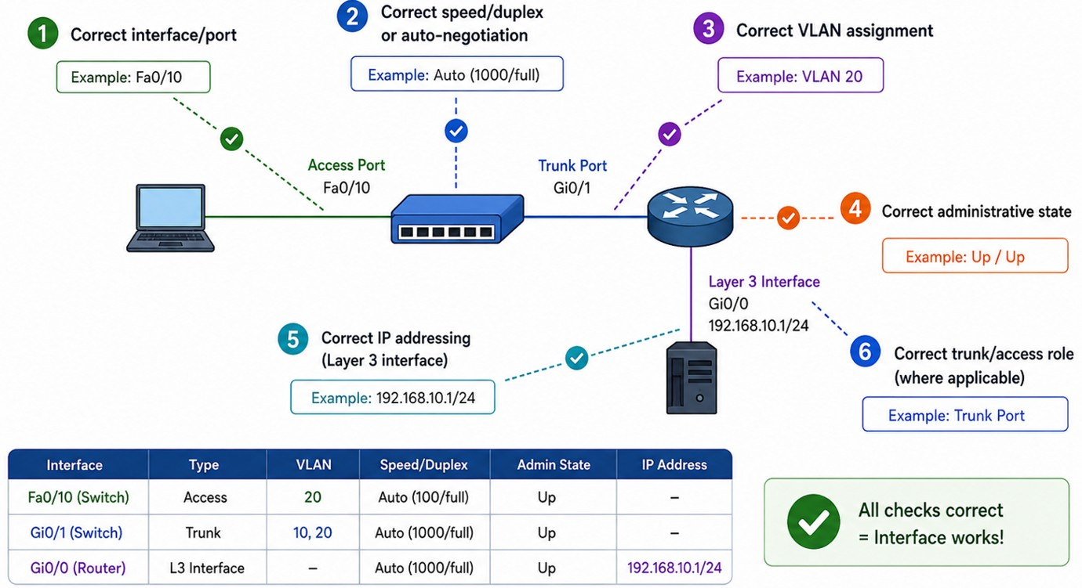
Interface Configuration — What to Check
CompTIA Network+ • Day 2 • Network Implementation • 14
Notes:
Correct interface/port.
Correct speed/duplex or auto-negotiation where applicable.
Correct VLAN assignment.
Correct administrative state.
Correct IP addressing when the interface is Layer 3.
Correct trunk/access role when applicable.

Slide 14
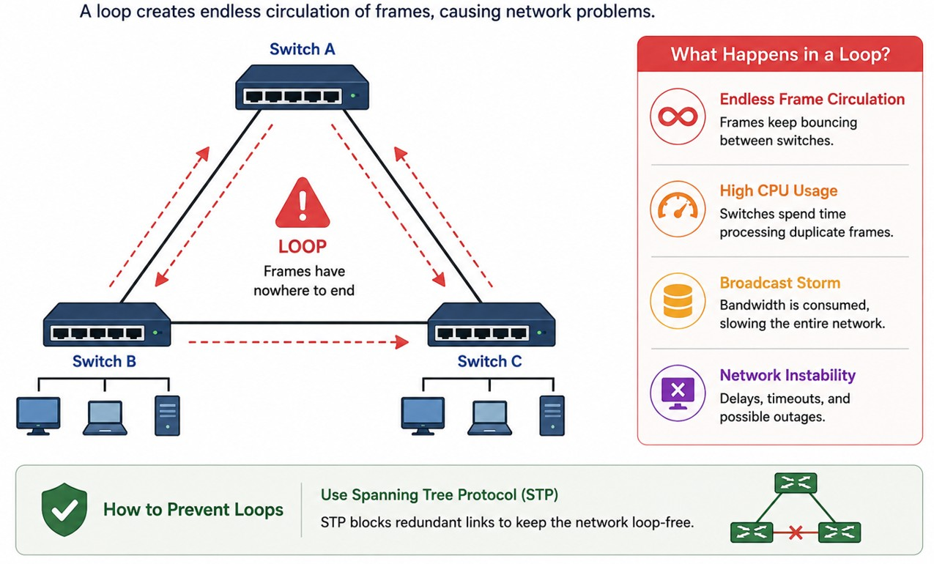
Spanning Tree — Why It Exists
CompTIA Network+ • Day 2 • Network Implementation • 15
Notes:
Redundant Layer 2 links can create loops.
Loops can cause broadcast storms and unstable MAC-table behavior.
Spanning Tree prevents Layer 2 loops by placing some redundant paths into a non-forwarding state.
If an active path fails, spanning tree can allow an alternate path to forward.

Slide 15
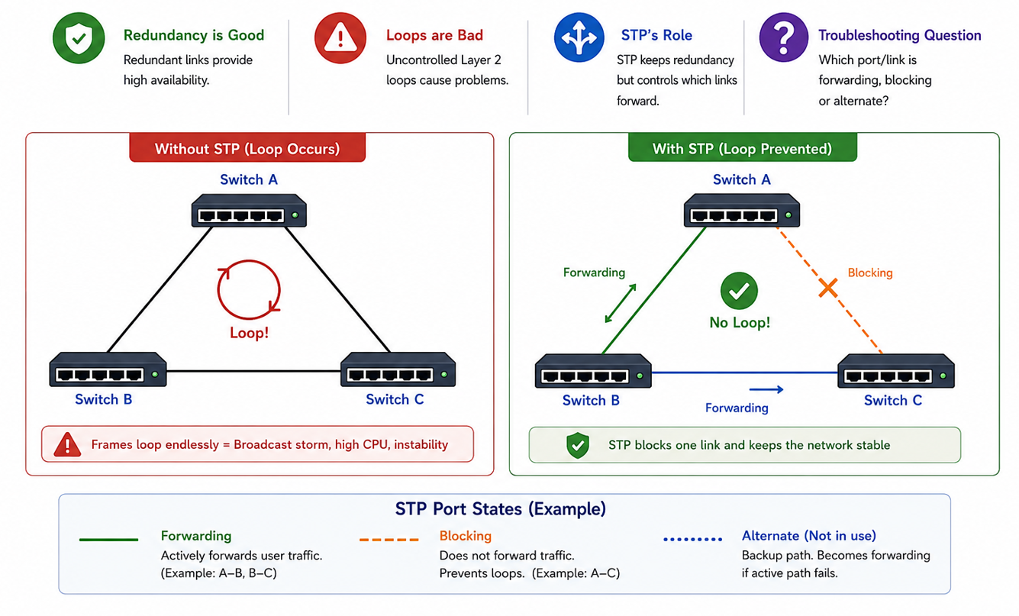
STP — The Mental Model
CompTIA Network+ • Day 2 • Network Implementation • 16
Notes:
Keep protocol-specific details secondary unless students need them for the lab.
Redundancy is good for availability.
Uncontrolled Layer 2 loops are bad.
STP keeps redundancy while controlling which links forward.
Troubleshooting question: Which port/link is forwarding, blocking or alternate?

Slide 16
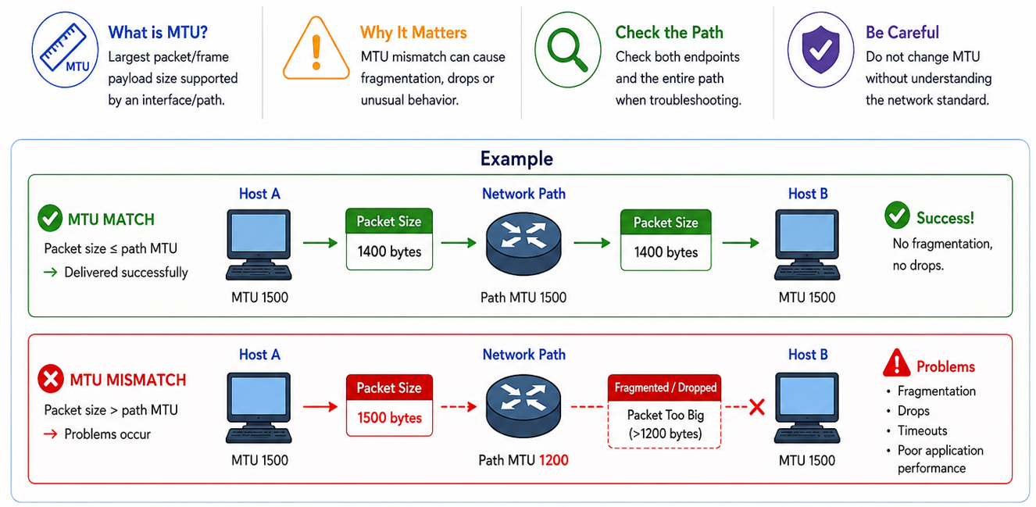
MTU — Maximum Transmission Unit
CompTIA Network+ • Day 2 • Network Implementation • 17
Notes:
Use the phrase 'packet too large for the path' as the intuition.
MTU is the largest packet/frame payload size supported by an interface/path under the relevant protocol.
An MTU mismatch can cause fragmentation, drops or unusual application behavior.
Check both endpoints and the path when diagnosing MTU-related symptoms.
Do not change MTU without understanding the required network standard.

Slide 17
2.3 Wireless Technologies
Channels • frequencies • SSID • security • AP types

Slide 18
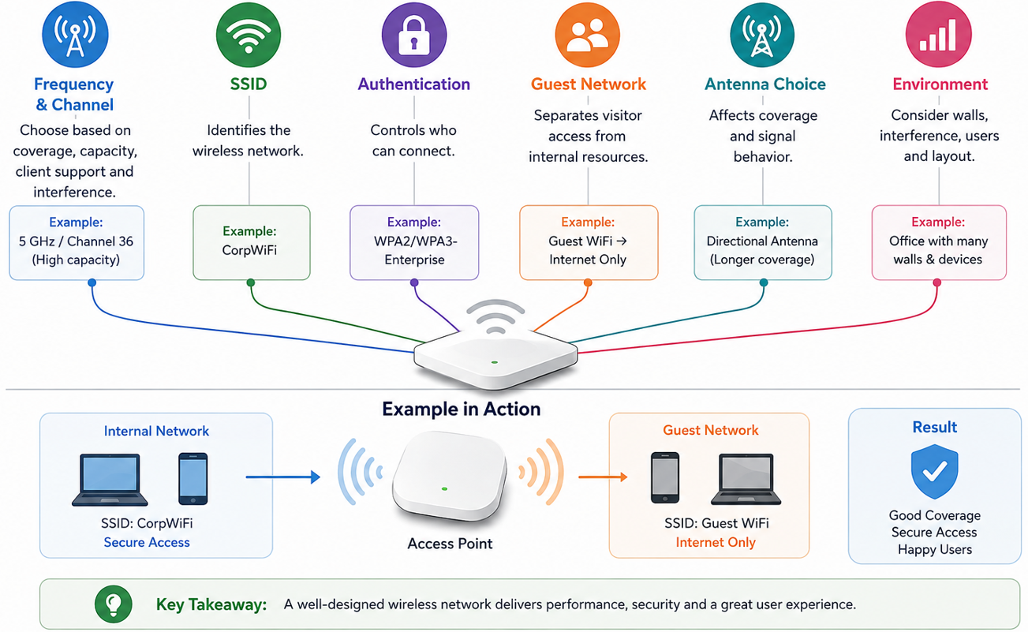
Wireless Design Starts With the Environment
.
CompTIA Network+ • Day 2 • Network Implementation • 19
Notes:
Choose frequency and channel based on coverage, capacity, client support and interference.
SSID identifies the wireless network.
Authentication controls who can connect.
Guest networks separate visitor access from internal resources.
Antenna choice affects coverage and signal behavior

Slide 19
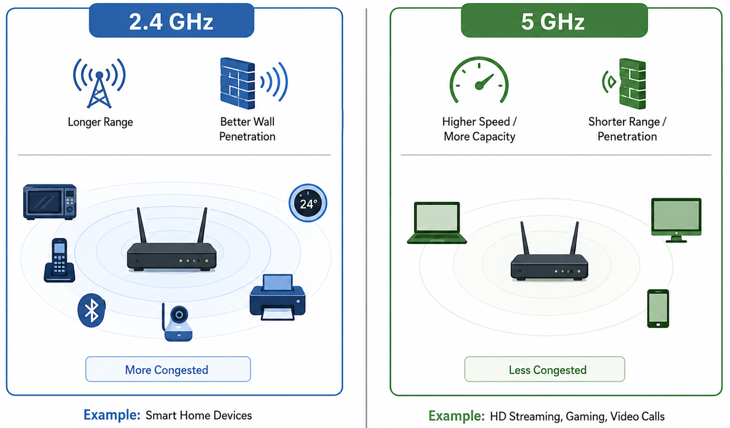
2.4 GHz vs 5 GHz
CompTIA Network+ • Day 2 • Network Implementation • 20
Notes:
The uploaded outline calls for frequency options. Keep this practical and avoid absolute performance claims.

Slide 20
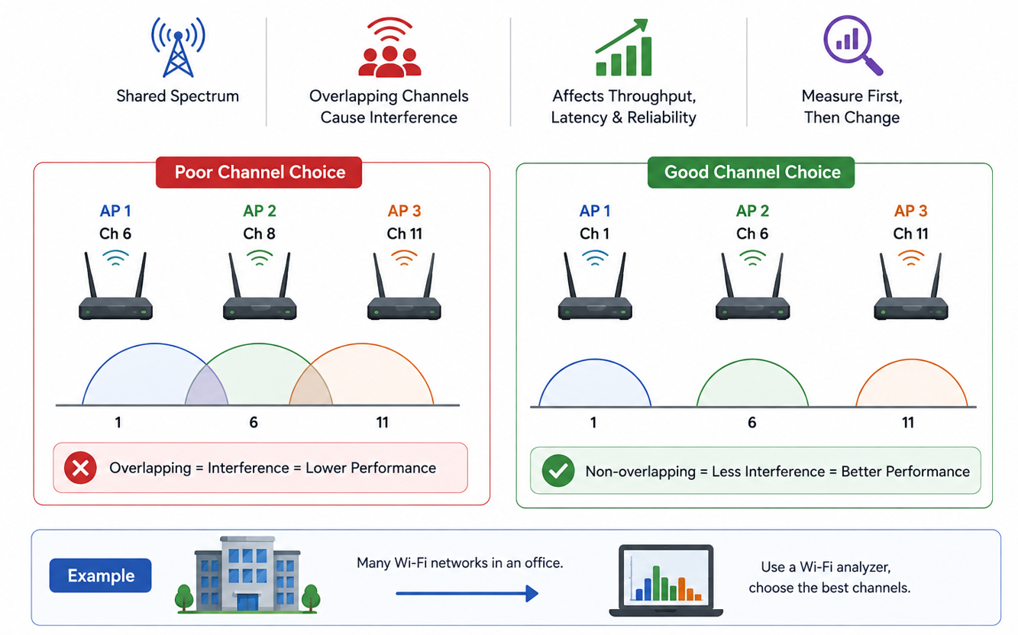
Wireless Channels
CompTIA Network+ • Day 2 • Network Implementation • 21
Notes:
Ask: 'If users complain that Wi-Fi is slow only in a crowded area, what evidence would you collect?’
Wireless networks share radio spectrum.
Nearby networks using overlapping/congested channels can compete for airtime.
Channel selection can affect throughput, latency and reliability.
Use measurement/analysis before changing channels.

Slide 21
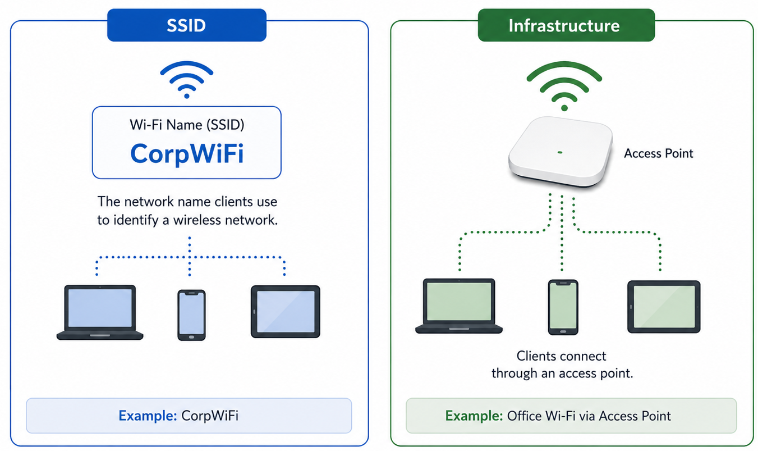
SSID
CompTIA Network+ • Day 2 • Network Implementation • 22
Notes:
The outline includes SSID and network types. Focus on recognition and purpose.

Slide 22
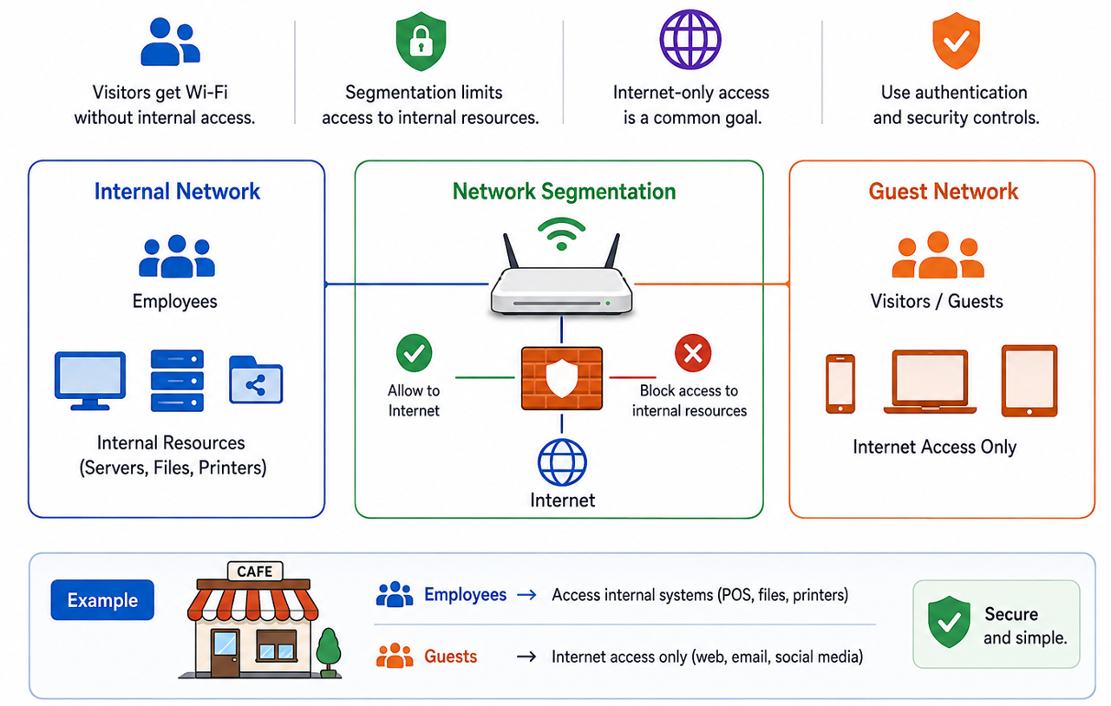
Guest Networks
CompTIA Network+ • Day 2 • Network Implementation • 23
Notes:
Guest access provides connectivity without giving visitors the same access as internal users.
Segmentation can limit access to internal resources.
Internet-only guest access is a common design goal.
Guest access should still use appropriate authentication and security controls.

Slide 23
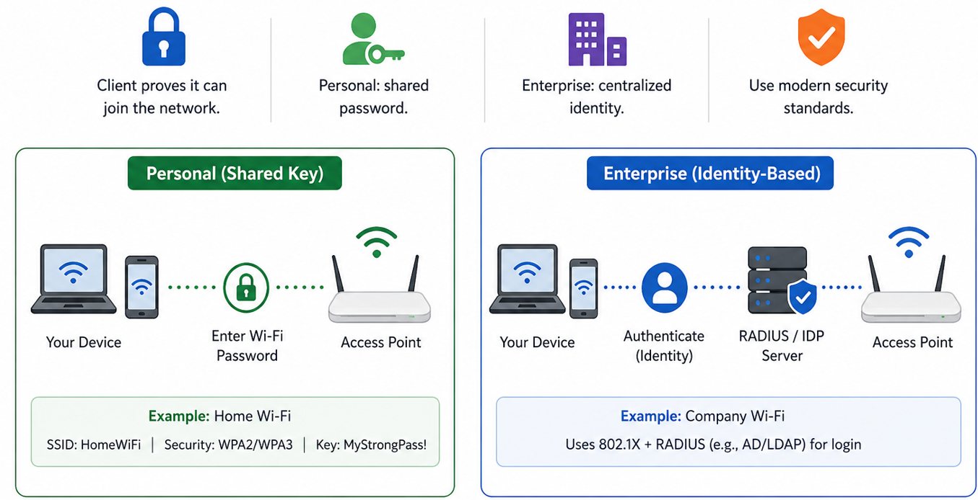
Wireless Authentication
CompTIA Network+ • Day 2 • Network Implementation • 24
Notes:
Authentication determines how a client proves it is allowed to join the network.
Personal deployments commonly use a shared credential/passphrase.
Enterprise deployments can use centralized identity-based authentication.
Use modern security standards appropriate to the environment.

Slide 24
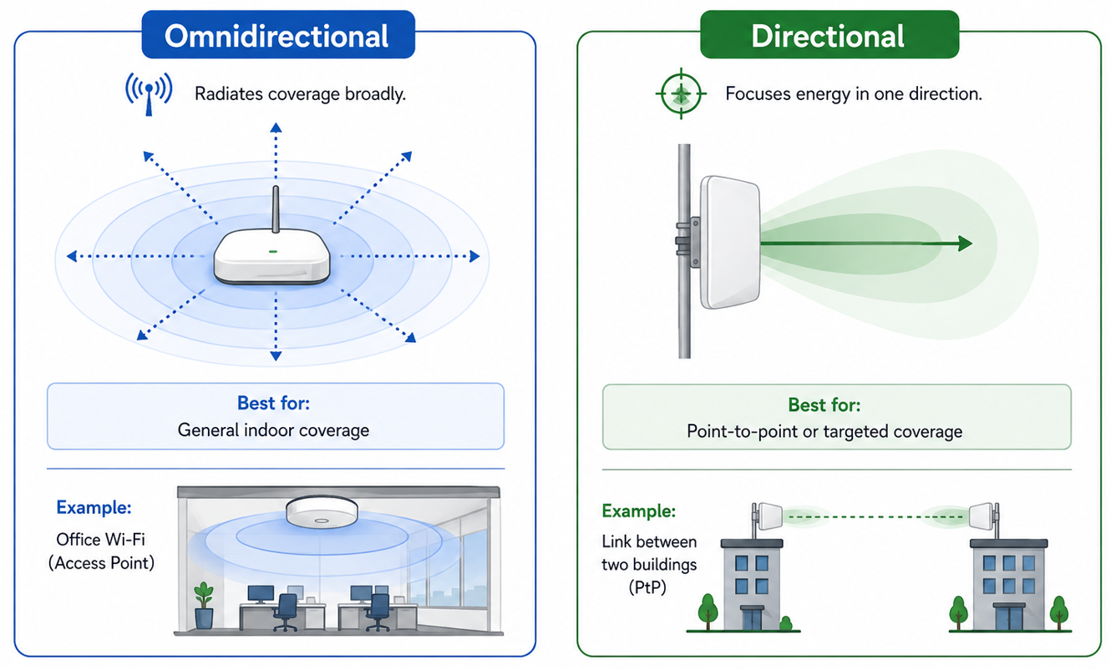
Antennas — Coverage vs Direction
CompTIA Network+ • Day 2 • Network Implementation • 25
Notes:
Explain that antenna choice changes coverage shape, not just 'signal strength'.

Slide 25
2.4 Physical Installation
Power • environment • installation implications

Slide 26
Physical Installation — Plan Before You Mount
Check location and coverage requirements.
Consider cable path, distance and connector/media type.
Provide appropriate power and network connectivity.
Allow physical access for maintenance.
Follow building, safety and organizational requirements.
CompTIA Network+ • Day 2 • Network Implementation • 28
Notes:
Ask learners to think beyond 'does it work?' and consider maintenance, safety and future access.

Slide 27
Power Considerations
Network devices require appropriate power sources.
PoE can deliver power over Ethernet to compatible devices.
Power budget matters when multiple PoE devices are connected.
UPS support can improve resilience for critical network equipment.
CompTIA Network+ • Day 2 • Network Implementation • 29
Notes:
Introduce PoE as a practical implementation consideration even though the outline simply lists power.

Slide 28
Environmental Factors
Temperature can affect equipment reliability.
Humidity, dust and airflow matter in equipment spaces.
Water exposure and physical hazards must be considered.
Electromagnetic interference can affect some installations.
Follow environmental requirements for the equipment and location.
CompTIA Network+ • Day 2 • Network Implementation • 30
Notes:
Tie environmental conditions to physical troubleshooting.

Slide 29
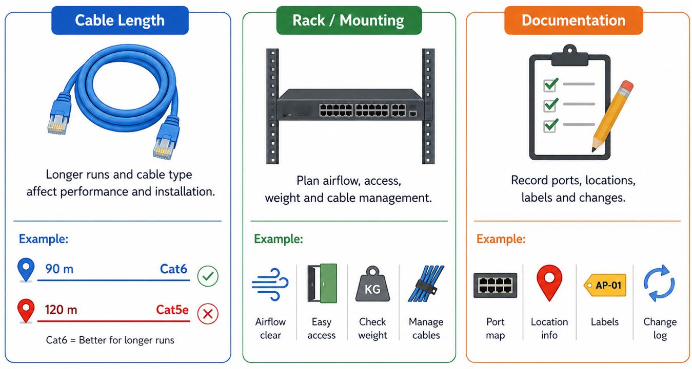
Installation Implications
CompTIA Network+ • Day 2 • Network Implementation • 31
Notes:
Good installation documentation becomes valuable during Day 3 operations and Day 5 troubleshooting.

Slide 30
Implementation Walkthrough
A small VLAN + routing + wireless design

Slide 31
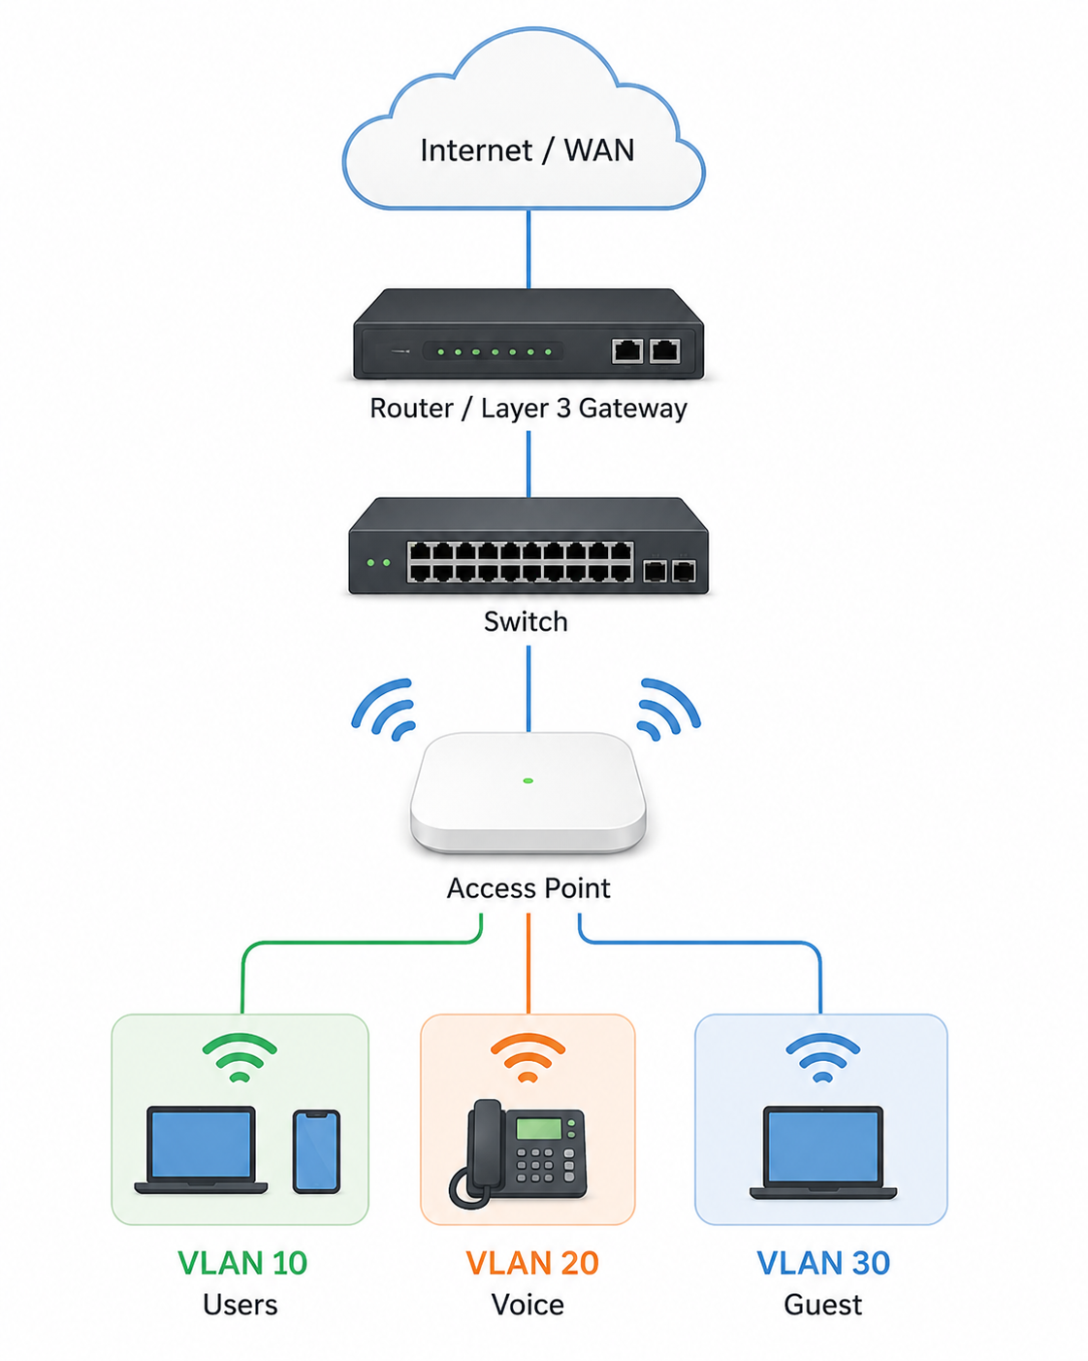
Example Network
Internet / WAN
↓
Router / Layer 3 gateway
↓
Switch ── Access Point
├── VLAN 10 — Users
├── VLAN 20 — Voice
└── VLAN 30 — Guest
CompTIA Network+ • Day 2 • Network Implementation • 33
Notes:
Draw this on the board. Ask where trunks, access ports, routing and guest segmentation would fit.

Slide 32
Implementation Sequence
1. Plan addressing and VLANs.
2. Configure switch VLANs and access ports.
3. Configure trunk links.
4. Configure Layer 3 interfaces/subinterfaces.
5. Configure routing as required.
6. Configure wireless SSIDs and security.
7. Verify connectivity and expected segmentation.
8. Document the final configuration.
CompTIA Network+ • Day 2 • Network Implementation • 34
Notes:
This is the implementation workflow learners should follow in the lab rather than configuring randomly.

Slide 33
Verification Checklist
Can each endpoint reach its default gateway?
Can devices reach permitted destinations?
Are VLANs carrying the expected traffic?
Is inter-VLAN routing working only where intended?
Are wireless clients receiving the expected network settings?
Are guest clients appropriately restricted?
Are interfaces and links stable?
CompTIA Network+ • Day 2 • Network Implementation • 35
Notes:
Use this checklist during the practical lab.

Slide 34
Day 2 Scenario Practice
Apply implementation concepts before the lab

Slide 35
Scenario 1 — Two Departments
Sales and HR share one switch but must be logically separated.
Sales uses VLAN 10.
HR uses VLAN 20.
They need Internet access but should not directly communicate.
Question: What switching and Layer 3 design would you choose?
CompTIA Network+ • Day 2 • Network Implementation • 37
Notes:
Expected reasoning: separate VLANs, access ports, appropriate gateway interfaces, and security policy/control for inter-VLAN restrictions.

Slide 36
Scenario 2 — Redundant Gateway
Two routers provide gateway service for the same LAN.
Users should keep one gateway address even if one router fails.
Question: Which concept from today's routing technologies addresses this?
CompTIA Network+ • Day 2 • Network Implementation • 38
Notes:
Expected: FHRP with a virtual IP.

Slide 37
Scenario 3 — Slow Wi-Fi
Users report slow Wi-Fi only during busy hours.
Signal coverage is acceptable.
Question: What would you investigate before replacing the access point?
CompTIA Network+ • Day 2 • Network Implementation • 39
Notes:
Expected: channel utilization/congestion, frequency/band, interference, client density and measurements.

Slide 38
Day 2 Knowledge Check
1. Static vs dynamic routing?
2. What is longest-prefix matching?
3. What is NAT used for?
4. What problem does FHRP solve?
5. What is a VIP?
6. Access port vs trunk?
7. Why is STP needed?
8. What is MTU?
9. What is an SSID?
10. Autonomous vs lightweight AP?
CompTIA Network+ • Day 2 • Network Implementation • 40
Notes:
Use this as a quick verbal check before labs.

Slide 39
Day 2 Lab Preview
Lab 1 — Static Routing
Lab 2 — Dynamic Routing Concepts
Lab 3 — NAT + Route Selection
Lab 4 — VLANs + Access/Trunk Ports
Lab 5 — Inter-VLAN Routing with Subinterfaces
Lab 6 — STP Observation
Lab 7 — MTU Scenario
Lab 8 — Wireless Design & Configuration
Lab 9 — Physical Installation Planning
Lab 10 — Integrated Network Implementation Challenge
CompTIA Network+ • Day 2 • Network Implementation • 41
Notes:
Transition to the Day 2 lab manual. Packet Tracer will be the primary simulation environment for routing/switching labs.

Slide 40
Day 2 Takeaways
Routing moves traffic between IP networks.
Static and dynamic routing solve different operational needs.
NAT translates address spaces; FHRP provides gateway redundancy.
VLANs create logical Layer 2 segmentation.
Trunks carry multiple VLANs; STP prevents Layer 2 loops.
MTU affects packet size and path behavior.
Wireless implementation depends on channels, frequencies, SSIDs, authentication and antennas.
Physical installation requires planning for power, environment, cabling and maintenance.
Tomorrow → operations, monitoring, documentation, DR and network services.
CompTIA Network+ • Day 2 • Network Implementation • 42
Notes:
Close Day 2 and bridge to Day 3 Network Operations.

